Slide 1
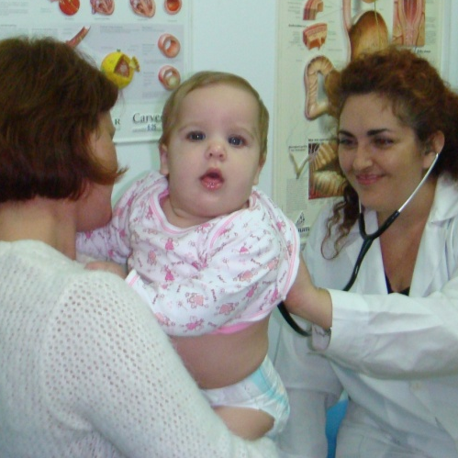
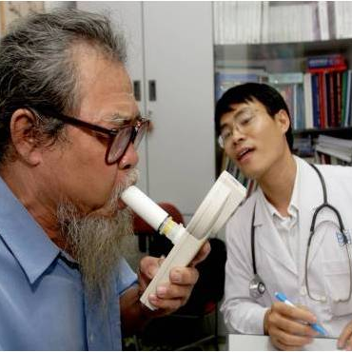
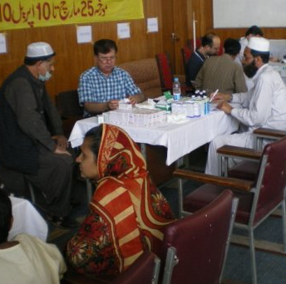
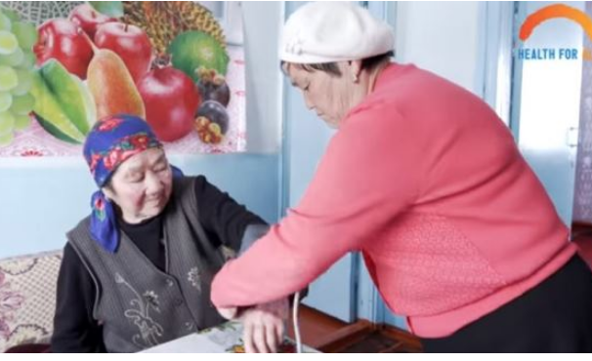
The importance of primary care
Siân Williams, Chief Executive Officer
International Primary Care Respiratory Group
Breathing and feeling well through universal access to right care
Notes:
End photo is taken from WHO primary care website – she is a community volunteer

Slide 2
Reaching 150,00 primary care professionals globally
Represent primary care on WHO Global Alliance Against Respiratory Disease
Montenegro

Slide 3
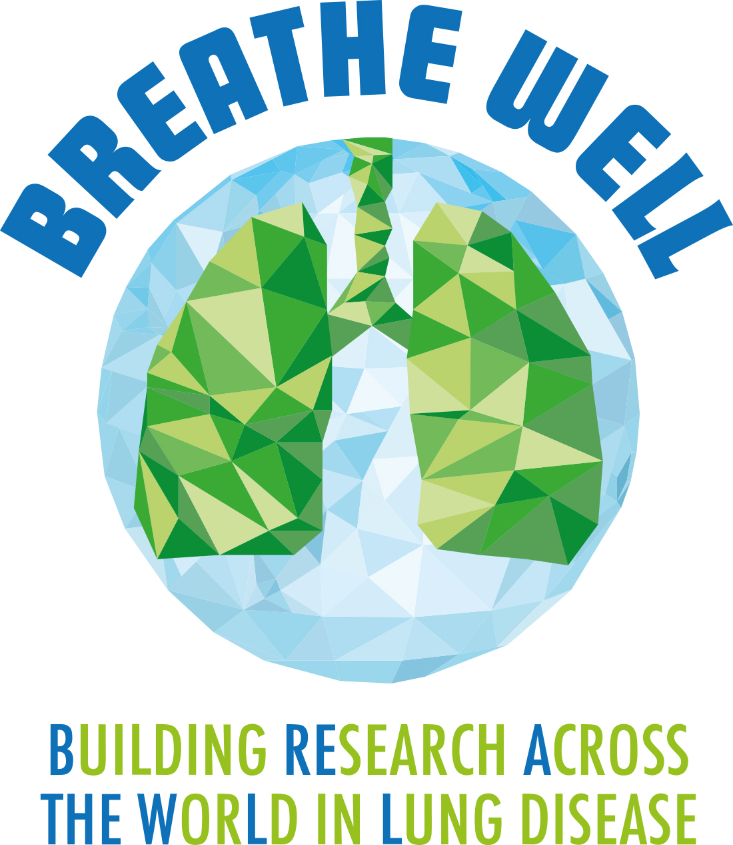
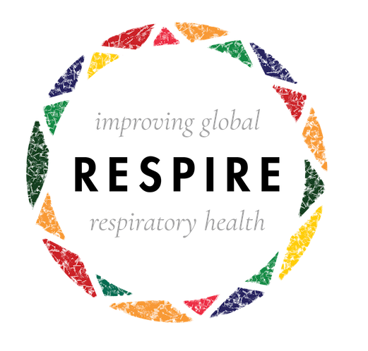


4 global health programmes to engage in & transfer knowledge to and from our network
In Uganda, Vietnam, Crete, Kyrgyzstan led by Leiden University Medical Center based on an IPCRG concept
NIHR Global Health Research Unit on Respiratory Health (RESPIRE) at The University of Edinburgh, Pakistan, Bangladesh, India, Malaysia
NIHR Global Health Research Group on Global COPD in Primary Care Breathe Well at University of Birmingham, China, Brazil, Georgia, FYR Macedonia
And now, NIHR - RECHARGE - rehabilitation

Slide 4
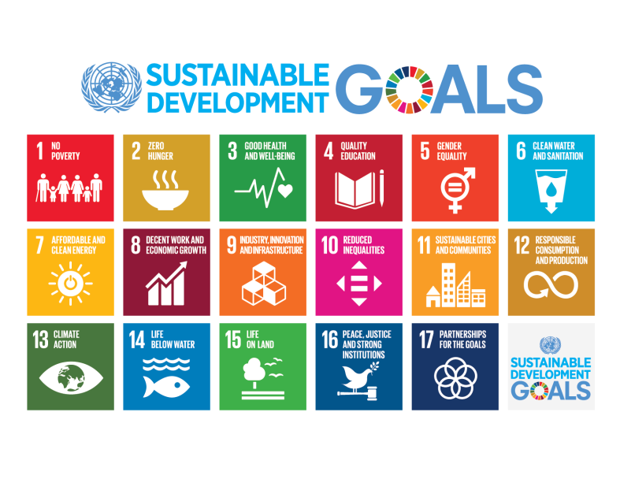
The UN’s most important strategic document for LMICs
Notes:
3, 5 and 6

Slide 5
The most important goal for us
3.4 By 2030, reduce by one third premature mortality from non-communicable diseases through prevention and treatment and promote mental health and well-being
3.8 Achieve universal health coverage, including financial risk protection, access to quality essential health-care services and access to safe, effective, quality and affordable essential medicines and vaccines for all
3.a Strengthen the implementation of the World Health Organization Framework Convention on Tobacco Control in all countries, as appropriate
3.c Substantially increase health financing and the recruitment, development, training and retention of the health workforce in developing countries, especially in least developed countries and small island developing States

Slide 6
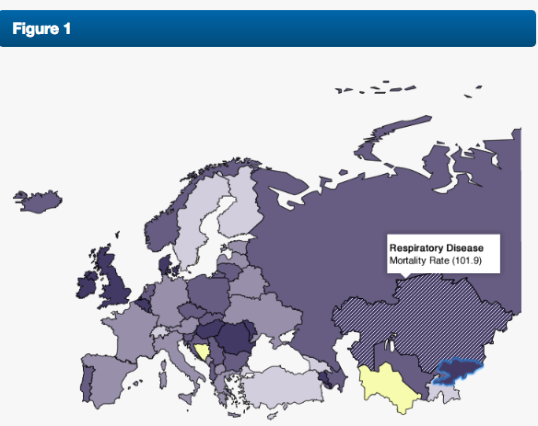
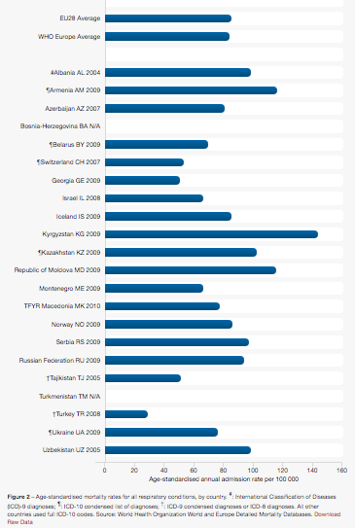
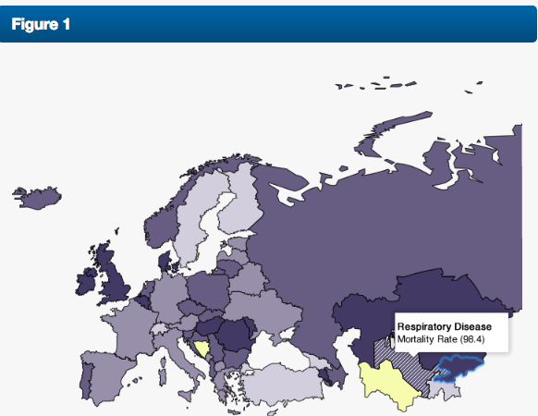
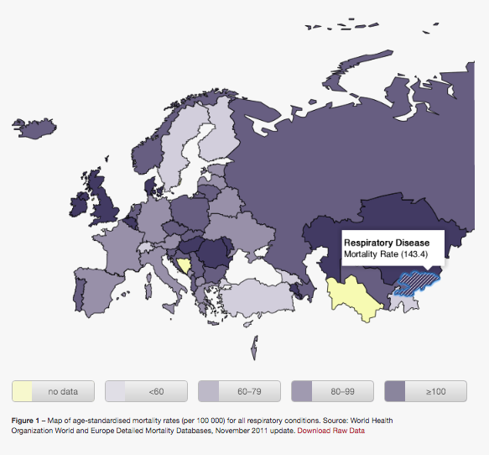
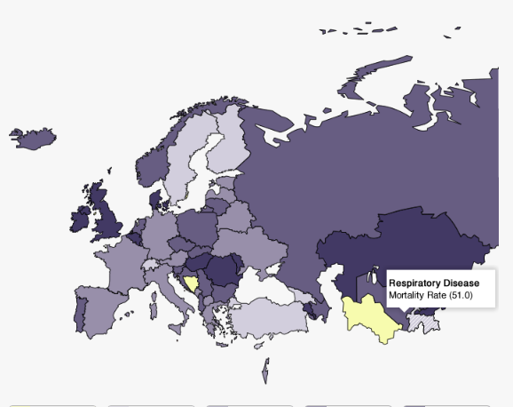
If we must reduce by 1/3 premature mortality from non-communicable diseases by 2030 in Kyrgyzstan, respiratory mortality should be a priority
Kazakhstan
Tajikistan
Kyrgyzstan
Uzbekistan

Slide 7
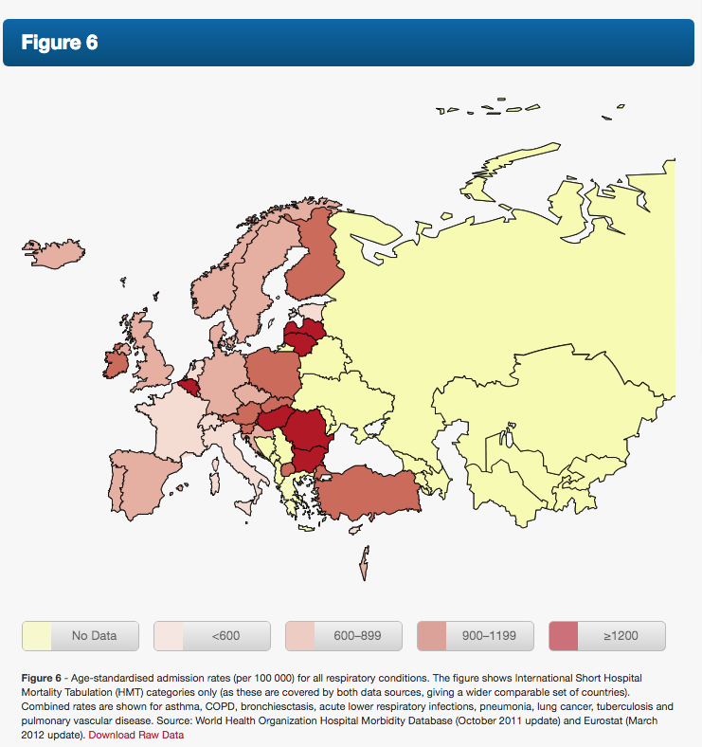
https://www.erswhitebook.org/chapters/the-burden-of-lung-disease/
If we improve respiratory health we could:
Reduce premature mortality of our citizens
Reduce inequity
Reduce expenditure on acute care (hospital admissions)
Therefore have more resources for other health needs

Slide 8
So how can we reduce it?
Achieve universal health coverage
SDG 3.8 Achieve universal health coverage, including financial risk protection, access to quality essential health-care services and access to safe, effective, quality and affordable essential medicines and vaccines for all
WHO measures progress towards UHC through 2 things:
The proportion of a population that can access essential quality health services
The proportion of the population that spends a large amount of household income on health.
Notes:
UHC means that all individuals and communities receive the health services they need without suffering financial hardship. It includes the full spectrum of essential, quality health services, from health promotion to prevention, treatment, rehabilitation, and palliative care.
UHC enables everyone to access the services that address the most important causes of disease and death, and ensures that the quality of those services is good enough to improve the health of the people who receive them.
Protecting people from the financial consequences of paying for health services out of their own pockets reduces the risk that people will be pushed into poverty because unexpected illness requires them to use up their life savings, sell assets, or borrow – destroying their futures and often those of their children.

Slide 9
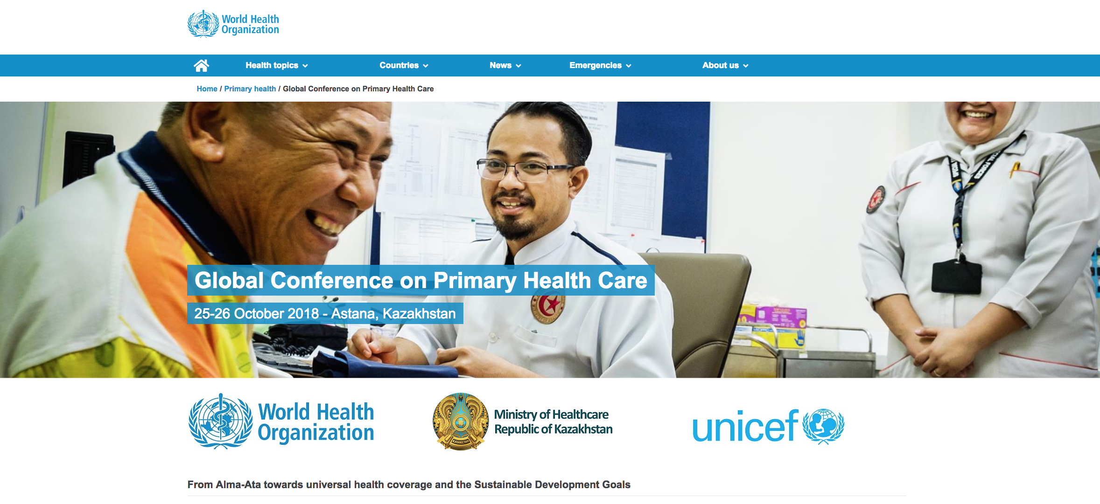
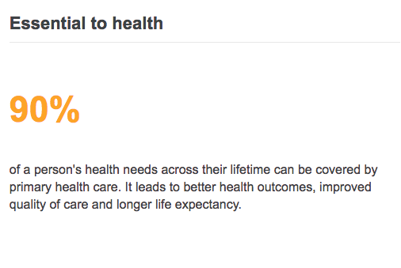
Primary care is the only way to achieve universal health coverage:
http://www.who.int/primary-health/en/

Slide 10
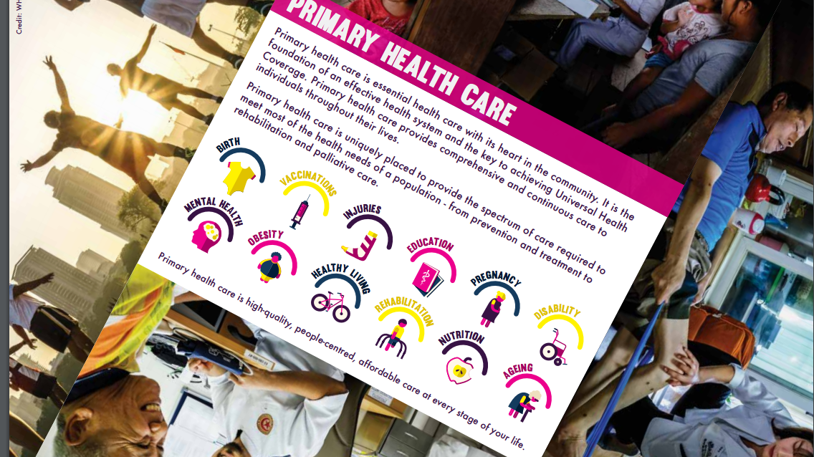
Notes:
First point of contact
Community-based
Along life-course
Primary to quaternary prevention
Relevant: can deal with 80-90% of an individuals’ needs over their lifetime and no more than required

Slide 11
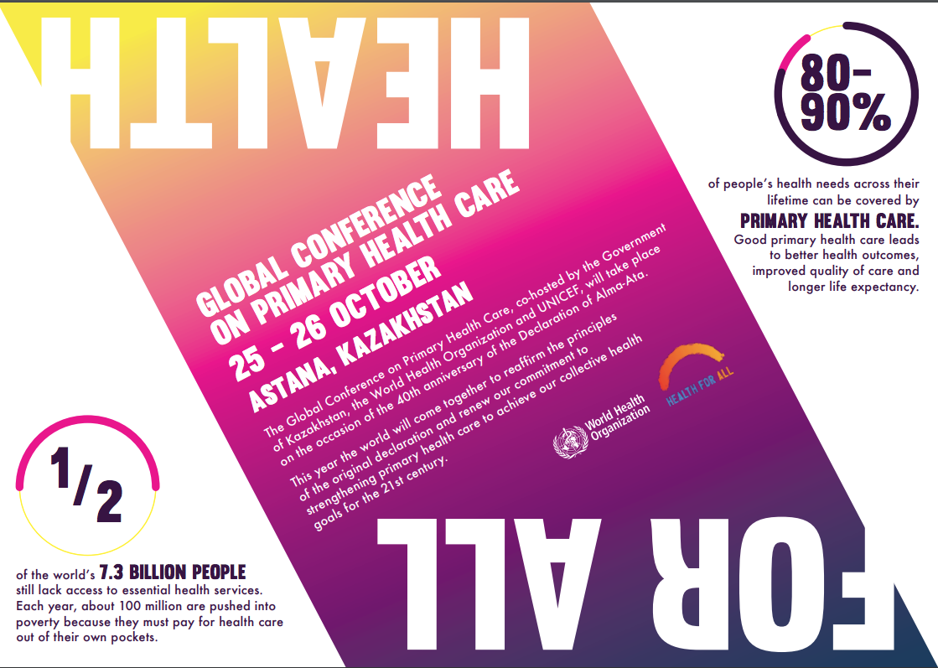

Slide 12
What is primary care?
First point of contact
May be a community worker, nurse or family physician
Family medicine is a medical specialism of generalism!

Slide 13
Family physicians are neighbourhood-based expert generalists who:
Deal compassionately with patients’ needs
Provide person-centred care: relating to patients as individuals
Use problem solving to help patients through uncertainty
Marginalise danger without medicalising normality
Take a collaborative approach to manage co-morbidity + coordinate complex care
Understand + utilise environment of their practice population
Understand + utilise interrelationships between health, social + family care
Approach problems holistically by understanding and respecting:
  patients’ values, preferences, priorities, cultures and family beliefs,
  how these will affect the experience and management of illness and health
  (Adapted from M Drage, 2016)
Notes:
Note – this is about family physicians, and in some countries, primary care is a broader WHO definition, not involving GPs trained in a vocational training programme.

Slide 14
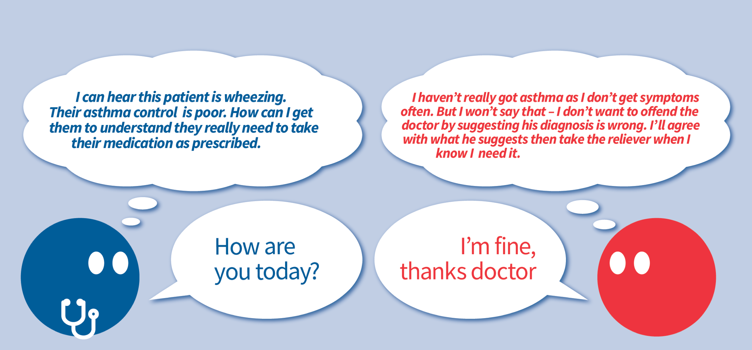
They ask the right questions and listen…so that they understand

Slide 15
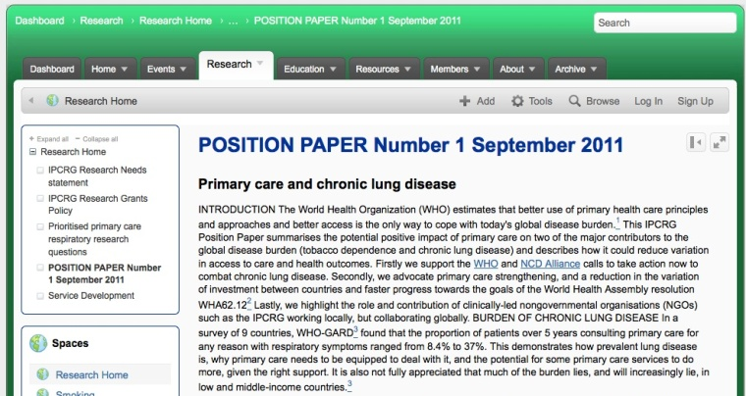
Primary care must include essential quality respiratory services because they add value:
They are accessible, cost-effective, reduce inequity
Treating tobacco dependence
Vaccination: flu, pneumococcal, TB
Maternal healthcare and information about smoke and dust exposure
Diagnosis of respiratory symptoms
Treatment and/or referral of acute problems:
  Pneumonia, respiratory failure
Management and treatment of:
  TB
  Asthma
  COPD
  Allergic rhinitis
Diagnosis and management of multi-morbidity
Palliative care
End of life care

Slide 16
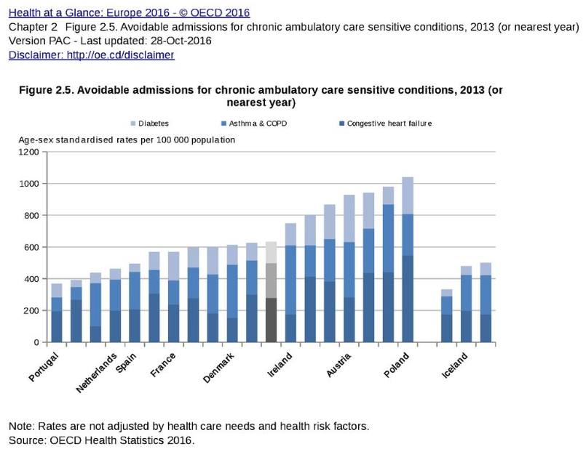
Admissions that could have been avoided if improved
“ambulatory services” available: OECD example
Rates not adjusted by health care need and health risk factors
Notes:
https://read.oecd-ilibrary.org/social-issues-migration-health/health-at-a-glance-europe-2016/avoidable-admissions-for-chronic-ambulatory-care-sensitive-conditions-2013-or-nearest-year_health_glance_eur-2016-graph23-en#page1

Slide 17
People with multimorbidity in Scotland are much more likely to have emergency and potentially preventable admissions
The Scottish School of Primary Care’s Multimorbidity Research Programme
Clinical data from 310 Scottish general practices for 1,754,133 registered patients

Slide 18
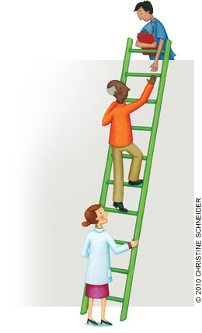
Stepped care of chronic diseases
Stage 1: Diagnosis
  Recognition and diagnosis with screening and / or diagnostic tools
Stage 2: Initial management
  Treatment
  Patient enablement
  Referral – when appropriate
Stage 3: Follow up
  Regular appointments – “reasonable” intervals
  Practice team – define roles and tasks
  Patient enablement

Slide 19

Stepped care of chronic diseases
Stage 4: Manage relapses or exacerbations (flare ups)
  Accessibility
  Practice team
  Patient enablement
Stage 5: Terminal care
  Practice and community team involvement
  Enablement of patient and family

Slide 20
A personal message from the Executive Director of Nursing Now
“Community engagement is at the heart of PHC. As the largest cadre in the health care global workforce nurses have the potential to be the biggest force for change in approaches to health.
Nurses are pivotal to community engagement and can work with people over time to help them manage NCDs and to tailor prevention activities especially when they come from the communities in which they live and work.”
Dr Barbara Stilwell (Personal message, 2018)
Global Campaign Executive Director, Nursing Now

Slide 21
The Triple Impact of Nursing
A report by the UK All-Party Parliamentary Committee on Global Health (2016) that inspired Nursing Now
Better health
Triple impact of nursing
Stronger economies
Greater gender equality
Notes:
Report of the All-Parliamentary Committee UK (APPG) on Global Health Office of Lord Crisp (2016):
Report conclusions:
Nurses are half the health workforce: Universal Health Coverage and other goals will not be achieved without strengthening nursing.
Nurses are systematically undervalued and could contribute more.
Developing nursing will have the Triple Impact of improving health, promoting gender equality and strengthening economies.

Slide 22
The Nursing Workforce
Nurses and midwives contribute more than 50% of the health workforce in many countries (WHO 2015)
Nurses can take primary care roles
Assistant ‘first aid’ roles
Treatment
Ultimately, diagnosis
Generalist and specialist roles

Slide 23
What is needed
Create a vision for primary care
Specify competences: Key skills include diagnosis and treatment of acute infections and NCDs at primary care level
Educate: increase evidence based knowledge and clinical skills
Identify roles of family physicians, nurses, feldshers
Agree appropriate delegation of authority from physicians to nurses
Inter-professional cooperation

Slide 24
Priorities for primary care workforce in Kyrgyzstan
Nursing Leadership
Postgraduate education and research
Professional and high quality care
Transfer of professional skills and knowledge across the family physician & nursing workforce
Systems thinking
Supportive policies and systems
Define competencies for levels of practice
Regulation
Authorisation to practice

Slide 25
Dr Tedros, Director General WHO, September 2018
Poor care not only jeopardises the health of individuals; it erodes trust and puts entire health systems and populations at risk...
Without quality, universal health coverage (UHC) remains an empty promise...
The same nurse who vaccinates children and cares for new mothers will also need to detect an unusual communicable disease….disease
All of this requires [ ] active learning systems... We must go deep into the messy realities of health services to understand local problems, find innovative solutions, learn from mistakes, scale up what works, and share experiences. Local learning needs to be prioritised, but local lessons must also be shared nationally and with the world...
Quality is not a given. It takes vision, planning, investment, compassion, meticulous execution, and rigorous monitoring, from the national level to the smallest, remotest clinic.
https://www.thelancet.com/journals/langlo/article/PIIS2214-109X(18)30394-2/fulltext
Notes:
UHC and health security are two sides of the same coin. This was painfully apparent during the west African Ebola outbreak of 2014–15, when the perceived lack of quality led to community distrust in the health system, decreased utilisation of services, and an increase in morbidity and mortality from non-Ebola conditions...

Slide 26
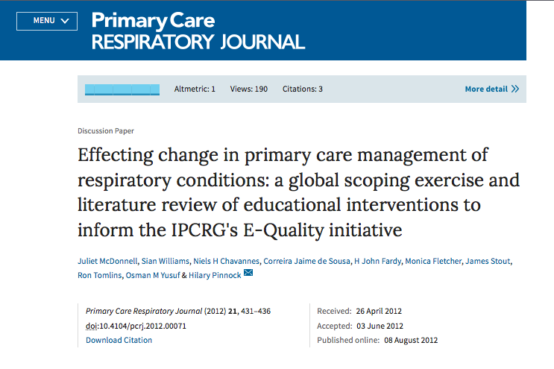
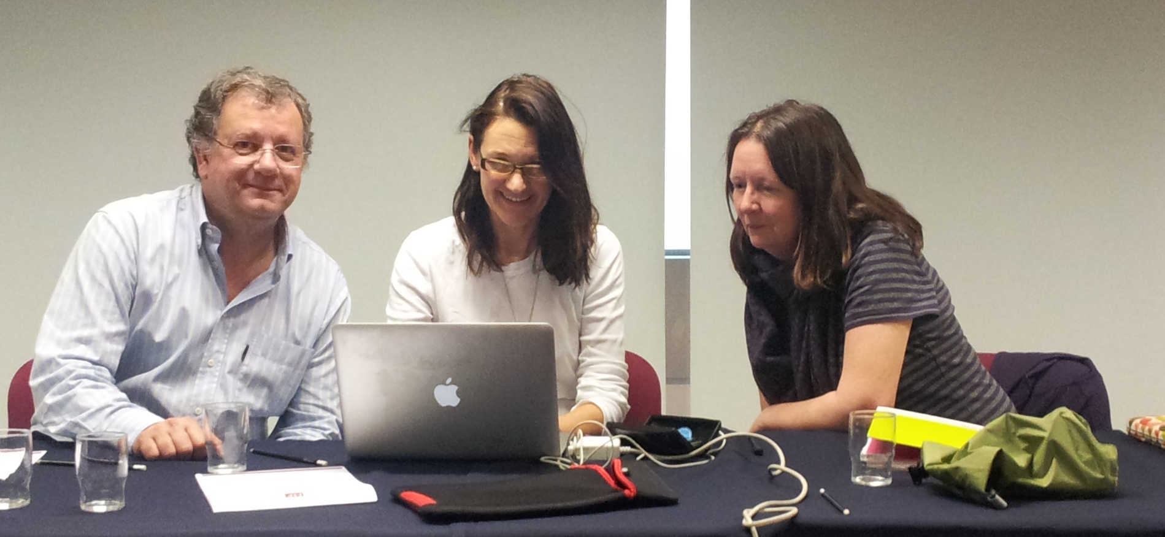
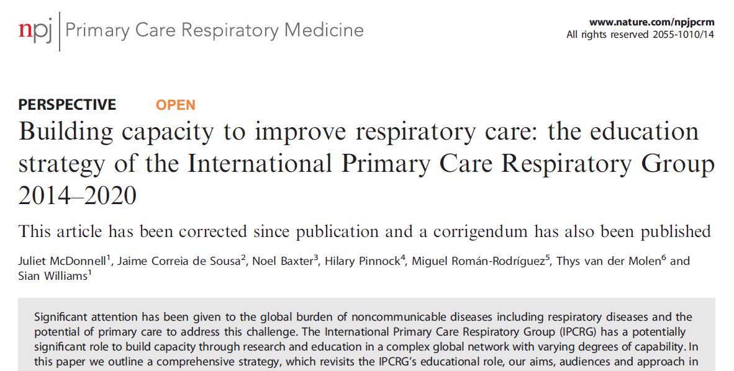
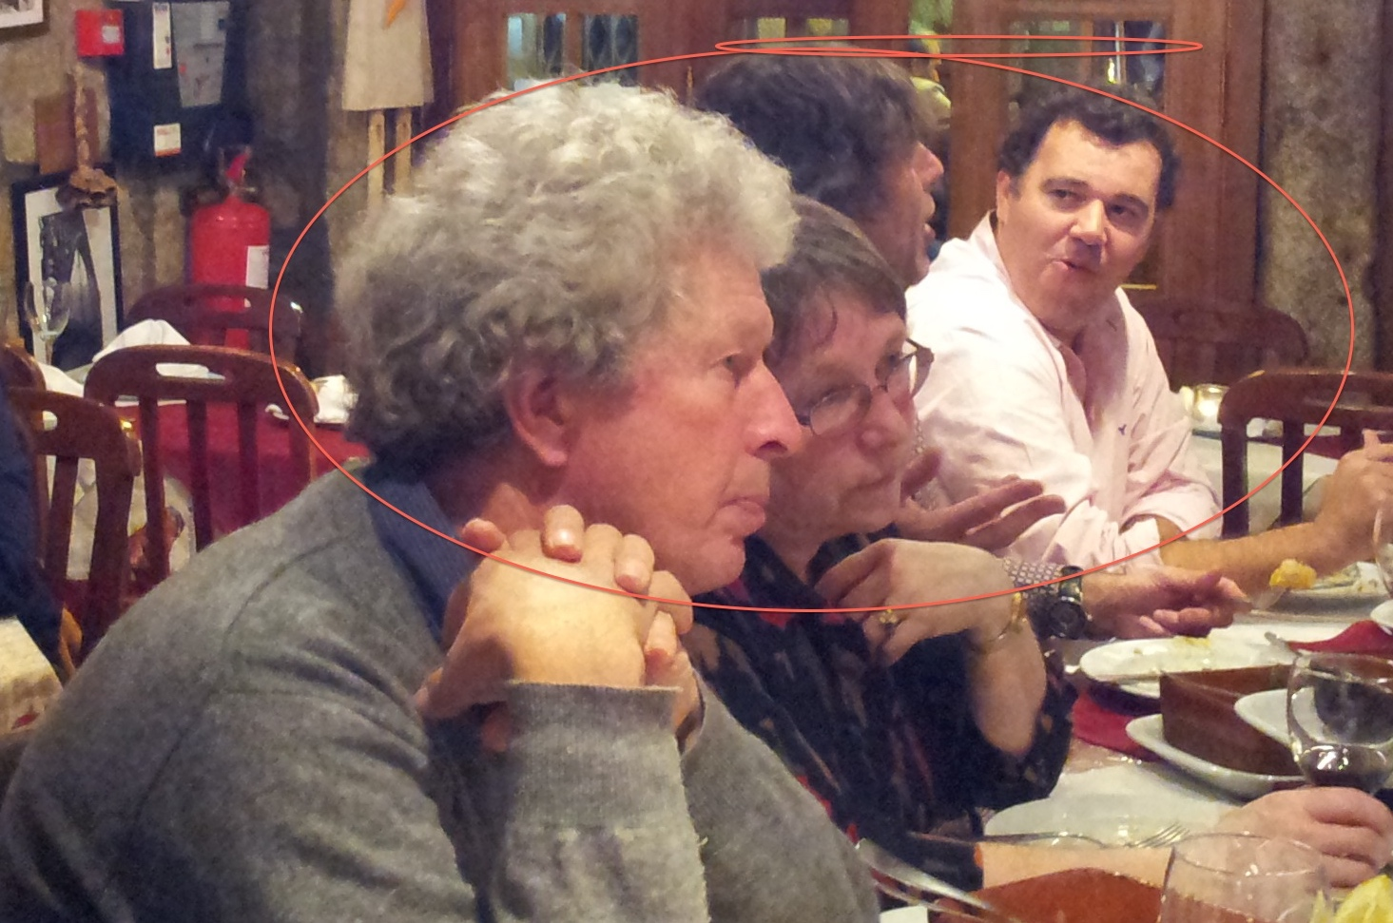
Education strategy
Notes:
Scoping review 2012
Education strategy 2014

Slide 27
Today we are focused on the workforce, but note the other elements that are needed
ENVIRONMENT
INFORMATION
MEDICINES AND VACCINES
Housing
Licensed
and approved
Right use
Indoor air pollution
Medical record
Access to affordable nutritious food
Affordability to
the payor
Ambient air pollution
Conduciveness to physical activity
Availability (stock)
Public information
Quality care for
children & adults with respiratory symptoms
Access to treatment and care: availability
Finance
Knowledge
and beliefs
Diagnostic knowledge: words and actions
Access to treatment care: affordability,
value (involves trust)
Investment in education
Diagnostic skills: words and actions
Leadership programmes
Experience
Incentives
Beliefs and experiences
Preferences
Risk factors (smoke, genes, physical activity, diet)
HEALTH SERVICES
AND WORKFORCE
FINANCING, LEADERSHIP, GOVERNANCE
PERSONAL
WHO Health Systems Framework for universal coverage adapted by IPCRG
Notes:
This will be offered as a handout
These are the obvious ones, but is that the right place to start?

Slide 28
If we can help children stay well through care and education, they can attend school, and become part of the solution….
4.4 By 2030, substantially increase the number of youth and adults who have relevant skills, including technical and vocational skills, for employment, decent jobs and entrepreneurship
4.5 By 2030, eliminate gender disparities in education and ensure equal access to all levels of education and vocational training for the vulnerable, including persons with disabilities, indigenous peoples and children in vulnerable situations
4.7 By 2030, ensure that all learners acquire the knowledge and skills needed to promote sustainable development, including, among others, through education for sustainable development and sustainable lifestyles

Slide 29
If we learn from FRESH AIR, we can show why it is so important to reach this goal
7.1 By 2030, ensure universal access to affordable, reliable and modern energy services

Slide 30
If we achieve affordable energy then we reach Goal 15 too…
15.2 By 2020, promote the implementation of sustainable management of all types of forests, halt deforestation, restore degraded forests and substantially increase afforestation and reforestation globally

Slide 31
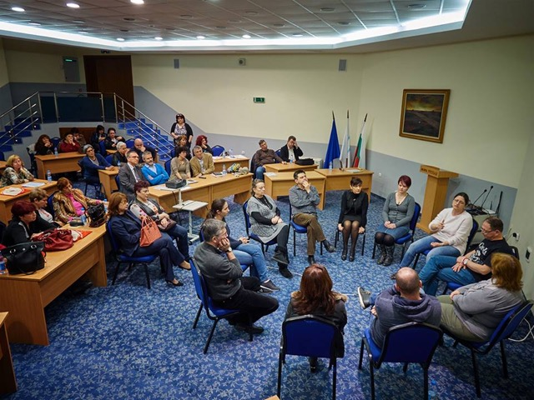
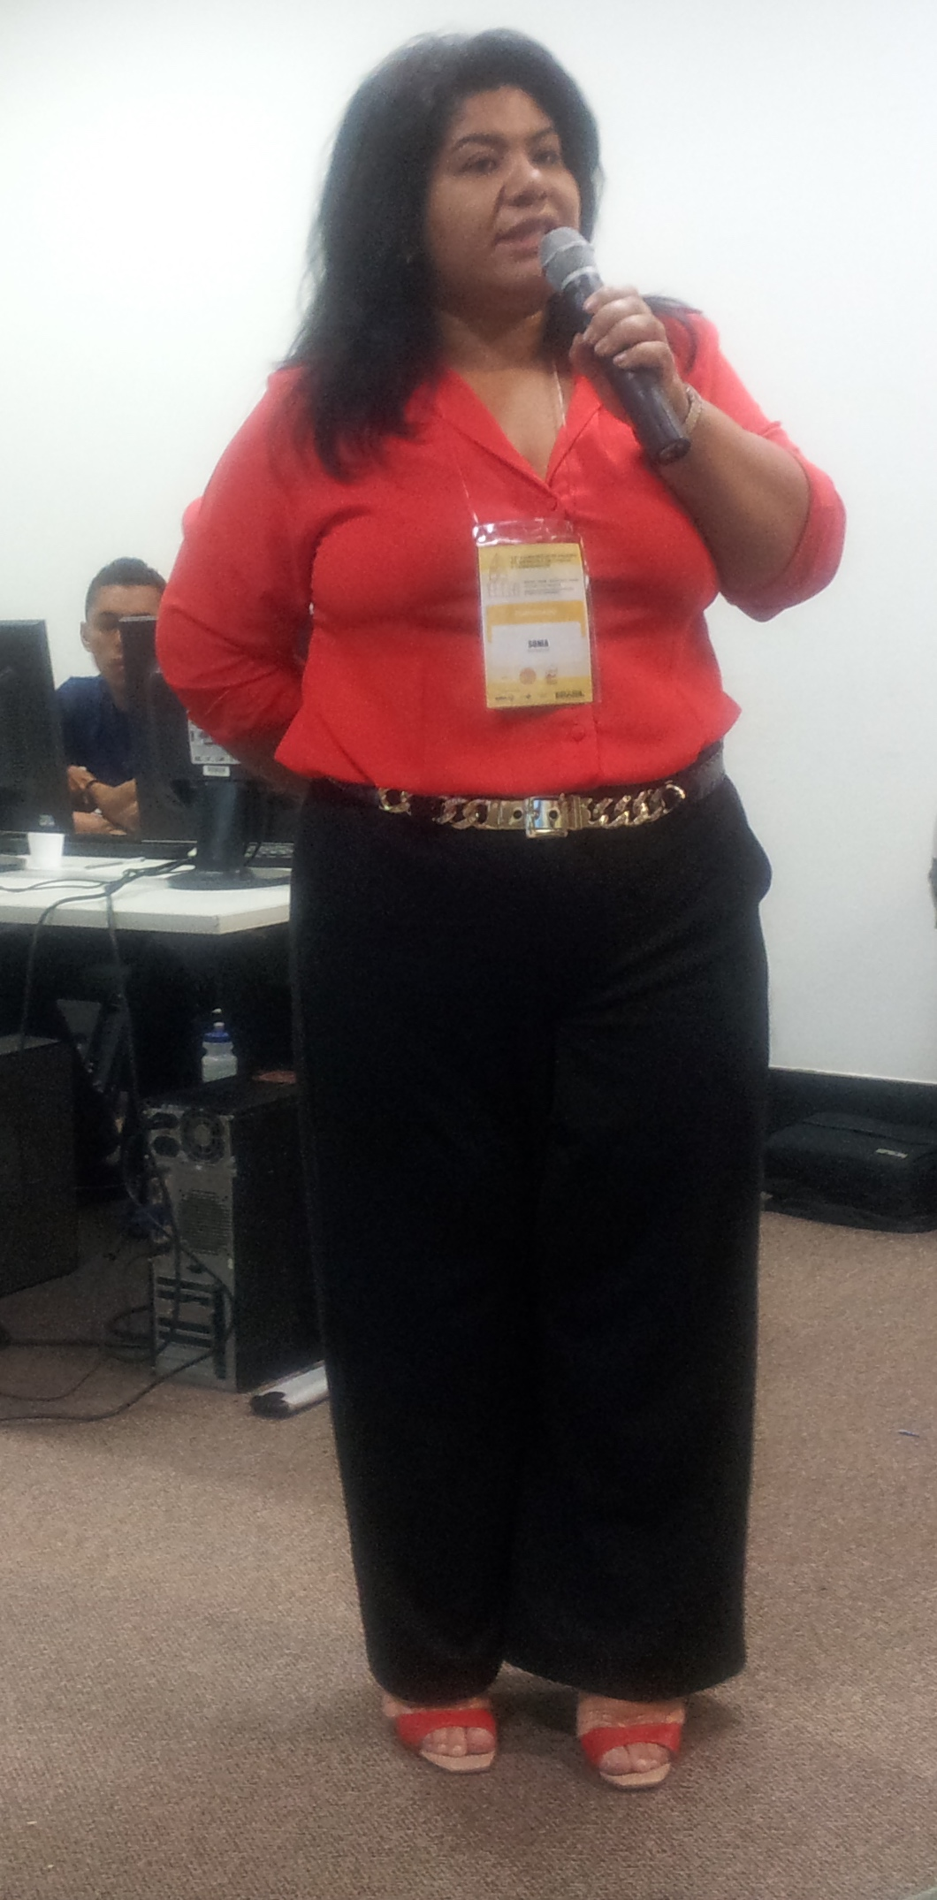
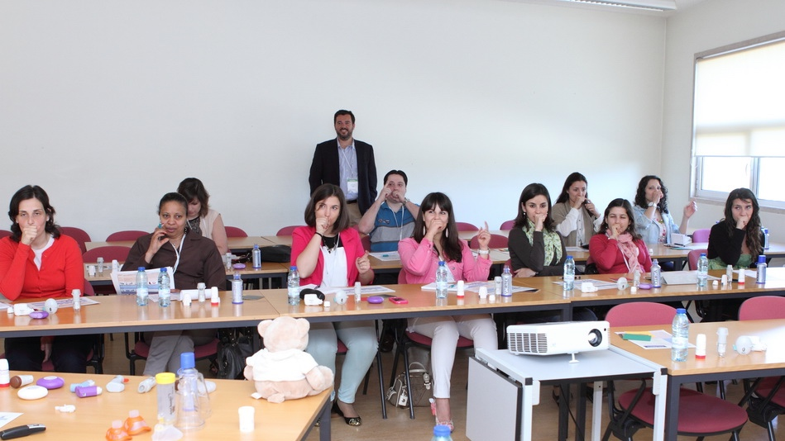
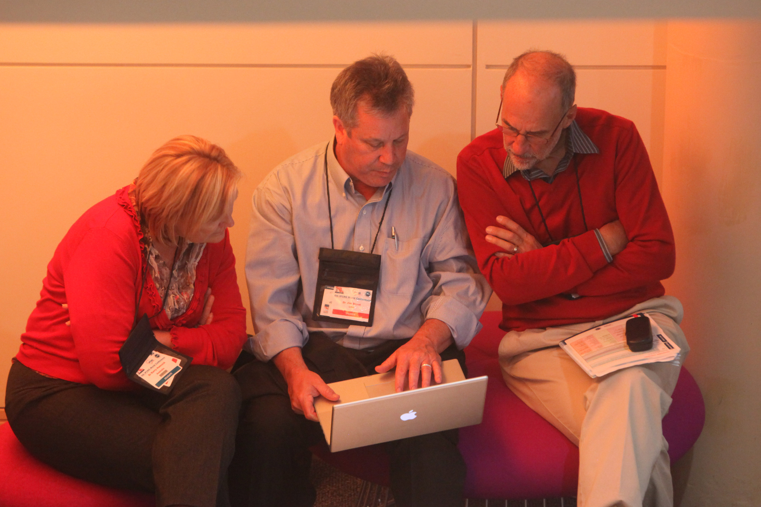
IPCRG calls for:
Primary care to diagnose and treat respiratory disease, tobacco dependence and exposure to indoor air pollution
Practical peer-led training and education
Integrated care systems, involving patients, multi-disciplinary health and social care
Generation of real life evidence to feed guidelines that are useful in primary care
Primary care as population health educators
Right incentives to practise population respiratory heath: go where the people in need are
Universal access to good quality inhaled medicines and tobacco treatment and training in how to use them
IPCRG that can leverage major clinician-led change working locally, collaborating globally
Governments and healthcare payors to invest in
Notes:
Primar

