Slide 1
How to identify and treat the COPD-asthma phenotype
Jaime Correia de Sousa, MD, MSc, PhD
Family Physician, Matosinhos, Portugal
Associate Professor, School of Medicine, Minho University, Portugal
President of the International Primary Care Respiratory Group

Slide 2
Diagnosis of asthma, COPD and asthma-COPD overlap syndrome (ACOS) A joint project of GINA and GOLD, updated 2016
GINA 2016

Slide 3
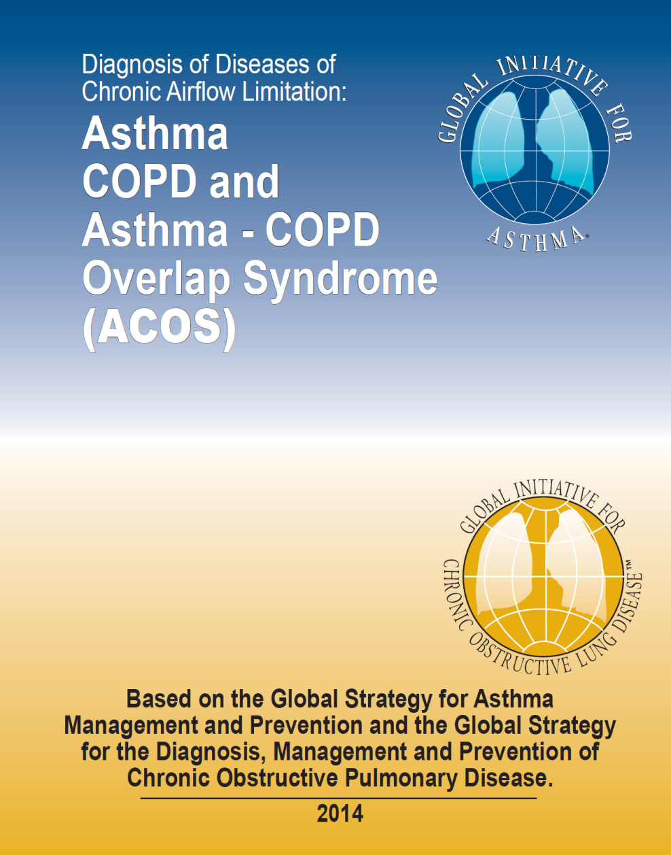
Diagnosis of diseases of chronic airflow limitation

Slide 4
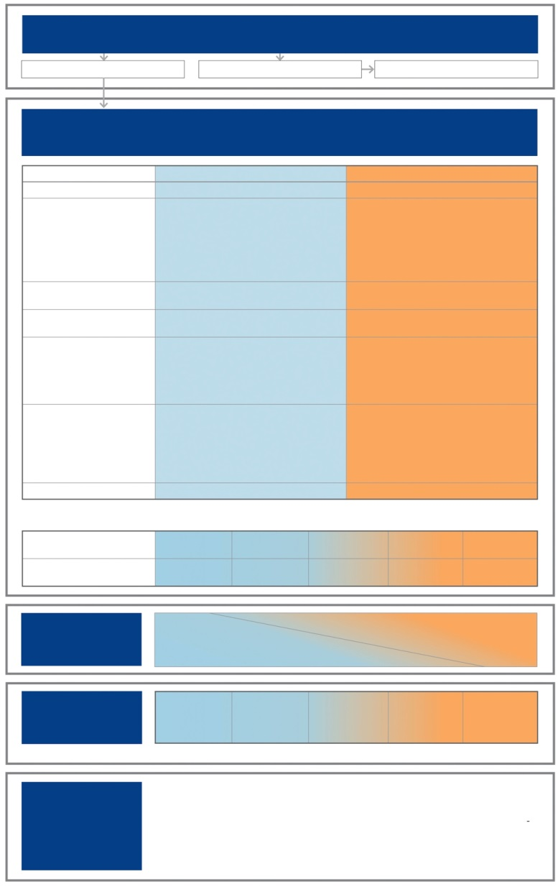
Stepwise approach to diagnosis and initial treatment
STEP 1
DIAGNOSE CHRONIC AIRWAYS DISEASE
Do symptoms suggest chronic airways disease?
Yes
No
Consider other diseases first
STEP 2
SYNDROMIC DIAGNOSIS IN ADULTS
(i) Assemble the features for asthma and for COPD that best describe the patient.
(ii) Compare number of features in favour of each diagnosis and select a diagnosis
For an adult who presents with respiratory symptoms:
Does the patient have chronic airways disease?
Syndromic diagnosis of asthma, COPD and ACOS
Spirometry
Commence initial therapy
Referral for specialized investigations (if necessary)
Features: if present suggest
ASTHMA
COPD
Age of onset
Before age 20 years
After age 40 years
Pattern of symptoms
Variation over minutes, hours or days
Worse during the night or early morning. Triggered by exercise, emotions including laughter, dust or exposure to allergens
Persistent despite treatment
Good and bad days but always daily symptoms and exertional dyspnea
Chronic cough & sputum preceded onset of dyspnea, unrelated to triggers
Lung function
Record of variable airflow limitation (spirometry or peak flow)
Record of persistent airflow limitation (FEV₁/FVC < 0.7 post-BD)
Lung function between symptoms
Normal
Abnormal
Past history or family history
Previous doctor diagnosis of asthma
Family history of asthma, and other allergic conditions (allergic rhinitis or eczema)
Previous doctor diagnosis of COPD, chronic bronchitis or emphysema
Heavy exposure to risk factor: tobacco smoke, biomass fuels
Time course
No worsening of symptoms over time. Variation in symptoms either seasonally, or from year to year
May improve spontaneously or have an immediate response to bronchodilators or to ICS over weeks
Symptoms slowly worsening over time (progressive course over years)
Rapid-acting bronchodilator treatment provides only limited relief
Chest X-ray
Normal
Severe hyperinflation
NOTE: • These features best distinguish between asthma and COPD. • Several positive features (3 or more) for either asthma or COPD suggest that diagnosis. • If there are a similar number for both asthma and COPD, consider diagnosis of ACOS
DIAGNOSIS
Asthma
Some features
of asthma
Features of both
Some features
of COPD
COPD
CONFIDENCE IN
DIAGNOSIS
Asthma
Asthma
Could be ACOS
Possibly COPD
COPD
STEP 3
PERFORM
SPIROMETRY
Marked
reversible airflow limitation
(pre-post bronchodilator) or other
proof of variable airflow limitation
FEV₁/FVC < 0.7
post-BD
STEP 4
INITIAL
TREATMENT*
Asthma drugs
No LABA
monotherapy
Asthma drugs
No LABA
monotherapy
ICS, and usually LABA
+/or LAMA
COPD drugs
COPD drugs
*Consult GINA and GOLD documents for recommended treatments.
STEP 5
SPECIALISED
INVESTIGATIONS
or REFER IF:
• Persistent symptoms and/or exacerbations despite treatment.
• Diagnostic uncertainty (e.g. suspected pulmonary hypertension, cardiovascular diseases and other causes of respiratory symptoms).
• Suspected asthma or COPD with atypical or additional symptoms or signs (e.g. haemoptysis, weight loss, night sweats, fever, signs of bronchiectasis or other structural lung disease).
• Few features of either asthma or COPD.
• Comorbidities present.
• Reasons for referral for either diagnosis as outlined in the GINA and GOLD strategy reports.
GINA 2016, Box 5-4

Slide 5
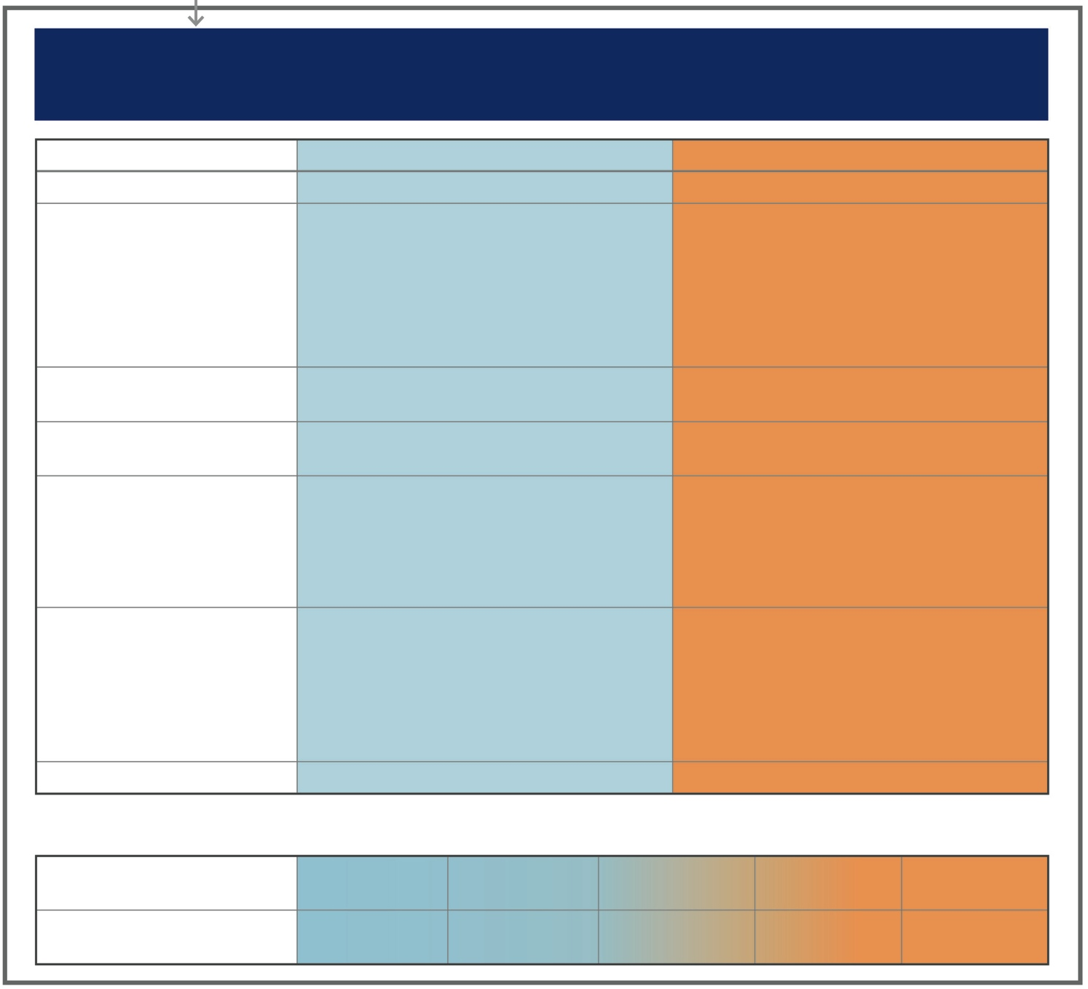
STEP 2
SYNDROMIC DIAGNOSIS IN ADULTS
(i) Assemble the features for asthma and for COPD that best describe the patient.
(ii) Compare number of features in favour of each diagnosis and select a diagnosis
Features: if present suggest -
ASTHMA
COPD
Age of onset
Before age 20 years
After age 40 years
Pattern of symptoms
Variation over minutes, hours or days
Worse during the night or early morning
Triggered by exercise, emotions including laughter, dust or exposure to allergens
Persistent despite treatment
Good and bad days but always daily symptoms and exertional dyspnea
Chronic cough & sputum preceded onset of dyspnea, unrelated to triggers
Lung function
Record of variable airflow limitation (spirometry or peak flow)
Record of persistent airflow limitation (FEV₁/FVC < 0.7 post-BD)
Lung function between symptoms
Normal
Abnormal
Past history or family history
Previous doctor diagnosis of asthma
Family history of asthma, and other allergic conditions (allergic rhinitis or eczema)
Previous doctor diagnosis of COPD, chronic bronchitis or emphysema
Heavy exposure to risk factor: tobacco smoke, biomass fuels
Time course
No worsening of symptoms over time. Variation in symptoms either seasonally, or from year to year
May improve spontaneously or have an immediate response to bronchodilators or to ICS over weeks
Symptoms slowly worsening over time (progressive course over years)
Rapid-acting bronchodilator treatment provides only limited relief
Chest X-ray
Normal
Severe hyperinflation
NOTE: • These features best distinguish between asthma and COPD. • Several positive features (3 or more) for either asthma or COPD suggest
that diagnosis. • If there are a similar number for both asthma and COPD, consider diagnosis of ACOS
DIAGNOSIS
Asthma
Some features
of asthma
Features of both
Some features
of COPD
COPD
CONFIDENCE IN
DIAGNOSIS
Asthma
Asthma
Could be ACOS
Possibly COPD
COPD
GINA 2016, Box 5-4
GINA 2014
© Global Initiative for Asthma

Slide 6


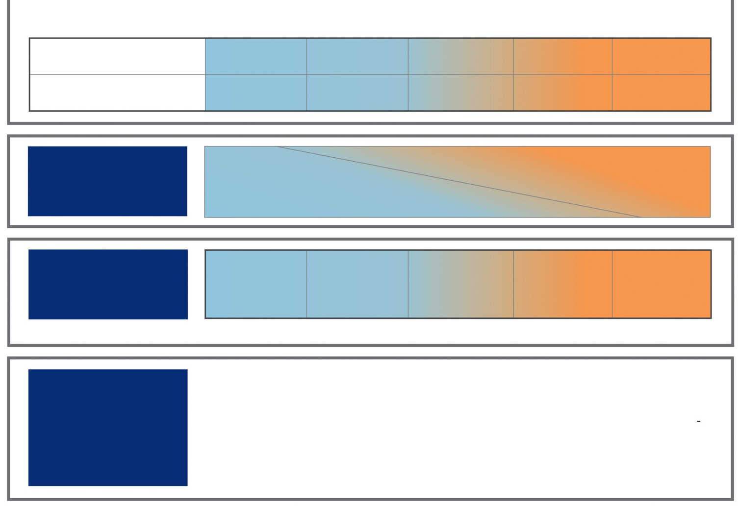
STEP 3
PERFORM
SPIROMETRY
Marked
reversible airflow limitation
(pre-post bronchodilator) or other
proof of variable airflow limitation
FEV₁/FVC < 0.7
post-BD
STEP 4
INITIAL
TREATMENT*
Asthma drugs
No LABA
monotherapy
Asthma drugs
No LABA
monotherapy
ICS and
consider LABA
+/or LAMA
COPD drugs
COPD drugs
*Consult GINA and GOLD documents for recommended treatments.
STEP 5
SPECIALISED
INVESTIGATIONS
or REFER IF:
Persistent symptoms and/or exacerbations despite treatment.
Diagnostic uncertainty (e.g. suspected pulmonary hypertension, cardiovascular diseases and other causes of respiratory symptoms).
Suspected asthma or COPD with atypical or additional symptoms or signs (e.g. haemoptysis,
weight loss, night sweats, fever, signs of bronchiectasis or other structural lung disease).
Few features of either asthma or COPD.
Comorbidities present.
Reasons for referral for either diagnosis as outlined in the GINA and GOLD strategy reports.
GINA 2016

Slide 7
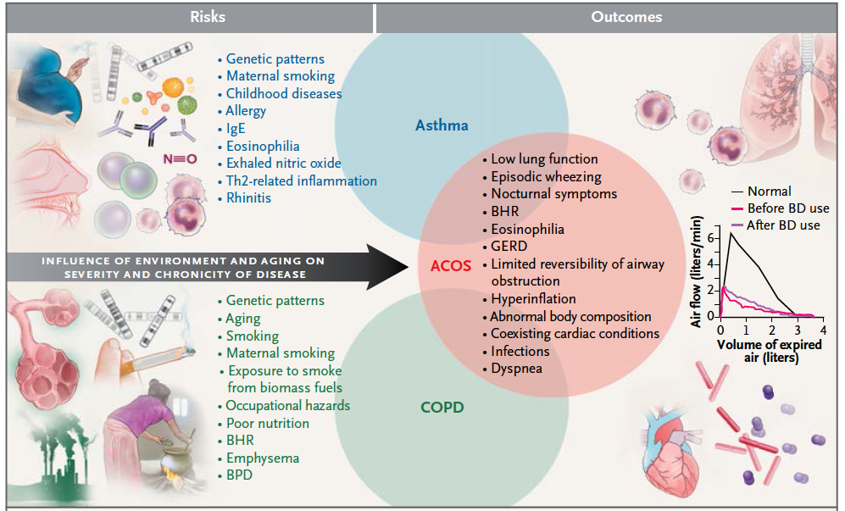
Who are the ACO?
Postma & Rabe. NEJM 2015
Notes:
El asma y la enfermedad pulmonar obstructiva crónica (EPOC) son dos enfermedades respiratorias crónicas diferentes en su etiopatogenia y fisiopatología.
Su naturaleza inflamatoria es muy diferente. La inflamación del asma es, típicamente, una inflamación de perfil Th2: con eosinófilos activados, células natural Killer y linfocitos T cooperadores (helper) tipo 2 (Th2) mastocitos y basófilos. La inflamación de la EPOC es típicamente Th1, con neutrófilos, linfocitos CD8, macrófagos, etc.
Aunque esta caracterización inmunológica define a ambas enfermedades en sus extremos, cerca del 50% de pacientes con asma presentan una inflamación no eosinofílica, y un subgrupo de ellos muestran persistencia de neutrofilia en la vía aérea, lo que se conoce como asma neutrofílico y aproximadamente un 20% de los pacientes EPOC pueden presentar un patrón inflamatorio de tipo Th2, con mayor sensibilidad al efecto de los esteroides inhalados
Más allá de la caracterización del mecanismo inflamatorio, en la práctica clínica, es relativamente frecuente encontrar pacientes con características comunes de ambas enfermedades. Difíciles de catalogar y que generan muchas dudas por tener características comunes a ambas entidades.
Se desconoce si esta situación obedece a la mera coincidencia de dos enfermedades prevalentes o si, por el contrario, subyace algún elemento patogénico común como sugiere la hipótesis holandesa y parecen probar algunos recientes trabajos sobre marcadores genéticos en el ACO

Slide 8

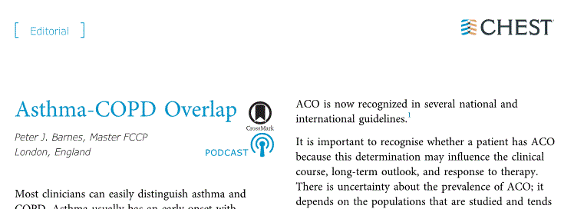
ACOs or ACO?
Barnes PJ. Asthma-COPD Overlap. Chest. 2016;149:7-8
Notes:
Un punto importante a la hora de definir el concepto es su propio nombre. La terminología.
Hasta el año pasado, el término utilizado para identificar estos pacientes era el de ACOS. Ha surgido una gran polémica en foros de discusión neumológicos sobre la pertinencia de la “s” de síndrome y finalmente parece que como propone Peter Barnes en un reciente editorial que acompaña un trabajo del grupo español de la cohorte CHAIN, parece más correcto referirnos a este solapamieto sin considerarlo como un síndorme

Slide 10
Consensus Document on the Overlap Phenotype COPD–Asthma in COPD
Major criteria
Very positive bronchodilator test (increase of FEV1 ≥ 15% and ≥ 400 ml, from baseline)
Eosinophilia in sputum
Personal history of Asthma (before 40 years)
Minor criteria
Elevated IgE
Personal history of atopy
Positive bronchodilator test on 2 or more occasions (increase in FEV1 ≥ 12% and ≥ 200 ml, from baseline)
2 major criteria
or
1 major + 2 minor

Slide 11
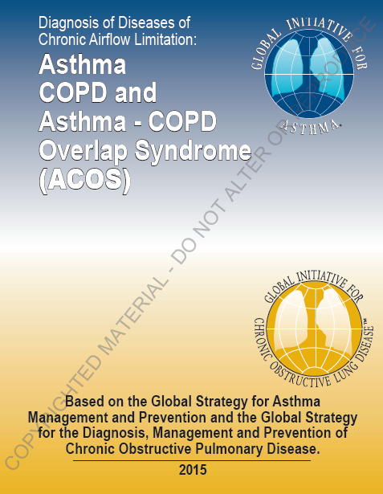

Who are the ACO?
ACO Markers
Reversibility
Bronchial hyper reactivity
Bronchial provocation test
Eosinophilia in sputum
Eosinophilia in peripheral blood
FeNO
IgE
Genetic markers
Notes:
Porque, en la práctica clínica es muy difícil diferenciar el tipo de inflamación que presenta nuestro paciente y es por ello que necesitamos marcadores que nos ayuden a diferenciar e identificar estos pacientes. Ya la GINA y la GOLD en su publicación conjunta del año 2015, proponen una serie de marcadores que pueden ayudar a identificar estos pacientes. Algunos de ellos muy asequibles para las consultas mientras otros no tanto.

Slide 12
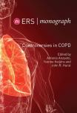
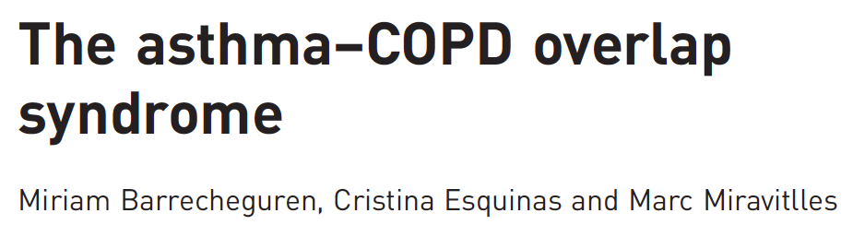

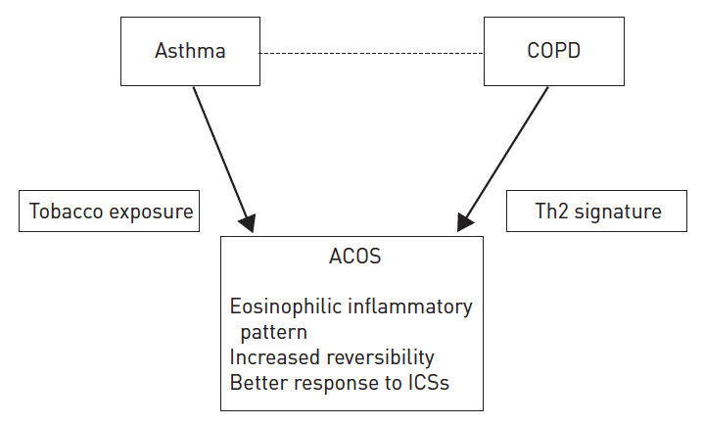
Notes:
Desde la salida de GESEPOC y la aproximación por fenotipos, en los últimos 5 años, han surgido multitud de trabajos discutiendo sobre el ACO, su definición y su diagnóstico. En este trabajo de Marc Miravitlles, otro de los padres del consenso que presentamos hoy, ya se propone un set más reducido de marcadores de ACO y un abordaje más práctico y menos restrictivo

Slide 13
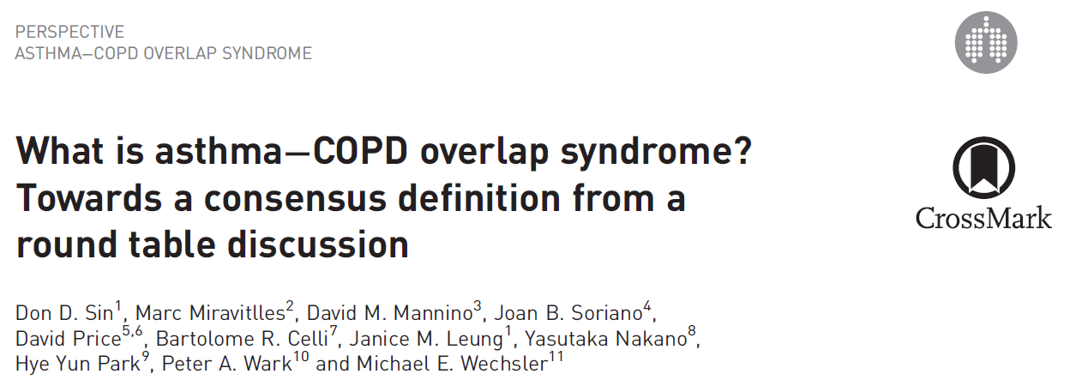
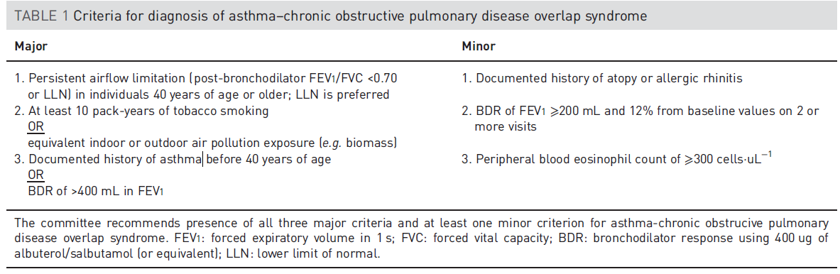
Eur Respir J 2016; 48: 664–673
3 major criteria
+
1 minor

Slide 14
"Al time" asthmatics who have smoked and developed fixed airflow obstruction
Smokers with COPD who have asthma characteristics
Notes:
Explicar consenso

Slide 15
Why is it important to identify them?
More exacerbations
More symptoms
Worse quality of life
Differently affected by co-morbidities
Increased costs
Specific treatment
Notes:
ACOS patients have more frequent exacerbations compared with patients with COPD [21,22& ,23& ].
They also have more respiratory symptoms such as dyspnoea and wheezing (but not more cough and sputum) and reduced physical activity compared with COPD alone [22& ].
ACOS patients have a lower self-rated health and more impaired health-related quality of life compared with COPD [24,25] and particularly with non-exacerbators with COPD [26].
As a consequence, ACOS patients consume from 2 to 6-fold more healthcare resources than those used by asthma or COPD patients [27]

Slide 16
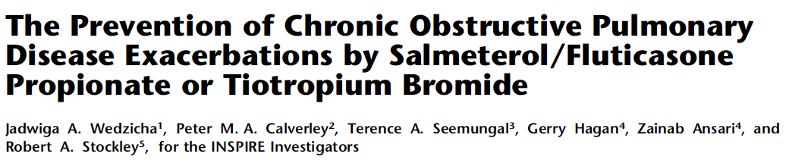
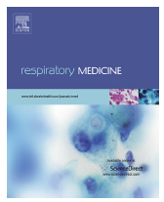
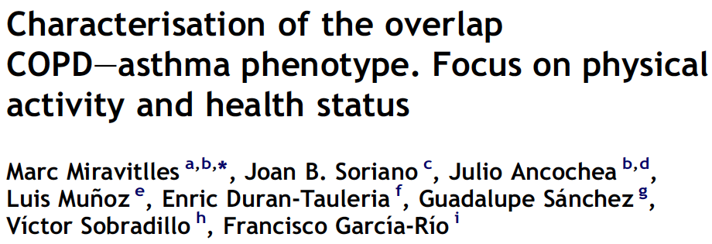
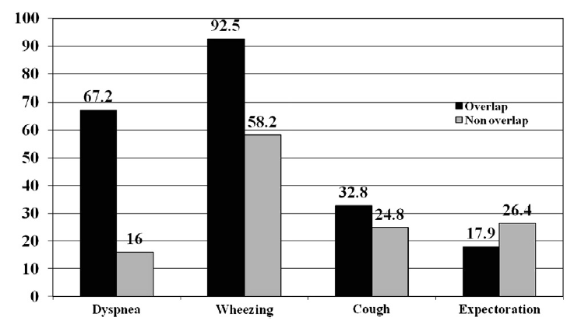


Slide 17
Post BD FEV1/FVC <70%
Smoking (or former) ≥ 10 pack-yrs
Present diagnosis of asthma
NO
YES
PBD > 15% and 400 ml
And / or blood eosinophilia > 300eosinophils/μL
YES
ACO

Slide 18
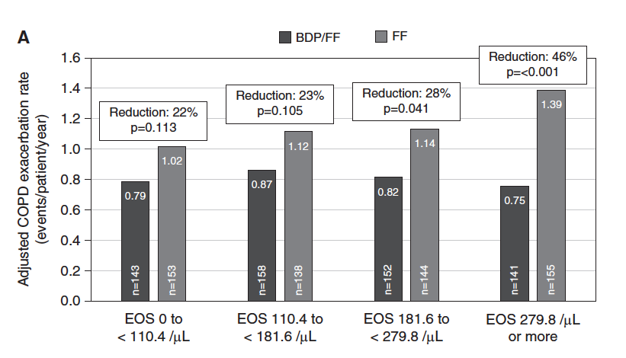
Eosinophils are a marker of response to ICS in COPD
Reduction of exacerbations
Siddiqui et al. AJRCCM 2015

Slide 19
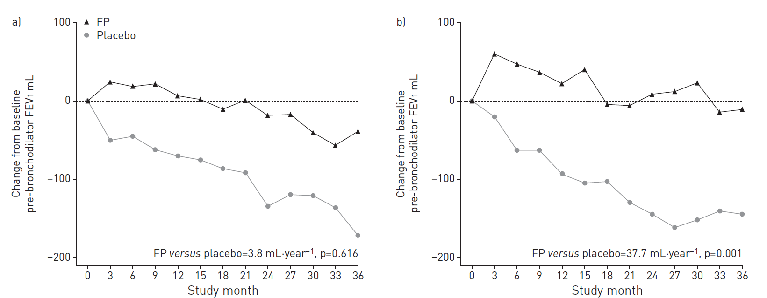
Eosinophils are a marker of response to ICS in COPD
Effect on lung function
A baseline blood eosinophil count of ⩾2% identifies a group of COPD patients with slower rates of decline in FEV1 when treated with ICS
Eos <2%
Eos >2%
Barnes N et al. ERJ 2016

Slide 20
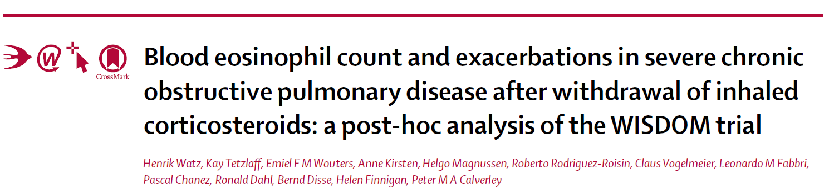
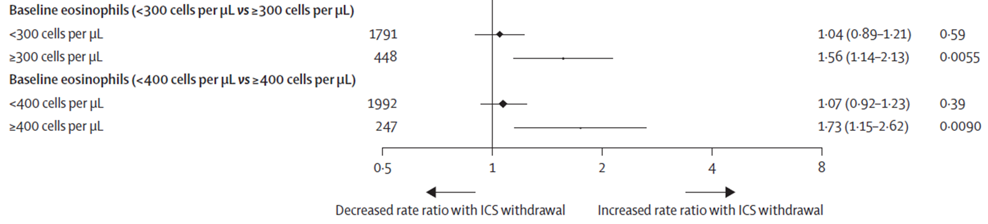
Eosinophils are a marker of response to ICS in COPD
Watz et al. Lancet Resp Med 2016

Slide 21

Respiratory Health: Adding Value
in a Resource Constrained World
In collaboration with:
GRESP Portugal
GRESP Brazil
GRAP Spain
GRAP Chile

Slide 22


Slide 23
Thank you for your attention!

