Slide 1
Chronic obstructive respiratory disease 2016. What’s new, and what isn’t
Jaime C Sousa (PT)
Ioanna Tsiligianni (GR)
Anders Østrem (NO), IPCRG

Slide 2

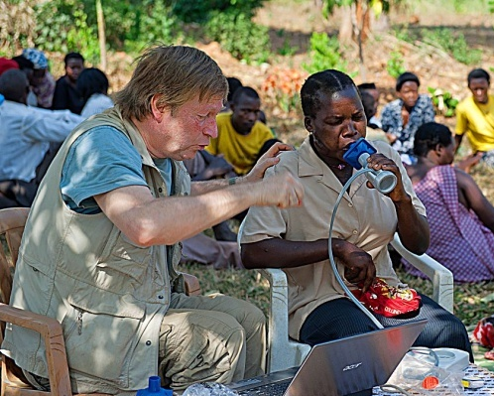
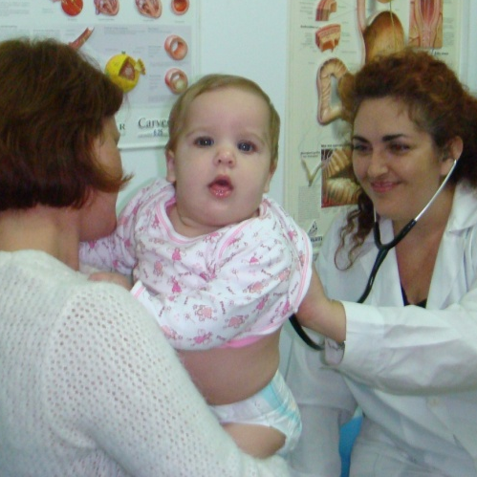
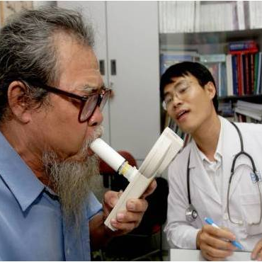
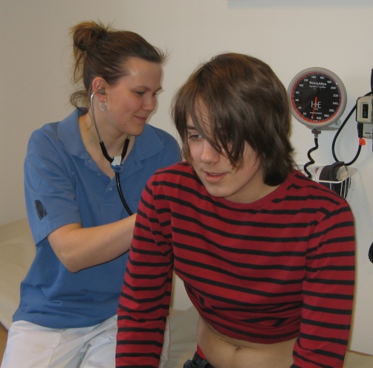
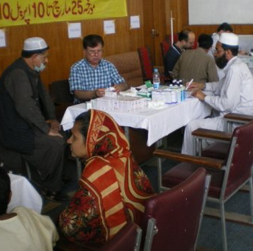
International Primary Care Respiratory Group
Promoting good clinical respiratory practice through research and education.
Notes:
Bullet page

Slide 3
What is the IPCRG?
An organisation of organisations
National primary care respiratory groups are members.
Established in 2000 and incorporated as a charity in Scotland
Currently 31 member countries with over an estimated 150,000 primary care doctors
www.theipcrg.org

Slide 4

Definition of COPD
COPD, a common preventable and treatable disease, is characterized by persistent airflow limitation that is usually progressive and associated with an enhanced chronic inflammatory response in the airways and the lung to noxious particles or gases.
Exacerbations and comorbidities contribute to the overall severity in individual patients.

Slide 5
Risk Factors for COPD
Genes
Exposure to particles
Tobacco smoke
Occupational dusts
Indoor air pollution from heating and cooking with biomass in poorly ventilated dwellings
Outdoor air pollution
Lung growth and development
Gender
Age
Respiratory infections
Socioeconomic status
Asthma/Bronchial hyperreactivity
Chronic Bronchitis

Slide 6
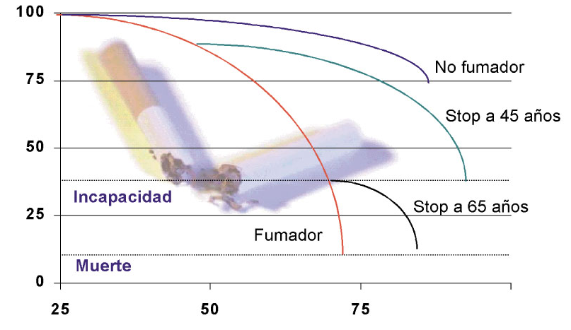
COPD-why?
FEV1
No smoker
No smoker
Stop 45 years
Disability
Stop 65 years
Current smoker
Dead
YEARS
Fletcher, Peto 1977

Slide 7
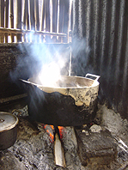
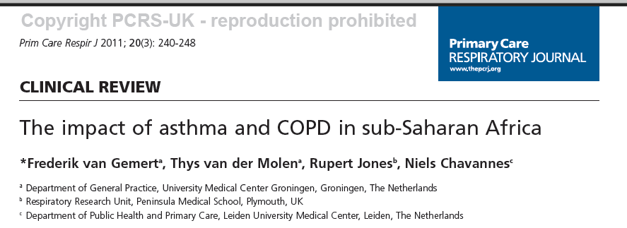
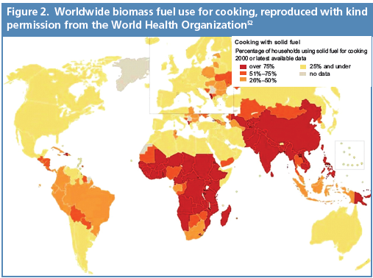
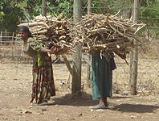
Not only smoking but smoke
Air pollution resulting from the burning of wood and other biomass fuels is estimated to kill two million women and children each year.

Slide 8
Why does early diagnosis matter?
Preserve lung function
Preserve quality of life for the patient
Encourage smoking cessation
Enable earlier interventions to prevent exacerbations
Reduce costs
Decrease mortality
Notes:
As most patients with COPD are diagnosed late in the disease, we suggested that patients would be advantaged by earlier diagnosis – in terms of lung function severity, symptoms and exacerbations – rather than clinicians simply focusing on those patients who are already diagnosed (as Enright and White suggest).

Slide 9
Barriers for early diagnosis - Doctor Centered
“Self inflicted condition”
Heartsink Disease
Misdiagnosis
Lack of motivation to actively screen
Perceived “lack of effective treatment”
Time pressures
Availability of spirometry

Slide 10
Barriers for early diagnosis - Patient Related
Low knowledge (ignorance) of the disease
Afraid of dangerous diagnosis (lung cancer)
Symptom adaptation – getting old
Excuse of the symptoms – smoker’s cough

Slide 11

.
Should we screen ALL smokers for
COPD?

Slide 12

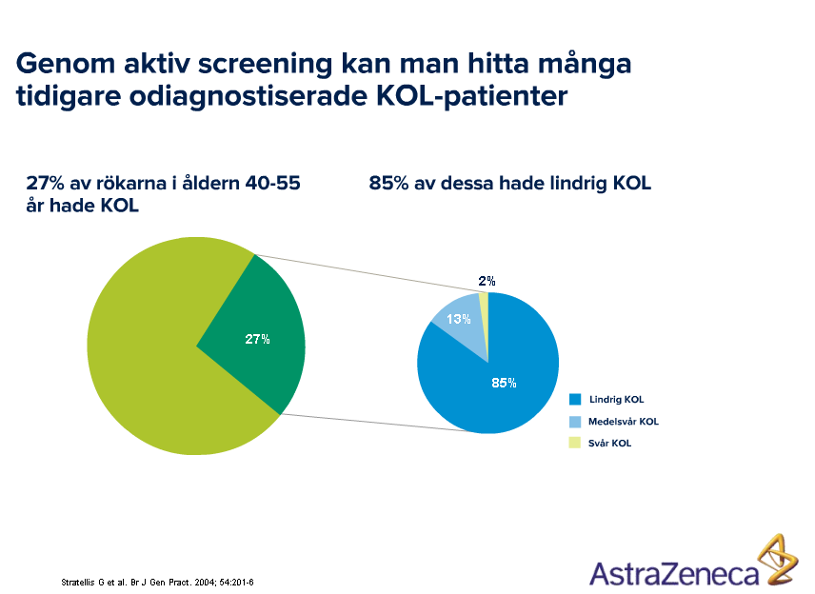
And who to screen?
With active screening you find lot of smokers with COPD, earlier unrecognised COPD
27% of the smokers, 40-55 years, had COPD
85% of those had mild COPD
Mild COPD
Moderate COPD
Severe COPD
Stratelis G et al. Br J Gen Pract 2004; 54:201-6

Slide 13
Case finding: Who should be tested with spirometry?
Smokers >10 pack-years
Age > 35
Symptoms:
Cough
Sputum
Shortness of breath
SPIROMETRY

Slide 14
Alternative approach to case-finding in primary care (IPCRG – 2009¹)
Option A
Option B
Positive on COPD risk evaluation questionnaire
Positive on IPCRG COPD risk evaluation questionnaire
Case-identification spirometry:
FEV₁ ≤80% predicted
or
FEV₁/FVC ≤80%
or
FEV₁/FEV₆ ≤80%
Smokers aged 35 years and older*
Smokers aged 35 years and older*
Symptoms suggestive of COPD
Symptoms suggestive of COPD
Diagnostic spirometry
LRTIs
Chest x-rays
Comorbidities²
*Patients aged 30 and over if high risk
1. Price D et al. Prim Care Respir J 2009
Notes:
COPD = chronic obstructive pulmonary disease; FEV_{1/6} = forced expiratory volume in 1 s/6 s; FVC = forced vital capacity.
Speaker notes
Targeted systematic case identification in primary care has been proposed as a strategy to improve diagnosis rates and enable early detection and management, including aggressive smoking cessation efforts.
The IPCRG currently recommends that all patients over 35 years old should be evaluated for their risks of developing COPD (see Figure), either by taking a history using validated screening questionnaires based on a combination of risk factors and symptoms, ‘case-identification’ spirometry, or standard diagnostic spirometry. Diagnostic spirometry should be offered to patients who have symptoms and risk factors, a positive screening questionnaire, or those who are not excluded by case-identification spirometry.
The aims of spirometry performed for case-identification purposes are to exclude those with normal lung function and identify those who require more complete investigation for COPD. In this context, spirometry protocols and standards will differ from those of spirometry performed for the purpose of achieving a definitive diagnosis. For case-identification, it is acceptable to perform a
The IPCRG proposes the following spirometry criteria for identifying symptomatic patients in whom the possibility of COPD cannot be excluded and who therefore require further diagnostic assessment for COPD (where available): FEV₁ ≤80% predicted value OR FEV₁/FVC ≤0.8 (80%) OR FEV₁/FEV₆ ≤0.8 (80%).
Reference
Price D, Crockett A, Arne M, et al. Spirometry in primary care case-identification, diagnosis and management of COPD. Prim Care Respir J 2009;18:216–23.

Slide 15
COPD case-finding questionnaire
For patients presenting with possible COPD and not suspected of having asthma
Question | Answer | Points
What is your age? | 40–49 years 50–59 years 60–69 years 70 years or older | 0 4 8 10
What is you height in metres? What is your weight in kilograms? | Calculated BMI <25.4 Calculated BMI 25.4–29.7 Calculated BMI >29.7 | 5 1 0
How many pack-years of cigarettes have you smoked? | 0–14 pack years 15–24 pack years 25–49 pack years 50+ pack years | 0 2 3 7
Does the weather affect your cough? | Yes No | 3 0
Do you ever cough up phlegm (sputum) from your chest when you don’t have a cold? | Yes No | 3 0
Do you usually cough up phlegm (sputum) from your chest first thing in the morning? | Yes No | 0 3
How frequently do you wheeze? | Never Occasionally or more often | 0 4
Do you have or have you had any allergies? | Yes No | 0 3
Ask all if they smoke
If so;
Cough
Sputum Spirometry
Shortness of breath
Price DB et al. Chest 2006
Notes:
BMI = body mass index; COPD = chronic obstructive pulmonary disease.
Speaker notes
Scoring system: add up the total number of points based on the patient’s response.
16 or few points suggests a diagnosis other than OCPD, probably asthma.
17 or more points suggests a diagnosis of COPD.
Reference
Price DB, Tinkelman DG, Nordyke RJ, et al. Scoring system and clinical application of COPD diagnostic questionnaires. Chest 2006;129:1531–9.

Slide 16

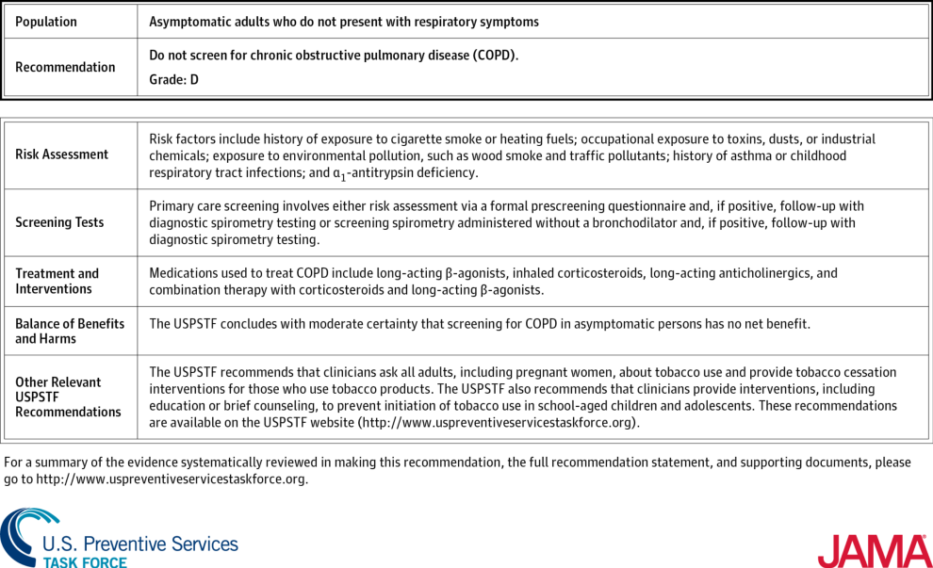
From: Screening for Chronic Obstructive Pulmonary Disease: US Preventive Services Task Force Recommendation Statement
JAMA. 2016;315(13):1372-1377. doi:10.1001/jama.2016.2638
Figure Legend:
Screening for Chronic Obstructive Pulmonary Disease: Clinical Summary
Date of download: 6/11/2016
Copyright © 2016 American Medical Association. All rights reserved.

Slide 17
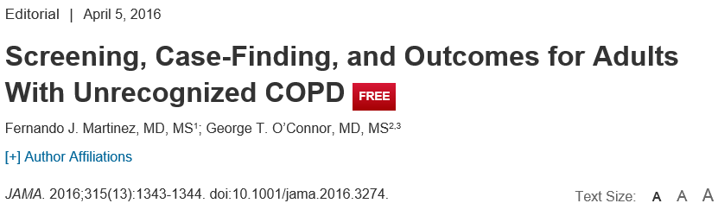
While the USPSTF recommends against screening asymptomatic adults for COPD, it does recommend that clinicians ask all adult patients about their use of tobacco and offer tobacco cessation interventions to users of tobacco products.
This recommendation is not applicable to “at-risk persons who present to clinicians with symptoms.”
For patients presenting with dyspnea and other respiratory symptoms, clinically appropriate diagnostic testing, perhaps including pulmonary function testing, is certainly warranted.
The USPSTF Recommendation Statement also “encourages clinicians… to pursue active case-finding for COPD in patients with risk factors, such as exposure to cigarette smoke….”⁶

Slide 18
Patients underestimate their condition
Data from the “Impact of COPD in Europe and North America” study in 2000¹ (n=3265) showed:
Of those too breathless to leave the house, 36% described their condition as mild or moderate
60% of those who were short of breath after walking for a few minutes on the flat described their condition as mild or moderate
1. Rennard S et al. Eur Respir J 2002;20:799–805.
Notes:
When data collected in Europe using the Confronting COPD questionnaire were combined with the American data, the results showed that for the third of patients who were too breathless to leave the house, 36% described their disease as mild or moderate, as did 60% of those who became short of breath after walking on the flat for a few minutes.¹
These data suggest that patients can understate the severity of their disease, making it difficult for physicians to assess the impact of patients’ symptoms on their lives. The data also suggest that the impact of COPD is similar in different regions despite regional differences in management of the disease.
1. Rennard S et al. Eur Respir J 2002;20:799–805.

Slide 19

Doctors and patients need to speak the same language to have a common understanding, and thus manage COPD optimally
I’m ok but I can’t walk up the stairs without losing my breath
How are you?
I’m fine, I think
Notes:
19
Improving dialogue between patients and physicians, whereby both are speaking the same language, is crucial to help patients communicate the impact of their disease, facilitating a common understanding, and thus assisting in improving the management of COPD. A survey of 121 patients with asthma or COPD highlighted the need for information about diagnostic tests, prognosis and long-term use of medication. In addition, patients wanted more written information about their disease, and one-third of patients wanted more participation in decisions about their treatment.¹
1. Koning et al. J Asthma 1995;32(5):355–363.

Slide 20
Diagnosis of COPD
A clinical diagnosis of COPD should be considered in any patient who has dyspnea, chronic cough or sputum production, and/or a history of exposure to risk factors for the disease.
Spirometry is required to make the diagnosis; the presence of a post-bronchodilator FEV₁/FVC < 0.70 confirms the presence of persistent airflow limitation and thus of COPD.

Slide 21
What do we actually want to know? And why?
FEV1 /FVC (prognosis,treatment)
Smoking status(treatment and prognosis)
Comorbidities (diagnosis, prognosis)
Symptoms (treatment, prognosis)
Dyspnea (treatment,prognosis)
Functional status (treatment)
Current treatment (treatment)
Patient goals (treatment)
Exacerbations (treatment)

Slide 22
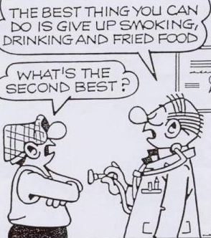
Behandling 1.
Film
Notes:
22

Slide 23
COPD Assesment
Assess symptoms-health status
Assess airflow limitation-spirometry
Assess risk of exacerbations
Assess comorbidities

Slide 24
Assess symptoms first
C | D
A | B
few Symptoms
A lot symptoms
BMRC <2
CAT<10
CCQ<1
BMRC ≥2
CAT≥10
CCQ≥1

Slide 25

Assessment of COPD
Assess symptoms
Assess degree of airflow limitation using spirometry
Assess risk of exacerbations
Assess comorbidities
COPD Assessment Test (CAT)
or
Clinical COPD Questionnaire (CCQ)
or
mMRC Breathlessness scale
© 2014 Global Initiative for Chronic Obstructive Lung Disease

Slide 26
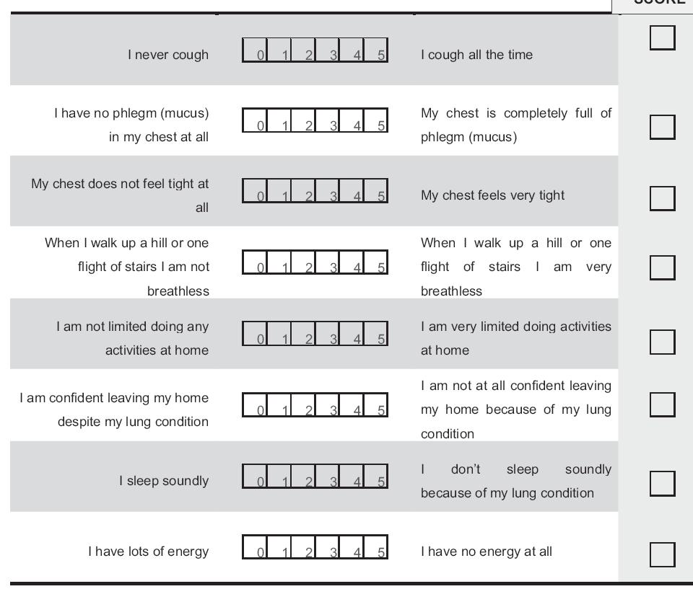
COPD Assessment Test (CAT): http://catestonline.org
Notes:
An 8-item measure of health status impairment in COPD

Slide 27
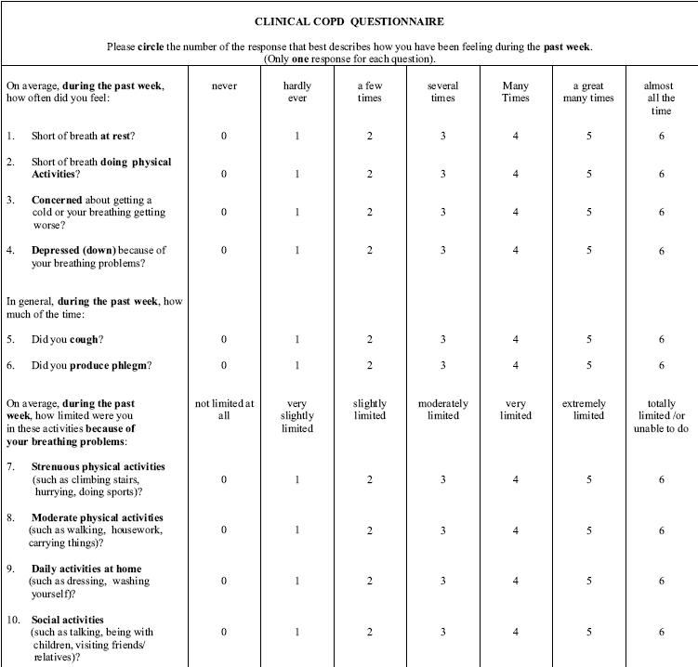
CCQ: COPD Clinical questionnaire
www.ccq.nl
Notes:
Total score (10 items )
symptom domain (4 items)
functional status domain (4 items)
mental state domain (2 items)
7 point scale: 0= asymptomatic/no limitation,
6= extremely symptomatic/totally limited

Slide 28
COPD Assesment: mMRC
Notes:
relates well to other measures of health status and predicts future mortality risk.

Slide 29
Assess risk next
GOLD
stage
C | D
A | B
Exacerbations
IV
High Risk
≥2
III
II
1
low Risk
I
0

Slide 30
Differences between COPD questionnaires
SGRQ | MRC Dyspnoea Questionnaire | CCQ | CAT
Measures impaired health and wellbeing | Measures dyspnoea only | Measures clinical disease control | Measures holistic impact of COPD on patients
Used largely in clinical trials | – | Used in clinical practice | Used in clinical practice
Long (76-items) | Short (5-items) | Short (10-items) | Short (8 items)
Patient completed | Patient completed | Patient completed | Patient completed
Computer required | Paper based | Paper based | Paper based
Complex to administer | Simple to administer | Simple to administer | Simple to administer
Notes:
30
The CAT has been designed to overcome the shortfalls of earlier questionnaires measuring disability in COPD.
This slide outlines the key differences between the CAT and the SGRQ, MRC Dyspnoea questionnaire and the CCQ.
The CAT is a simple, short, easy to use self-administered, paper-based questionnaire for use in clinical practice.
The SGRQ is significantly longer¹ than the CAT and the CCQ slightly longer (although still relatively quick to administer, approximately 2 minutes²).
The SGRQ is complex to administer and score¹ and must be analysed on a computer.
The MRC dyspnoea questionnaire measures dyspnoea only³ whereas CAT is a holistic measure of the impact of COPD on the patient,
The SGRQ is predominantly used in clinical trials;¹ other questionnaires are designed for use in clinical practice.²
1. Jones PW et al. Resp med 1991; 85 (Suppl B): 25–31;
2. Van der Molen et al. Health and Quality of Life Outcomes 2003; 1: 13–22;
3. Bestall JC et al. Thorax 1999; 54: 581–6.
13/581/B
14/19/A
15/29/A
13/581/A
13/582/A
14/15/A
15/26/A
14/14/A
15/30/A
13/581/C
14/15/A
15/26/B
13/582/A
15/26/A
15/26/B
14/19/A
15/30/A

Slide 31
Assessment of COPD
Assess symptoms
Assess degree of airflow limitation using spirometry
Assess risk of exacerbations
Assess comorbidities
Use spirometry for grading severity according to spirometry, using four grades split at 80%, 50% and 30% of predicted value
© 2014 Global Initiative for Chronic Obstructive Lung Disease

Slide 32
Classification of Severity of Airflow Limitation in COPD*
In patients with FEV₁/FVC < 0.70:
GOLD 1: Mild FEV₁ > 80% predicted
GOLD 2: Moderate 50% < FEV₁ < 80% predicted
GOLD 3: Severe 30% < FEV₁ < 50% predicted
GOLD 4: Very Severe FEV₁ < 30% predicted
*Based on Post-Bronchodilator FEV₁

Slide 33
Assessment of risk;
Assess degree of airflow limitation, FEV1.
Assess exacerbations
Use history of exacerbations.
Two exacerbations or more within the last year
indicates of high risk risk or
Hospitalization for a COPD exacerbation.
© 2014 Global Initiative for Chronic Obstructive Lung Disease

Slide 34
Classification of COPD
Obstruction
Exacerbations
C | D
A | B
IV
High Risk
≥2
III
II
1
low Risk
I
0
BMRC <2
CAT<10
CCQ<1
BMRC ≥2
CAT≥10
CCQ≥1
Symptoms

Slide 35
Treatment options COPD
Patient group | Non-pharmacologic treatment | First choice | Alternative choice
A |  | SAMA prn or SABA prn | LAMA or LABA or SABA and SAMA
B |  | LAMA or LABA | LAMA and LABA
C |  | ICS + LABA or LAMA | LAMA and LABA or LAMA and PDE4-inh. or LABA and PDE4-inh.
D |  | ICS + LABA and/or LAMA | ICS + LABA and LAMA or ICS+LABA and PDE4-inh. or LAMA and LABA or LAMA and PDE4-inh.
Smoking cessation
Flu vaccination
Pulmonary rehabilitation
Physical activity

Slide 36
Combined Assessment of COPD (Assess symptoms first)
≥ 2
or
> 1 leading
to hospital
admission
1 (not leading
to hospital
admission)
4
(C)
(D)
3
Risk
(GOLD Classification of Airflow Limitation))
Risk
(Exacerbation history)
2
(A)
(B)
1
0
CAT < 10
CAT > 10
Symptoms
mMRC 0–1
mMRC > 2
Breathlessness
© 2014 Global Initiative for Chronic Obstructive Lung Disease

Slide 37
Smoking Cessation
Effects of smoking cessation intervention on COPD patients
Reasons why GPs keep their distance from the SC intervention
How could we overcome these barriers?
SC is the only effective intervention to prevent, to slow progress and to improve outcome in COPD!
Smoking is the most important single cause of morbidity and mortality.

Slide 38
Smoking cessation improves lung function in mild/moderate COPD
Over 5-years, the rate of decline in FEV₁ among quitters was half the rate among smokers (31±48 mL versus 62±55 ml, p<0.001)
82
840
673
146
599
541
Quitters
Smokers
80
208
54
507
78
2682
152
23
2335
37
% predicted FEV₁
134
76
2059
74
1818
124
1652
72
0
0
1
2
3
4
5
Study visit (year)
Scanlon PD et al. Am J Respir Crit Care Med 2000
Numbers of patients are shown in circles
Notes:
FEV₁ = forced expiratory volume in 1 second.
Speaker notes
Current smokers, 35−60 years of age, with mild-to-moderate airflow limitation were enrolled (N=5,887).
Participants were randomized, on a 2:1 basis, to engage in an intensive, long-term smoking cessation program or to receive usual care.
Participants in both groups completed annual health questionnaires and lung function measurements and participants was followed for 5 yr.
Participants who stopped smoking experienced an improvement in FEV₁ in the year after quitting (an average of 47 ml or 2% improvement).
The rate of decline in FEV₁ among sustained quitters was half the rate among continuing smokers (31±48 mL vs 62± 55 ml; mean ± SD), which was comparable to never-smokers.
Results indicate that smokers with airflow obstruction will benefit from quitting despite previous smoking history.
Reference
Scanlon PD, Connett JE, Waller LA, et al. for the Lung Health Study Research Group. Smoking cessation and lung function in mild-to-moderate chronic obstructive pulmonary disease: The Lung Health Study. Am J Respir Crit Care Med 2000;161:381–90.

Slide 39
Therapy-what GOLD says?
Patient Group | Recommended First Choice | Alternative Choice | Other Possible Treatments
A Less symptoms, low risk | SAMA or SABA | LAMA or LABA or SAMA + SABA | Theophylline
B More symptoms, low risk | LAMA or LABA | LAMA + LABA | SAMA + SABA or Theophylline
C Less symptoms, high risk | LABA + ICS or LAMA | LAMA + LABA or LAMA + PD4I or LABA + PD4I | SABA and/or SAMA and/or Theophylline
D More symptoms, high risk | LABA + ICS and/or LAMA | LABA + ICS + LAMA Or LABA + ICS + PD4I or LAMA + LABA or LAMA `+ PD4I | Carbocysteine SABA and/or SAMA Theophylline
Low risk- No ICS
Vestbo J,. Am J Respir Crit Care Med 2013; 187: 347–365

Slide 40
COPD Assesment:
Co-morbidities
COPD patients are at increased risk for:
Cardiovascular diseases
Osteoporosis
Respiratory infections
Anxiety and Depression
Diabetes
Lung cancer
These comorbid conditions may influence mortality and hospitalizations and should be looked for routinely, and treated appropriately.

Slide 41
What GOLD says
Patient Group | Recommended First Choice | Alternative Choice | Other Possible Treatments
A Less symptoms, low risk | SAMA or SABA | LAMA or LABA or SAMA + SABA | Theophylline
B More symptoms, low risk | LAMA or LABA | LAMA + LABA | SAMA + SABA or Theophylline
C Less symptoms, high risk | LABA + ICS or LAMA | LAMA + LABA or LAMA + PD4I or LABA + PD4I | SABA and/or SAMA and/or Theophylline
D More symptoms, high risk | LABA + ICS and/or LAMA | LABA + ICS + LAMA Or LABA + ICS + PD4I or LAMA + LABA or LAMA `+ PD4I | Carbocysteine SABA and/or SAMA Theophylline
Low risk- No ICS
Vestbo J,. Am J Respir Crit Care Med 2013; 187: 347–365
Notes:
Speaker Notes
Pharmacotherapy for patients with COPD varies by ABCD classification.
Bronchodilators are prescribed on an as-needed basis, or on a regular basis to prevent or reduce symptoms.
Long-acting bronchodilators are convenient and more effective at producing maintained symptom relief than short-acting bronchodilators.
Combining bronchodilators from different pharmacological classes may improve efficacy and decrease the risk of side effects compared to increasing the dose of a single bronchodilator.
Reference
Global Strategy for the Diagnosis, Management, and Prevention of Chronic Obstructive Pulmonary Disease, Global Initiative for Chronic Obstructive Lung Disease (GOLD) 2013. Available from: http://www.goldcopd.org.
ANNOTATION: p36A

Slide 42
A patient with COPD
A 58-year-old man was diagnosed with COPD 10 years before
He has dyspnea after walking a few meters
Current smoker (smoking history ~70 PY)
No comorbidities apart of hypertension (ACE inhibitor)
Physical examination: reduced breath sounds
SaO₂ 98%, BMI 30 kg/m², HR 72 bpm, BP 135/90 mmHg
He had one chest infection in the previous year for which he received a course of oral antibiotics
FEV1% pred: 57%

Slide 43
What is the initial treatment option for this patient?

Slide 44

GOLD 2011–2015 Combined assessment of COPD
4
≥2
or ≥1 leading to hospital admission
Patients are classified in one of four groups:
A: Low risk, less symptoms
B: Low risk, more symptoms
C: High risk, less symptoms
D: High risk, more symptoms
C
D
3
Risk
no. of exacerbations in previous year
Risk
GOLD classification of airflow limitation
2
1 (not leading to hospital admission)
A
B
1
0
mMRC 0‒1
CAT <10
mMRC ≥2
CAT ≥10
Symptoms
mMRC or CAT Score
GOLD 2014
Notes:
CAT = COPD Assessment Test; COPD = chronic obstructive pulmonary disease; GOLD = Global initiative for Chronic Obstructive Lung Disease; mMRC = modified Medical Research Council.
Reference
GOLD. Global Strategy for the Diagnosis, Management, and Prevention of Chronic Obstructive Pulmonary Disease, Updated 2014. Available at http://www.goldcopd.com/

Slide 45
GOLD 2015 Manage stable COPD: Pharmacologic (initial)*
Patient | Recommended first choice | Alternative choice |  | Other possible treatments†
A | SAMA prn or SABA prn | LAMA or LABA or SABA and SAMA |  | Theophylline
B | LAMA or LABA | LAMA and LABA |  | SABA and/or SAMA Theophylline
C | ICS + LABA or LAMA | LAMA and LABA or LAMA and PDE4-inh. or LABA and PDE4-inh. |  | SABA and/or SAMA Theophylline
D | ICS + LABA and/or LAMA | ICS + LABA and LAMA or ICS+LABA and PDE4-inh. or LAMA and LABA or LAMA and PDE4-inh. |  | Carbocysteine SABA and/or SAMA Theophylline
*Medications in each box are mentioned in alphabetical order, and therefore not necessarily in order of preference
†Medications in this column can be used alone or in combination with other options in the recommended first choice and alternative choice columns
GOLD 2014
Notes:
GOLD = Global initiative for chronic Obstructive Lung Disease; ICS = inhaled corticosteroids; LABA = long-acting β₂-agonist; LAMA = long-acting muscarinic antagonist; PDE-4inh. = phosphodiesterase type 4 inhibitor; SABA = short-acting β₂-agonist; SAMA = short-acting muscarinic antagonist.
Speaker notes
Medications in each box are mentioned in alphabetical order, and therefore not necessarily in order of preference.
There is no evidence to recommend one class of long-acting bronchodilators over another.
Only short-term studies of combination of long-acting bronchodilators are available and patients should be carefully followed and the treatment effect evaluated.
Theophylline or carbocysteine may be used if LABD are unavailable or unaffordable
Reference
GOLD. Global Strategy for the Diagnosis, Management, and Prevention of Chronic Obstructive Pulmonary Disease, Updated 2014. Available at http://www.goldcopd.com/

Slide 46
Burden may be further exacerbated by inappropriate treatment with ICS (GOLD B)
GOLD first choice therapy
GOLD second choice therapy
% of patients
N=3191
Baldwin M, Jones R, Price D et al. IPCRG 2014
Data derived from the Optimum Patient Care Database

Slide 47
Tiotropium vs LABA
7 studies in Cochrane review with 12,223 participants
Tio Vs salmeterol, formoterol and indacaterol
Compared with LABA, Tiotropium less:
participants with >=1 exacerbations
(OR 0.86; 95% CI 0.79 to 0.93)
serious adverse events (OR 0.88; 95% CI 0.78 to 0.99)
no statistical difference in FEV1 or mortality
Tio some evidence of more cost-effective in six economic evaluations
Chong J, Karner C, Poole P. Tiotropium versus long-acting beta-agonists for stable COPD. Cochrane Database of Systematic Reviews 2012, Issue 9. Art. No.: CD009157
Notes:
All the studies estimated tiotropium to be better than salmeterol based on medical outcomes (exacerbations or quality of life) and/or lower total costs, including respiratory medications and hospitalisations.

Slide 48
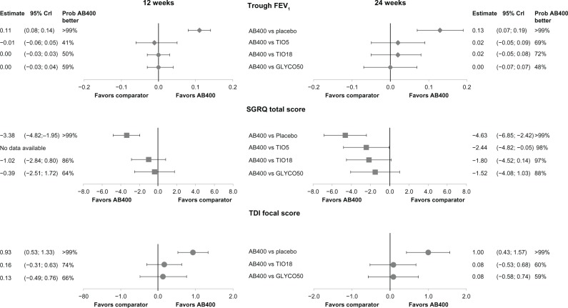
Which LAMA? Systematic review- Aclidinium vs Glycopyrrium and Tio
Not much difference between them
Karabis A, Lindner L, Mocarski M, et al. Int J Chron Obstruct Pulmon Dis. 2013;8:405-423.
Notes:
BACKGROUND:
Aclidinium bromide is a new long-acting muscarinic antagonist (LAMA) indicated for maintenance bronchodilator treatment of chronic obstructive pulmonary disease (COPD). The efficacy of aclidinium was compared with tiotropium and glycopyrronium, using a network meta-analysis (NMA) of randomized controlled trials (RCTs) in moderate-to-severe COPD patients.
METHODS:
A systematic review was performed to identify RCTs evaluating aclidinium 400 μg twice daily (BID), glycopyrronium 50 μg once daily (OD), tiotropium 18 μg OD, or tiotropium 5 μg OD in adults with moderate-to-severe COPD. The outcomes of interest were: trough forced expiratory volume in 1 second (FEV1); St George's Respiratory Questionnaire (SGRQ) total score and proportion of patients achieving ≥4 unit change; Transition Dyspnea Index (TDI) focal score and proportion of patients achieving ≥1 point change. The results were synthesized by means of a Bayesian NMA.
RESULTS:
Twenty-one studies (22,542 patients) were included: aclidinium 400 μg BID (three studies); tiotropium 5 μg OD (three studies); tiotropium 18 μg OD (13 studies); and glycopyrronium 50 μg OD (two studies). Regarding trough FEV1 at 24 weeks, aclidinium demonstrated comparable efficacy to tiotropium 5 μg (difference in change from baseline [CFB]), (0.02 L [95% credible interval CrI -0.05, 0.09]); tiotropium 18 μg (0.02 L [95% CrI -0.05, 0.08]); and glycopyrronium (0.00 L [95% CrI -0.07, 0.07]). Aclidinium resulted in higher improvement in SGRQ score at 24 weeks, compared to tiotropium 5 μg (difference in CFB, -2.44 [95% CrI -4.82, -0.05]); and comparable results to tiotropium 18 μg (-1.80 [95% CrI -4.52, 0.14]) and glycopyrronium (-1.52 [95% CrI -4.08, 1.03]). Improvements in TDI score were comparable for all treatments.
CONCLUSION:
Maintenance treatment with aclidinium 400 μg BID is expected to produce similar improvements in lung function, health-related quality of life, and dyspnea compared to tiotropium 5 μg OD; tiotropium 18 μg OD; and glycopyrronium 50 μg OD.

Slide 49
Same patient
Our patient received tiotropium 18 μg once daily
He didn’t wanted to quit smoking
Improvement in symptoms after 3 months but still breathlesness on exertion
What would you do?

Slide 50
Global Strategy for Diagnosis, Management and Prevention of COPD Manage Stable COPD: Non-pharmacologic
Patient Group | Essential | Recommended | Depending on local guidelines
A | Smoking cessation (can include pharmacologic treatment) | Physical activity | Flu vaccination Pneumococcal vaccination
B, C, D | Smoking cessation (can include pharmacologic treatment) Pulmonary rehabilitation | Physical activity | Flu vaccination Pneumococcal vaccination
© 2015 Global Initiative for Chronic Obstructive Lung Disease

Slide 51
GOLD 2015 Manage stable COPD: Pharmacologic (initial)*
Patient | Recommended first choice | Alternative choice |  | Other possible treatments†
A | SAMA prn or SABA prn | LAMA or LABA or SABA and SAMA |  | Theophylline
B | LAMA or LABA | LAMA and LABA |  | SABA and/or SAMA Theophylline
C | ICS + LABA or LAMA | LAMA and LABA or LAMA and PDE4-inh. or LABA and PDE4-inh. |  | SABA and/or SAMA Theophylline
D | ICS + LABA and/or LAMA | ICS + LABA and LAMA or ICS+LABA and PDE4-inh. or LAMA and LABA or LAMA and PDE4-inh. |  | Carbocysteine SABA and/or SAMA Theophylline
*Medications in each box are mentioned in alphabetical order, and therefore not necessarily in order of preference
†Medications in this column can be used alone or in combination with other options in the recommended first choice and alternative choice columns
GOLD 2014
Notes:
GOLD = Global initiative for chronic Obstructive Lung Disease; ICS = inhaled corticosteroids; LABA = long-acting β₂-agonist; LAMA = long-acting muscarinic antagonist; PDE-4inh. = phosphodiesterase type 4 inhibitor; SABA = short-acting β₂-agonist; SAMA = short-acting muscarinic antagonist.
Speaker notes
Medications in each box are mentioned in alphabetical order, and therefore not necessarily in order of preference.
There is no evidence to recommend one class of long-acting bronchodilators over another.
Only short-term studies of combination of long-acting bronchodilators are available and patients should be carefully followed and the treatment effect evaluated.
Theophylline or carbocysteine may be used if LABD are unavailable or unaffordable
Reference
GOLD. Global Strategy for the Diagnosis, Management, and Prevention of Chronic Obstructive Pulmonary Disease, Updated 2014. Available at http://www.goldcopd.com/

Slide 52
What if this patient had a history of hospitalization because of an exacerbation in the previous year and/or an FEV₁ of 37% predicted?

Slide 53
GOLD 2011–2015 Combined assessment of COPD
4
≥2
or ≥1 leading to hospital admission
Patients are classified in one of four groups:
A: Low risk, less symptoms
B: Low risk, more symptoms
C: High risk, less symptoms
D: High risk, more symptoms
C
D
3
Risk
no. of exacerbations in previous year
Risk
GOLD classification of airflow limitation
2
1 (not leading to hospital admission)
A
B
1
0
mMRC 0‒1
CAT <10
mMRC ≥2
CAT ≥10
Symptoms
mMRC or CAT Score
GOLD 2014
Notes:
CAT = COPD Assessment Test; COPD = chronic obstructive pulmonary disease; GOLD = Global initiative for chronic Obstructive Lung Disease; mMRC = modified Medical Research Council.
Reference
GOLD. Global Strategy for the Diagnosis, Management, and Prevention of Chronic Obstructive Pulmonary Disease, Updated 2014. Available at http://www.goldcopd.com/

Slide 54
ICS + LABA is more effective than monocomponents alone in improving lung function, health status and exacerbations in patients with moderate to severe COPD
Patient | Recommended first choice | Alternative choice |  | Other possible treatments†
A | SAMA prn or SABA prn | LAMA or LABA or SABA and SAMA |  | Theophylline
B | LAMA or LABA | LAMA and LABA |  | SABA and/or SAMA Theophylline
C | ICS + LABA or LAMA | LAMA and LABA or LAMA and PDE4-inh. or LABA and PDE4-inh. |  | SABA and/or SAMA Theophylline
D | ICS + LABA and/or LAMA | ICS + LABA and LAMA or ICS+LABA and PDE4-inh. or LAMA and LABA or LAMA and PDE4-inh. |  | Carbocysteine SABA and/or SAMA Theophylline
*Medications in each box are mentioned in alphabetical order, and therefore not necessarily in order of preference. †Medications in this column can be used alone or in combination with other options in the recommended first choice and alternative choice columns
GOLD 2014
Notes:
GOLD = Global initiative for chronic Obstructive Lung Disease; ICS = inhaled corticosteroids; LABA = long-acting β₂-agonist; LAMA = long-acting muscarinic antagonist; PDE-4inh. = phosphodiesterase type 4 inhibitor; QoL = quality of life; SABA = short-acting β₂-agonist; SAMA = short-acting muscarinic antagonist.
Speaker notes
Medications in each box are mentioned in alphabetical order, and therefore not necessarily in order of preference.
There is no evidence to recommend one class of long-acting bronchodilators over another.
Only short-term studies of combination f long-acting bronchodilators are available and patients should be carefully followed and the treatment effect evaluated.
Theophylline or carbocysteine may be used if LABD are unavailable or unaffordable.
Reference
GOLD. Global Strategy for the Diagnosis, Management, and Prevention of Chronic Obstructive Pulmonary Disease, Updated 2014. Available at http://www.goldcopd.com/

Slide 55
Patients who may benefit from ICS
Asthma-COPD overlap syndrome
Eosinophilic airway inflammation
Frequent exacerbators (on effective bronchodilation)
Patients who are already on ICS (?)
Notes:
COPD = chronic obstructive pulmonary disease; ICS = inhaled corticosteroid.

Slide 56
Case 2
Man, 68 years old.
Contact due to increased shortness of breath in periods and is coughing.
Past medical history; retired, office worker.
Smokes 15-20 cigarettes pr day since 14 years old.
Feels quite well, over the years been treated for pneumonia, last year had three episodes of “bronchitis” for which he received antibiotics.
Less active than before but has not thought much about this, puts it down to age.
Examination; Blood pressure normal, Normal lung sounds, ECG normal, no temperature, normal CRP.

Slide 57
Describe the curve
Interpreter the reversibility test
More information?
Diagnosis?
Management?
CCQ = 1,6

Slide 58
Classification of COPD
Obstruction
Exacerbations
C | D
A | B
IV
High Risk
≥2
III
II
1
low Risk
I
0
BMRC <2
CAT<10
CCQ<1
BMRC ≥2
CAT≥10
CCQ≥1
Symptoms

Slide 59
Treatment options COPD
Patient group | Non-pharmacologic treatment | First choice | Alternative choice
A |  | SAMA prn or SABA prn | LAMA or LABA or SABA and SAMA
B |  | LAMA or LABA | LAMA and LABA
C |  | ICS + LABA or LAMA | LAMA and LABA or LAMA and PDE4-inh. or LABA and PDE4-inh.
D |  | ICS + LABA and/or LAMA | ICS + LABA and LAMA or ICS+LABA and PDE4-inh. or LAMA and LABA or LAMA and PDE4-inh.
Smoking cessation
Flu vaccination
Pulmonary rehabilitation
Physical activity

Slide 60
What did I do?
Smoking cessation:
He was struck by the loss of lung function (Fev1 = 53%).
Varenicline + follow-up
Information about COPD
Referred to physiotherapist for exercise programme.
Medication; ICS/LABA combination
Chest x-ray.
Regular follow-up, first in 6 weeks.

Slide 61
Thank you!!!!!!!!!!!
www.theipcrg.org

