Slide 1
Influenza guidelines for GPs/FPs
Jaime Correia de Sousa, MD, MSc, PhD
Family Physician, Matosinhos, Portugal
Associate Professor, School of Medicine, Minho University, Portugal
President of the International Primary Care Respiratory Group

Slide 2
Session Outline
Main recommendations for influenza vaccination
  WHO, CDC, ECDC,
  GINA, GOLD
  IPCRG, ERS, ESWI
Where is the evidence?

Slide 3



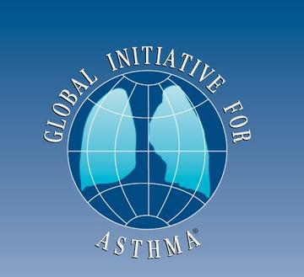



Main recommendations for influenza vaccination

Slide 4
Vaccines against influenza
WHO position paper
Pregnant women should be vaccinated with trivalent inactivated vaccines (TIV) at any stage of pregnancy.
Children aged <6 months are not eligible to receive currently licensed influenza vacines.
Children aged 6–23 months, because of a high burden of severe disease in this group, should be considered a target group for influenza immunization when sufficient resources are available and with due consideration for competing health priorities and operational feasibility.
November 2012

Slide 5
Vaccines against influenza
WHO position paper
Children aged 2–5 years have a high burden of disease, but less than those aged <2 years. Children aged 2–5 years respond better to vaccination with TIV than younger children.
Elderly persons (≥65 years of age) have the highest risk of mortality from influenza, and vaccination of the elderly has traditionally been the main focus of influenza vaccine policy.
Increasing evidence demonstrates that available influenza vaccines are less effective in this population compared to younger adults.
Persons with specific chronic diseases are at high risk for severe influenza.
Health-care workers are an important priority group for influenza vaccination, not only to protect the individual and maintain health-care services during influenza epidemics, but also to reduce spread of influenza to vulnerable patient groups.
November 2012

Slide 6
Vaccination: Who Should Do It, Who Should Not and Who Should Take Precautions
Everyone 6 months and older is recommended for annual flu vaccination with rare exception.
For the 2016-2017 season, CDC recommends use of injectable flu vaccines--inactivated influenza vaccine (or IIV) or the recombinant influenza vaccine (RIV).
The nasal spray flu vaccine (live attenuated influenza vaccine or LAIV) should not be used during 2016-2017.
Vaccination is particularly important for people who are at high risk for serious flu complications from influenza.
https://www.cdc.gov/flu/protect/whoshouldvax.htm
Updated 7 September 2016

Slide 7
Seasonal influenza vaccination in Europe
All 31 Member States indicated that they had implemented national seasonal influenza vaccination recommendations (e.g. age, risk and target group recommendations and guidelines).
The seasonal influenza vaccination was recommended for patients with immunosuppression due to disease or treatment; metabolic disorders; and chronic pulmonary, cardiovascular and renal diseases.
28 Member States recommended vaccination of individuals with hepatic disease and HIV/AIDS. In the 2012–13 influenza season, vaccination for those with morbid obesity was recommended in 15 countries.
28 Member States indicated that influenza vaccination was recommended for pregnant women.
30 Member States recommend vaccination for Healthcare workers.
ECDC Technical Report 2015

Slide 8

Global Strategy for Asthma Management and Prevention
Influenza causes significant morbidity and mortality in the general population, and the risk can be reduced by annual vaccination.
Influenza contributes to some acute asthma exacerbations, and patients with moderate-severe asthma are advised to receive an influenza vaccination every year, or when vaccination of the general population is advised (Evidence D).
However, patients should be advised that vaccination is not expected to reduce the frequency or severity of asthma exacerbations (Evidence A).
There is no evidence for an increase in asthma exacerbations after vaccination with inactivated trivalent vaccines compared to placebo.
GINA 2016 Update

Slide 9
Global Strategy for the Diagnosis, Management, and Prevention of Chronic Obstructive Pulmonary Disease
Influenza and pneumococcal vaccination should be offered to every COPD patient.
Influenza vaccination can reduce serious illness (such as lower respiratory tract infections requiring hospitalization and death in COPD patients (Evidence A).
Vaccines containing killed or live, inactivated viruses are recommended as they are more effective in elderly patients with COPD.
The strains are adjusted each year for appropriate effectiveness and should be given once each year.
GOLD 2016 Update

Slide 10
IPCRG Position Paper
Primary care and chronic lung disease
Influenza vaccination plays its part in reducing COPD and asthma exacerbations
IPCRG Position Paper Number 1, September 2011

Slide 11
European Respiratory Society
Guidelines
Eur Respir J 2005

Slide 12
European Respiratory Society
Guidelines
Recommendations for influenza vaccination
The influenza vaccine should be given yearly to persons at increased risk for complications due to influenza.
Vaccination is recommended for immunocompetent adults belonging to one, or more, of the following categories:
  aged ≥ 65 yrs;
  institutionalisation;
  chronic cardiac diseases;
  chronic pulmonary diseases;
  diabetes mellitus;
  chronic renal diseases;
  haemoglobinopathies;
  females who will be in the second or third trimester of pregnancy during the influenza season
Eur Respir J 2005

Slide 13

The European Scientific Working Group on Influenza (ESWI)

Slide 14
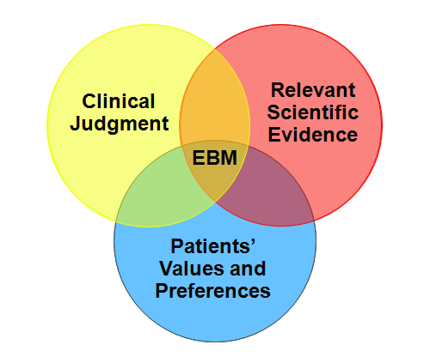
Where is the evidence?

Slide 15

Influenza vaccine for patients with chronic obstructive pulmonary disease
It appears, from the limited number of studies performed, that inactivated vaccine reduces exacerbations in COPD patients.
The size of effect was similar to that seen in large observational studies, and was due to a reduction in exacerbations occurring three or more weeks after vaccination, and due to influenza.
There is a mild increase in transient local adverse effects with vaccination, but no evidence of an increase in early exacerbations.
Published 25 January 2006

Slide 16
Vaccines for preventing influenza in the elderly
The available evidence is of poor quality and provides no guidance regarding the safety, efficacy or effectiveness of influenza vaccines for people aged 65 years or older.
To resolve the uncertainty, an adequately powered publicly-funded randomised, placebo-controlled trial run over several seasons should be undertaken.
Published 17 February 2010

Slide 17
Vaccines to prevent influenza in healthy adults
Influenza vaccines have a very modest effect in reducing influenza symptoms and working days lost in the general population, including pregnant women.
No evidence of association between influenza vaccination and serious adverse events was found in the comparative studies considered in the review.
This review includes 90 studies, 24 of which (26.7%) were funded totally or partially by industry. Out of the 48 RCTs, 17 were industry-funded (35.4%).
Published 13 March 2014

Slide 18
Influenza vaccination for healthcare workers who care for people aged 60 or older living in long-term care institutions
Our review findings have not identified conclusive evidence of benefit of HCW vaccination programmes on specific outcomes of laboratory-proven influenza, its complications (lower respiratory tract infection, hospitalisation or death due to lower respiratory tract illness), or all cause mortality in people over the age of 60 who live in care institutions.
This review did not find information on co-interventions with healthcare worker vaccination: hand-washing, face masks, early detection of laboratory-proven influenza, quarantine, avoiding admissions, antivirals and asking healthcare workers with influenza or influenza-like illness (ILI) not to work.
This review does not provide reasonable evidence to support the vaccination of healthcare workers to prevent influenza in those aged 60 years or older resident in LTCIs. High quality RCTs are required to avoid the risks of bias in methodology and conduct identified by this review and to test further these interventions in combination.
Published 2 June 2016

Slide 19
The authors re-arranged the Cochrane data according to a biological and conceptual framework based on the basic sequence of events throughout the ‘patient journey’ (exposure, infection, clinical outcome, observation) and using broad outcome definitions
They regard these findings as substantial evidence for the ability of influenza vaccine to reduce the risk of influenza infection and influenza-related disease and death in the elderly.

Slide 20
Conclusions
Most Public Health authorities and respiratory organizations recommend influenza vaccination, at least in some selected groups of patients.
Controversy still remains about the effectiveness of influenza vaccination.
We need a balanced consensus for European family physicians.

Slide 21


Slide 22

Respiratory Health: Adding Value
in a Resource Constrained World
In collaboration with:
GRESP Portugal
GRESP Brazil
GRAP Spain
GRAP Chile

Slide 23
Thank you for your attention!

