Slide 1


IPCRG presentations on respiratory diseases
Allergic disease:
A practical approach in primary care
Notes:
1
Title page option 1

Slide 2
Contents
Common allergic conditions in primary care
Diagnosis prevention and testing
Svein Høegh Henrichsen
Aria Guidelines A practical approach
    The carat questionnaire
Jaime Correia de Sousa

Slide 3
Common allergic conditions in primary care
Diagnosis?Prevention?
Svein Høegh Henrichsen G.P. Oslo, Norway
Researcher University of Oslo
Chair Norwegian College of General Practise
Working group on Respiratory Disease
Member Norwegian Governments Tobacco Council
Notes:
Title page option 1

Slide 4
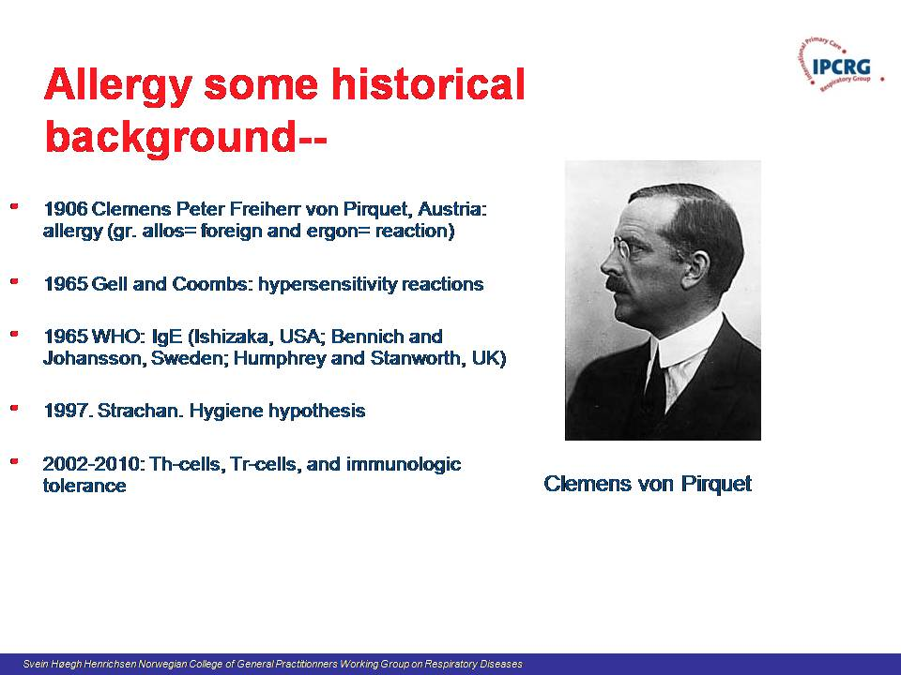

Slide 5
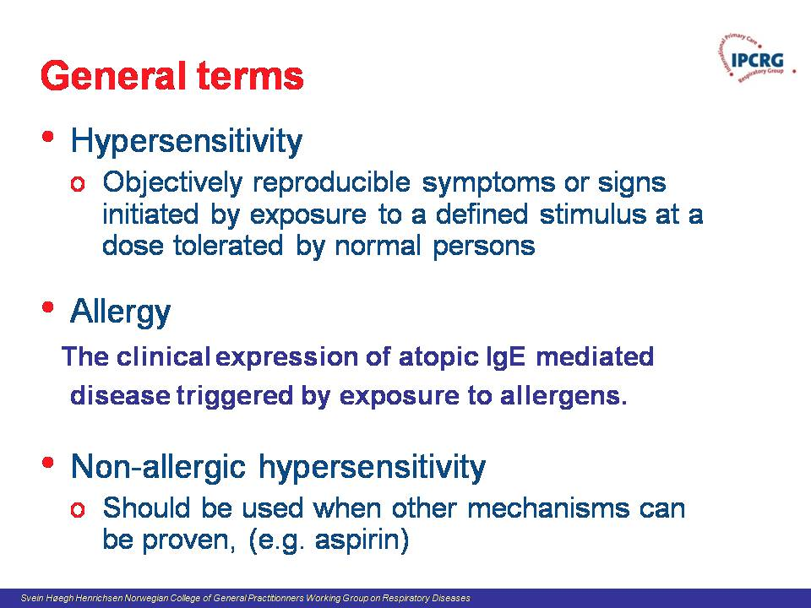

Slide 6
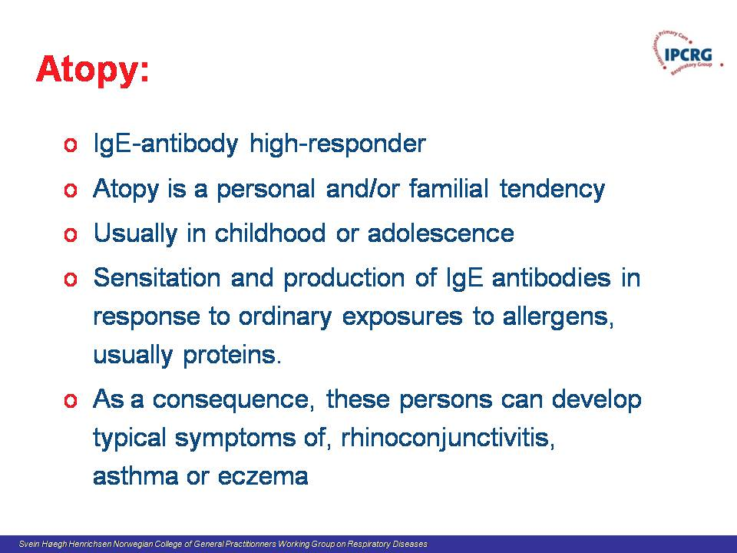

Slide 7
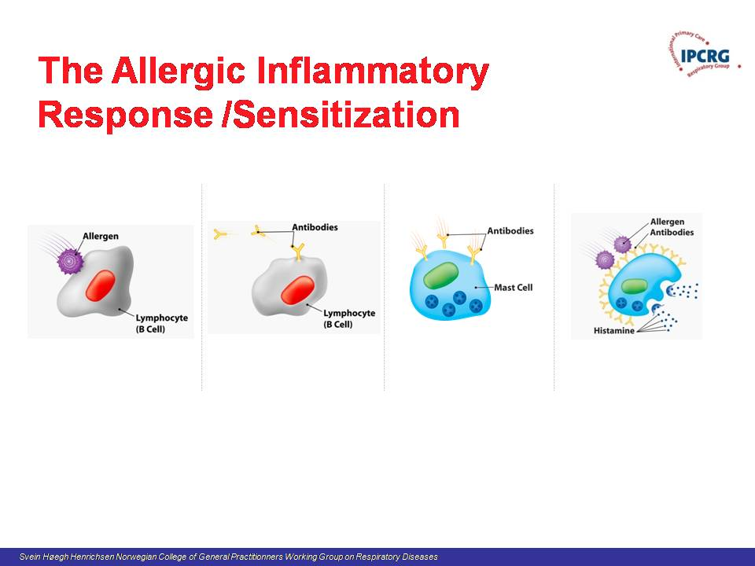

Slide 8
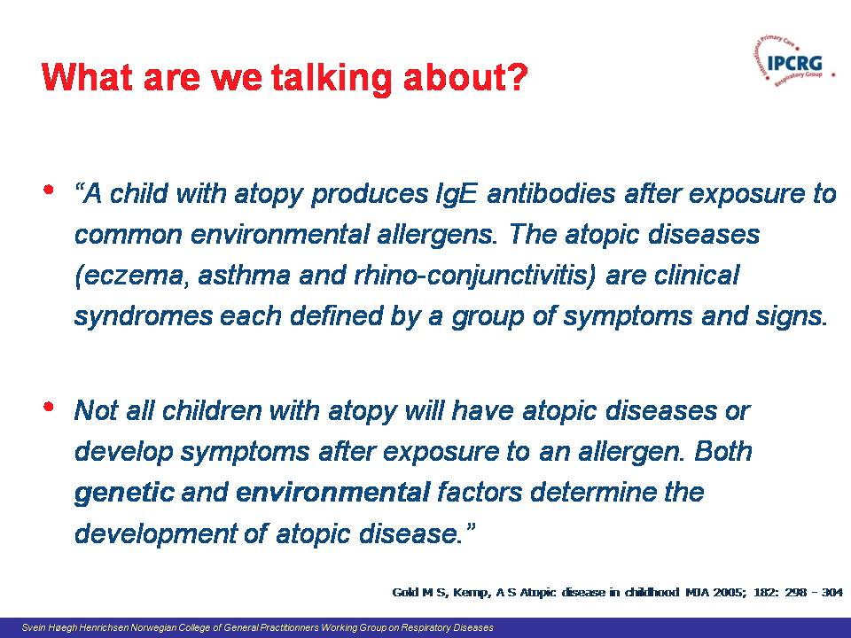

Slide 9
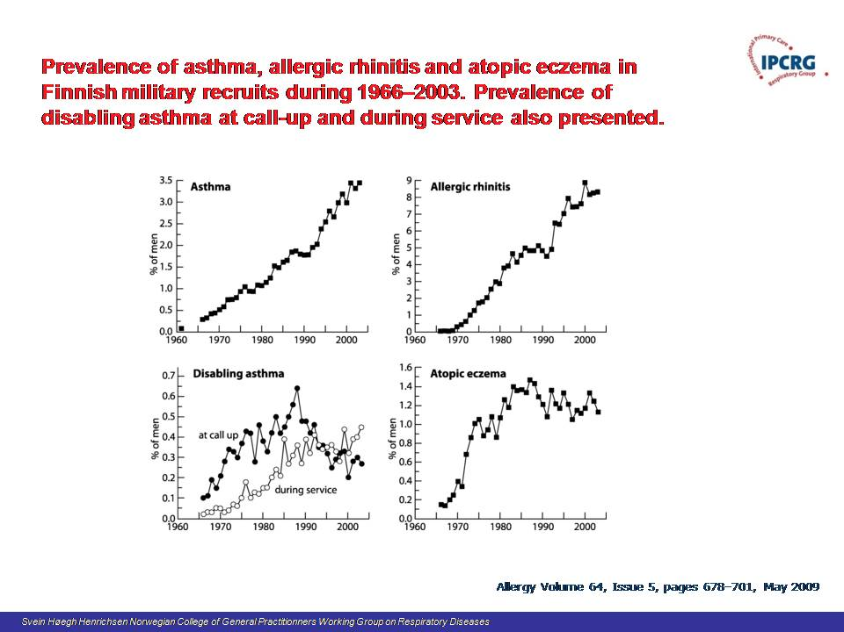

Slide 10
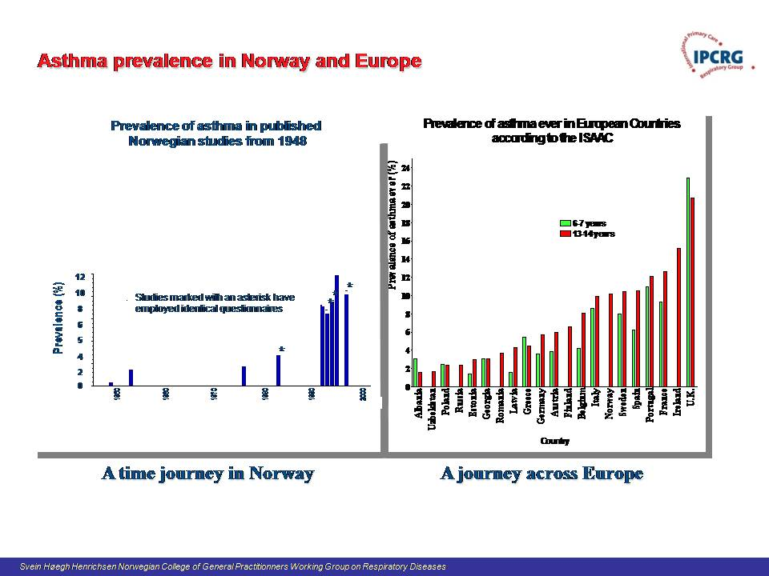

Slide 11
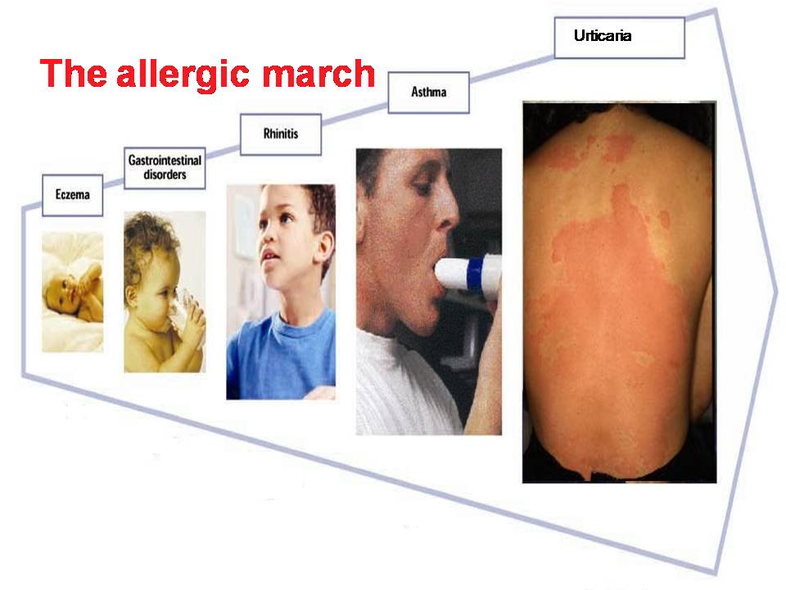

Slide 12
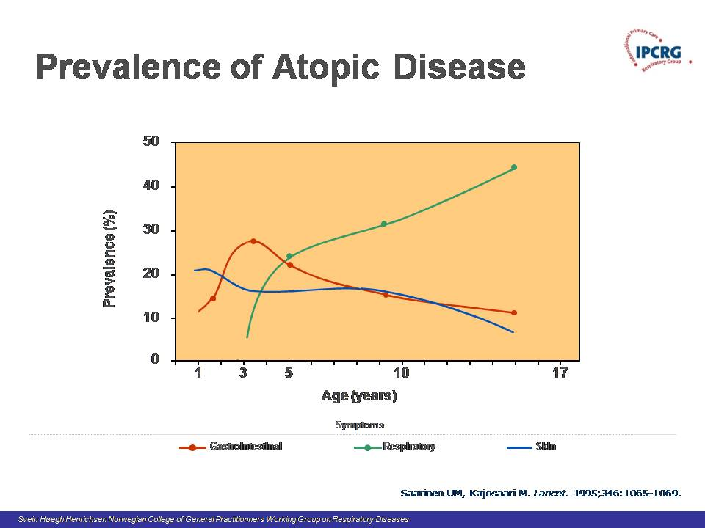

Slide 13
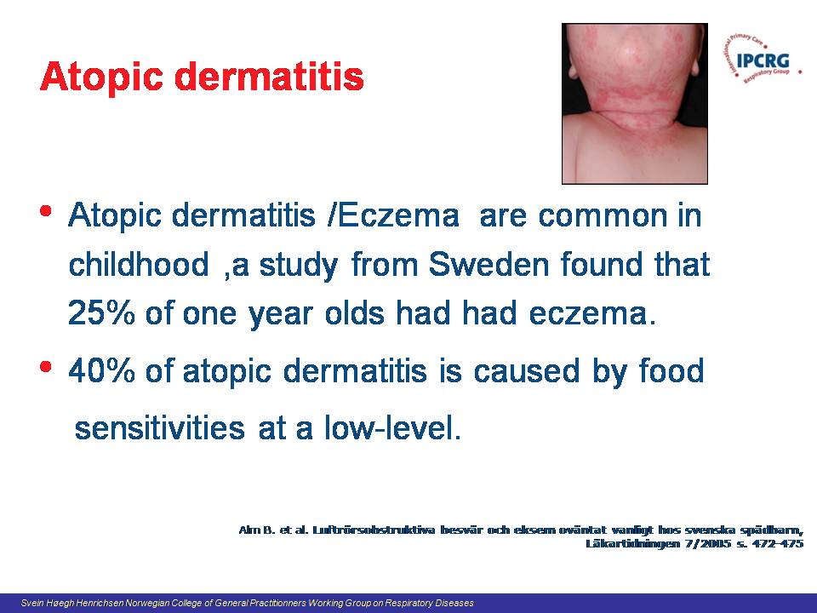

Slide 14
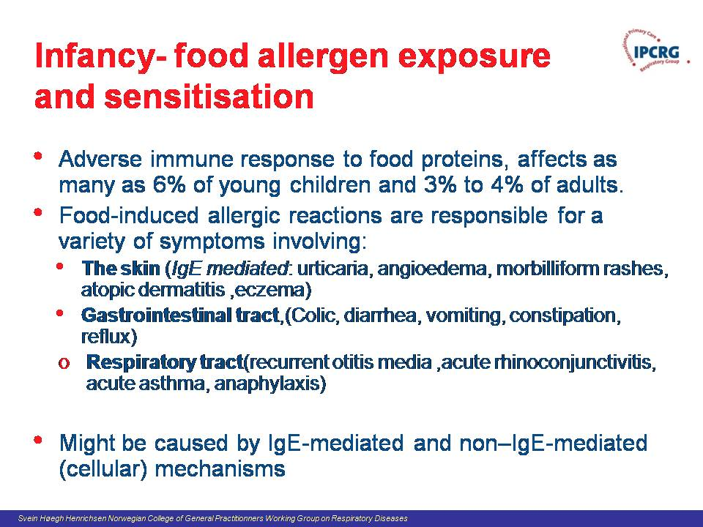

Slide 15
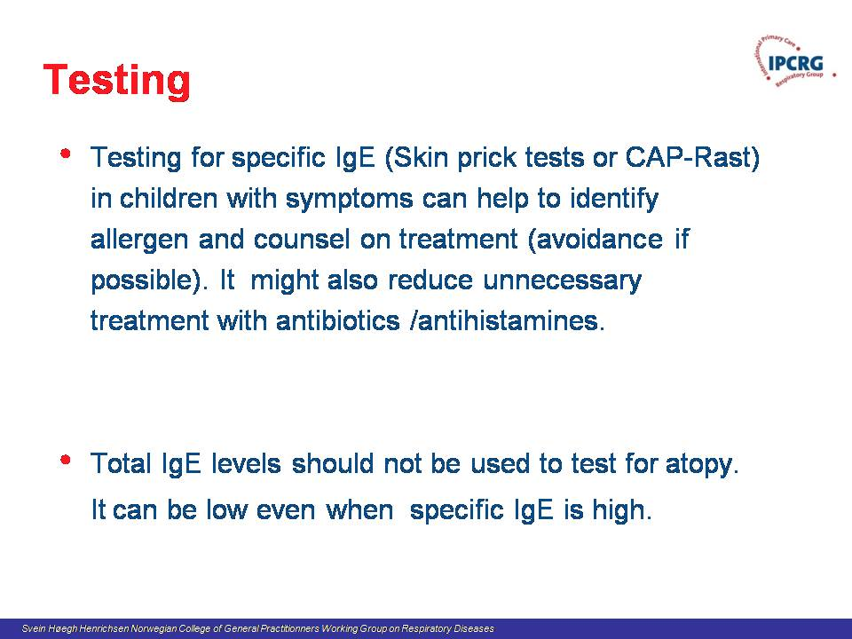

Slide 16
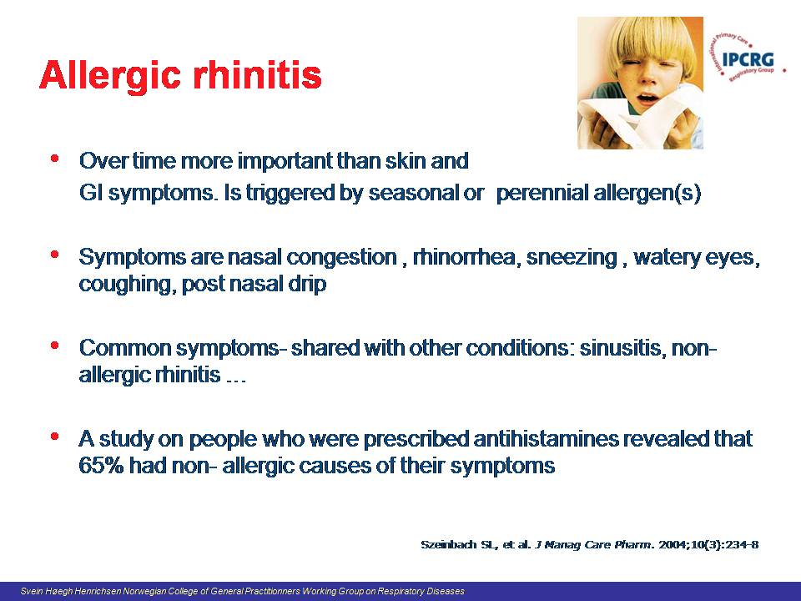

Slide 17
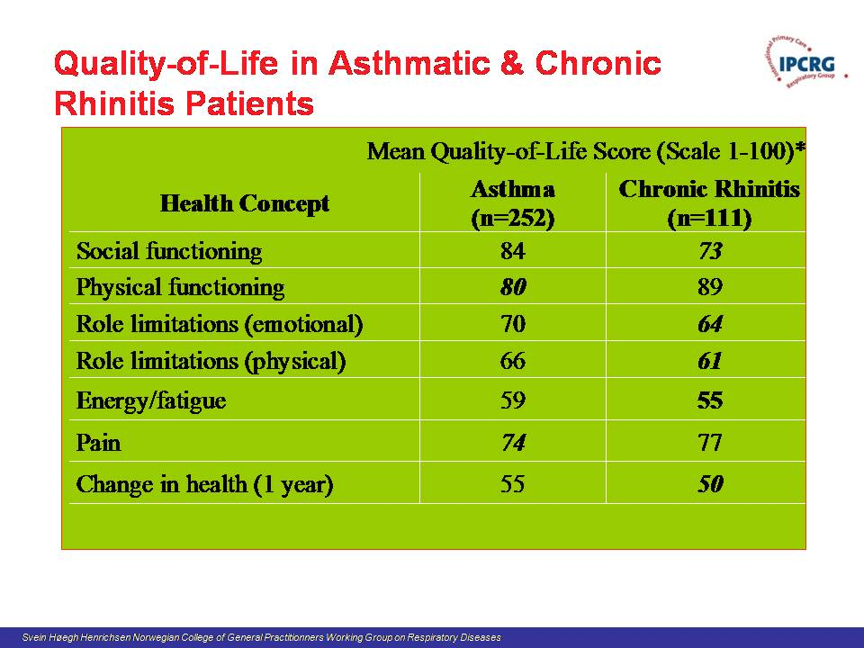

Slide 18
Cumulative Threshold Disease
House dust mite
Symptoms
Birch pollen
Cat dander
No avoidance
Measures
Normal Exposure
Normal threshold
No avoidance
measures
Third allergen
Ie.Increased exposure
Normal threshold
Avoidance measures
employed
Third allergen
1. Pharmacia & Upjohn Diagnostics. The Value of Allergen Identification. 1998. Publication 98006.01.
2. Ciprandi G, et al. J Allergy Clin Immunol. 1995;96:971-979.
3. Boner AL, et al. Clin Exp Allergy. 1993;23:1021-1026.
Notes:
AR patients are seldom monosensitized
They get symptoms when exposure load

Slide 19
Cumulative Threshold Disease
House dust mite
Symptoms
Birch pollen
Cat dander
No avoidance
Measures
Normal Exposure
Normal threshold
No avoidance
measures
Third allergen
Ie.Increased exposure
Normal threshold
Avoidance measures
employed
Third allergen
Lowered threshold-
Stress,infections
Irritants,SMOKING
1. Pharmacia & Upjohn Diagnostics. The Value of Allergen Identification. 1998. Publication 98006.01.
2. Ciprandi G, et al. J Allergy Clin Immunol. 1995;96:971-979.
3. Boner AL, et al. Clin Exp Allergy. 1993;23:1021-1026.
Notes:
AR patients are seldom monosensitized
They get symptoms when exposure load

Slide 20
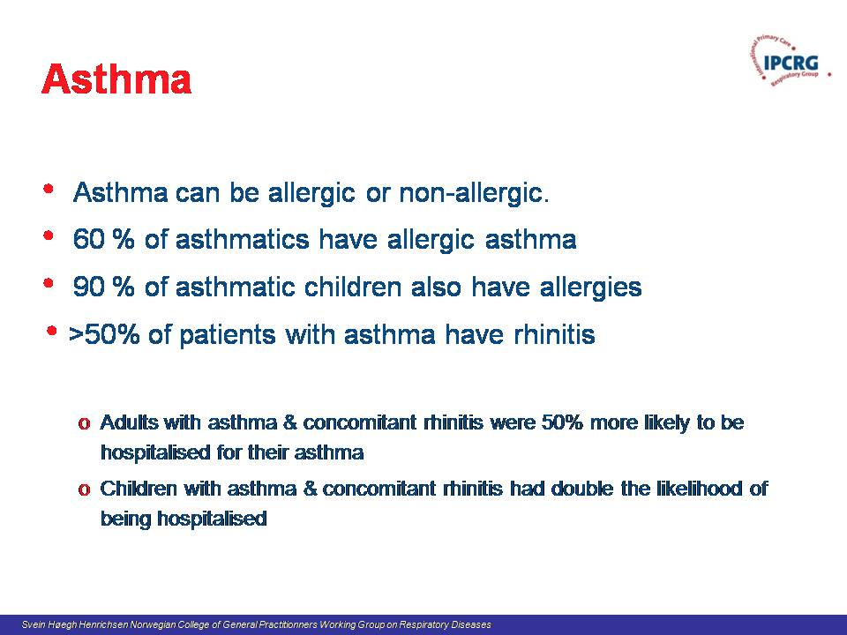

Slide 21
Common allergic conditions in primary care
Prevention?
Svein Høegh Henrichsen G.P. Oslo, Norway
Chair Norwegian College of General Practise
Working group on Respiratory Disease
Notes:
Title page option 1

Slide 22
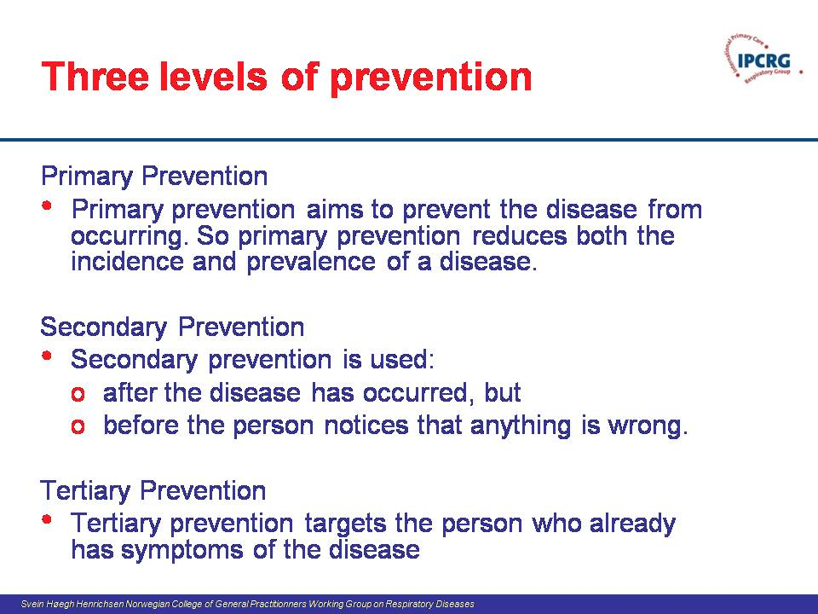

Slide 23
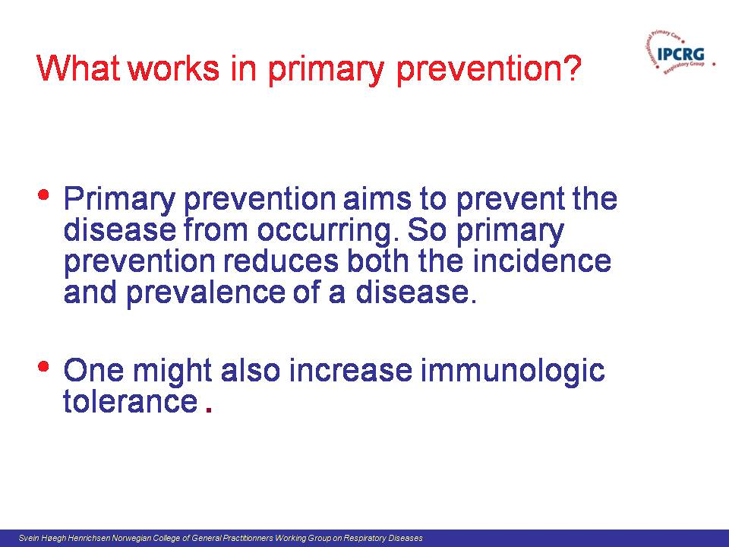

Slide 24
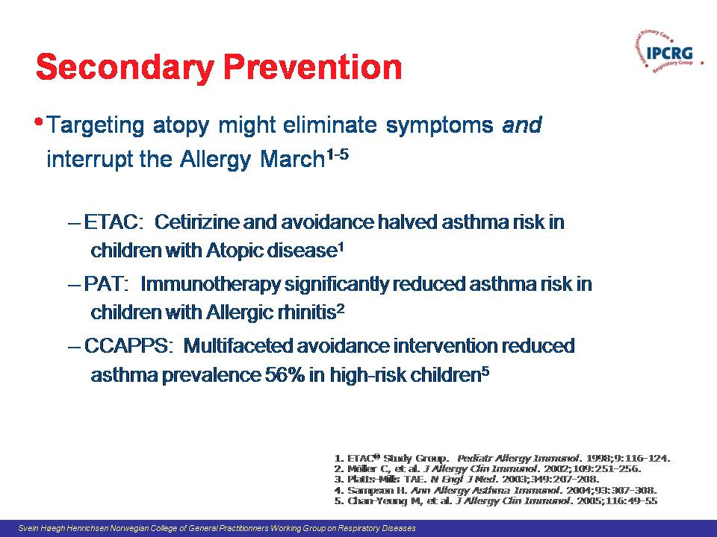

Slide 25
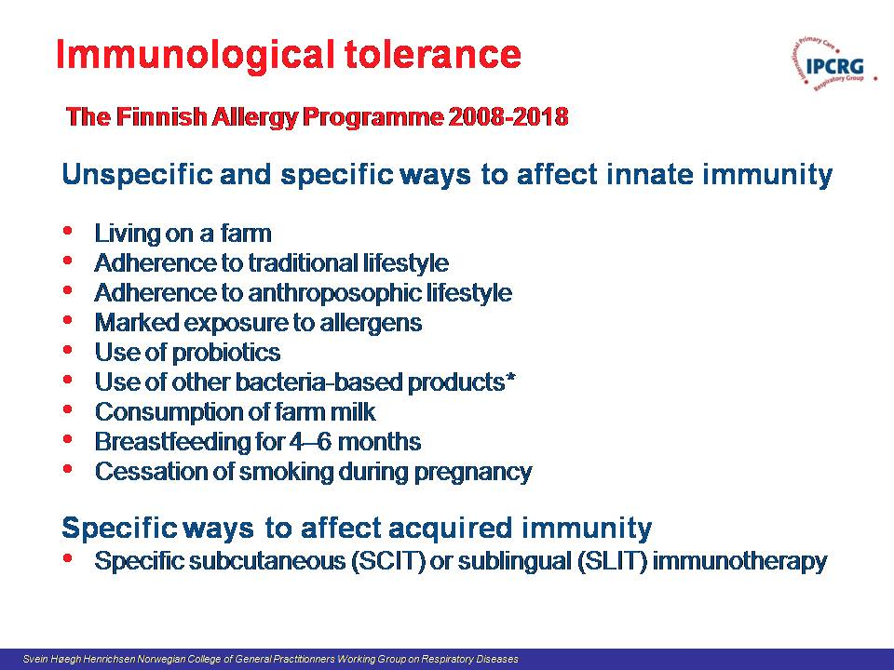

Slide 26
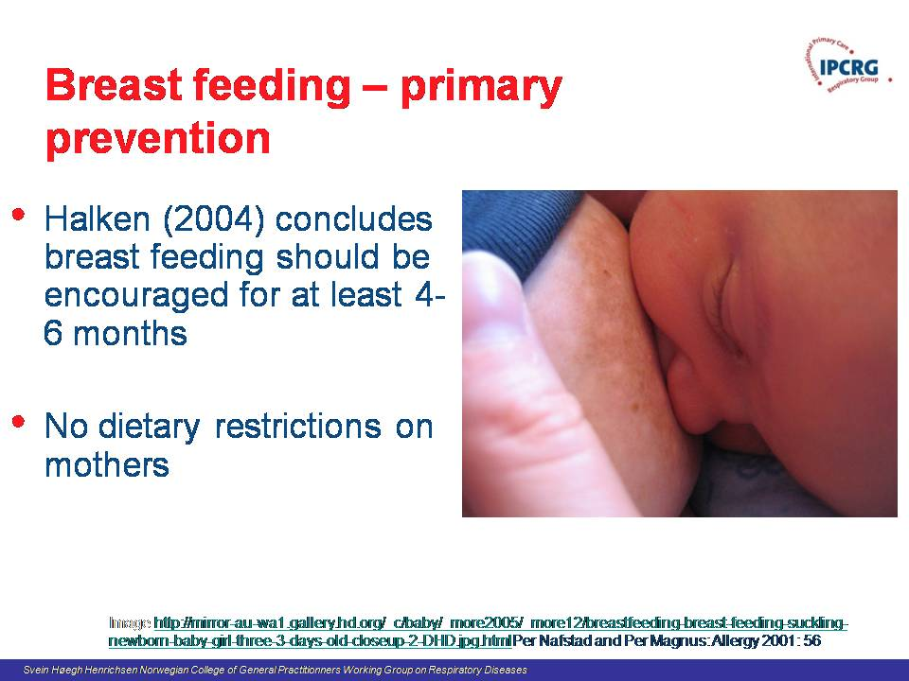

Slide 27
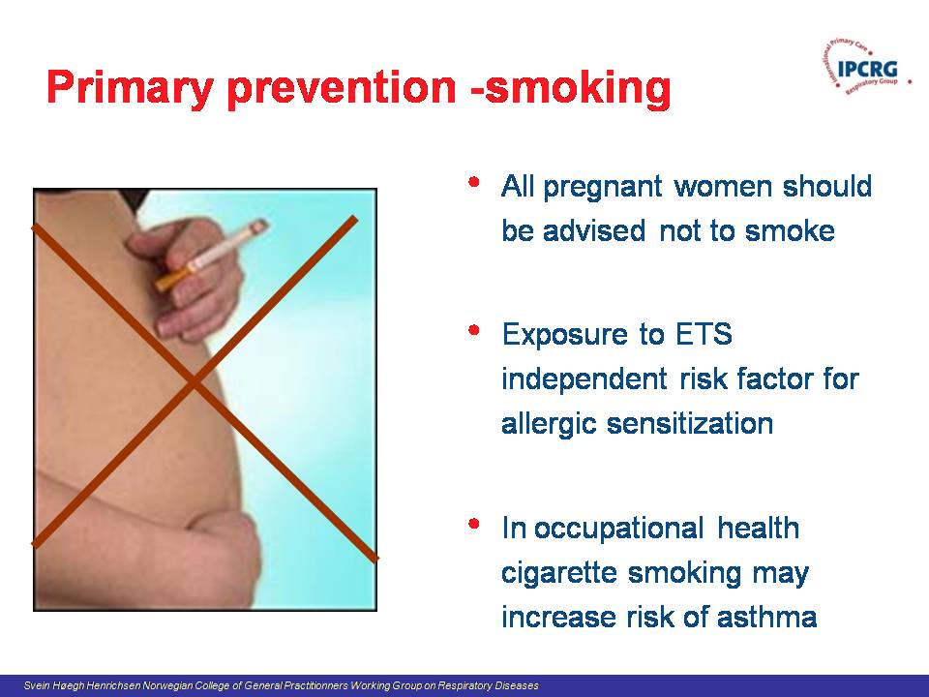

Slide 28
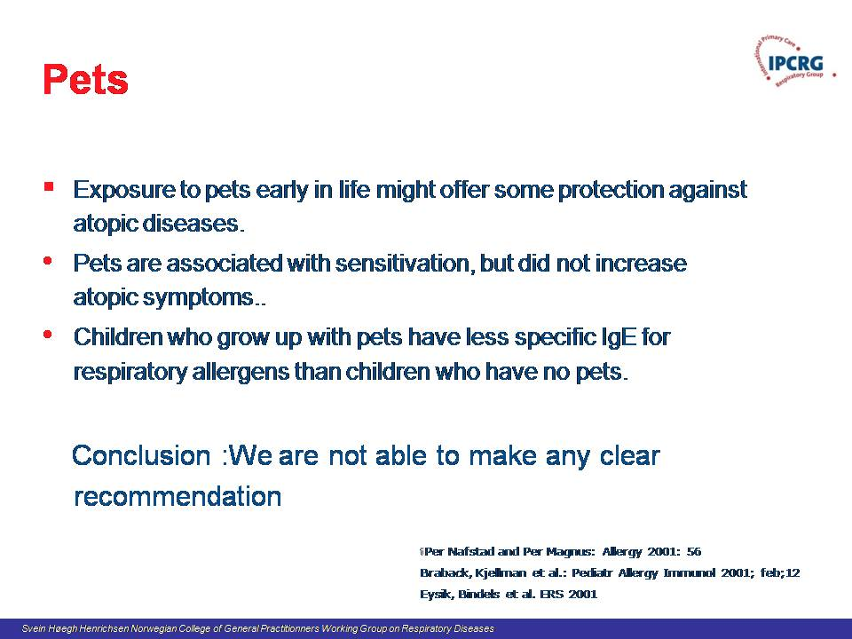

Slide 29
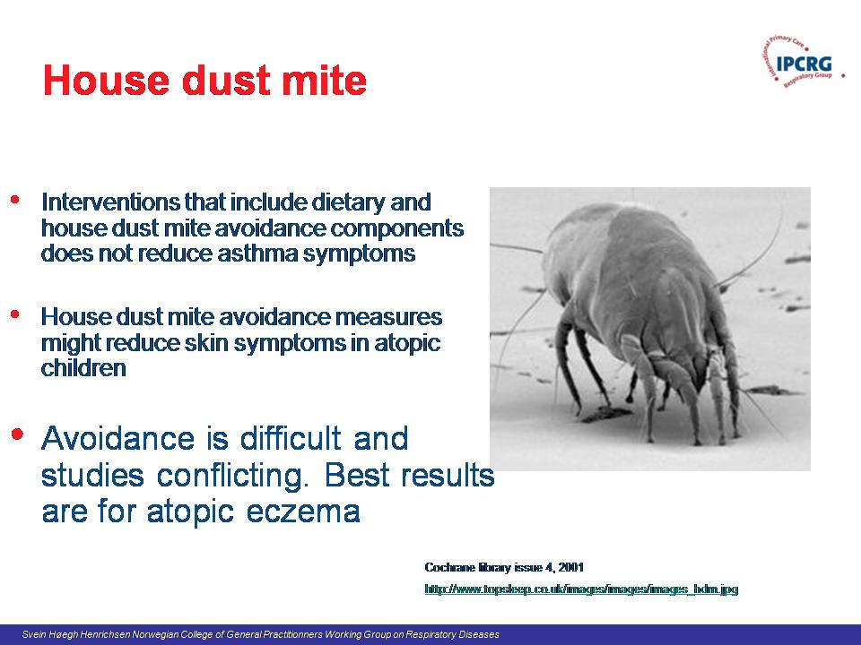

Slide 30
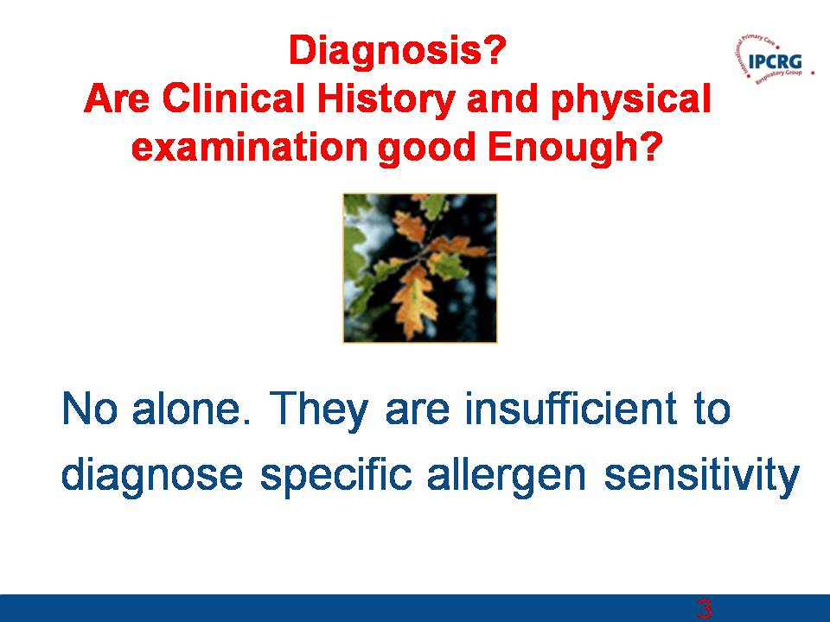

Slide 31
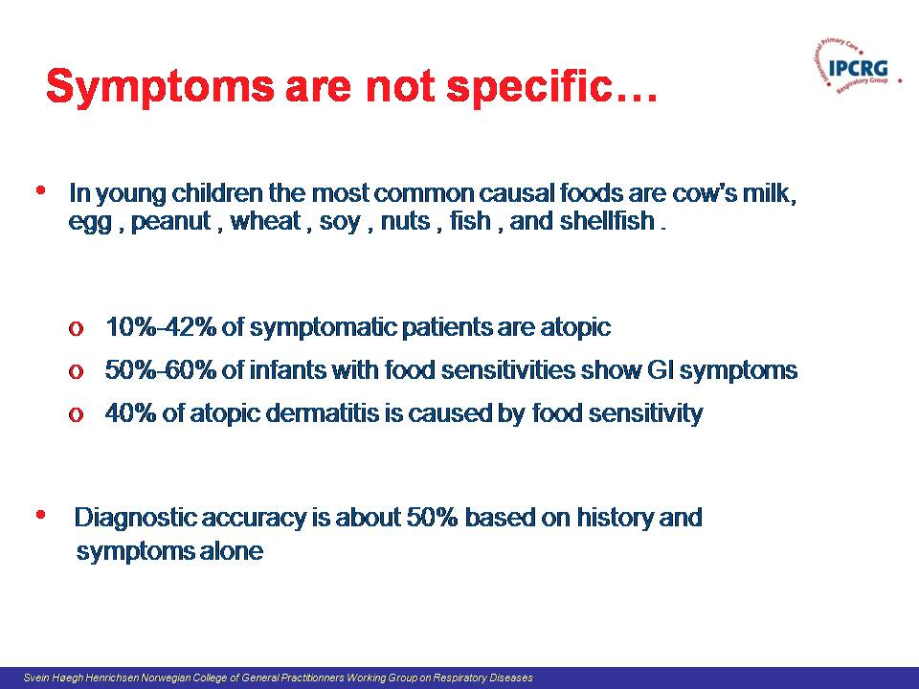

Slide 32
Testing
History and physical alone gives correct diagnosis only 50% of the time¹
Different causes demand different treatment
Testing for specific IgE levels can rule in/out atopy
If atopic:
  – Antihistamines probably drug of choice
  – Testing can help clinician in advising avoidance measures
If non-atopic:
  – Results will allow you to focus on other etiologies
  – Drugs of choice may include decongestants/steroids
  – Patient can avoid unnecessary/ineffective treatment
1. Homburger HA. Arch Pathol Lab Med. 2004;128:1028-1031.
Notes:
Non-allergic rhinitis, sinusitis, and allergic rhinitis present with similar symptoms. A definitive diagnosis of URD is difficult without objective evidence. In fact, studies show that primary care physicians correctly diagnose allergies only 50% of the time using history and physical (H&P) alone.¹
The most persuasive reason for testing? Diagnostic test results may affect how you manage your patient. Treatment options for atopic and non-atopic patients are different, and you can’t select an effective treatment without a definitive diagnosis. Right now, you may be prescribing antihistamines, but they won’t work if the patient is not allergic.
Specific IgE testing will definitively rule in or rule out atopy (allergy) as a cause of nasal symptoms.
If your patient is allergic, testing can identify the specific offending allergens so you can counsel for avoidance and prescribe antihistamines with the confidence that they will truly target the underlying etiology.
If there is no atopy, you will then be able to focus your evaluation on other possibile non-allergic etiologies and select appropriate, effective treatments.
Homburger HA. Arch Pathol Lab Med. 2004;128:1028-1031.

Slide 33
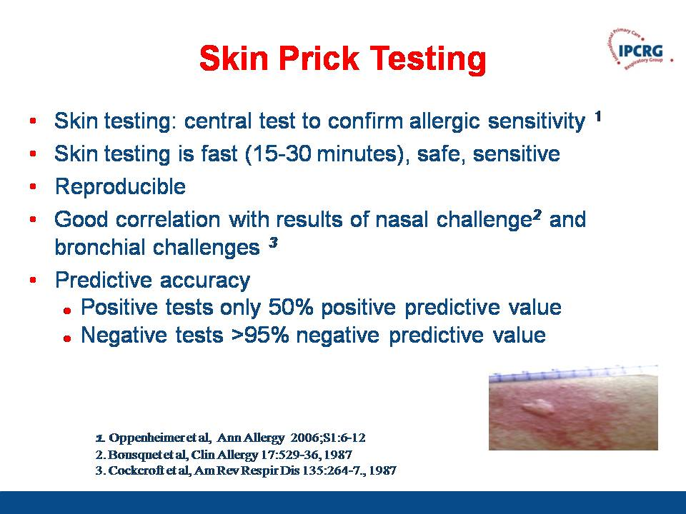

Slide 34
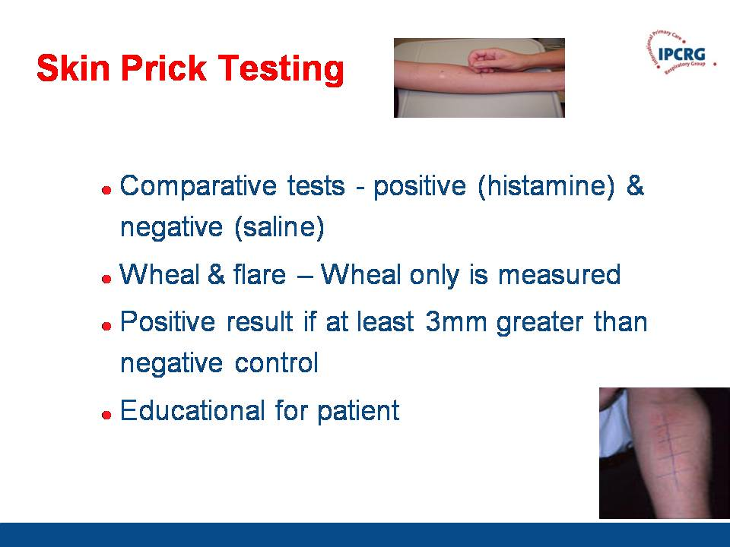

Slide 35
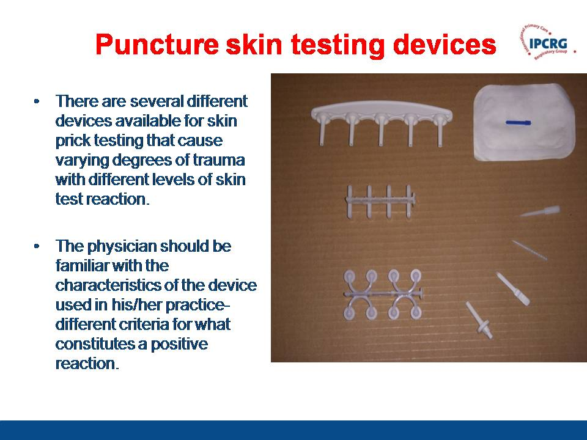

Slide 36
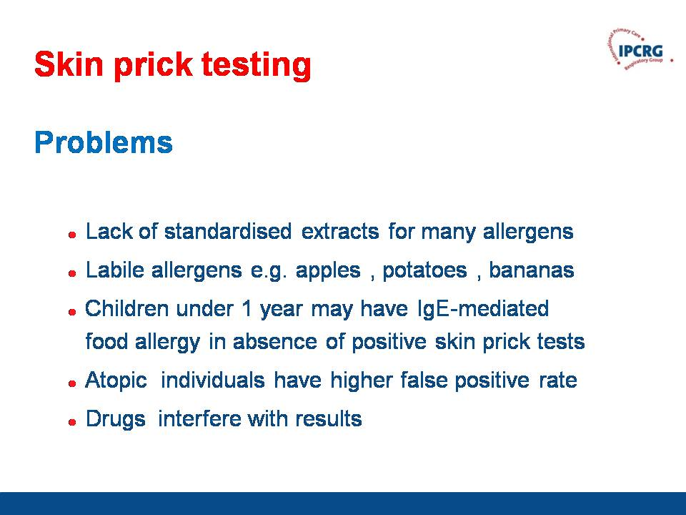

Slide 37
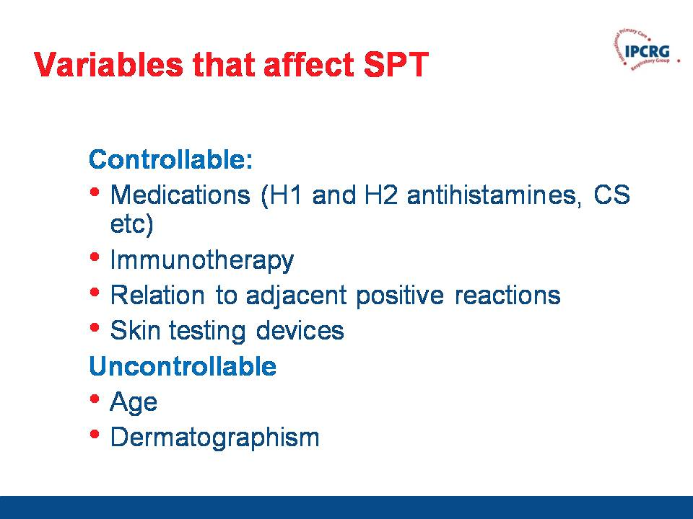

Slide 38
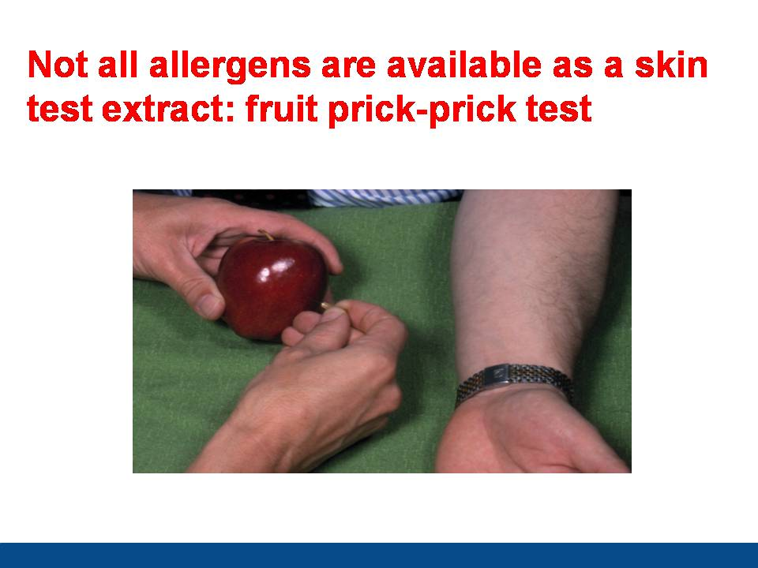

Slide 39
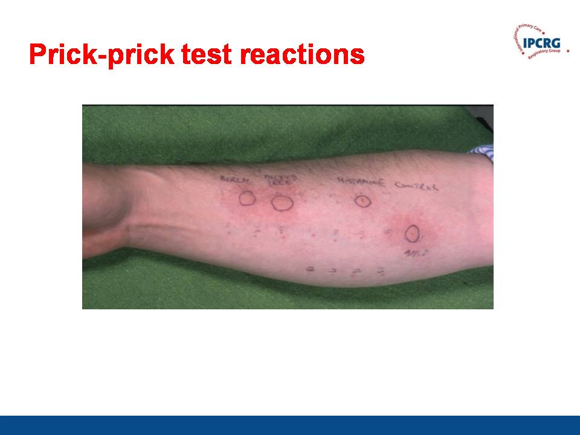

Slide 40
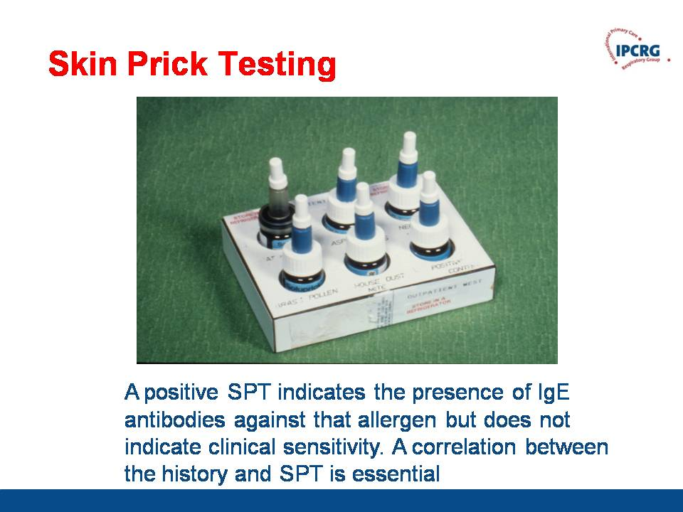

Slide 41
Quantitative Measurements of spesific IgE/
Blood test – easily done
In vitro blood testing and skin prick testing (SPT) viewed as equally good
Regional respiratory profiles
  Geographic pollen patterns
  Regional disease prevalence
  Cross reactivity to other allergens in each inhalant class
Allergy March profiles include key food/inhalant allergens
  Six foods account for 90% of food allergy reactions in children⁴
  Inhalants include common/cross-reactive indoor and outdoor allergens
  Generally recommended for children ≤6 years of age, based on symptoms
Notes:
CAP RAST offers primary care clinicians an exceedingly valuable and relatively convenient tool for use in your daily management of common illnesses and allergy-like symptoms.
It’s an FDA-cleared quantitative measure of specific IgE.
Unlike skin prick testing, CAP RAST requires only a single blood draw.
CAP RAST is covered under most insurance plans.
It offers accuracy superior to RAST^{TM1}, which is very important: despite what you’ve been told about previous in vitro allergy test modalities and their shortcomings, CAP RAST is NOT RAST, but several generations beyond. Its enhanced accuracy and sensitivity is consistently reproducible lab to lab,² and evidence presented in more than 2,000 peer-reviewed scientific publications has established CAP RAST as the de facto standard for in vitro allergy testing.³
In fact, in vitro blood testing and skin prick testing (SPT) are now viewed as interchangeable.⁴ (Hidden slide available here.)
CAP RAST is available throughout the nation from clinical laboratories including Quest Diagnostics.
Williams PB, et al. J Allergy Clin Immunol. 2000;105:1221-1230.
Szeinbach SL, et al. Ann Allergy Asthma Immunol. 2001;86:373-381.
Johansson SGO. Expert Rev Mol Diagn. 2004;4:273-279.
Hamilton RG. In: Pediatric Allergy: Principles and Practice. Mosby-Year Book, Inc; 2003:233-242.

Slide 42
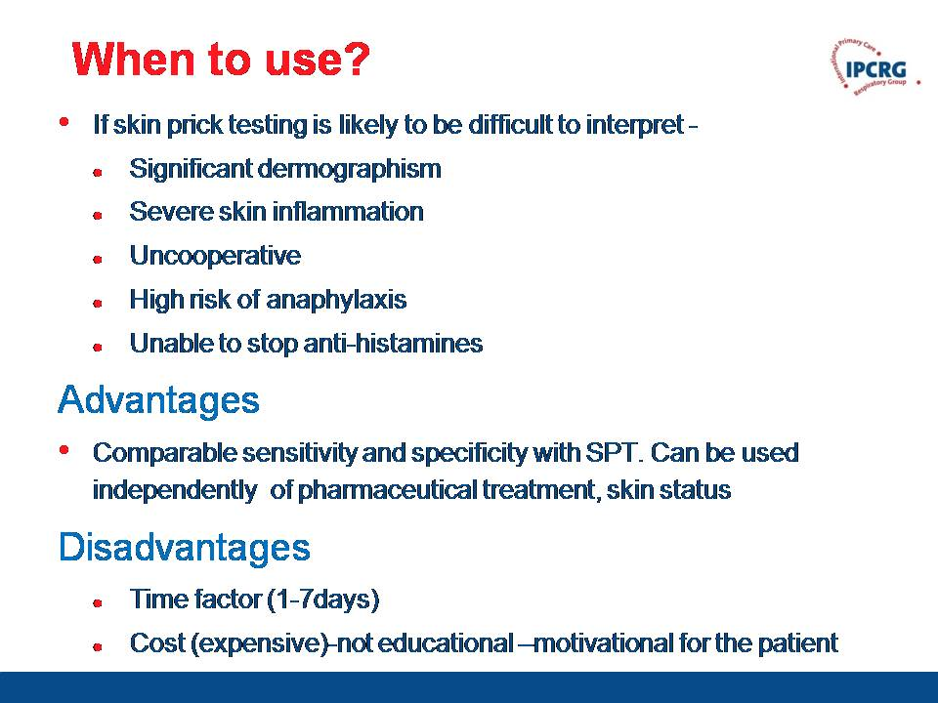

Slide 43
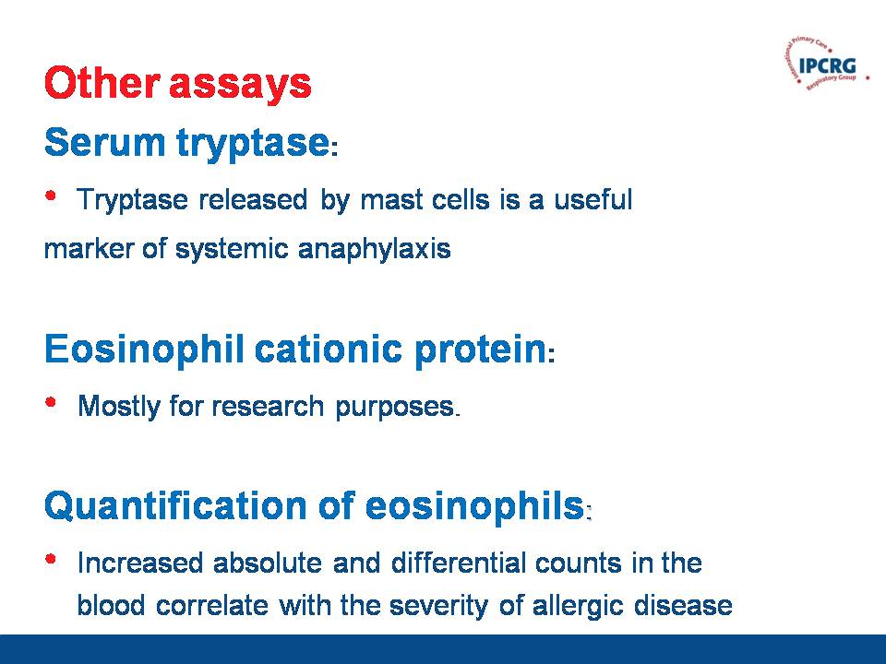

Slide 44
Common allergic conditions in primary care -
Treatment
Jaime Correia de Sousa
Notes:
Title page option 1

Slide 45
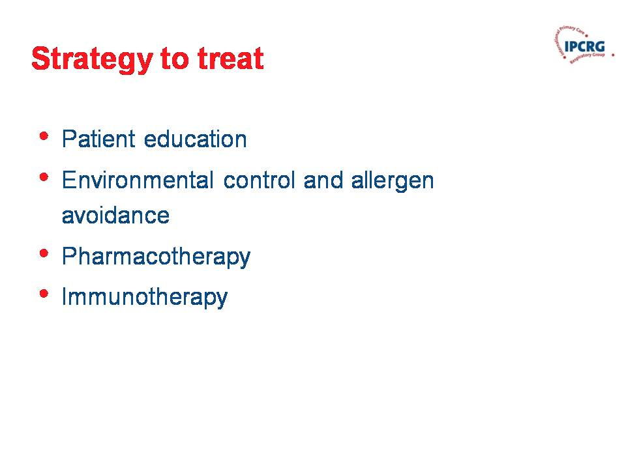

Slide 46
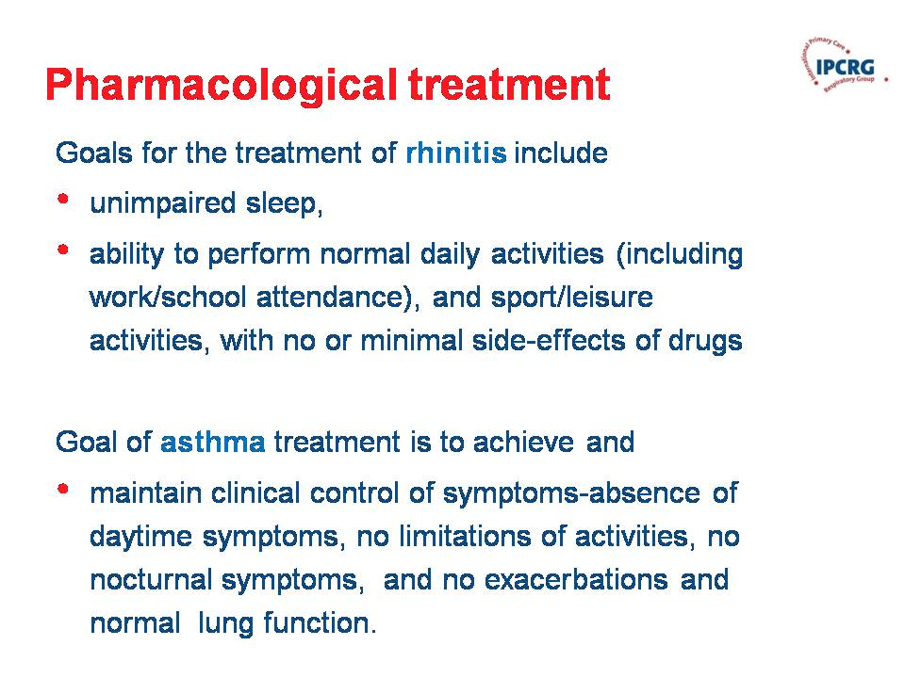

Slide 47
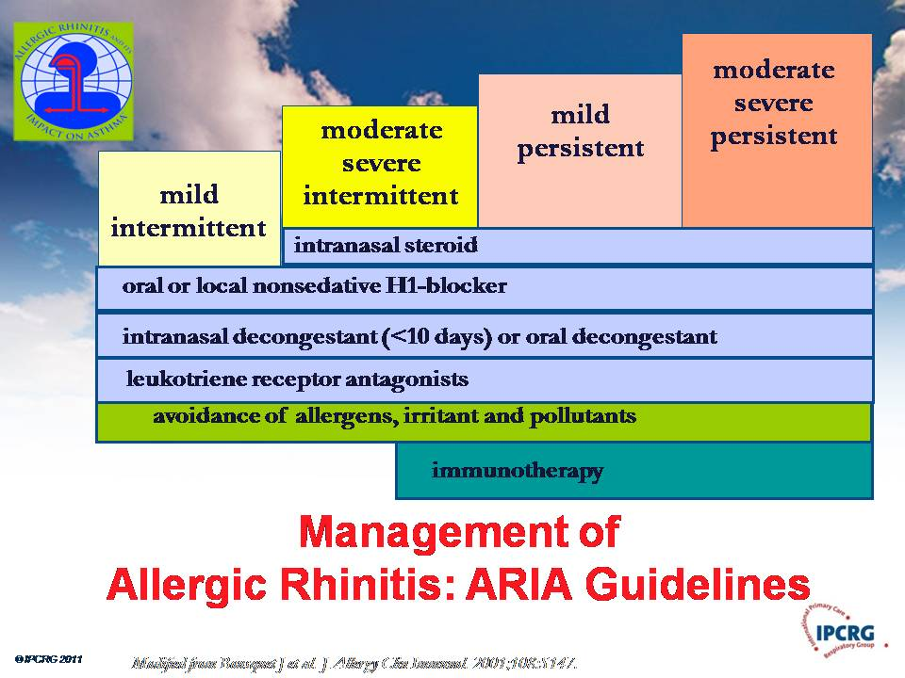

Slide 48
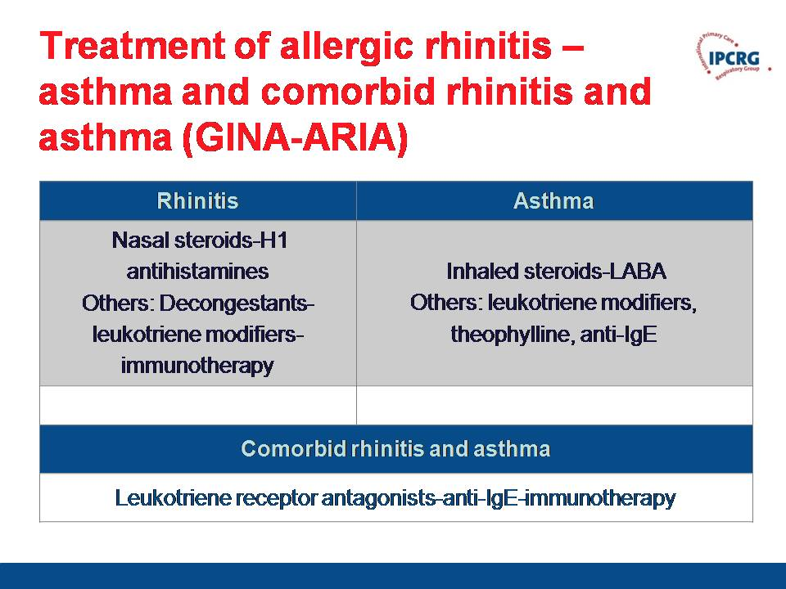

Slide 49
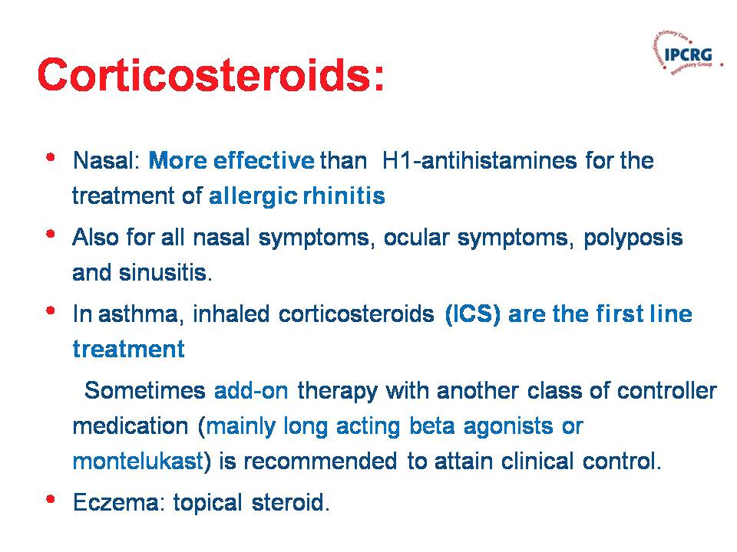

Slide 50
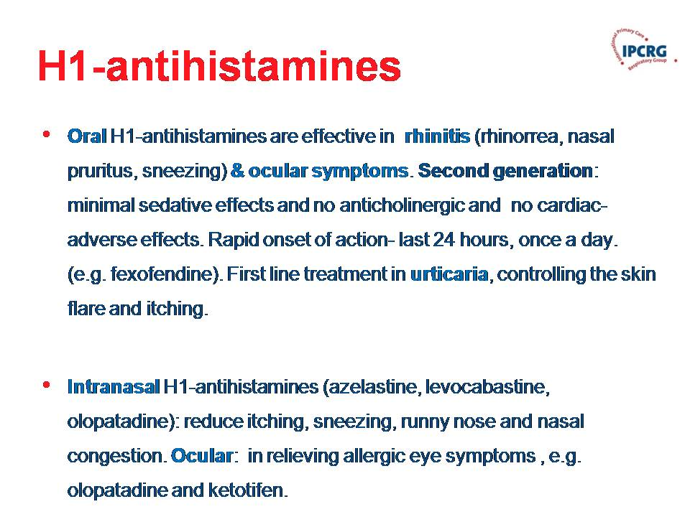

Slide 51
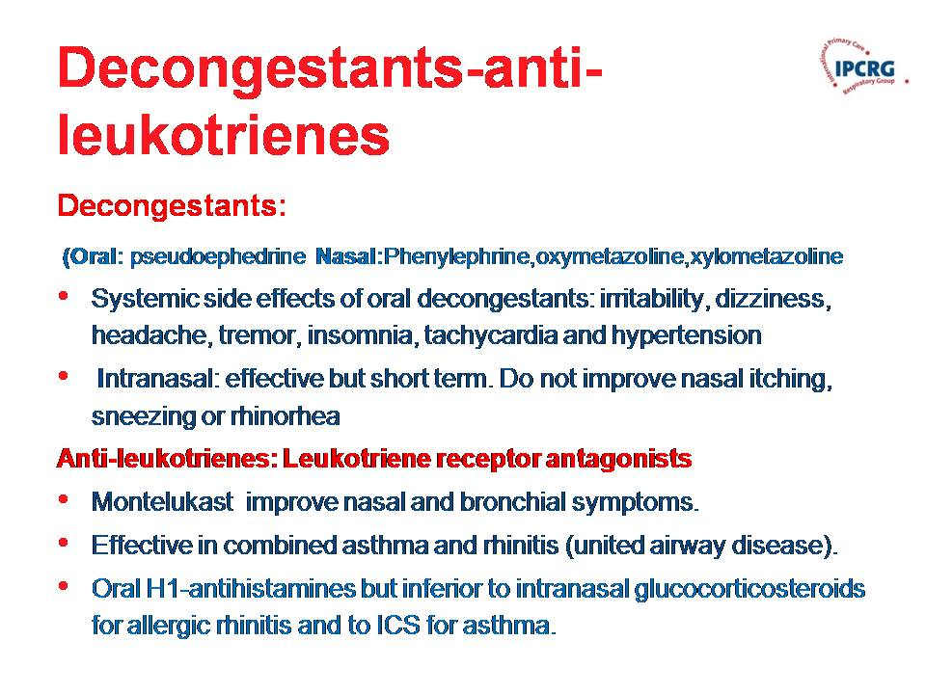

Slide 52
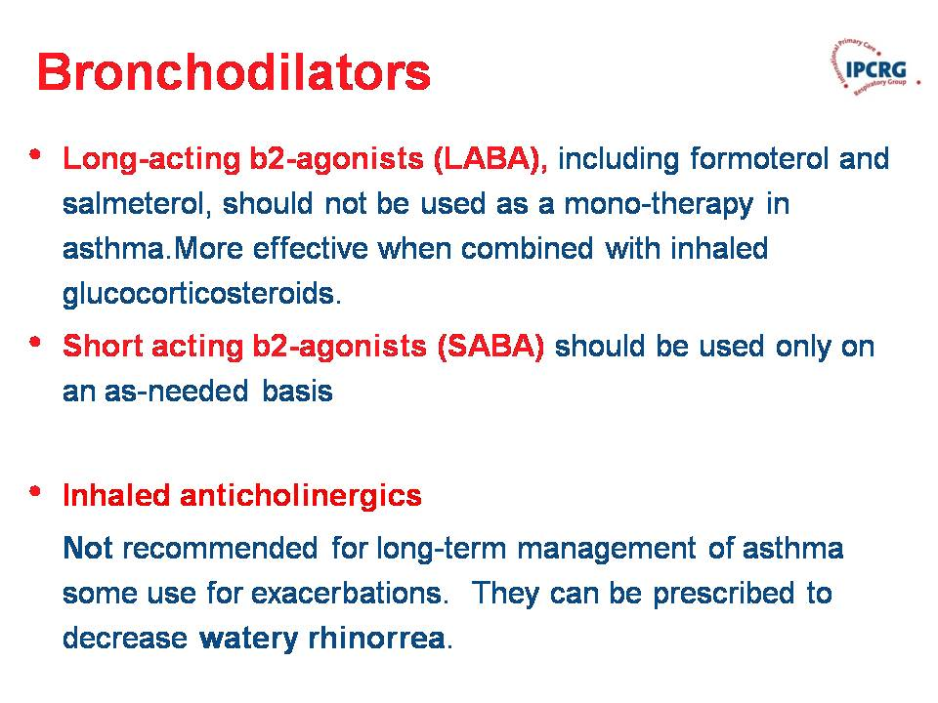

Slide 53
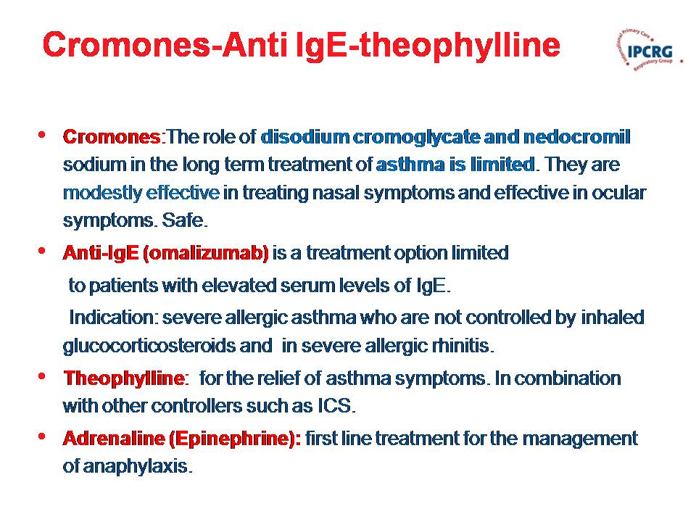

Slide 54
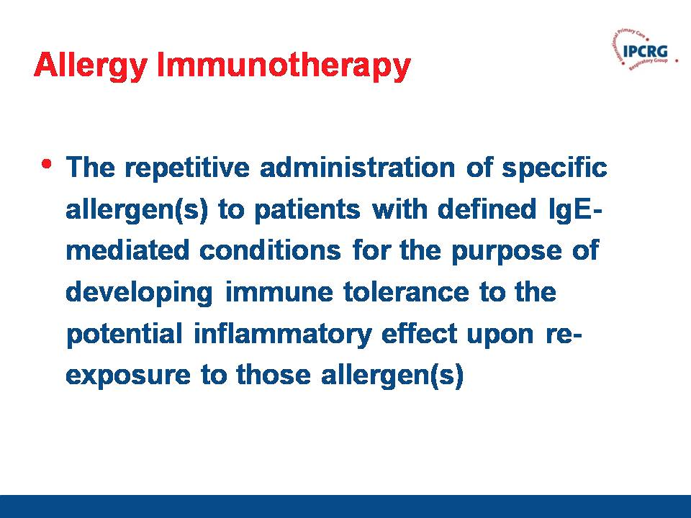

Slide 55
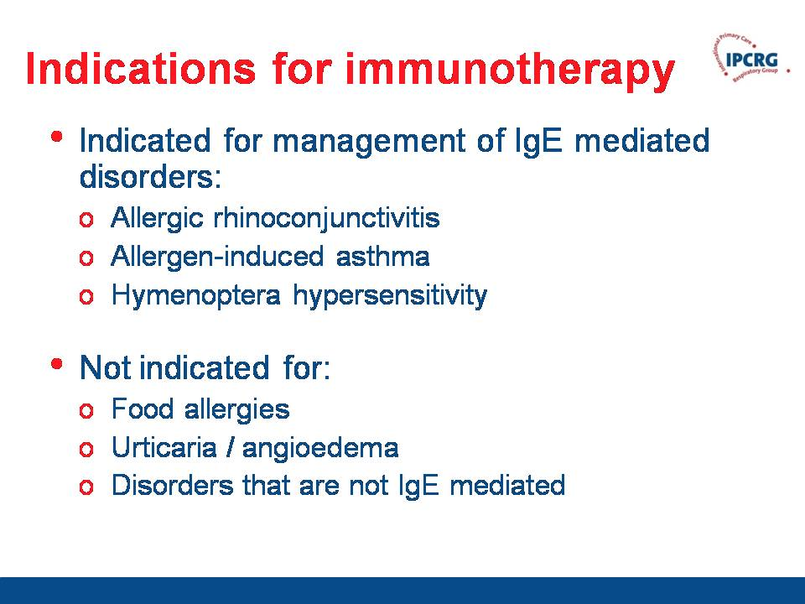

Slide 56
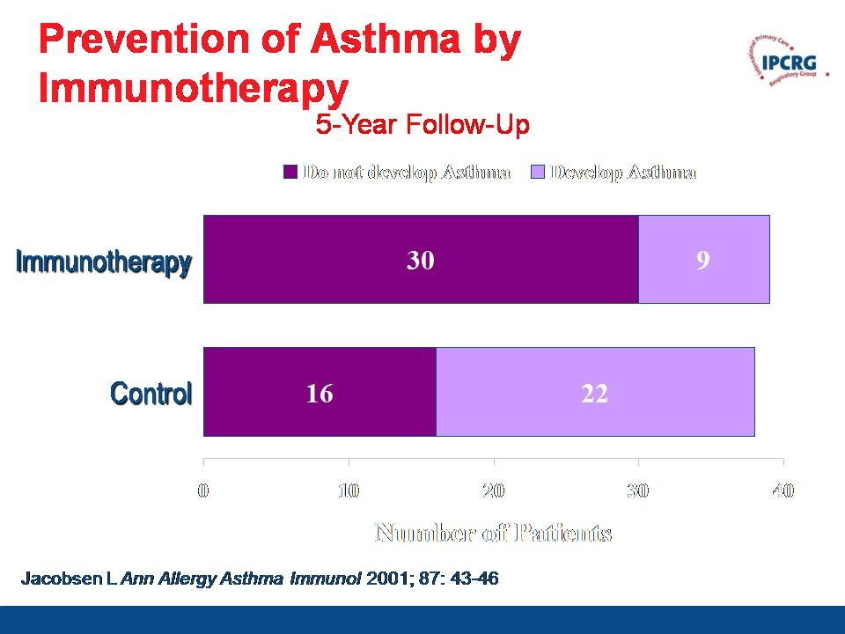

Slide 57
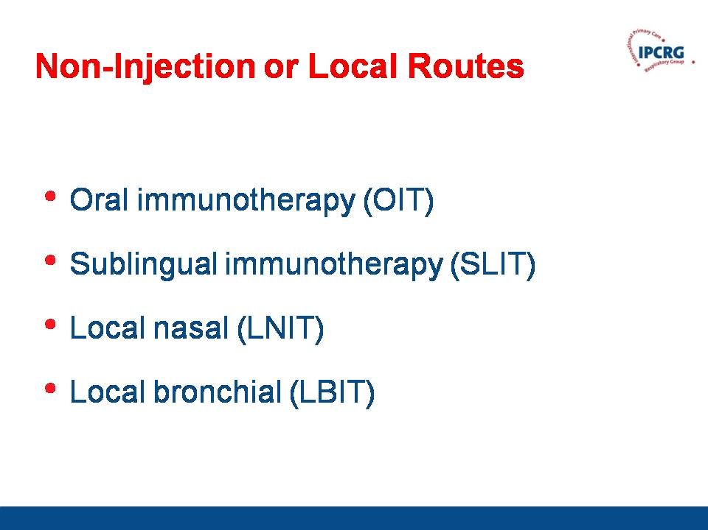

Slide 58
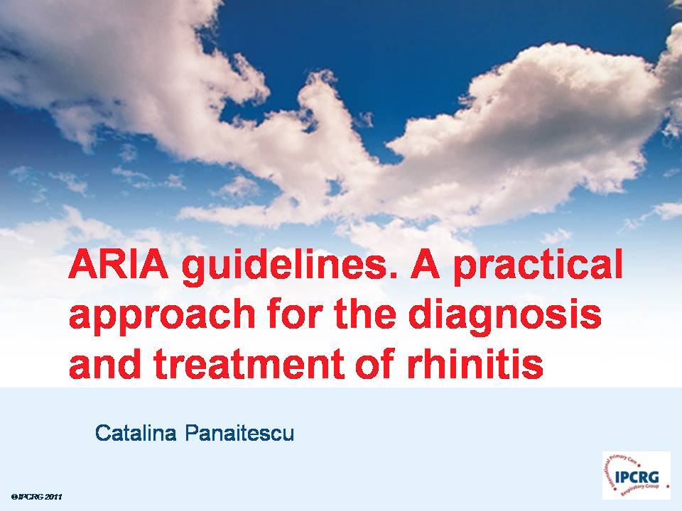

Slide 59
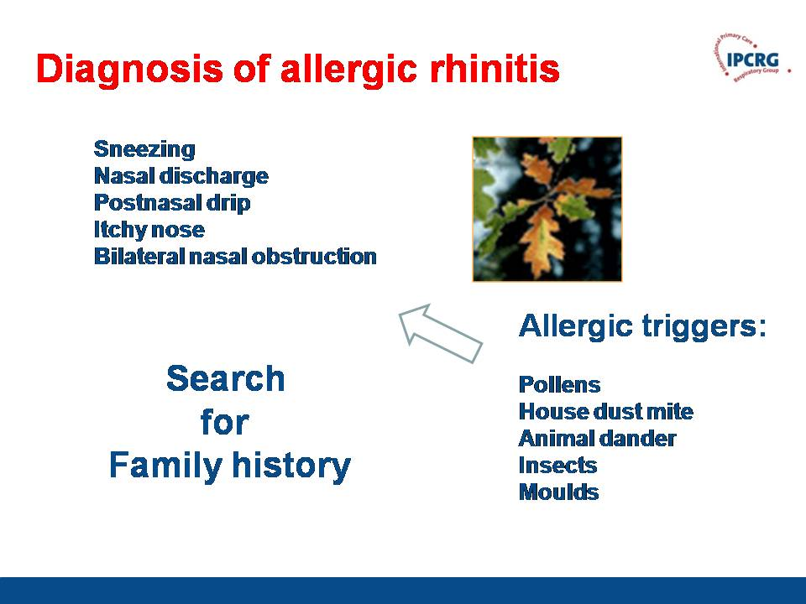

Slide 60


Slide 61


Slide 62


Slide 63


Slide 64


Slide 65


Slide 66


Slide 67


Slide 68


Slide 69


Slide 70


Slide 71
Authors
Jaime Correia de Sousa
Svein Høegh Henrichsen
G.P. Oslo, Norway, Researcher University of Oslo
Chair Norwegian College of General Practise
Working group on Respiratory Disease
Thanks to Dr. Ionna Tsiglianni , Dr. Catalina Panaitescu and Dr Len Frommer for providing many of our slides

Slide 72
NEXT IPCRG MEETINGS
IPCRG 3rd scientific meeting –
Uppsala 2013
  23rd - 24th May in Uppsala (Sweden)
IPCRG 7th IPCRG World Conference
Athens 2014
21st – 24th May in Athens (Greece)

