Slide 1



IPCRG presentations on respiratory diseases COPD: Early detection and management of stable disease and exacerbations.
Notes:
Title page option 1

Slide 2

Contents
What’s new on COPD – Definition, classification
The benefits of early diagnosis. Strategies to encourage earlier diagnosis in primary care
Management of stable disease
Management of COPD exacerbations
Notes:
Bullet page

Slide 3
What’s new on COPD – Definition, burden, diagnosis and assessment
Ioanna Tsiligianni
Notes:
Title page option 1

Slide 4

Global Strategy for Diagnosis, Management and Prevention of COPD. Updated 2011
Definition of COPD
COPD, a common preventable and treatable disease, is characterized by persistent airflow limitation that is usually progressive and associated with an enhanced chronic inflammatory response in the airways and the lung to noxious particles or gases.
Exacerbations and comorbidities contribute to the overall severity in individual patients.

Slide 5

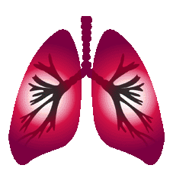
Global Strategy for Diagnosis, Management and Prevention of COPD. Updated 2011
Physiopathology
Small Airways Disease
Airway inflammation
Airway fibrosis, luminal plugs
Increased airway resistance
Parenchymal Destruction
Loss of alveolar attachments
Decrease of elastic recoil
AIRFLOW LIMITATION

Slide 6
Impact of COPD
Only heart disease, cancer, and cerebrovascular disease have a higher mortality rate
Possibly approximately 25 million people if undiagnosed cases are included
COPD was ranked 12th for burden of disease in 1990
By 2020, COPD is projected to rank 5th
Hurd S. Impact of COPD Chest. 2000;117:1S-4S

Slide 7
COPD – and why?

Slide 8
Global Strategy for Diagnosis, Management and Prevention of COPD. Updated 2011
Risk Factors for COPD
Genes
Exposure to particles
Tobacco smoke
Occupational dusts
Indoor air pollution from heating and cooking with biomass in poorly ventilated dwellings
Outdoor air pollution
Lung growth and development
Gender
Age
Respiratory infections
Socioeconomic status
Asthma/Bronchial hyperreactivity
Chronic Bronchitis

Slide 9
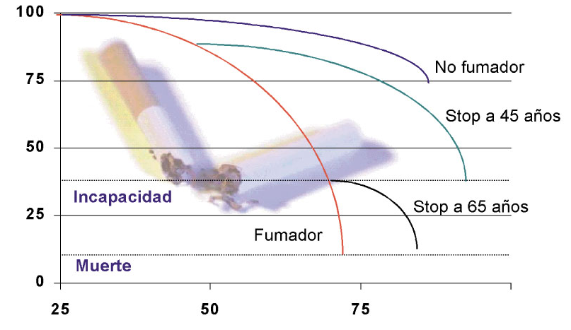
COPD – and why?
FEV1
Fletcher, Peto 1977
No smoker
No smoker
Stop 45 years
Disability
Stop 65 years
Current smoker
Dead
YEARS

Slide 10
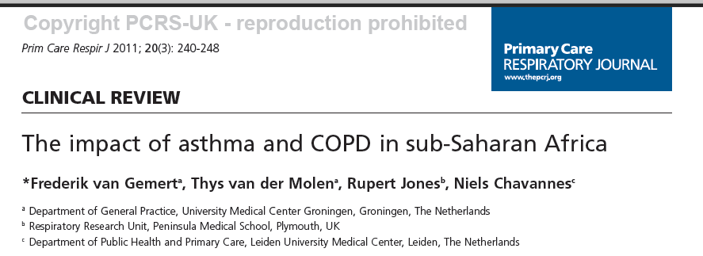
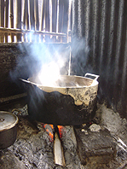
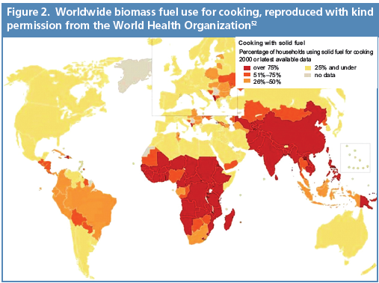

Not only smoking but smoke
Air pollution resulting from the burning of wood and other biomass fuels is estimated to kill two million women and children each year.

Slide 11
COPD – Other causes
Burning of biomass fuels
Industrial pollution
Mining – coal, silica etc
Car exhaust pollution

Slide 12
Global Strategy for Diagnosis, Management and Prevention of COPD. Updated 2011
Diagnosis of COPD
A clinical diagnosis of COPD should be considered in any patient who has dyspnea, chronic cough or sputum production, and/or a history of exposure to risk factors for the disease.
Spirometry is required to make the diagnosis; the presence of a post-bronchodilator FEV₁/FVC < 0.70 confirms the presence of persistent airflow limitation and thus of COPD.

Slide 13
Diagnosis: Spirometry
Spirometry should be performed after the administration of an adequate dose of a short- acting inhaled bronchodilator to minimize variability.
A post-bronchodilator FEV1/FVC < 0.70 confirms the presence of airflow limitation.
Where possible, values should be compared to age-related normal values to avoid overiagnosis in the elderly.

Slide 14
Global Strategy for Diagnosis, Management and Prevention of COPD. Updated 2011
Diagnosis: Spirometry
5
Normal
4
3
Volume, liters
FEV₁ = 1.8L
FVC = 3.2L
FEV₁/FVC = 0.56
2
Obstructive
1
1
2
3
4
5
6
Time, seconds

Slide 15
Classification of Severity of Airflow Limitation in COPD*
In patients with FEV₁/FVC < 0.70:
GOLD 1: Mild FEV₁ > 80% predicted
GOLD 2: Moderate 50% < FEV₁ < 80% predicted
GOLD 3: Severe 30% < FEV₁ < 50% predicted
GOLD 4: Very Severe FEV₁ < 30% predicted
*Based on Post-Bronchodilator FEV₁

Slide 16
COPD Assesment
Assess symptoms-health status
Assess airflow limitation-spirometry
Assess risk of exacerbations
Assess comorbidities

Slide 17
COPD – The benefits of early diagnosis, Strategies to encourage earlier diagnosis in primary care
Miguel Román Rodríguez
Notes:
Title page option 1

Slide 18
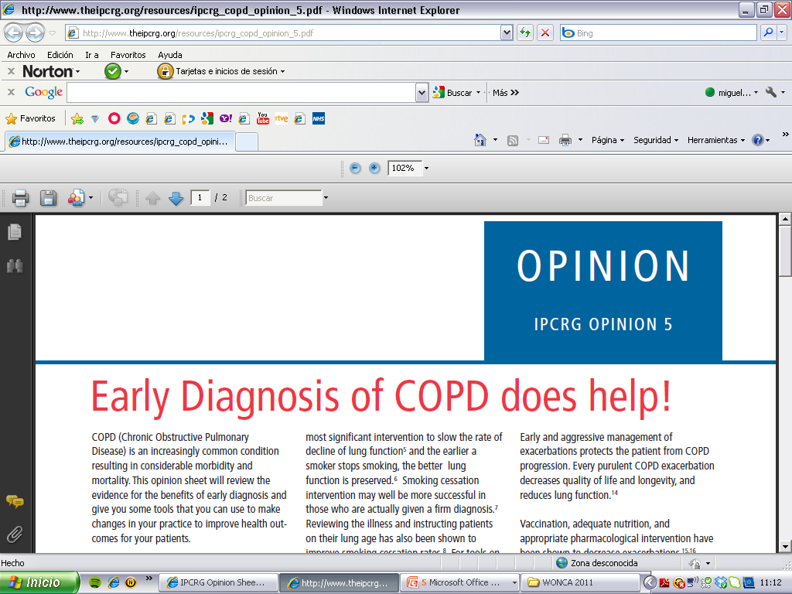
Why does early diagnosis matter?
What are the barriers to making a diagnosis earlier?
How do we promote early diagnosis?
Can early intervention and screening help?

Slide 19
COPD – the background
An increasingly common condition
Considerable morbidity and mortality
Most patients remain undiagnosed and diagnosis is given late
Many of these costs could be reduced by earlier intervention
Early diagnosis could improve smoking cessation
Early intervention could delay lung function decline

Slide 20
Why does early diagnosis matter?
Preserve lung function
Preserve quality of life for the patient
Encourage smoking cessation
Enable earlier interventions to prevent exacerbations
Reduce costs
Decrease mortality
Notes:
As most patients with COPD are diagnosed late in the disease, we suggested that patients would be advantaged by earlier diagnosis – in terms of lung function severity, symptoms and exacerbations – rather than clinicians simply focusing on those patients who are already diagnosed (as Enright and White suggest).

Slide 21
What are the barriers to earlier diagnosis?
It is difficult to chart the progression of COPD currently.
There are no accepted biochemical or clinical markers to allow measurement of COPD activity.
There are however clinical predictors (of disease progression) through increased frequency of exacerbations in those with the clinical phenotype of cough and sputum.
Notes:
Evidence for short-acting bronchodilator (SABD) use in symptomatic mild COPD is extrapolated from patients with more severe disease, but they continue to be included in all world guidelines.
The widespread use of SABD in these guidelines belies the lack of evidence.
The use of long-acting bronchodilators (LABD) in GOLD stage II showed a small 6 ml improvement in FEV1 annually on treatment with tiotropium, but this was additive to other therapies and not in a population without treatment.
Also, FEV1 improvement does not capture all of the benefit of bronchodilators as evidenced by health status improvement and exacerbation reduction. There is no data to support the use of LABD in GOLD stage I disease.

Slide 22
Barriers for early diagnosis - Doctor Centered
Lack of interest – a heart sink disease
Lack of facilities for diagnosis – spirometry
Smoking or lifestyle related

Slide 23
Barriers for early diagnosis - Patient Related
Low knowledge (ignorance) of the disease
Afraid of danger diagnosis (lung cancer)
Adaptation – getting old
Excuse of the symptoms – smoker’s cough

Slide 24
Is early detection of COPD a waste of resources?_{1,2}
Decline in lung function is faster in GOLD stages I to II than III or IV
Patients with symptomatic GOLD stage I are more likely to progress
There is no evidence that late smoking cessation reduces decline in lung function
There is some evidence that isolated abnormal spirometry influences smoking cessation
Late diagnosis leads to no access to pulmonary rehabilitation or drugs which can improve symptoms and reduce exacerbations
Opportunistic case finding of symptomatic disease does not involve additional resources of screening; certainly in many countries this is part of the core services that primary care should provide.
Enright P, White P. Detecting mild COPD: don’t waste resources. Prim Care Respir J 2011;20(1):6-8
Jones R. Earlier detection of COPD. Prim Care Respir J 2011;20(2):222-222.

Slide 25

.
Should we screen ALL smokers for
COPD?

Slide 26
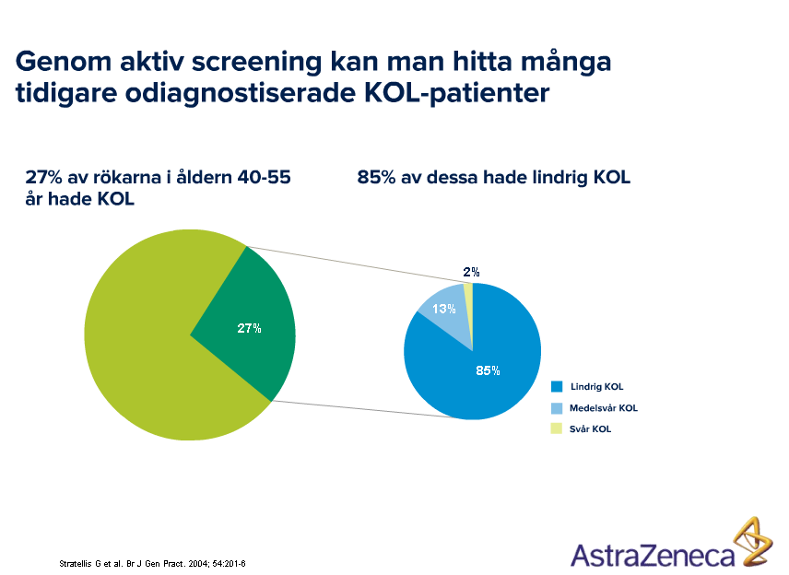
And who to screen?
With active screening you find lot of smokers with COPD, earlier unrecognised COPD
27% of the smokers, 40-55 years, had COPD
85% of those had mild COPD
Mild COPD
Moderate COPD
Severe COPD
Stratelis G et al. Br J Gen Pract 2004; 54:201-6

Slide 27
The dangers of screening
Spirometry in early COPD (GOLD 1) may be normal and a disincentive to smoking cessation
There is limited evidence that isolated abnormal spirometry influences smoking cessation
Smoking cessation is the only thing that influences disease outcome

Slide 28
The dangers of screening
Smith-Sivertsen T, Rortveit G.Scand J Prim Health Care. 2004 Dec;22(4):196-201. Department of Public Health and Primary Health Care, University of Bergen
Should general practitioners screen smokers for COPD?
The COPD diagnosis can usually be made by means of spirometry before symptoms appear. General practitioners are these days encouraged, from several quarters, to screen their smoking patients for early COPD. Smoking cessation is still the only available treatment that indisputably improves the long-term prognosis of this disease.
CONCLUSIONS:
A large randomized study is needed, in which the independent effect of spirometry as part of a smoking cessation programme is studied. Until such a study has shown convincing results, and has been followed by a cost-benefit analysis in favour of screening, screening for pre-clinical COPD in general practice should not be recommended. However, it is important to diagnose people who may benefit from symptom-relieving treatment, and therefore patients with smoking-related symptoms should be offered spirometry. Finally, the general practitioner should strive to offer smoking cessation counseling to all smokers, regardless of their lung function.

Slide 29

Could It Be COPD?
Question 1 Do you smoke? Or have you been a smoker? Question 2 Are you older than 35 years? Question 3 Do you cough several times most days? Question 4 Do you bring up phlegm or mucus most days? Question 5 Do you get out of breath more easily than others your age?
Question 1 Do you cough several times most
days? Yes No Question 2 Do you bring up phlegm or mucus most days? Yes No Question 3 Do you get out of breath more easily than others your age? Yes No

Slide 30
. Case-finding
An example of case-finding is a family physician performing spirometry (or refer to spirometry) during an office visit for a 40-year-old smoker because the patient complains of a chronic morning cough.
The physician then discusses the results with the patient and refers him or her to a local smoking-cessation program.

Slide 31
Case finding: Who should be tested with spirometry?
Smokers >10 paq-year
Age > 35
Symptoms:
Cough
Sputum
Shortness of breath
SPIROMETRY

Slide 32
If you test one smoker
with cough every day
You will diagnose
one patient
With COPD
a week

Slide 33
Can early intervention and screening really help?
All major guidelines recommend early diagnosis of symptomatic disease – the most recent being the UK NICE guidelines 3 state:
“Spirometry should be performed in patients who are over 35, current or ex-smokers, and have a chronic cough. Spirometry should be considered in patients with chronic bronchitis. A significant proportion of these will go on to develop airflow limitation.”
The health care worker must suspect the possible diagnosis from symptoms and risk factors (not only smoking), consider screening with questionnaires or mini-spirometers, and offer proper spirometry to confirm the diagnosis.
National Clinical Guideline, C. (2010). Chronic Obstructive Pulmonary Disease: Management of adults with COPD
Notes:
Conventional advice is so dull and we all love the maverick. In their refreshing and plausible editorial in the most recent issue of the PCRJ, Enright and White challenge the conventional wisdom on early detection of COPD by stating that early detection of COPD is a waste of resources.1 The advice they offer is attractive, but it should not be trusted and here is why. If we do not detect early symptomatic disease, we detect it late – i.e. when the lung damage is irreversible and will progress. The decline in lung function is much faster in GOLD stages I to II than it is for stages III or IV.2 There is no evidence that late smoking cessation reduces decline in lung function. If symptomatic individuals with COPD are not diagnosed early, they are denied proper education on the management of symptoms and preservation of lung function. Furthermore, they have no access to pulmonary rehabilitation or drugs which can improve symptoms and reduce exacerbations. Opportunistic case finding of symptomatic disease does not involve additional resources of screening; certainly in the UK, this is part of the core services that primary care should provide and is remunerated to do so. The authors state that in many countries clinicians fail to manage patients with diagnosed COPD effectively, but this does not mean that earlier diagnosis is wrong The authors correctly state that the progression of early disease is unclear, but patients with symptomatic GOLD stage I are more likely to progress3 – which is why only symptomatic people should be diagnosed. All major guidelines recommend early diagnosis of symptomatic disease – the most recent being the UK NICE guidelines,4 which examined the subject very thoroughly and state: “Spirometry should be performed in patients who are over 35, current or ex-smokers, and have a chronic cough. Spirometry should be considered in patients with chronic bronchitis. A significant proportion of these will go on to develop airflow limitation.” Following the nihilistic advice in Enright and White’s editorial1 will condemn people to preventable, intractable lung disease.

Slide 34
The challenge of early detection
Pulmonary damage
Intermitent symptoms
Breathlessness
Obstruction

Slide 35
Conclusions
COPD is a slowly progressing disease which is often unrecognised until it is clinically apparent and moderately advanced.
What to look for: Fatigue, dyspnoea, “smokers cough”, chronic cough, sputum production, wheezing
- people do not see the doctor for this
We need a Spirometer to confirm the diagnosis and assess severity
The public health message is that chronic cough and sputum are not normal - their presence should trigger a search for underlying cause(s).
Early intervention will help to preserve lung function which in turn will reduce the risk of COPD exacerbations
Earlier diagnosis would enable healthcare workers to encourage smoking cessation

Slide 36
Assesment and clasification of COPD patient
Ioanna Tsiligianni / Miguel Roman

Slide 37
Global Strategy for Diagnosis, Management and Prevention of COPD. Updated 2011
COPD Assesment
Determine the severity of the disease, its impact on the patient’s health status and the risk of future events (for example exacerbations) to guide therapy. Consider the following aspects of the disease separately:
severity of the spirometric abnormality
current level of patient’s symptoms
frequency of exacerbations
presence of comorbidities.

Slide 38
Patients underestimate their condition
Data from the Impact of COPD in Europe and North America
in 2000 Study¹ (n=3265) showed:
Of those too breathless to leave the house, 36% described their condition as mild or moderate
60% of those who were short of breath after walking for a few minutes on the flat described their condition as mild or moderate
1. Rennard S et al. Eur Respir J 2002;20:799–805.
Notes:
When data collected in Europe using the Confronting COPD questionnaire were combined with the American data, the results showed that for the third of patients who were too breathless to leave the house, 36% described their disease as mild or moderate, as did 60% of those who became short of breath after walking on the flat for a few minutes.¹
These data suggest that patients can understate the severity of their disease, making it difficult for physicians to assess the impact of patients’ symptoms on their lives. The data also suggest that the impact of COPD is similar in different regions despite regional differences in management of the disease.
1. Rennard S et al. Eur Respir J 2002;20:799–805.

Slide 39
Need for simple tools- patients and physicians a common understanding
Significant numbers of patients have COPD that is under-recognised, untreated and sub-optimally managed, despite widening use of spirometry
Exacerbations occur that go unreported
Physicians in general may under-treat patients with COPD, which can lead to a poor QoL
Patients need help and support in realising and understanding the full impact of their disease
Physicians may not fully realise the extent to which COPD is limiting a patient’s life
Simple tool are needed to achieve a mutual understanding of disease status and impact, and help to optimise disease management
Notes:
It is clear that the management of COPD needs to be improved. Around 11% of patients with the disease remain undiagnosed, and a significant proportion are not treated or are sub-optimally managed, leading to poor quality of life.¹ The problem is further compounded by the fact that many patients with COPD do not consult their physician until late into the course of their disease. Even those patients under the care of a physician do not report all exacerbations, with 49% of exacerbations going unreported.² Patients also overstate their COPD control. Of patients with a severe/high moderate degree of breathlessness, 52% considered themselves to be well or completely controlled.¹ These findings confirm that patients and physicians require a tool to facilitate fact-based dialogue and to help achieve a mutual understanding of disease status and impact. A better understanding would help physicians optimise COPD management and thus improve patients’ quality of life.
1. Confronting COPD in America: Executive Summary; http://www.aarc.org/resources/confronting_copd/exesum.pdf; last accessed 130808.
2. Seemungal TAR et al. Am J Respir Crit Care Med 1998;157:1418–1422.

Slide 40
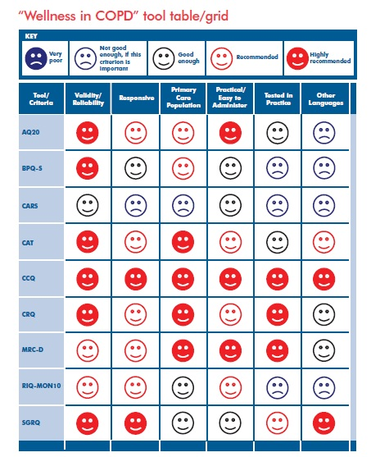
IPCRG Users’Guide to COPD “Wellness” Tools. International Primary Care Respiratory Group. 2010 September. Cave AJ, Tsiligianni I, Chavannes N, Correia de Sousa J, Yaman H. Available from: http://www.theipcrg.org/resources/ipcrg_users_guide_to_copd_wellness_tools.pdf
Notes:
CARS COPD ACTIVITY RATING SCALE

Slide 41
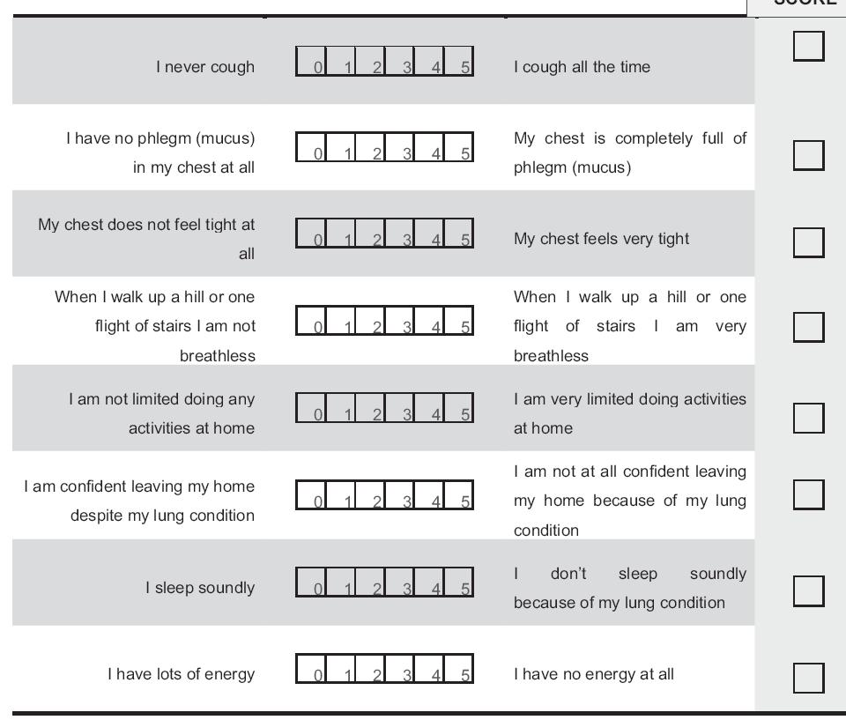
COPD Assessment Test (CAT): http://catestonline.org
Notes:
An 8-item measure of health status impairment in COPD

Slide 42
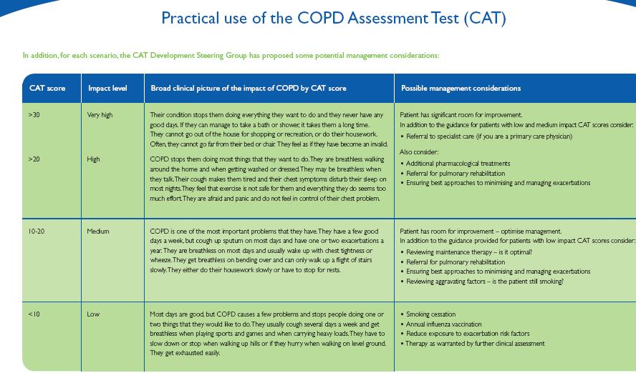

Slide 43
COPD Assesment: current level of patient’s symptoms
Notes:
relates well to other measures of health status and predicts future mortality risk.

Slide 44
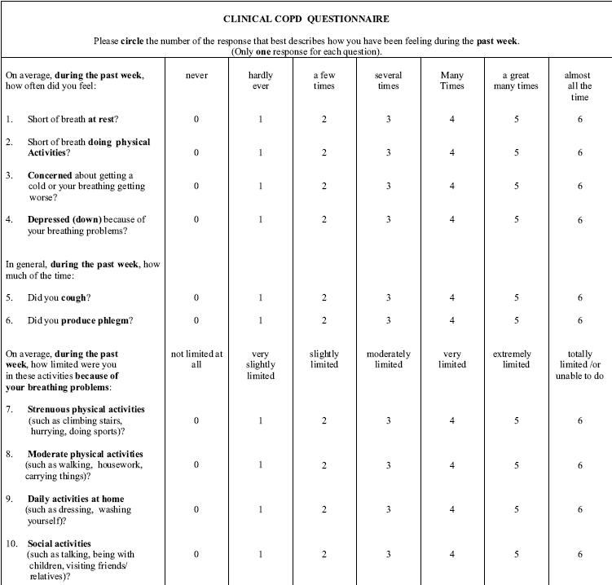
CCQ: COPD Clinical questionnaire

Slide 45
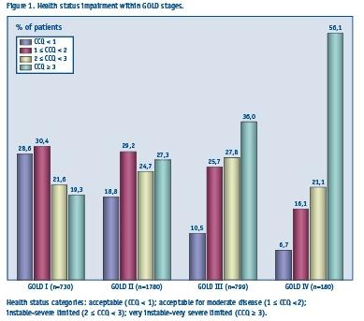

Slide 46
Differences between COPD questionnaires
SGRQ | MRC Dyspnoea Questionnaire | CCQ | CAT
Measures impaired health and wellbeing | Measures dyspnoea only | Measures clinical disease control | Measures holistic impact of COPD on patients
Used largely in clinical trials | – | Used in clinical practice | Used in clinical practice
Long (76-items) | Short (5-items) | Short (10-items) | Short (8 items)
Patient completed | Patient completed | Patient completed | Patient completed
Computer required | Paper based | Paper based | Paper based
Complex to administer | Simple to administer | Simple to administer | Simple to administer
Notes:
46
The CAT has been designed to overcome the shortfalls of earlier questionnaires measuring disability in COPD.
This slide outlines the key differences between the CAT and the SGRQ, MRC Dyspnoea questionnaire and the CCQ.
The CAT is a simple, short, easy to use self-administered, paper-based questionnaire for use in clinical practice.
The SGRQ is significantly longer¹ than the CAT and the CCQ slightly longer (although still relatively quick to administer, approximately 2 minutes²).
The SGRQ is complex to administer and score¹ and must be analysed on a computer.
The MRC dyspnoea questionnaire measures dyspnoea only³ whereas CAT is a holistic measure of the impact of COPD on the patient,
The SGRQ is predominantly used in clinical trials;¹ other questionnaires are designed for use in clinical practice.²
1. Jones PW et al. Resp med 1991; 85 (Suppl B): 25–31;
2. Van der Molen et al. Health and Quality of Life Outcomes 2003; 1: 13–22;
3. Bestall JC et al. Thorax 1999; 54: 581–6.
13/581/B
14/19/A
15/29/A
13/581/A
13/582/A
14/15/A
15/26/A
14/14/A
15/30/A
13/581/C
14/15/A
15/26/B
13/582/A
15/26/A
15/26/B
14/19/A
15/30/A

Slide 47
COPD Assesment:
frequency of exacerbations
Two or more exacerbations within the last year.

Slide 48
Global Strategy for Diagnosis, Management and Prevention of COPD. Updated 2011
D: More Symtoms, high risk
4
(C)
(D)
> 2
3
C: Less symptoms, high risk
Risk
(Exacerbation history)
Risk
(GOLD Classification of Airflow Limitation)
B: More symtoms, low risk
2
(A)
(B)
1
A: Les symptoms, low risk
1
0
mMRC 0-1
CAT < 10 or CCQ<1
mMRC > 2
CAT > 10 or CCQ>1
Symptoms

Slide 49
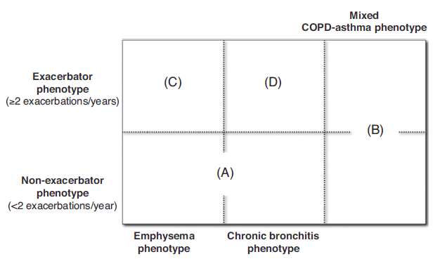
COPD Phenotypes. Spanish GesEPOC guidelines 2012

Slide 50
COPD Assesment:
Co-morbidities
COPD patients are at increased risk for:
Cardiovascular diseases
Osteoporosis
Respiratory infections
Anxiety and Depression
Diabetes
Lung cancer
These comorbid conditions may influence mortality and hospitalizations and should be looked for routinely, and treated appropriately.

Slide 51
Comorbidity and Mortality in COPD Related Hospitalizations
40
COPD
Non-COPD
30
Mortaliyty (%)
20
10
0
RF
Pneum
HF
IHD
Hypert
TM
Diabetes
PVD
Holguin et al. CHEST 2005; 128:2005
Notes:
Figure 3. Estimated in-hospital mortality of hospital discharges associated with selected comorbidities
in patients with and without COPD, NHDS 1979 to 2001. Bars represent the age-adjusted percentage
with SE bars. Black bars show patients with COPD (either as primary or secondary discharge
diagnosis). White bars show patients without any mention of a COPD discharge diagnosis. The
in-hospital mortality for all listed comorbidities is different across COPD categories (p 0.01). See
Comorbidity and Mortality in COPD Related Hospitalizations in the United
States, 1979 to 2001*
Fernando Holguin, MD; Erik Folch, MD; Stephen C. Redd, MD; and
David M. Mannino, MD, FCCP
Study objectives: COPD is one of the leading causes of mortality and morbidity in the United
States, yet little is known about the prevalence of comorbid conditions and mortality in
hospitalized patients with COPD.
Design: From the National Hospital Discharge Survey, 1979 to 2001, we evaluated whether or not
COPD in adults > 25 years old is associated with increased prevalence and in-hospital mortality
of several comorbidities.
Results: During 1979 to 2001, there were an estimated total of 47,404,700 hospital discharges
(8.5% of all hospitalizations in adults > 25 years old) of patients with COPD; 37,540,374
discharges (79.2%) were made with COPD as a secondary diagnosis, and 9,864,278 discharges
(20.8%) were made with COPD as the primary diagnosis. The prevalence and in-hospital
mortality for pneumonia, congestive heart failure, ischemic heart disease, thoracic malignancies,
and respiratory failure were larger in hospital discharges with any mention of COPD.
Conclusions: In a nationally representative sample of hospitalizations, any mention of COPD in
the discharge diagnosis is associated with higher hospitalization prevalence and in-hospital
mortality from other comorbidities. These results highlight the fact that the burden of disease
associated with COPD is likely underestimated. (CHEST 2005; 128:2005–2011)

Slide 52
Cardiovascular disease
One of the most common COPD-associated comorbidities
prevalence increases with increasing COPD severity
increase in mortality and morbidity
Cardiovascular comorbidities occurred in 22.6% of patients with COPD (risk ratio, 4.01)¹
Prevalence (%) of cardiovascular diseases in COPD patients vs control subjects
 | COPD patients | Control subjects | Odds ratio
Congestive heart failure | 7.2 | 0.9 | 8.48
Ventricular tachycardia/fibrillation | 0.8 | 0.1 | 7.94
Pulmonary embolism | 0.3 | 0.1 | 4.69
Myocardial infarction | 1.8 | 0.4 | 4.42
Atrial fibrillation | 4.7 | 1.1 | 4.41
Notes:
¹Soriano JB, Visick GT, Muellerova H, et al. Chest 2005; 128(4): 2099–2107; ²Sidney S, Sorel M, Quesenberry CP, Jr., et al. Chest 2005; 128(4): 2068–2075

Slide 53
COPD: Systemic effect - Osteoporosis
100%
13
20
80%
41
32
60%
49
Percentage of subject group
40%
48
55
20%
31
11
0%
Healthy subjects
n=38
FEV₁>50% pred
n=35
FEV₁<50% pred
n=46
No bone loss
Osteopenia
Osteoporosis
Bolton CE, AJRCCM 2004

Slide 54
Diabetes mellitus
The prevalence of type 2 diabetes mellitus is increased in COPD compared with control subjects (17.2% vs 13.0%)¹
Risk of developing diabetes mellitus increased even with mild disease²
Risk of diabetes mellitus in COPD patients by disease severity (GOLD category)
GOLD stage | Odds ratio | 95% confidence interval
3 or 4 | 1.5 | 1.1–1.9
2 | 1.4 | 1.2–1.6
1 | 0.9 | 0.8–1.1
¹Sin DD, Man SF. Circulation 2003; 107(11): 1514–1519; ²Mannino DM, Thorn D, Swensen A, Holguin F. Eur Respir J. 2008; 32(4): 962–969.

Slide 55
COPD assesment:
Aditional Investigations
Chest X-ray Diagnose comorbidities.
Lung Volumes and Diffusing Capacity: Help to characterize severity, but not essential to patient management.
Oximetry and Arterial Blood Gases: Need for supplemental oxygen therapy.
Alpha-1 Antitrypsin Deficiency Screening: under 45 years or with a strong family history of COPD.
Exercise Testing: indicator of health status and predictor of prognosis.
Composite Scores: Several variables identify patients at increased risk for mortality.

Slide 56
Management of stable disease
Ioanna Tsiligianni

Slide 57
Therapeutic Options: Key Points
Smoking cessation has the greatest capacity to influence the natural history of COPD. Health care providers should encourage all patients who smoke to quit.
Pharmacotherapy and nicotine replacement reliably increase long-term smoking abstinence rates.
All COPD patients benefit from regular physical activity and should repeatedly be encouraged to remain active.

Slide 58
Smoking Cessation
Effects of smoking cessation intervention
on COPD patients
Reasons why GPs keep their distance from the SC intervention
How could we overcome these barriers?
SC is the only effective intervention to prevent, to slow progress and to improve outcome in COPD!
Smoking is the most important single cause of morbidity and mortality.

Slide 59
Therapeutic Options: Key Points
Appropriate pharmacologic therapy can reduce COPD symptoms, reduce the frequency and severity of exacerbations, and improve health status and exercise tolerance.
None of the existing medications for COPD has been shown conclusively to modify the long-term decline in lung function.
Influenza and pneumococcal vaccination should be offered depending on local guidelines.

Slide 60
Global Strategy for Diagnosis, Management and Prevention of COPD Therapeutic Options: Key Points
Beta₂-agonists
Short-acting beta₂-agonists
Long-acting beta₂-agonists
Anticholinergics
Short-acting anticholinergics
Long-acting anticholinergics
Combination short-acting beta₂-agonists + anticholinergic in one inhaler
Methylxanthines
Inhaled corticosteroids
Combination long-acting beta₂-agonists + corticosteroids in one inhaler
Systemic corticosteroids
Phosphodiesterase-4 inhibitors

Slide 61
Therapeutic Options: Bronchodilators
Long-acting inhaled bronchodilators are convenient and more effective for symptom relief than short-acting bronchodilators.
Long-acting inhaled bronchodilators reduce exacerbations and related hospitalizations and improve symptoms and health status.
Combining bronchodilators of different pharmacological classes may improve efficacy and decrease the risk of side effects compared to increasing the dose of a single bronchodilator.

Slide 62
Therapeutic Options:
CS-PDE-4
Long-term treatment with inhaled corticosteroids added to long-acting bronchodilators is recommended for patients with high risk of exacerbations.
In patients with severe and very severe COPD (GOLD 3 and 4) and a history of exacerbations and chronic bronchitis, the phospodiesterase-4 inhibitor (PDE-4), roflumilast, reduces exacerbations

Slide 63

Goals of therapy for stable COPD
Relieve symptoms
Improve exercise tolerance
Improve health status
Prevent disease progression
Prevent and treat exacerbations
Reduce mortality
Reduce
symptoms
Reduce
risk

Slide 64
Manage Stable COPD: All Patients
Avoidance of risk factors
- smoking cessation
- reduction of indoor pollution
- reduction of occupational exposure
Influenza vaccination

Slide 65
Manage Stable COPD: Non-pharmacologic
Patient | Essential | Recommended | Depending on local guidelines
A | Smoking cessation (can include pharmacologic treatment) | Physical activity | Flu vaccination Pneumococcal vaccination
B, C, D | Smoking cessation (can include pharmacologic treatment) Pulmonary rehabilitation | Physical activity | Flu vaccination Pneumococcal vaccination

Slide 66
Manage Stable COPD: Pharmacologic Therapy
Patient | First choice | Second choice |  | Alternative Choices
A | SAMA prn or SABA prn | LAMA or LABA or SABA and SAMA |  | Theophylline
B | LAMA or LABA | LAMA and LABA |  | SABA and/or SAMA Theophylline
C | ICS + LABA or LAMA | LAMA and LABA |  | PDE4-inh. SABA and/or SAMA Theophylline
D | ICS + LABA or LAMA | ICS and LAMA or ICS + LABA and LAMA or ICS+LABA and PDE4-inh. or LAMA and LABA or LAMA and PDE4-inh. |  | Carbocysteine SABA and/or SAMA Theophylline

Slide 67
Manage Stable COPD: Pharmacologic Therapy
Groups A, B, C or D severity assessment based on:
FEV₁: GOLD 1, 2, 3 and 4
Symptoms (mMRC or CAT questionnaires) score
Exacerbations/year
(C) | (D)
LABA/ICS or LAMA | LABA/ICS or LAMA
LABA + LAMA | LABA/ICS + LAMA; LABA/ICS + PDE4; LAMA + PDE4
SABA or SAMA p.r.n. | LAMA or LABA
SABA + SAMA; LABA or LAMA | LABA + LAMA
(A) | (B)
GOLD 4
≥2
GOLD 3
Exacerbations per year
GOLD 2
<2
GOLD 1
mMRC 0−1 CAT <10
mMRC 2+
CAT 10+
GOLD 2011
Notes:
Reference:
Revised GOLD 2011 http://www.goldcopd.org/guidelines-global-strategy-for-diagnosis-management.html

Slide 68
Management of COPD exacerbations
Miguel Roman Rodriguez

Slide 69
Goals of therapy for stable COPD
Relieve symptoms
Improve exercise tolerance
Improve health status
Prevent disease progression
Prevent and treat exacerbations
Reduce mortality
Reduce
symptoms
Reduce
risk

Slide 70
What is an acute COPD exacerbation?
“A sustained worsening of the patient's condition, from the stable state and beyond normal day-to-day variations, that is acute in onset and necessitates a change in regular medication in a patient with underlying COPD”

Slide 71
Exacerbations are Commonly Caused by Infection and Air Pollution^{1,2}
The cause of one-third of severe exacerbations cannot be identified
Aetiology of COPD exacerbations²
≈ 80%
Systemic symptoms: fever, chills, tachycardia, vasodilation, and/or malaise
≈ 20%
Mucoid sputum
Infectious
Noninfectious
Purulent sputum
Allergies Weather extremes Smoking Pollution Stress Undertreatment or nonadherence
Bacterial
Atypical
Viral
≈ 40% − 50%
≈ 5% − 10%
Bacterial-viral
co-infection (25%)
≈ 40% − 50%
Notes:
Key message:
The majority of exacerbations are due to infection

Slide 72
Exacerbation Frequency Worsens with COPD Severity, but Can Occur at Any GOLD Level
Exacerbations become more frequent and more severe as the severity increases
Annual estimated frequencies of exacerbations
In the ECLIPSE study (2,138 patients) the single best predictor of exacerbations was a history of exacerbations
GOLD spirometric level³ |  | ECLIPSE study¹
 | FEV₁ predicted | Total | Exacerbations requiring hospitalization | Frequent exacerbators
 |  | Number exacerbations in year 1/patient |  | Patients with ≥2 exacerbations/yr
GOLD 1: Mild | ≥80%
GOLD 2: Moderate | ≥50% to <80% | 0.85 | 0.11 | 22%
GOLD 3: Severe | ≥30% to <50% | 1.34 | 0.25 | 33%
GOLD 4: Very Severe | <30% | 2.00 | 0.54 | 47%
Two-thirds of exacerbations are not reported by patients
Notes:
Key message:
Exacerbation frequency worsens with COPD severity; however, the prevalence of exacerbations is underestimated because not all patients report them to their physicians.

Slide 73
Worse Prognosis in Frequent Exacerbators
Frequent exacerbators Patients with ≥2 exacerbations/year
Poorer HRQoL
Increased mortality
Increased inflammation
More recurrent exacerbations
Faster decline in lung function
Higher hospital readmission
Higher myocardial infarction rate
Adapted from Wedzicha et al. Lancet 2007; 370:786-796; Donaldson et al. Thorax 2006; 61:164-168; Donaldson et al. Chest 2010; 137:1091-1097; Decramer et al. Am J Respir Crit Care Med 2010; 181:A1526.
Notes:
Key message:
Patients with frequent exacerbations (frequent exacerbators) have worse overall prognosis than patients without frequent exacerbations

Slide 74
Worse Prognosis in Frequent Exacerbators
≥3 acute exacerbations requiring hospitalisation is associated with a risk of death 4.30 times greater than for those patients not requiring hospitalization
Group A
Patients with no acute exacerbations
Group B
Patients with 1–2 acute exacerbations of COPD requiring hospital management
Group C
Patients with ≥3 acute exacerbations of COPD requiring hospital management
1.0
0.8
A
0.6
p<0.0002
Probability of surviving
B
p<0.0001
0.4
p=0.069
C
0.2
0
10
20
30
40
50
60
Time (months)
Soler-Cataluña et al. Thorax 2005; 60:925-931.
Notes:
Key message:
Patients with more exacerbations have a higher risk of mortality

Slide 75
How are COPD Exacerbations Best Managed?
Prevention
Treatment
Use of a Patient Action Plan

Slide 76
Prevention of COPD Exacerbations
Access to patients
Smoking cessation
Influenza vaccination
Annually
Pneumococcal vaccination
Every 5–10 years
Pulmonary rehabilitation
Self-management education
Optimize maintenance bronchodilator therapy
Combination therapy
Moderate to severe COPD with >1 exacerbation/yr
Roflumilast¹
Chronic productive cough
Mucolytics
Notes:
Key message:
There are several strategies that should be adopted to prevent future exacerbations, such as smoking cessation, influenza and pneumococcal vaccinations, pharmacologic therapy optimization, and pulmonary rehabilitation.
Combination therapy: Inhaled corticosteroid and long-acting β-agonist

Slide 77
Management of COPD Exacerbations
Patient use of custom action plan
Increasing severity
Increase in dose/frequency of inhaled bronchodilators
Prevent and treat respiratory failure
Systemic corticosteroids
Oxygen (low concentrations to prevent hypercapnia)
Antibiotics (if change in sputum)
Consider BIPAP
Follow-up visit 48-72 hours
Consideration and management of comorbidities
Consider appropriate exacerbation prevention strategies
Adapted from Hurst and Wedzicha. BMC Medicine 2009; 7:40.
Notes:
Key message:
Management of exacerbationsis based on the implementation/optimization of bronchodilators and corticosteroids, the use of oxygen therapy, treatment of the cause of the exacerbation, and resolution of possible comorbidities

Slide 78
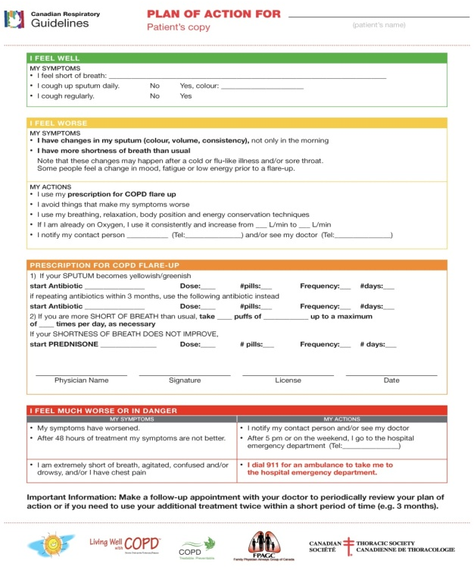
Patient Action Plans
Action plans are designed to^{2,3}
Help patients recognise a deterioration in their symptoms
Initiate changes to treatment early
Reduce the impact of the exacerbation
Developed in partnership with patients and caregivers to provide guidance for handling exacerbations^{3,4}
Regular respiratory medication and actions to remain stable
Symptom recognition and actions to manage exacerbations
A list of contacts
Actions for symptom worsening or dangerous situations
Notes:
Key message:
A Patient Action plan helps patients recognize and anticipate early symptoms of an exacerbation and provides an approach to increase the strategies for managing the exacerbation

Slide 79
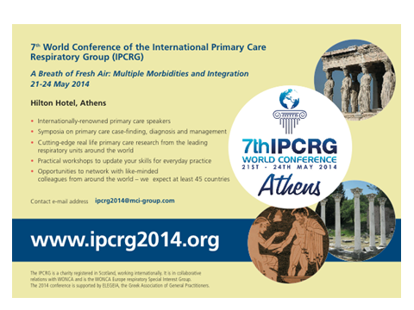
IPCRG 7th IPCRG World Conference
Athens 2014 21st – 24th May

Slide 80
Thank you for your attention!

