Slide 1

Spirometry made easy
Miguel Román-Rodríguez MD
Family Physician
Son Pisa Primary Health Care Centre, Palma de Mallorca. Spain
Spanish Primary Care Respiratory Group

Slide 2
Objectives
To know the important spirometry parameters
To identify a “good quality” spirometry
To identify the different spirometry patterns
To accurately “read” the results of the test

Slide 3
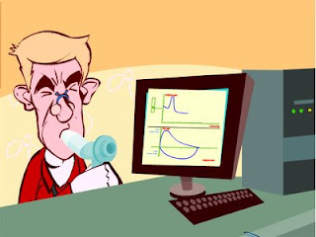
Forced spirometry
Spirometry measures airflow and lung volumes, and is the preferred lung function test for COPD and asthma in primary care
Forced exhalation from a maximal inspiration

Slide 4
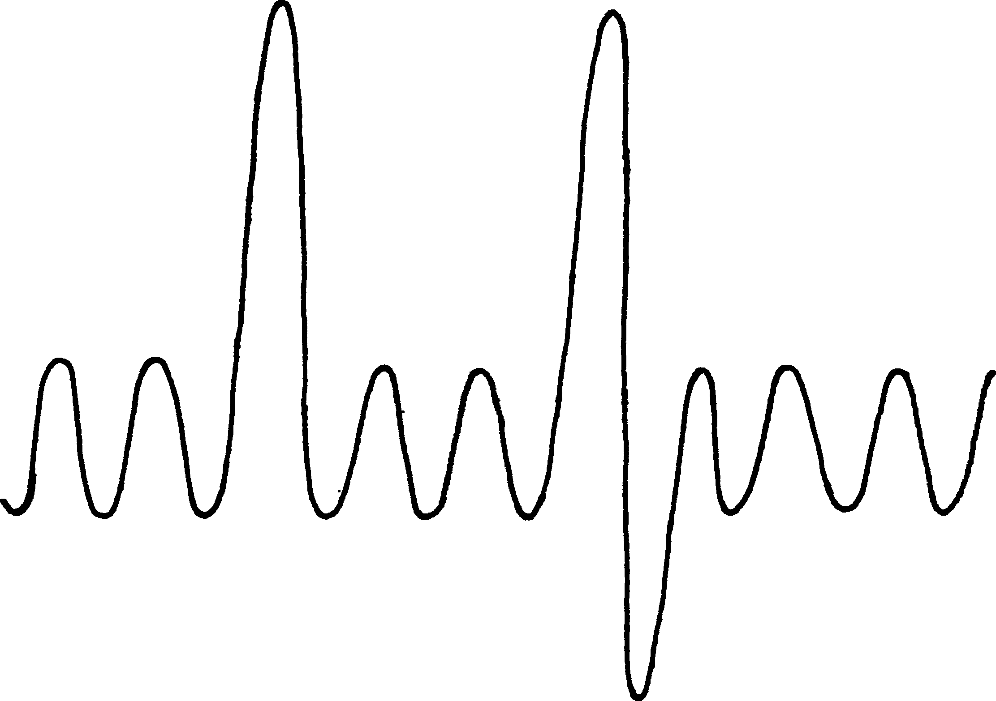
Inspiratory Reserve Volume (IRV)
Inspiratory Capacity (IC)
Total Lung Capacity (TLC)
Vital Capaciity (VC)
Tidal Volume (TV)
Expiratory Reserve Volume (ERV)
Residual Functional Capacity (RFC)
Residual Volume (RV)

Slide 5
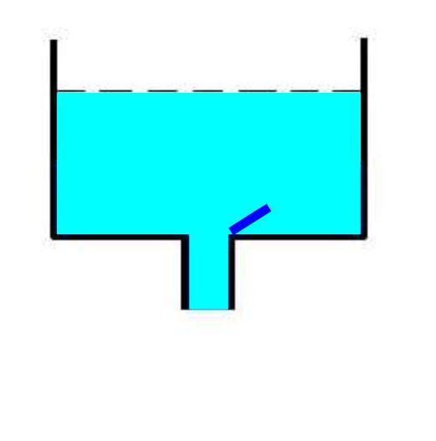
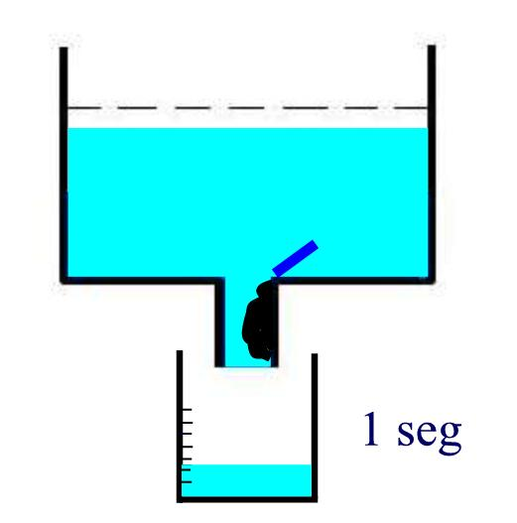
FEV1
Exhaled volume in the first second of a forced expiration after a maximal inspiration.

Slide 6
FVC
Total volume of exhaled air in a forced expiratory manoeuvre after a maximal inspiration.
The less total volume /capacity the less FVC

Slide 7
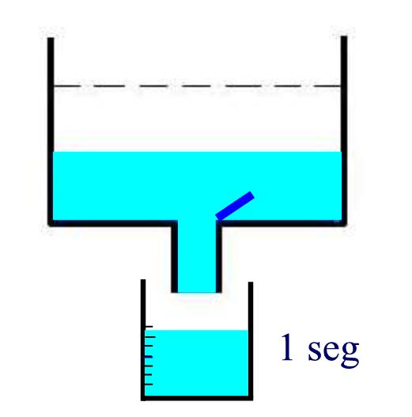
Bronchial obstruction generates less volume in the first second

Slide 8
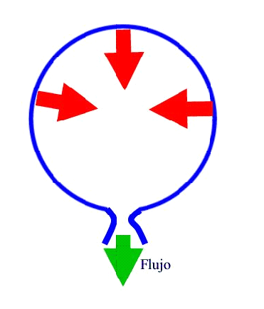
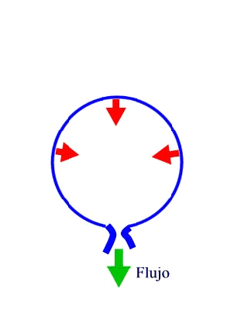
FLOW
FLOW
FLOW
FEV1 / FVC
Best obstruction measurement
% of forced vital capacity expelled during the first second

Slide 9
Important measurements
FVC: Forced Vital Capacity
Volume of air exhaled after full inspiration and full exhalation
FEV1: Forced Expiratory Volume in 1 second
Volume of air exhaled in the first second of forced exhalation.
FEV1 / FVC:
Ratio of vital capacity exhaled in 1 second expressed as a percentage of the total volume of air exhaled after full inspiration and full exhalation

Slide 10

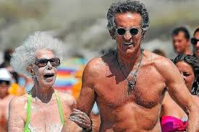
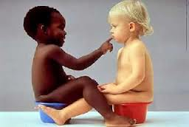
Does anyone blow the same?
Height
  Tall people have larger lungs
Age
  Respiratory function declines with age
Sex
  Lung volumes smaller in females
Ethnicity
  Peculiarly studies show Black and Asian people as a whole, have smaller lung volumes (12-20 %).
  No studies for Pacific People.
Posture
  Little difference between sitting and standing. Reduced in supine position.

Slide 11
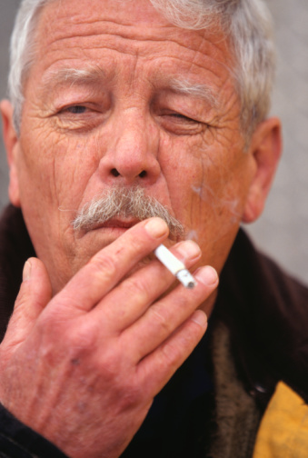
When to perform a spirometry?
Asthma and COPD diagnosis and follow up
To asses chronic respiratory symptoms
To identify smokers at risk of COPD

Slide 12
When NOT to perform a spirometry?
Absolute contraindications
Recent pneumothorax
Pulmonary Embolism (before anticoagulation)
Active respiratory infection
Recent myocardial infarction or unstable angor pectoris
Retinal detachment
Aortic Aneurisms
Recent abdominal surgery
Intracranial hypertension
Relative contraindications
Traqueostomy
Problems holding the mouthpiece
Facial hemiparesis
Poor mental condition.

Slide 13
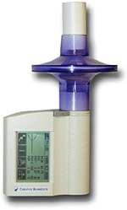
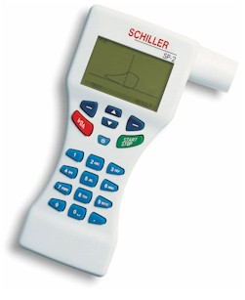
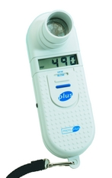
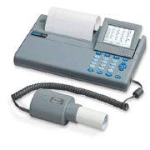
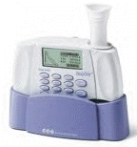
Spirometry must be used in primary care
Have we got spirometers in our practices?

Slide 14
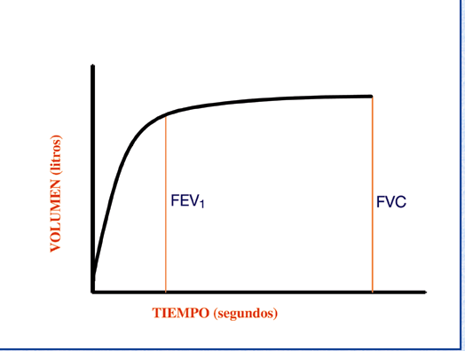
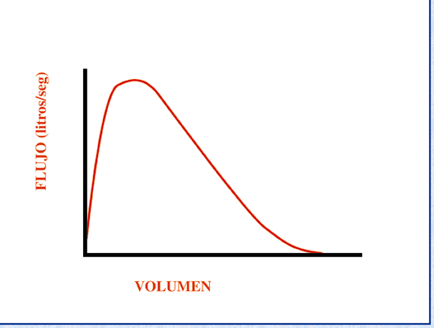
The most important matter: curves
Any test is only as good as its accuracy
Time/volume
Flow/volume

Slide 15
The most important matter: curves
FEV1: Volume of air exhaled in the first second of a forced exhalation after complete inspiration
FVC
5
4
FEV₁ = 4L
FVC = 5L
FEV₁/FVC = 0.8
3
FVC: Total volume of air exhaled after full inspiration and full exhalation
2
Volume, liters
1
1
2
3
4
5
6
Time, seconds
1

Slide 16
The most important matter: curves
Peak-flow: Maximum airflow during the manoeuvre
FEV₁
FVC

Slide 17
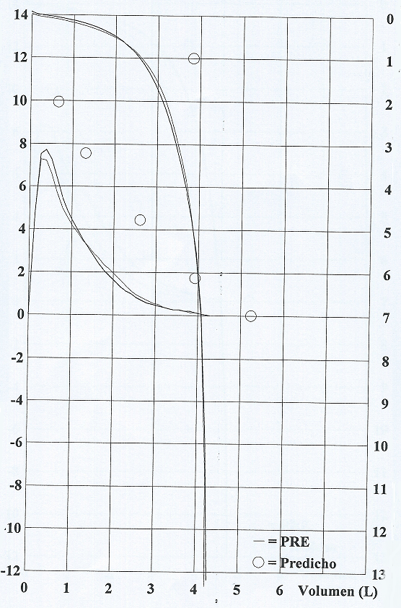
FEV1

Slide 18
Spirometry Interpretation

Slide 19
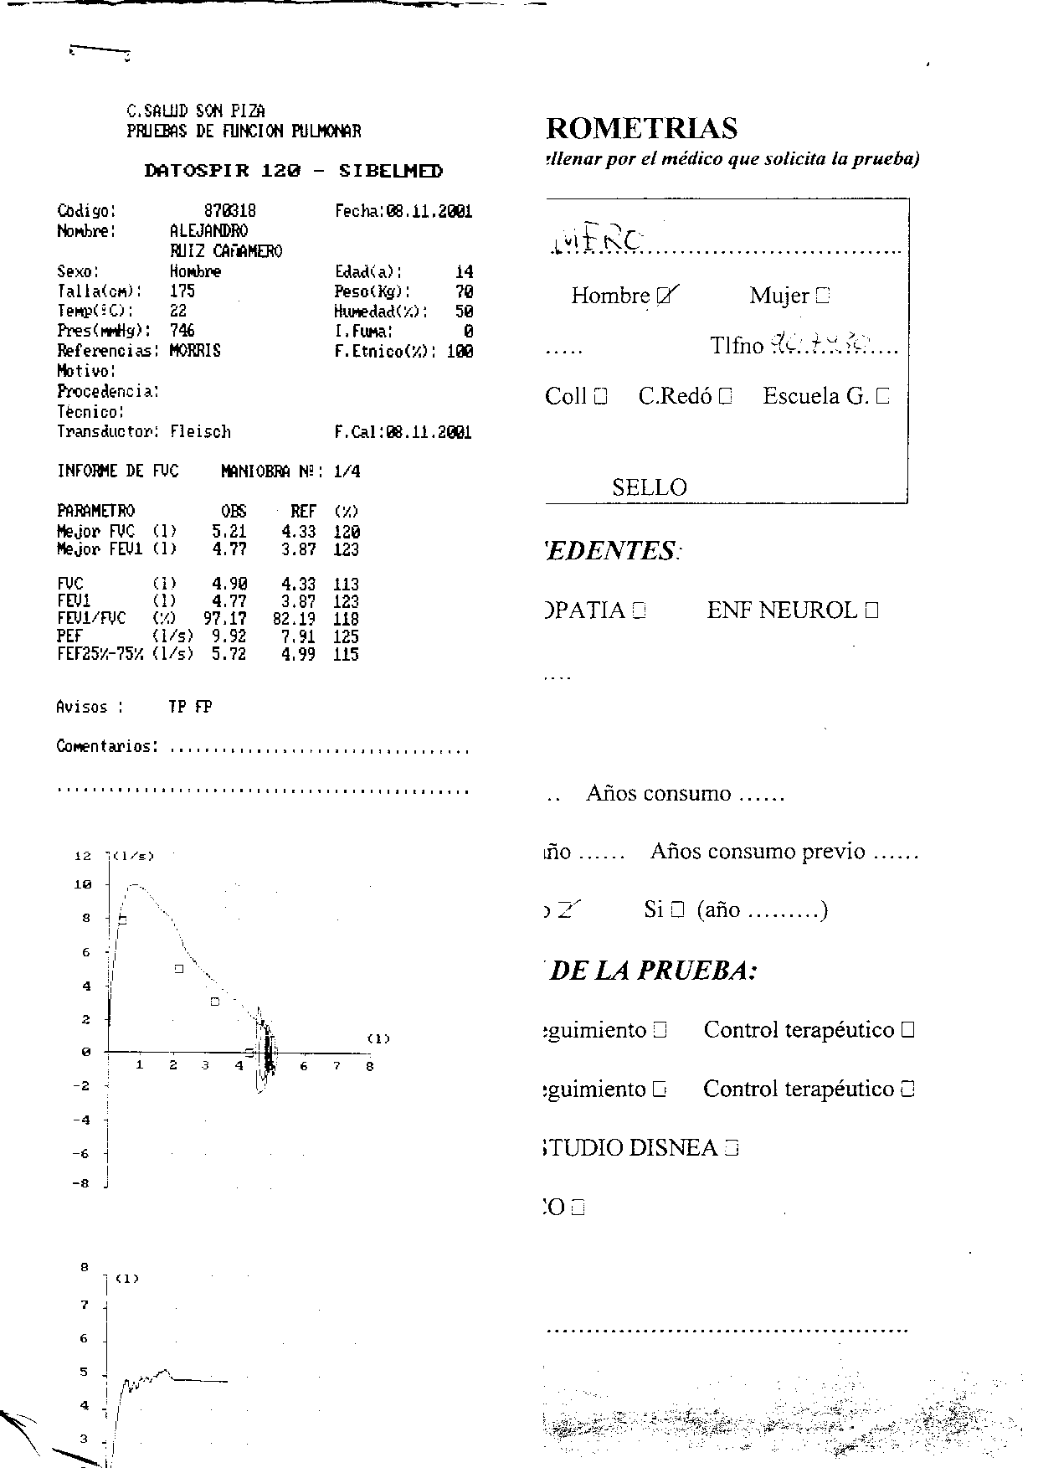

Slide 20
Spirometry Interpretation
Is it acceptable and reproducible?
The traces’ shape
Measurements assessment

Slide 21
Reasons for unacceptable /unreliable readings:
Inadequate or incomplete inhalation
Slow start to the forced exhalation
Lack of blast effort during exhalation
Coughing
Additional breath taken during manoeuvre
Lips not tight around the mouthpiece
Exhalation stops before complete expiration

Slide 22
Reasons for unacceptable /unreliable readings:
Airflow [L/s]
Inadequate initial effort
Cough
Hesitation
Early ending
Volume [L]
Notes:
A inspecção da curva D/V ajuda a decidir se a medição foi feita correctamente e a confirmar a presença duma alteração.
A curva débito-volume pode ser usada para avaliar a aceitabilidade das manobras espirométricas.
A falta de um pico inicial sugere pouco esforço.
A tosse é fácilmente reconhecível. Uma curva que inclua tosse pode ser aceitável se o declive total não estiver interrompido
Uma queda abrupta da curva expiratória sugere que o doente deixou de soprar demasiado cedo.
Se a manobra for completada com um esforço inspiratório para voltar à capacidade pulmonar total, uma falha no início e no fim da curva sugerem uma fuga de ar.

Slide 23
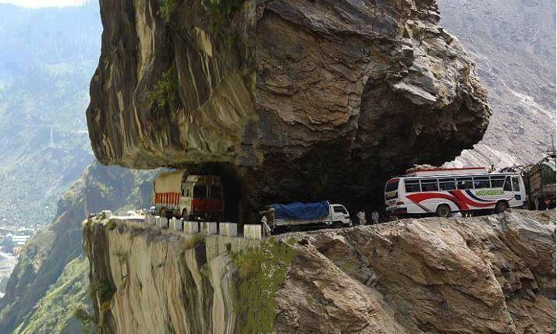

Please be careful with the curves !!

Slide 24
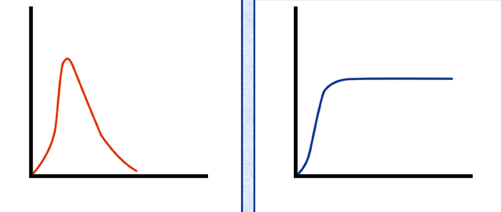
Doubtful start: extrapolated volume

Slide 25
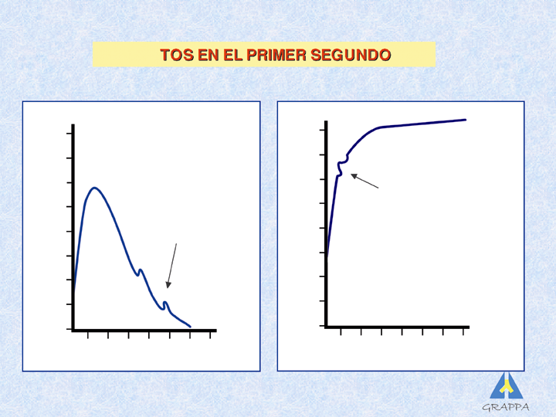
Flow problem: cough

Slide 26
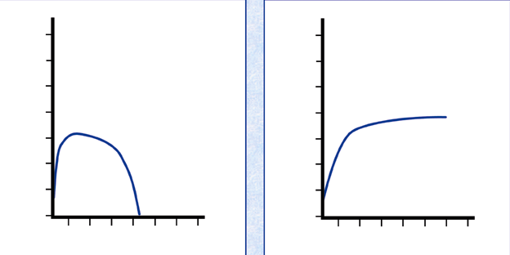
Weak effort: no shouting, no peak

Slide 27
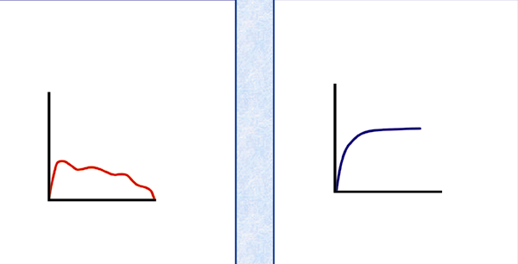
Variable effort

Slide 28
Early ending: short encouragement

Slide 29
Reproducibility
Mínimum of 3 and máximum of 8 manouvers
Less tan 5% or 100 ml difference in FEV1 and FVC
Best test= best parameters sum

Slide 30
Reproducibility

Slide 31
Is there an obstruction?
FVC
5
4
FEV₁ = 4L
FVC = 5L
FEV₁/FVC = 0.8
Volume, liters
3
2
1
1
2
3
4
5
6
1
Time, seconds

Slide 32
Spirometric patterns
Obstructive
Restrictive
Mixed
Normal

Slide 35
Obstruction

Slide 36
Restriction

Slide 37
Mixed

Slide 38
Spirometric patterns
FEV₁/FVC
FVC
FEV₁
Obstruction
N
Restriction
N
N
Mixed
Obstruction and hyperinflation

Slide 39
Spirometric patterns
FEV₁/FVC
FVC
FEV₁
Obstruction
N
Restriction
N
N
Mixed
Obstruction and hyperinflation

Slide 40
Any other assesment?
Severity of obstruction
Mild Obstruction | FEV₁ ≥ 80%
Moderate Obstruction | FEV1 < 80% ≥ 50%
Severe Obstruction | FEV1 < 50% ≥ 35%
Very Severe Obstruction | FEV1 < 35%
GOLD classification

Slide 41
Quick spirometry assesment
FEV₁ /FVC
≥ 70%
Normal
< 70%
Obstruction
FVC
FVC
< 80% ref value
< 80% ref. value
≥ 80% ref value
Mixed pattern
≥ 80% ref value
OBSTRUCTION
+ HYPERINFLATION (↑VR)
NORMAL
RESTRICTION
OBSTRUCTION
OBSTRUCTION
+
RESTRICTION
(VR normal)

Slide 42
Reversibility Test
Second full spirometry 15 minutes after inhalation of 400µg of salbutamol or equivalent
Essential for the diagnosis of respiratory diseases
EX
Flow (L/s)
Post
Positive: Increase in FEV₁ ≥ 12% and 200 ml from basal values
Bronchodilation
PRÉ
Volume (L)
IN
Notes:
Geralmente útil relatar as alterações absolutas (em ml) assim como a alteração em % do valor basal, para estabelecer a melhoria no contexto clínico
Considera-se actualmente que:
FEV1 <8% ou < 150 ml é uma variação normal.

Slide 43
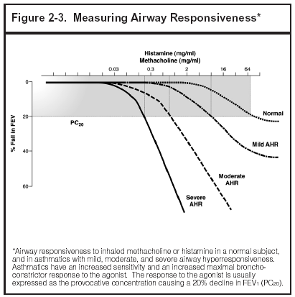
Bronchial provocation test
Useful to identify bronchial hyperreactivity
Useful when asthma is suspected and normal spirometry
Progressive increasing inhalation doses of Histamine, methacholine, allergens, hypertonic solution, or exercise
Positive test: 20% decrease in FEV₁ or more

Slide 44
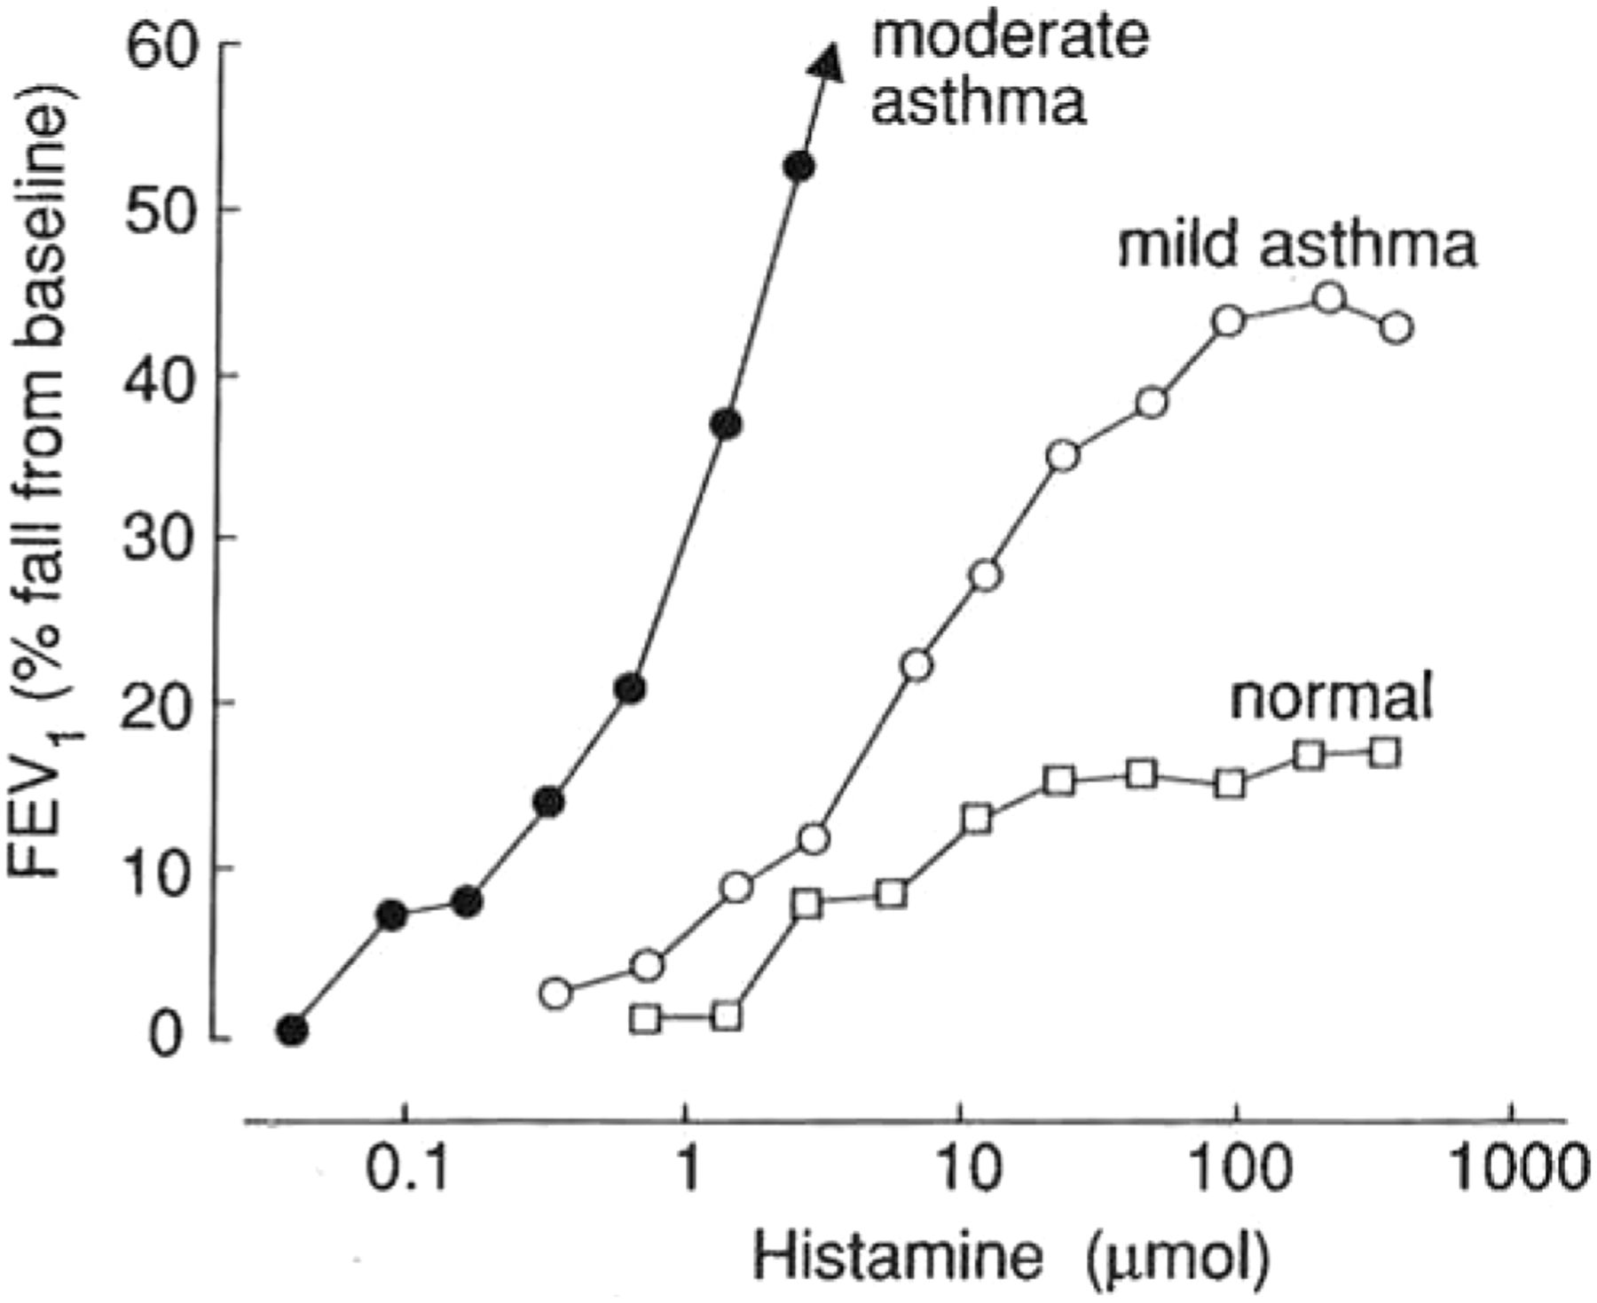
Bronchial provocation test

Slide 45
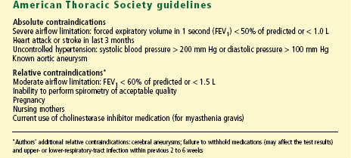
Contraindications to methacholine challenge testing

Slide 46
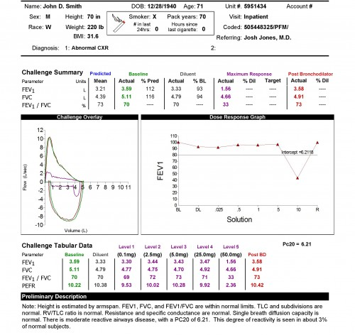

Slide 47
Let’s practice

Slide 48
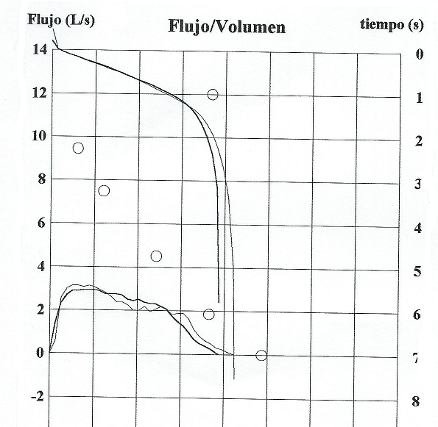
Notes:
No hay pico

Slide 49
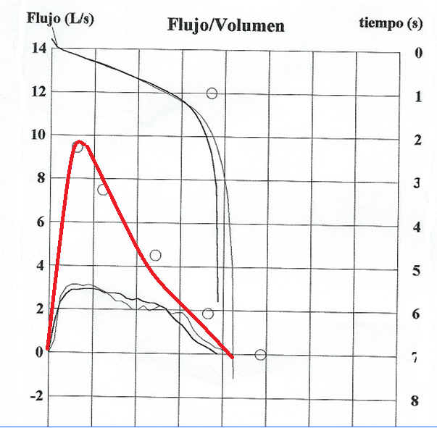

Slide 50
Notes:
Normal
Nuestro compañero de la mañana , ávido de poner en marcha la espirometría ha decidido poner en marcha el espirómetro y actuar como conejillo de indias . Esta es la espirometría que obtenemos
PREGUNTA :
¿ Aunque la espirometría sea normal debemos hacer prueba broncodilatadora ¿

Slide 51
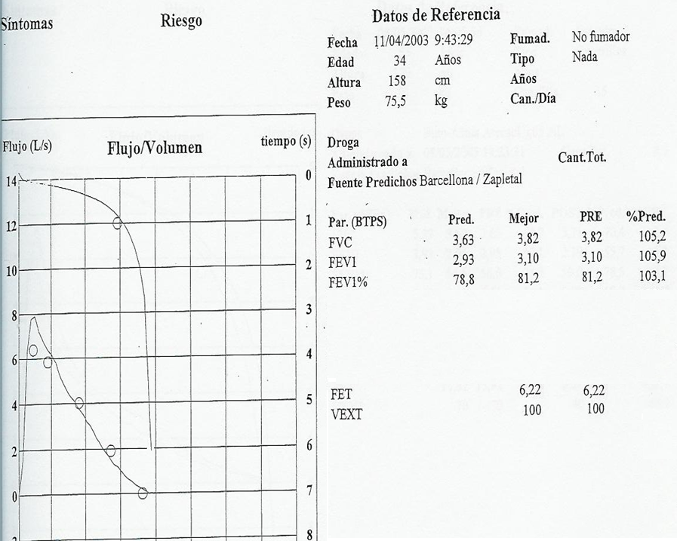

Slide 52
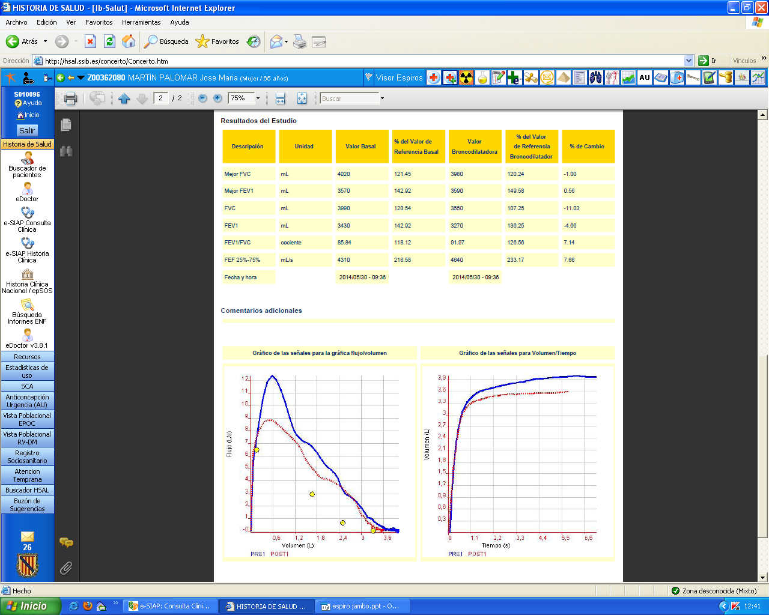
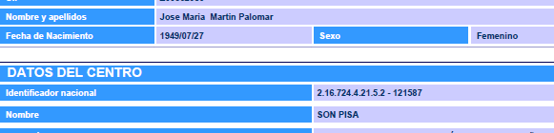
Non acceptable
Notes:
Hombre con valores de referencia de mujer

Slide 53
Acceptable
Notes:
Chepa normal

Slide 54
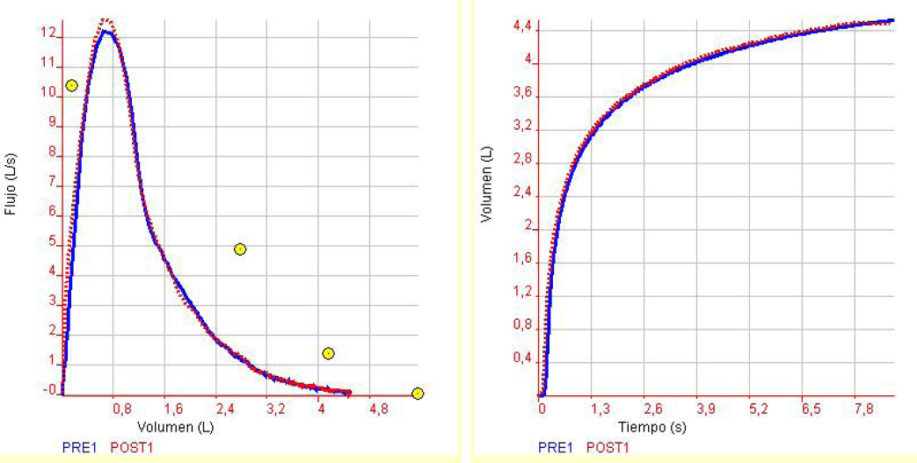
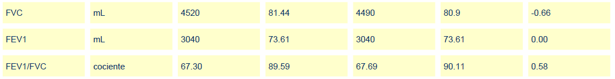

Slide 55
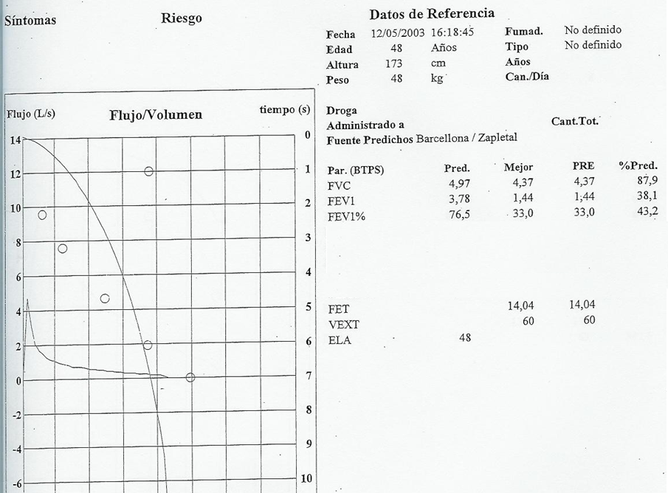

Slide 56
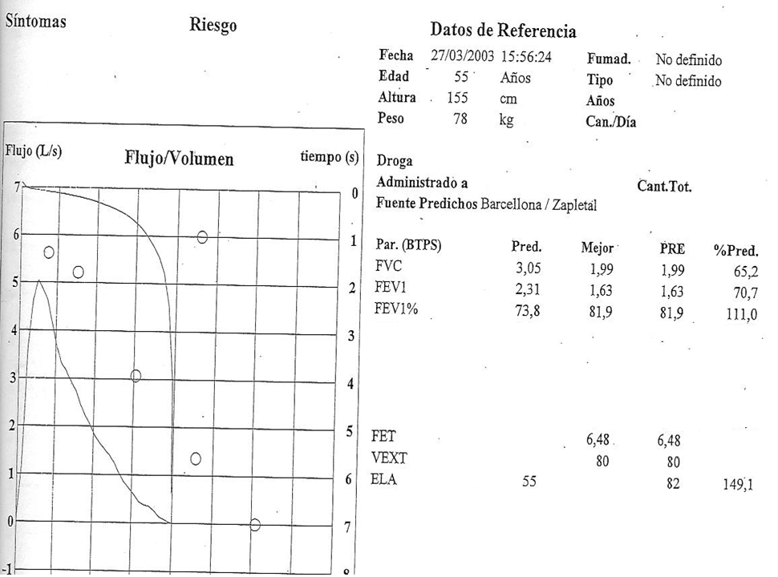

Slide 57
Notes:
Normal

Slide 58
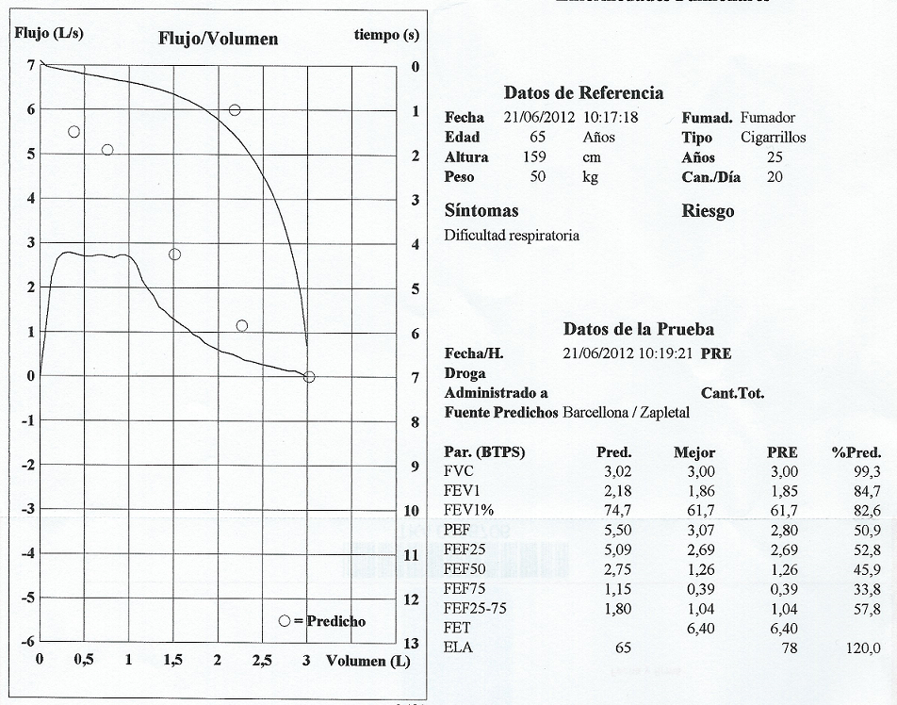
Non acceptable

Slide 59

Notes:
Asma

Slide 60
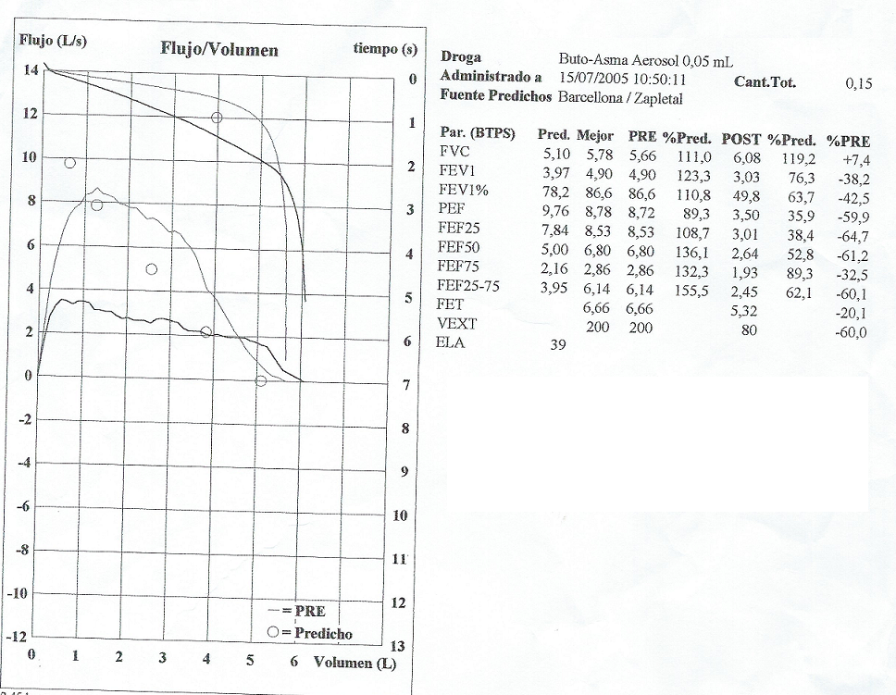
Non acceptable

Slide 61
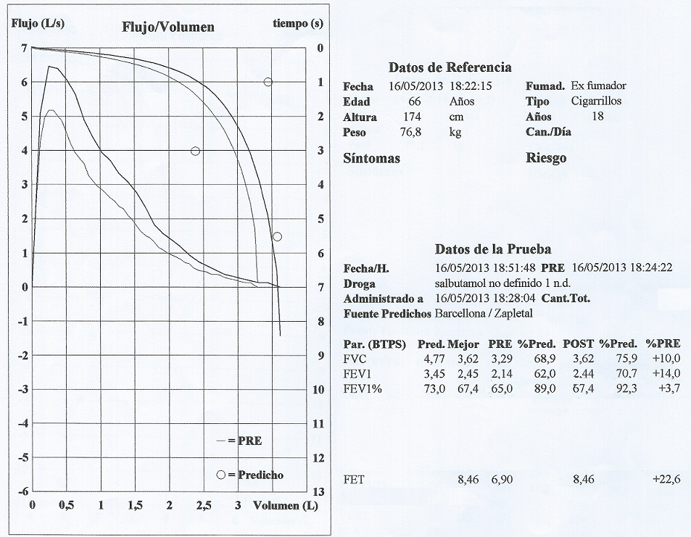

Slide 62

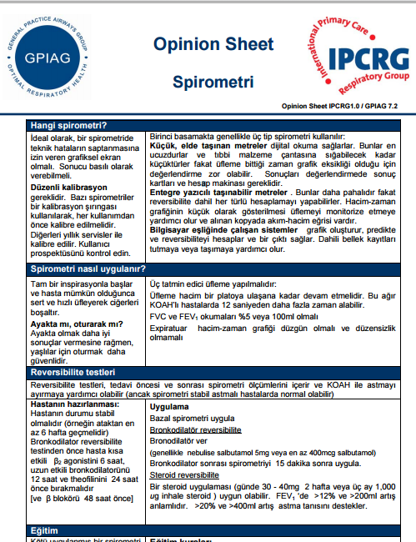
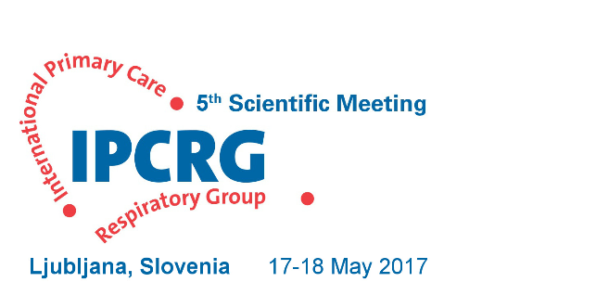
http://www.theipcrg.org/
Notes:
Let me introduce myself. I’m Miguel Roman a phamily physician based in Mallorca and pracising in Son Pisa Primary Care Health Centre
I’m involved in the IPCRG AND THE Spanish semFYC respiratory working group with national training and research projects going on
And the first treasure that you will keep with you when leaving Mallorca will be the contact to the IPCRG WEBSITE, where yu can find any material you could need to develop excellent respiratory primary care to your patients, to teach your colleagues or to link to research networks all over the world. Please visit this website once you get back home
I know that some Turkish colleagues are attending today and I have got a Pearl of the treasure to give to them. This translated opinión sheet in spiroemtry will be very helpfull and you can download form the website but I will also give it to you printed at the end of the meeting

Slide 63

Respiratory Health: Adding Value
in a Resource Constrained World
In collaboration with:
GRESP Portugal
GRESP Brazil
GRAP Spain
GRAP Chile

Slide 64
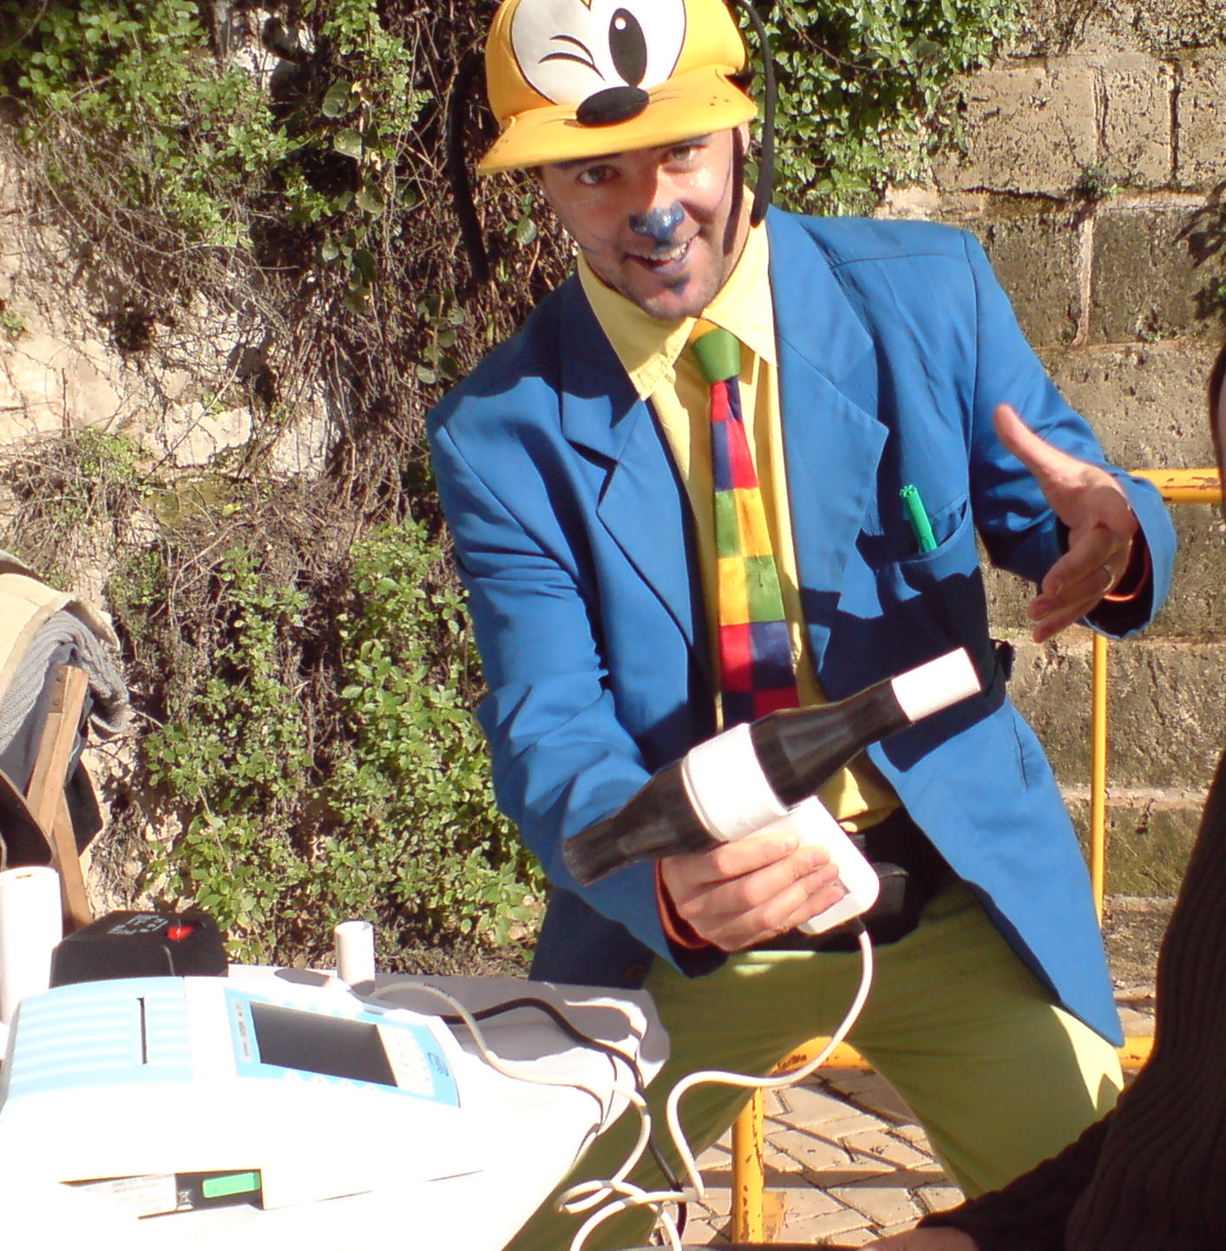
Now you are ready for that...
Go home and try!
Thank you for your attention!

Slide 65
Notes:
EPOC sin pico y restrictivo asociado. Cuidado

Slide 66
x
Notes:
No forzada

Slide 67

Notes:
Falta de pico

Slide 68
x
Notes:
Mala calidad por flujo alterado (tos)

Slide 69
