Slide 1
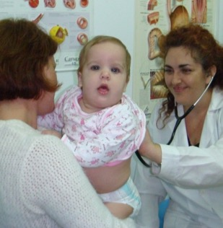
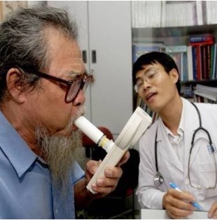
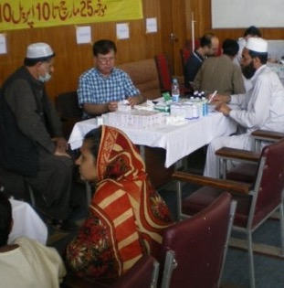
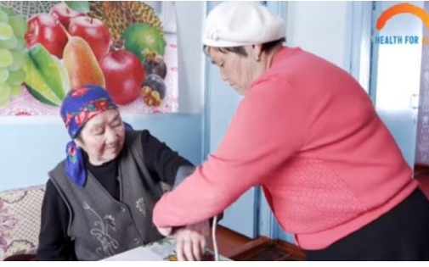
Diagnosis and management of asthma and COPD in primary care: the latest position October 2019 - presentation to WHO-GARD General Assembly
Siân Williams, Chief Executive Officer IPCRG
Breathing and feeling well through universal access to right care www.ipcrg.org
Notes:
End photo is taken from WHO primary care website – she is a community volunteer

Slide 2
What I’ll cover today
Brief introduction to IPCRG
Why primary care
Prevention
Diagnosis
Management including palliative care
Lessons about implementation and scaling up
Recommendations for WHO-GARD

Slide 3
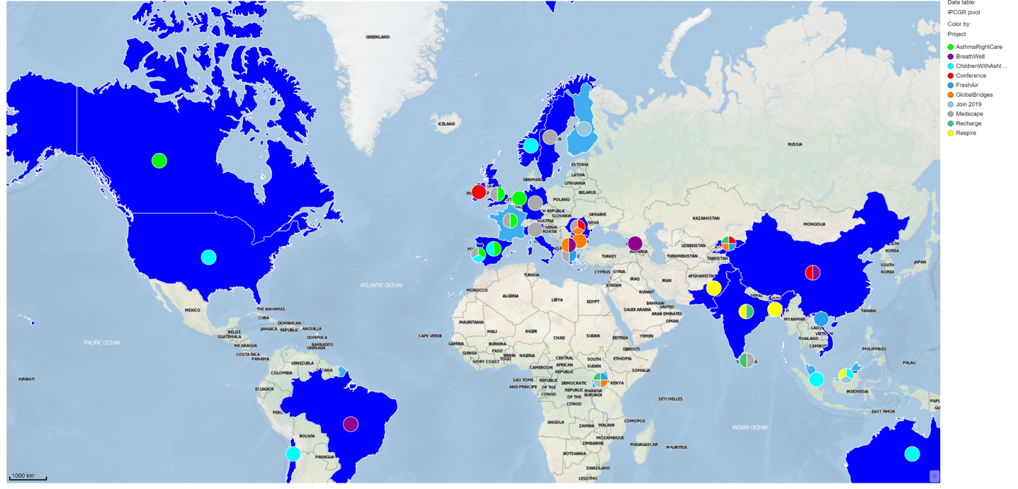
IPCRG: 34 member countries; reaches 150,000 primary care professionals globally; this week in Tunisia, Bangladesh & China

Slide 4
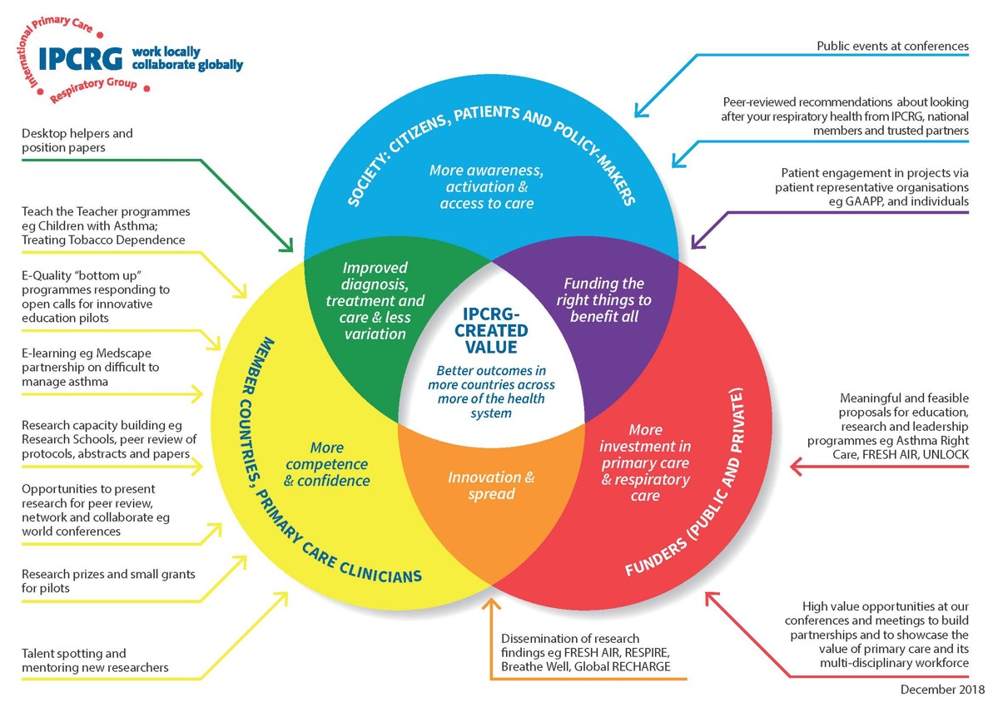
Current projects
Asthma Right Care Teach the Teacher for Pharmacists 10 countries)
Children with Asthma Teach the Teacher (4 countries)
4 global health research programmes in 13 LMICs
2 e-learning programmes
1 care research needs prioritization
Supporting new groups in Tunisia, Israel, Lebanon
2020 Conferences Beijing and Dublin

Slide 5
Brief introduction to IPCRG
Why primary care
Prevention
Diagnosis
Management including palliative care
Lessons about implementation and scaling up
Recommendations for WHO-GARD

Slide 6
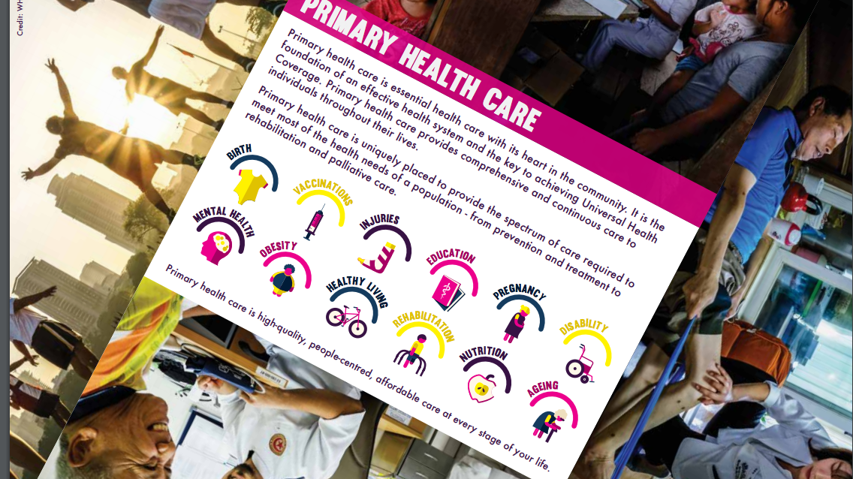
Why primary care?
First point of contact
Community-based
Along life-course
Primary to quaternary prevention
Can deal with 80-90% of an individuals’ needs over their lifetime and no more than required
Family medicine is a vocationally trained generalist specialism!

Slide 7
Family physicians are neighbourhood-based expert generalists who:
Deal compassionately with patients’ needs
Provide person-centred care: relating to patients as individuals
Use problem solving to help patients through uncertainty
Marginalise danger without medicalising normality
Take a collaborative approach to manage co-morbidity + coordinate complex care
Understand + utilise environment of their practice population
Understand + utilise interrelationships between health, social + family care
Approach problems holistically by understanding and respecting:
  patients’ values, preferences, priorities, cultures and family beliefs,
  how these will affect the experience and management of illness and health
  (Adapted from M Drage, 2016)
Notes:
Note – this is about family physicians, and in some countries, primary care is a broader WHO definition, not involving GPs trained in a vocational training programme.
For example – do I stay indoors and not exercise, or go out and exercise? I can’t get to appointment because someone needs to be home with my children….

Slide 8


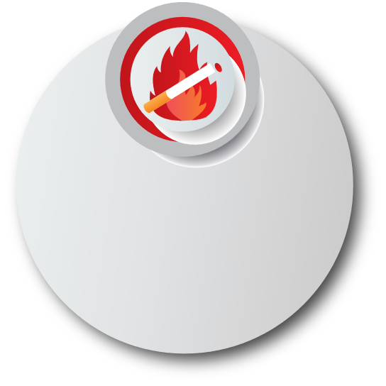




The problem
Exposure to smoke in pregnancy leads to miscarriages, early delivery and low birth weight and can harm children’s lung and brain development
Estimates suggest
there will be
2 billion smokers
by 2040³
1.8 billion people
will still rely on biomass for cooking and heating in 2040⁴
Implementation research is needed to test how interventions can work in low-resource settings
3. https://who.int/tobacco/en/atlas38.pdf
4. https://healthdata.org/news-release/chronic-obstructive-pulmonary-disease-caused-32-million-deaths-worldwise-2015
5. https://unicef.org/publications/files/UNICEF_Clear_the_Air_for_Children_30_Oct_2016.pdf

Slide 9
The system problem
5 global health problems (Prof Sir Muir Gray) | Asthma | COPD
Unwarranted variation | Diagnosis, management, outcomes | Diagnosis, management, outcomes
Harm |  | High dose ICS
Failure to prevent disease and disability and death | Over-reliance on symptom relief; underuse of routine anti-inflammatory medicine | Under-diagnosis, underuse of smoking cessation; inadequate access to physical activity and PR
Waste of human and physical resources through low-value activity | Hospital admission for ambulatory-care sensitive conditions | Hospital admission for ambulatory-care sensitive conditions
Inequity | Poorer populations | Women, poorer populations

Slide 10
Right Care. Lancet Series 2017
“With the focus firmly on universal health coverage as a central part to the UN Sustainable Development Goals, there is an opportunity to examine how to achieve optimum access to, and delivery of, healthcare and services.
Underuse and overuse of medical and health services exist side-by-side with poor outcomes for health and wellbeing.
This Series ….provides a framework to begin to address overuse and underuse together to achieve the right care for health and wellbeing… achieving the right care is both an urgent task and an enormous opportunity.”
Notes:
NHS cares for 65 million people. Sees more than 1million people every 36 hours.
NHS England. Sustainable Improvement and Horizons Team 2017. Leading large scale change: a practical guide.

Slide 11
Brief introduction to IPCRG
Why primary care
Prevention
Diagnosis
Management including palliative care
Lessons about implementation and scaling up
Recommendations for WHO-GARD

Slide 12
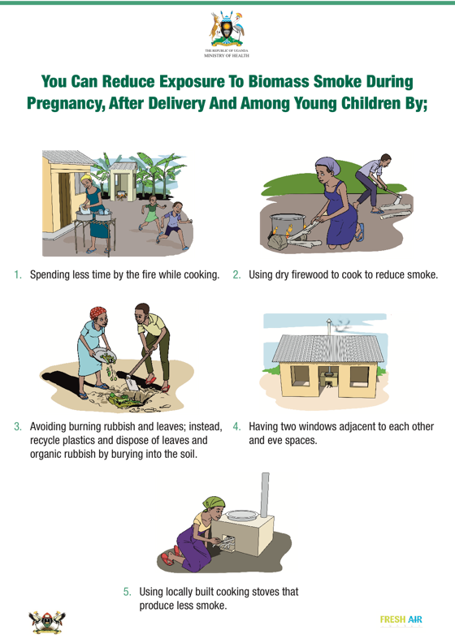
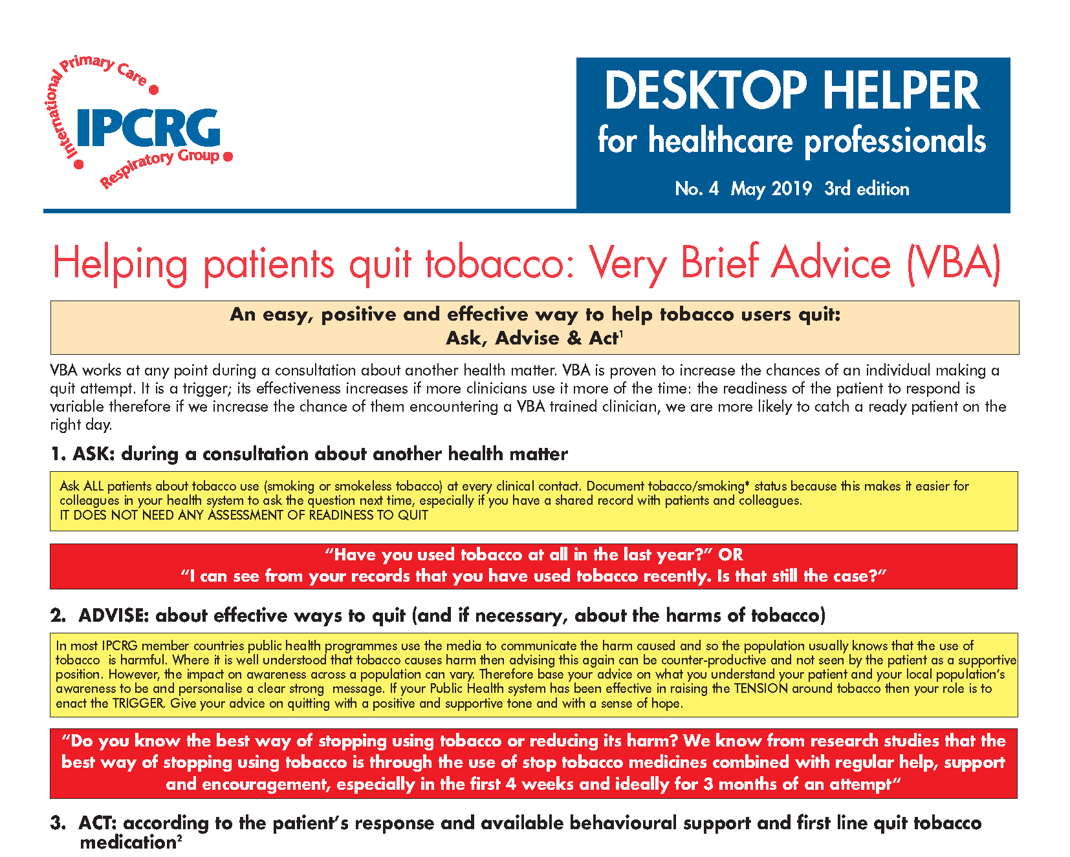
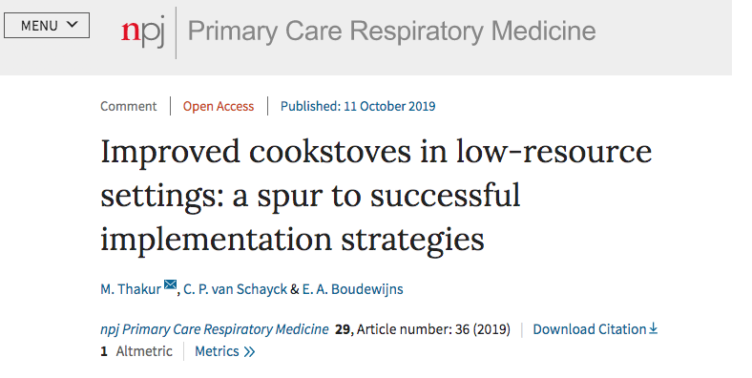
Primary care’s “Upstream” role

Slide 13
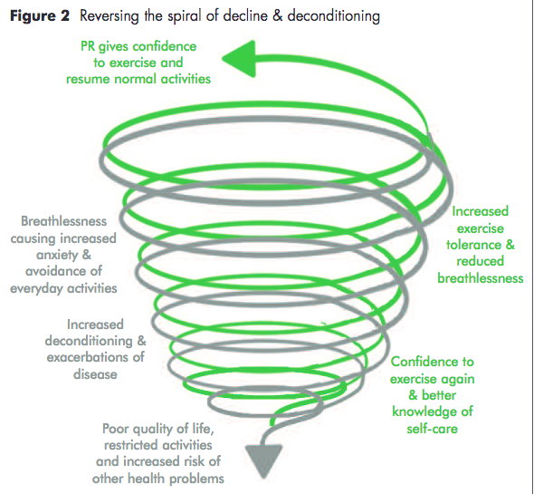

Slide 14
Brief introduction to IPCRG
Why primary care
Prevention
Diagnosis
Management including palliative care
Lessons about implementation and scaling up
Recommendations for WHO-GARD

Slide 15
1st phase of analysis of our primary care respiratory research question prioritisation exercise
 | Disease area | Original number of Q | Final number of Qs by academics
1 | Asthma diagnosis and screening | 46 | 11
2 | Asthma management and prognosis | 120 | 11
3 | Children with asthma | 20 | 8
4 | Asthma self-management | 40 | 20
5 | COPD diagnosis and screening | 45 | 22
6 | COPD management | 89 | 42
7 | Multi-morbidity | 4 | 4
8 | COPD self-management/pulmonary rehabilitation | 34 | 16
9 | COPD prognosis | 27 | 16
10 | Infections/ pneumonia (in primary care) | 36 | 5
11 | Allergic rhinitis/ other allergic conditions | 15 | 7
12 | Lung cancer (in primary care) | 12 | 6
13 | TB (in primary care) | 33 | Pending
14 | Tobacco dependence | 14 | 24
15 | Air pollution | 5 | 2
16 | Health economics: | 8 | 1
17 | Sleep Apnoea | 6 | 6
18 | Lung Fibrosis/ ILD/ occupational lung diseases | 7 | 3
19 | Other respiratory conditions/ general | 47 | 15
Total 608 219
Notes:
Need to confirm where is asthma – COPD overlap

Slide 16

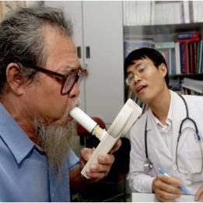

Qualitative analysis by A Abdel Aal, R Jordan
Need for better education and training for primary care clinicians
Need to adapt current diagnostic and treatment guidelines to LMIC
Need for simple diagnostic and monitoring methods that are accessible for primary care
Analysis and results are pending, but these are some examples of emerging themes
In 2012, 46% of the questions
were about diagnosis…. http://dx.doi.org/10.4104/pcrj.2012.00006

Slide 17


What we have learned from from
Where infectious disease is prevalent, asthma diagnosis is missed.

Slide 18








Patient background
Diagnosis case study for teaching primary care…
David is recalling his journey to the doctor’s office. It’s Friday afternoon in the city, in summer…
Yesterday we heard about impact on respiratory health of air temperature, ambient air pollution, migration, health service utilisation…….
this is where it comes together
I cycled 5 km through the city to reach the clinic before it closed and I am anxious
Explore patient background and history
I checked my smartphone app for the weather. The air quality isn’t good, I keep sneezing and
my nose feels itchy
Physical exam and symptoms
I have been breathless, waking at night, and coughing and my chest has felt tight for 3–4 days. I’ve experienced
these issues before but didn’t feel the need to see a doctor about them
Clinical assessment
I have not needed to see a doctor in the last 5 years but I had my tonsils and adenoids removed
in childhood
make diagnosis
confirm diagnosis
This is my second spring/summer since moving to this country
from West Africa
David did not wait long in the waiting room as the receptionist was concerned and arranged for him to see a doctor quickly…

Slide 19


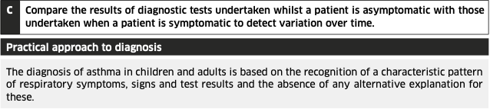
https://www.brit-thoracic.org.uk/document-library/guidelines/asthma/btssign-guideline-for-the-management-of-asthma-2019/

Slide 20
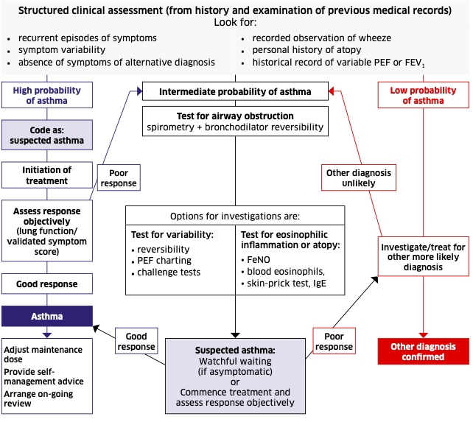

Slide 21
Spirometry is feasible in primary care
National courses
WONCA for 10+ years
Self-paced distance learning
Need
training + support +
spirometers + consumables
+ time + motivation
New digital options in testing
Stout, J. W., Smith, K.,et al (2012). Learning
from a distance: Effectiveness of online spirometry training
improving asthma care. Academic Pediatrics, 12, 88-95.

Slide 22
Brief introduction to IPCRG
Why primary care
Prevention
Diagnosis
Management including palliative care
Lessons about implementation and scaling up
Recommendations for WHO-GARD

Slide 23
Supply-side Demand-side
The right diagnosis is not made because asthma is a variable disease and needs more than one visit but the clinician only sees the patient once
The individual communication of the diagnosis is not right
Prescribing is not right
Dispensing is not right
Patient beliefs about asthma are
not right
Patient beliefs about medicines are not elicited or addressed
Practical problems of using medicines are not addressed

Slide 24
Change for improvement starts with ‘hunches’
SABA/RELIEVER use IN ASTHMA Needs major improvement
Over-reliance needs defining
Not “use” but “reliance”
= type of dependency
First Saba conversations affect future use
Occur in many settings
(pharmacies, EDs, GP/FP)
Need to understand these conversations
Apply the evidence about achieving change at scale
Disrupt comfort with the current state!
Gain acceptance of room for improvement
Move on to addressing underuse of ICS
Asthma is low
priority for change
This is despite:
Unwarranted variation in outcomes
Avoidable mortality, morbidity and HCU
Substantial investment in education over time
HCPs need to want change
Messages about asthma improvement will only be received and adopted once HCPs desire change
ED, emergency department; FP, family practitioner; GP, general practitioner; HCU, healthcare utilisation;
HCP, healthcare professional; ICS, inhaled corticosteroid; SABA, short-acting beta₂-agonist

Slide 25


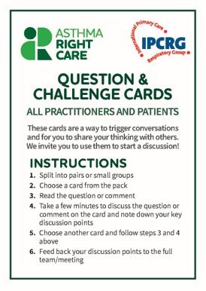
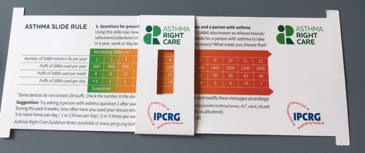
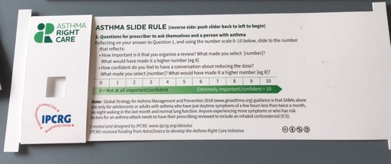
Asthma Right care: prototype conversation pieces for discussion and co-creation in design charrettes & now teaching materials
SABA Slide Rule: what happens now? Raise discomfort
SABA Slide Rule – inspired by the Readiness Ruler
5 case studies for teaching
Mild asthma
“Chest infection”
Transition from child to adult
Seen in ED, but not admitted
Difficult to manage (moderate or severe?)
Ambition: embrace more people, more methods,
bring joy to lives: let’s have fun, while being challenging
Moyers TB, et al. J Consult Clin Psychol 2009;77:1113–1124
Notes:
The what

Slide 26
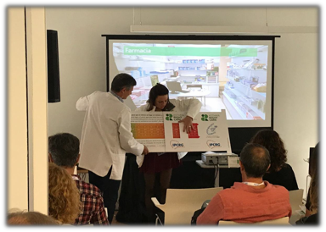
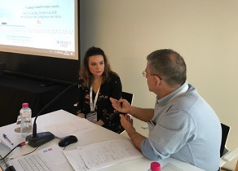
Summary of the Asthma Right Care movement
10,000 frontline HCPs and global primary care leaders reached so far
4 international and multiple national conferences attended
Materials produced:
  Asthma Right Care Slide Rule (English, Spanish and Portuguese)
  Question Cards in different formats (English, Spanish and Portuguese)
  Reliever Reliance Test (led by Rob Horne; IPCRG endorsed)
  5 teaching case studies (primary care, ED, etc)
Mild asthma
“Chest infection”
Transition from child to adult
Seen in ED, but not admitted
Difficult to manage (moderate or severe?)
ED, emergency department; HCP, healthcare professional; SABA, short-acting beta₂-agonist

Slide 27


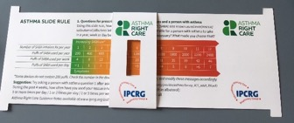
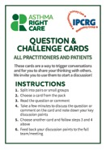
1
Kickstarting action
Emerging and building momentum
2
  Nurturing voices
  Cultivating diverse interests and motivations
3
Influencing and interacting
Navigating a complex array of relationships
Netherlands, Greece,
France
ENVIRONMENT
Propellant & Plastic
INFORMATION
Coding
Public Information
MEDICINES
ICS: SABA Ratio
Inhaler Use
New cultures
& languages
6 drivers in asthma health system
Argentina, Mexico, Brazil
Ireland, the Gulf
More parts of health system
More
geographies
WORKFORCE
GPs / Pharmacist / Nurses
FINANCE & LEADERSHIP
PERSONAL
Networking
Policy Briefing
Going deeper:
paradigm / behaviour shift
Unconscious Incompetence
Asthma Slide Rule & Question Cards
Conscious Incompetence: what could I do better?
Conscious Competence
What is right care?
Regional Teach the Teacher Master Classes to create trusted regional master teachers
Unconscious Competence
Mastery: Conscious Competence of Unconscious Incompetence
Nesta 2017. We change the world: what can we learn from global social movements for health? Accessible at: https://media.nesta.org.uk/documents/we_change_the_world_report.pdf (accessed August 2019)

Slide 28
Pulmonary Rehabilitation Thorax 2001;56:779-784
Stop Smoking Support with pharmacotherapy Thorax. 65(8):711-8, 2010 Aug
LABA OBA Y Cost effectiveness of long acting bronchodilators for COPD. Mayo Clinic Proc 2007;82:575-582
Triple Therapy NICE COPD management of COPD in adults in primary and secondary care 2010
Flu vaccination in at risk population: we await data on pneumococcal vaccination J Epidemiol Community Health. 1998 Feb;52(2):120-5
Tiotropium Health technology Assessment KCE reports 108C Neyt M et al
This is based on HIGH INCOME country data and was originally developed in 2011 for the UK. Some interventions are now recommended in more people eg triple therapy, and others may now be lower cost and therefore have better value for money in LMICs. There are also new interventions eg text messaging and apps that are being researched which may be low cost to the payor once they are developed and validated. However, current evidence supports their use as adjunct to professional care not substitutes.
COPD Value Pyramid: used in United Kingdom Outcomes Strategy for COPD adapted to include workforce leadership and education
https://www.networks.nhs.uk/nhs-networks/london-lungs/latest-edition-of-thorax-publication
https://assets.publishing.service.gov.uk/government/uploads/system/uploads/attachment_data/file/216531/dh_134001.pdf
Education and training to underpin all implementation; and improved diagnosis to ensure allocation of interventions to the right people
Foundation: invest in leadership to build trust between different parts of the system, and respect for primary care, which is the highest value input in a health system: it can deliver 90% of a person’s health needs over their lifetime, and is highly cost-effective
Notes:
Note:QALY = quality adjusted life year
These calculations are based on high income country studies. It is likely the costs would be lower in Kyrgyzstan.
E-health might be part of the solution, eg text messaging and what’s app, but first we need trained workforce, with sufficient pay to be motivated to care; we need nurses who have direct patient care responsibilities, not just administration: will increase motivation and effiiciency

Slide 29
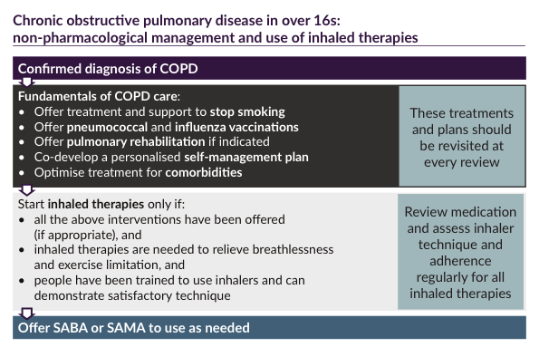
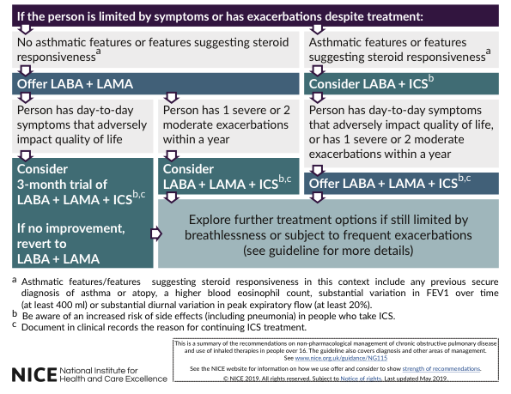

Slide 30



What we have learned from from
Pulmonary rehabilitation sessions can be run effectively and affordably in the community.
Very Brief Advice for smoking cessation can be delivered, but challenges remain due to lack of availability of smoking cessation medication and counselling*
* See VBA Plus Helping Patients Quit Tobacco IPCRG desktop helper https://www.theipcrg.org/x/aIJZ

Slide 31
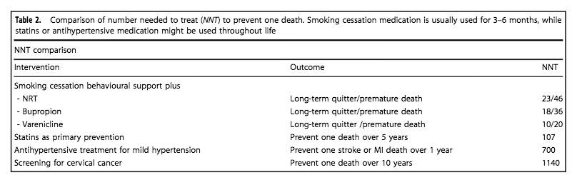
Effectiveness of interventions
Van Schayck CP, Williams S, Barchilon V et al. http://dx.doi.org/10.1038/s41533-017-0039-5

Slide 32
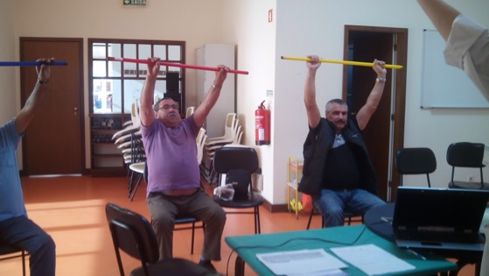
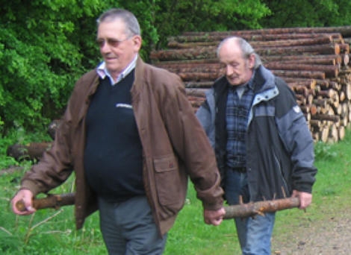
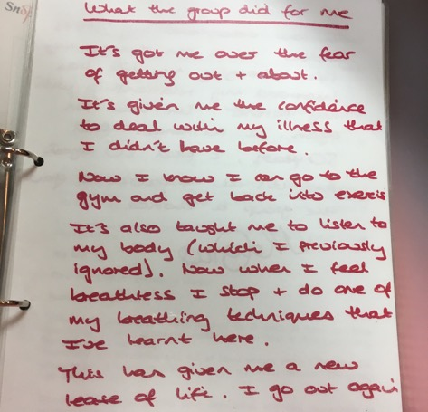
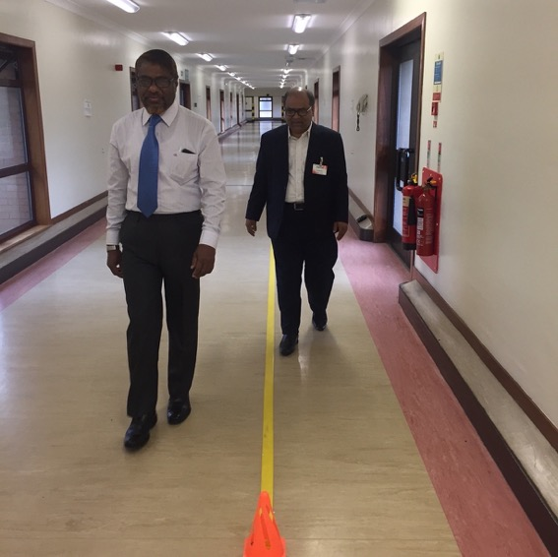
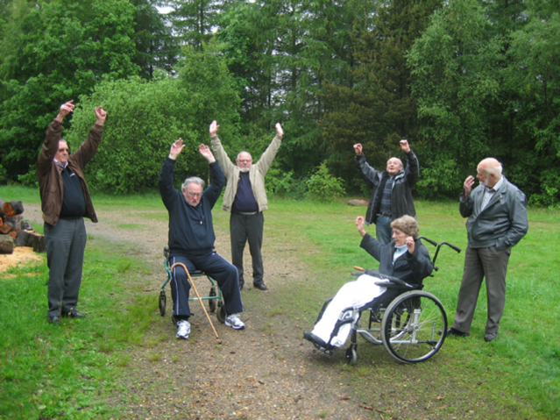
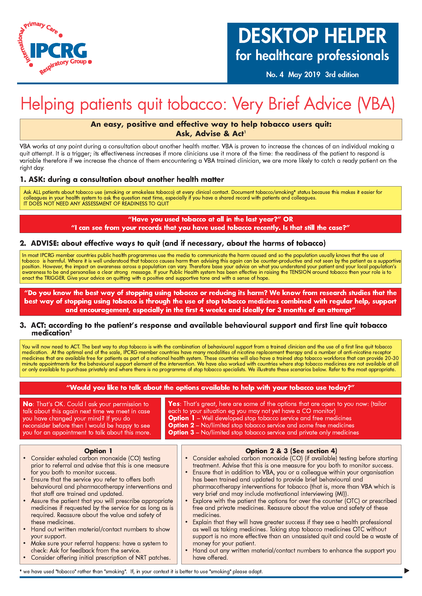
Physical activity

Slide 33
Spathis A, Booth S et al. The Breathing, Thinking, Functioning clinical model: a proposal to facilitate evidence-based breathlessness management in chronic respiratory disease
npj Primary Care Respiratory Medicine 27:27 (2017)

Slide 34
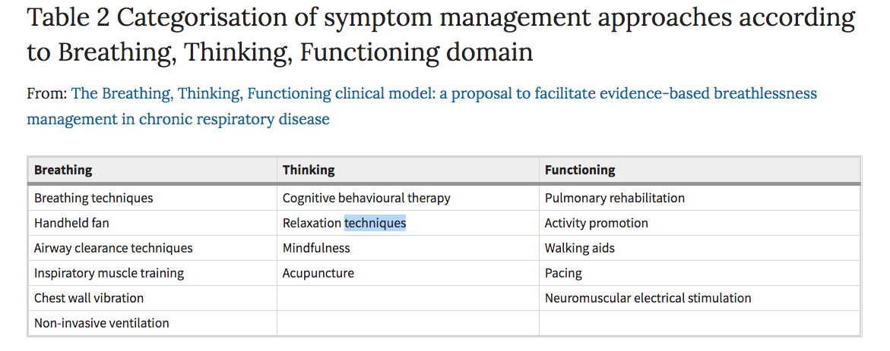
Spathis A, Booth S et al. The Breathing, Thinking, Functioning clinical model: a proposal to facilitate evidence-based breathlessness management in chronic respiratory disease
npj Primary Care Respiratory Medicine 27:27 (2017)

Slide 35
Brief introduction to IPCRG
Why primary care
Prevention
Diagnosis
Management including palliative care
Lessons about implementation and scaling up
Recommendations for WHO-GARD

Slide 36


What we have learned from from
Implementation research needs to be underpinned with actions that build trust in the process and workforce and ensure local compatibility.
Education and training interventions should include a wide spectrum of healthcare professionals and community health workers (not just doctors).

Slide 37




To achieve our vision, we need to go where the greatest need is and co-create teaching & research capacity
Education: In Uganda, Kyrgyzstan, FYR Macedonia, Romania, Bulgaria
Global RECHARGE
Implementation science in Uganda, Vietnam, Crete, Kyrgyzstan coordinated by Leiden University MC based on an IPCRG concept
NIHR Global Health Research Group on Pulmonary Rehabilitation at University of Leicester, Kyrgyzstan, Sri Lanka, India, Uganda, Vietnam
NIHR Global Health Research Group on Global COPD in Primary Care Breathe Well at University of Birmingham, China, Brazil, Georgia, FYR Macedonia
NIHR Global Health Research Unit on Respiratory Health (RESPIRE) at The University of Edinburgh, Pakistan, Bangladesh, India, Malaysia

Slide 38
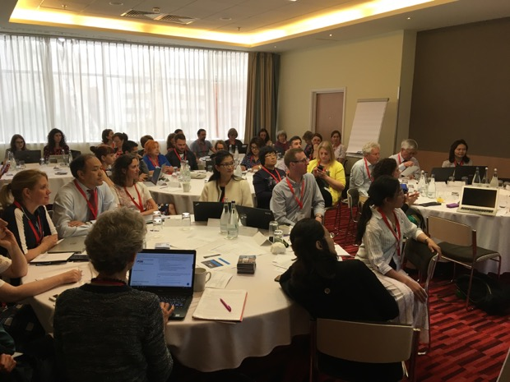
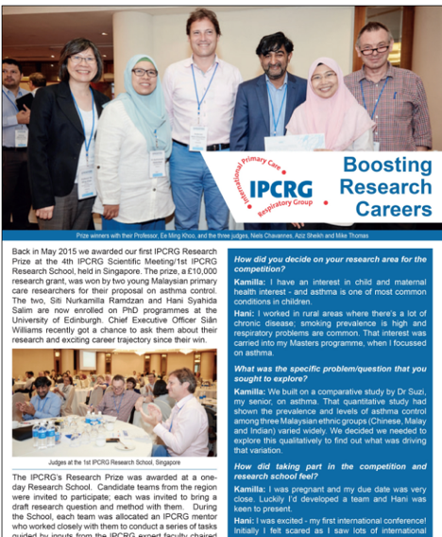
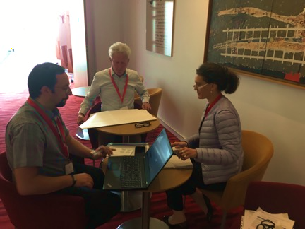
2015 to 2019 research capacity-building
https://www.theipcrg.org/display/DoResearch/Malaysian+Case+Study

Slide 39
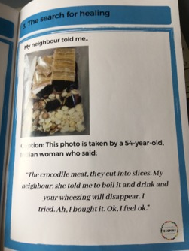
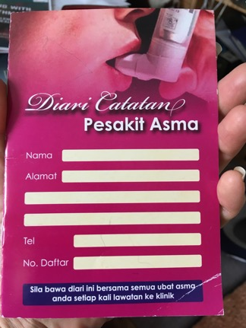
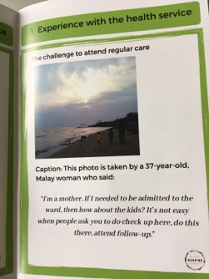
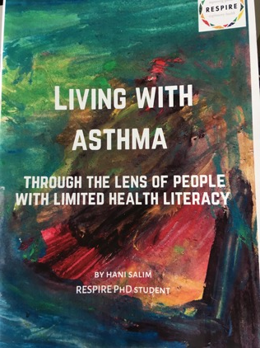
Primary care problems & solutions
Malaysian Primary care research

Slide 40
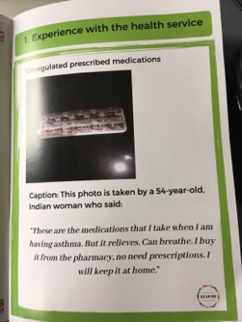
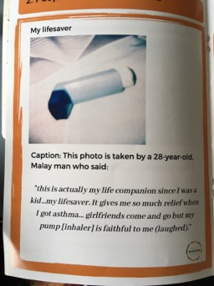
Primary care problems & solutions
Malaysian Primary care research

Slide 41
Dr Tedros, Director General WHO, September 2018
Poor care not only jeopardises the health of individuals;
it erodes trust and puts entire health systems and populations at risk...
Without quality, universal health coverage (UHC) remains an empty promise...
The same nurse who vaccinates children and cares for new mothers will also need to detect an unusual communicable disease….
All of this requires [ ] active learning systems... We must go deep into the messy realities of health services to understand local problems, find innovative solutions, learn from mistakes, scale up what works, and share experiences. Local learning needs to be prioritised, but local lessons must also be shared nationally and with the world...
Quality is not a given. It takes vision, planning, investment, compassion,
meticulous execution, and rigorous monitoring, from the national level to
the smallest, remotest clinic.
https://www.thelancet.com/journals/langlo/article/PIIS2214-109X(18)30394-2/fulltext
Notes:
UHC and health security are two sides of the same coin. This was painfully apparent during the west African Ebola outbreak of 2014–15, when the perceived lack of quality led to community distrust in the health system, decreased utilisation of services, and an increase in morbidity and mortality from non-Ebola conditions...

Slide 42
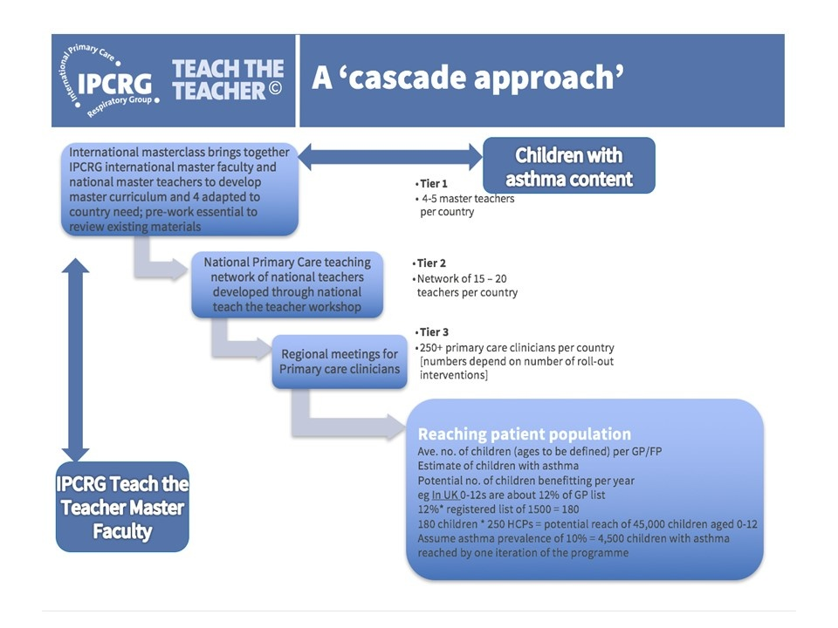
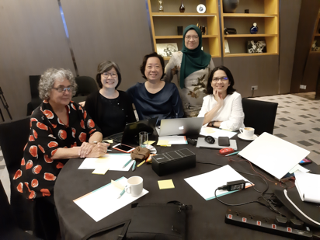
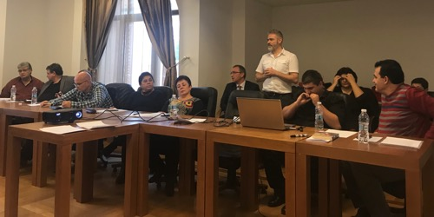
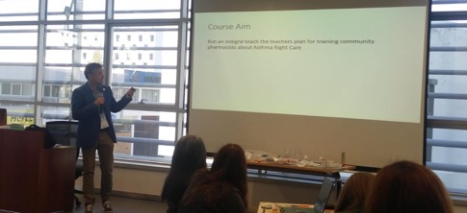
Tier 1 Children with Asthma KL 2019
Tier 2 Treat tobacco dependence, Bulgaria 2018
Tier 1 Pharmacist Asthma Right Care Porto 2019

Slide 43
Brief introduction to IPCRG
Why primary care
Prevention
Diagnosis
Management including palliative care
Lessons about implementation and scaling up
Recommendations for WHO-GARD

Slide 44
Richard Horton, The Lancet 2017
“What is right care? …. it is care that weighs up benefits and harms, is patient-centred… and is informed by evidence, including cost-effectiveness… most medical services fall into a grey zone where the benefit and harm ratio for a given individual is unknown.
However, an important start is to think about and aim to influence, the drivers of poor, unnecessary, and harmful care… these drivers fall into three important categories: money, finance, and organisations; knowledge, beliefs, assumptions, bias, and uncertainty; and power and human relationships”.
Kleinert S, Horton R. Lancet 2017;390:101–102.

Slide 45
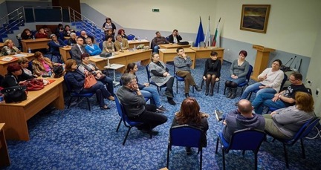
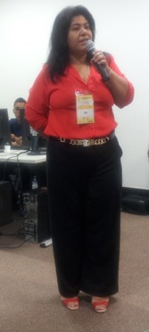
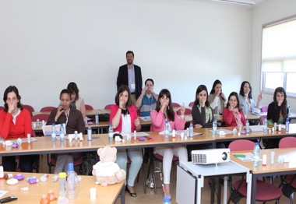
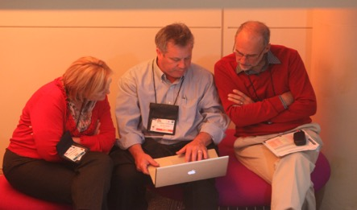
We call on governments
& payors
Primary care to prevent, diagnose and treat respiratory disease & tobacco dependence applying right care
Practical peer-led training and education
Integrated care systems, involving patients, primary and secondary, multi-disciplinary health and social care
Generation of real life evidence to feed guidelines that are useful in primary care
Primary care as population health educators
Right incentives to practise population respiratory heath: go where the people in need are
Universal access to good quality inhaled medicines and tobacco treatment and training in how to use them
IPCRG that can leverage major clinician-led change working locally, collaborating globally
To build trust primary care and to invest in
Notes:
Primar

Slide 46

The 10th IPCRG World Conference is the leading learning and networking opportunity aimed at all healthcare professionals who work in primary care, within family medicine or in the community and have a respiratory interest.
Key Dates
Call for Sessions: 31 October 2019 (now closed)
Call for Abstracts (Oral Presentations & Posters): 27 January 2020
More information at http://www.ipcrg2020.org/

Slide 47

1st IPCRG China Conference
Cooperation between IPCRG & CARDPC
Beijing, China, October 23rd -25th 2020
The conference aims to bring together physicians, primary care physicians, nurses, researchers, medical officers and other personnel interested in respiratory medicine to discuss with each other new technology and new developments. The programme includes clinical and scientific issues in primary care about asthma and COPD diagnosis, pharmacological and non-pharmacological treatment and task-shifting
www.theipcrg.org

