Slide 1

workshop on respiratory diseases
Challenging asthma
Ioanna Tsiligianni
President Elect IPCRG, GP, PhD, MPH
Assistant Professor, Clinic of Social and Family Medicine, University of Crete, Heraklion, Greece
Miguel Román Rodríguez
GP at Son Pisa Primary Health Care practice. Palma. Mallorca Chronic respiratory diseases research unit Director. Instituto de Investigación Sanitaria de Baleares IdISBa . Spain

Slide 2
Session Outline
Definition of challenging/difficult to manage asthma
What is asthma control and reasons for poor control
Group Work / Case vignettes
How to measure asthma control?
Difficult to manage asthma: a practical guide

Slide 3

Primary prevention of asthma
GINA 2018
  A systematic review of randomized controlled trials on maternal dietary intake of fish or long-chain polyunsaturated fatty acids during pregnancy showed no consistent effects on the risk of wheeze, asthma or atopy in the child (Best Am J Clin Nutr 2016)
  One recent study demonstrated decreased wheeze/asthma in pre-school children at high risk for asthma when mothers were given a high dose fish oil supplement in the third trimester (Bisgard NEJM 2016); but ‘fish oil’ is not well defined, and the optimal dosing regimen has not been established
What’s new in GINA 2018?
Notes:
1. Best KP, Gold M, Kennedy D, Martin J, Makrides M. Omega-3 long-chain PUFA intake during pregnancy and allergic disease outcomes in the offspring: a systematic review and meta-analysis of observational studies and randomized controlled trials. Am J Clin Nutr 2016;103:128-43.
2. Bisgaard H, Stokholm J, Chawes BL, Vissing NH, Bjarnadottir E, Schoos AM, Wolsk HM, et al. Fish oil-derived fatty acids in pregnancy and wheeze and asthma in offspring. N Engl J Med 2016;375:2530-9.

Slide 4
Introduction
Definition
Difficult to manage asthma, is asthma that either the patient or the clinician finds difficult to manage.
A patient with difficult to manage asthma has daily symptoms and regular exacerbations despite apparently best treatment.

Slide 5
Introduction
There are two main groups of patients with difficult to manage asthma:
  People whose asthma has been controlled in the past but who have now lost control.
  People whose asthma has never been controlled.

Slide 6
Introduction
Losing control of asthma is not always the same as having an asthma attack, or a flare-up.
Asthma can be uncontrolled with symptoms that are tolerated by the patient.
Of course, when a patient has a flare-up, asthma control is lost.

Slide 7
What does asthma control mean?

Slide 8
What is asthma control?
As previously defined by the Global Initiative for Asthma (GINA)
Minimal to no daytime asthma symptoms
No limitations on activities
No nocturnal symptoms or awakenings
Minimal to no need for reliever or rescue therapy
Normal lung function (FEV₁ or PEF)
No exacerbations
www.ginasthma.org

Slide 9
Is her asthma controlled?
As previously defined by the Global Initiative for Asthma (GINA)
Characteristic | Controlled (All of the following) | Partly controlled (Any present in any week) | Uncontrolled
Daytime symptoms | Twice or less per week | More than twice per week | 3 or more features of partly controlled asthma present in any week
Limitations of activities | None | Any
Nocturnal symptoms / awakening | None | Any
Need for rescue / “reliever” treatment | Twice or less per week | More than twice per week
Lung function (PEF or FEV1) | Normal | < 80% predicted or personal best (if known) on any day
www.ginasthma.org
Notes:
There are many tools to measure asthma control but independently of which one we use, we find that Sara’s asthma is uncontrolled as we can objective in this slide
Depending on level of asthma control, the patient is assigned to one of five treatment steps
Treatment is adjusted in a continuous cycle driven by changes in asthma control status. The cycle involves:
- Assessing Asthma Control
- Treating to Achieve Control
- Monitoring to Maintain Control

Slide 10
How to describe a patient’s asthma control?
As defined by the Global Initiative for Asthma (GINA),
Asthma control has two domains:
  symptom control (previously called ‘current clinical control’)
  future risk of adverse outcomes
Both should always be assessed.

Slide 11
GINA assessment of symptom control
A. Symptom control
In the past 4 weeks, has the patient had: | Well-controlled | Partly controlled | Uncontrolled
Daytime asthma symptoms more than twice a week? Yes No | None of these | 1-2 of these | 3-4 of these
Any night waking due to asthma? Yes No
Reliever needed for symptoms* more than twice a week? Yes No
Any activity limitation due to asthma? Yes No
Level of asthma symptom control
*Excludes reliever taken before exercise, because many people take this routinely
This classification is the same as the GINA 2010-12 assessment of ‘current control’, except that lung function now appears only in the assessment of risk factors
GINA 2016, Box 2-2A

Slide 12
GINA assessment of symptom control
A. Symptom control
In the past 4 weeks, has the patient had: | Well-controlled | Partly controlled | Uncontrolled
Daytime asthma symptoms more than twice a week? Yes No | None of these | 1-2 of these | 3-4 of these
Any night waking due to asthma? Yes No
Reliever needed for symptoms* more than twice a week? Yes No
Any activity limitation due to asthma? Yes No
B. Risk factors for poor asthma outcomes
Assess risk factors at diagnosis and periodically Measure FEV₁ at start of treatment, after 3 to 6 months of treatment to record the patient’s personal best, then periodically for ongoing risk assessment ASSESS PATIENT’S RISKS FOR: Exacerbations Fixed airflow limitation Medication side-effects
Level of asthma symptom control
GINA 2016 Box 2-2B (1/4)

Slide 13
How do we measure asthma control?

Slide 14
How do we measure asthma control?
History
Prescription review
Questionnaires
Objective measures
Notes:
Occasional daytime symptoms defined as less than twice a week maybe consistent with good control but disturbed sleep due to asthma signals loss of control.
Exhaled Nitric oxide as a measure of inflammation may have a place in clinical care in the future.

Slide 15

The control-based asthma management cycle
Diagnosis
Symptom control & risk factors
(including lung function)
Inhaler technique & adherence
Patient preference
ASSESS
REVIEW RESPONSE
Symptoms
Exacerbations
Side-effects
Patient satisfaction
Lung function
ADJUST TREATMENT
Asthma medications
Non-pharmacological strategies
Treat modifiable risk factors
GINA 2016, Box 3-2

Slide 16
How to assess asthma control in practice?
Simple tools that both healthcare providers and patients can use.
  Asthma Control Test (ACT)
    Validated instrument. 5 questions based upon day/night-time symptoms, rescue bronchodilator use and daily activities.
  Control of Allergic Rhinitis and Asthma Test (CARAT)
    Validated instrument. 4 questions on rhinitis + 6 on asthma. Available in several languages
  Asthma Control Questionnaire (ACQ)
    7-item questionnaire. Based upon day/night-time symptoms, daily activities, rescue bronchodilator
  Royal College of Physicians (RCP)
    3 questions based upon day/night-time symptoms and daily activities
Juniper et al ERJ 1999;14:902-7, Br Med J 1990;301:651-653, Nathan J Allergy Clin Immun, 2004:113:59-65

Slide 17
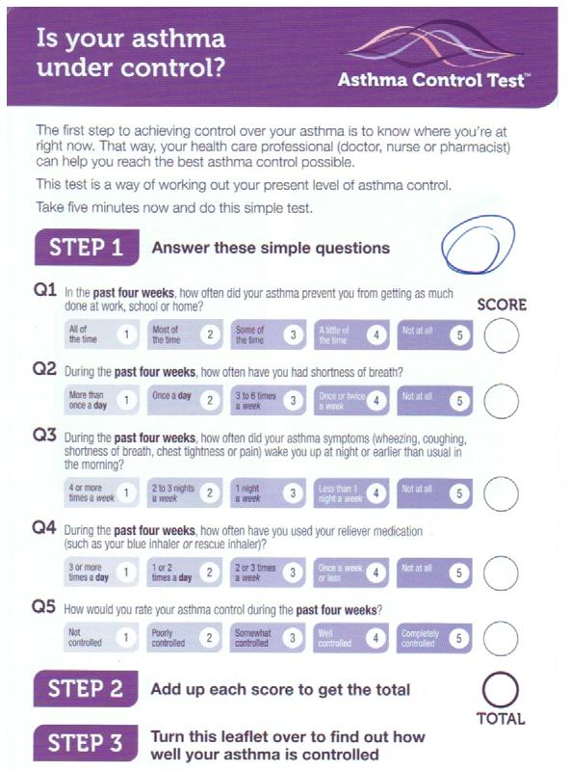
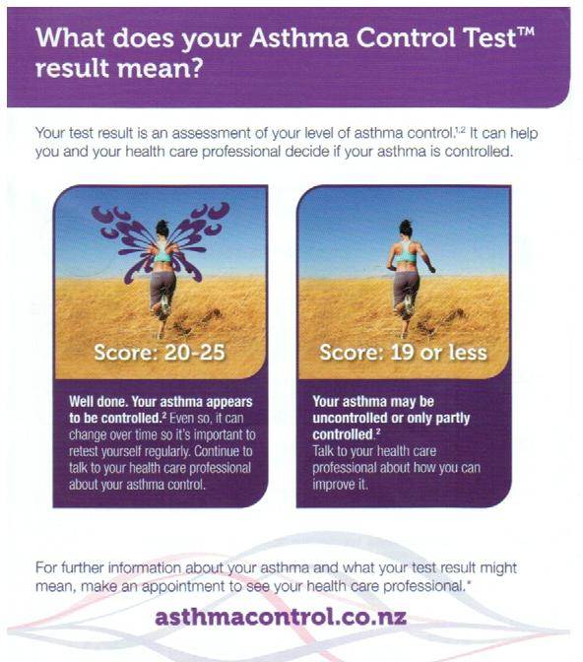
  Asthma Control Test (ACT)

Slide 18
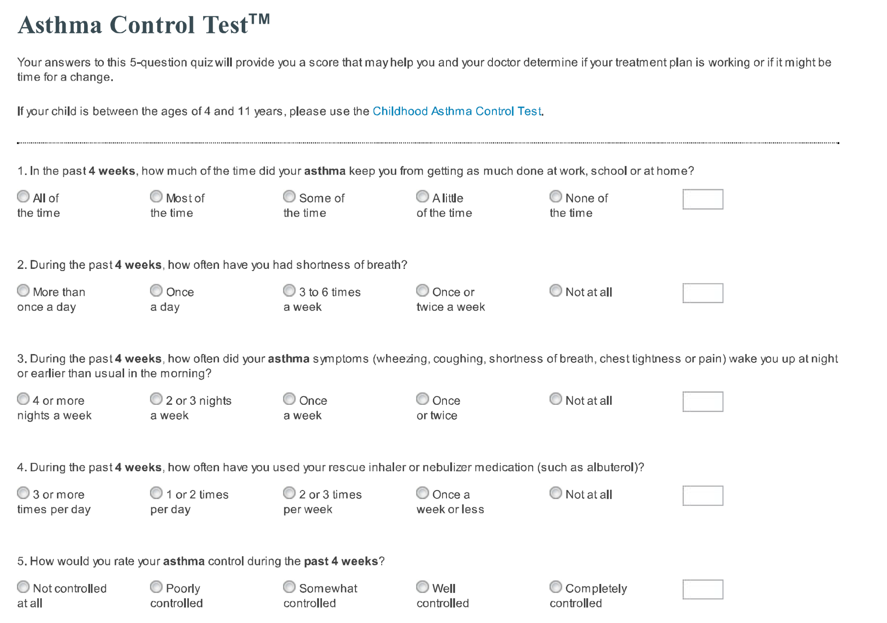

Slide 19
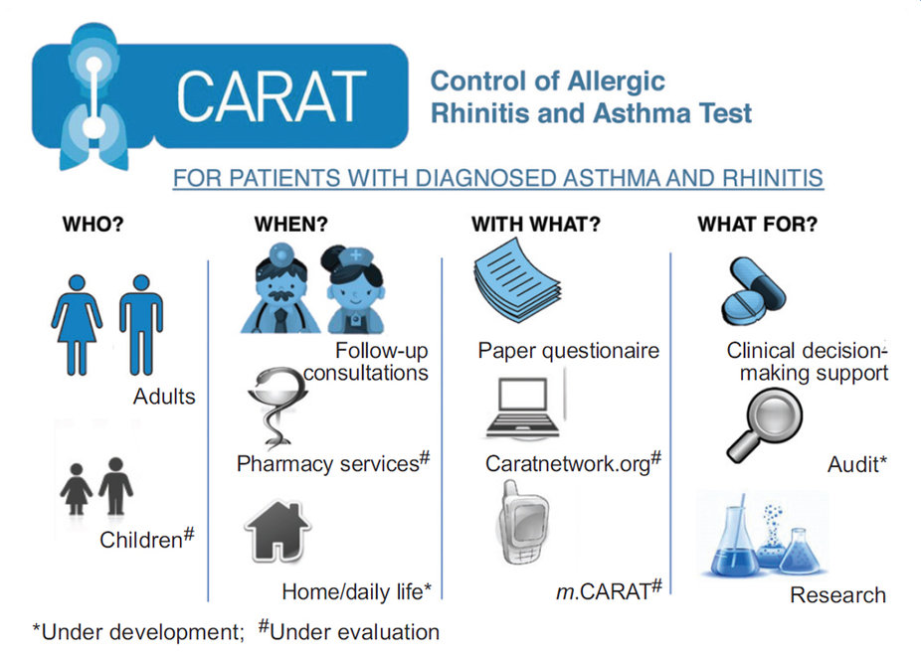

Slide 20
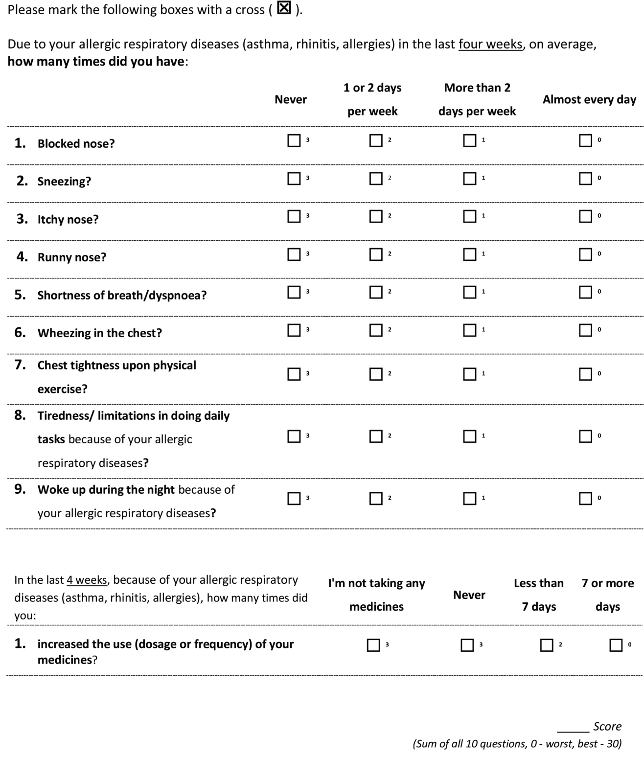
Scores
Total scores > 24 indicate good disease control
Score of the upper airway: controlled if score is > 8
Score of the lower airway : controlled if score is > 16

Slide 21
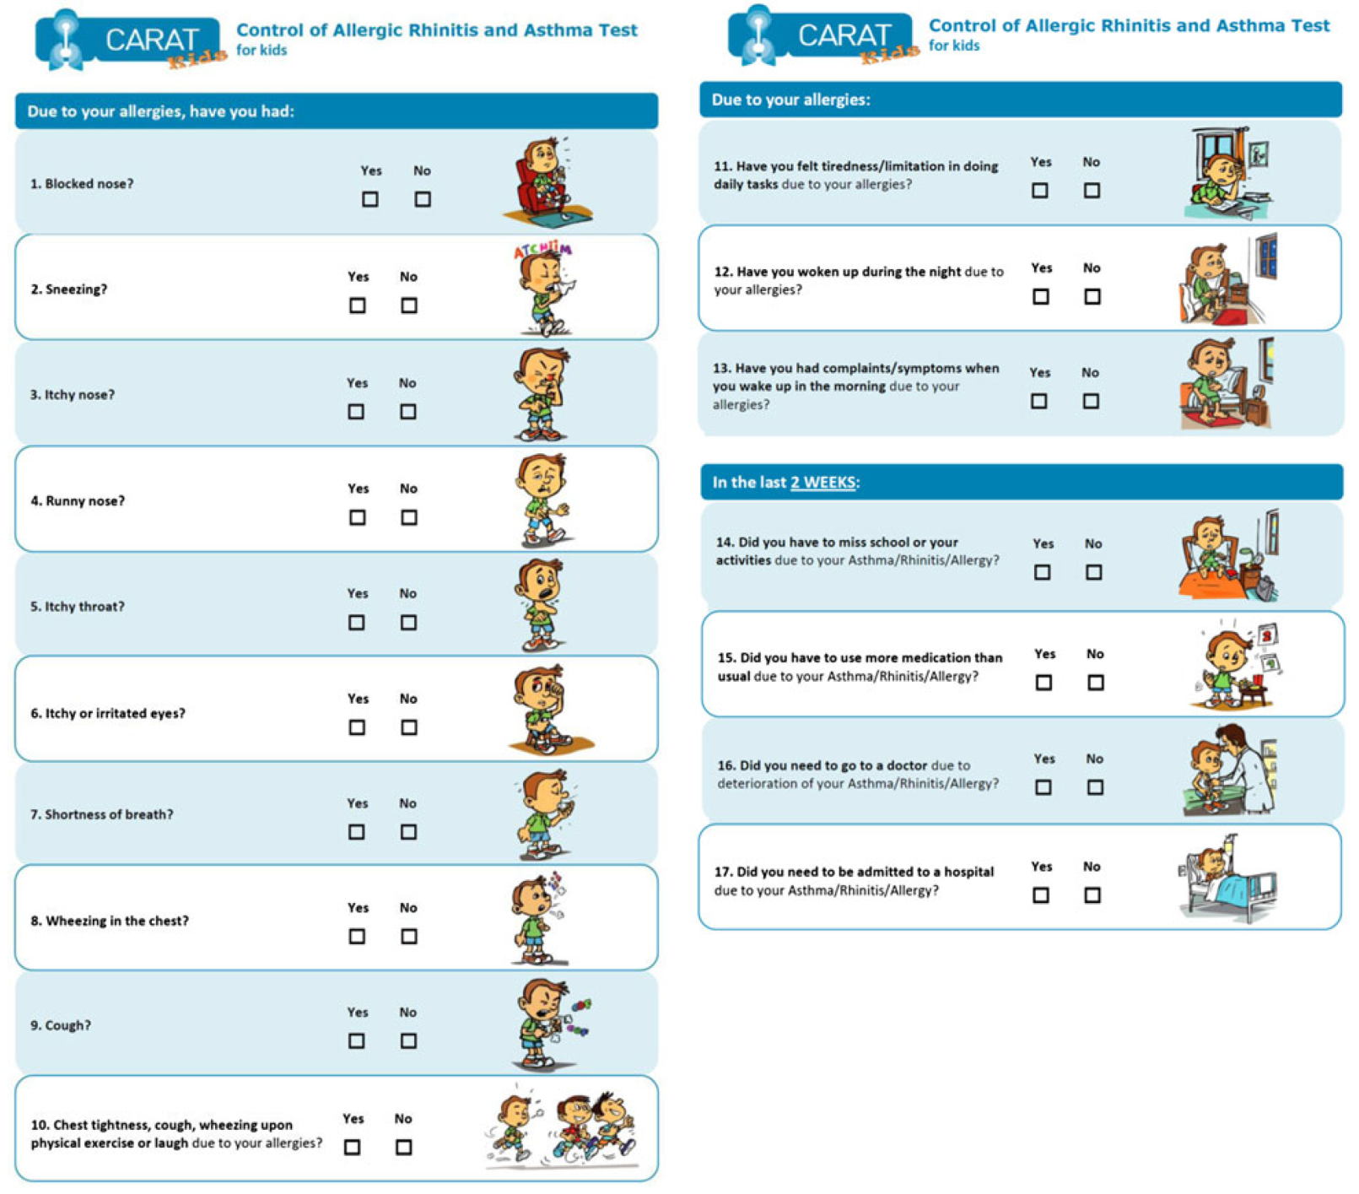

Slide 22
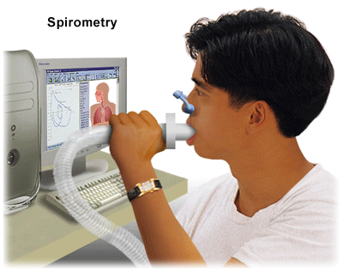
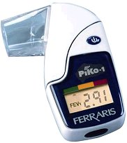
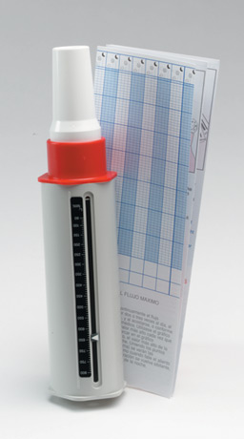

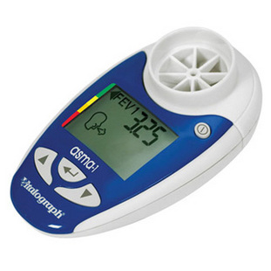
Objective measures

Slide 23
Clinical case

Slide 24
Clinical case
Sara- 43 year old, goes for a routine asthma consultation:
Never smoked
Atopic dermatitis since childhood
Asthma diagnosis since 1992
Never tested for allergenic sensitivity
She is regularly taking inhaled beta-2 agonists and corticosteroids medium dose fixed combination and salbutamol as needed
Daytime symptoms > twice a week
Nocturnal awakenings
In recent weeks used rescue medication 2/3 times a week

Slide 25
Is her asthma controlled?
As previously defined by the Global Initiative for Asthma (GINA)
Characteristic | Controlled (All of the following) | Partly controlled (Any present in any week) | Uncontrolled
Daytime symptoms | Twice or less per week | More than twice per week | 3 or more features of partly controlled asthma present in any week
Limitations of activities | None | Any
Nocturnal symptoms / awakening | None | Any
Need for rescue / “reliever” treatment | Twice or less per week | More than twice per week
Lung function (PEF or FEV1) | Normal | < 80% predicted or personal best (if known) on any day
www.ginasthma.org
Notes:
There are many tools to measure asthma control but independently of which one we use, we find that Sara’s asthma is uncontrolled as we can objective in this slide
Depending on level of asthma control, the patient is assigned to one of five treatment steps
Treatment is adjusted in a continuous cycle driven by changes in asthma control status. The cycle involves:
- Assessing Asthma Control
- Treating to Achieve Control
- Monitoring to Maintain Control

Slide 26
Reasons for poor asthma control

Slide 27
Reasons for poor asthma control
Wrong diagnosis or confounding illness
Incorrect choice of inhaler or poor technique
Concurrent smoking
Concomitant rhinitis
Unintentional or intentional nonadherence
Individual variation in treatment response
Under treatment
Haughney J et al. Respir Med. 2008;102:1681–93.

Slide 28
Clinical Case
Sara- 43 year old, goes for a routine asthma consultation:
Never smoked
Atopic dermatitis since childhood
Asthma diagnosis since 1992
Never tested for allergenic sensitivity
Once we check asthma control and we discover that she has an uncontrolled asthma
What to do next?
Notes:
Sara and to get her maintenance treatment prescription

Slide 29
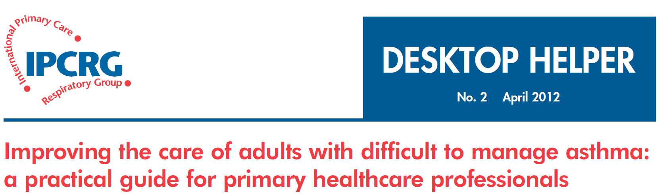
SIMPLES
Smoking
Inhaler technique
Monitoring
Pharmacotherapy
Lifestyle
Education
Support

Slide 30
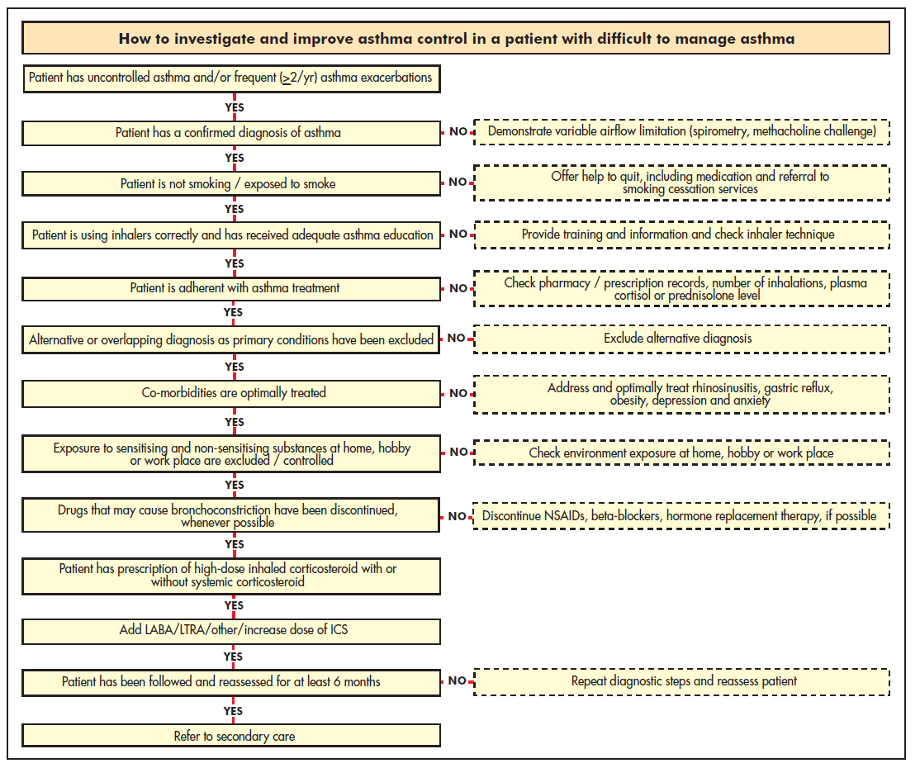

Slide 31
Step1: confirm the diagnosis of asthma
If the patient is not responding as expected to asthma therapy:
  Confirm the asthma diagnosis and rule out (or in) confounding illness before changing or increasing medications
Tools for asthma diagnosis must be stratified by age
Objective measures of reversible airflow obstruction (spirometry, PEF) are important if available

Slide 32
Diagnosing asthma in primary care
IPCRG guidelines. Prim Care Respir J. 2006;15:20–34.
Compatible clinical history
  Episodic or persistent dyspnoea, wheeze, tightness, cough
  Triggers (allergic, irritant)
  Risk factors for asthma development
  Consider occupational asthma for adults with recent onset
Objective evidence
  Spirometry or peak expiratory flow
  Bronchoprovocation test (methacholine challenge)
Ancillary tests
  Chest x-ray
  Eosinophils, IgE level
  Allergy testing
  Exhaled nitric oxide
  Induced sputum
Notes:
A diagnosis of asthma should ideally be based on objective evidence of reversible airflow obstruction. Guidelines vary in their criteria for this (IPCRG spirometry at http://www.theipcrg.org/resources/resources_diagnostics.php).

Slide 33
FORCED SPIROMETRY WITH REVERSIBILITY TEST
Obstruction negative RT
NORMAL
Obstruction positive RT
PEF Variability
Spirometry after oral CS
PEF <20%
PEF >20%
Negative
Broncoprovocation test
(metacoline)
Exercise test
Positive
Negative
Positive
Reassess
DIAGNOSIS OF ASTHMA

Slide 34

Patient with
respiratory symptoms
Are the symptoms typical of asthma?
YES
NO
Detailed history/examination
for asthma
History/examination supports
asthma diagnosis?
Further history and tests for
alternative diagnoses
Alternative diagnosis confirmed?
Clinical urgency, and other diagnoses unlikely
NO
YES
Perform spirometry/PEF
with reversibility test
Results support asthma diagnosis?
Repeat on another
occasion or arrange
other tests
Confirms asthma diagnosis?
NO
YES
NO
Empiric treatment with
ICS and prn SABA
Review response
Diagnostic testing
within 1-3 months
YES
NO
YES
Consider trial of treatment for
most likely diagnosis, or refer
for further investigations
Treat for ASTHMA
Treat for alternative diagnosis
GINA 2016, Box 1-1 (4/4)
© Global Initiative for Asthma

Slide 35
Step 2: question about smoking
Smoking adversely impacts asthma control
  Current smokers are almost 3 times more likely than non-smokers to be hospitalised for their asthma over a 12-month period
Why does smoking adversely impact asthma?
  Asthma misdiagnosed as COPD or concomitant COPD
  Relative steroid resistance
Price D et al. Clin Exp Allergy. 2005;35:282–7.
Notes:
There is clear evidence now that concurrent smoking adversely impacts asthma control.

Slide 36
Clinical approach to smoking
Tools
  Take a smoking history
  Investigate the possibility of COPD
    IPCRG guidance includes tool to differentiate asthma from COPD*
Solutions
  Encourage smokers to quit!
    IPCRG guidance on smoking cessation: http://www.theipcrg.org/smoking/index.php
  Try alternative therapy:
    Leukotriene receptor antagonist
    Possibly theophylline
*IPCRG Guidelines: diagnosis of respiratory diseases in primary care. Prim Care Respir J. 2006;15:20–34.
Notes:
Clinical approach to suspected smokers with asthma
It is important to identify the current smoking habits of patients with asthma, particularly those whose symptoms are poorly controlled. Patients who do not admit to smoking during an oral history may be more likely to admit to smoking on a written self-completed questionnaire, as they may feel less threatened.
For patients who are suspected or confirmed smokers, the consultation should include investigations to exclude COPD. The IPCRG guidelines for diagnosing respiratory diseases in primary care include a tool to help differentiate between asthma and COPD (lhttp://www.thepcrj.org/journ/view_article.php?article_id=137&volissue=12).
The ideal therapy for smokers with asthma is to quit smoking. The IPCRG has published guidance on smoking cessation (http://www.theipcrg.org/smoking/index.php). The percentage of neutrophils in induced sputum falls after patients quit smoking; thus, while neutrophils do not respond to steroids they do respond to smoking cessation.
For patients who continue to smoke, alternatives to inhaled steroids for treating asthma include leukotriene modifiers, theophylline, or possibly high-dose inhaled steroids (up to 1600 µg/day), although this last alternative is not yet fully supported by clinical trial evidence.

Slide 37
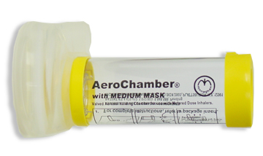

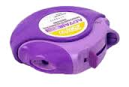

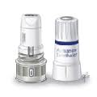
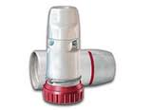
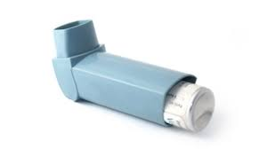
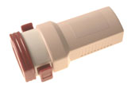
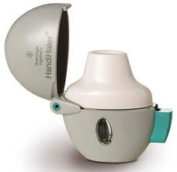
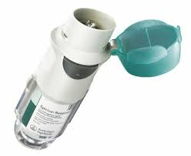
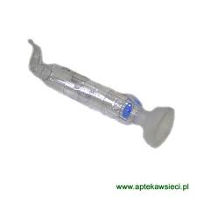

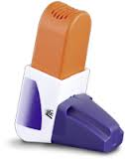

Step 3: assess inhaler technique

Slide 38
Step 3: assess inhaler technique
Correct inhaler choice or poor technique
Problems with inhaler technique are common in clinical practice & can lead to poor asthma control
All patients should be trained in technique, and trainers should be competent with the inhalation technique

Slide 39
Inhaler choice and technique
Key recommendations:
Take patient preference into account when choosing the inhaler device
Simplify the regimen and do not mix inhaler device types
The choice of steroid inhaler is most important because of the narrower therapeutic window
Invest the time to train each patient in proper inhaler technique:
    Observe technique & let patient observe self (using video demonstrations)
    Devices to check technique & maintain trained technique are available
Recheck inhaler technique on each revisit
Haughney J et al. Respir Med. 2008;102:1681–93.
Notes:
39
Choosing an inhaler device
The three most common types of inhaler device available are 1) pressurised metered-dose inhalers (MDIs), 2) breath-actuated MDIs, and 3) dry powder inhalers (DPIs). Available in generic form and the least expensive, MDIs are also frequently used incorrectly, as these devices require coordination between inhalation and actuation of the inhaler. Use of a breath-actuated MDI can improve lung deposition and decrease oropharyngeal deposition. DPI use instead requires adequate acceleration rate on inhalation to obtain good lung deposition and avoid excess orophayngeal deposition.
Key features of MDIs and DPIs
Metered-dose inhalers:
Require slow and deep inhalation over 5 seconds, with co-ordination between dose release and start of inhalation (good co-ordination not critical if slow inhalation but dose has to be released after the start of the inhalation);
Can be used with spacers, large or small (spacers scored lowest in patient preference);
Solving common problems:
poor coordination of actuation & inhalation → switch to breath-actuated MDI;
stopping inhalation when cold spray hits the throat ("cold Freon effect") → add a spacer or switch to inhaler with CFC-free propellant;
inhaling too fast → switch to ultrafine particle inhaler;
inhaling through the nose → training to inhale through mouth.
Dry powder inhalers:
Breath-actuated;
Require adequate acceleration on inhalation: must inhale deeply and forcibly at the start of the inhalation;
If the patient does not inhale fast enough or long enough:
Not all the dose is emitted;
Particles generated are too big to enter the lungs, resulting in increased oropharyngeal deposition.
Do not prescribe to children <5 years old;
Do not prescribe to patients with insufficient inspiratory effort;
Sensitive to moisture, store in dry place.
If the dose is supplied in a capsule then two inhalations are required to empty the dose.
Inhaler training aids:
Several devices to check inhaler technique and maintain trained technique are now available. For use with a MDI, the Aerosol Inhalation Monitor (AIM, Vitalograph Ltd, Buckingham, England) provides useful feedback about a patient’s technique, whilst the 2Tone Trainer (Canday Medical Ltd., Newmarket, England) is a training aid to help patients use a slow inhalation flow. The AeroChamber Plus spacer (Forest Pharmaceuticals, Inc., St. Louis, US) makes a noise when the inhalation flow used is too fast.
For use with a dry powder inhaler, the In-Check Dial (Clement Clarke International Ltd., Essex, UK) is a device to check if the patient can generate the required fast inhalation. The Turbuhaler whistle (AstraZeneca International, London, UK) is an example of a simple device that has been introduced to check for the required inhalation rate for patients prescribed this device. Finally, the Novolizer (MEDA Pharma GmbH & Co. KG, Bad Homburg, Germany) has been designed to release its dose only when the required inhalation rate is achieved.

Slide 40

Step 4: assess adherence to treatment

Slide 41

Step 4: assess adherence to treatment
Asking?

Slide 42
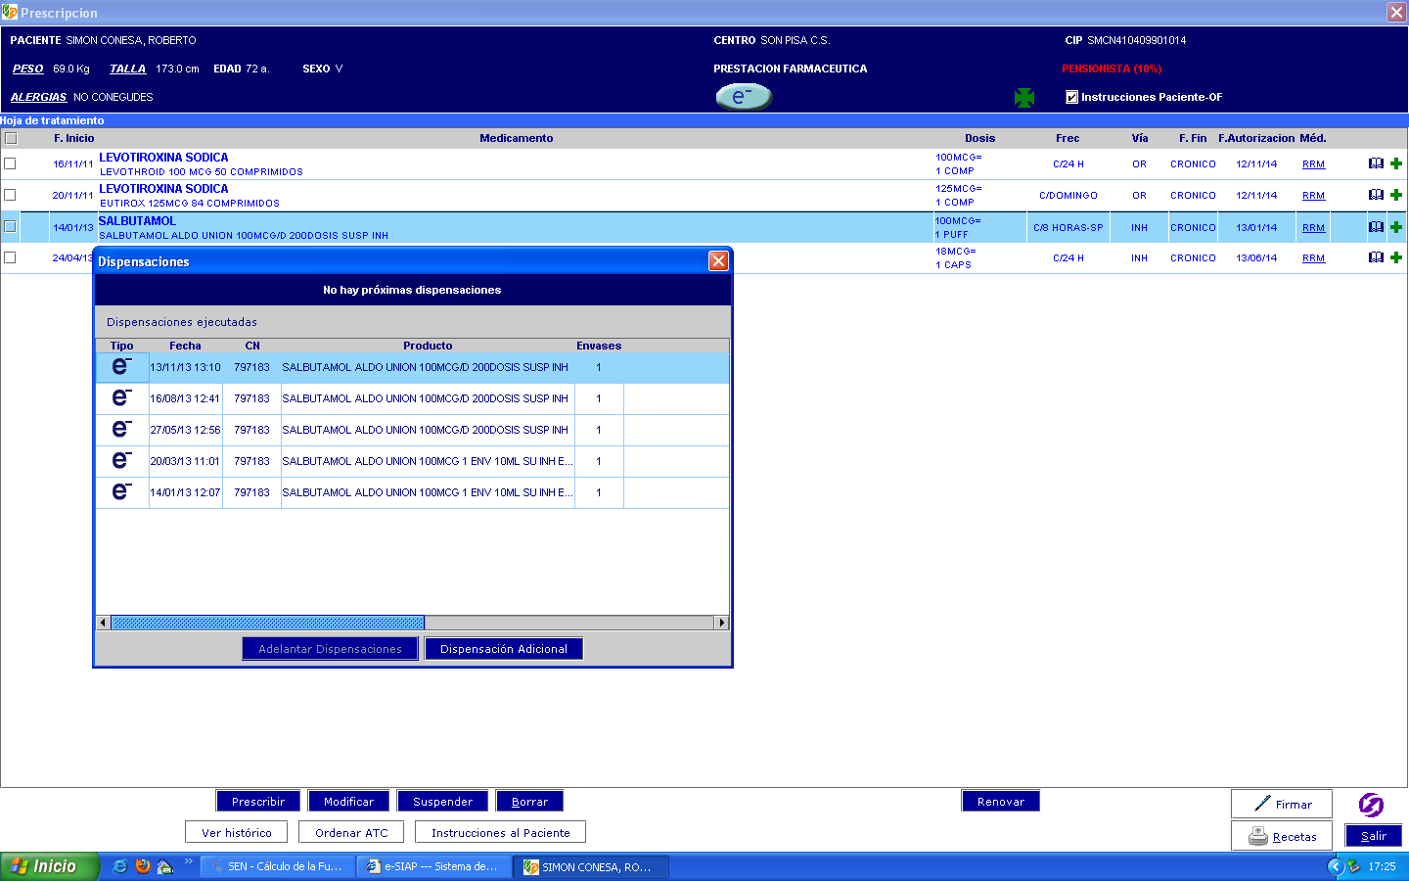
Step 4: assess adherence to treatment
Electronic prescription
Asking?

Slide 43

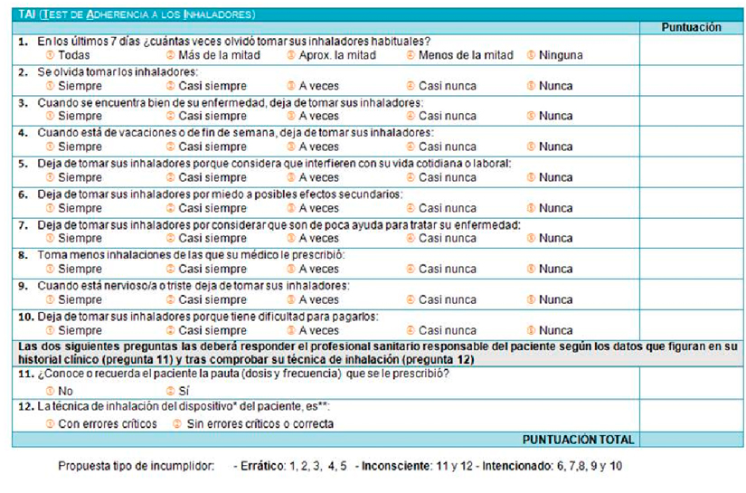
Notes:
En España, sólo el 37’5% de pacientes adultos con asma o EPOC mantiene un correcto cumplimiento de su tratamiento con inhaladores. muestra de aproximadamente 1.000 pacientes respiratorios de nuestro país.
Durante la extracción de estas conclusiones, el Dr. Plaza ha confirmado la fiabilidad del TAI tanto para identificar al paciente respiratorio con pobre adherencia al tratamiento como para determinar el grado de adherencia al mismo (bajo, medio o alto). Y es que el test ha sido desarrollado y validado por un grupo de 200 profesionales sanitarios de toda España implicados en el tratamiento de personas con asma o EPOC: neumólogos, alergólogos, médicos de atención primaria o personal de enfermería.
Asma son menos cumplidores que EPOC, pues estos últimos son más conscientes de su enfermedad y de sus consecuencias,
Diseñado específicamente pensando en las características diferenciales de la terapia inhalada.
Consta de 12 preguntas que el paciente cumplimenta en la misma consulta, en un tiempo medio de 6 minutos
Breve cuestionario que el médico también debe completar para garantizar la objetividad del test.

Slide 44
Step 4: assess adherence to treatment
Unintentional & intentional nonadherence
Nonadherence to asthma therapy, particularly to inhaled steroids, is a common problem contributing to poor asthma control
Nonadherence is often a hidden problem as assessment of adherence is often not included in routine asthma review
Barriers to assessing adherence:
  Patient and physician may prefer to avoid the subject
  Lack of clear, easy methods for addressing barriers to adherence
  Perception that little can be done?
Appreciating the factors involved is the first step toward improving adherence
Horne R. Chest. 2006;130:65S–72S.

Slide 45
Nonadherence: identifying the causes
Tools for identifying & assessing nonadherence:
Interventions to facilitate optimal adherence are likely to be more effective
We need to tailor the intervention & support according to specific barriers & patient preferences
Haughney J et al. Respir Med. 2008;102:1681–93.

Slide 46
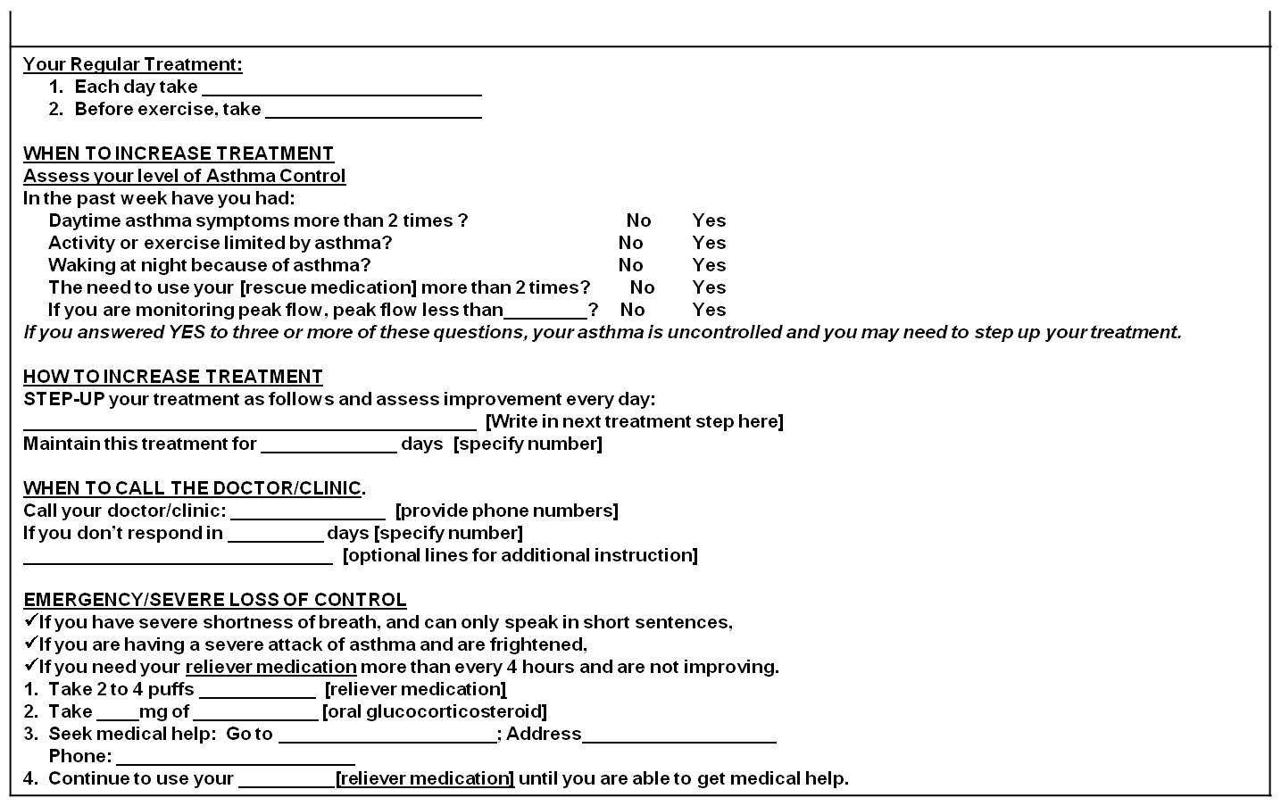
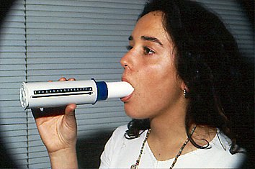
Written action plan
Non adherence
Action - Provide training on self-management skills
Notes:
The use of a written action plan itself has independently demonstrated better outcomes in asthma control and decrease exacerbations.
The use of peak-flow measurements could also be useful if available in cases of bad perceivers

Slide 47
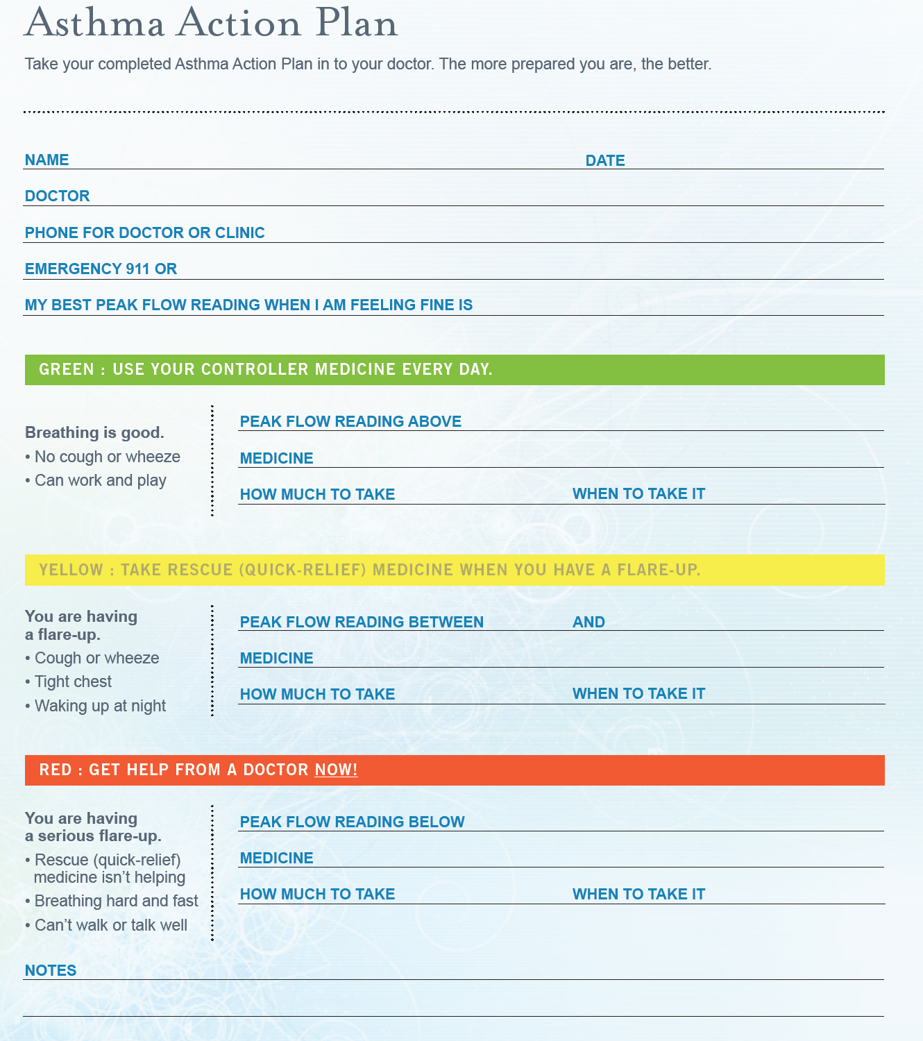

Slide 48
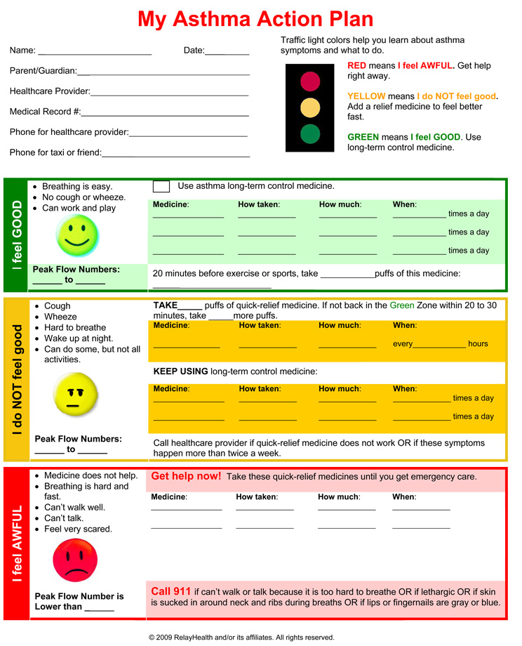

Slide 49



Step 5: exclude alternative or overlapping diagnosis as primary conditions
  Consider occupational asthma for adults with recent onset

Slide 50
Wrong diagnosis or confounding illness
Action - Rule out (or in) confounding illness before changing medications
Chronic rhino-sinusitis,
Reflux disease
Obstructive sleep apnoea syndrome
Cardiac disorders
Vocal cord dysfunction
Anaemia
Obesity
Depression and anxiety

Slide 51




Step 6: Identify and treat co-morbidities

Slide 52
Co morbidities can worsen asthma symptoms - identify and treat them
Allergic rhinitis
COPD
Gastro-oesophageal reflux disease (GERD)
Respiratory infection
Cardiac disorders
Anaemia
Vocal cord dysfunction
Notes:
The presence of comorbidities can worsen asthma symptoms, and these should be treated to successfully control asthma.

Slide 53
Concomitant rhinitis
Patients with asthma & concomitant rhinitis use more health care resources than those without rhinitis
Children with asthma & concomitant rhinitis had double the likelihood of being hospitalised and significantly increased likelihood of a physician visit for asthma than those without rhinitis
>50% of patients with asthma have rhinitis
  Both allergic & nonallergic rhinitis are linked to asthma
Price D et al Clin Exp Allergy. 2005;35:282–7. Thomas M et al. Pediatrics. 2005;115:129–34.
Notes:
Many patients with asthma, over 50% in most studies, have rhinitis.
Patients with asthma who have rhinitis, both adults and children, use more health-care resources than those without rhinitis, indicating that their asthma is less well-controlled.

Slide 54
Treating co morbid rhinitis & asthma
Upper airway treatment options | Lower airway treatment options
Nasal steroids | Inhaled steroids
Antihistamines
Upper and lower airway treatment options
Leukotriene receptor antagonists
Anti-IgE
Immunotherapy

Slide 55
Perimenstrual asthma, and asthma in pregnancy-NEW GINA 2018
Perimenstrual (catamenial) asthma – new section added
  Asthma worse premenstrually in ~20% women
  More common in older women, higher BMI, longer duration and more severe asthma; often have dysmenorrhea, shorter cycles, longer bleeding; aspirin-exacerbated respiratory disease more common (Sanchez-Ramos Exp Rev Respir Med 2017)
  Add-on treatment: oral contraceptives and/or LTRA may be helpful
The recommendation against stopping ICS during pregnancy has been reinforced
  ICS reduce the risk of exacerbations in pregnancy (Evidence A) (Schatz AAAI 2005; Murphy Clin Chest Med 2011)
  Stopping ICS increases the risk of exacerbations in pregnancy (Evidence A) (Murphy Thorax 2006)
What’s new in GINA 2018?
Notes:
Sanchez-Ramos JL, Pereira-Vega AR, Alvarado-Gomez F, Maldonado-Perez JA, Svanes C, Gomez-Real F. Risk factors for premenstrual asthma: a systematic review and meta-analysis. Expert Rev Respir Med 2017;11:57-72.
Schatz M, Leibman C. Inhaled corticosteroid use and outcomes in pregnancy. Annals of Allergy, Asthma & Immunology 2005;95:234-8.
Murphy VE, Gibson PG. Asthma in pregnancy. Clin Chest Med 2011;32:93-110
Murphy VE, Clifton VL, Gibson PG. Asthma exacerbations during pregnancy: incidence and association with adverse pregnancy outcomes. Thorax 2006;61:169-76.

Slide 56
Step 7: control environmental factors
Exposure to sensitising and non- sensitising substances at home, hobby or work place are excluded / controlled

Slide 57


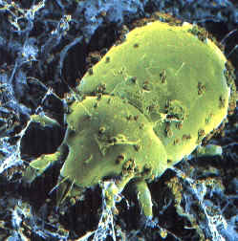
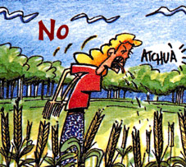
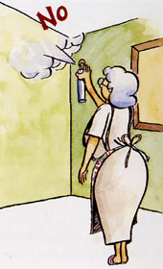
Environmental Factors:
Action - Advice on allergens avoidance
Animals outside the home (cats, dogs, hamsters)
Dust Mites: Allergy Waterproof Cases
Damp cloth and vacuum
Home Humidity <50%
No carpets in the bedroom
Washing with hot water weekly
Pollens: Close windows in time of pollination
Snuff: Avoid smoking and passive exposure
Fungi: Remove mildew stains on the walls
Avoid wood stoves, smoke, air fresheners, etc..
Notes:
Measures to prevent the development of asthma, and asthma exacerbations by avoiding or reducing exposure to risk factors should be implemented wherever possible.
Asthma exacerbations may be caused by a variety of risk factors – allergens, viral infections, pollutants and drugs.
Reducing exposure to some categories of risk factors improves the control of asthma and reduces medications needs.

Slide 58
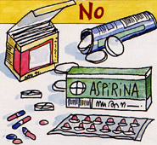
Step 8: think about other medications
NSAID’s
Iron-dextran
Carbamazepine
Vaccines
Allergen extracts (immunotherapy)
Antibiotics: penicillins, tetras, erythromycin, sulfa
Beta-blockers (oral and topical eye drops)
Cholinesterase inhibitors: tacrine, rivastigmine
MDI propellants

Slide 59
Step 9: Consider individual variation in treatment response
Randomised controlled trials (RCTs) are the basis of recommendations made by clinical guidelines.
However, several factors limit our ability to generalise RCT results to our patients.
Haughney J et al. Respir Med. 2008;102:1681–93.
Notes:
Bullet page

Slide 60
Step 10: consider stepping up treatment
If the patient already has high-dose inhaled corticosteroid with or without systemic corticosteroid
Add LABA /LTRA /other /increase dose of ICS
Follow and reassess for at least 6 months

Slide 61

Stepwise management – pharmacotherapy-new GINA 2018
Diagnosis
Symptom control & risk factors
(including lung function)
Inhaler technique & adherence
Patient preference
REVIEW RESPONSE
ASSESS
Symptoms
Exacerbations
Side-effects
Patient satisfaction
Lung function
ADJUST TREATMENT
Asthma medications
Non-pharmacological strategies
Treat modifiable risk factors
*Not for children <12 years
**For children 6-11 years, the preferred Step 3 treatment is medium dose ICS
#For patients prescribed BDP/formoterol or BUD/ formoterol maintenance and reliever therapy
 Tiotropium by mist inhaler is an add-on treatment for patients ≥12 years with a history of exacerbations
STEP 5
STEP 4
STEP 3
Refer for add-on treatment
e.g.
tiotropium,* anti-IgE,
anti-IL5*
PREFERRED
CONTROLLER
CHOICE
STEP 1
STEP 2
Med/high
ICS/LABA
Low dose ICS
Low dose
ICS/LABA**
Other
controller
options
Consider low dose ICS
Leukotriene receptor antagonists (LTRA)
Low dose theophylline*
Med/high dose ICS
Low dose ICS + LTRA
(or + theoph*)
Add tiotropium*
Med/high dose
ICS + LTRA
(or + theoph*)
Add low
dose OCS
RELIEVER
As-needed short-acting beta²-agonist (SABA)
As-needed SABA or
low dose ICS/formoterol#
GINA 2018, Box 3-5 (2/8) (upper part)

Slide 62
Treatment steps – changes in 2018
Step 1
  It is explained that the reason ICS should be considered for patients with mild asthma (rather than prescribing SABA alone) is to reduce their risk of serious exacerbations (Pauwels, Lancet 2003; O’Byrne AJRCCM 2001; Reddel Lancet 2017)
Steps 3-4
  From the large FDA LABA safety studies: adding LABA to ICS in a combination inhaler reduces risk of exacerbations and improves symptoms and lung function, compared with the same dose of ICS alone, but with only a small reduction in reliever use (Stempel NEJM 2016, Peters NEJM 2016)
Step 5 and Box 3-14: management of severe asthma
  Subcutaneous benralizumab (monoclonal anti-IL5 receptor α antibody) is another add-on treatment for patients aged ≥12 years with severe eosinophilic asthma
What’s new in GINA 2018?
Notes:
1. Reddel HK, Busse WW, Pedersen S, Tan WC, Chen YZ, Jorup C, Lythgoe D, et al. Should recommendations about starting inhaled corticosteroid treatment for mild asthma be based on symptom frequency: a post-hoc efficacy analysis of the START study. Lancet 2017;389:157-66.
2. Peters SP, Bleecker ER, Canonica GW, Park YB, Ramirez R, Hollis S, Fjallbrant H, et al. Serious asthma events with budesonide plus formoterol vs. budesonide alone. N Engl J Med 2016;375:850-60.
3. Stempel DA, Raphiou IH, Kral KM, Yeakey AM, Emmett AH, Prazma CM, Buaron KS, et al. Serious asthma events with fluticasone plus salmeterol versus fluticasone alone. N Engl J Med 2016;374:1822-30.

Slide 63
SYGMA 1
SYGMA 2

Slide 64
SYGMA 1
Medium daily ICS dose in FOR/BUD = 57mcgr
Medium daily ICS dose in BUD mant = 340 mcgr
<20%

Slide 65
SYGMA 2
Medium daily ICS dose in FOR/BUD = 66mcgr
Medium daily ICS dose in BUD mant = 267 mcgr
25%

Slide 66
Assessment of risk factors for poor asthma outcomes, new GINA 2018
Risk factors for exacerbations include:
Uncontrolled asthma symptoms Additional risk factors, even if the patient has few symptoms: High SABA use (≥3 canisters/year) Having ≥1 exacerbation in last 12 months Low FEV₁; higher bronchodilator reversibility Incorrect inhaler technique and/or poor adherence Smoking Obesity, chronic rhinosinusitis, pregnancy, blood eosinophilia Elevated FeNO in adults with allergic asthma taking ICS Ever intubated for asthma
Risk factors for fixed airflow limitation include:
No ICS treatment, smoking, occupational exposure, mucus hypersecretion, blood eosinophilia; pre-term birth, low birth weight
Risk factors for medication side-effects include:
Frequent oral steroids, high dose/potent ICS, P450 inhibitors
GINA 2018, Box 2-2B (4/4)

Slide 67

Step 11: consider a referral to secondary care
Doubts about diagnosis and tests unavailable:
  Bronchoprovocation test
  Allergy test
  Rhino fibro-scope
Occupational asthma
Treating co-morbidities
Pregnancy in a bad controlled patient
Not available treatments (immunotherapy…)
5% suffering from difficult to control asthma
Notes:
67
It includes all patients with particularly aggressive asthma which is inadequate or poorly controlled, despite following an appropriate control based therapeutic strategy
Synonyms for difficult to control asthma: refractory asthma, refractory asthma, glucocorticoid resistant asthma and steroid dependent asthma

Slide 68
Step 11: consider a referral to secondary care
Who to refer?
Patients who continue to have difficult to manage asthma after review and taking steps to reduce all possible causes and despite being on guideline-based treatment should be referred to a specialist clinic.

Slide 69
Where to refer?
Patients should be referred to clinics with experience in difficult to manage asthma, able to provide care and treatment by a multidisciplinary team.
What to include in a referral letter?
Occupation
Onset of symptoms
Dyspnoea
Specified dyspnoea
Cough
Specified cough
Wheezing
Smoking
Known allergies
Peak flow
Spirometry and bronchodilatation test
Use of asthma medication
Other diseases
Other current medication

Slide 70

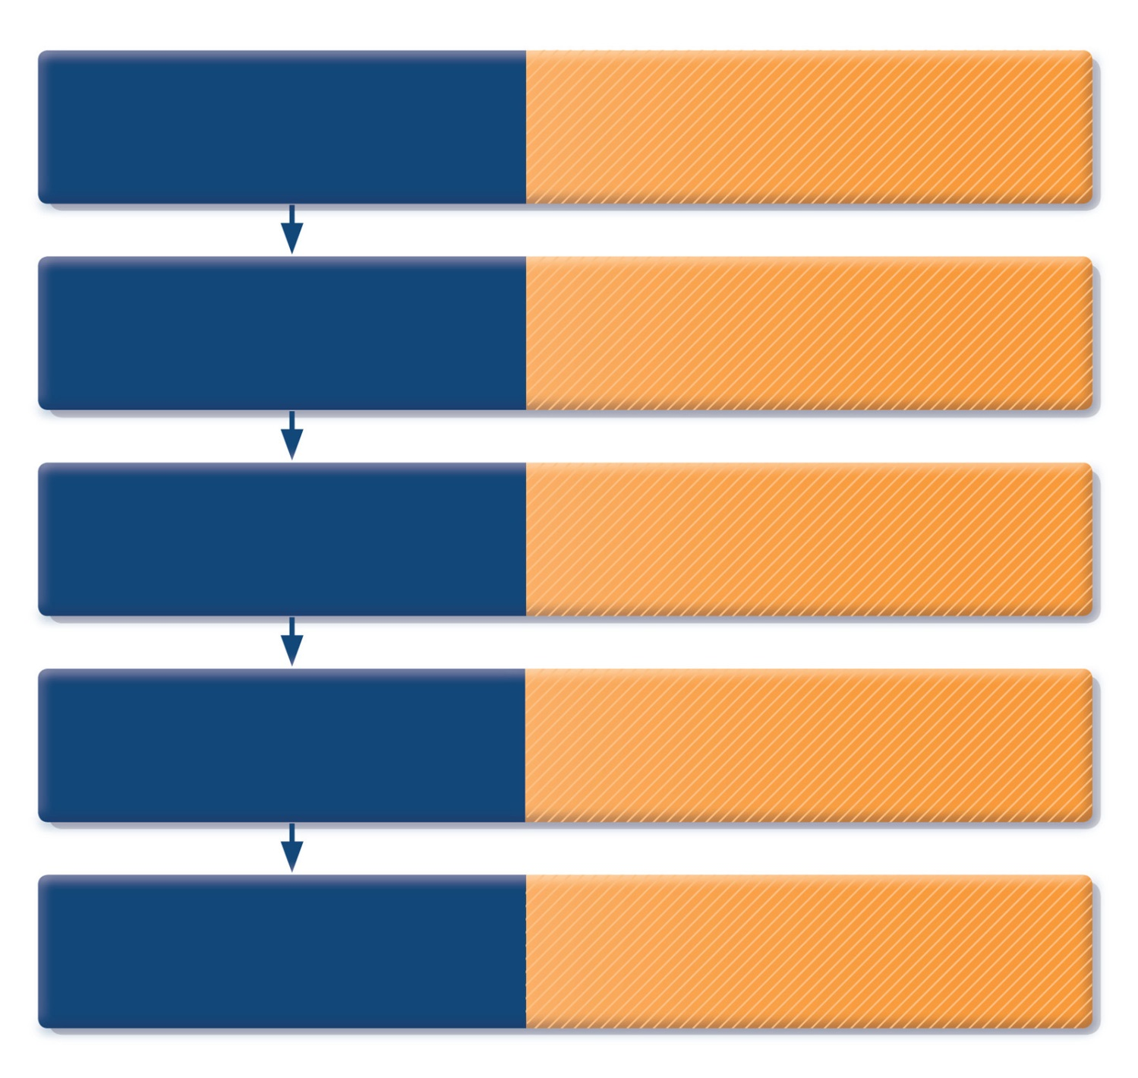
How to distinguish between uncontrolled and severe asthma
Watch patient using their
inhaler. Discuss adherence
and barriers to use
Compare inhaler technique with a device-specific checklist, and correct errors;
recheck frequently. Have an empathic discussion about barriers to adherence.
Confirm the diagnosis
of asthma
If lung function normal during symptoms, consider halving ICS dose and repeating
lung function after 2–3 weeks.
Remove potential
risk factors. Assess and
manage comorbidities
Check for risk factors or inducers such as smoking, beta-blockers, NSAIDs, allergen exposure. Check for comorbidities such as rhinitis, obesity, GERD, depression/anxiety.
Consider treatment
step-up
Consider step up to next treatment level.
Use shared decision-making, and balance potential benefits and risks.
Refer to a specialist or
severe asthma clinic
If asthma still uncontrolled after 3–6 months
on Step 4 treatment, refer for expert advice. Refer earlier if asthma symptoms severe,
or doubts about diagnosis.
GINA 2016, Box 2-4 (5/5)
© Global Initiative for Asthma

Slide 71
Conclusions: what should we do?
Empower/enable the patient
Written action plan
Identify triggers and allergens and avoid
Check adherence and good inhaler technique
Rule out or treat co-morbidities
Changes in pharmacological treatment
Refer only when needed

Slide 72
Exhaled nitric oxide (FeNO)-new GINA 2018
FeNO is becoming more widely available in some countries
All sections on FeNO have been reviewed and updated
Decisions about initial asthma treatment
  GINA recommends at least low dose ICS in almost all patients with asthma, to reduce risk of asthma exacerbations and death
    SABA-only treatment considered only if symptoms < twice/month,
    no night waking, and no risk factors for exacerbations
  In non-smoking patients, FeNO >50 ppb is associated with a good short-term response to ICS in symptoms and lung function
  There are no studies examining the long-term safety (i.e. for risk of exacerbations) of withholding ICS if initial FeNO is low
  In patients with a diagnosis or suspected diagnosis of asthma, FeNO can support the decision to start ICS, but cannot safely be recommended for deciding against treatment with ICS
What’s new in GINA 2018?

Slide 73

Respiratory Health: Adding Value
in a Resource Constrained World
In collaboration with:
GRESP Portugal
GRESP Brazil
GRAP Spain
GRAP Chile
Thank you for your attention!
www.theipcrg.org

