Slide 1
Providing personalised care to adults with asthma
A learning resource for primary care professionals

Slide 2
About this learning resource
This learning resource is aimed at primary care professionals including GPs, family physicians, nurses and pharmacists who are provide care for adults with asthma or who present with symptoms that may be asthma.
It forms part of resource pack on providing personalised care to adults with asthma, including a Desktop Helper providing practical guidance, a Position Paper and a summary of relevant evidence. They are are available at www.ipcrg.org/personalisation
These resources were developed with the input of experience-led experts, including patients and clinicians. See www.ipcrg.org/personalisation for a list of these experts.
The development of these resources was funded by a grant from GlaxoSmithKline. They took no part in drafting the content.
The disclaimer covering this resources is available at this link: Disclaimer
These resources are covered by Creative Commons licences under the Attribution-NonCommercial-ShareAlike CC BY-NC-SA licence.
The IPCRG is a registered charity (SC No 035056) and company limited by guarantee (Company No 256268). PO Box 11961, Westhill, AB32 9AE, UK
Notes:
This is an introduction, not a slide for teaching.

Slide 3
Structure of this learning resource
Part 1: Information about this learning resource:
  About the learning resource
  How to use it
  Learning objectives
Part 2: Understanding personalised care for adults with asthma:
  What is personalised care?
  Why does it matter for adults with asthma?
  How does it relate to personalised medicine?
  The features of personalised care
Part 3: Practical advice for providing personalised care:
  Diagnosis: ask, advise, act, examples of tools
  Planning treatment: ask, advise, act, examples of tools
  Treatment review: ask, advise, act, examples of tools
  Part 4: References and sources of more information
  Part 5: Model for evaluation and feedback

Slide 4
How to use this resource
By individuals as a tool for self-study:
  Read through the slides in your own time;
  Reflect on the questions about applying personalised care in your own practice;
  It will take around 45 minutes to work through this resource.
By primary care education providers as part of continuing professional education programmes:
  Use the “key points” summary slides to provide an overview of personalised care in lectures;
  Select and adapt slides to use as part of lectures on primary care practice;
  Use questions about applying personalised care in practice in small group work.
Links to tools, examples and sources of more support are provided throughout.
References and sources of further information are given at the end.
Notes:
Note: when you adapt these, you will be able to shorten the words on the slide – however, in order to assist translation we have used fuller sentences. Bullet points often omit verbs, which makes translation difficult.

Slide 5
Learning objectives
After working through this resource, you will be better able to:
Describe what personalised care is
Explain why personalised care is important for adults with asthma
Provide care that is personalised to adults with asthma in ways that are feasible and effective in primary care practice.

Slide 6
Personalised care: summary points
Personalised care identifies what is most important to each person and ensures care is designed around their individual needs
Personalised care can support patients to develop the knowledge, skills and confidence to self-manage their asthma
A person’s ability to self-manage their asthma has major impact on their outcomes: asthma control, exacerbations, hospital admissions and quality of life

Slide 7
What is personalised care?
Identifies what is most important to each person and ensures that the care they receive is designed around their individual needs
Supports people to develop the knowledge, skills and confidence they need to more effectively manage and make informed decisions about their own health and health care
Encompasses shared decision-making, personalised care planning and self-management support
Is sometimes called person-centred care or personalisation. (The Health Foundation, 2014)

Slide 8
Why does personalised care matter for adults with asthma?
Evidence shows ability to self-manage asthma has major impact on outcomes including asthma control, exacerbations, hospital admissions and quality of life (Pinnock, 2015)
Clinicians can support patients to develop the knowledge, skills and confidence to self-manage by listening to their views and preferences, understanding their personal circumstances and priorities and taking account of these when providing information and prescribing medication
If care is personalised and decision-making is shared, people are more likely to accept necessity of medication, have fewer concerns about adverse effects, understand their triggers and feel they have the ability to control their own asthma. This improves patient outcomes. (Wilson et al, 2010; Horne & Weinman, 2002)
Personalised care also makes more efficient use of healthcare resources by reducing waste of medicines and preventable hospital admissions. (NHS England, 2016)

Slide 9
How does personalised care relate to personalised medicine?
Personalised medicine uses biomedical advances, including genome sequencing, to target therapies to achieve the best outcomes in the management of an individual patient’s disease or predisposition to disease.
It recognises that one disease may have many different forms, or ‘subtypes’, resulting from the complex interaction of biological make-up and the diverse pathological and physiological processes. (NHS England, 2016)
Recently it has been seen as an advance in asthma care by using a ‘treatable traits’ approach. (Agusti et al, 2016)
While personalised medicine offers enormous potential for improved outcomes for patients with asthma and other chronic respiratory diseases, these potential benefits will only be realised if it is delivered within an overall framework of personalised care.
This is because research shows that patients use their own beliefs and preferences to make decisions about whether to start and continue taking a personalised medicine in the same way as a non-personalised medicine. (Horne, 2017)
But only 40% of people take the medicines they are prescribed and only 30% of these take them as directed, which means only 12% or people are taking the right medicines in the right way (IPCRG Asthma Right Care)*
Therefore, understanding and taking account of patients’ beliefs and preferences and helping them develop knowledge is essential to enable them to make informed choices about treatment, including personalised medicine.
Notes:
*Asthma Right Care combines data from
Williams, L. K., et al. (2011). "Quantifying the proportion of severe asthma exacerbations attributable to inhaled corticosteroid nonadherence." J Allergy Clin Immunol 128(6): 1185-1191 e1182.
Chrystyn, H., et al. (2017). "Device errors in asthma and COPD: systematic literature review and meta-analysis." NPJ Prim Care Respir Med 27(1): 22
BTS/SIGN Asthma 2016

Slide 10
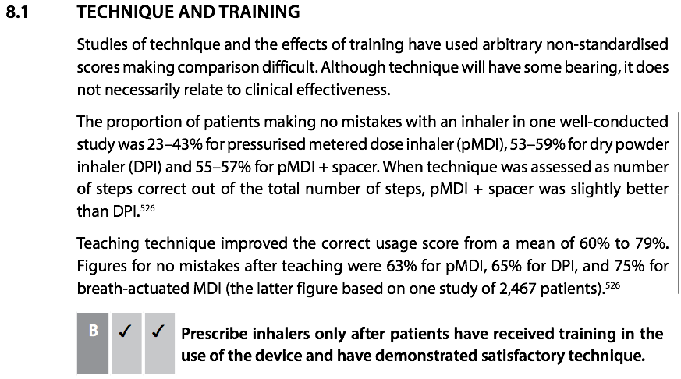
You could insert a slide on adherence here eg BTS/SIGN 2016

Slide 11
Features of personalised care
Puts people in control of their own health care by involving them in discussions and decisions as summed up by “nothing about me without me”
Requires finding out about people’s preferences, belief and existing knowledge and views
Involves sharing information with patients in ways they can understand
Quality of the conversation between patient and clinician is key at every stage
Gives time for patient to ask questions and express their feelings, without being rushed
Encompasses compassionate care whereby clinicians treat patients with compassion and dignity. (The Health Foundation, 2014)

Slide 12
What is really going on here?

Slide 13
What is really going on here?
Notes:
Be good to get better quality versions of these from Kate

Slide 14
Diagnosis: Summary points
How the diagnosis is made and communicated is very important as it influences how person feels about having asthma and their ability to self-manage
Diagnosis needs to be based on a structured clinical assessment
Use open questions that draw out the patient’s existing beliefs and knowledge and how they feel about asthma
Explain that asthma is manageable with the right treatment and that self-management is crucial
  Explain what asthma is using props and provide sources of more information.

Slide 15
Diagnosis
How the diagnosis is made and communicated is very important as it has an impact on how people feel about having asthma
This will influence their ability to self-manage. E.g. if a patient does not accept the diagnosis they are more likely to be non-adherent
Diagnosis for many patients is a process that takes place over several visits, rather than a one-off event, and this allows for an on-going dialogue between clinician and patient.
Base diagnosis on structured clinical assessment, including objective testing. Further details and advice on testing can be found in international and national guidelines on asthma management, for example the British guideline on the management of asthma, known as the BTS/SIGN Guideline, (available at BTS/SIGN guideline on asthma management) or the Australian Asthma Handbook (available at: AAH diagnosing asthma in adults).

Slide 16
Diagnosis: reflecting on practice
Take a few moments to think about the questions you ask patients when you are considering a diagnosis of asthma.
How do you explore what they think might be going on?
How do you explore their existing beliefs and knowledge about asthma?

Slide 17
Diagnosis: ask
  Use open questions that draw out the patient’s existing beliefs and knowledge and how they feel:
      Why are you here today?
      What do you think it could be?
      What do you know about asthma?
      How do you feel about being diagnosed with asthma?

Slide 18
Diagnosis
Part 3: Practical advice for providing personalised care

Slide 19
Diagnosis: advise
  Explain that asthma is manageable with the right treatment and need not restrict their life and what they want to do
  Explain many famous sports people and public figures have asthma
  Explain self-management by patients is crucial. That means they need to develop understanding of asthma and what triggers it, and develop awareness of their own asthma symptoms and control
  Explain there are benefits of an accurate diagnosis including:
    Treatment being more effective
    Feeling better
    Having fewer limitations on activities
    Not being prescribed incorrect treatment, such as antibiotics for a chest infection.
Part 3: Practical advice for providing personalised care

Slide 20
Diagnosis: act
  Help patients participate in the diagnostic process by using an objectively monitored test of treatment (inhaled corticosteroids not short-acting beta-agonists)
  Show what asthma is using props such as models, pictures, metaphors and videos Remember that people prefer to take in information in different ways: to read text, images; listening, video, touch a model
  Provide internet links to reliable sources of information such as patient association websites
  Be compassionate; use phrases that indicate empathy with and care for the patient as this can help develop trust.
Part 3: Practical advice for providing personalised care

Slide 21
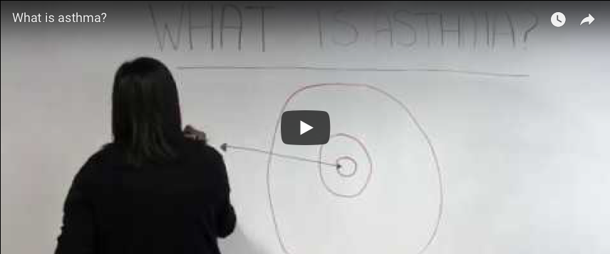
Diagnosis: examples of tools
What is asthma? A short film produced by Asthma UK
Part 3: Practical advice for providing personalised care

Slide 22
Diagnosis: examples of tools
Poster produced by the National Asthma Council Australia available at: What is asthma?
Part 3: Practical advice for providing personalised care

Slide 23
Diagnosis: examples of tools
Diagnostic algorithm from the British guideline on the management of asthma, produced by the British Thoracic Society and available at: BTS guideline on asthma management.
Part 3: Practical advice for providing personalised care

Slide 24
Planning treatment: summary points
Treatment must be planned together with the patient and take account of their priorities and preferences
Set treatment goals together with the patient.
Explain there are different types of inhaler available.
Demonstrate inhaler technique using props.
Identify potential triggers with the patient.
Tailor the treatment plan to take account of the patient’s personal circumstances.
Develop with the patient a written asthma action plan.
Help patients who smoke to quit.
Part 3: Practical advice for providing personalised care

Slide 25
Planning treatment
Treatment needs to be planned together with the patient.
It must take account of their priorities and preferences and their work and family situations.
A patient is more likely to adhere to treatment if they are:
  Believe it is necessary
  Confident it is likely to be effective
  Feel it takes account of their preferences as far as possible
Part 3: Practical advice for providing personalised care

Slide 26
Planning treatment: reflection on practice
Take a few moments to think about the questions you ask patients when you are prescribing treatment for asthma.
  How do you explore what their treatment goals are?
  How do you explore what they preferences are?
  How do you explore factors that might affect whether they adhere to treatment ?
Part 3: Practical advice for providing personalised care

Slide 27
Planning treatment: ask
  How does your asthma affect your daily life now and how would you like to change that?
  Where would you like to be in terms of your asthma in 6 months?
  What type of activities would you like to be able to do?
  What do you think will be important for you in an inhaler (eg how portable it is)?
  What factors could get in the way of using your medication (eg if you have to pay for prescriptions, are you concerned about the cost?)
  Have you used tobacco in the last 12 months, including only occasional use?
Part 3: Practical advice for providing personalised care

Slide 28
Planning treatment: advise
  Explain there are different types of inhaler available and advise which ones would be appropriate
  Explain what spacers are for, discuss if they want or need one and prescribe if appropriate after discussion
  Prime the patient that inhaler technique will be reviewed as a matter of course by saying “we all drift off in our techniques over time, so we will check it with you from time to time.”
  Give examples of potential triggers, eg allergens, exercise, environmental factors.
Part 3: Practical advice for providing personalised care

Slide 29
Planning treatment
Part 3: Practical advice for providing personalised care

Slide 30
Planning treatment: act
  Show the patient sample inhalers
  Demonstrate inhaler technique using props, offer leaflets and videos to assist technique. Training materials for different inhalers and spacers are accessible at this link: www.rightbreathe.com
  Identify potential triggers with the patient
  Tailor the treatment plan to take account of the patient’s personal circumstances, ability and willingness to avoid their asthma triggers
  Develop with the patient a written asthma action plan which explains clearly how to recognise something is going wrong, what to do and when and how to seek help. Example Asthma action plan
  Help patients who smoke to quit. Refer to the IPCRG Desktop Helper available at this link Helping patients quit smoking: brief interventions for healthcare professionals
  At the end of the session, ask the patient to summarise what you have agreed and check that they understand and support this
Part 3: Practical advice for providing personalised care

Slide 31
Planning treatment:examples of tools
The IPCRG Desktop Helper available by clicking on the link Helping patients quit smoking: brief interventions for healthcare professionals.
Part 3: Practical advice for providing personalised care
Notes:
Note this is being simplified – to the 3 As – Ask Advise and Act. Please check on www.ipcrg.org/desktophelpers

Slide 32
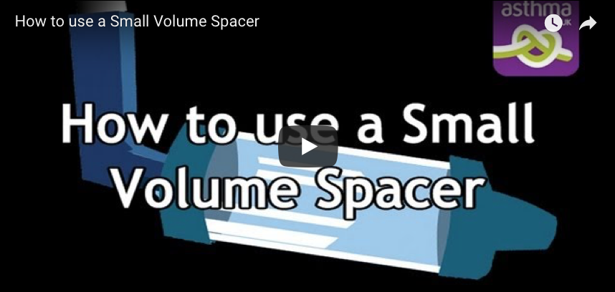
Planning treatment: examples of tools
Video produced by Asthma UK on how to use a small volume spacer
See this link for more training videos on different inhalers and spacers www.rightbreathe.com.
Part 3: Practical advice for providing personalised care

Slide 33
Treatment review: Summary points
Treatment reviews are important opportunities to follow up on how effectively patients are managing their symptoms
  Agree the frequency and format of reviews with the patient
  Ask the patient to bring their own inhaler to the review and check inhaler technique using this
  Use a recognised patient questionnaire to assess symptoms
Enable patients to report if they are not taking their medication as prescribed.
Part 3: Practical advice for providing personalised care

Slide 34
Treatment review
Treatment reviews are important opportunities to follow up on how effectively patients are managing their symptoms
If a patient is not using their medication as prescribed, treatment reviews are an opportunity for clinicians to discuss this with them
It is very important patients are enabled to give their own perspective and describe how they are using medication in their day to day life
This means it is important they have space to talk about how they are managing without feeling they may be judged or rushed.
Part 3: Practical advice for providing personalised care

Slide 35
Treatment review: reflection on practice
Reflect on your own experience of treatment reviews.
What do you as a clinician want to get out of a treatment review?
What purpose do you think they serve for patients?
Part 3: Practical advice for providing personalised care

Slide 36
Treatment review by checklist: a patient’s perspective
“My annual asthma review takes 10 minutes. Every year I see a different nurse. The nurse works through a checklist of questions on the computer and gets me to demonstrate my inhaler technique. There’s no discussion. They might as well send me the checklist to do by myself.”
Part 3: Practical advice for providing personalised care

Slide 37
Treatment review: how to ask
Set the scene so the patient feels able to report if they are not taking their medication as prescribed. For example explain
“Many patients don’t take their medication as outlined in their treatment plan for different reasons. Have you changed your treatment plan?”
Provide constructive feedback to the patient from the perspective of a coach supporting them to reach their goals, rather than judging them.
Part 3: Practical advice for providing personalised care

Slide 38
Treatment review: ask
  How do you feel about your asthma at the moment?
  Did you reach your goals?
  Did you have to adapt your treatment plan?
  Are you using any alternative therapies?
  Have their been any changes in your work or family situation?
Part 3: Practical advice for providing personalised care

Slide 39
Treatment review: action to take
  Agree the frequency and format of reviews with the patient
  Ask the patient to bring their own inhaler to the review and check inhaler technique using this
  Use a recognised patient questionnaire to assess their symptoms. Examples of questionnaires include:
    CARAT (available at: CARAT)
    Asthma Control Test™ (available at: ACT)
    Asthma Control Questionnaire (available at: ACQ)
  Discuss medication usage with the patient to explore if they are over-relying on short-acting beta2agonists(SABA) to manage asthma. The IPCRG Asthma Right Care slide rule and question cards are available by clicking on this link to help with this: Asthma Right Care.
  Monitor treatment performance, including clinical outcomes, patient relevant outcomes and economic impact
  Use asthma review checklists as a way of prompting points of conversation and recording shared decisions but try to avoid this feeling like a tick box episode
If the patient has daily symptoms and regular exacerbations despite apparently using the best treatment, refer to the IPCRG Desktop Helper on Improving care for difficult to manage asthma (available at: Difficult to Manage Asthma)
Part 3: Practical advice for providing personalised care

Slide 40
Treatment review: examples of tools
  The IPCRG Asthma Right Care slide rule and question cards can help explore if the patient is over-relying on short-acting beta2agonists(SABA) to manage asthma. They are available by clicking on this link to help with this: Asthma Right Care.
Part 3: Practical advice for providing personalised care

Slide 41
Treatment review: examples of tools
If the patient has daily symptoms and regular exacerbations despite apparently using the best treatment and using their inhalers correctly, refer to the IPCRG Desktop Helper on Improving care for difficult to manage asthma (available at: Difficult to Manage Asthma)
Uses the SIMPLES method
Part 3: Practical advice for providing personalised care
Notes:
Available in a number of languages at that link

Slide 42
Treatment review: a perspective on patient management
“As clinicians we need to understand and respect that 90% of the time patients with asthma and other chronic conditions are managing their conditions. They may not be managing them as we as clinicians would like, but they are managing them.”
Part 3: Practical advice for providing personalised care

Slide 43
References
Agusti A, et al. (2016) Treatable traits: toward precision medicine of chronic airway diseases. Eur Respir J. 47:410–419
The Health Foundation (2014) Person-centred Care Made Simple.
Horne R, Weinman J. (2002) Self-regulation and self-management in asthma: exploring the role of illness perceptions and treatment beliefs in explaining non-adherence to preventer medication. Psychol Health. 17:17e32
Horne R. (2017)The Human Dimension: Putting the Person into Personalised Medicine, The New Bioethics. 23:1,38-48,
Asthma Right Care: https://www.theipcrg.org/display/TreatP/Asthma+Right+Care+-+Information+for+clinicians+and+patients
NHS England (2016) Improving Outcomes through Personalised Medicine.
Pinnock H. (2015) Supported self-management for asthma. Breathe.11(2):98-109. doi:10.1183/20734735.015614
Wilson SR, et al. (2010) Shared treatment decision making improves adherence and outcomes in poorly controlled asthma. Am J Respir Crit Care Med. 181(6):566–77
A list references for the evidence used to develop this learning resource is available at: www.ipcrg.org/personalisation

Slide 44
Sources of further information
A list of references for the evidence used to develop this learning resource is available at: www.ipcrg.org/personalisation
An IPCRG 2-page desktop helper giving succinct practical advice and a position paper making the case for personalised care are available at: www.ipcrg.org/personalisation
The British guideline on the management of asthma (known as the BTS/SIGN Guideline), which includes diagnostic algorithms and recommended diagnostic tests is available at: https://www.brit-thoracic.org.uk/standards-of-care/guidelines/btssign-british-guideline-on-the-management-of-asthma/
Examples of information resources for patients explaining what asthma is and how it can be managed are available at: https://www.asthma.org.uk/advice/
IPCRG Desktop Helpers providing practical guidance on a range of issues including helping patients quit smoking and difficult to manage asthma are available at: www.ipcrg.org/desktophelpers

Slide 45
Sources of further information
An example asthma Action Plan example is available at https://www.asthma.org.uk/advice/manage-your-asthma/action-plan/
Tools for demonstrating inhaler technique and how to use spacers are available at: www.rightbreathe.com
  Patient questionnaires are available at:
    IPCRG Desktop Helper CARAT: http://www.caratnetwork.org/)
    Asthma Control Test™: http://www.asthmacontroltest.com
    Asthma Control Questionnaire: (Available at: https://www.qoltech.co.uk/acq.html
IPCRG Asthma Right Care tools are available at: https://www.theipcrg.org/display/TreatP/Asthma+Right+Care+-+Information+for+clinicians+and+patients

Slide 46
Evaluating your programme and impact
Participant reactions
Participant use of new knowledge and skills
Impact on participants, practice and service users
Participant learning
Organisational support and change
IPCRG model of education evaluation based on Evaluating Professional Development . T Guskey 2002.
Notes:
Lecture 7 ( Saturday afternoon)

Slide 47
Feedback
Please share how you use these slides with us.
We are particularly interested to know how you evaluate impact.
businessmanager@theipcrg.org

