Slide 1
Asthma Case Studies
Martha
IPCRG received funding from AstraZeneca to develop the Asthma Right Care Initiative

Slide 2
About these slides
Please feel free to use, update and share some or all of these slides in your non-commercial presentations to colleagues or patients
The slides are provided under creative commons licence CC BY-NC-ND.
  BY stands for attribution (the obligation to credit the author and other parties designated for attribution);
  NC stands for NonCommercial (commercial use is excluded from the licence grant);
  ND means NoDerivatives (only verbatim copies of the work can be shared)
When using our slides, please retain the source attribution: IPCRG 2019 Jaime Correia de Sousa, MD, PhD, on behalf of the Asthma Right Care Team

Slide 3
What you will learn
Indicators for, and risks of over-reliance on SABAs
Recommendations for the management of current mild asthma
What is the Asthma Right Care social movement
How social movements can enable large scale change
How you can be part of that change

Slide 4

The patient
Martha is 42 years old
She is a white-collar worker in a service company
She is married with two children
She lives in a modern apartment, without carpets or pets

Slide 5
General medical history
Martha was diagnosed with asthma when she was 5 years old
Her mother and youngest brother both have asthma
She does not have any other comorbidities
Martha does not smoke and nor does her partner

Slide 6
Respiratory history
2 years ago, Martha started inhaled budesonide 200 µg twice daily and she was also prescribed a salbutamol inhaler for symptom relief.
6 months ago Martha was prescribed a salbutamol inhaler during an emergency department visit for her asthma. At this time she was not advised to use her budesonide inhaler.

Slide 7
Current presentation
Martha has booked an appointment as she is “not feeling well”
When specifically questioned, she admits that if she makes small efforts (e.g. walking up the stairs to the third floor) she is short of breath
On the CARAT questionnaire Martha indicates that she has nocturnal respiratory symptoms once or twice a week

Slide 8
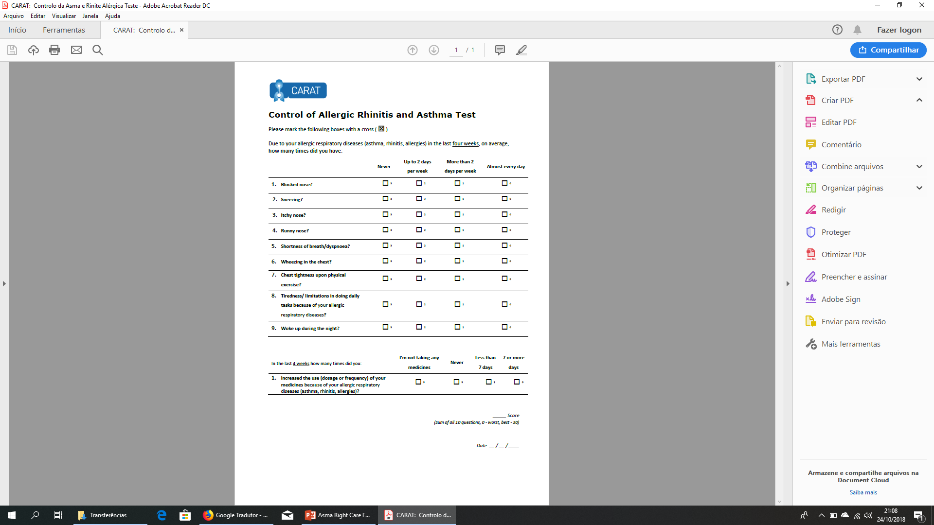
x
x
x
x
x
x
x
x
x
x
x
x
22
x
x
Lourenço O, Calado S, Sá-Sousa A, Fonseca J. Evaluation of allergic rhinitis and asthma control in a Portuguese community pharmacy setting. J Manag Care Spec Pharm. 2014 May;20(5):513-22. http://www.amcp.org/WorkArea/DownloadAsset.aspx?id=18027
CARAT, Control of Allergic Rhinitis and Asthma Test
Available at: https://www.new.caratnetwork.org. Accessed March 2019.
Notes:
CARAT has 10 questions that ask about symptoms during the previous 4 weeks (Table 1). CARAT total score (CARAT-t) ranges from 0 to 30, with a score higher than 24 indicating good overall control. The questionnaire is further divided into 2 sections: the first section relates to allergic rhinitis (CARAT-r), with a score range of 0 to 12 and a value higher than 8 identifying controlled AR; the second section relates to asthma (CARAT-a), with a score range of 0 to 18 and a value of 16 or higher identifying controlled asthma. So:
Total score ≥ 24 (good overall control)
A score ≥ 8 in questions 1 to 4 (good control for upper airways)
A score ≥ 16 in questions 5 to 10 (good control for lower airways)
People in English speaking countries might prefer to use an ACT score instead of CARAT. It’s OK to provide that alternative.

Slide 9
x
x
x
x
x
x
x
x
x
x
x
x
x
x
x
22
x
Lourenço O, Calado S, Sá-Sousa A, Fonseca J. Evaluation of allergic rhinitis and asthma control in a Portuguese community pharmacy setting. J Manag Care Spec Pharm. 2014 May;20(5):513-22. http://www.amcp.org/WorkArea/DownloadAsset.aspx?id=18027
CARAT, Control of Allergic Rhinitis and Asthma Test
Available at: https://www.new.caratnetwork.org. Accessed March 2019.
Notes:
CARAT has 10 questions that ask about symptoms during the previous 4 weeks (Table 1). CARAT total score (CARAT-t) ranges from 0 to 30, with a score higher than 24 indicating good overall control. The questionnaire is further divided into 2 sections: the first section relates to allergic rhinitis (CARAT-r), with a score range of 0 to 12 and a value higher than 8 identifying controlled AR; the second section relates to asthma (CARAT-a), with a score range of 0 to 18 and a value of 16 or higher identifying controlled asthma. So:
Total score ≥ 24 (good overall control)
A score ≥ 8 in questions 1 to 4 (good control for upper airways)
A score ≥ 16 in questions 5 to 10 (good control for lower airways)
People in English speaking countries might prefer to use an ACT score instead of CARAT. It’s OK to provide that alternative.

Slide 10
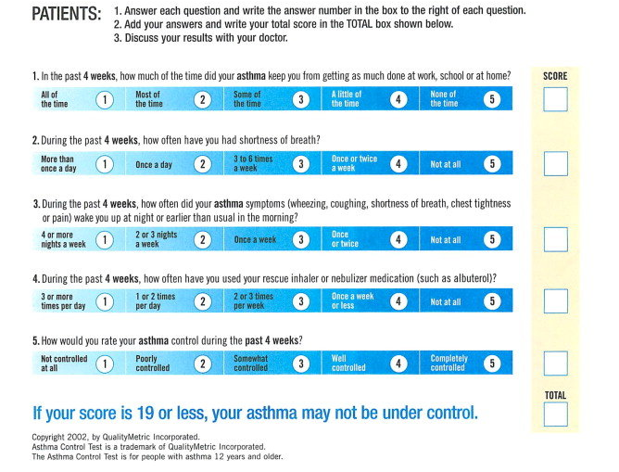
ACT: Asthma Control Questionnaire
Available at: https://www.asthmacontroltest.com/. Accessed March 2019.

Slide 11
Reasons for poor asthma control
Wrong diagnosis or confounding illness
Incorrect choice of inhaler or poor technique
Concurrent smoking
Concomitant rhinitis
Unintentional or intentional nonadherence
Individual variation in treatment response
Under treatment

Slide 12
What are your immediate reactions to Martha’s current presentation?
This is asthma, Martha should continue to use salbutamol whether she feels asthma symptoms
I need to confirm the diagnosis of asthma
I need to check Martha’s inhaler technique
I need to order allergy skin prick tests
I need to review Martha’s medication with her
(there may be more than one right answer)

Slide 13
Clinical considerations
Confirm the diagnosis of asthma
Martha’s diagnosis was made in childhood and may
warrant review
However:
Martha has a medical and family history of asthma
3 years ago Martha underwent spirometry which demonstrated reversible airway obstruction following administration of a bronchodilator
Everything seems to indicate that it is asthma

Slide 14
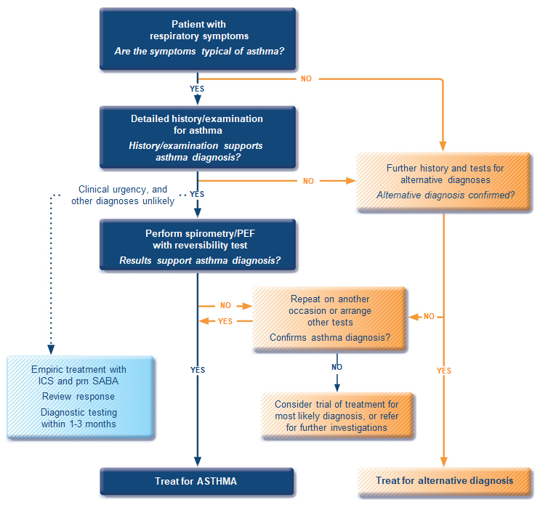
GINA 2018 guidelines for the diagnosis of asthma
ICS, inhaled corticosteroid; PEF, peak expiratory flow; SABA, short-acting beta₂-agonist.
Available at: www.gina.com. Accessed March 2019.

Slide 15
Clinical considerations
Review the medical history
Martha was diagnosed with asthma when she was 5 years old
  From the age of 12 until about 10 years ago she had almost no symptoms
  Martha had symptoms and a new asthma attack after the birth of her youngest daughter when she was 32 years old
When she has an upper airway tract infection, she reports both cough and wheezing
She has no occupational history of relevant exposures
She has no smoking history
She has no pets at home

Slide 16
Clinical considerations
Medication review
Martha reports that last month she used a whole canister of salbutamol that she bought from the pharmacy without prescription
She recognises that she is seldom using budesonide because she thinks salbutamol gives her more relief

Slide 17
Clinical considerations
Evaluation and tests
Spirometry was performed 3 years ago, with a positive result
  A new spirometry should be considered although it is not mandatory for her immediate clinical management
Allergy testing was performed a few years ago and Martha is sensitive to house dust mites (skin prick test and specific IgEs)
  There is no need for further testing at the moment

Slide 18
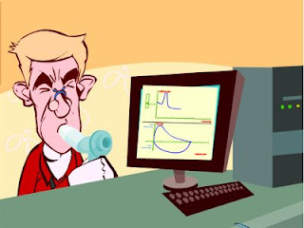
Spirometry
Spirometry measures airflow and lung volumes, and is the preferred lung function test for asthma in primary care
Forced exhalation from a maximal inspiration
FVC: Forced vital capacity | FEV1: Forced Expiratory Volume in 1 second | FEV1/FVC
Volume of air exhaled after full inspiration and full exhalation | Volume of air exhaled in the first second of forced exhalation | Ratio of vital capacity exhaled in 1 second expressed as a percentage of the total volume of air exhaled after full inspiration and full exhalation
For further guidance visit: http://bit.ly/IPCRG-SPIROMETRY-WONCA-2018

Slide 19
Spirometric patterns
FEV1/FVC
FVC
FEV1
Obstruction
N
Restriction
N
N
Mixed
Obstruction and hyperinflation
Mild Obstruction | FEV1 ≥80%
Moderate Obstruction | FEV1 <80% ≥50%
Severe Obstruction | FEV1 <50% ≥35%
Very Severe Obstruction | FEV1 <35%
For further guidance visit: http://bit.ly/IPCRG-SPIROMETRY-WONCA-2018

Slide 20
Quick spirometry assessment
FEV₁ /FVC
≥70%
Normal
<70%
Obstruction
FVC
FVC
< 80% ref value
<80% ref. value
≥80% ref value
Mixed pattern
≥80% ref value
OBSTRUCTION
+ HYPERINFLATION (↑VR)
NORMAL
RESTRICTION
OBSTRUCTION
OBSTRUCTION
+
RESTRICTION
(VR normal)
For further guidance visit: http://bit.ly/IPCRG-SPIROMETRY-WONCA-2018

Slide 21
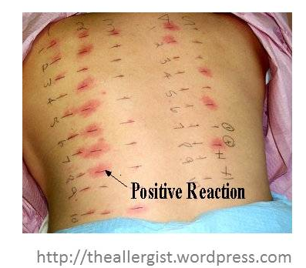
Allergy testing and how to interpret the results
Skin prick test is the most sensitive test for allergies
  Suspected allergens are mixed with liquid to form a solution
  Drops are placed on the skin surface
  The top surface of the skin is pricked beneath each drops
  A positive reaction is indicated by reddening, itch and swelling

Slide 22
Clinical considerations
Inhaler technique
As Martha is using two inhalation devices with different inhalation techniques it is possible that they are not being properly used
Martha’s inhaler technique should be reviewed at all appointments
Martha should be asked to bring her own inhalers to the appointments

Slide 23
How to review inhalation technique
Ask the patient beforehand to bring their own inhaler for the consultation
Ask them to demonstrate how they use their inhaler
Correct some aspects and explain why
If possible use videos
    Observe technique and let the patient observe self (using video demonstrations)
Show you are available to review their technique if necessary
Ask the patient to bring their own inhaler for the next appointment
Notes:
Resources for reviewing inhaler technique:
Asthma review series: Part 3 - Inhaler Technique and Recording Peak Flow. Available at: https://www.youtube.com/watch?v=ZhIcT57i32g
Asthma inhaler techniques (children). Available at: https://www.youtube.com/watch?v=fHcG8DXUwdQ
Asthma: inhaler techniques: Available at: https://www.nhs.uk/Video/Pages/Childrensasthmainhaler.aspx

Slide 24
Management
Discuss with the patient
Shared decision on disease management is critical to treatment success
There is a need to review with Martha several aspects of her condition
Asthma as an airways inflammatory disease
Therapeutic goals
The role of each drug
How and when to use them
Martha’s fears and expectations regarding medication
Martha’s beliefs relating to the treatment effects
Any financial difficulties for buying inhalers

Slide 25

Question cards

Slide 26
Management
Medication adjustment
Martha remembers that her family doctor told her about the need to use budesonide, but she forgets to do it and anyway she prefers salbutamol

Slide 27
Would you propose any medication adjustment?
To continue to use salbutamol whenever she feels asthma symptoms?
To use budesonide 200 µg twice daily (as previously prescribed) + salbutamol whenever she feels asthma symptoms?
To replace budesonide with budesonide / formoterol in the same inhaler twice daily + salbutamol inhaler whenever she feels asthma symptoms?
To replace budesonide with budesonide / formoterol in the same inhaler twice daily + when needed?
To use budesonide 200 µg twice daily (as prescribed previously) and prescribe budesonide / formoterol in the same inhaler to be used when needed?

Slide 28
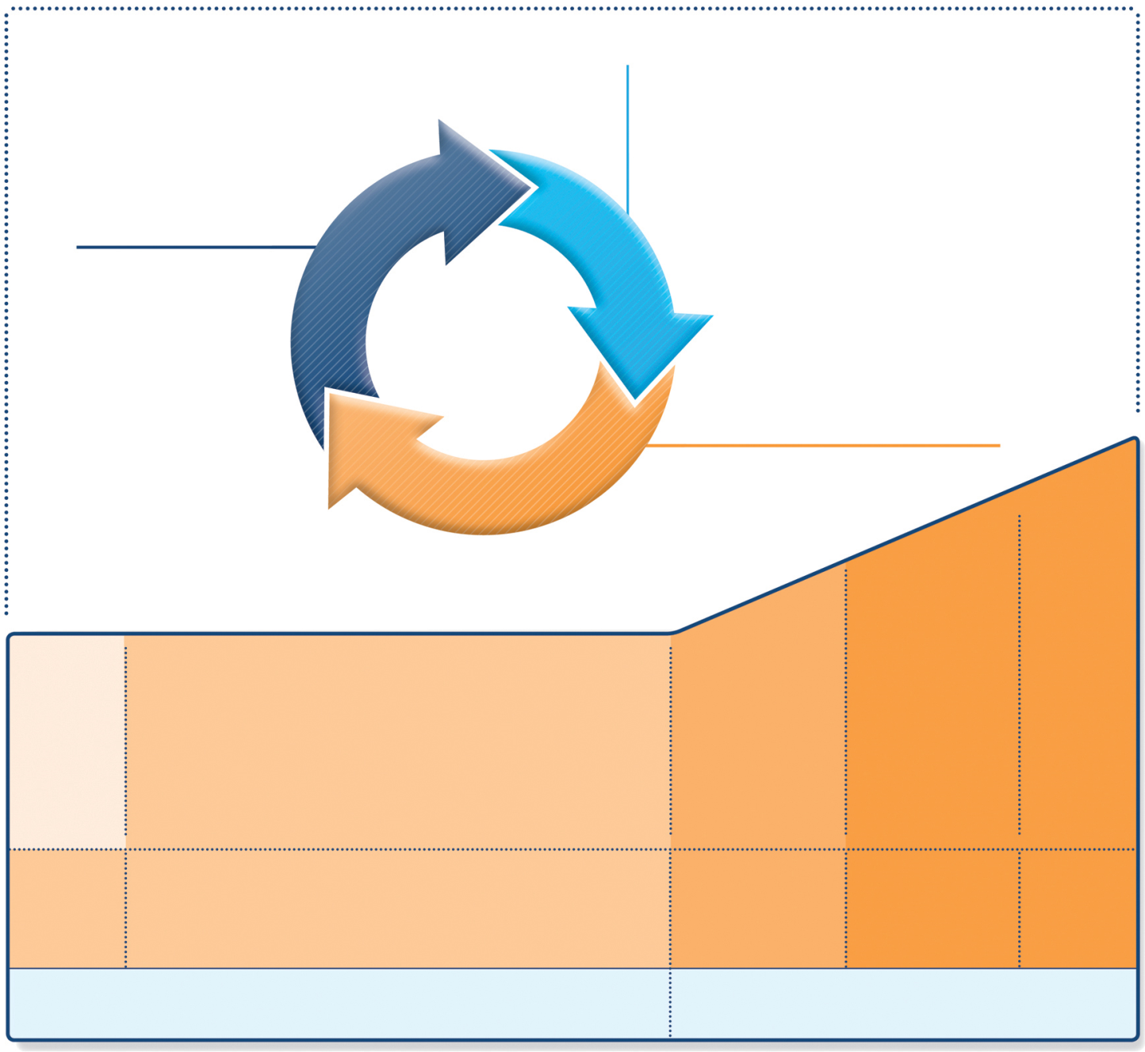
GINA 2018
Diagnosis
Symptom control & risk factors
(including lung function)
Inhaler technique & adherence
Patient preference
REVIEW RESPONSE
ASSESS
Symptoms
Exacerbations
Side-effects
Patient satisfaction
Lung function
ADJUST TREATMENT
Asthma medications
Non-pharmacological strategies
Treat modifiable risk factors
STEP 5
STEP 4
STEP 3
Refer for add-on treatment
e.g.
tiotropium,* anti-IgE,
anti-IL5*
*Not for children <12 years
**For children 6-11 years, the preferred Step 3 treatment is medium dose ICS
#For patients prescribed BDP/formoterol or BUD/ formoterol maintenance and reliever therapy
 Tiotropium by mist inhaler is an add-on treatment for patients ≥12 years with a history of exacerbations
PREFERRED
CONTROLLER
CHOICE
STEP 1
STEP 2
Med/high
ICS/LABA
Low dose ICS
Low dose
ICS/LABA**
Other
controller
options
Consider low dose ICS
Leukotriene receptor antagonists (LTRA)
Low dose theophylline*
Med/high dose ICS
Low dose ICS + LTRA
(or + theoph*)
Add tiotropium*
Med/high dose
ICS + LTRA
(or + theoph*)
Add low
dose OCS
RELIEVER
As-needed short-acting beta²-agonist (SABA)
As-needed SABA or
low dose ICS/formoterol#
Available at: www.gina.com. Accessed March 2019.

Slide 29
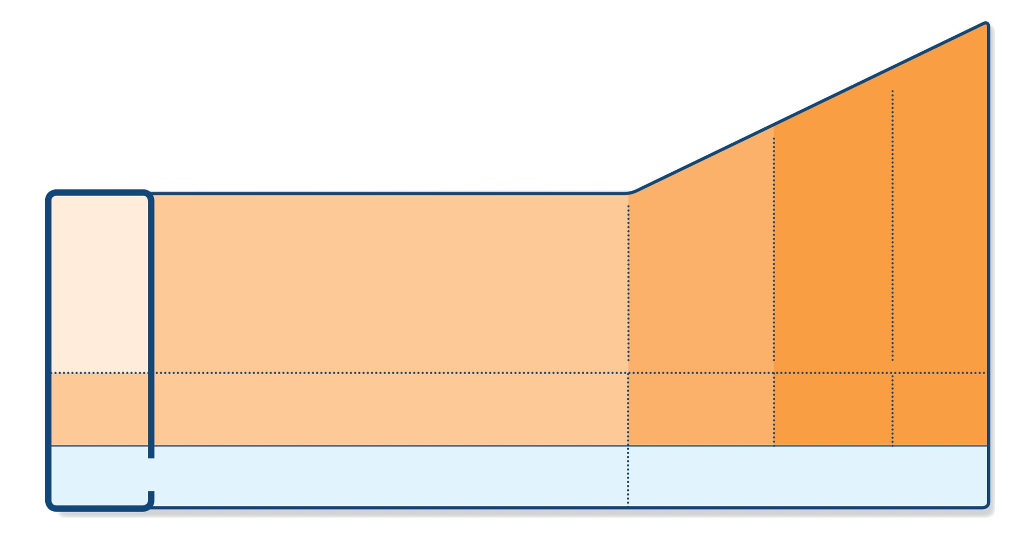
GINA 2018: Step 1
As-needed reliever inhaler
Preferred option: as-needed inhaled short-acting beta₂-agonist (SABA)
  SABAs are highly effective for relief of asthma symptoms
  However, there is insufficient evidence about the safety of treating asthma with SABA alone so this option should be reserved for patients with infrequent symptoms (less than twice a month) of short duration, and with no night wakening and normal lung function
Other options:
  Consider adding regular low dose ICS for patients at risk of exacerbations
STEP 5
STEP 4
PREFERRED
CONTROLLER
CHOICE
STEP 1
STEP 2
STEP 3
Refer for
add-on treatment
e.g.
tiotropium,* anti-IgE,
anti-IL5*
Med/high
ICS/LABA
Low dose
ICS/LABA**
Low dose ICS
Other
controller
options
Consider low dose ICS
Leukotriene receptor antagonists (LTRA)
Low dose theophylline*
Med/high dose ICS
Low dose ICS+LTRA
(or + theoph*)
Add tiotropium*
High dose ICS
+ LTRA
(or + theoph*)
Add low
dose OCS
As-needed short-acting beta₂-agonist (SABA)
As-needed SABA or
low dose ICS/formoterol#
RELIEVER
ICS, inhaled corticosteroid; SABA, short-acting beta₂-agonist.
Available at: www.gina.com. Accessed March 2019.

Slide 30
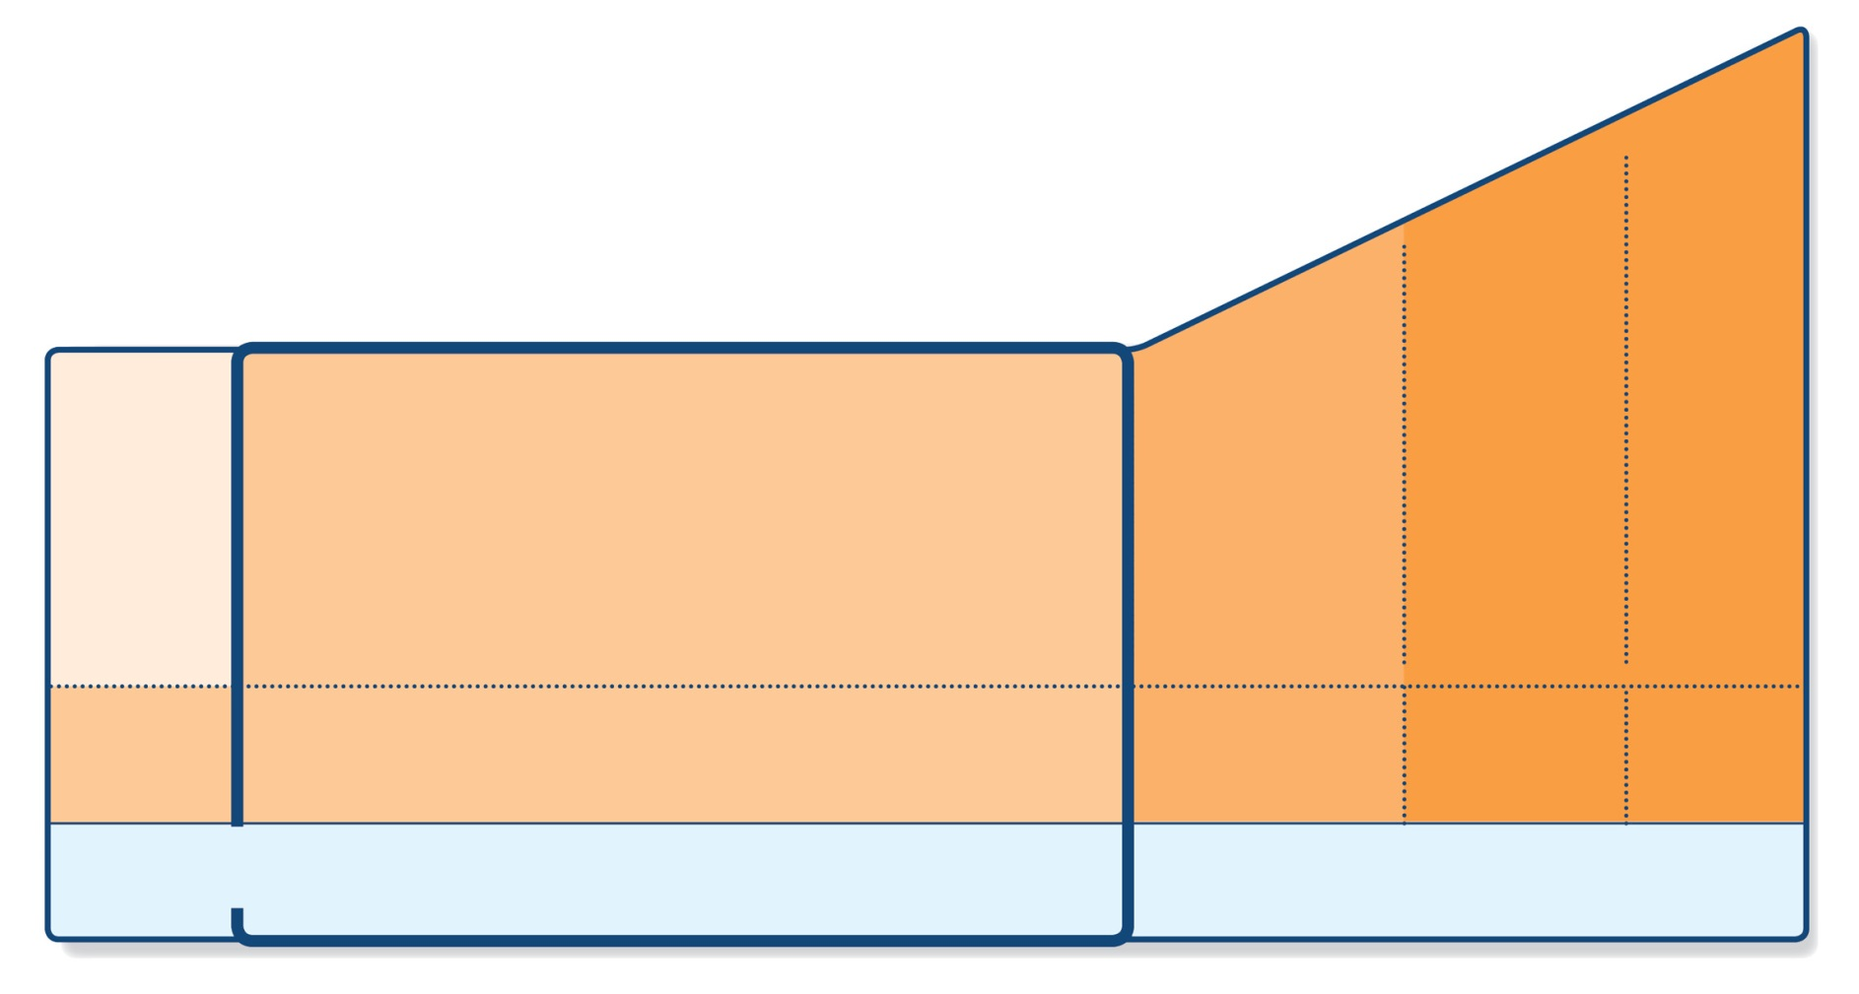
GINA 2018: Step 2
Low-dose controller + as-needed reliever
Preferred option: regular low dose ICS with as-needed SABA
  Low dose ICS reduces symptoms and reduces risk of exacerbations and asthma-related hospitalization and death
Other options:
  Leukotriene receptor antagonists (LTRA) with as-needed SABA
  Combination low dose ICS/long-acting beta₂-agonist (LABA)
  with as-needed SABA
  Intermittent ICS with as-needed SABA for purely seasonal allergic asthma with no interval symptoms
STEP 5
STEP 4
PREFERRED
CONTROLLER
CHOICE
STEP 1
STEP 2
STEP 3
Refer for
add-on treatment
e.g.
tiotropium,* anti-IgE,
anti-IL5*
Med/high
ICS/LABA
Low dose
ICS/LABA**
Low dose ICS
Other
controller
options
Consider low dose ICS
Leukotriene receptor antagonists (LTRA)
Low dose theophylline*
Med/high dose ICS
Low dose ICS+LTRA
(or + theoph*)
Add tiotropium*
High dose ICS
+ LTRA
(or + theoph*)
Add low
dose OCS
As-needed short-acting beta₂-agonist (SABA)
As-needed SABA or
low dose ICS/formoterol#
RELIEVER
ICS, inhaled corticosteroid; SABA, short-acting beta₂-agonist.
Available at: www.gina.com. Accessed March 2019.

Slide 31
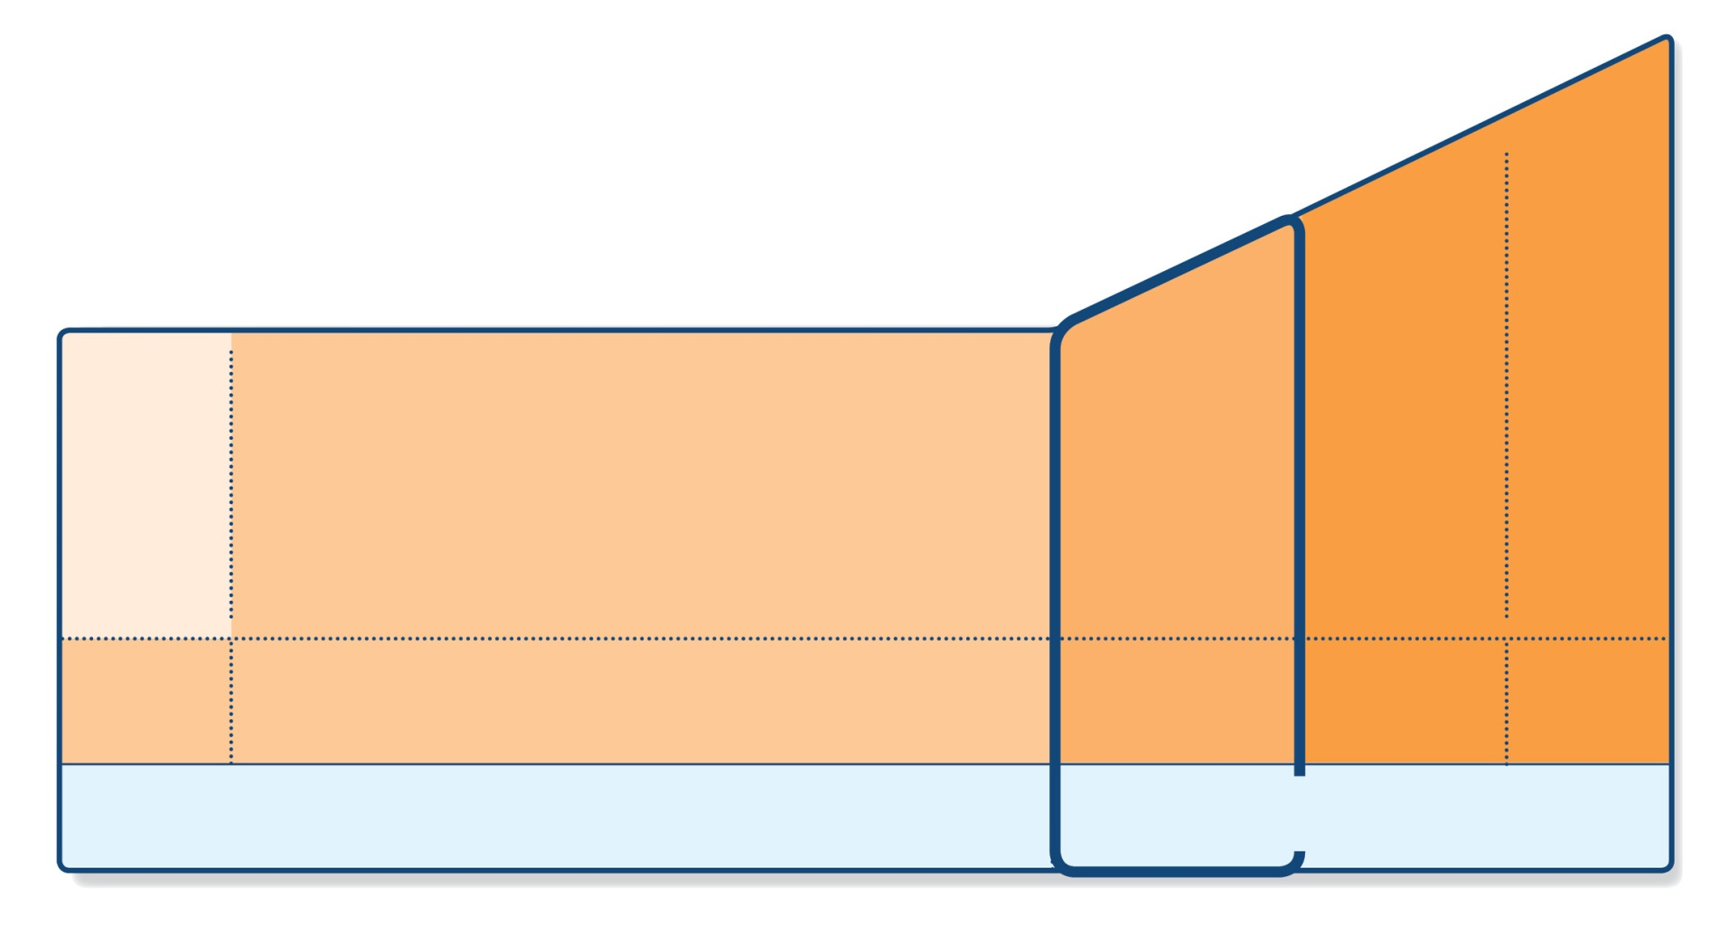
GINA 2018: Step 3
One or two controllers + as-needed reliever
Before considering step-up check inhaler technique and adherence, confirm diagnosis
Adults/adolescents: preferred options are either combination low dose ICS/LABA maintenance with as-needed SABA, OR combination low dose ICS/formoterol maintenance and reliever regimen*
  Adding LABA reduces symptoms and exacerbations and increases FEV₁, while allowing lower dose of ICS
  In at-risk patients, maintenance and reliever regimen significantly reduces exacerbations with similar level of symptom control and lower ICS doses compared with other regimens
Children 6-11 years: preferred option is medium dose ICS with as-needed SABA
Other options
  Adults/adolescents: Increase ICS dose or add LTRA or theophylline (less effective than ICS/LABA)
  Adults: consider adding SLIT (see Non-pharmacological interventions)
  Children 6-11 years – add LABA (similar effect as increasing ICS)
STEP 5
STEP 4
PREFERRED
CONTROLLER
CHOICE
STEP 1
STEP 2
STEP 3
Refer for
add-on treatment
e.g.
tiotropium,* anti-IgE,
anti-IL5*
Med/high
ICS/LABA
Low dose
ICS/LABA**
Low dose ICS
Other
controller
options
Consider low dose ICS
Leukotriene receptor antagonists (LTRA)
Low dose theophylline*
Med/high dose ICS
Low dose ICS+LTRA
(or + theoph*)
Add tiotropium*
High dose ICS
+ LTRA
(or + theoph*)
Add low
dose OCS
As-needed short-acting beta₂-agonist (SABA)
As-needed SABA or
low dose ICS/formoterol#
RELIEVER
*Approved only for low dose beclometasone/formoterol and low dose budesonide/formoterol
ICS, inhaled corticosteroid; LABA, long-acting bronchodilator; SABA, short-acting beta₂-agonist.
Available at: www.gina.com. Accessed March 2019.

Slide 32
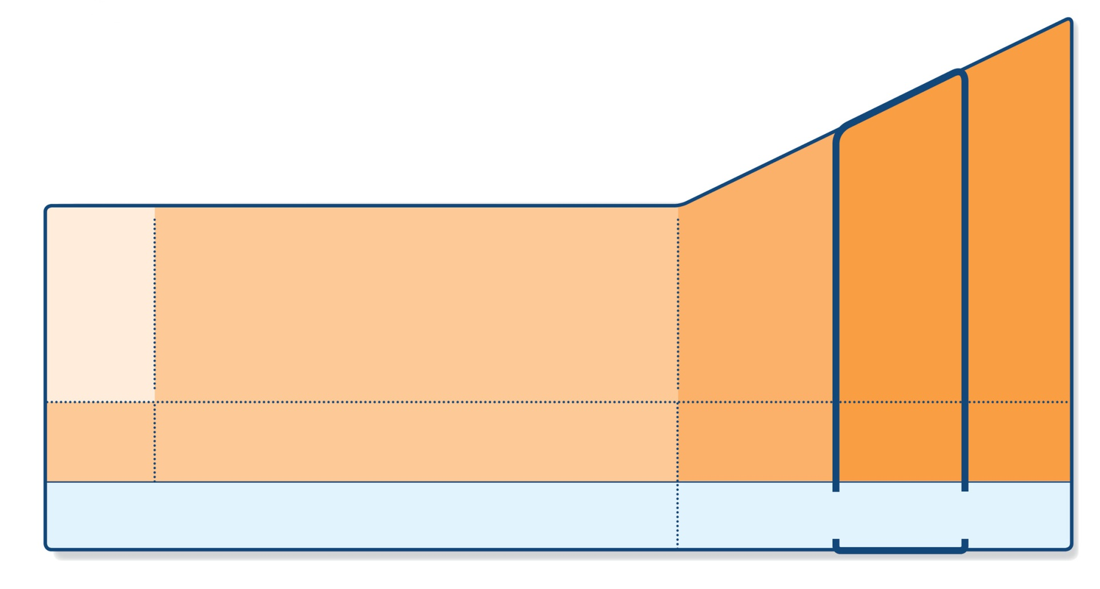
GINA 2018: Step 4
Two or more controllers + as-needed reliever
Before considering step-up check inhaler technique and adherence
Adults or adolescents: preferred option is combination low dose ICS/formoterol as maintenance and reliever regimen*, OR combination medium dose ICS/LABA with as-needed SABA
Children 6–11 years: preferred option is to refer for expert advice
Other options (adults or adolescents)
  Tiotropium by mist inhaler may be used as add-on therapy for patients aged ≥12 years with a history of exacerbations
  Adults: consider adding SLIT
  Trial of high dose combination ICS/LABA, but little extra benefit and increased risk of side-effects
  Increase dosing frequency (for budesonide-containing inhalers)
  Add-on LTRA or low dose theophylline
STEP 5
STEP 4
PREFERRED
CONTROLLER
CHOICE
STEP 1
STEP 2
STEP 3
Refer for
add-on treatment
e.g.
tiotropium,* anti-IgE,
anti-IL5*
Med/high
ICS/LABA
Low dose
ICS/LABA**
Low dose ICS
Other
controller
options
Consider low dose ICS
Leukotriene receptor antagonists (LTRA)
Low dose theophylline*
Med/high dose ICS
Low dose ICS+LTRA
(or + theoph*)
Add tiotropium*
High dose ICS
+ LTRA
(or + theoph*)
Add low
dose OCS
As-needed short-acting beta₂-agonist (SABA)
As-needed SABA or
low dose ICS/formoterol#
RELIEVER
*Approved only for low dose beclometasone/formoterol and low dose budesonide/formoterol
ICS, inhaled corticosteroid; LABA, long-acting bronchodilator; SABA, short-acting beta₂-agonist.
Available at: www.gina.com. Accessed March 2019.

Slide 33
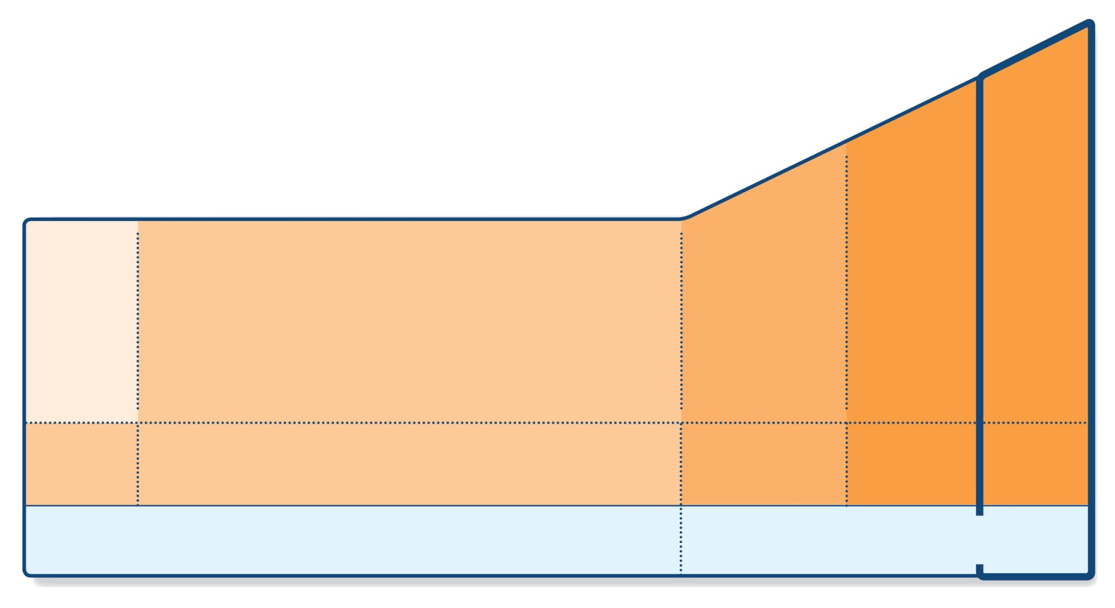
GINA 2018: Step 5
Higher level care and/or add-on treatment
Preferred option is referral for specialist investigation and consideration of add-on treatment
  If symptoms uncontrolled or exacerbations persist despite Step 4 treatment, check inhaler technique and adherence before referring
  Add-on tiotropium for patients ≥12 years with history of exacerbations
  Add-on anti-IgE (omalizumab) for patients with severe allergic asthma
  Add-on anti-IL5 (mepolizumab (SC) or reslizumab (IV)) for severe eosinophilic asthma (≥12 yrs)
Other add-on treatment options at Step 5 include:
  Sputum-guided treatment: this is available in specialized centers; reduces exacerbations and/or corticosteroid dose
  Add-on low dose oral corticosteroids (≤7.5mg/day prednisone equivalent): this may benefit some patients, but has significant systemic side-effects. Assess and monitor for osteoporosis
STEP 5
STEP 4
PREFERRED
CONTROLLER
CHOICE
STEP 1
STEP 2
STEP 3
Refer for
add-on treatment
e.g.
tiotropium,* anti-IgE,
anti-IL5*
Med/high
ICS/LABA
Low dose
ICS/LABA**
Low dose ICS
Other
controller
options
Consider low dose ICS
Leukotriene receptor antagonists (LTRA)
Low dose theophylline*
Med/high dose ICS
Low dose ICS+LTRA
(or + theoph*)
Add tiotropium*
High dose ICS
+ LTRA
(or + theoph*)
Add low
dose OCS
As-needed short-acting beta₂-agonist (SABA)
As-needed SABA or
low dose ICS/formoterol#
RELIEVER
*Approved only for low dose beclometasone/formoterol and low dose budesonide/formoterol
ICS, inhaled corticosteroid; LABA, long-acting bronchodilator; SABA, short-acting beta₂-agonist.
Available at: www.gina.com. Accessed March 2019.

Slide 34
Thoughts on medication adjustment having reviewed current guidelines?
To continue to use salbutamol whenever she feels asthma symptoms?
To use budesonide 200 µg twice daily (as previously prescribed) + salbutamol whenever she feels asthma symptoms?
To replace budesonide with budesonide / formoterol in the same inhaler twice daily + salbutamol inhaler whenever she feels asthma symptoms?
To replace budesonide with budesonide / formoterol in the same inhaler twice daily + when needed?
To use budesonide 200 µg twice daily (as prescribed previously) and prescribe budesonide / formoterol in the same inhaler to be used when needed?

Slide 35
Management
The new plan
Obtain Martha’s agreement to take her medications as prescribed
Provide Martha with a written action plan that has been developed and agreed on together

Slide 36
Written Personalised Asthma Action Plan (PAAP)
Written PAAP
A written PAAP is an essential part of managing long-term disease¹
SIGN-BTS recommend that all people with asthma should be offered self-management education which includes a written AAP²
  In addition, GINA also highlights the importance of supporting long-term asthma management³
  These recommendations are based on literature reviews that show that supported PAAPs improve asthma control, reduce exacerbations and improve quality of life^{2,3}
Why are they useful?
  Pinpoint signs that the asthma is getting worse⁴
  Keep track of when to take medicines⁴
  Aid daily monitoring as well as long-term control⁴
  Provide information on what to do in the event of an asthma attack⁴
  The overall aim of a written PAAP is to help take early action to prevent or reduce the severity of asthma attack symptoms⁴
GINA, Global Initiative for Asthma; PAAP, personalised asthma action plan; SIGN-BTS, Scottish Intercollegiate Guidelines Network- British Thoracic Society.
1. Gibson PG, et al. Thorax 2004;59:94–99; 2. SIGN-BTS. British guideline on the management of asthma. Consultation 2016; 3. GINA Strategy for asthma management and prevention 2016; 4. Pinnock H. Breathe 2015;11:98–109.

Slide 37
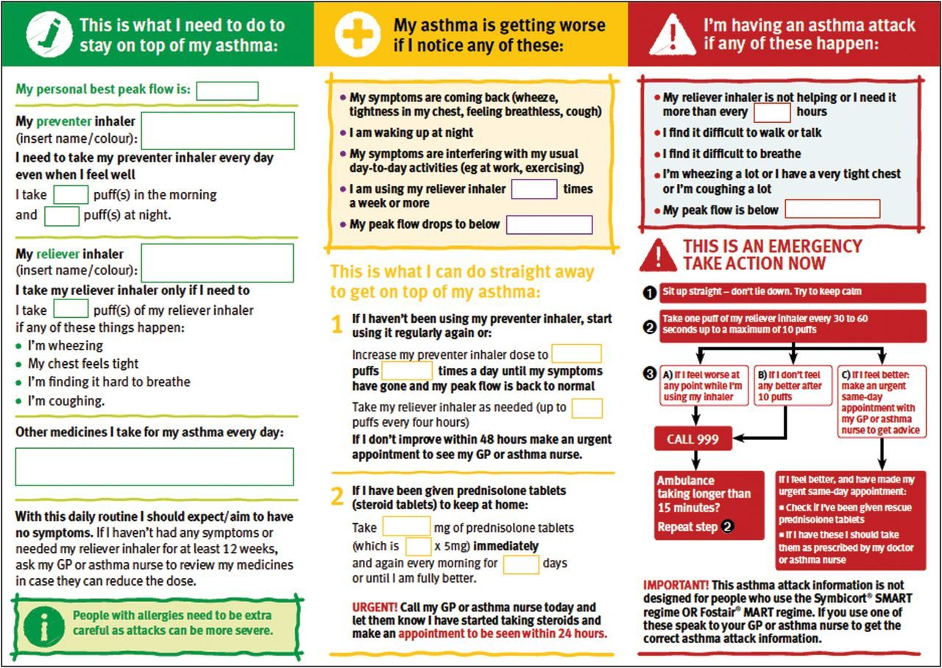
PAAP example for adults
Hilary Pinnock. Supported self-management for asthma. Breathe (Sheff). 2015 Jun; 11(2): 98–109. doi: 10.1183/20734735.015614 https://www.ncbi.nlm.nih.gov/pmc/articles/PMC4487370/pdf/EDU-0156-2014.pdf

Slide 38
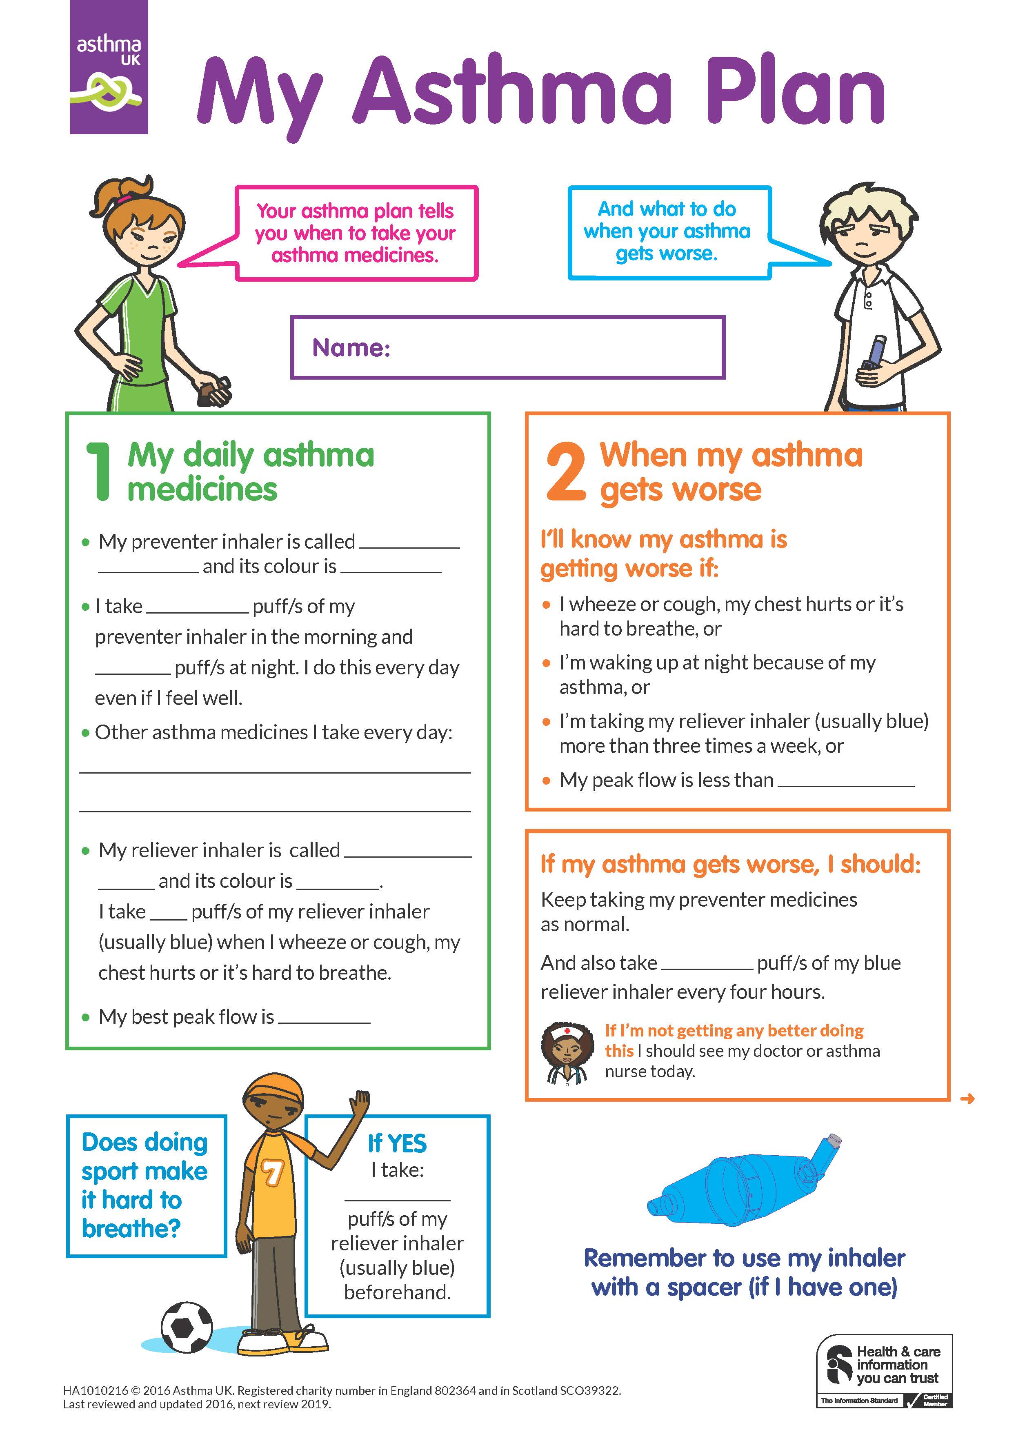
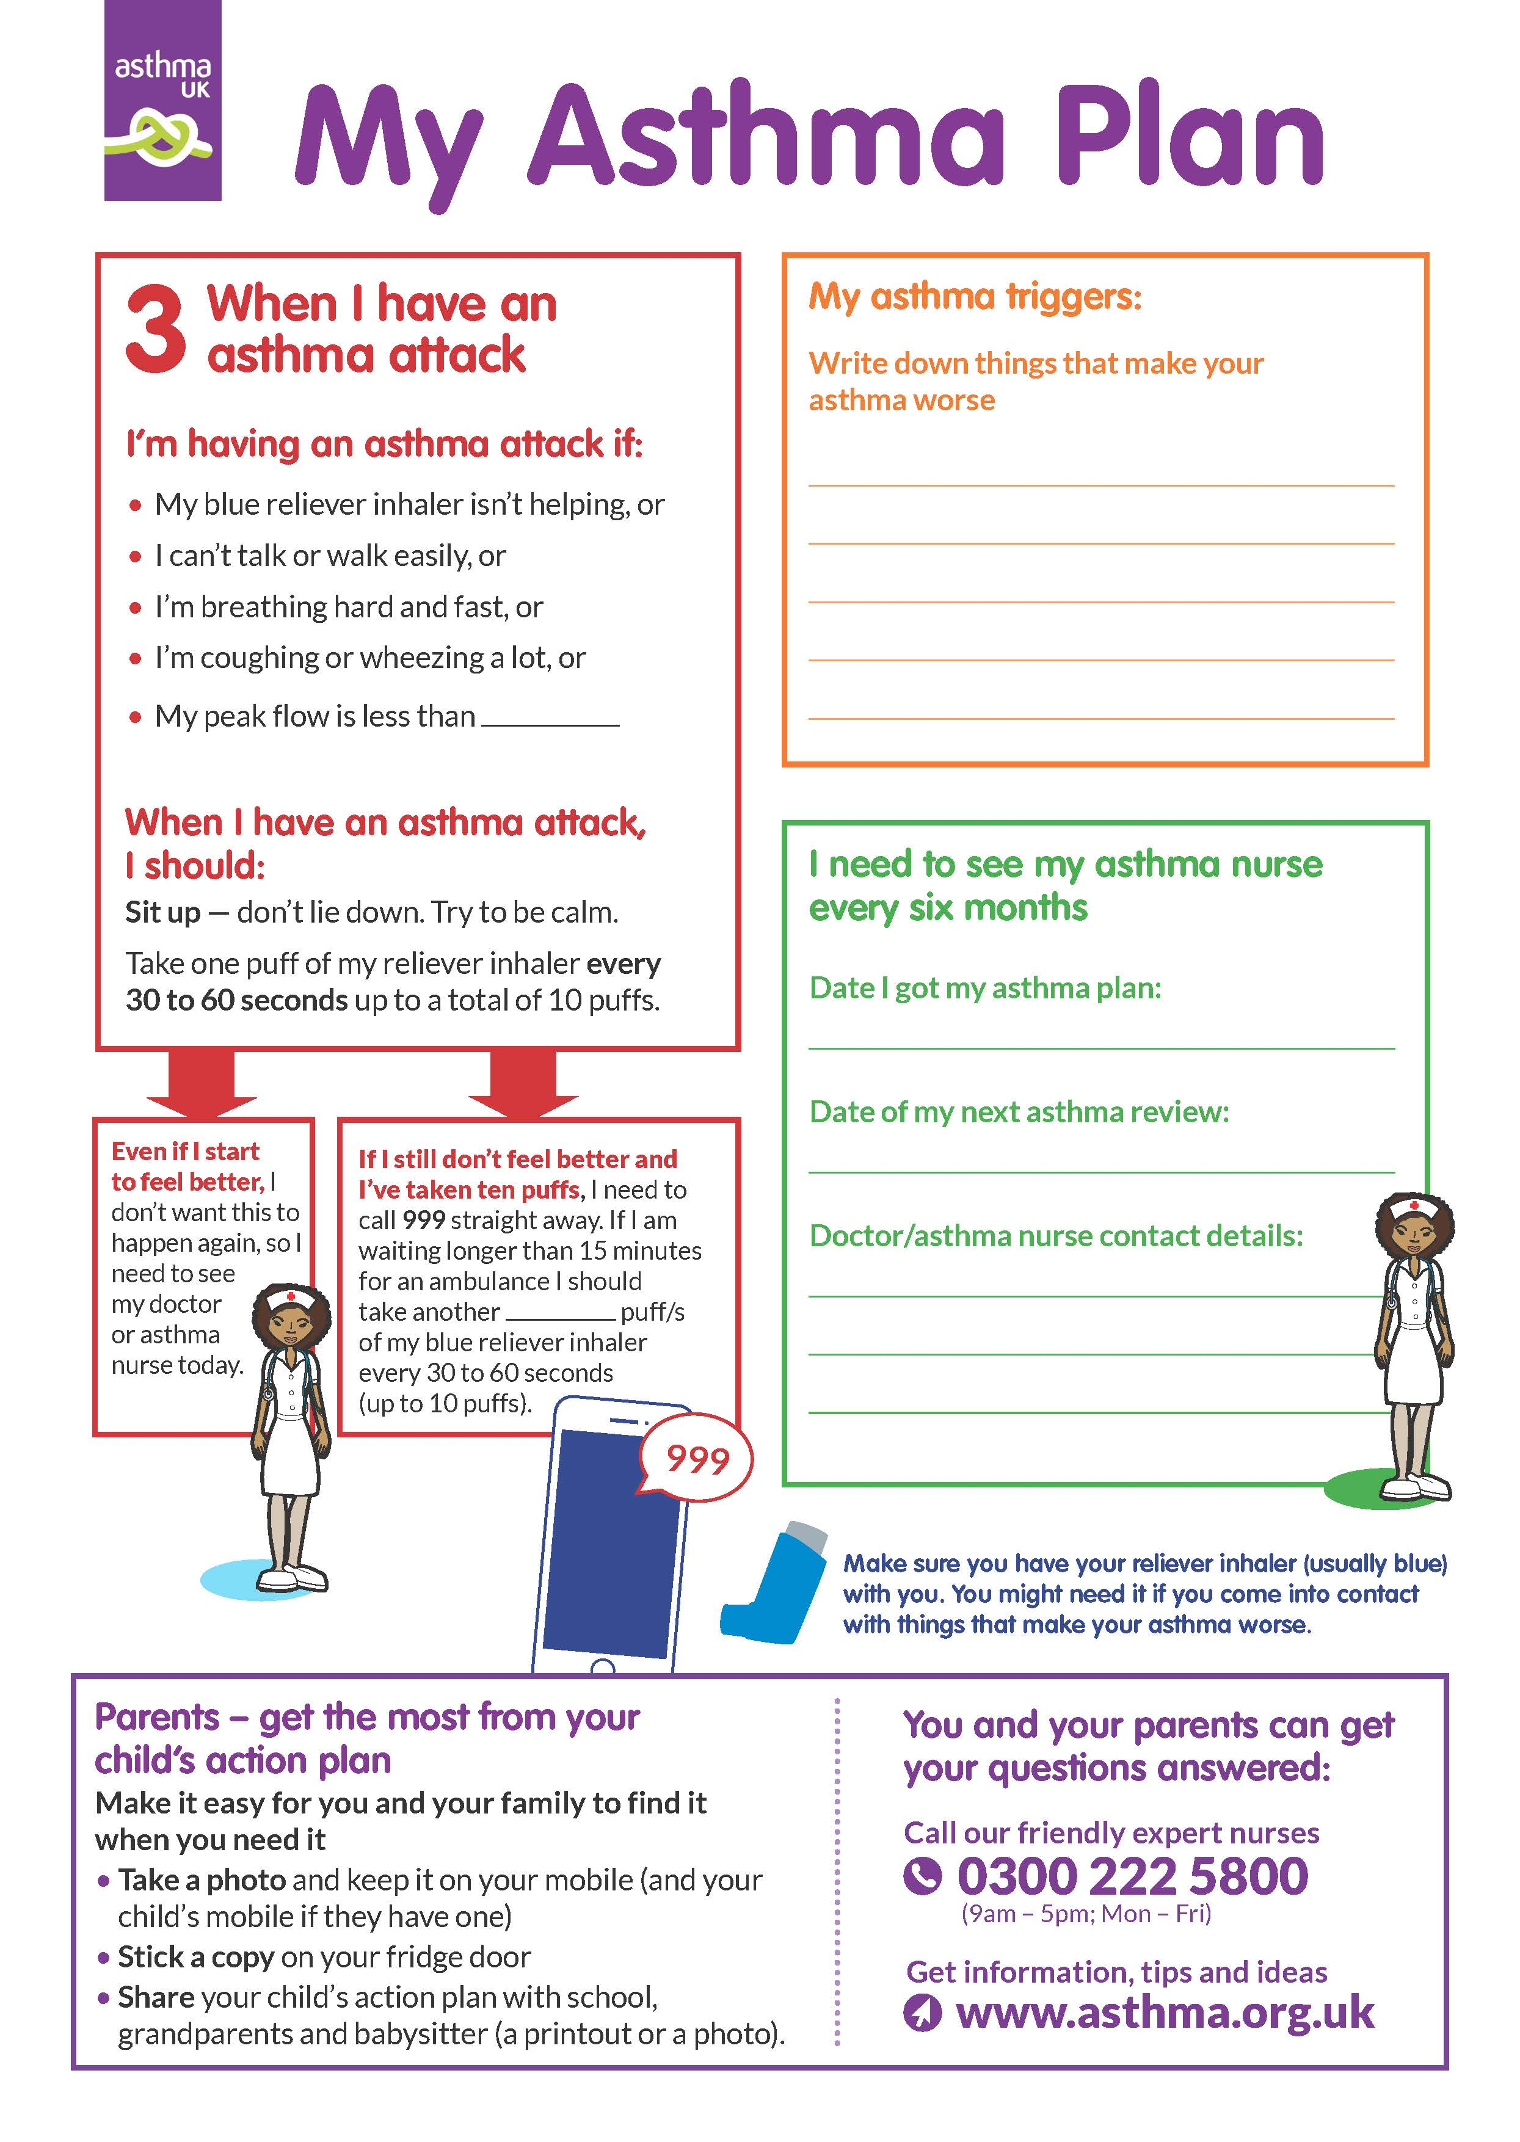
PAAP example for children
Child Asthma Action Plan
Available at: https://www.asthma.org.uk/def9655d/globalassets/health-advice/resources/children/child-asthma-action-plan.pdf . Accessed March 2019.

Slide 39
Steps to help Martha live better with her asthma
Identify symptom triggers
Advise Martha to avoid smoky environments
Recommend regular physical exercise
Suggest a review of inhaler technique at all future consultations

Slide 40








Key asthma triggers
Psychological
triggers³
Air pollution¹
Medications*³
Exposure to bacteria²
House dust mites⁶
Smoking^{3,4}
Flowers/pollen³
Household pets^{3,4}
Exercise⁵
Alcohol³
Air-conditioning³
URTI³
URTI = upper respiratory tract infection
*Beta-blockers and non-steroidal anti-inflammatory drugs.
1. Esposito S, et al. BMC Pulm Med 2014;14:130; 2. Beigelman A, et al. Curr Opin Allergy Clin Immunol 2014;14:137–142; 3. See K, et al. Singapore Med J 2015 epub; 4. Vernon M, et al. J Asthma 2012;49:991–998; 5. Global Initiative for Asthma. Global Strategy for Asthma Management and Prevention, 2016. Available from: www.ginasthma.org; 6. Lim FL, et al. PLoS One 2015;10:e0124905.

Slide 41
Asthma Right Care: a movement for Global Change
Movement for Global Change
IPCRG received funding from AstraZeneca to develop the Asthma Right Care Initiative

Slide 42
Every system is perfectly designed to get the results it gets
(Earl Conway and Paul Batalden)
That is, both intended and unintended consequences are designed into our systems
Notes:
Both intended and unintended consequences are designed into our systems

Slide 43

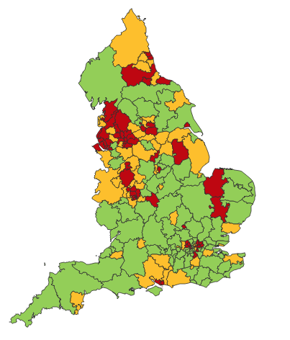

Making a case for change
Asthma illustrates all 5 global healthcare problems (Sir Muir Gray):
Unwarranted variation
Harm, even when quality is high (over-diagnosis, over-treatment)
Failure to prevent disease and disability
Waste of human and physical resources through low value activity
Inequity
And new challenges are forming:
Financial constraints
Rising expectations of personalised care
Climate change/pollution
Increasing need
PHE Fingertips data Asthma admissions per 1000 population 2012/13 data
Notes:
Unwarranted variation as defined by Wennberg: Variation in utilization of health care services that cannot be explained by variation in patient illness or patient preferences
http://www.nhsconfed.org/~/media/Confederation/Files/Events/ACE15/1430%20Inaugural%20NHS%20value%20lecture.pdf

Slide 44
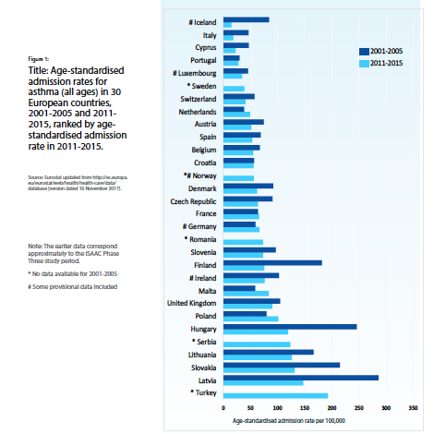
Change for improvement starts with “hunches”
Use of SABA in asthma in need of major improvement
  Over-reliance, but how to define?
  Note choice of language: not ”use” but “reliance” = type of dependency
1st conversations about SABAs may effect future use
  Occur in many places eg community pharmacies, EDs, GP/FP
  We need to know more about these
Asthma is low priority for change in general HCP despite evidence of
  unwarranted variation in outcomes
  avoidable mortality, morbidity and healthcare utilisation
  education programmes
Need to want to change for messages about
asthma improvement to be received & adopted
Let’s apply the evidence about achieving change at scale
Start to disrupt comfort with the current state!
Then when people accept there’s room for improvement,
move on to addressing underuse of ICS
Global Asthma Report 2018
http://globalasthmareport.org/Global%20Asthma%20Report%202018.pdf
Notes:
Hunches - this is a proven improvement technique

Slide 45

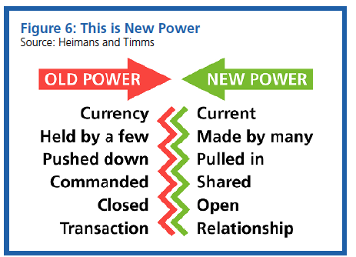
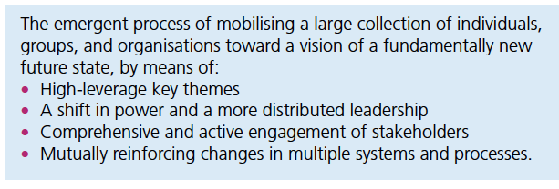
Our approach: evidence about
1. Right Care. Lancet Series 2017
2. Leading large scale change
“Many countries struggle with the question about sustainability, fairness, and equity of their health systems. With the focus firmly on universal health coverage as a central part to the UN Sustainable Development Goals, there is an opportunity to examine how to achieve optimum access to, and delivery of, health care and services. Underuse and overuse of medical and health services exist side-by-side with poor outcomes for health and wellbeing.
This Series ….provides a framework to begin to address overuse and underuse together to achieve the right care for health and wellbeing. The authors argue that achieving the right care is both an urgent task and an enormous opportunity.”
Nesta 2017. We change the world: what can we learn from global social movements for health?
Notes:
NHS cares for 65 million people. Sees more than 1million people every 36 hours.
NHS England. Sustainable Improvement and Horizons Team 2017. Leading large scale change: a practical guide.

Slide 46
Richard Horton, Editor, the Lancet 2017
What is right care? …. it is care that weighs up benefits
and harms, is patient-centred (taking individual circumstances, values, and wishes into account), and is informed by evidence, including cost-effectiveness. ….acknowledge that most medical services fall into a grey zone where the benefit and harm ratio for a given individual is unknown. However, an important start is to think about, and aim to influence, the drivers of poor, unnecessary, and harmful care. The authors argue that these drivers fall into three important categories: [1] money, finance, and organisations; [2] knowledge, beliefs, assumptions, bias, and uncertainty; and [3] power and human relationships.
https://www.thelancet.com/journals/lancet/article/PIIS0140-6736(16)32588-0/fulltext
Notes:
UHC and health security are two sides of the same coin. This was painfully apparent during the west African Ebola outbreak of 2014–15, when the perceived lack of quality led to community distrust in the health system, decreased utilisation of services, and an increase in morbidity and mortality from non-Ebola conditions...

Slide 47
Our case for change
“It is time to refocus attention on asthma because the total burden of disease in terms of quality of life is high yet avoidable and there is significant unwarranted variation and waste.
Only ≅ 40% of people take their prescribed treatment
Of whom only ≅ 30% then use it right
So only ≅12% are taking the right treatment right
Therefore the value of investment is severely compromised.”
BTS/SIGN Asthma 2016
Chrystyn, H., et al. (2017). "Device errors in asthma and COPD: systematic literature review and meta-analysis." NPJ Prim Care Respir Med 27(1): 22

Slide 48
What is Right Care?
Our working definitions
Doing the right things and only the right things in the right way for the right people at the right time in the right place, whatever that means in the local context
Improving the value that each person with asthma derives from their own care and treatment and the value the whole population derives from the investment in asthma care by addressing unwarranted variation; reducing waste, avoidable harm and avoidable symptoms

Slide 49
Aim
Scope
To sort asthma care once and for all for the person with asthma and for the healthcare system so that there is no unwarranted variation, and no avoidable waste or harm*.
That is
We can and should do better by getting it right first time!
The pathway from the first time someone (adult or parent) is offered a SABA, wherever that is, through to all possibilities (existing and new) for review
Phase 1: SABA use
*waste is waste of human, financial, health facility, energy and pharmacological assets.

Slide 50
What is the best single measure for our aim of asthma right care? Ultimately….
A shift in the practice average ratio of reliever:inhaled corticosteroid inhalers prescribed in a year, where the ideal ratio is 1:6 but is currently more likely to be 2:1

Slide 51
Asthma Right Care as a social movement
It’s all about the FOLLOWERS: We need to get the right people engaged, who will connect through the right channels to engage the maximum numbers of followers who are inspired to do something different: to reduce reliance on short-acting beta-agonists, and to increase faith in and use of guideline-indicated effective medicines.

Slide 52

Getting our social movement going
Sept 2017
May 2018
2019-2020
Kick starting action
Emerging and building momentum
  Nurturing voices
  Cultivating diverse interests and motivations
2
Steering Group formed and meets
3
Influencing and interacting
Navigating a complex array of relationships
National Champions Identified
SCALING UP
Delivery Team meeting
Delivery Team meeting
Delivery Team meeting
Delivery Team meeting
Symposium
Pervasiveness: affect all or just part of system?
National Steering Group Stakeholder
Mapping
Invitation UK
National Design Charrette
Pilot Phase
National Steering Group Stakeholder
Mapping
Invitation Portugal
National Design Charrette
Pilot Phase
Depth: ways of thinking and doing – cognitive, behavioural or paradigm shift?
Size: number
of people, geography
National Steering Group Stakeholder
Mapping
Invitation Canada
National Design Charrette
Pilot Phase
National Steering Group Stakeholder
Mapping
Invitation Spain
National Design Charrette
Pilot Phase
Notes:
References:
Nesta 2017. We change the world: what can we learn from global social movements for health?
NHS England. Sustainable Improvement and Horizons Team 2017. Leading large scale change: a practical guide.

Slide 53


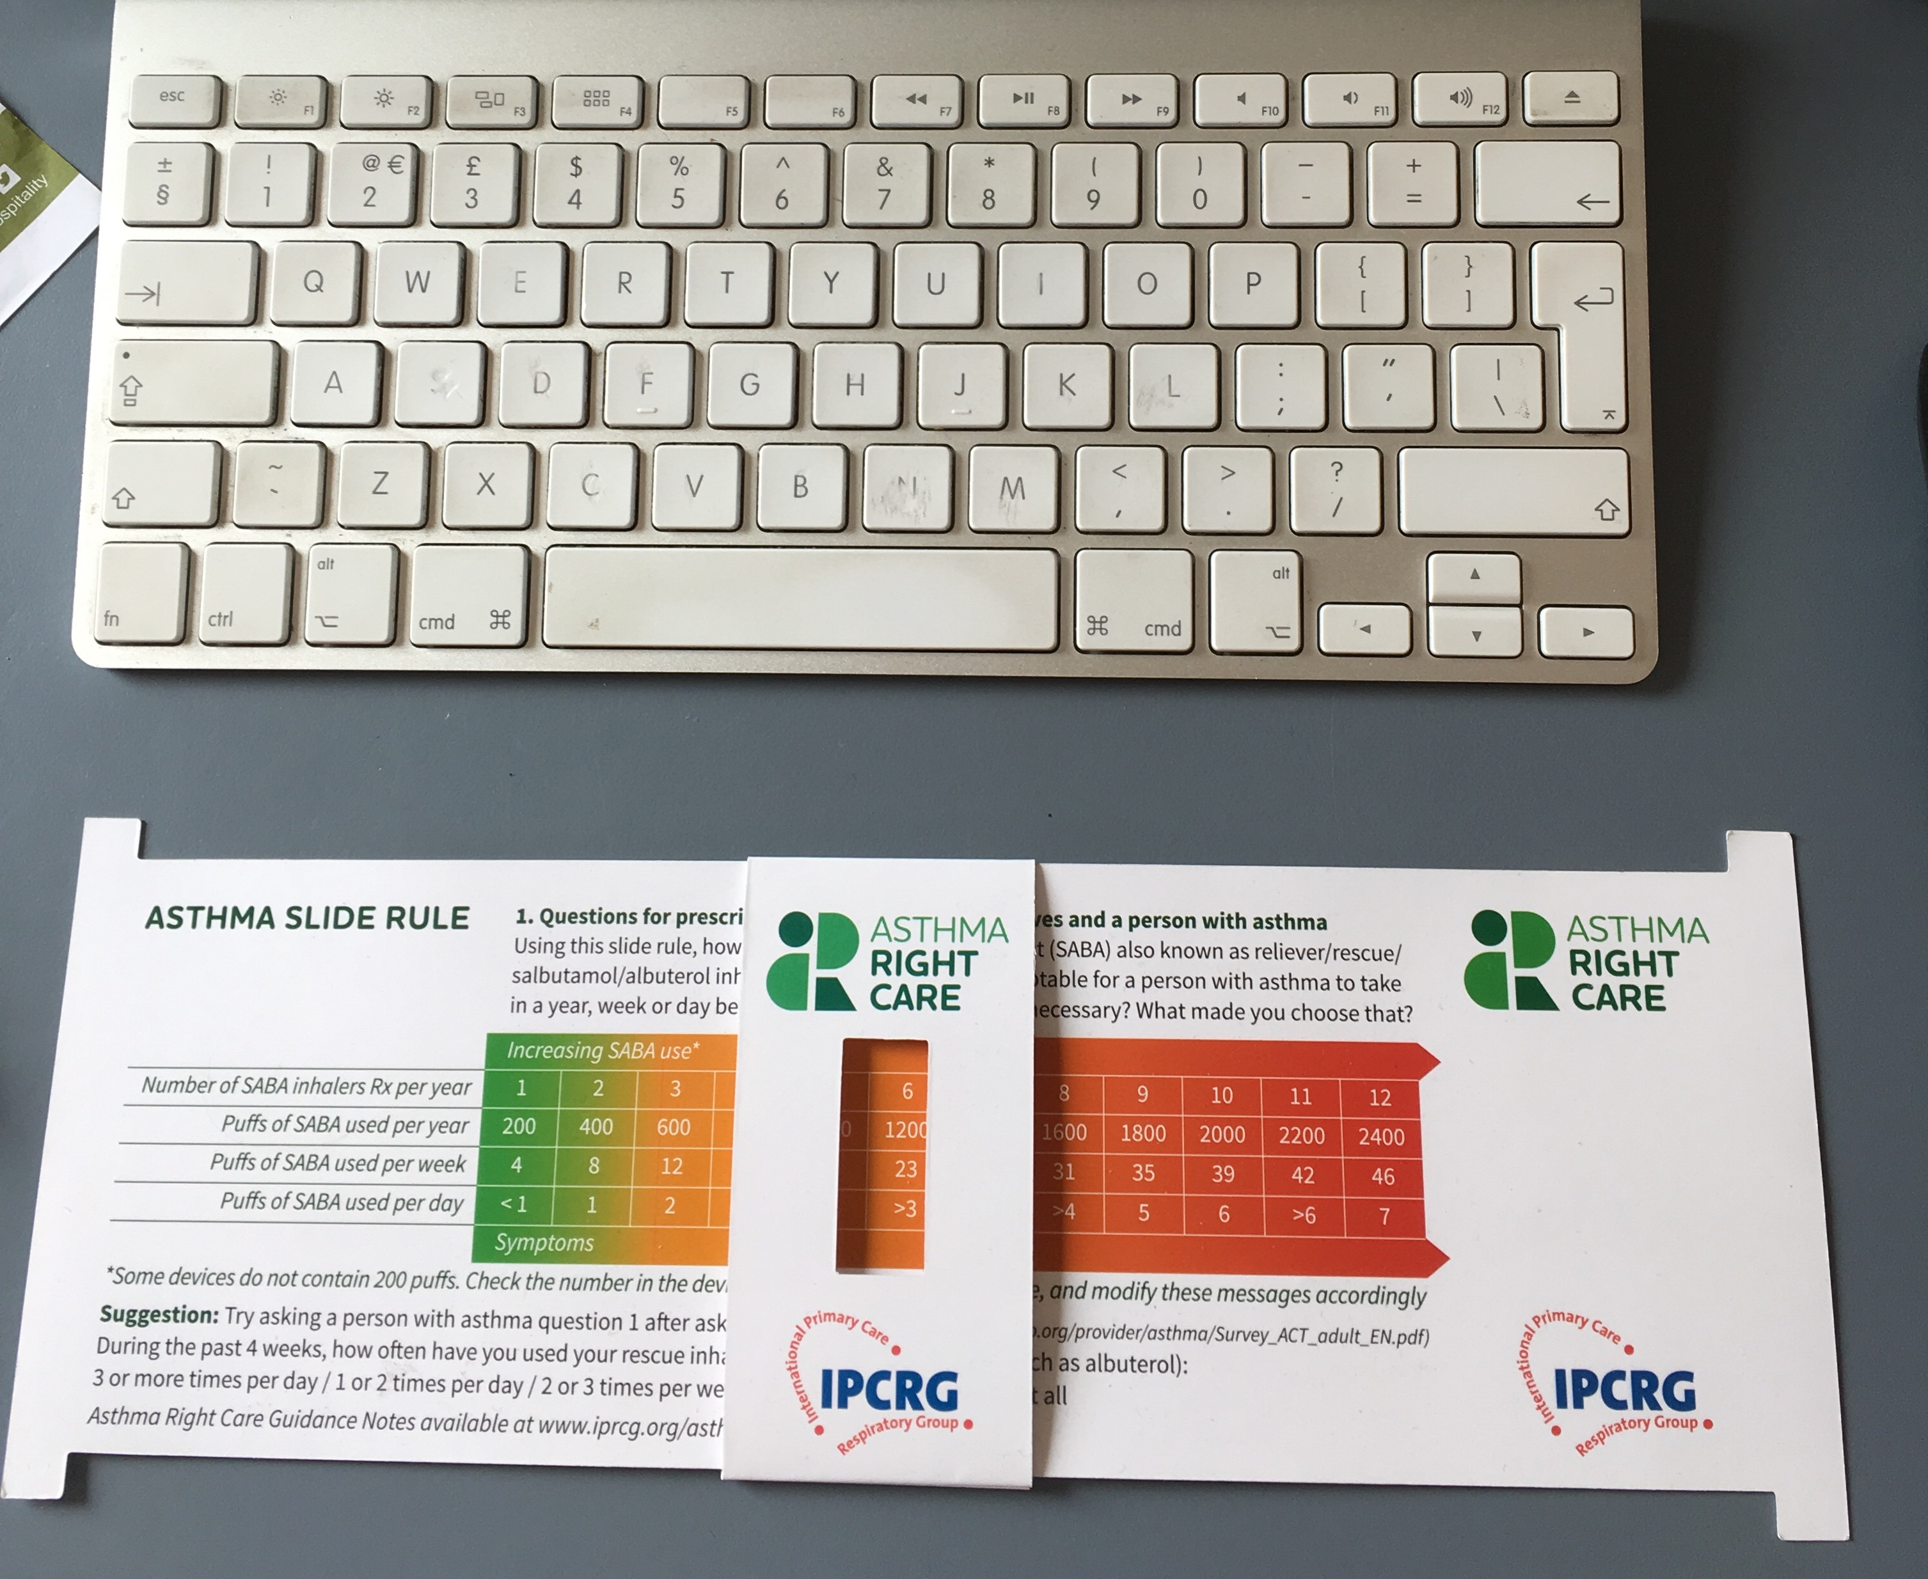
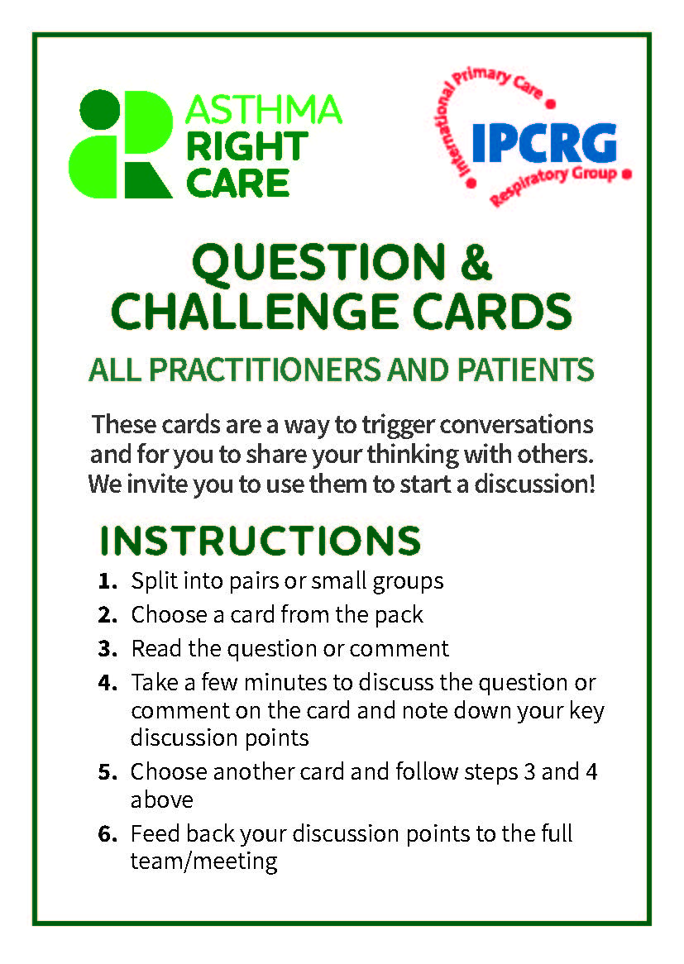

Kickstarting action
Emerging and building momentum
2
  Nurturing voices
  Cultivating diverse interests and motivations
3
Influencing and interacting
Navigating a complex array of relationships
Netherlands, Greece
France
ENVIRONMENT
Propellant & Plastic
INFORMATION
Coding
Public Information
MEDICINES
ICS: SABA Ratio
Inhaler Use
New Cultures
& Languages
Argentina Mexico Brazil
Ireland, the Gulf
6 drivers in asthma health system
More parts of health system
More
geographies
Original 4
UK & Canada
Spain
Portugal
WORKFORCE
GPs / Pharmacist / Nurses
FINANCE & LEADERSHIP
PERSONAL
Networking
Policy Briefing
Going deeper:
Paradigm / behaviour shift
Unconscious Incompetence
Asthma Slide Rule & Question Cards
Conscious Incompetence: what could I do better?
Conscious Competence
What is right care?
Regional Teach The Teacher Master Classes to create trusted regional master teachers
Unconscious Competence
Mastery: Conscious Competence of Unconscious Incompetence

Slide 54
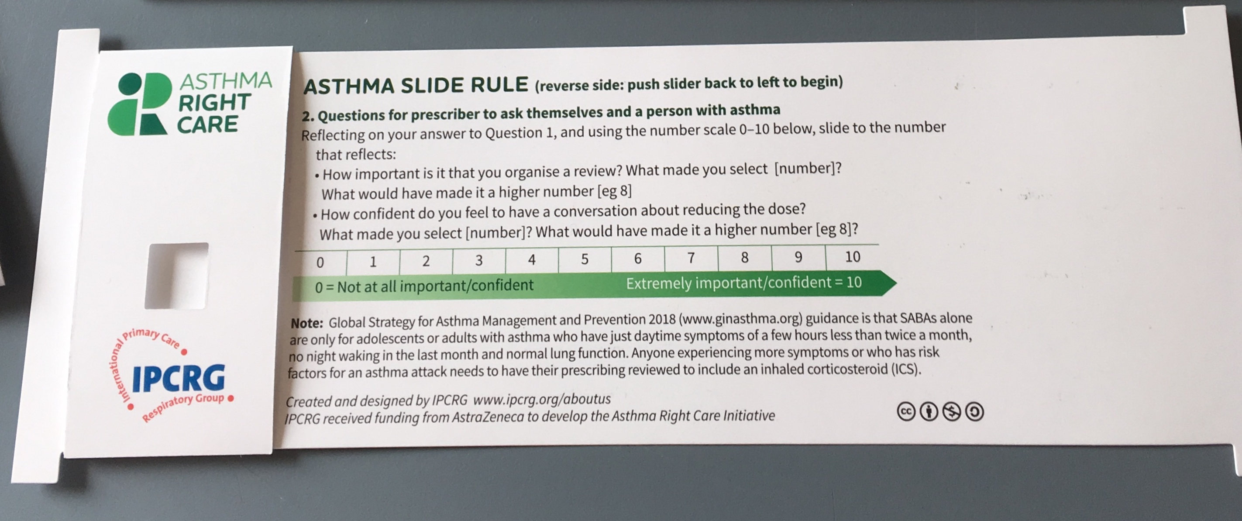
Prototype conversation pieces for discussion and co-creation in the design charrettes
Hunch 1: Lack of knowledge about how many puffs or doses in an inhaler and how many is too many in a year
Hunch 2: Pharmacists keen to do more but out of date “take your blue inhaler to open up your airways” – reveals no investment in education since this was the norm
Hunch 3: General practitioners/family physicians keen to emphasise art rather than science of the consultation, and so not up-to-date with guidelines eg “What’s the probability of them having asthma?” not routine question yet
Ambition: Embrace more people, more methods, bring joy to lives: let’s have fun, while being challenging

Slide 55
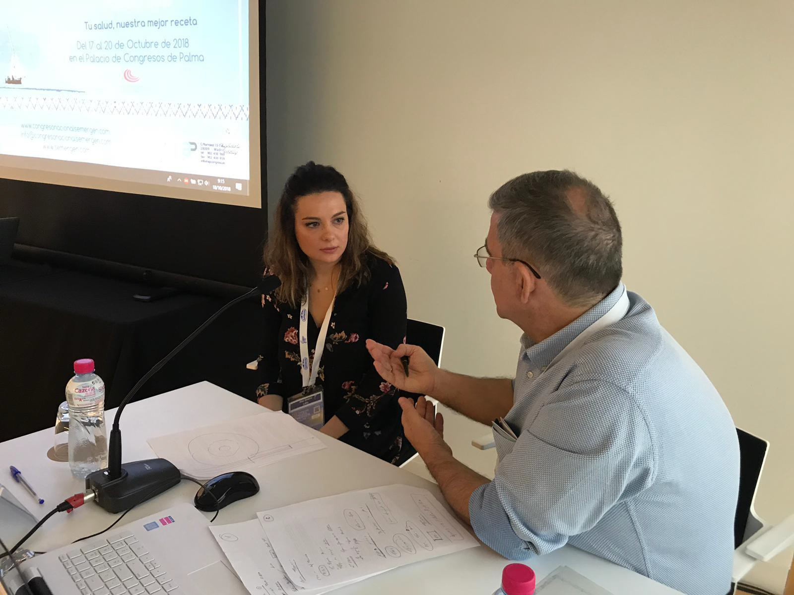
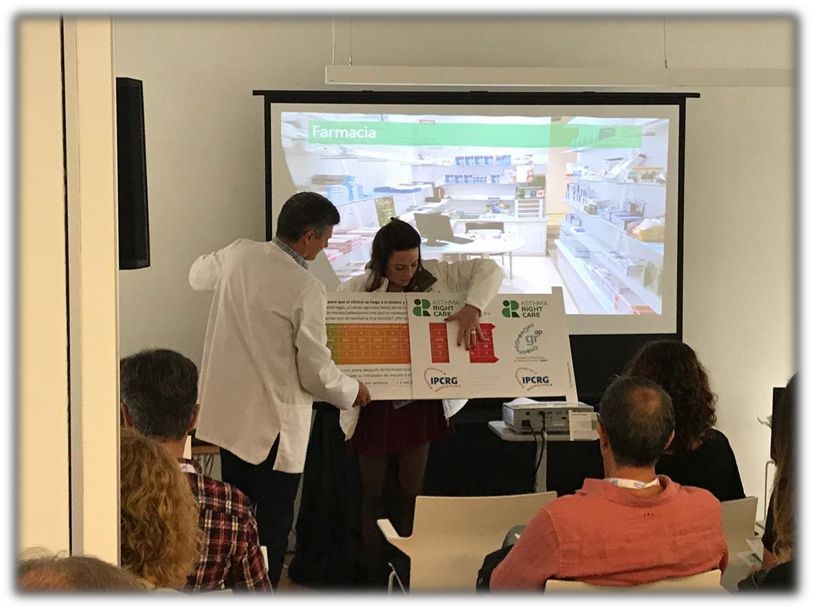
Summary of the Asthma Right Care movement
c. 10,000 frontline healthcare professionals and global primary care leaders reached so far
4 international conferences attended
Multiple national conferences
Materials produced
  Asthma Right Care Slide Rule and Guidance Notes produced in English, Spanish and Portuguese
  Question Cards produced in different formats and in English, Spanish and Portuguese
  SABA questionnaire from Rob Horne endorsed by IPCRG
  New asthma narrative from Rob Horne

Slide 56
What has Asthma Right Care changed for you?
It has changed my approach to leading a large scale change for asthma management. It means to move towards a new vision that is better and fundamentally different from the Status Quo. This Project has pointed me in the right direction for creating and sustaining large scale change and transformation.This framework helps us to increase personal value, value for the population and rates of higher value intervention.
Mar Martinez, GP
ARC is changing our lives because we are reflecting about our work quality in a biopsychosocial dimension while we try to make every single step to provide all the asthma right care to patients and caregivers reconciling it with daily work. At the same time it is incredible how we can apply this knowledge to other diseases and procedures.
Teamwork is very rewarding, making us grow as a person and as a healthcare professional.
Cláudia Vicente, GP

Slide 57
Summary of learning
Be brave: talk numbers!
  Eg Systematic review 2018 “excessive over-use” but NO definition
  What is the ratio we should be aiming for between ICS and SABA? What’s yours?
Be curious about what happens outside the consulting room and why
Be passionate about equity and safety
Select your words carefully;
  “Over-reliance” vs over-use
  SABA for asthma vs SABA for COPD
  Dose or puff
  Rescue or relieve
  Stops asthma vs stops asthma attacks
  “As directed” by your GP….
  “As needed”…
  A “puff” is a breathless moment: count those moments…. 2400 breathless moments in a year = 12 inhalers
Consider role of pharmacist
  The “rate limiting step” in most asthma pathways is the quality of the interaction with the pharmacist

Slide 58
Findings: impact of a social movement
How is it different from previous change programmes on asthma care?
Who are the followers?
Why do they engage?
What impact on motivation, opportunity and capability?
Does it have more impact on the system?
(COM-B) Michie et al 2011
Participant reactions
Participant use of new knowledge and skills
Impact on participants, practice and service users
Participant learning
Organisational support and change
IPCRG model of evaluation after Guskey

Slide 59
Findings: supply-side (COM-B)
The right diagnosis is not made because asthma is a variable disease and needs more than one visit but the clinician only sees the patient once. Possible reasons:
  Primary care not incentivised for long term care so only sees the patient once for diagnosis and treatment (M)
  Follow-up and review not part of normal care so the suggestion to return is considered by the patient to be clinician "upselling” (O)
  Education and training needs (C)
The individual communication of the diagnosis is not accurate:
  Is bronchoconstriction AND inflammation explained?
  Are the words asthma actually used? Some clinicians avoid it for fear of worrying their patients
  Are there visual tools and models available to help explain?
  Is it described as a chronic/long term condition or episodic?
  Is the treatment linked to the diagnosis?
  Are metaphors used to help describe the problem?

Slide 60
Findings: supply-side
Prescribing is not right because:
  The diagnosis is made through a "trial of treatment" which is often still SABA, although it should be ICS; never reviewed and the person continues on SABA (C)
  Lack of knowledge by the prescriber about what is right despite MANY educational initiatives and guidelines. (Very strong signal from asthma slide rule and NOTE NEW 2019 GINA GUIDELINES – SABA alone not recommended)
  Intervention happens in the Emergency Department, and is never reviewed in primary care; ED practice may be out of date; ED practice may suit patients - eg episodic use of oral steroids despite risks of harm (C)
  Lack of access to the right medicine (affordability, stocks, formulary) (O)
  The wrong incentives (eg in some LMICs there's a limit on the number of ICS that can be prescribed, but not SABA) (M)
  Inadequate shared decision-making about treatment which affects adherence (C)

Slide 61
Findings: supply-side
Dispensing is not right because
  There is little investment in pharmacist education (C)
  Pharmacists are not incentivised to offer patient support & education (M)
  Pharmacists may spot a problem but are not confident to challenge the prescriber (who may provide a supply of business) (M)
  Pharmacists are out of date: 30 years ago it used to be taught "first take the SABA to open up the airways, then take the ICS." We now know that's not right (C)
  Pharmacists are able to sell SABA over the counter (normally only "for emergencies") and so they do: it's in their interests to keep customers happy and, they hope, healthy. (O)

Slide 62
Findings: demand-side
Patient beliefs about asthma. Assuming they have been given the diagnosis
  How grave/important is an asthma diagnosis?
  How rare/common is an asthma diagnosis?
  How specific is the word “asthma”?
Patient beliefs about medicines
  SABA
  ICS
Practical problems of using medicines:
  Are the inhalers available?
  Are they affordable?
  Does the person know the name of their medicine and what it’s for (eg asthma or COPD….it matters in the story about over-reliance on SABA)
  Can they use/still use the inhaler?
  Were they prescribed a spacer?
  Has anyone taught the patient how to use the inhaler?

Slide 63


Slide 64
What can you commit to?
Act now!
Find out more at www.ipcrg.org/asthmarightcare
IPCRG received funding from AstraZeneca to develop the Asthma Right Care Initiative

Slide 65
Additional resources

Slide 66
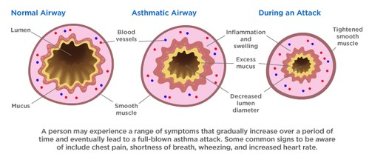
Asthma is an inflammatory disease
Asthma is a chronic inflammatory disease of the airways leading to bronchial constriction
HealthCentral. Anatomy of an asthma attack. Available at: https://www.healthcentral.com/article/anatomy-of-an-asthma-attack-infographic?ap=2012

Slide 67
SABA overuse:
An indicator of poor control (1)
UK National Review of Asthma Deaths 2012 to 2013
39% people on SABA at time of death had been prescribed more than 12 in the year before they died
  4% had been prescribed >50 SABA inhalers
  Those prescribed >12 were likely to have had poorly
  controlled asthma
National Review of Asthma Deaths: Available at: https://www.rcplondon.ac.uk/projects/national-review-asthma-deaths. Accessed March 2019.

Slide 68
SABA overuse:
An indicator of poor control (2)
“There is a progressive risk of hospital admission associated with the prescription of more than three SABA inhalers a year”
Healthcare resource use | 1-3 inhalers N=5888 | 4-12 inhalers N=2054 | >13 inhalers N=285
Inpatient episodes | 20 | 33 | 2
Crude inpatient episode rate per 100 population | 0.34 | 1.61 | 0.70
Hull SA, et al. NPJ Prim Care Respir Med. 2016;26:16049.

Slide 69
SABA overuse:
An indicator of poor control (3)
“There is some evidence that electronic alerts reduce excessive prescribing of SABAs, when delivered as part of a multicomponent intervention in an integrated health care system”
Literature review to synthesise the evidence for the use of computerised alerts that identify excessive prescribing of SABAs to improve asthma management for people with asthma
 | SABA prescribing | ICS prescribing | ICS-SABA prescribing | ICS-LABA prescribing
Study 1 |  | No effect
Study 2 | No effect | No effect
Study 3 | Positive effect | No effect |  | Positive effect
Study 4 |  | No effect | Positive effect
SABA short-acting beta₂- agonist, ICS inhaled corticosteroid, LABA long-acting beta₂-agonist.
McKibben S, et al. NPJ Prim Care Respir Med. 2018;28:14.

Slide 70
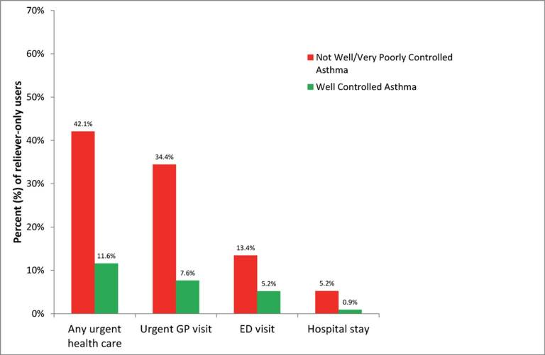
SABA overuse:
An indicator of poor control (4)
“One-quarter of the reliever-only population had needed urgent asthma healthcare in the previous year, demonstrating the importance of identifying such patients”
Cross-sectional population-based
Internet survey in Australia
Of 2686 participants ≥16 years with
current asthma randomly drawn from
a web-based panel, 1038 (50.7% male)
used only reliever medication
ED, emergency department.
Reddel HK, et al. BMJ Open. 2017;7:e016688.

Slide 71
Paradoxical reliance on SABA at GINA Step 1
SABA bronchodilator alone is the recommended GINA Step 1, despite the fact that asthma is a chronic inflammatory disease
At step 1, the patient has autonomy and their perception of need and disease control is accepted
BUT:
  Studies confirm that when symptoms worsen, most patients
  increase SABA use, instead of using controller medication
SABA, short-acting β2 agonist.
O’Byrne PM, et al. Eur Respir J. 2017;50:1701103.

Slide 72
Poor adherence to maintenance therapy and guidelines are not helpful
Poor adherence to maintenance pharmacotherapy is a reality in asthma
There is a switch in recommendation from Step 1 (use a SABA as-needed)
to Step 2 (use an ICS fixed-dose regimen and minimise SABA use)
“The medication that treats the underlying disease,
which patients are encouraged to take (the ICS) is not the one that the patient perceives is benefitting them (the SABA), which they are now discouraged from taking”
ICS, inhaled corticosteroid; SABA, short-acting β2 agonist.
O’Byrne PM, et al. Eur Respir J. 2017;50:1701103.

