Slide 1
Asthma Case Studies
Transition From Paediatric to Adult Asthma
IPCRG received funding from AstraZeneca to develop the Asthma Right Care Initiative

Slide 2
About these slides
Please feel free to use, update and share some or all of these slides in your non-commercial presentations to colleagues or patients
The slides are provided under creative commons licence CC BY-NC-ND.
  BY stands for attribution (the obligation to credit the author and other parties designated for attribution);
  NC stands for NonCommercial (commercial use is excluded from the licence grant);
  ND means NoDerivatives (only verbatim copies of the work can be shared)
When using our slides, please retain the source attribution: IPCRG 2019 Miguel Román-Rodriguez on behalf of the Asthma Right Care Team

Slide 3
What you will learn
The challenges associated with managing the adolescent patient with asthma
The importance of supporting self-management of enhancing an adolescent’s sense of control and independence
The role of SABA/ICS therapy for adolescent patients with asthma

Slide 4

The patient
Anna is 16 years old
She lives at home with her parents
She is in her 6th year of high school

Slide 5
General medical history
Anna was diagnosed with asthma during childhood
Her current prescribed regimen is:
  Beclomethasone 250 µg, 2 puffs BID
  Salbutamol as needed
Anna has seasonal allergic rhinitis (ragweed, birch pollen)
  Treated with desloratadine + intranasal mometasone furoate

Slide 6
Respiratory history
Her last ICS inhaler was issued 1.5 years ago
She has visited the emergency department twice in the last
2 years

Slide 7
Current presentation
Anna has been experiencing severe asthma symptoms for
the last 4-7 days
  Continuously wheezing
  Persistent cough
  Dyspnoea
She has tried to avoid coming to see you but is now feeling
really unwell

Slide 8
Clinical considerations
Medication use
Anna tells you she has been taking >12 puffs/day of salbutamol for the last 2 weeks
Anna reports she is not taking any maintenance medication for her asthma

Slide 9
Reasons for poor asthma control
Wrong diagnosis or confounding illness
Incorrect choice of inhaler or poor technique
Concurrent smoking
Concomitant rhinitis
Unintentional or intentional nonadherence
Individual variation in treatment response
Under treatment

Slide 10
Clinical considerations
Initial examination
Anna cannot complete full sentences
She has expiratory wheeze
Her O₂ saturation is 95%
Her PEF is 250 L/min (45% of her best personal value)
You prescribe nebulized salbutamol for Anna as an immediate treatment

Slide 11
What are your immediate reactions to Anna’s current presentation?
Anna is having an asthma flare and needs oral corticosteroids
Anna is having an asthma flare and needs to go straight to the emergency department
Anna needs to step up her maintenance treatment to formoterol/budesonide combination
Anna may have a chest infection
Anna needs to start taking her maintenance therapy regularly
(there may be more than one right answer)

Slide 12
Clinical considerations
Review of medical records
At her last scheduled primary care visit 2 years ago, Anna was not smoking and her mother was happy and felt Anna was coping perfectly with her asthma
  No asthma symptoms
  Salbutamol us <2-3 times a week
  ACT score 23
  No exacerbations in the previous 3 years
  Spirometry: FEV₁ 85% of predicted, PEF 520 L/min
  BMI 22
  Good adherence, taking >80% of prescribed doses
Anna was last seen by a paediatrician 2 years ago and has not seen a primary care team member since then; she does not know her current primary care physician or nurse

Slide 13
Clinical considerations
What has changed in the last 2 years?
While Anna is receiving her nebulizer you speak with Anna’s mother who reports that:
  Anna has been smoking “not much, but regularly”
  No longer participates in sport and has gained weight
  Anna is difficult to control and will not take her parents advice
  She never speaks about her asthma but uses salbutamol compulsively
  …Anna is not adhering to her maintenance treatment and you decide Anna’s asthma is poorly controlled

Slide 14
What has changed during these 2 years?
THE PAST | THE PRESENT
Does sport | Does no sport
No smoking | Smoking
Good adherence | Poor adherence
Follow-up visits | No follow-up visits
Infrequent salbutamol use | Compulsive salbutamol use
Asthma controlled | Asthma uncontrolled
No exacerbations | Exacerbations

Slide 15
Adolescence is a challenging time for the management of chronic conditions
Physiological changes
Psychological challenges
Life-style changes
Poor medication adherence

Slide 16
Asthma in adolescents
Physiological changes
Hormonal changes can affect asthma control
  More boys than girls experience remission of asthma during adolescence
Early puberty has been reported to be an independent risk factor for the persistence of asthma into adolescence, and for the severity of asthma in adulthood
Increased BMI in girls has been associated with both early puberty and increased asthma risk
Bender BG. Am J Respir Crit Care Med 2006; 173: 953-957.

Slide 17
Asthma in adolescents
Psychological challenges
An adolescent’s age is not a reliable indicator of cognitive, emotional or social maturity
Adolescents may deny or disregard asthma symptoms
Adolescents’ concerns about confidentiality may prevent them using health care services
Mental health disorders are common among young people
  Psychological distress is common (e.g. feelings of hopelessness or recent loss)
  A significant proportion of adult mental health problems emerge during adolescence
Bender BG. Am J Respir Crit Care Med 2006; 173: 953-957.

Slide 18
Asthma in adolescents
Life-style changes
Adolescence is a time when people can begin risky behaviour which can continue into adulthood:¹
  Smoking: Among adolescent boys, those with lower quality of life are most likely to start smoking.
  Drug and alcohol use
  Poor eating habits
  Physical inactivity
Life events (new school, moving house) and family problems¹
Adolescents with chronic disease show higher rates of health risk behaviours than healthy adolescents¹
Specific intervention to address risk factors such as smoking, alcohol consumption and obesity can be effective in reducing premature mortality²
1. Bender BG. Am J Respir Crit Care Med 2006; 173: 953-957; 2. Watkins D, et al. BMJ Global Health 2019;4:e001335.

Slide 19
Asthma in adolescents
Poor medication adherence
Poor adherence to treatment is common
  Depression, risk-taking behaviour and poor adherence to medicines are interrelated
Adolescents with asthma who adhere poorly to asthma treatment and hide their asthma are more likely to start smoking than other adolescents with asthma
Bender BG. Am J Respir Crit Care Med 2006; 173: 953-957.

Slide 20
Asthma management in adolescents
Confirm the diagnosis if possible
Consider whether exercise-related symptoms may be due to a non-asthma cause
Consider psychosocial and behavioural factors such as non-adherence to preventer medicines, smoking or exposure to other people’s tobacco smoke
Consider possible hormonal management if flare-ups are affected by the menstrual cycle
Plan regular asthma review as for adults in a primary care physician who treats adults
Explain to young people that asthma medicines do not have any effects on sexual activity
Discuss the transition and check that the adolescent is satisfied with the adult services
Explore barriers for proper adherence and motivating factors
Consider step-down for adolescents taking regular inhaled corticosteroid whose asthma has been well controlled for at least 3 months
Available at: http://www.asthmahandbook.org.au/populations/adolescents/.

Slide 21
Management
The new plan
You initiate guideline-based treatment for the management of an asthma exacerbation and prescribe oral corticosteroids
You prescribe a combination SABA/ICS inhaler
You schedule a follow-up visit in 24 hours

Slide 22
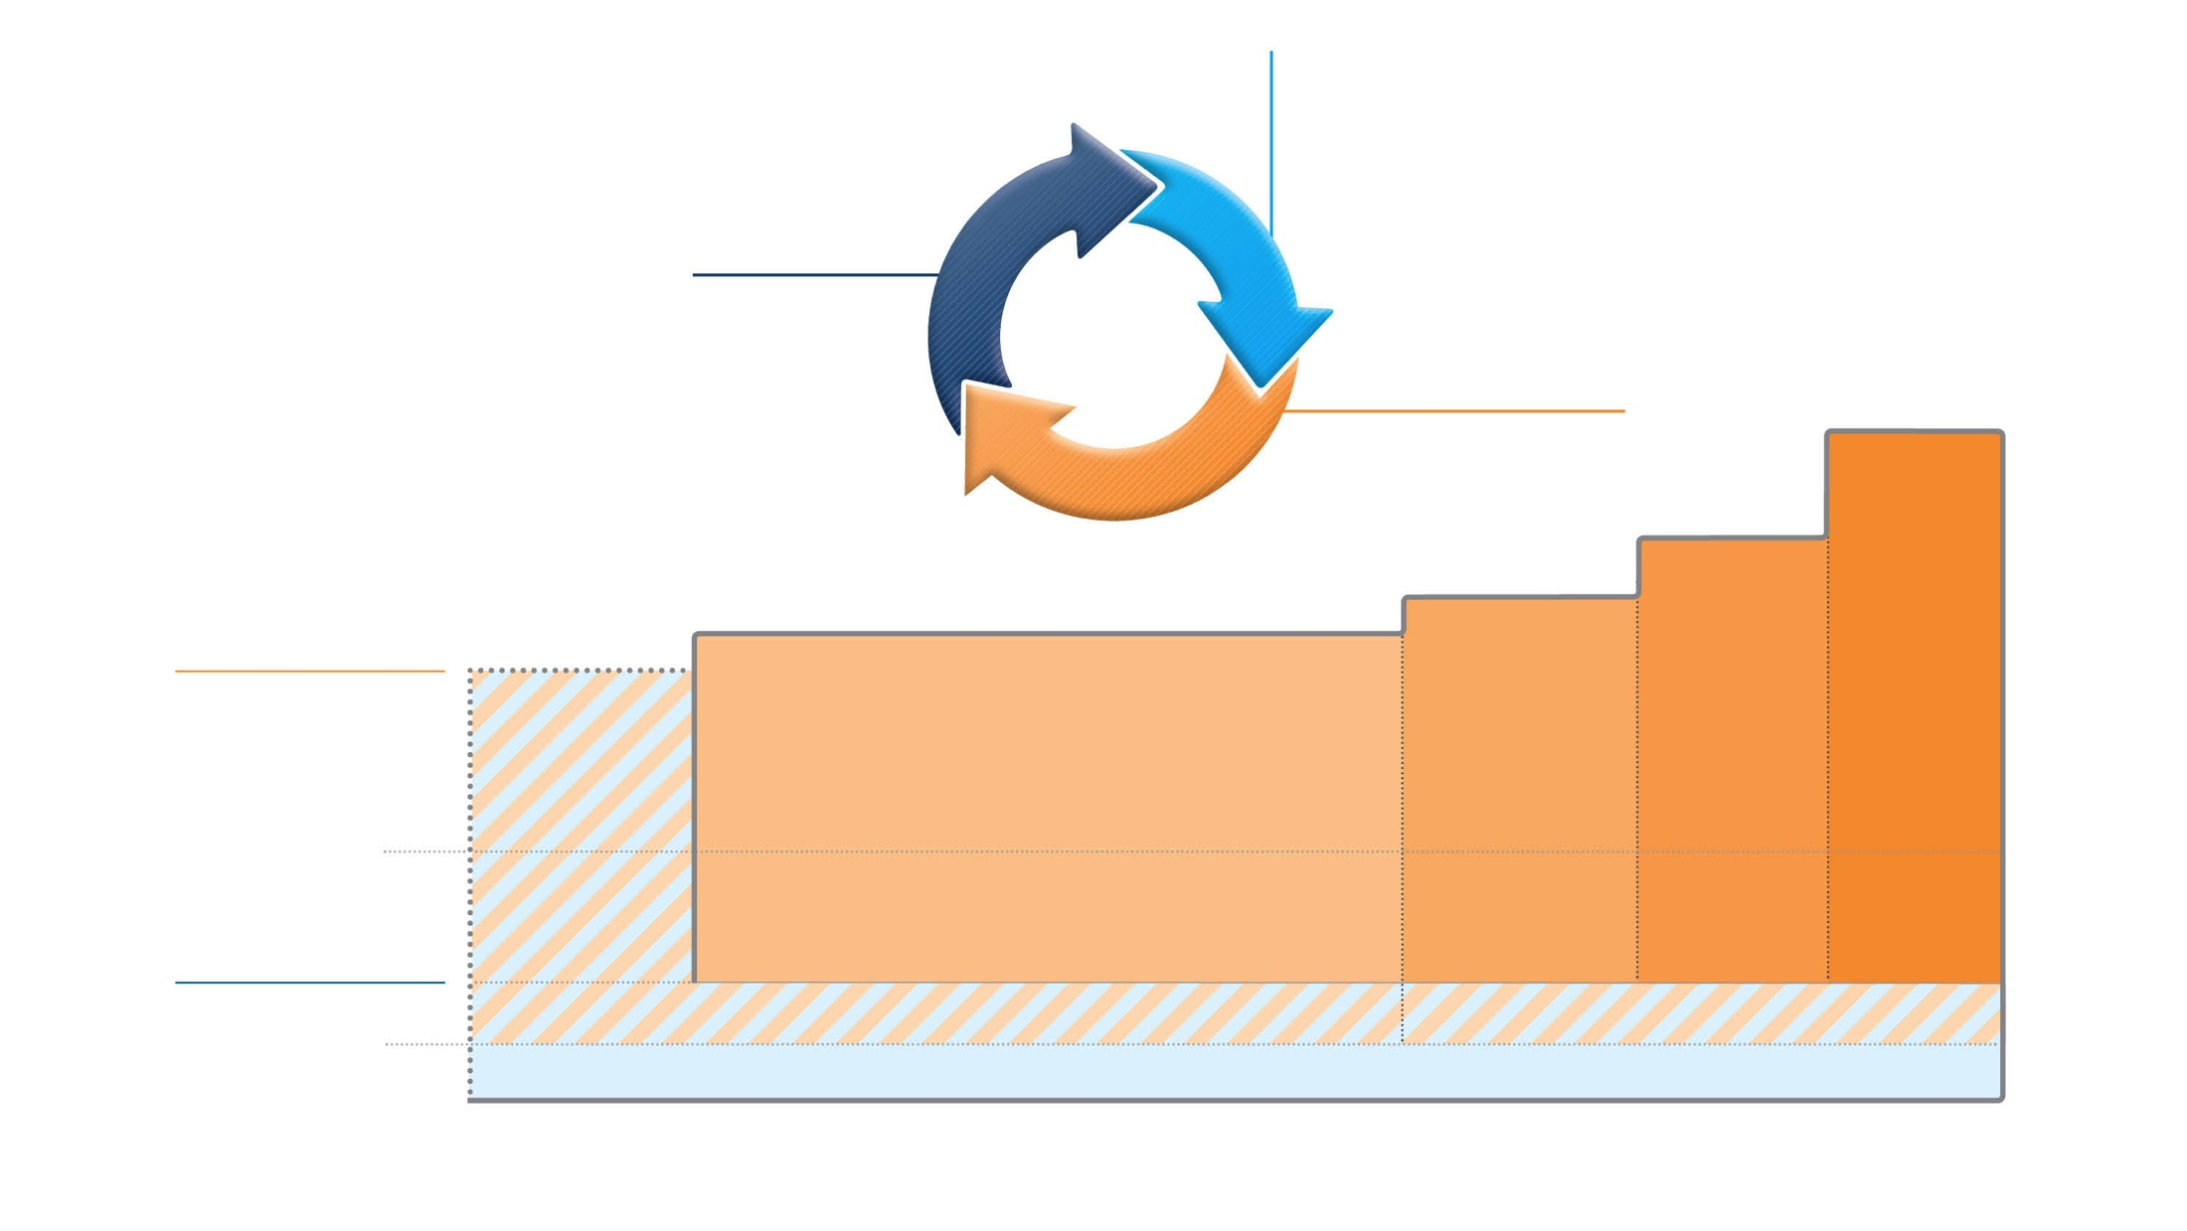
GINA 2019
Adults & adolescents 12+ years
Confirmation of diagnosis if necessary Symptom control & modifiable
risk factors (including lung function)
Comorbidities
Inhaler technique & adherence Patient goals
ASSESS
Personalized asthma management:
Assess, Adjust, Review response
REVIEW RESPONSE
Symptoms Exacerbations Side-effects Lung function
Patient satisfaction
ADJUST
Treatment of modifiable risk factors & comorbidities
Non-pharmacological strategies Education & skills training Asthma medications
STEP 5
High dose ICS-LABA
Refer for phenotypic assessment
± add-on therapy, e.g.tiotropium, anti-IgE,
anti-IL5/5R,
anti-IL4R
Asthma medication options: Adjust treatment up and down for individual patient needs
STEP 4
Medium dose ICS-LABA
STEP 3
Low dose ICS-LABA
STEP 2
Daily low dose inhaled corticosteroid (ICS), or as-needed low dose ICS-formoterol *
PREFERRED CONTROLLER
to prevent exacerbations and control symptoms
STEP 1
As-needed low dose
ICS-formoterol *
Other controller options
Low dose ICS taken whenever SABA is taken †
Leukotriene receptor antagonist (LTRA), or low dose ICS taken whenever SABA taken †
Medium dose ICS, or low dose ICS+LTRA #
High dose ICS, add-on tiotropium, or add-on LTRA #
Add low dose OCS, but consider
side-effects
PREFERRED RELIEVER
As-needed low dose ICS-formoterol *
As-needed low dose ICS-formoterol ‡
Other reliever option
As-needed short-acting β₂ -agonist (SABA)
* Off-label; data only with budesonide-formoterol (bud-form)
† Off-label; separate or combination ICS and SABA inhalers
‡ Low-dose ICS-form is the reliever for patients prescribed bud-form or BDP-form maintenance and reliever therapy
# Consider adding HDM SLIT for sensitized patients with allergic rhinitis and FEV >70% predicted
1
Available at: www.gina.com. Accessed April 2019.

Slide 23
GINA 2019: Step 4
Preferred controller: Low dose ICS-formoterol as maintenance and reliever therapy, OR medium dose ICS-LABA maintenance plus as-needed SABA
Other controller options:
  Add-on tiotropium by mist inhaler for patients ≥6 years with a history of exacerbations
  Add-on LTRA
  Increasing to high dose ICS-LABA
Children aged 6-11 years: Continue controller, and refer for expert advice
STEP 5
High dose ICS-LABA
Refer for phenotypic assessment
± add-on therapy, e.g.tiotropium, anti-IgE,
anti-IL5/5R,
anti-IL4R
STEP 4
Medium dose ICS-LABA
STEP 3
Low dose ICS-LABA
STEP 2
Daily low dose inhaled corticosteroid (ICS), or as-needed low dose ICS-formoterol *
PREFERRED CONTROLLER
to prevent exacerbations and control symptoms
STEP 1
As-needed low dose
ICS-formoterol *
Other controller options
Low dose ICS taken whenever SABA is taken †
Leukotriene receptor antagonist (LTRA), or low dose ICS taken whenever SABA taken †
Medium dose ICS, or low dose ICS+LTRA #
High dose ICS, add-on tiotropium, or add-on LTRA #
Add low dose OCS, but consider
side-effects
PREFERRED RELIEVER
As-needed low dose ICS-formoterol *
As-needed low dose ICS-formoterol ‡
Other reliever option
As-needed short-acting β₂ -agonist (SABA)
ICS, inhaled corticosteroid; LABA, long-acting bronchodilator; SABA, short-acting beta₂-agonist.
Available at: www.gina.com. Accessed March 2019.

Slide 24
At the follow-up visit 24-hours later
Explore Anna’s over reliance on SABA and help Anna understand the need for maintenance treatment
Offer self-management support and aim to enhance Anna’s sense of control and independence
Explore motivation for tobacco cessation
Explore possible mental disorders

Slide 25
Self-management support
Ensure Anna has a written asthma action plan appropriate to her age and self-management capability
Encourage self-management and provide support and education. Repeat the key information at each visit
Explore whether new technology is appropriate
  Text message reminders
  Online information
  Electronic written asthma action plan and direct them to appropriate resources and programs (e.g. peer-led asthma education, if available)

Slide 26
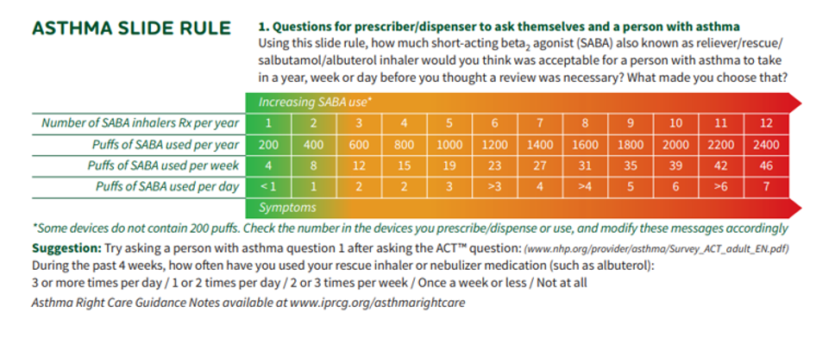
Asthma Slide Rule Front

Slide 27
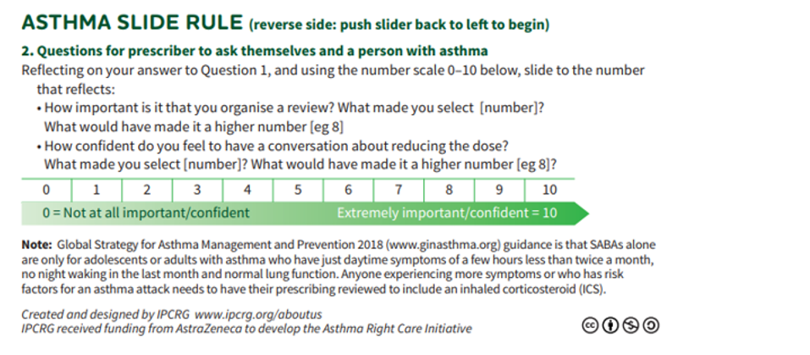
Asthma Slide Rule Back

Slide 28

Initiating challenging conversations

Slide 29
Written Personalised Asthma Action Plan (PAAP)
Written PAAP
A written PAAP is an essential part of managing long-term disease¹
SIGN-BTS recommend that all people with asthma should be offered self-management education which includes a written AAP²
  In addition, GINA also highlights the importance of supporting long-term asthma management³
  These recommendations are based on literature reviews that show that supported PAAPs improve asthma control, reduce exacerbations and improve quality of life^{2,3}
Why are they useful?
  Pinpoint signs that the asthma is getting worse⁴
  Keep track of when to take medicines⁴
  Aid daily monitoring as well as long-term control⁴
  Provide information on what to do in the event of an asthma attack⁴
  The overall aim of a written PAAP is to help take early action to prevent or reduce the severity of asthma attack symptoms⁴
GINA, Global Initiative for Asthma; PAAP, personalised asthma action plan; SIGN-BTS, Scottish Intercollegiate Guidelines Network- British Thoracic Society.
1. Gibson PG, et al. Thorax 2004;59:94–99; 2. SIGN-BTS. British guideline on the management of asthma. Consultation 2016; 3. GINA Strategy for asthma management and prevention 2016; 4. Pinnock H. Breathe 2015;11:98–109.

Slide 30
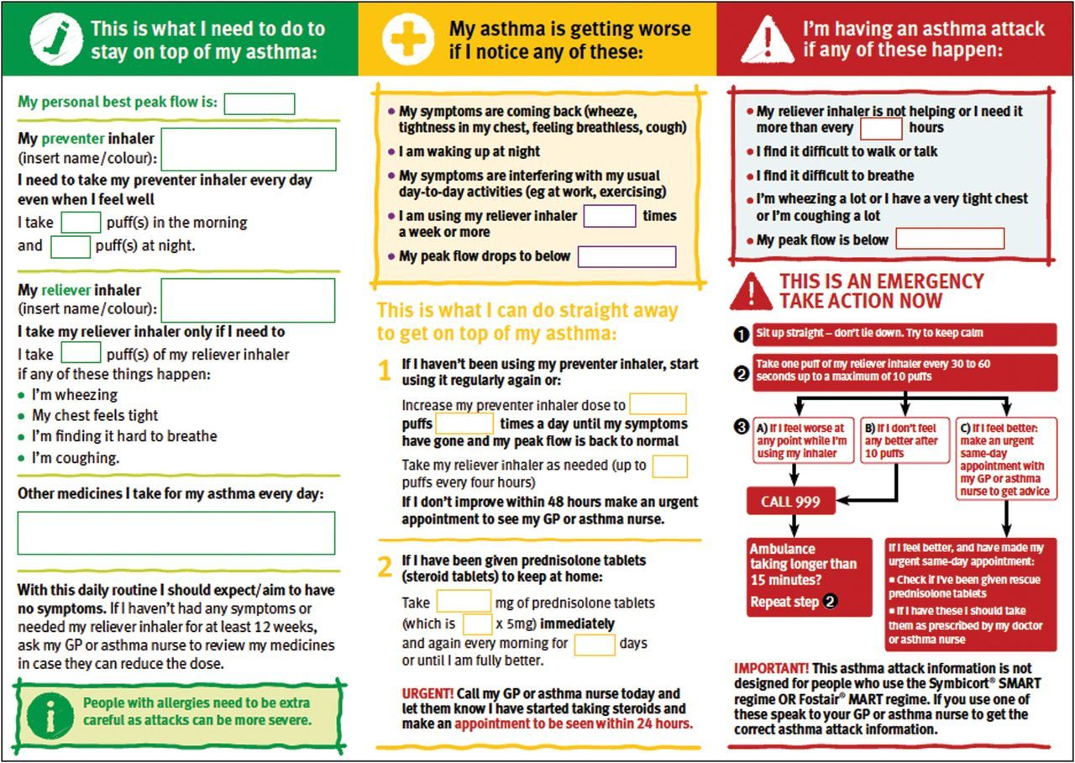
PAAP example for adults
Hilary Pinnock. Supported self-management for asthma. Breathe (Sheff). 2015 Jun; 11(2): 98–109. doi: 10.1183/20734735.015614 https://www.ncbi.nlm.nih.gov/pmc/articles/PMC4487370/pdf/EDU-0156-2014.pdf

Slide 31
Steps to help Anna live better with her asthma
Arrange to see Anna alone with no parents around
Discuss confidentiality with her
Discuss the risks associated with smoking and other risky behaviours with her
Assess Anna for the presence of mental health disorders
Arrange follow-up visits to monitoring Anna so that her medicines can be adjusted at the lowest effective doses
Take an open, non-judgemental approach to assessing and discussing Anna’s adherence to her medicine

Slide 32
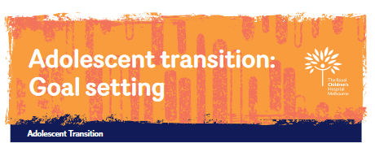
Adolescent transition programs
"A purposeful, planned process that addresses the medical, psychosocial and educational/vocational needs of adolescents and young adults with chronic physical and medical conditions as they move from child-centred to adult-oriented health care systems"
Available at: https://www.rch.org.au/transition/for_health_professionals/For_Health_Professionals/
.

Slide 33
The aims of transition
Provide high quality, coordinated, uninterrupted health care that is patient-centred, age and developmentally appropriate and culturally competent, flexible, responsive and comprehensive with respect to all persons involved
Promote skills in communication, decision-making, assertiveness and self-care, self-determination and self-advocacy
Enhance the young person's sense of control and independence
Provide support and guidance for the parent/carer of the young person
To maximize life-long functioning and potential
Available at: https://www.rch.org.au/transition/for_health_professionals/For_Health_Professionals/
.

Slide 34
Asthma Right Care: a movement for Global Change
Movement for Global Change
IPCRG received funding from AstraZeneca to develop the Asthma Right Care Initiative

Slide 35
Every system is perfectly designed to get the results it gets
(Earl Conway and Paul Batalden)
That is, both intended and unintended consequences are designed into our systems
Notes:
Both intended and unintended consequences are designed into our systems

Slide 36

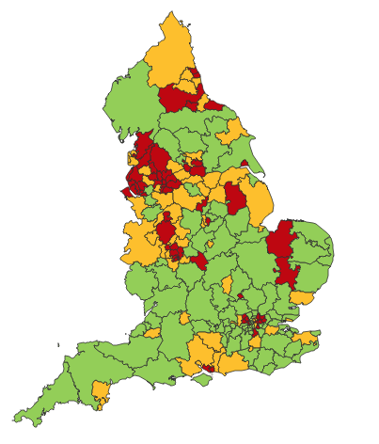

Making a case for change
Asthma illustrates all 5 global healthcare problems (Sir Muir Gray):
Unwarranted variation
Harm, even when quality is high (over-diagnosis, over-treatment)
Failure to prevent disease and disability
Waste of human and physical resources through low value activity
Inequity
And new challenges are forming:
Financial constraints
Rising expectations of personalised care
Climate change/pollution
Increasing need
PHE Fingertips data Asthma admissions per 1000 population 2012/13 data
Notes:
Unwarranted variation as defined by Wennberg: Variation in utilization of health care services that cannot be explained by variation in patient illness or patient preferences
http://www.nhsconfed.org/~/media/Confederation/Files/Events/ACE15/1430%20Inaugural%20NHS%20value%20lecture.pdf

Slide 37
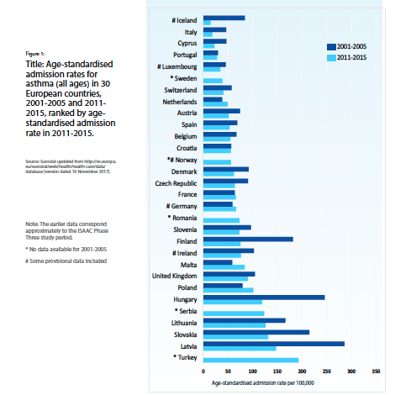
Change for improvement starts with “hunches”
Use of SABA in asthma in need of major improvement
  Over-reliance, but how to define?
  Note choice of language: not ”use” but “reliance” = type of dependency
1st conversations about SABAs may effect future use
  Occur in many places eg community pharmacies, EDs, GP/FP
  We need to know more about these
Asthma is low priority for change in general HCP despite evidence of
  unwarranted variation in outcomes
  avoidable mortality, morbidity and healthcare utilisation
  education programmes
Need to want to change for messages about
asthma improvement to be received & adopted
Let’s apply the evidence about achieving change at scale
Start to disrupt comfort with the current state!
Then when people accept there’s room for improvement,
move on to addressing underuse of ICS
Global Asthma Report 2018
http://globalasthmareport.org/Global%20Asthma%20Report%202018.pdf
Notes:
Hunches - this is a proven improvement technique

Slide 38

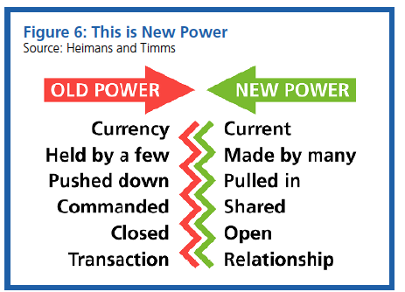
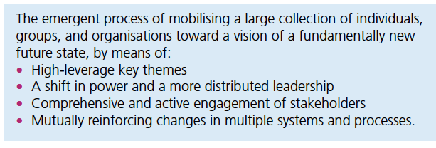
Our approach: evidence about
1. Right Care. Lancet Series 2017
2. Leading large scale change
“Many countries struggle with the question about sustainability, fairness, and equity of their health systems. With the focus firmly on universal health coverage as a central part to the UN Sustainable Development Goals, there is an opportunity to examine how to achieve optimum access to, and delivery of, health care and services. Underuse and overuse of medical and health services exist side-by-side with poor outcomes for health and wellbeing.
This Series ….provides a framework to begin to address overuse and underuse together to achieve the right care for health and wellbeing. The authors argue that achieving the right care is both an urgent task and an enormous opportunity.”
Nesta 2017. We change the world: what can we learn from global social movements for health?
Notes:
NHS cares for 65 million people. Sees more than 1million people every 36 hours.
NHS England. Sustainable Improvement and Horizons Team 2017. Leading large scale change: a practical guide.

Slide 39
Richard Horton, Editor, the Lancet 2017
What is right care? …. it is care that weighs up benefits
and harms, is patient-centred (taking individual circumstances, values, and wishes into account), and is informed by evidence, including cost-effectiveness. ….acknowledge that most medical services fall into a grey zone where the benefit and harm ratio for a given individual is unknown. However, an important start is to think about, and aim to influence, the drivers of poor, unnecessary, and harmful care. The authors argue that these drivers fall into three important categories: [1] money, finance, and organisations; [2] knowledge, beliefs, assumptions, bias, and uncertainty; and [3] power and human relationships.
https://www.thelancet.com/journals/lancet/article/PIIS0140-6736(16)32588-0/fulltext
Notes:
UHC and health security are two sides of the same coin. This was painfully apparent during the west African Ebola outbreak of 2014–15, when the perceived lack of quality led to community distrust in the health system, decreased utilisation of services, and an increase in morbidity and mortality from non-Ebola conditions...

Slide 40
Our case for change
“It is time to refocus attention on asthma because the total burden of disease in terms of quality of life is high yet avoidable and there is significant unwarranted variation and waste.
Only ≅ 40% of people take their prescribed treatment
Of whom only ≅ 30% then use it right
So only ≅12% are taking the right treatment right
Therefore the value of investment is severely compromised.”
BTS/SIGN Asthma 2016
Chrystyn, H., et al. (2017). "Device errors in asthma and COPD: systematic literature review and meta-analysis." NPJ Prim Care Respir Med 27(1): 22

Slide 41
What is Right Care?
Our working definitions
Doing the right things and only the right things in the right way for the right people at the right time in the right place, whatever that means in the local context
Improving the value that each person with asthma derives from their own care and treatment and the value the whole population derives from the investment in asthma care by addressing unwarranted variation; reducing waste, avoidable harm and avoidable symptoms

Slide 42
Aim
Scope
To sort asthma care once and for all for the person with asthma and for the healthcare system so that there is no unwarranted variation, and no avoidable waste or harm*.
That is
We can and should do better by getting it right first time!
The pathway from the first time someone (adult or parent) is offered a SABA, wherever that is, through to all possibilities (existing and new) for review
Phase 1: SABA use
*waste is waste of human, financial, health facility, energy and pharmacological assets.

Slide 43
What is the best single measure for our aim of asthma right care? Ultimately….
A shift in the practice average ratio of reliever:inhaled corticosteroid inhalers prescribed in a year, where the ideal ratio is 1:6 but is currently more likely to be 2:1

Slide 44
Asthma Right Care as a social movement
It’s all about the FOLLOWERS: We need to get the right people engaged, who will connect through the right channels to engage the maximum numbers of followers who are inspired to do something different: to reduce reliance on short-acting beta-agonists, and to increase faith in and use of guideline-indicated effective medicines.

Slide 45

Getting our social movement going
Sept 2017
May 2018
2019-2020
Kick starting action
Emerging and building momentum
  Nurturing voices
  Cultivating diverse interests and motivations
2
Steering Group formed and meets
3
Influencing and interacting
Navigating a complex array of relationships
National Champions Identified
SCALING UP
Delivery Team meeting
Delivery Team meeting
Delivery Team meeting
Delivery Team meeting
Symposium
Pervasiveness: affect all or just part of system?
National Steering Group Stakeholder
Mapping
Invitation UK
National Design Charrette
Pilot Phase
National Steering Group Stakeholder
Mapping
Invitation Portugal
National Design Charrette
Pilot Phase
Depth: ways of thinking and doing – cognitive, behavioural or paradigm shift?
Size: number
of people, geography
National Steering Group Stakeholder
Mapping
Invitation Canada
National Design Charrette
Pilot Phase
National Steering Group Stakeholder
Mapping
Invitation Spain
National Design Charrette
Pilot Phase
Notes:
References:
Nesta 2017. We change the world: what can we learn from global social movements for health?
NHS England. Sustainable Improvement and Horizons Team 2017. Leading large scale change: a practical guide.

Slide 46


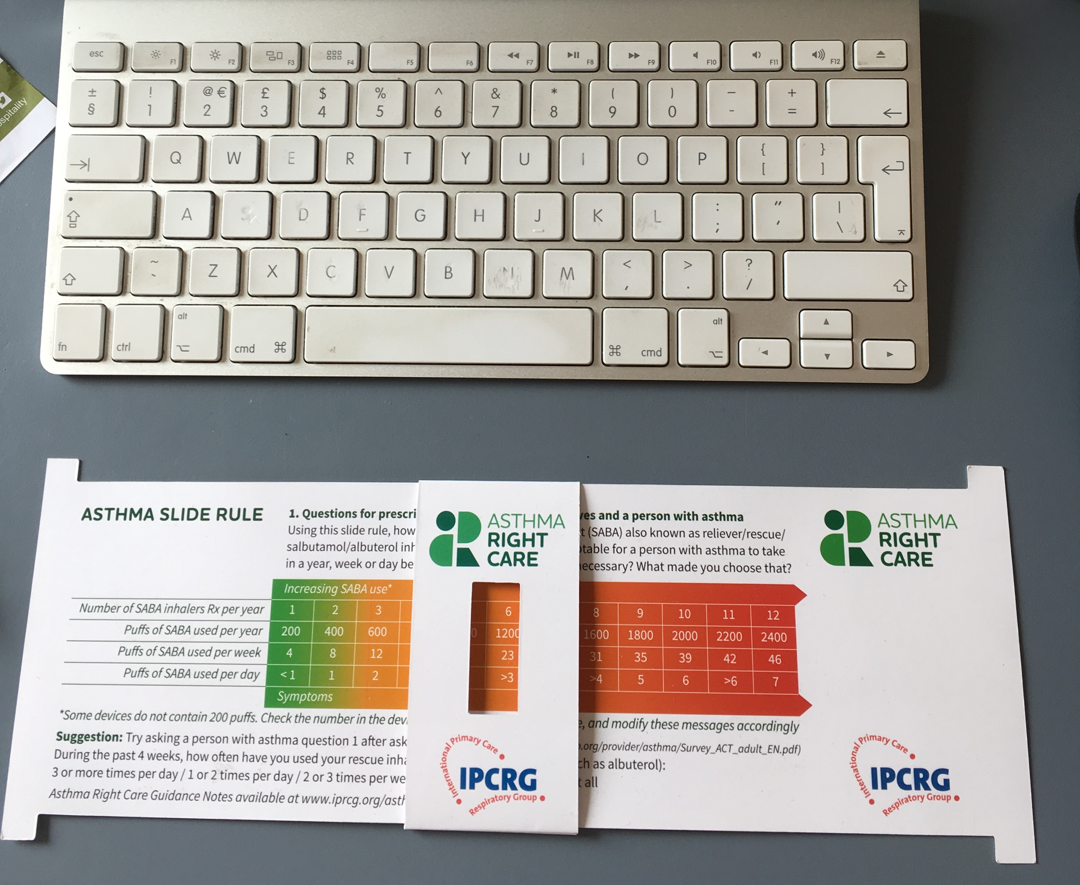
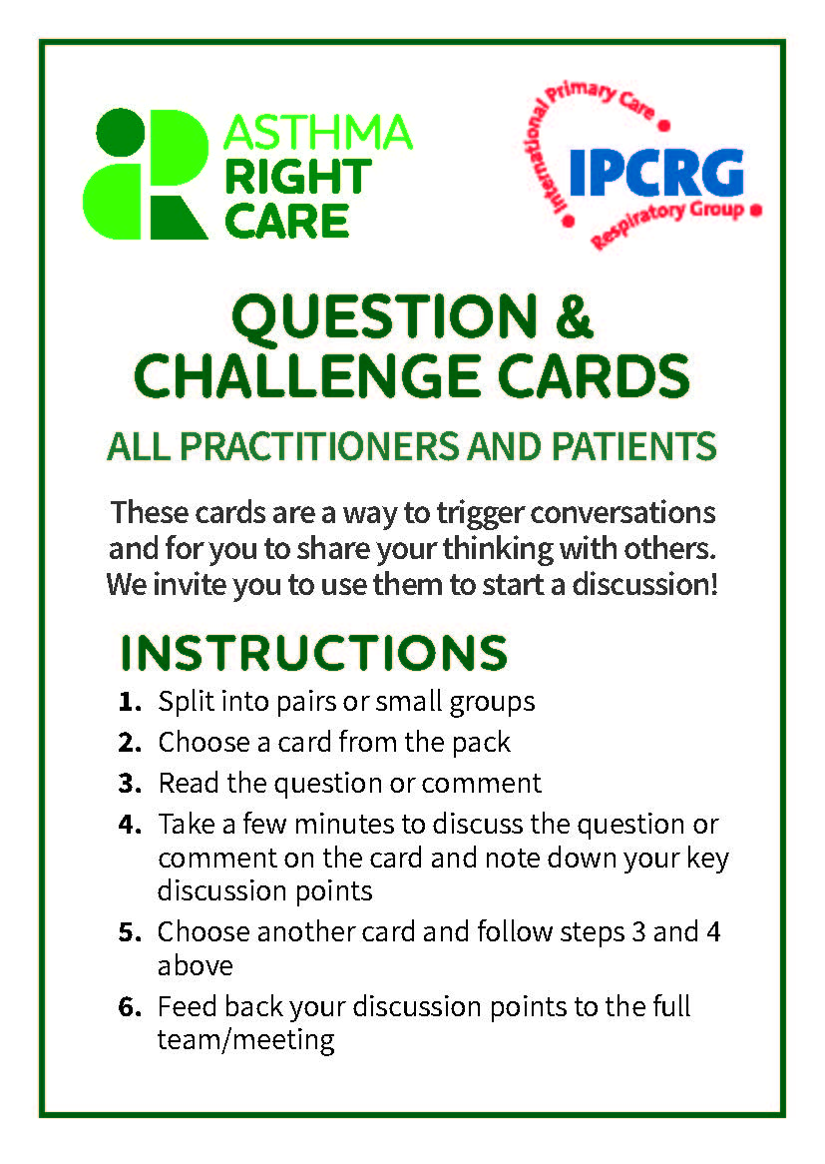
Kickstarting action
Emerging and building momentum
2
  Nurturing voices
  Cultivating diverse interests and motivations
3
Influencing and interacting
Navigating a complex array of relationships
Netherlands, Greece
France
ENVIRONMENT
Propellant & Plastic
INFORMATION
Coding
Public Information
MEDICINES
ICS: SABA Ratio
Inhaler Use
New Cultures
& Languages
Argentina Mexico Brazil
Ireland, the Gulf
6 drivers in asthma health system
More parts of health system
More
geographies
Original 4
UK & Canada
Spain
Portugal
WORKFORCE
GPs / Pharmacist / Nurses
FINANCE & LEADERSHIP
PERSONAL
Networking
Policy Briefing
Going deeper:
Paradigm / behaviour shift
Unconscious Incompetence
Asthma Slide Rule & Question Cards
Conscious Incompetence: what could I do better?
Conscious Competence
Regional Teach The Teacher Master Classes to create trusted regional master teachers
What is right care?
Unconscious Competence
Mastery: Conscious Competence of Unconscious Incompetence

Slide 47
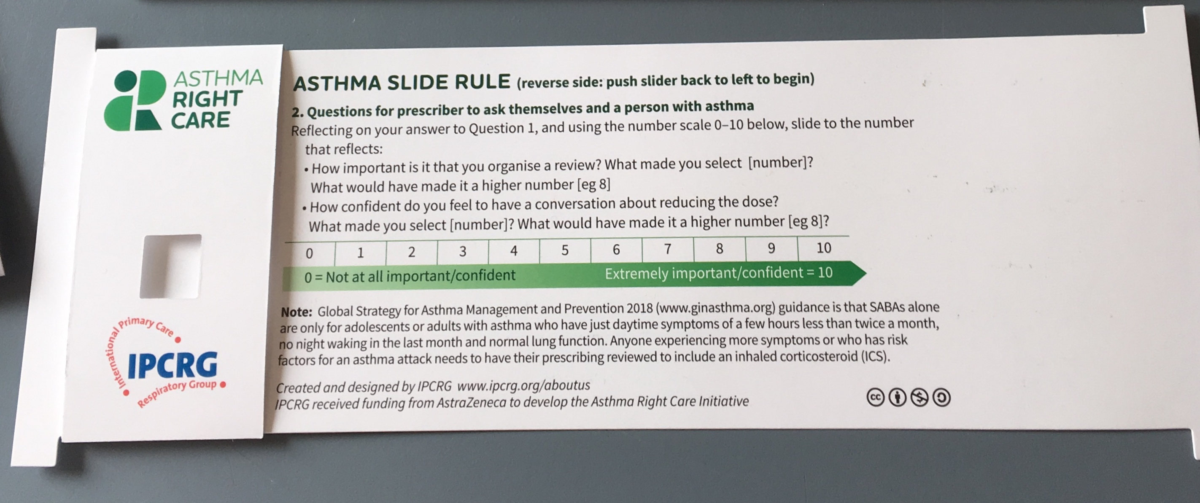
Prototype conversation pieces for discussion and co-creation in the design charrettes
Hunch 1: Lack of knowledge about how many puffs or doses in an inhaler and how many is too many in a year
Hunch 2: Pharmacists keen to do more but out of date “take your blue inhaler to open up your airways” – reveals no investment in education since this was the norm
Hunch 3: General practitioners/family physicians keen to emphasise art rather than science of the consultation, and so not up-to-date with guidelines eg “What’s the probability of them having asthma?” not routine question yet
Ambition: Embrace more people, more methods, bring joy to lives: let’s have fun, while being challenging

Slide 48
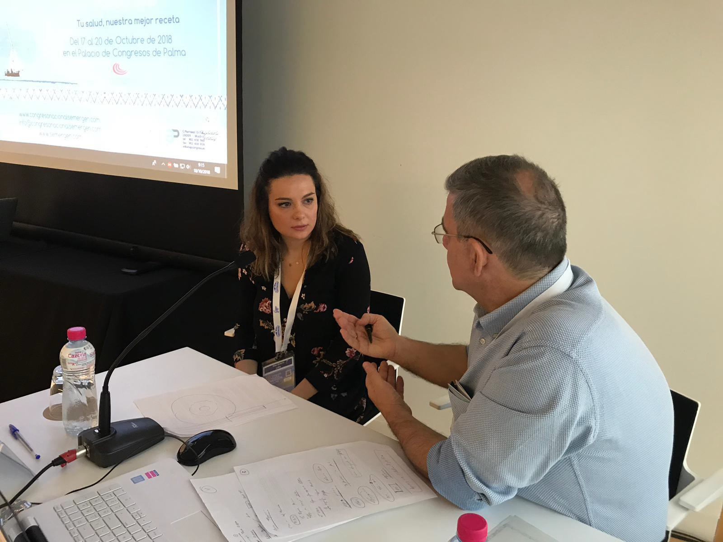
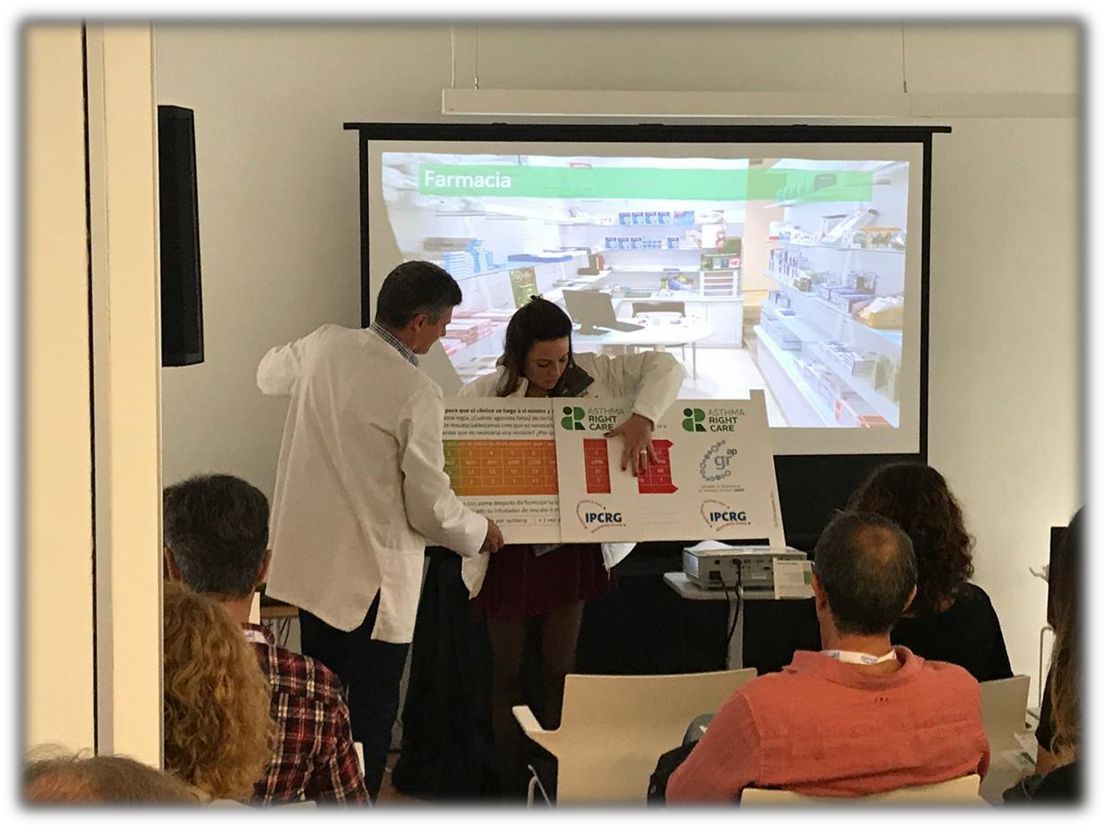
Summary of the Asthma Right Care movement
c. 10,000 frontline healthcare professionals and global primary care leaders reached so far
4 international conferences attended
Multiple national conferences
Materials produced
  Asthma Right Care Slide Rule and Guidance Notes produced in English, Spanish and Portuguese
  Question Cards produced in different formats and in English, Spanish and Portuguese
  SABA questionnaire from Rob Horne endorsed by IPCRG
  New asthma narrative from Rob Horne

Slide 49
What has Asthma Right Care changed for you?
It has changed my approach to leading a large scale change for asthma management. It means to move towards a new vision that is better and fundamentally different from the Status Quo. This Project has pointed me in the right direction for creating and sustaining large scale change and transformation.This framework helps us to increase personal value, value for the population and rates of higher value intervention.
Mar Martinez, GP
ARC is changing our lives because we are reflecting about our work quality in a biopsychosocial dimension while we try to make every single step to provide all the asthma right care to patients and caregivers reconciling it with daily work. At the same time it is incredible how we can apply this knowledge to other diseases and procedures.
Teamwork is very rewarding, making us grow as a person and as a healthcare professional.
Cláudia Vicente, GP

Slide 50
Summary of learning
Be brave: talk numbers!
  Eg Systematic review 2018 “excessive over-use” but NO definition
  What is the ratio we should be aiming for between ICS and SABA? What’s yours?
Be curious about what happens outside the consulting room and why
Be passionate about equity and safety
Select your words carefully;
  “Over-reliance” vs over-use
  SABA for asthma vs SABA for COPD
  Dose or puff
  Rescue or relieve
  Stops asthma vs stops asthma attacks
  “As directed” by your GP….
  “As needed”…
  A “puff” is a breathless moment: count those moments…. 2400 breathless moments in a year = 12 inhalers
Consider role of pharmacist
  The “rate limiting step” in most asthma pathways is the quality of the interaction with the pharmacist

Slide 51
Findings: impact of a social movement
How is it different from previous change programmes on asthma care?
Who are the followers?
Why do they engage?
What impact on motivation, opportunity and capability?
Does it have more impact on the system?
(COM-B) Michie et al 2011
Participant reactions
Participant use of new knowledge and skills
Impact on participants, practice and service users
Participant learning
Organisational support and change
IPCRG model of evaluation after Guskey

Slide 52
Findings: supply-side (COM-B)
The right diagnosis is not made because asthma is a variable disease and needs more than one visit but the clinician only sees the patient once. Possible reasons:
  Primary care not incentivised for long term care so only sees the patient once for diagnosis and treatment (M)
  Follow-up and review not part of normal care so the suggestion to return is considered by the patient to be clinician "upselling” (O)
  Education and training needs (C)
The individual communication of the diagnosis is not accurate:
  Is bronchoconstriction AND inflammation explained?
  Are the words asthma actually used? Some clinicians avoid it for fear of worrying their patients
  Are there visual tools and models available to help explain?
  Is it described as a chronic/long term condition or episodic?
  Is the treatment linked to the diagnosis?
  Are metaphors used to help describe the problem?

Slide 53
Findings: supply-side
Prescribing is not right because:
  The diagnosis is made through a "trial of treatment" which is often still SABA, although it should be ICS; never reviewed and the person continues on SABA (C)
  Lack of knowledge by the prescriber about what is right despite MANY educational initiatives and guidelines. (Very strong signal from asthma slide rule and NOTE NEW 2019 GINA GUIDELINES – SABA alone not recommended)
  Intervention happens in the Emergency Department, and is never reviewed in primary care; ED practice may be out of date; ED practice may suit patients - eg episodic use of oral steroids despite risks of harm (C)
  Lack of access to the right medicine (affordability, stocks, formulary) (O)
  The wrong incentives (eg in some LMICs there's a limit on the number of ICS that can be prescribed, but not SABA) (M)
  Inadequate shared decision-making about treatment which affects adherence (C)

Slide 54
Findings: supply-side
Dispensing is not right because
  There is little investment in pharmacist education (C)
  Pharmacists are not incentivised to offer patient support & education (M)
  Pharmacists may spot a problem but are not confident to challenge the prescriber (who may provide a supply of business) (M)
  Pharmacists are out of date: 30 years ago it used to be taught "first take the SABA to open up the airways, then take the ICS." We now know that's not right (C)
  Pharmacists are able to sell SABA over the counter (normally only "for emergencies") and so they do: it's in their interests to keep customers happy and, they hope, healthy. (O)

Slide 55
Findings: demand-side
Patient beliefs about asthma. Assuming they have been given the diagnosis
  How grave/important is an asthma diagnosis?
  How rare/common is an asthma diagnosis?
  How specific is the word “asthma”?
Patient beliefs about medicines
  SABA
  ICS
Practical problems of using medicines:
  Are the inhalers available?
  Are they affordable?
  Does the person know the name of their medicine and what it’s for (eg asthma or COPD….it matters in the story about over-reliance on SABA)
  Can they use/still use the inhaler?
  Were they prescribed a spacer?
  Has anyone taught the patient how to use the inhaler?

Slide 56


Slide 57
What can you commit to?
Act now!
Find out more at www.ipcrg.org/asthmarightcare
IPCRG received funding from AstraZeneca to develop the Asthma Right Care Initiative

Slide 58
Additional resources

Slide 59
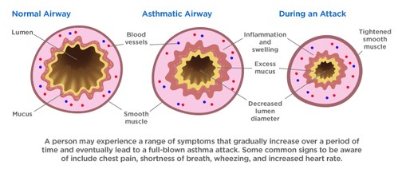
Asthma is an inflammatory disease
Asthma is a chronic inflammatory disease of the airways leading to bronchial constriction
HealthCentral. Anatomy of an asthma attack. Available at: https://www.healthcentral.com/article/anatomy-of-an-asthma-attack-infographic?ap=2012

Slide 60
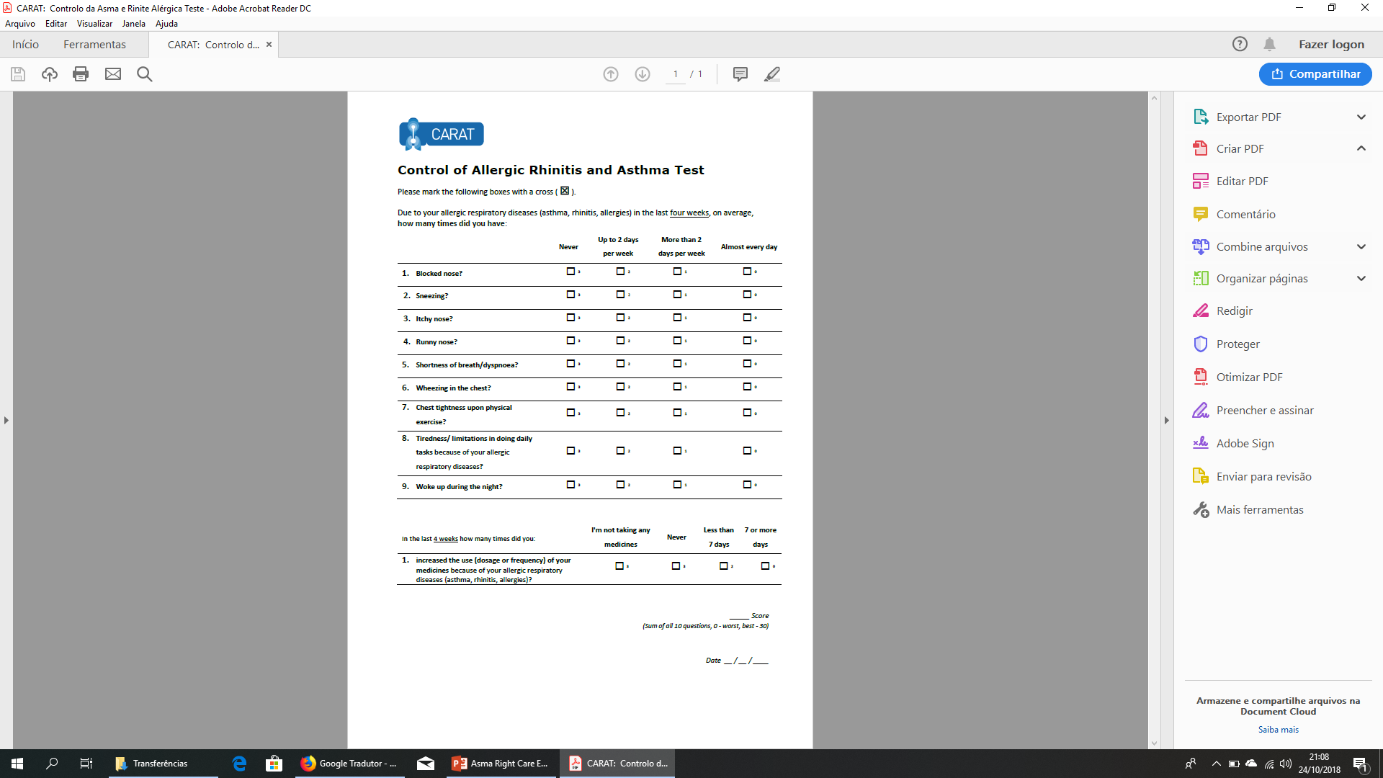
x
x
x
x
x
x
x
x
x
x
x
x
22
x
x
Lourenço O, Calado S, Sá-Sousa A, Fonseca J. Evaluation of allergic rhinitis and asthma control in a Portuguese community pharmacy setting. J Manag Care Spec Pharm. 2014 May;20(5):513-22. http://www.amcp.org/WorkArea/DownloadAsset.aspx?id=18027
CARAT, Control of Allergic Rhinitis and Asthma Test
Available at: https://www.new.caratnetwork.org. Accessed March 2019.
Notes:
CARAT has 10 questions that ask about symptoms during the previous 4 weeks (Table 1). CARAT total score (CARAT-t) ranges from 0 to 30, with a score higher than 24 indicating good overall control. The questionnaire is further divided into 2 sections: the first section relates to allergic rhinitis (CARAT-r), with a score range of 0 to 12 and a value higher than 8 identifying controlled AR; the second section relates to asthma (CARAT-a), with a score range of 0 to 18 and a value of 16 or higher identifying controlled asthma. So:
Total score ≥ 24 (good overall control)
A score ≥ 8 in questions 1 to 4 (good control for upper airways)
A score ≥ 16 in questions 5 to 10 (good control for lower airways)
People in English speaking countries might prefer to use an ACT score instead of CARAT. It’s OK to provide that alternative.

Slide 61
x
x
x
x
x
x
x
x
x
x
x
x
x
x
x
22
x
Lourenço O, Calado S, Sá-Sousa A, Fonseca J. Evaluation of allergic rhinitis and asthma control in a Portuguese community pharmacy setting. J Manag Care Spec Pharm. 2014 May;20(5):513-22. http://www.amcp.org/WorkArea/DownloadAsset.aspx?id=18027
CARAT, Control of Allergic Rhinitis and Asthma Test
Available at: https://www.new.caratnetwork.org. Accessed March 2019.
Notes:
CARAT has 10 questions that ask about symptoms during the previous 4 weeks (Table 1). CARAT total score (CARAT-t) ranges from 0 to 30, with a score higher than 24 indicating good overall control. The questionnaire is further divided into 2 sections: the first section relates to allergic rhinitis (CARAT-r), with a score range of 0 to 12 and a value higher than 8 identifying controlled AR; the second section relates to asthma (CARAT-a), with a score range of 0 to 18 and a value of 16 or higher identifying controlled asthma. So:
Total score ≥ 24 (good overall control)
A score ≥ 8 in questions 1 to 4 (good control for upper airways)
A score ≥ 16 in questions 5 to 10 (good control for lower airways)
People in English speaking countries might prefer to use an ACT score instead of CARAT. It’s OK to provide that alternative.

Slide 62
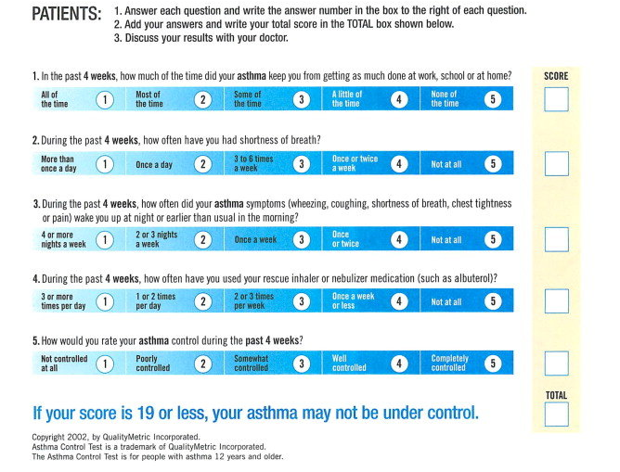
ACT: Asthma Control Questionnaire
Available at: https://www.asthmacontroltest.com/. Accessed March 2019.

Slide 63
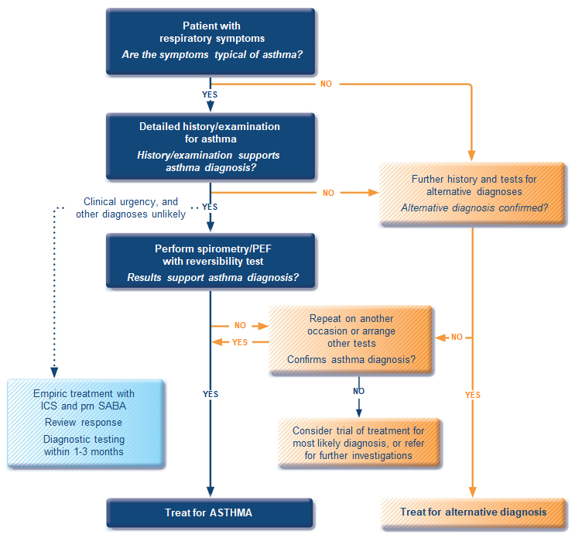
GINA 2018 guidelines for the diagnosis of asthma
ICS, inhaled corticosteroid; PEF, peak expiratory flow; SABA, short-acting beta₂-agonist.
Available at: www.gina.com. Accessed March 2019.

Slide 64
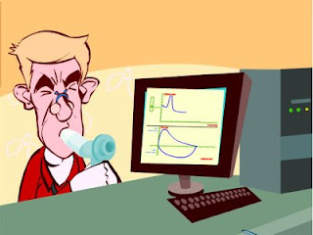
Spirometry
Spirometry measures airflow and lung volumes, and is the preferred lung function test for asthma in primary care
Forced exhalation from a maximal inspiration
FVC: Forced vital capacity | FEV1: Forced Expiratory Volume in 1 second | FEV1/FVC
Volume of air exhaled after full inspiration and full exhalation | Volume of air exhaled in the first second of forced exhalation | Ratio of vital capacity exhaled in 1 second expressed as a percentage of the total volume of air exhaled after full inspiration and full exhalation
For further guidance visit: http://bit.ly/IPCRG-SPIROMETRY-WONCA-2018

Slide 65
Spirometric patterns
FEV1/FVC
FVC
FEV1
Obstruction
N
Restriction
N
N
Mixed
Obstruction and hyperinflation
Mild Obstruction | FEV1 ≥80%
Moderate Obstruction | FEV1 <80% ≥50%
Severe Obstruction | FEV1 <50% ≥35%
Very Severe Obstruction | FEV1 <35%
For further guidance visit: http://bit.ly/IPCRG-SPIROMETRY-WONCA-2018

Slide 66
Quick spirometry assessment
FEV₁ /FVC
≥70%
Normal
<70%
Obstruction
FVC
FVC
< 80% ref value
<80% ref. value
≥80% ref value
Mixed pattern
≥80% ref value
OBSTRUCTION
+ HYPERINFLATION (↑VR)
NORMAL
RESTRICTION
OBSTRUCTION
OBSTRUCTION
+
RESTRICTION
(VR normal)
For further guidance visit: http://bit.ly/IPCRG-SPIROMETRY-WONCA-2018

Slide 67
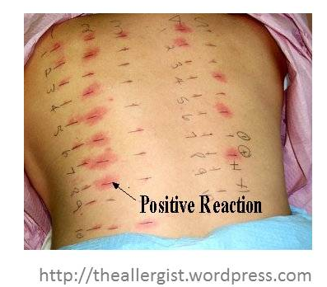
Allergy testing and how to interpret the results
Skin prick test is the most sensitive test for allergies
  Suspected allergens are mixed with liquid to form a solution
  Drops are placed on the skin surface
  The top surface of the skin is pricked beneath each drops
  A positive reaction is indicated by reddening, itch and swelling

Slide 68
How to review inhalation technique
Ask the patient beforehand to bring their own inhaler for the consultation
Ask them to demonstrate how they use their inhaler
Correct some aspects and explain why
If possible use videos
    Observe technique and let the patient observe self (using video demonstrations)
Show you are available to review their technique if necessary
Ask the patient to bring their own inhaler for the next appointment
Notes:
Resources for reviewing inhaler technique:
Asthma review series: Part 3 - Inhaler Technique and Recording Peak Flow. Available at: https://www.youtube.com/watch?v=ZhIcT57i32g
Asthma inhaler techniques (children). Available at: https://www.youtube.com/watch?v=fHcG8DXUwdQ
Asthma: inhaler techniques: Available at: https://www.nhs.uk/Video/Pages/Childrensasthmainhaler.aspx

Slide 69
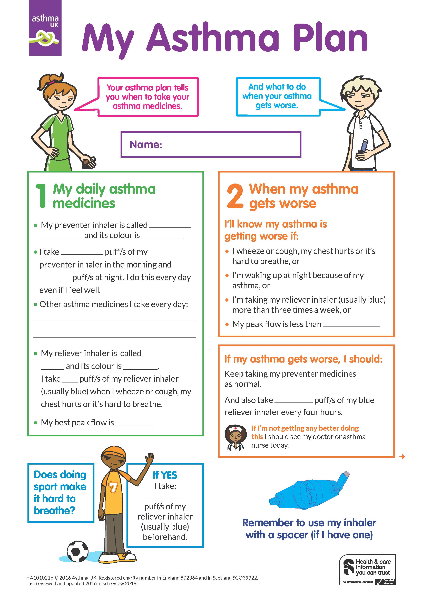
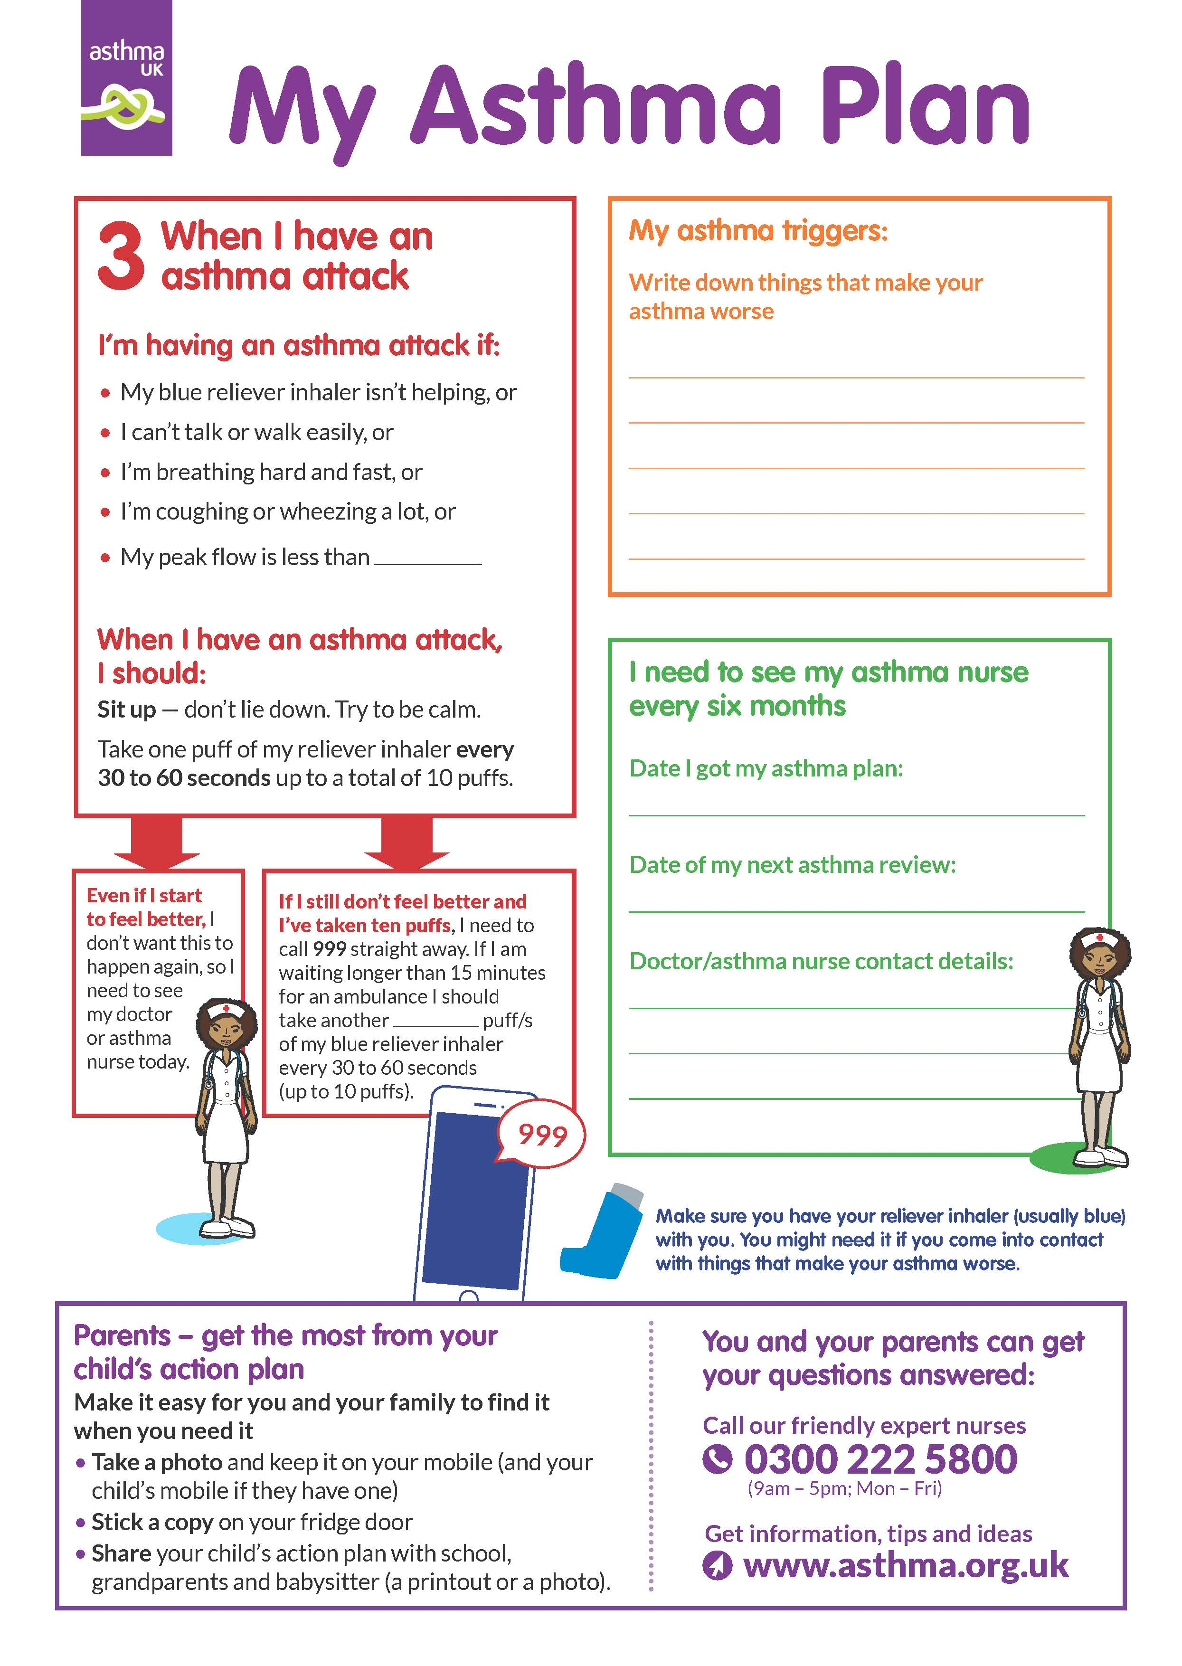
Child Asthma Action Plan
Child Asthma Action Plan
Available at: https://www.asthma.org.uk/def9655d/globalassets/health-advice/resources/children/child-asthma-action-plan.pdf . Accessed March 2019.

Slide 70
GINA 2019: Step 1
Preferred controller: as-needed low dose ICS-formoterol (off-label)
  High importance given to reducing exacerbations
  High importance given to poor adherence with regular ICS in patients with infrequent symptoms, which would expose them to risks of SABA-only treatment
Other controller options:
  Consider adding regular low dose ICS taken whenever SABA is taken
STEP 5
High dose ICS-LABA
Refer for phenotypic assessment
± add-on therapy, e.g.tiotropium, anti-IgE,
anti-IL5/5R,
anti-IL4R
STEP 4
Medium dose ICS-LABA
STEP 3
Low dose ICS-LABA
STEP 2
Daily low dose inhaled corticosteroid (ICS), or as-needed low dose ICS-formoterol *
PREFERRED CONTROLLER
to prevent exacerbations and control symptoms
STEP 1
As-needed low dose
ICS-formoterol *
Other controller options
Low dose ICS taken whenever SABA is taken †
Leukotriene receptor antagonist (LTRA), or low dose ICS taken whenever SABA taken †
Medium dose ICS, or low dose ICS+LTRA #
High dose ICS, add-on tiotropium, or add-on LTRA #
Add low dose OCS, but consider
side-effects
PREFERRED RELIEVER
As-needed low dose ICS-formoterol *
As-needed low dose ICS-formoterol ‡
Other reliever option
As-needed short-acting β₂ -agonist (SABA)
ICS, inhaled corticosteroid; SABA, short-acting beta₂-agonist.
Available at: www.gina.com. Accessed March 2019.

Slide 71
GINA 2019: Step 2
Preferred controllers: Daily low dose ICS plus an as-needed SABA, or as-needed low dose ICS-formoterol (off-label)
  Low dose ICS reduces symptoms and reduces risk of exacerbations and asthma-related hospitalization and death
Other controller options:
  Low dose ICS taken whenever SABA is taken
  Leukotrine receptor antagonists
  Daily low dose ICS-LABA
STEP 5
High dose ICS-LABA
Refer for phenotypic assessment
± add-on therapy, e.g.tiotropium, anti-IgE,
anti-IL5/5R,
anti-IL4R
STEP 4
Medium dose ICS-LABA
STEP 3
Low dose ICS-LABA
STEP 2
Daily low dose inhaled corticosteroid (ICS), or as-needed low dose ICS-formoterol *
PREFERRED CONTROLLER
to prevent exacerbations and control symptoms
STEP 1
As-needed low dose
ICS-formoterol *
Other controller options
Low dose ICS taken whenever SABA is taken †
Leukotriene receptor antagonist (LTRA), or low dose ICS taken whenever SABA taken †
Medium dose ICS, or low dose ICS+LTRA #
High dose ICS, add-on tiotropium, or add-on LTRA #
Add low dose OCS, but consider
side-effects
PREFERRED RELIEVER
As-needed low dose ICS-formoterol *
As-needed low dose ICS-formoterol ‡
Other reliever option
As-needed short-acting β₂ -agonist (SABA)
ICS, inhaled corticosteroid; SABA, short-acting beta₂-agonist.
Available at: www.gina.com. Accessed March 2019.

Slide 72
GINA 2019: Step 3
Preferred controller: Low dose ICS-LABA maintenance plus as-needed SABA, OR low dose ICS-formoterol maintenance and reliever therapy
Other controller options:
  Medium dose ICS, or low dose ICS plus LTRA
For children aged 6-11 years the preferred controller is medium dose ICS or low dose ICS-LABA
STEP 5
High dose ICS-LABA
Refer for phenotypic assessment
± add-on therapy, e.g.tiotropium, anti-IgE,
anti-IL5/5R,
anti-IL4R
STEP 4
Medium dose ICS-LABA
STEP 3
Low dose ICS-LABA
STEP 2
Daily low dose inhaled corticosteroid (ICS), or as-needed low dose ICS-formoterol *
PREFERRED CONTROLLER
to prevent exacerbations and control symptoms
STEP 1
As-needed low dose
ICS-formoterol *
Other controller options
Low dose ICS taken whenever SABA is taken †
Leukotriene receptor antagonist (LTRA), or low dose ICS taken whenever SABA taken †
Medium dose ICS, or low dose ICS+LTRA #
High dose ICS, add-on tiotropium, or add-on LTRA #
Add low dose OCS, but consider
side-effects
PREFERRED RELIEVER
As-needed low dose ICS-formoterol *
As-needed low dose ICS-formoterol ‡
Other reliever option
As-needed short-acting β₂ -agonist (SABA)
ICS, inhaled corticosteroid; LABA, long-acting bronchodilator; SABA, short-acting beta₂-agonist.
Available at: www.gina.com. Accessed March 2019.

Slide 73
GINA 2019: Step 5
Refer for phenotypic investigation ± add-on treatment
Add-on treatments include:
  Tiotropium by mist inhaler for patients ≥6 years with a history of exacerbations
  For severe allergic asthma, anti-IgE (SC omalizumab, ≥6 years)
  For severe eosinophilic asthma, anti-IL5 (SC mepolizumab, ≥6 years, or IV reslizumab, ≥18 years) or anti-IL5R (SC benralizumab, ≥12 years) or anti-IL4R (SC dupilumab, ≥12 years)
STEP 5
High dose ICS-LABA
Refer for phenotypic assessment
± add-on therapy, e.g.tiotropium, anti-IgE,
anti-IL5/5R,
anti-IL4R
STEP 4
Medium dose ICS-LABA
STEP 3
Low dose ICS-LABA
STEP 2
Daily low dose inhaled corticosteroid (ICS), or as-needed low dose ICS-formoterol *
PREFERRED CONTROLLER
to prevent exacerbations and control symptoms
STEP 1
As-needed low dose
ICS-formoterol *
Other controller options
Low dose ICS taken whenever SABA is taken †
Leukotriene receptor antagonist (LTRA), or low dose ICS taken whenever SABA taken †
Medium dose ICS, or low dose ICS+LTRA #
High dose ICS, add-on tiotropium, or add-on LTRA #
Add low dose OCS, but consider
side-effects
PREFERRED RELIEVER
As-needed low dose ICS-formoterol *
As-needed low dose ICS-formoterol ‡
Other reliever option
As-needed short-acting β₂ -agonist (SABA)
ICS, inhaled corticosteroid; LABA, long-acting bronchodilator; SABA, short-acting beta₂-agonist.
Available at: www.gina.com. Accessed March 2019.

Slide 74








Key asthma triggers
Psychological
triggers³
Air pollution¹
Medications*³
Exposure to bacteria²
House dust mites⁶
Smoking^{3,4}
Flowers/pollen³
Household pets^{3,4}
Exercise⁵
Alcohol³
Air-conditioning³
URTI³
URTI = upper respiratory tract infection
*Beta-blockers and non-steroidal anti-inflammatory drugs.
1. Esposito S, et al. BMC Pulm Med 2014;14:130; 2. Beigelman A, et al. Curr Opin Allergy Clin Immunol 2014;14:137–142; 3. See K, et al. Singapore Med J 2015 epub; 4. Vernon M, et al. J Asthma 2012;49:991–998; 5. Global Initiative for Asthma. Global Strategy for Asthma Management and Prevention, 2016. Available from: www.ginasthma.org; 6. Lim FL, et al. PLoS One 2015;10:e0124905.

Slide 75
SABA overuse:
An indicator of poor control (1)
UK National Review of Asthma Deaths 2012 to 2013
39% people on SABA at time of death had been prescribed more than 12 in the year before they died
  4% had been prescribed >50 SABA inhalers
  Those prescribed >12 were likely to have had poorly
  controlled asthma
National Review of Asthma Deaths: Available at: https://www.rcplondon.ac.uk/projects/national-review-asthma-deaths. Accessed March 2019.

Slide 76
SABA overuse:
An indicator of poor control (2)
“There is a progressive risk of hospital admission associated with the prescription of more than three SABA inhalers a year”
Healthcare resource use | 1-3 inhalers N=5888 | 4-12 inhalers N=2054 | >13 inhalers N=285
Inpatient episodes | 20 | 33 | 2
Crude inpatient episode rate per 100 population | 0.34 | 1.61 | 0.70
Hull SA, et al. NPJ Prim Care Respir Med. 2016;26:16049.

Slide 77
SABA overuse:
An indicator of poor control (3)
“There is some evidence that electronic alerts reduce excessive prescribing of SABAs, when delivered as part of a multicomponent intervention in an integrated health care system”
Literature review to synthesise the evidence for the use of computerised alerts that identify excessive prescribing of SABAs to improve asthma management for people with asthma
 | SABA prescribing | ICS prescribing | ICS-SABA prescribing | ICS-LABA prescribing
Study 1 |  | No effect
Study 2 | No effect | No effect
Study 3 | Positive effect | No effect |  | Positive effect
Study 4 |  | No effect | Positive effect
SABA short-acting beta₂- agonist, ICS inhaled corticosteroid, LABA long-acting beta₂-agonist.
McKibben S, et al. NPJ Prim Care Respir Med. 2018;28:14.

Slide 78
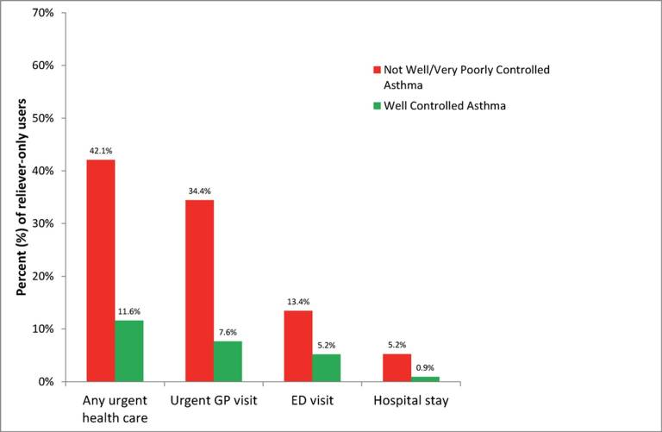
SABA overuse:
An indicator of poor control (4)
“One-quarter of the reliever-only population had needed urgent asthma healthcare in the previous year, demonstrating the importance of identifying such patients”
Cross-sectional population-based
Internet survey in Australia
Of 2686 participants ≥16 years with
current asthma randomly drawn from
a web-based panel, 1038 (50.7% male)
used only reliever medication
ED, emergency department.
Reddel HK, et al. BMJ Open. 2017;7:e016688.

