Slide 1
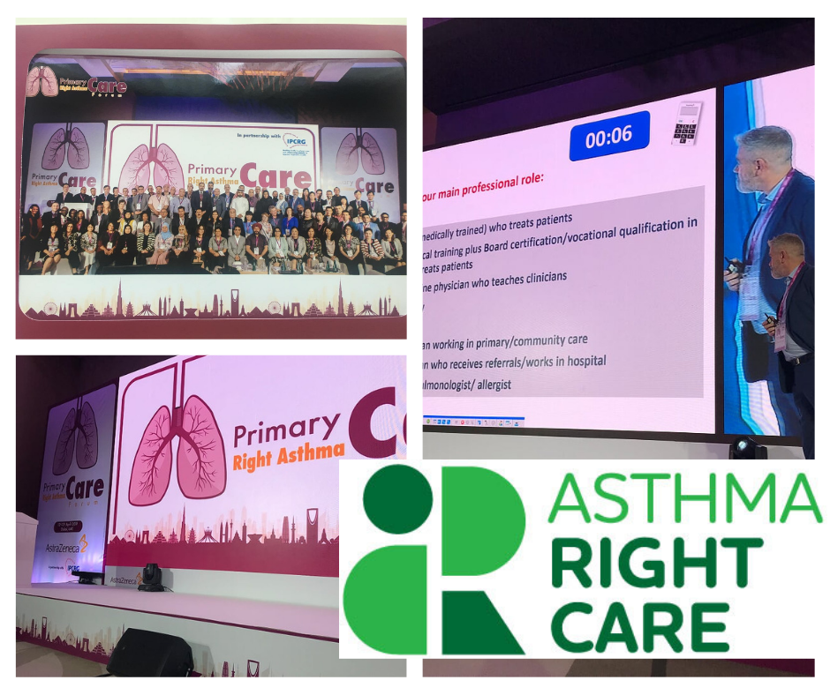
The first time, the initiative of an IPCRG-Tunisia is discussed
April2019 #IPCRG worked with Astra Zeneca to facilitate an
#AsthmaRightCare
meeting in Dubai

Slide 2
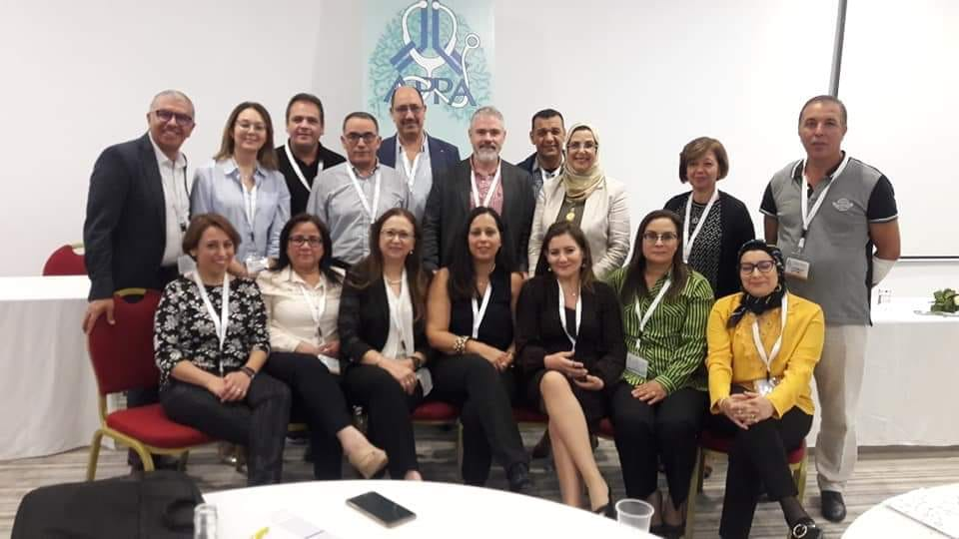
IPCRG
Tunisia
23th May 2020

Slide 3
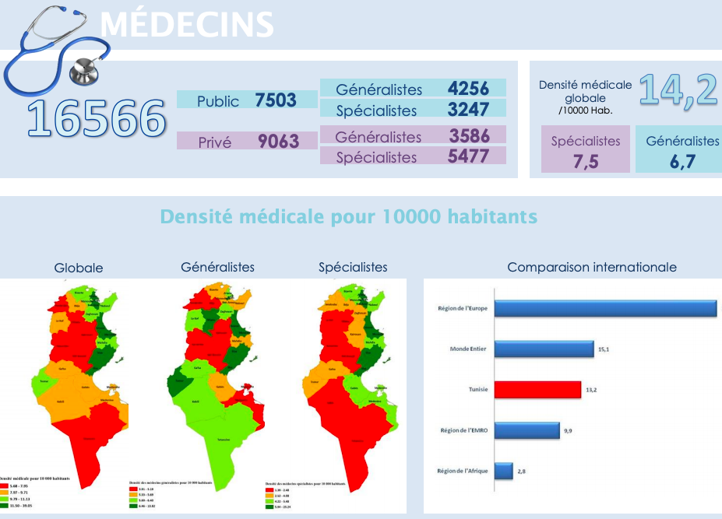

Slide 4
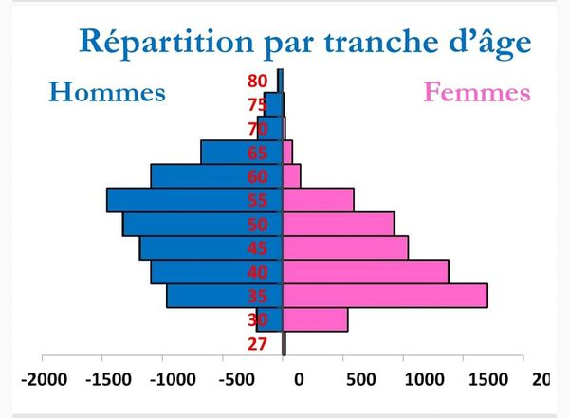
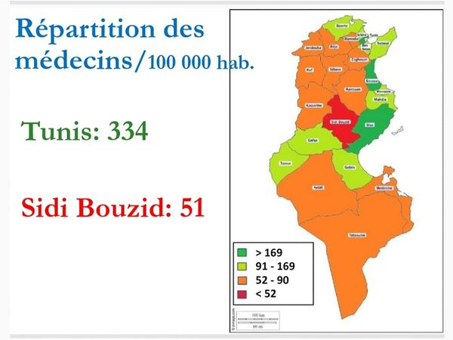
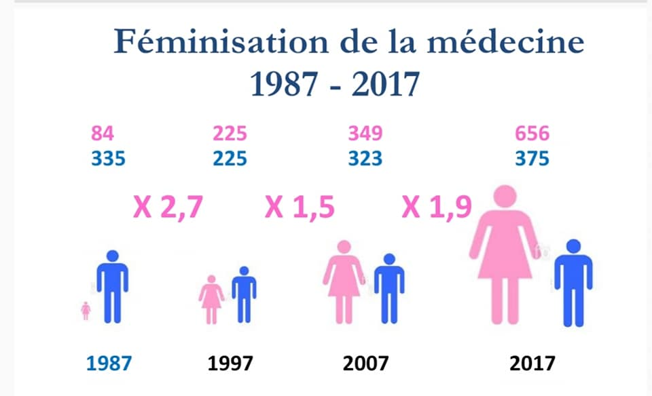
Primary Care Medicine in Tunisia : Inequalities & Gender Shift

Slide 5
Insights of Respiratory Care in Tunisia
Private Secondary Care
Public Secondary Care
Private Primary Care
Public Primary Care
Usual Care
Serious/Difficult to treat conditions

Slide 6
Insights of Respiratory Care in Tunisia
Private Secondary Care
Public Secondary Care
Private Primary Care
Public Primary Care
Usual Care
Serious/Difficult to treat conditions

Slide 7
The AIM of the IPCRG-TUNISIA GROUP We Have a Dream ….
Private Secondary Care
Public Secondary Care
Private Primary Care
Public Primary Care
Usual Care
Serious/Difficult to treat Conditions

Slide 8
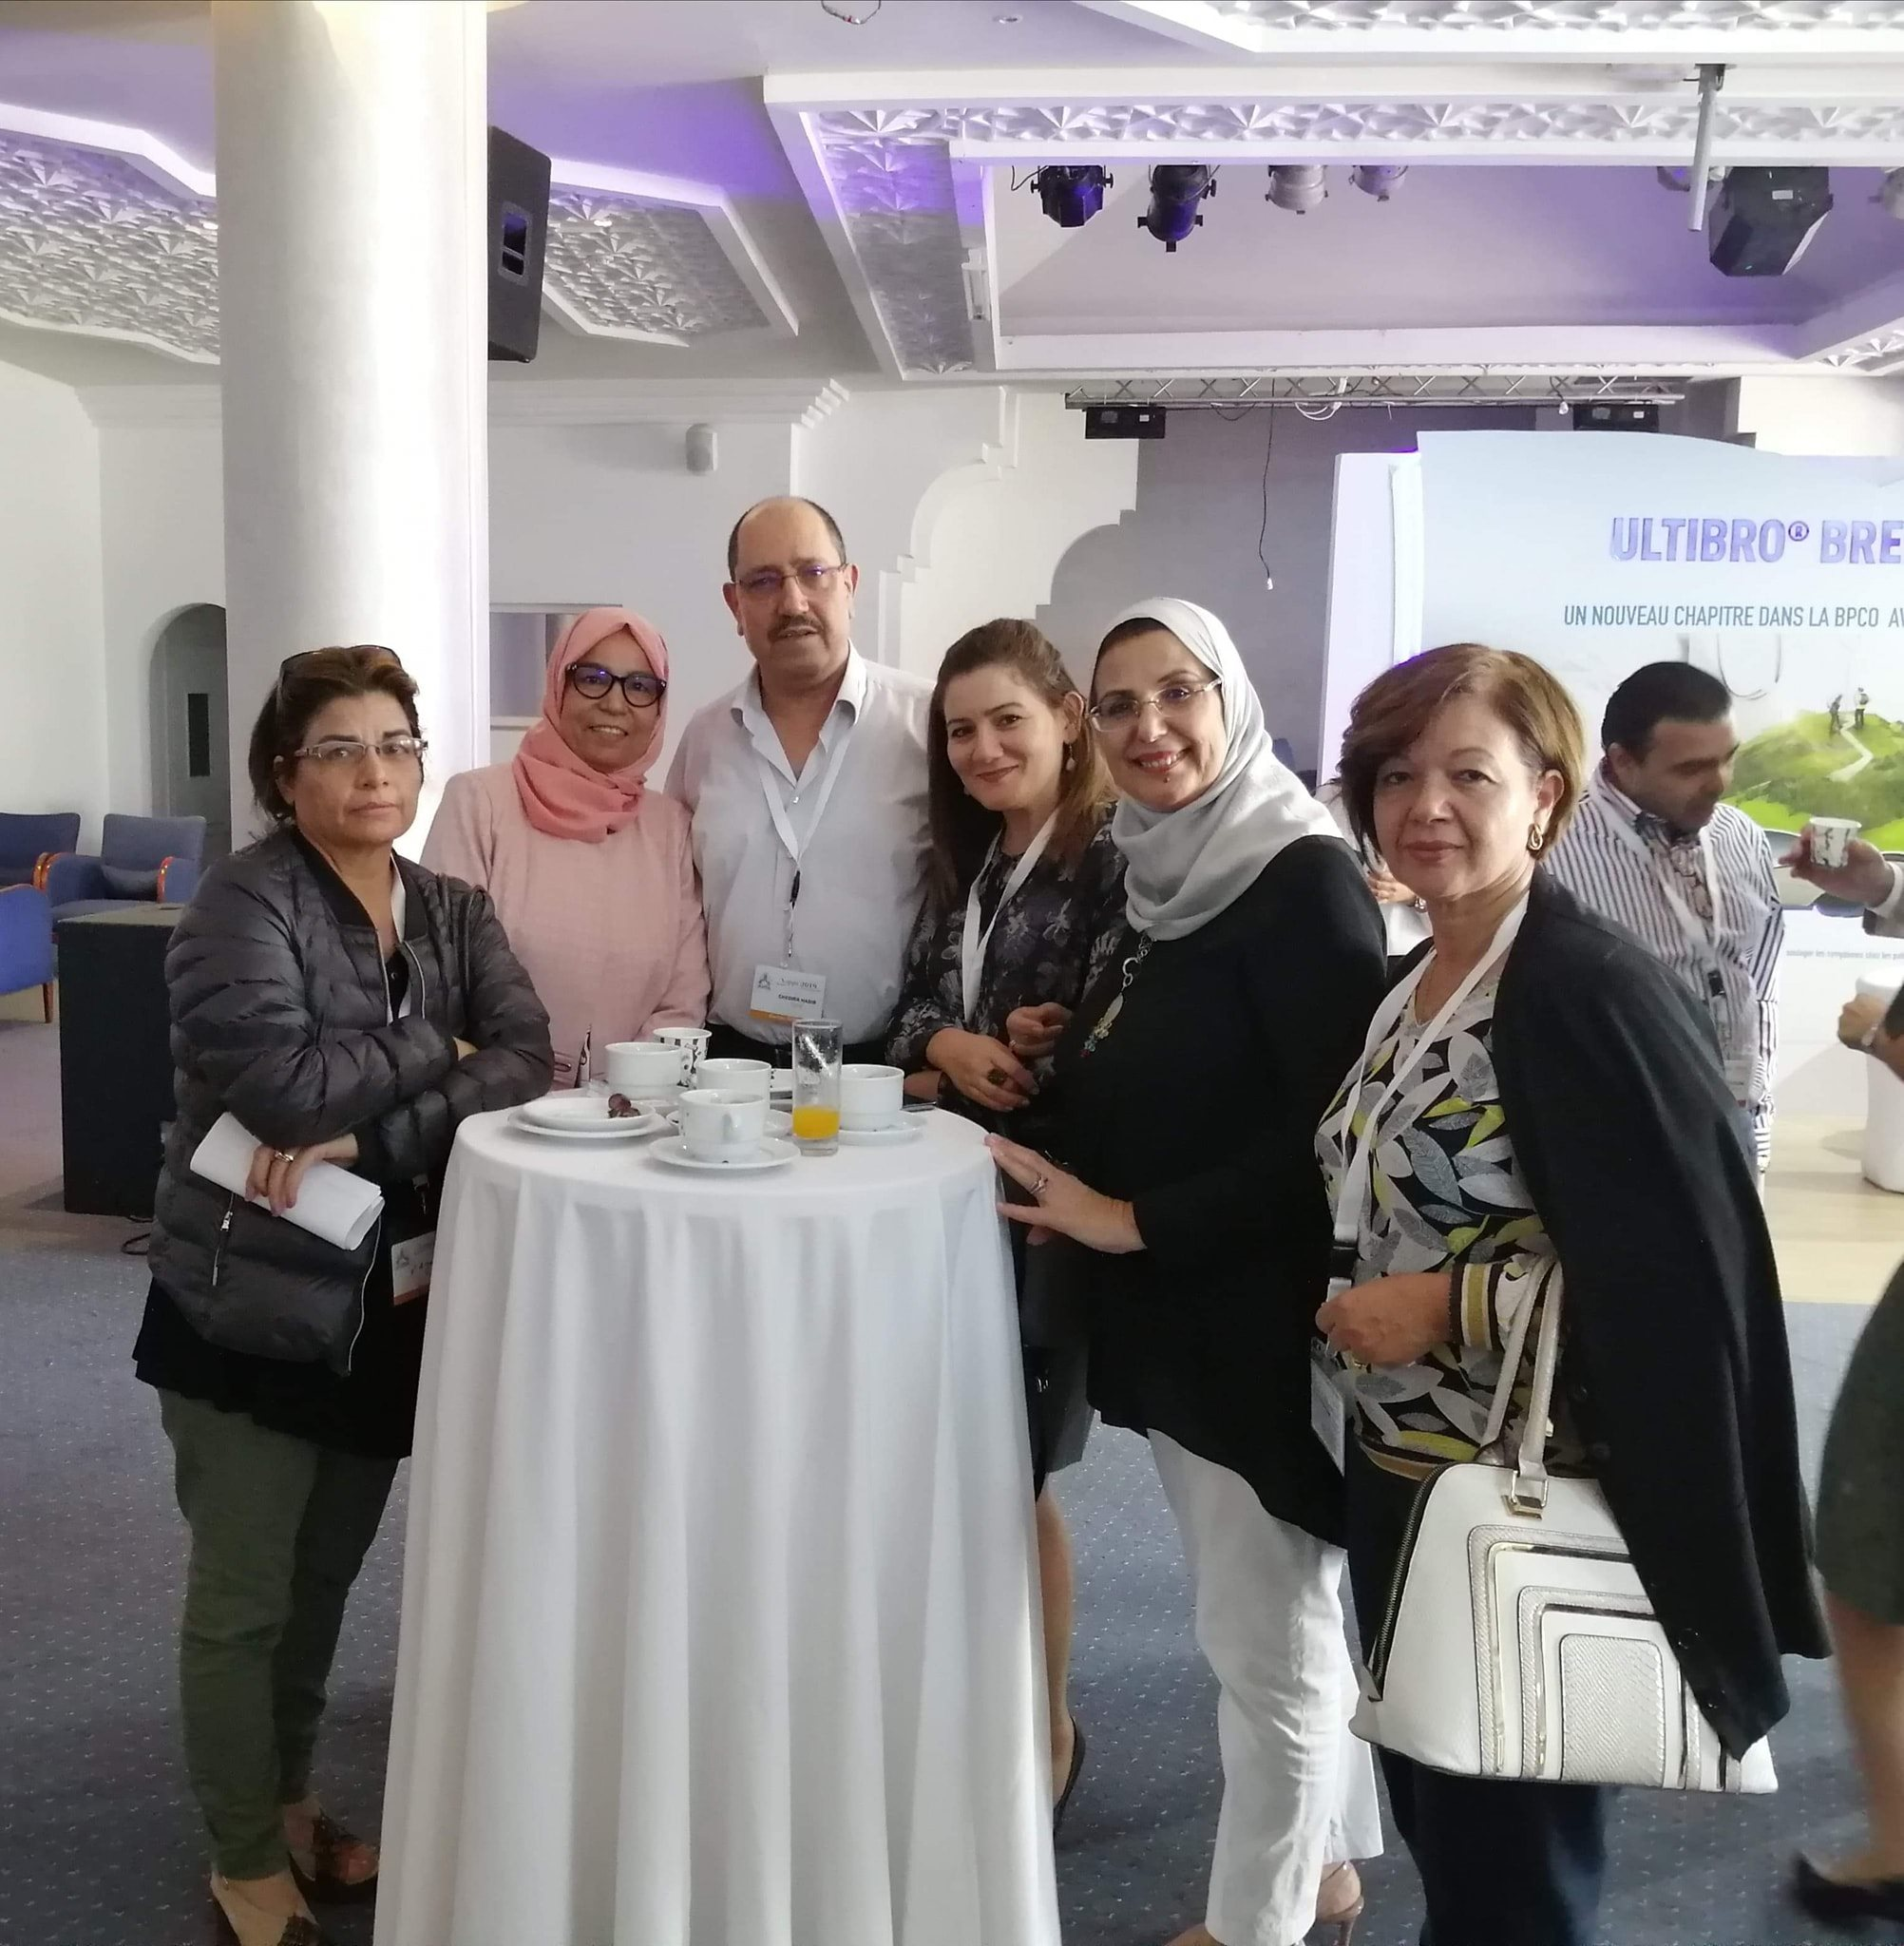
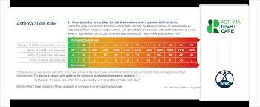
First Experiences

Slide 9
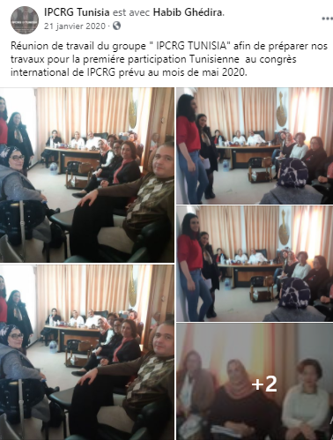

Slide 13
Next Steps
Formalize the Group National & International levels
Executive Committee Elections
Task Force : COVID-19 & Post-COVID Management
Translate and advocacy for B-2 Overreliance ruler and Questionnaire
Survey among Primary Care Health Professionals : Educational needs

Slide 14
Adapted
Tools/Guidelines/References
International
Expertise / Tools
in Primary Respiratory Care
Research & Educational Programmes
Local
Expertise / Tools
in Respiratory Medicine
Primary Care Health Professionals
Family Medicine

