Slide 1
AGM
President’s Report 2021
11th World Conference IPCRG,
5-7 May 2022, Málaga, Spain
Janwillem Kocks, the Netherlands

Slide 2
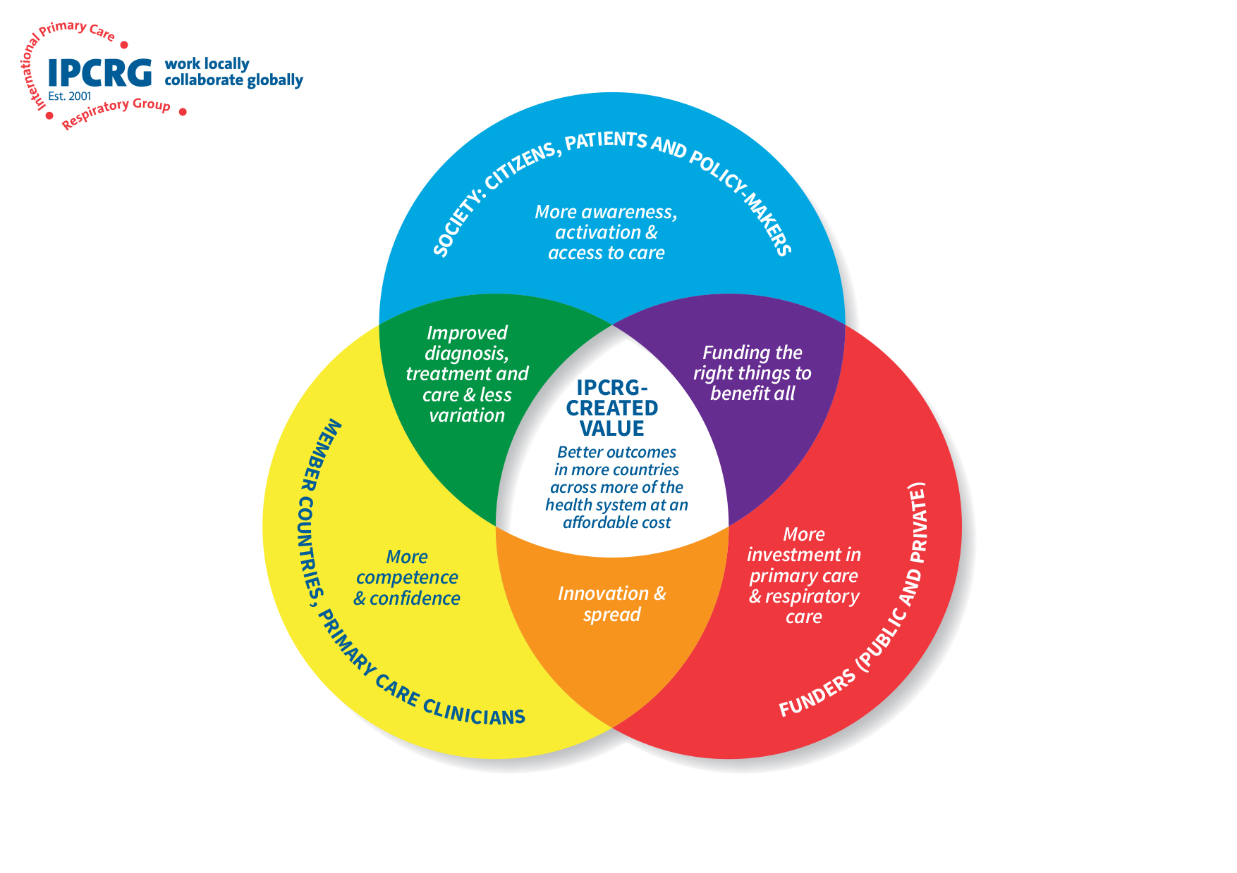
Strategic goals: Creating value (1/3)
Create value for our country members
  37 national organisations and also individual clinicians
  improving their confidence and competence
  promoting good clinical primary care practice
    including family physicians, general practitioners, pharmacists, nurses, physiotherapists, community health workers and other members of the primary care team

Slide 3
Strategic goals: Creating value (2/3)
Create value for society
  raising awareness of respiratory health amongst citizens and policy-makers
  influencing the availability of good quality primary respiratory care in their community

Slide 4
Strategic goals: Creating value (3/3)
Create value for our funders
  increasing the focus on respiratory health in communities
  improving accuracy of diagnosis in primary care
  reducing the variation and inequity in care
  improving outcomes in primary care.

Slide 5
Refinement and restatement of scope
To prioritise our efforts with countries where there is a commitment to family medicine including
  a national strategy
  the start of an infrastructure in terms of a vocational training programme
  an understanding of the family medicine holistic approach

Slide 6
Highlights 2021

Slide 7


Response to COVID-19
Remote respiratory consultation
iQ&A question and answer service focused on the COVID-19 questions raised by our Sentinel Network
Research by prize-winners of an IPCRG Research school
  Pakistan and India mentored by IPCRG faculty

Slide 8
World Conference
First online conference
  10th world conference postponed from 2020 and planned in conjunction with our Irish group
707 attendees from 49 countries

Slide 9
Education and change programmes
Two online Teach the Teacher Tier 1 programmes
Continued growth of our social movement for ‘Asthma Right Care’ to 17 countries
Webinars with International Pharmaceutical Federation
Initiation of ‘COPD Right Care’
Development of a self-funded project ‘How We Breathe’
  a video using 3D visualisation and animation
Roll-out of Teach the Teacher programme in children with asthma
  Tier 3 and 4 in Malaysia and Tier 2 in Spain.

Slide 10
Research and research strengthening
New e-Delphi exercise
  “Prioritising primary care respiratory research needs: results from the 2020 International Primary Care Respiratory Group (IPCRG) global e-Delphi exercise”
Coordination of the Global Health Respiratory Network
Romanian prize-winners of our first Research School
  manuscript on adolescents’ attitudes to e-cigarettes
Continued in 8 of our low and middle income member countries
Final publications from our innovative FRESH AIR programme
Leading stakeholder engagement in RESPIRE and stakeholder engagement and dissemination for Breathe Well

Slide 11
Operations
Active Education sub-committee building on education strategy 2014-2020
Generation of a new research strategy by our Research Leadership team
Further exploration of free and low cost online tools to enable colleagues from across the world to participate.
Recruitment of additional project managers
A sustained positive financial position
A new policy published
  IPCRG is committed to lower cost, lower environmental impact and improved social impact: the triple bottom line in global primary care

Slide 12
IPCRG’s strategy to add value

