Slide 1
Bringing climate into the consultation
Dr Tamsin Ellis
@ClimateGP
Co-chair of Greener Practice
Associate at the Centre for Sustainable Healthcare
North Central London lead for net zero primary care

Slide 2
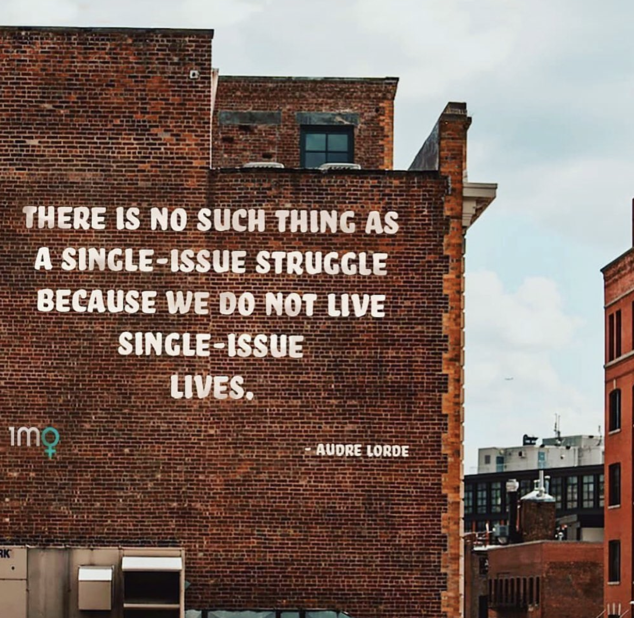
Consultations are conversations

Slide 3
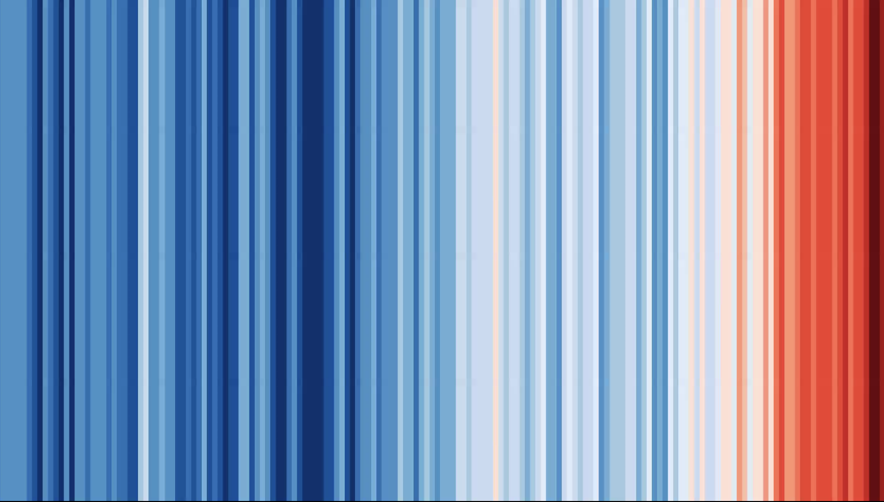
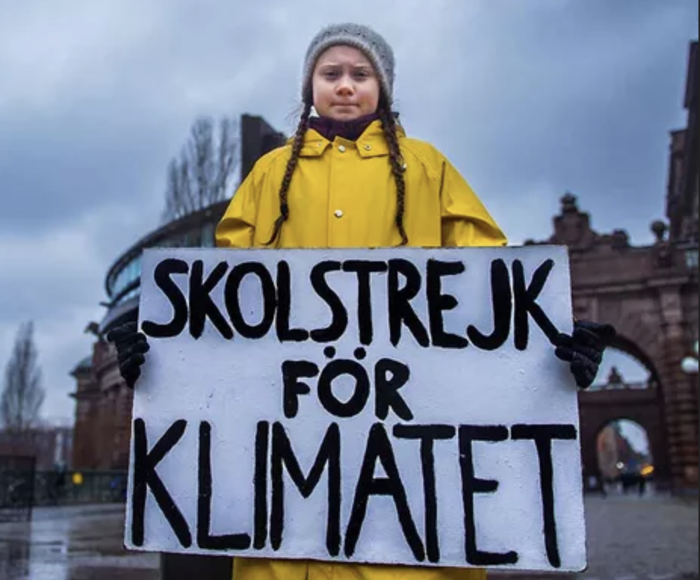
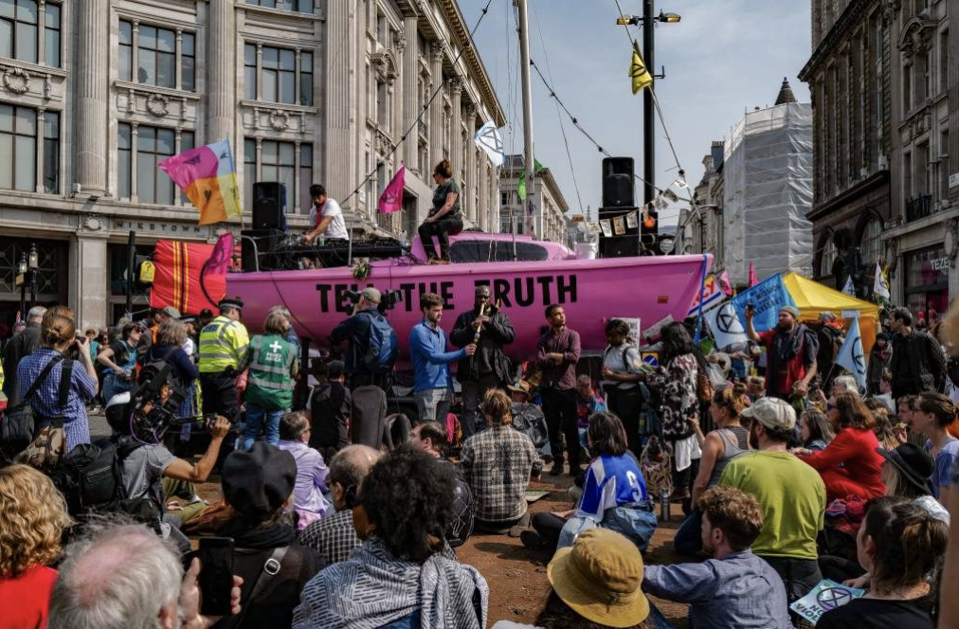
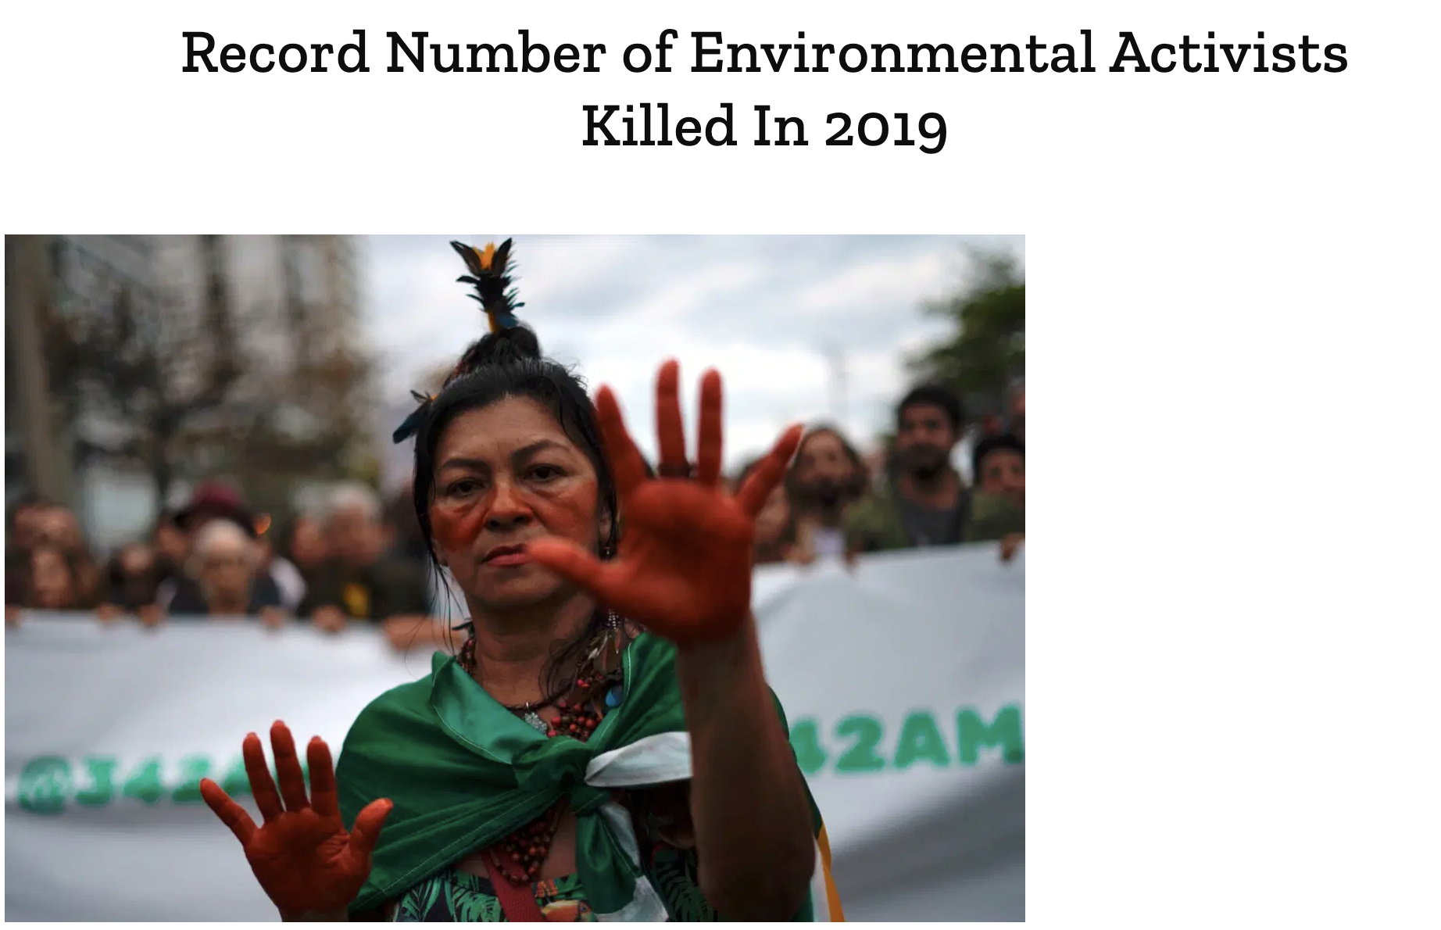

Slide 4
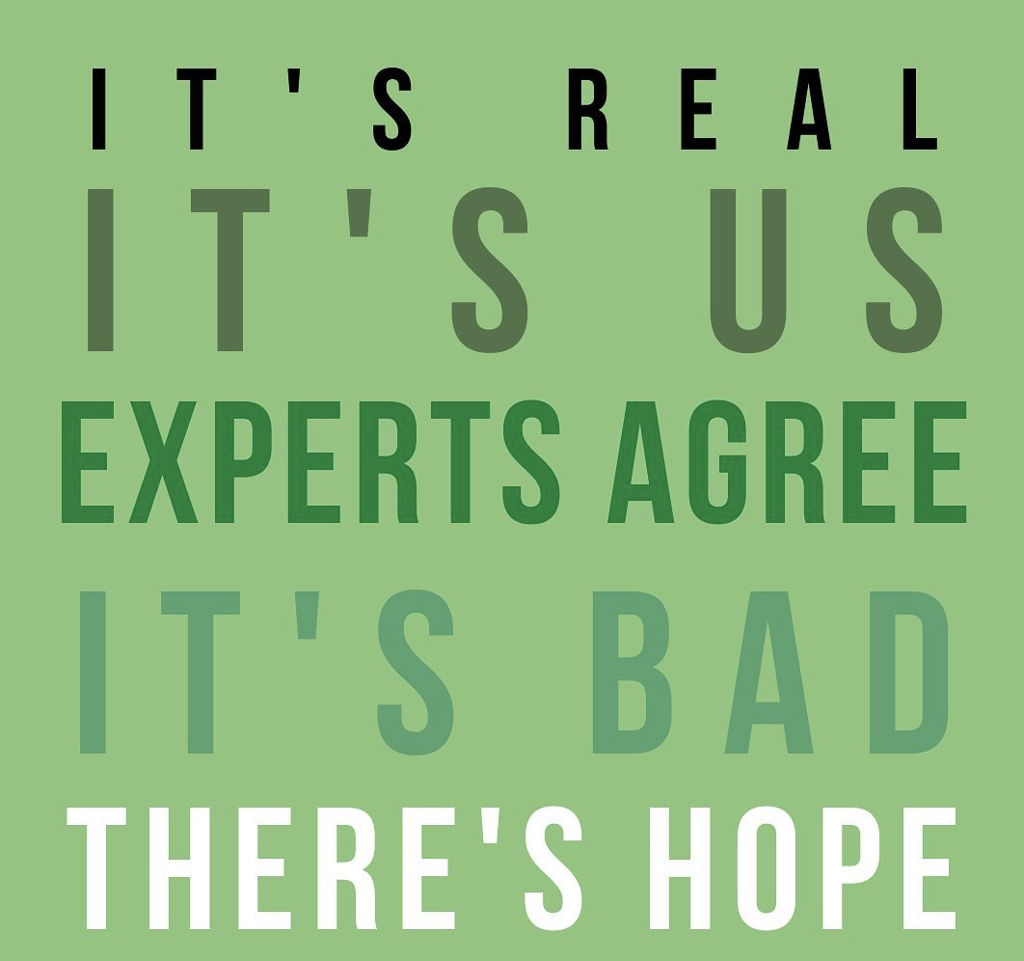
Ed Maibach - Professor Climate change communication

Slide 5

What can I do?
I’m just one person?

Slide 6
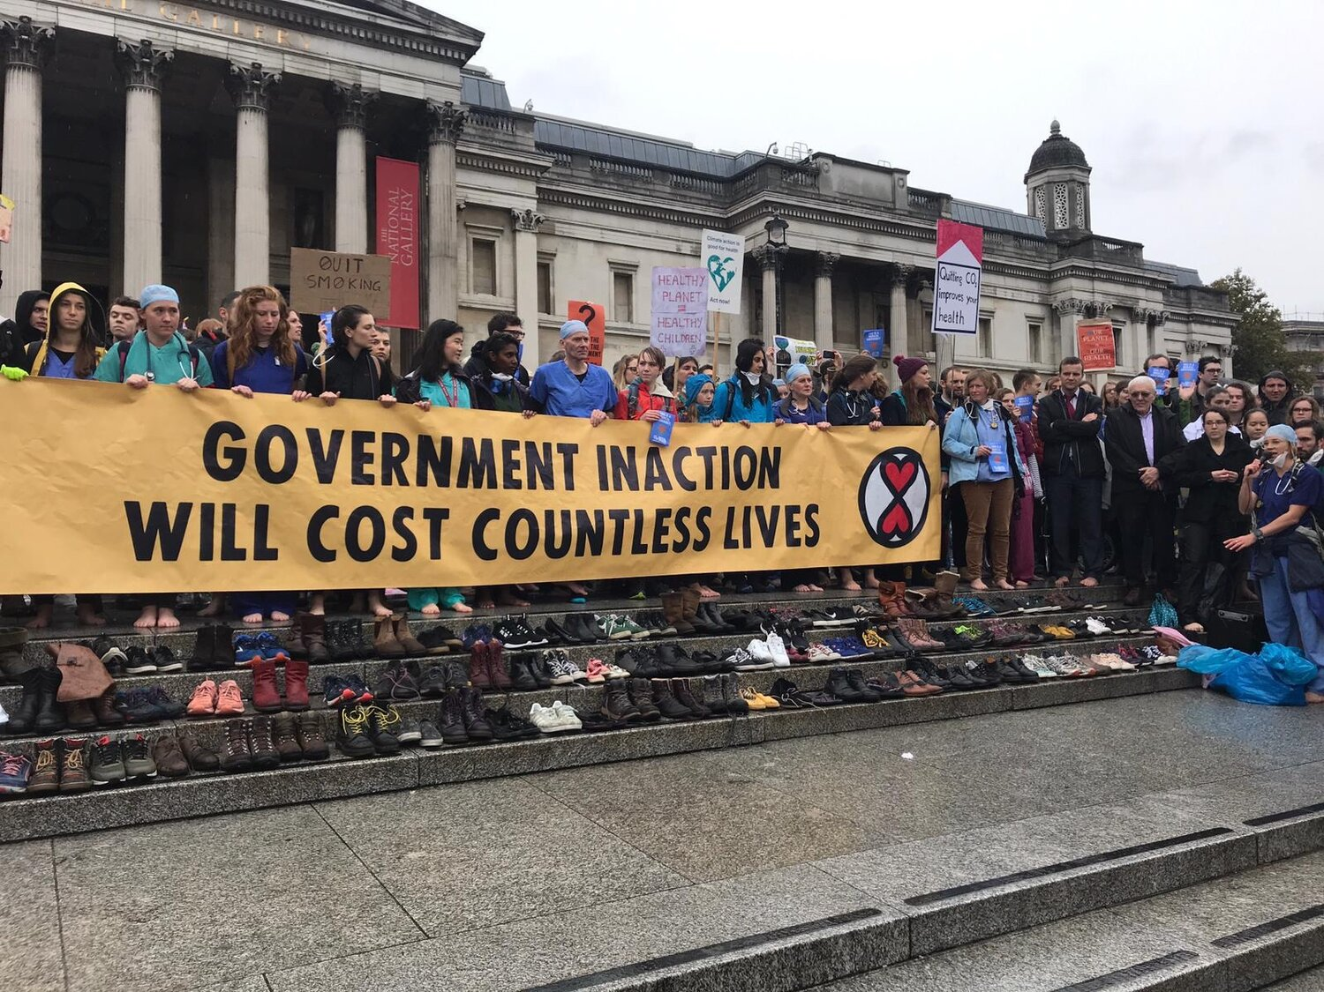
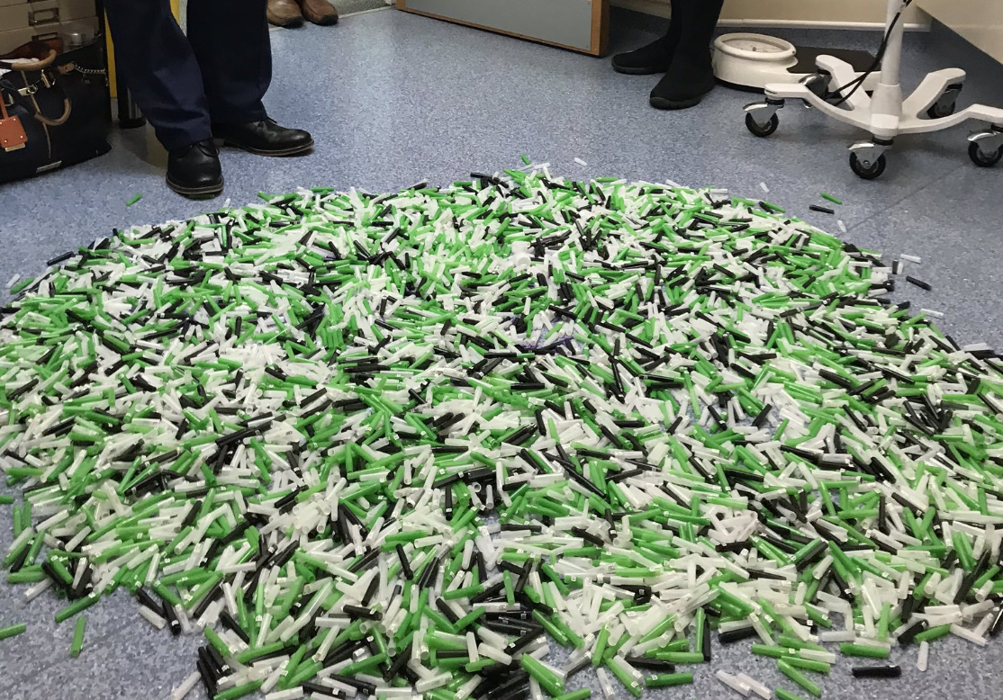
‘Doctors for Extinction Rebellion lay 110 pairs of shoes on steps of Trafalgar Square to mark number of deaths each day from air pollution’
6 months of needle caps from one phlebotomist in a GP surgery

Slide 7
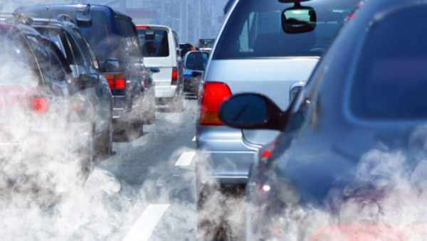
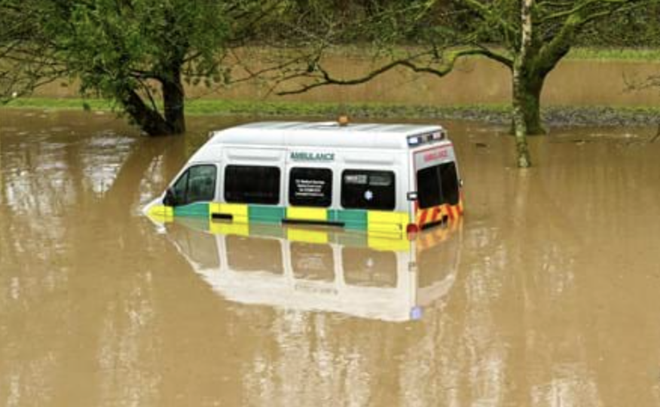
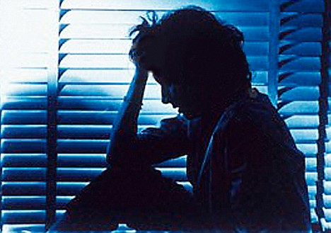
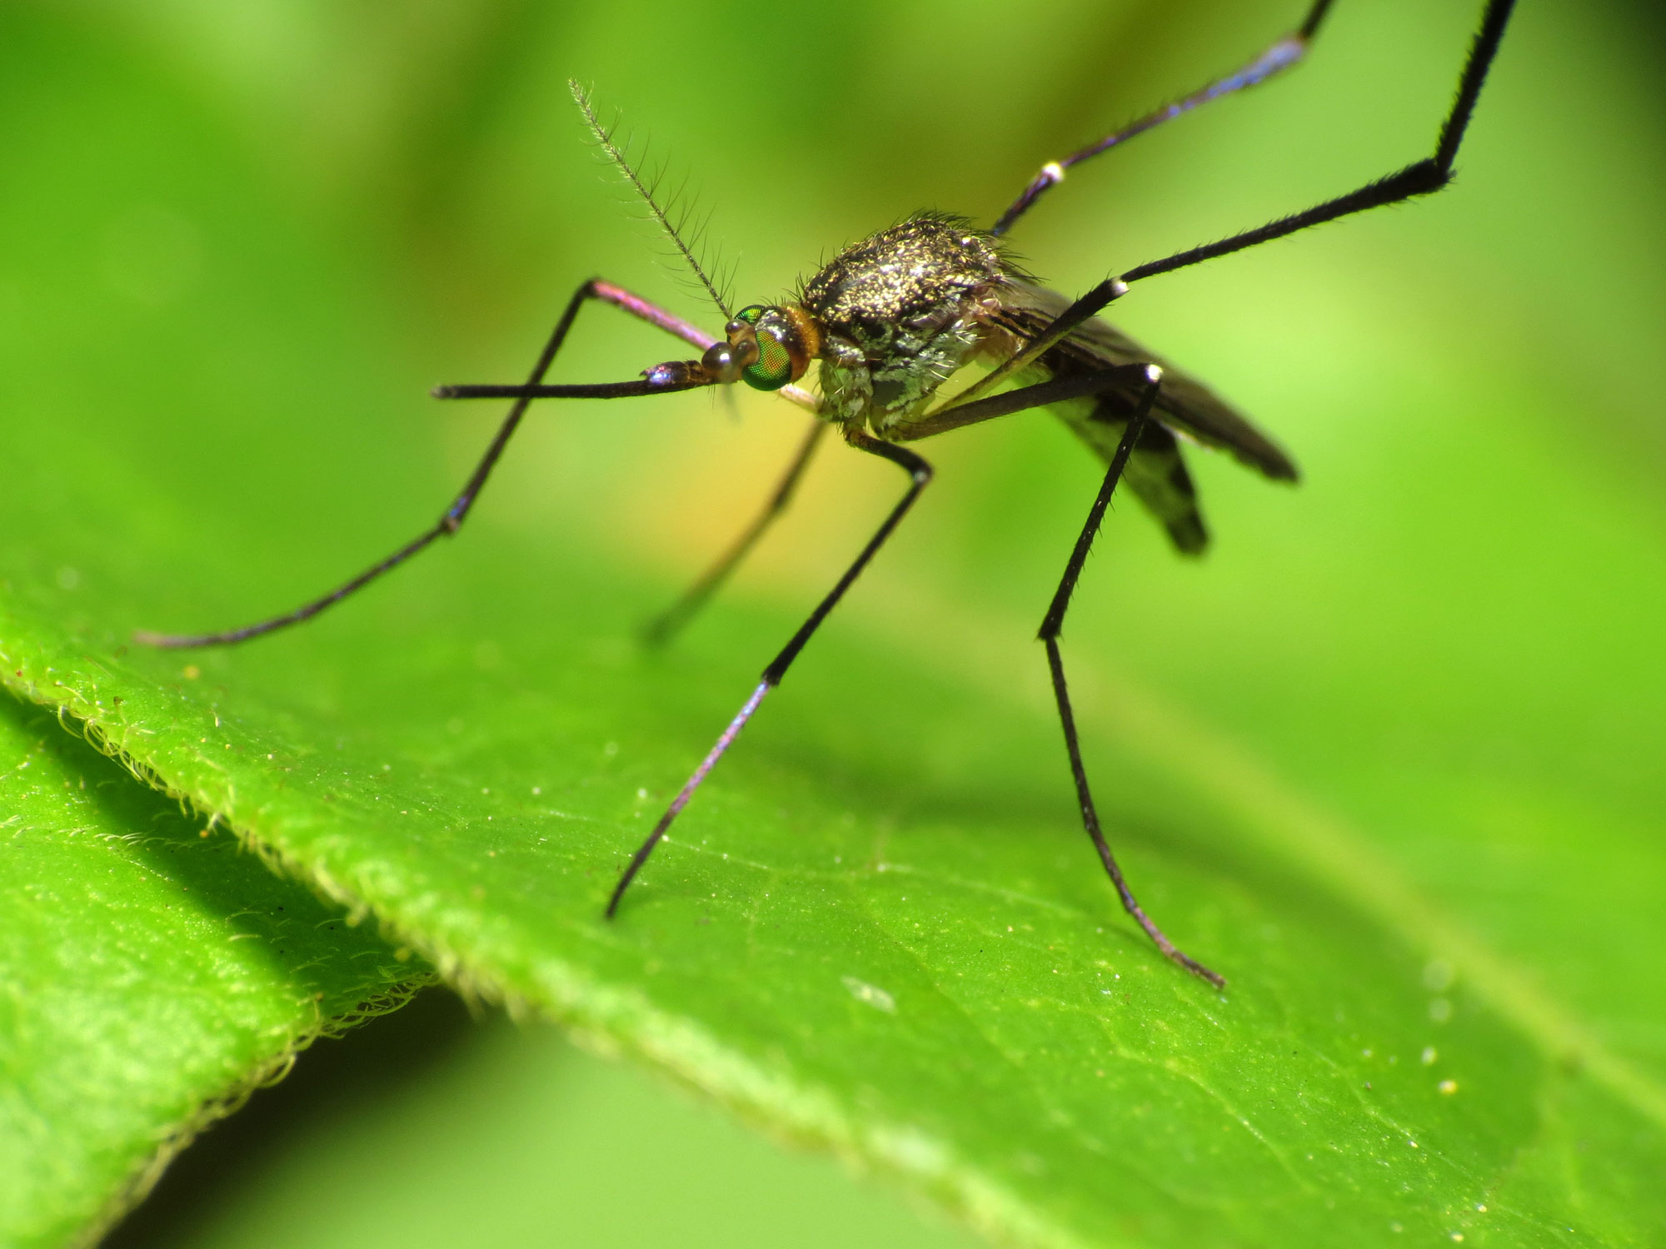
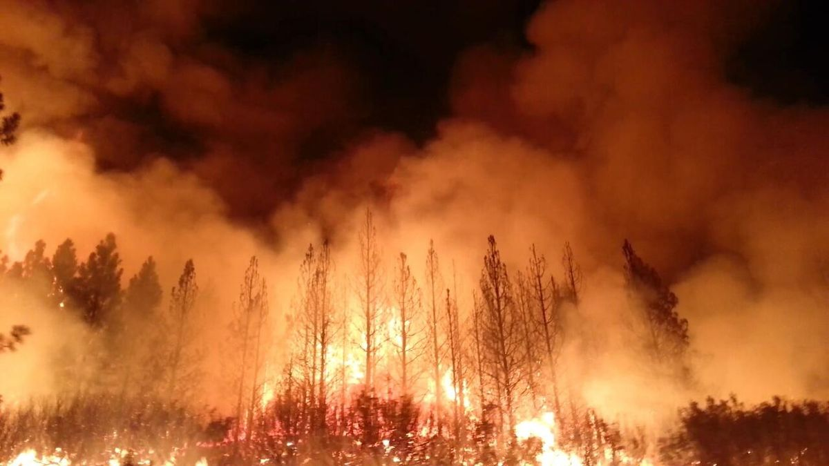
Health impacts for primary care
AIR POLLUTION
WHO estimates 7 million deaths each year are linked with air pollution.
UK ‘Air pollution is the biggest environmental threat to health in the UK’ - 36,000 deaths/year’
Gov UK
WEATHER
8% of healthcare buildings operate in flood risk zones
Increase diarrheal illness and forced migration
UK Health Alliance on Climate change
Climate fairness/justice
HEAT
Summer heat death predictions set to rise to 7000/yr by 2050
GPs seeing the most vulnerable
UK parliament: Heatwaves: adapting to climate change
SOCIAL & HEALTH INEQUALITY
Increase in mental health, domestic violence and insecure housing
INFECTION
Increased transmission of vector borne disease

Slide 8
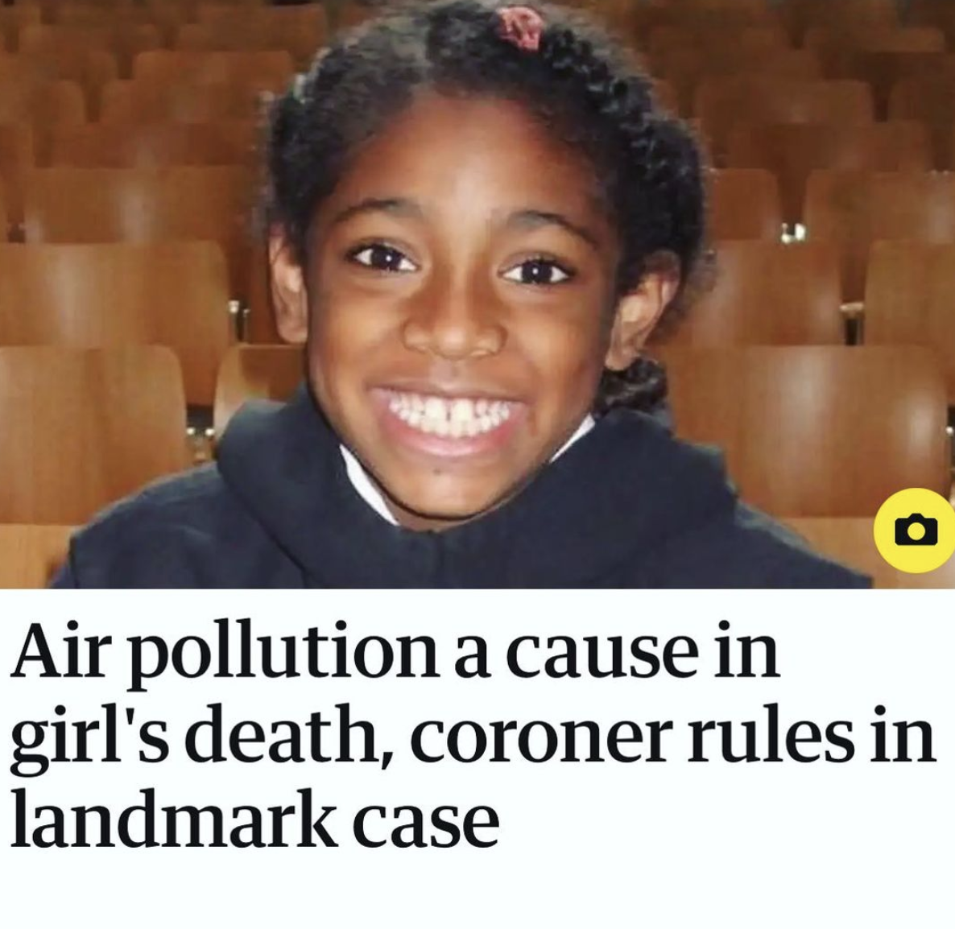
Ella Kissi-Debrah
"The failure to reduce pollution levels to legal limits possibly contributed to her death, as did the failure to provide her mother with information about the potential for air pollution to exacerbate asthma.”
Report to prevent future deaths
Air pollution contributed to the deaths of more than 4,000 Londoners in 2019
99% of London exceeds WHO air pollution limits
Imperial College London
Notes:
This is Ella Kissi-Debrah died in 2013 from an asthma attack.
She lived just 25 metres from the South Circular Road in Lewisham. In the three years leading up to her death, she attended hospital 27 times.
Her mother Rosamund Adoo Kissi-Debrah faught tirelessly for 7 years to have the contribution of excessive air pollution listed on her death certificate. Owing to the fact she was exposed to dangerously high levels of nitrogen dioxide and particulate matter which exacerbated her asthma.
The ruling also shines another light at social inequity. The poorest and marginalised in our society are most at risk. Those who can’t afford to own a car are the ones suffering from pollution in built up areas in towns and cities.

Slide 9
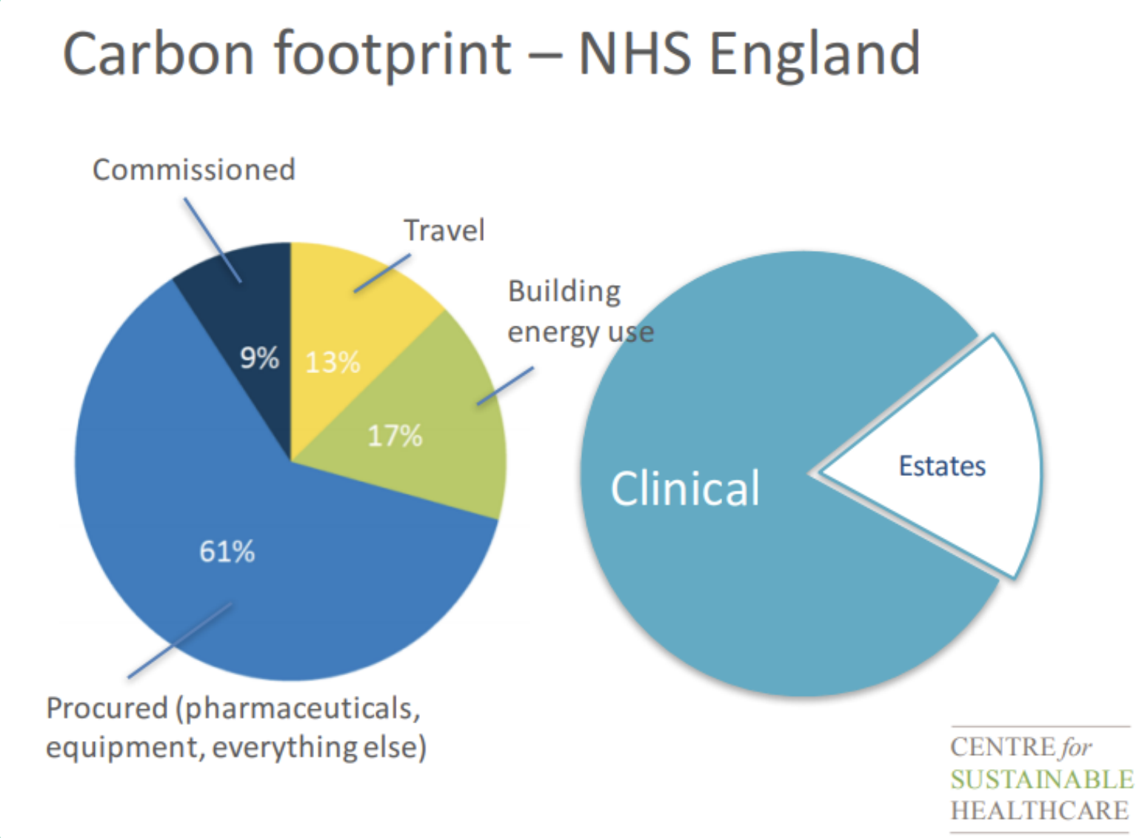

Slide 10


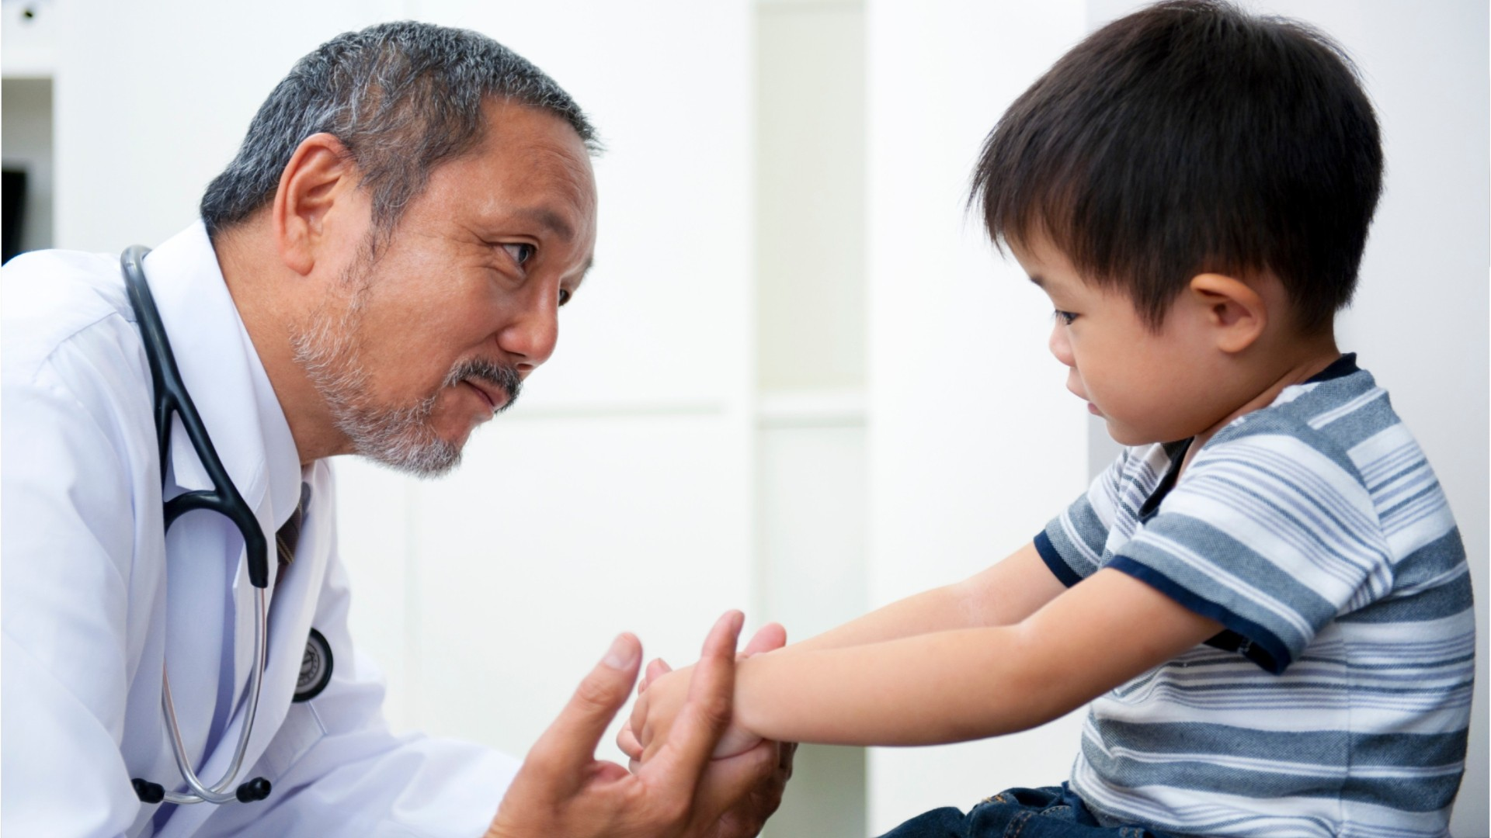
‘Good for you, good for the planet’

Slide 11
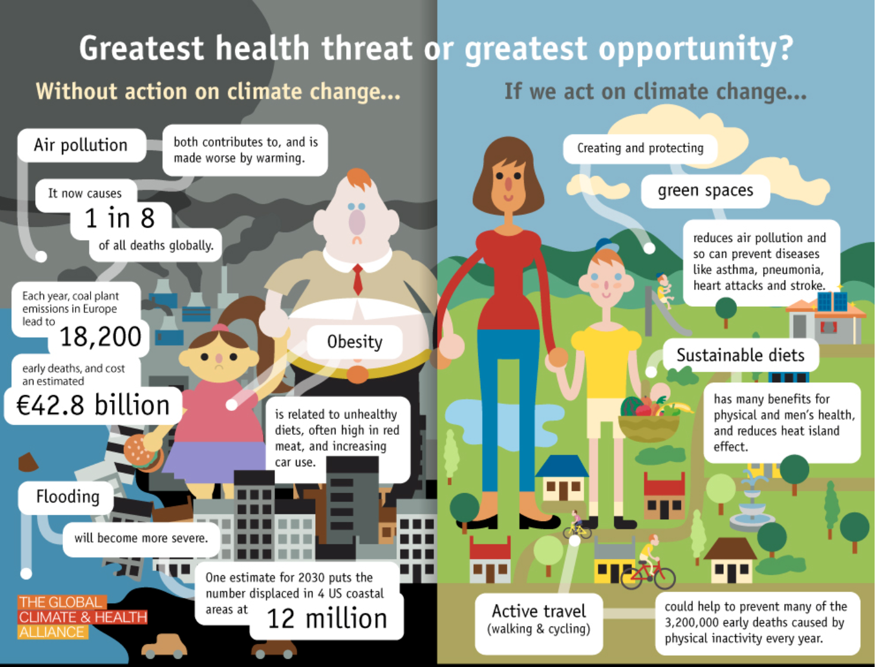

Slide 12
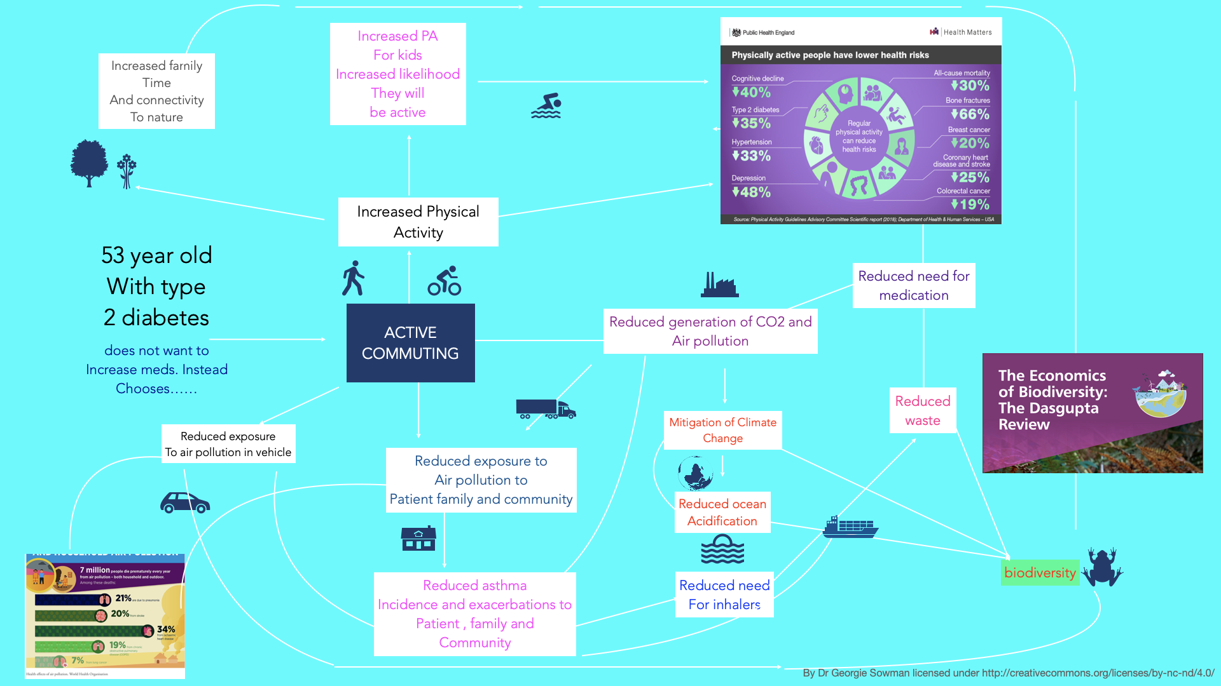
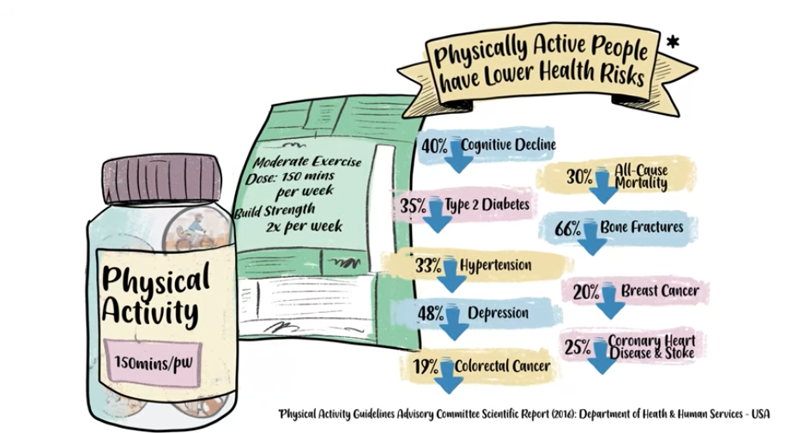




Sally
Active commuting
Reduced emissions
Works in an office
Poorly controlled diabetes on metformin
Two children
Does not want more medication
With thanks to Dr Georgie Sowman

Slide 13
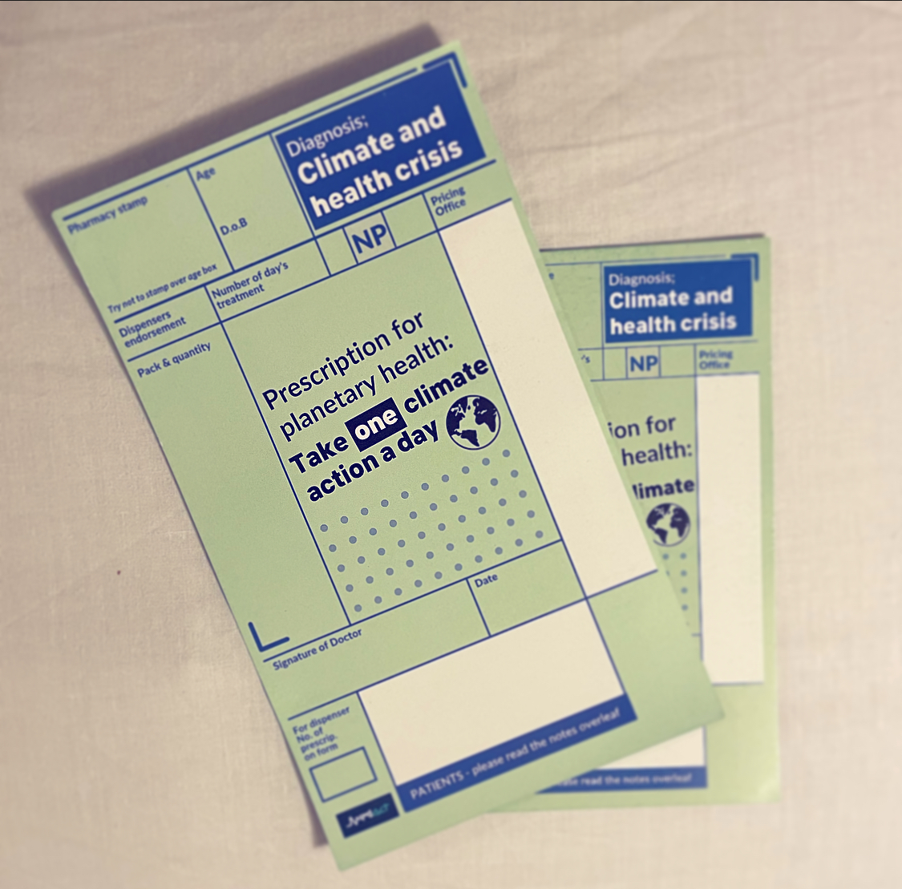
What can we do?

Slide 14
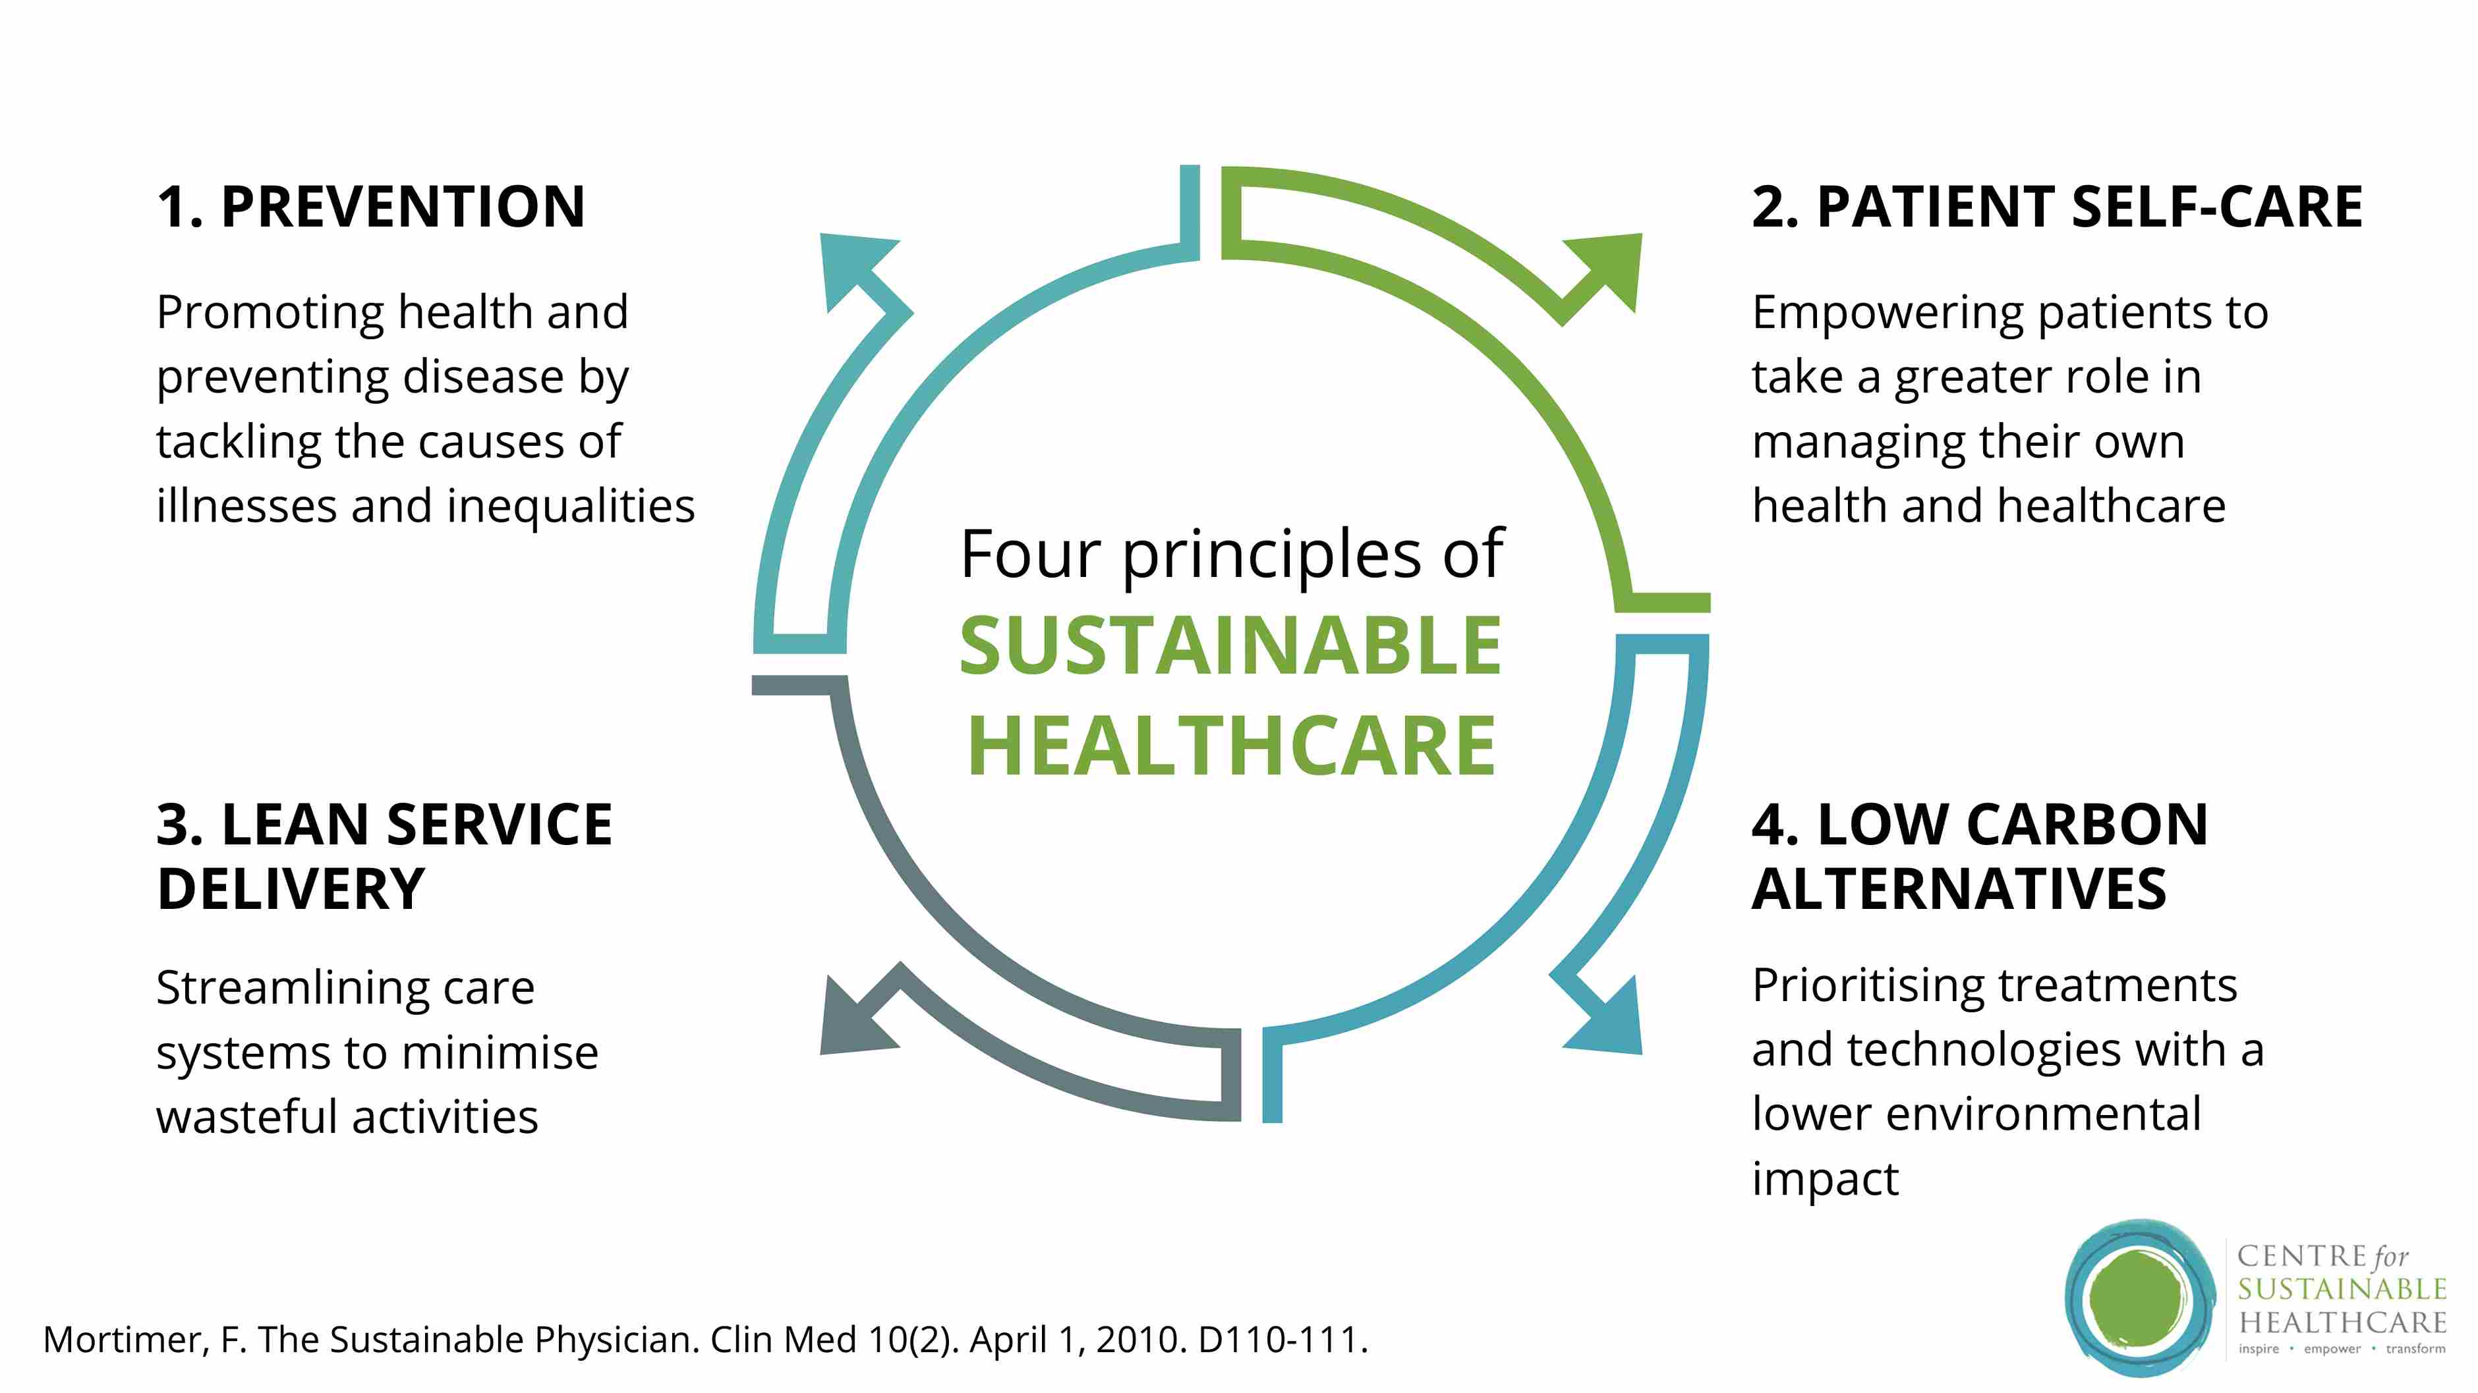

Slide 15
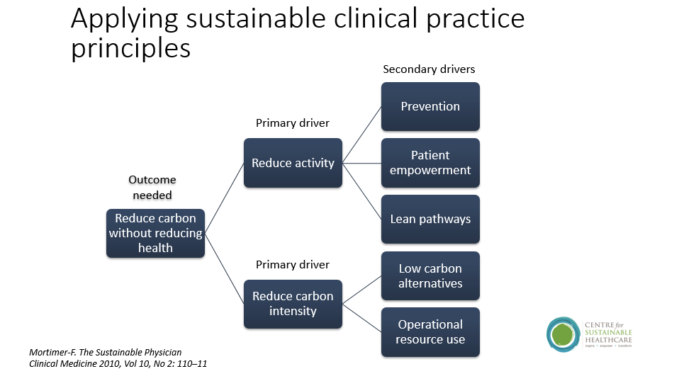
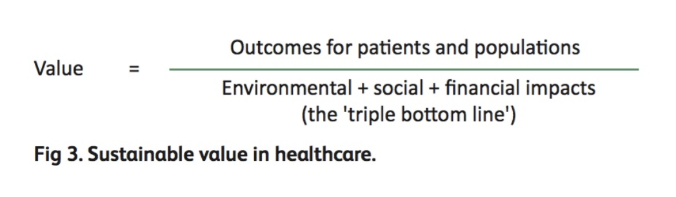

Slide 16
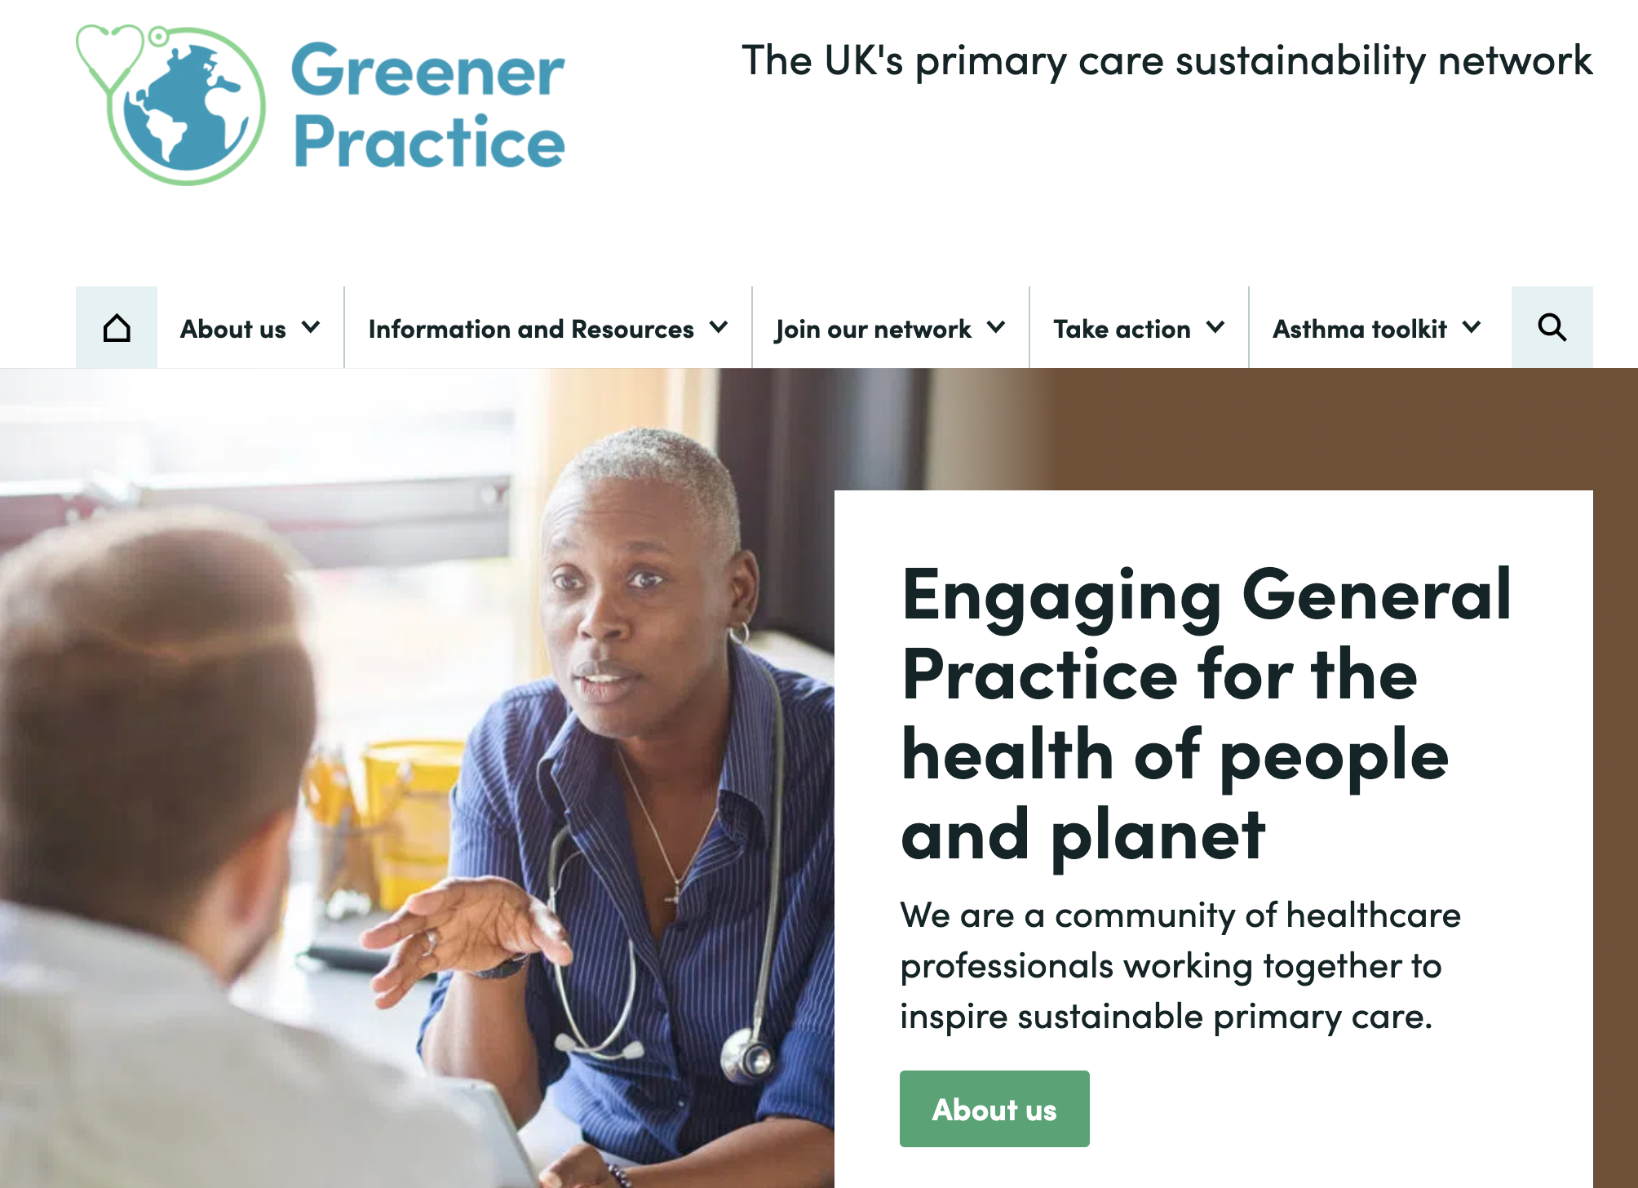


Slide 17

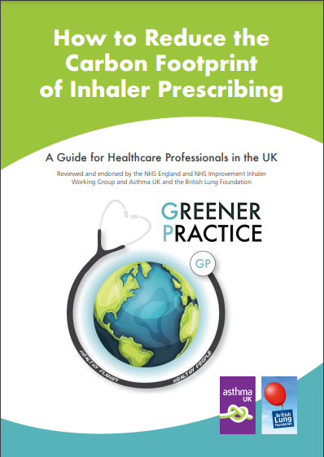
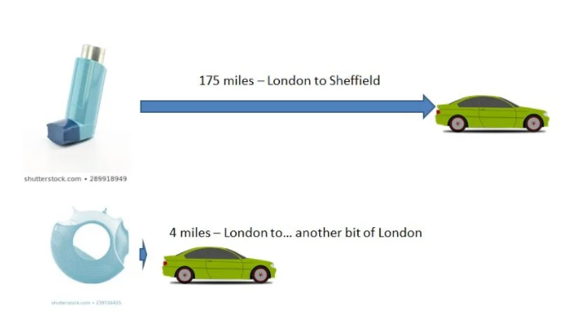
Guide to reducing the inhaler carbon footprint

Slide 18
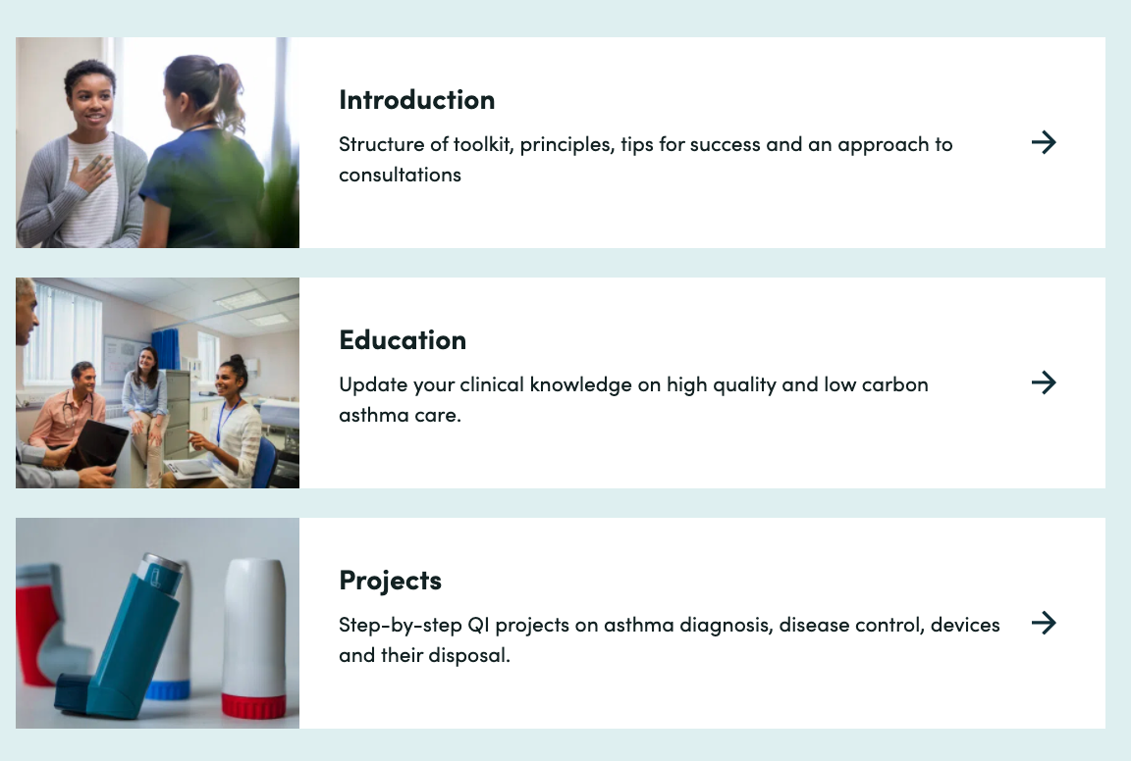
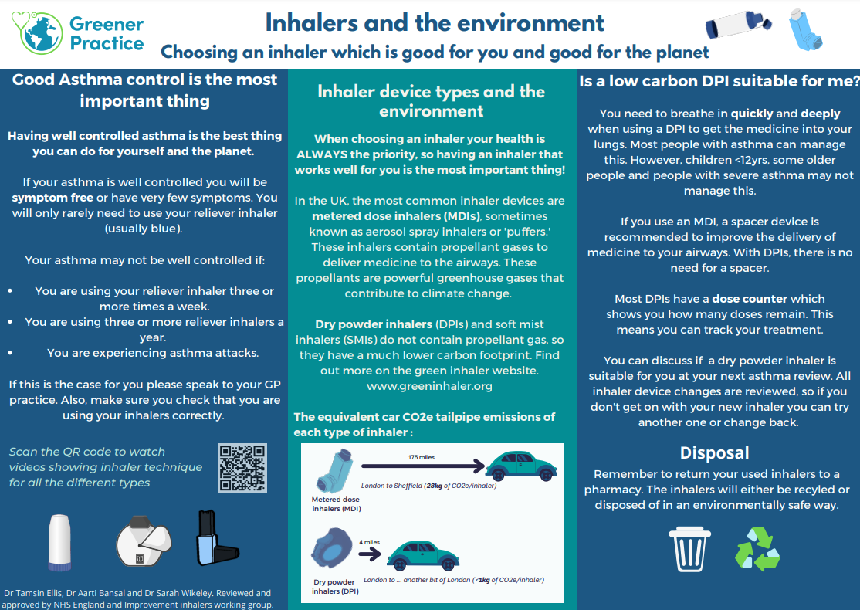
High-quality and low-carbon quality improvement toolkit

Slide 19
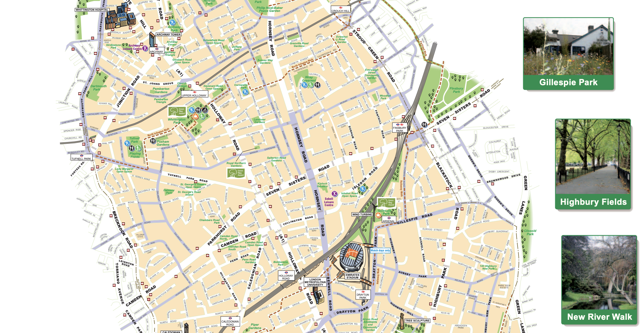

Slide 20

Want to know more?
Drtamsinellis@gmail.com
@ClimateGP

