Slide 1
COPD and Mental Health
An IPCRG Initiative
Holistic and Practical Guidance for Primary Care
Boehringer Ingelheim provided an unrestricted educational grant to support the development, typesetting, printing and
associated costs but did not contribute to the content of this document

Slide 2
COPD and Mental Health
Case Studies
COPD and Anxiety
Bjorn Stallberg, Liz Steed, Stephanie Taylor

Slide 3
About these slides
Please feel free to use, update and share some or all of these slides in your non-commercial presentations to colleagues or patients
There is a general introduction to COPD and mental health, followed by a case study
The slides are provided under creative commons licence CC BY-NC-ND
  BY stands for attribution (the obligation to credit the author and other parties designated for attribution)
  NC stands for NonCommercial (commercial use is excluded from the license grant)
  ND means NoDerivatives (only verbatim copies of the work can be shared)
When using our slides, please retain the source attribution: IPCRG 2022 COPD and Mental Health

Slide 4
Glossary of terms, abbreviations and acronyms
BMI, body mass index
CBT, cognitive behavioural therapy
COPD, chronic obstructive pulmonary disease
FEV₁, forced expiratory volume in 1 second
FVC, forced vital capacity
GAD-7, Generalized Anxiety Disorder 7-item scale
GOLD, Global Initiative for Chronic Obstructive Lung Disease
GP, General Practitioner
HbA1c, glycated haemoglobin
LABA, long-acting beta agonist
LAMA, long-acting muscarinic antagonist
LDL, low-density lipoprotein
PCP, primary care physician
PHQ-4, Patient Health Questionnaire 4
PHQ-9, Patient Health Questionnaire 9
QoL, quality of life
SSRI, selective serotonin reuptake inhibitor

Slide 5
Our aim
To highlight the importance of assessing for and treatment of anxiety in people with COPD and provide an evidence-based intervention example through a clinical case

Slide 6
What you will learn
Why we are focused on anxiety
What anxiety means in people with chronic respiratory disease
How we can improve the management of people with chronic respiratory disease and anxiety
How you can be part of that change

Slide 7
Mental disorders:
Important comorbidities in COPD
Anxiety and depression are common in COPD and are associated with poorer health status and increased risk of exacerbations and emergency hospital admissions¹
Multiple studies have demonstrated an association between cigarette smoking and increased anxiety symptoms or disorders²
Smoking, depression and anxiety are all associated with a higher risk of death in people with COPD³
PCPs often have low confidence to evaluate and treat mental health problems due to the complex inter-relationships between them and symptoms such as breathlessness
1. GOLD 2022. Available at: https://goldcopd.org/2022-gold-reports-2/;
2. Moylan S, et al. Brain Behav 2013;3:302-26; 3. Lou P, et al. Respir Care 2014;59:54-61.

Slide 8
Prevalence and impact of anxiety in COPD
Anxiety has been recognized as a significant problem in COPD, with an estimated prevalence of up to 40%¹
People with COPD are up to ten times more likely to experience panic disorder or panic attacks compared with general population samples²
Anxiety is associated with impaired health-related QoL³ and increased mortality risk⁴
1. Panagioti M. Int J Chron Obstruct Pulmon Dis 2014;9:1289-306; 2. Livermore N, et al. Respir Med 2010;104:1246-53;
3. Blakemore A, et al. Int J Chron Obstruct Pulmon Dis 2014;9:501-12; 4. Vikjord SAA, et al. Respir Med 2020;171:106089.

Slide 9
Case study

Slide 10

Background
Johan is a 68 year old man
He retired 4 years ago before which he had worked as a book-keeper in a small office for most of his working life
He lives alone in a small town and has two children and five grandchildren
He enjoys reading
He used to walk a lot but due to his breathlessness he prefers to stay at home

Slide 11
Medical history
Medical conditions: Hypertension Type 2 diabetes mellitus COPD | Current medication: Amlodipine Enalapril Atorvastatin Metformin Fixed combination of LAMA/LABA and SABA as needed
Has a routine check-up with his GP twice a year Usually renews all his prescriptions when visiting his GP | Obese since his forties: weight 102 kg, height 177 cm (BMI 33)

Slide 12
Respiratory history I
Johan has been a smoker since age 14 years and is still a daily smoker
He was diagnosed with COPD about ten years ago
Spirometry was performed a year ago: FEV₁ 55% predicted and FEV₁/FVC 0.55
He has been prescribed a fixed combination of LAMA/LABA and SABA as needed for the last 5 years

Slide 13
Respiratory history II
Recorded in Johan’s notes from a previous visit:
  He experiences breathlessness when walking with people of the same age
  He has had one severe COPD exacerbation (2 years ago)
  He often has symptoms at night including cough and sometimes breathlessness
  He uses extra SABA daily, but with limited effect on his breathlessness

Slide 14
Presenting appointment
Johan had scheduled a routine check-up
  Blood test shows good diabetes control (HbA1c 49 mmol/mol, total cholesterol 5.6 mmol/L and LDL cholesterol 2.4 mmol/L)
  Blood pressure 140/85 mmHg
His GP was, as usual, a bit rushed but on the question “how are you”, he sighs and answers that his COPD is a bit worse with more breathlessness, everything just seems to be harder, he’s not sure he’s coping that well. He also needs a new prescription of SABA

Slide 15
What his GP offered
They acknowledged COPD is a hard condition to live with
They prescribed 3 more SABA canisters and also renewed all Johan’s other medications
They agree his next appointment should be in 6 months
His GP rushes on to see his next patient

Slide 16


Slide 17
What is your opinion about Johan’s visit?
Was this a typical visit in primary care for someone with COPD?
What could have been done differently?
What was lacking?
What would you suggest to improve the consultation?
Were there clues that something else was going on with Johan?

Slide 18
Something important was missed
Johan’s GP seemed friendly and tried to take a patient-centred approach, but how did they deal with the patients comment about not coping and increasingly staying at home?
  Evidence shows that rather than elicit mental health concerns GPs often tend to close them down (Guthrie, 2017)
Simply asking patients to say more if they indicate some non-medical concerns can be helpful
‘Can you tell me a bit more about that?’

Slide 19

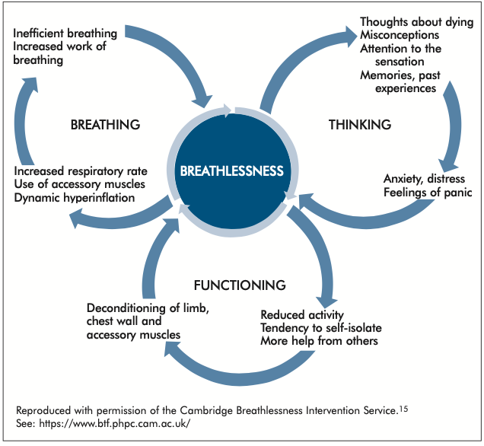
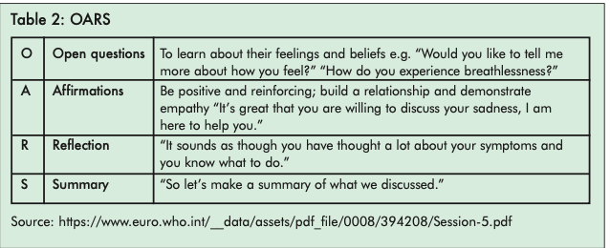
Available at: https://www.ipcrg.org/dth12.

Slide 20
Diagnosing anxiety
I’ve stopped going out, just in case I get breathless
Before using questionnaires you need to suspect anxiety is a problem
Anxiety can affect feelings, thoughts, behaviours and symptoms, so clues in any of these areas can be helpful
Anxiety is underpinned by feelings of threat and inability to cope
I feel nervous all the time as if something terrible is going to happen
My heart starts pounding, I feel sweaty, I can’t breathe and I don’t know what to do
I can’t stop thinking about ‘what if I can’t catch my breath’

Slide 21
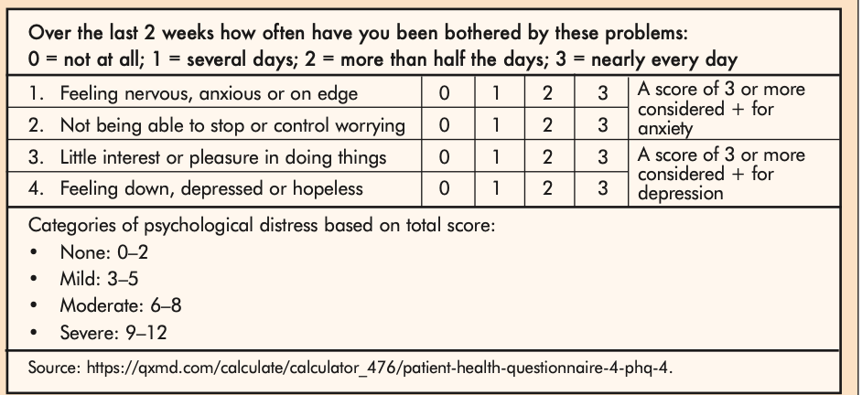
Identifying mental health problems in people with COPD: PHQ-4
For very brief measurement of depression and anxiety
Can be completed online
Available at: https://www.ipcrg.org/dth12.

Slide 22
More detailed evaluation of anxiety: GAD-7
Gives a more comprehensive indicator of anxiety
A score ≥8 suggests a need to explore symptoms further
Generalized Anxiety Disorder 7- item (GAD-7)
Over the last 2 weeks, how often have you been bothered by the following problems: | Not at all | Several days | More than half the days | Nearly every day
1. Feeling nervous, anxious or on edge? | 0 | 1 | 2 | 3
2. Not being able to stop or control worrying? | 0 | 1 | 2 | 3
3. Worrying too much about different things? | 0 | 1 | 2 | 3
4. Trouble relaxing? | 0 | 1 | 2 | 3
5. Being so restless that it is hard to sit still? | 0 | 1 | 2 | 3
6. Becoming easily annoyed or irritable? | 0 | 1 | 2 | 3
7. Feeling afraid as if something awful might happen? | 0 | 1 | 2 | 3
Sapra A. Cureus 2020;21:12.

Slide 23
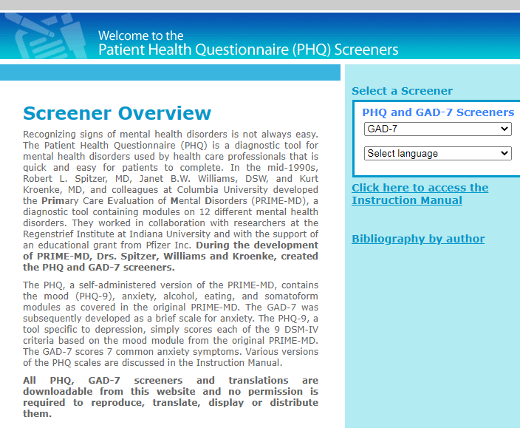
GAD-7
GAD-7 is available in many languages
Free to download on the PHQ website: www.phqscreeners.com

Slide 24
Managing anxiety
Many practitioners report low confidence in dealing with mental health concerns, or worry they won’t have the time or skills to deal with them. Having options to hand can be helpful:
  Referral for CBT (face to face, online or self-help all have potential benefits)¹
BUT
How psychological treatment is introduced can be critical in uptake
1. Williams M. Int J Chron Obstruct Pulmon Dis 2020;15:903-19.

Slide 25
Cognitive Behavioural Therapy
Systematic reviews ¹⁻⁴ have suggested CBT may improve:
  Depression
  Anxiety
  Breathlessness
  Quality of Life
Although length of time before benefit and intensity of treatment required may differ depending on the individual
1. Pollok J, et al. Cochrane Database Syst Rev 2019;3:CD012347; 2. Williams M. Int J Chron Obstruct Pulmon Dis 2020;15:903-19;
3. Ma RC, et al. Complement Ther Clin Pract 2020;38:101071; 4. Zhang X, et al. Clin Resp J 2020;14:891-900.

Slide 26
Discussing CBT as an option: Top Tips
Acknowedge that COPD, like all chronic illness, may affect people psychologically and emotionally as well as physically
Suggest that managing this is just as important as managing physical symptoms
Say that anxiety is common in COPD (but avoid saying it’s normal which suggests it doesn’t need to be managed)
Say you would like to review them in 6-8 weeks time, to emphasise your commitment to this approach
‘Many people with COPD have anxiety, it’s just as important we manage this just like your breathlessness’

Slide 27
Introducing CBT
”We know breathlessness is frightening and affects us emotionally as well as physically. Learning how to deal with this fear and anxiety is just as important as managing your physical symptoms. CBT is one way of doing this and just looks at how our thoughts, feelings, behaviours and symptoms interact”
As with any treatment you recommend, checking how likely/confident your patient is to carry it out on a scale of 1-10 is helpful
  Scores of 7 or less suggest more support or a revised plan may be needed

Slide 28
Other interventions to address breathlessness may relieve anxiety
Intervention | Purpose/aim
Mindfulness/meditation | 20-minute mindful breathing reduces breathelessness in lung disease, and anxiety/depression in advanced disease; enhances non-evaluative attention and may increase self-efficacy
Relaxation techniques | Some evidence that relaxation interventions can help anxiety, breathlessness and fatigue in COPD. Guided imagery (“thinking of a nice place”), progressive muscular relaxation and counting are most acceptable
Acupuncture/pressure | Improves breathlessness in advanced disease and may reduce anxiety
Singing therapy | Most evidence suggests singing therapy can improve lung function; some evidence suggests it may improve anxiety and QoL; anecdotal evidence also suggest it is of value
Positive psychology giving sense of control/confidence | Not evidence-based, however, holistic breathlessness services reduce anxiety/depression and use positive psychology, improving self-efficacy
Social presence | Experimental evidence in healthy volunteers for social presence reducing breathless perception; patients describe reassurance from presence of others
Available at: https://www.ipcrg.org/dth12.

Slide 29
Pharmacological interventions
Anxiety may be managed using SSRIs but the evidence is weak¹
Benzodiazepines may be considered for short-term use (no more than 4 weeks) only for people with acute distressing anxiety
1. Usmani ZA, et al. Cochrane Database Syst Rev 2011;11;CD008483.

Slide 30
Smoking cessation in people with COPD and mental disorders
Mental health problems are negatively associated with successful smoking cessation^{1,2}
Tobacco smokers with mental health problems tend to be:^{3,4}
  More addicted to smoking
  Smoke more cigarettes
  More likely to relapse
  Require support for repeated quit attempts
Contrary to population belief, quitting smoking reduces anxiety and depression and the effect size is as large, or larger, than antidepressants for mood and anxiety disorders¹
1. IPCRG Desktop Helper, No 12. Available at: www.ipcrg.org/dth12;
2. Hashimoto R, et al. Respir Investig 2020;58:387-94; 3. Royal College of Physicians, Royal College of Psychiatrists, 2013; 4. Ho SY, et al. Gen Hosp Psychiatry 2015;37:399-407.

Slide 31
Supporting smoking cessation
Healthcare professional |  | Patient response
ASK tobacco use at every clinical contact -“I can see from your records that you have used tobacco recently. Is that still the case?” |  | ”Yes, I smoke 15 cigarettes per day for about 40 years, without any previous attempts at smoking cessation”
ADVISE about effective ways to quit (and if necessary, about the harms of tobacco) -“Do you know the best way of stopping using tobacco or reducing its harm?” |  | ”Not really, I have never thought of that till now you are asking”
ACT according to the patient’s response -“Would you like to talk about the options available to help with your tobacco use today?” |  | ”Yes, that would be helpful”
Record your interaction in the patient’s notes

Slide 32
Johan’s consultation - revisited
You acknowledge COPD is a hard condition to live with
You administer the PHQ-4 and note that further assessment for anxiety is needed - he then scores 10 on the GAD-7
  You note that at this time he is not presenting symptoms of depression, but make a note to follow-up this up at the next visit
You arrange for CBT (referral or schedule a consultation at a later date)
  You agree also on a telephone review to see how the CBT is progressing in 6-8 weeks
You ASK/ADVISE/ACT on smoking cessation and schedule a consultation to discuss options with Johan

Slide 33
Summary
When reviewing a person with COPD evaluate all the comorbid conditions
Be vigilant for anxiety and depression
Diagnosis and interventions to treat comorbid anxiety and depression in people with COPD will improve their QoL and their COPD outcome

