Slide 1
COPD and Mental Health
An IPCRG Initiative
Holistic and Practical Guidance for Primary Care
Boehringer Ingelheim provided an unrestricted educational grant to support the development, typesetting, printing and
associated costs but did not contribute to the content of this document

Slide 2
COPD and Mental Health Case Studies COPD and Tobacco Dependence Izolde Bouloukaki (Greece) and Catalina Panaitescu (Romania)

Slide 3
About these slides
Please feel free to use, update and share some or all of these slides in your non-commercial presentations to colleagues or patients
There is a general introduction to COPD and mental health, followed by a case study
The slides are provided under creative commons licence CC BY-NC-ND
BY stands for attribution (the obligation to credit the author and other parties designated for attribution)
NC stands for NonCommercial (commercial use is excluded from the license grant)
ND means NoDerivatives (only verbatim copies of the work can be shared)
When using our slides, please retain the source attribution: IPCRG 2022 COPD and Mental Health

Slide 4
Glossary of terms, abbreviations and acronyms
ACE inhibitor, angiotensin-converting enzyme inhibitor
AIS, Athens Insomnia Scale
BMI, body mass index
CAT, COPD Assessment Tool
COPD, chronic obstructive pulmonary disease
FSS, Fatigue Severity Scale
FEV₁, forced expiratory volume in 1 second
FVC, forced vital capacity
GAD-7, General Anxiety Disorder 7 scale
GP, general practitioner
GOLD, Global Initiative for Chronic Obstructive Lung Disease
LABA, long-acting beta agonist
mMRC, modified Medical Research Council Dyspnoea Scle
PHQ-9, Patient Health Questionnaire 9
PSQI, Pittsburgh Sleep Quality Index
SABA, short-acting beta agonist
SC, smoking cessation
TIA, transient ischaemic attack
VBA, very brief advice

Slide 5
Our aim
To highlight the importance of smoking cessation in people with COPD and anxiety and provide an evidence-based intervention example through a clinical case

Slide 6
What you will learn
Understand the importance of evaluating smoking status in people with COPD and anxiety
Identify the main barriers to smoking cessation in people with COPD and anxiety and appropriate methods to overcome them
How to apply a structured smoking cessation intervention for people with COPD and anxiety

Slide 7
The challenge of smoking cessation in people with COPD
Smoking cessation is the most effective intervention in stopping the progression of COPD, as well as increasing survival and reducing mortality¹
30–50% of people with symptomatic moderate to very severe COPD continue to smoke²
Smoking cessation may be more effective when counselling and pharmacological treatments are combined.³ However, even when a combined approach is taken, 65–85% are still smoking at 1 year²
People with COPD often have comorbidities which require special attention in the effort to quit smoking
1. Tonnesen P. Eur Respir Rev 2013;22:37-43; 2. Tashkin DP. Intern Emerg Med 2021;16:545-7; 3. GOLD 2022. Available at: https://goldcopd.org/2022-gold-reports-2/.

Slide 8
Mental disorders: Important comorbidities in COPD
Anxiety and depression are common in COPD and are associated with poorer health status, increased risk of exacerbations and emergency hospital admissions¹
Multiple studies have demonstrated an association between cigarette smoking and increased anxiety symptoms or disorders²
Smoking, depression and anxiety are all associated with a higher risk of death in people with COPD³
1. GOLD 2022. Available at: https://goldcopd.org/2022-gold-reports-2/; 2. Moylan S, et al. Brain Behav 2013;3:302-26; 3. Lou P, et al. Respir Care 2014;59:54-61.

Slide 9
Smoking cessation in people with COPD and mental disorders
Mental health problems are negatively associated with successful smoking cessation^{1,2}
Tobacco smokers with mental health problems tend to be:^{3,4}
More addicted to smoking
Smoke more cigarettes
More likely to relapse
Require support for repeated quit attempts
Contrary to population belief, quitting smoking reduces anxiety and depression and the effect size is as large, or larger, than antidepressants for mood and anxiety disorders¹
1. IPCRG Desktop Helper, No 12. Available at: www.ipcrg.org/dth12; 2. Hashimoto R, et al. Respir Investig 2020;58:387-94; 3. Royal College of Physicians, Royal College of Psychiatrists, 2013; 4. Ho SY, et al. Gen Hosp Psychiatry 2015;37:399-407.

Slide 10
Case study

Slide 11
Background
“I am always a bit tired and I feel like I use most of my energy just trying to breathe when I walk”
Mr JD is 67 years old and used to work as a taxi driver
Her recently retired and spends most of his time at home, reading the newspaper and watching TV
He drives his wife for the weekly shopping and occasionally participates in small household chores. But she is five years younger, likes to run the house and ‘spoil’ him
He had planned to fill his mornings by taking his 3 year old granddaughter to the park but has not been able to as he got very tired very quickly and was not able to keep up with her

Slide 12
Medial history and risk factors
Medical conditions: Hypertension Hypercholesterolaemia TIA COPD | Recommended medication: ACE inhibitor+diuretic Antiplatelet drug Statin LABA and SABA as needed
Risk assessment: Alcohol consumption: occasionally Smoking status: current smoker (37.5 pack year) BMI = 29.7 kg / m² Exercise: limited, he feels constantly fatigued | Allergies: none Vaccinations: up to date with influenza, pneumococcal and COVID-19 vaccinations
Mr JD has shown good adherence to his recommended treatment for his cardiovascaular and cerebrovascular pathologies, especially after his TIA
Although he also has been prescribed a long-term treatment for his COPD he rarely takes it as he feels he has too many medicines to take and his ‘bronchitis’ only bothers him when he gets a cold
His last episode of ‘bronchitis’ was a year ago; he was prescribed a new treatment but didn’t need to go to hospital

Slide 13
Reason for visiting his GP
Mr JD has come for a prescription renewal

Slide 14
What should you do?
Scenario 1?
“How do you feel?”
Clinical exam and general recommendations
“You know that smoking is bad for you don’t you?”
Prescription renewal
Scenario 2?
Assessment of:
Symptoms
Risk of future events
Comorbidities
Clinical examination
VBA for Smoking Cessation
Prescription renewal

Slide 15
Assessment of symptoms
Modified Medical Research Council (mMRC) dyspnoea scale:
Grade | Description of breathlesness
0 | “I only get breathless with strenuous exercise”
1 | “I get short of breath when hurrying on level ground or walking up a slight hill”
2 | “On level ground, I walk slower than people of the same age because of breathlessness, or have to stop for breath when walking at my own pace”
3 | “I stop for breath after walking about 100 yards or after a few minutes on level ground”
4 | “I am too breathless to leave the house or I am breathless when dressing”

Slide 16
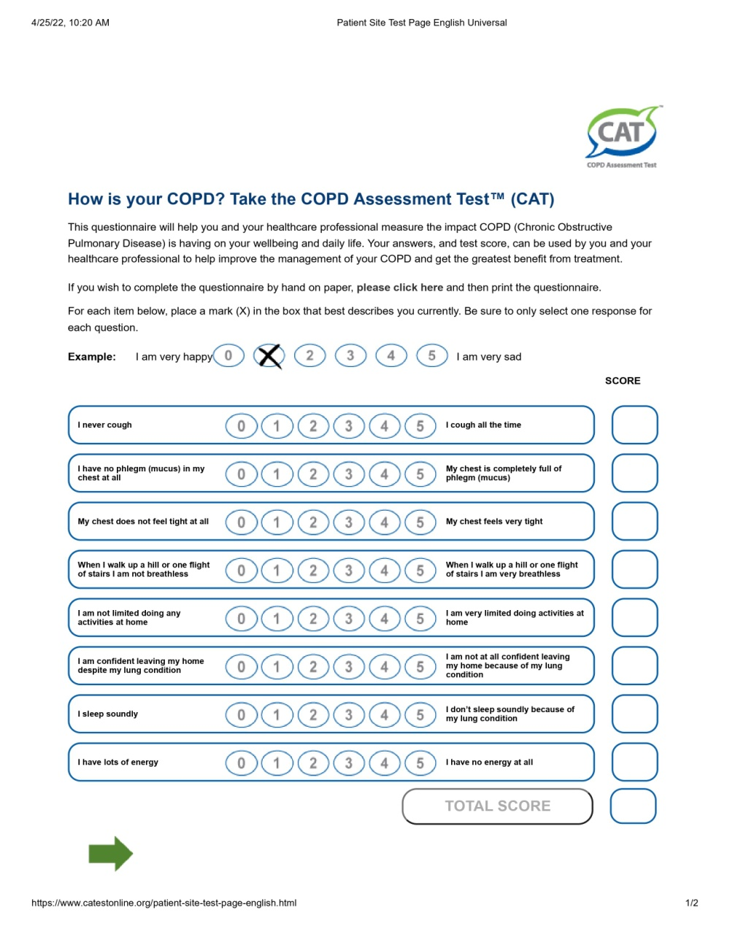
Impact on quality of life
X
X
X
X
X
X
X
X
20

Slide 17
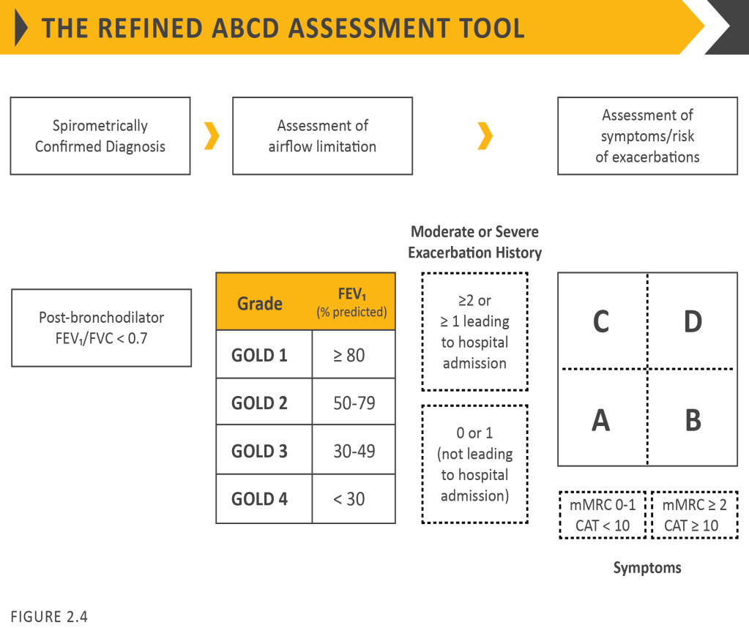
Combined COPD assessment
1. GOLD 2022. Available at: https://goldcopd.org/2022-gold-reports-2/.

Slide 18
Risk of future events
Incidence of exacerbation is high in COPD patients¹
Smoking is a major factor in COPD exacerbations²
There is a high prevalence of COPD exacerbations requiring admission to a hospital unit in those patients who continue to smoke²
Previous admission for exacerbation is a strong predictor and can identify patients at risk¹
The review of the existing literature for COPD patients showed the following:
The evidence is strong (GRADE level A) to suggest that smoking cessation is a key intervention
for smokers with COPD and should constitute a core element of long-term management of these patients³
1. GOLD 2022 Report, pg. 31, https://goldcopd.org/2022-gold-reports-2/
2. Badaran E, et al. Eur Respir J 2012;40:1055;
3. Tobacco Cessation Guidelines for High Risk Groups. Available at: https://ensp.network/tob-g/.

Slide 19
Supporting smoking cessation
Healthcare professional |  | Patient response
ASK tobacco use at every clinical contact -“I can see from your records that you have used tobacco recently. Is that still the case?” |  | ”Yes, I smoke 15 cigarettes per day for about 40 years, without any previous attempts at smoking cessation”
ADVISE about effective ways to quit (and if necessary, about the harms of tobacco) -“Do you know the best way of stopping using tobacco or reducing its harm?” |  | ”Not really, I have never thought of that till now you are asking”
ACT according to the patient’s response -“Would you like to talk about the options available to help with your tobacco use today?” |  | ”Yes, that would be helpful”
Record your interaction in the patient’s notes

Slide 20
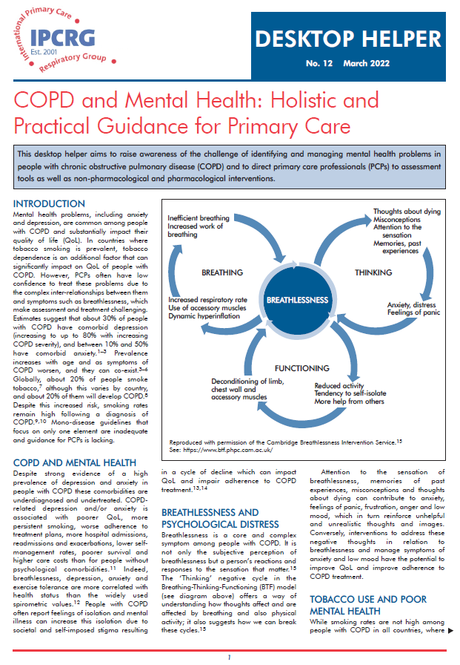
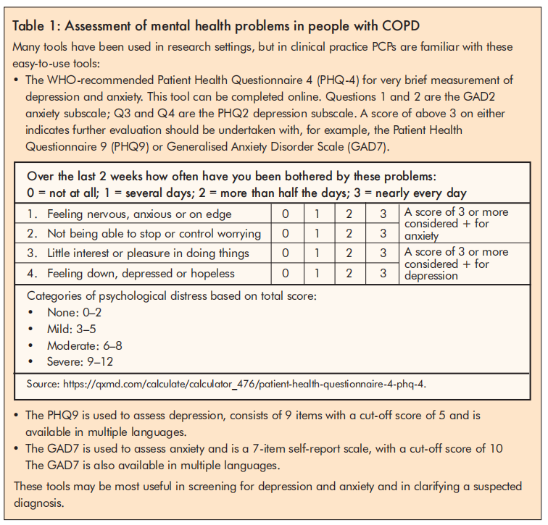
Comorbidities: Assessment of mental health problems in people with COPD
Available at: https://www.ipcrg.org/dth12.

Slide 21
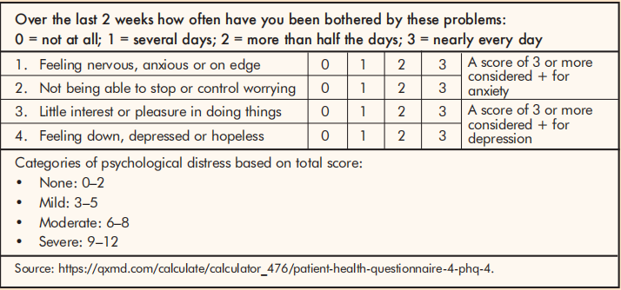
Comorbidities: Assessment of mental health for Mr JD
Regular consultation
Specific assessment
PHQ-9 | 6 | 0-4: normal/minimal depression 5-9: mild depression 10-14: moderate depression 15-19: moderately severe depression
GAD-7 | 10 | 0-4: normal/minimal anxiety 5-9: mild anxiety 10-14: moderate anxiety 15-19: moderately severe anxiety
FSS* | 40 | Score ≥36 indicates fatigue
AIS** | 7 | 0-5: absence of insomnia 6-9: mild insomnia 10-15: moderate insomnia 16-25: severe insomnia
PSQI# | 6 | Score ≥5 is indicative of poor sleep quality
6
*Individuals rate their agreement with nine statements concerning the severity, frequency and impact of fatigue on daily life.
** A 8-item self-assessment psychometric instrument, which has been used as a tool to evaluate the severity of insomnia.
# A 7 component instrument used to measure the quality and patterns of sleep in adults over the last month.

Slide 22
Barriers to the assessment of mental health problems for people with COPD
Patient-perceived barriers
Lack of knowledge
Reluctance to disclose symptoms of anxiety or depression
Physician-perceived barriers
Lack of a standardised diagnostic approach for anxiety and depression
Short-consultation time
Lack of confidence to pursue in-depth psychological assessment
System-level barriers
Poor communication between primary care and mental health systems
Lack of adequate resources for mental health treatment
In order to address these barriers, an integrated treatment approach is required from healthcare professionals, patients and caregivers
Natali D, et al. Breathe 2020;16:190315.

Slide 23
Thinking about Mr JD
Challenges | Positives
He has 3 comorbid conditions in addition to his COPD | He is up to date with his vaccinations
He takes 4 medications every day plus his reliever as needed (he does not like to take too many medicines) | He has a good relationship with his doctor
Low adherence to the COPD treatment | He adheres well to his other medication regimen
He has a GAD with no previous formal diagnosis or appropriate management | He really wants to try to stop smoking

Slide 24
Next steps: Motivational interviewing
Aim |  | Conversation
Clarify that you are not judgmental about tobacco use |  | “We know how hard this is and that this is an addiction and that nicotine is more addictive than heroin…”
Encourage the person to imagine and communicate what they think might be the benefits of quitting |  | “Did you know you that after quitting smoking will get fewer bronchitis episodes?” “Did you know that you will likely feel much calmer and more positive, and have a better quality of life, after giving up smoking?” “You may also find that you will be able to fall asleep more easily, and sleep for longer once in bed
Consider positive reinforcement (pleasure) to motivate the patient to quit smoking |  | “Did you know that if you quit smoking your energy levels will increase and you will be able to be around for grandchildren growing up?”

Slide 25
Management plan for Mr JD
Provide counselling (empathic understanding and respect): ASK / ADVISE / ACT
Discuss pharmacological treatment
Nicotine replacement therapy
Varenicline
Bupropion
Assist with developing a ‘quit’ plan including setting a ‘quit date’
Schedule a next review date
Use email, text or phone as options for follow-up sessions
Discuss abstinence and suggest coping strategies
Encourage social support
Assist in dealing with barriers such as fear of failure, dealing with stress, weight gain and social pressures to smoke
Provide advice on nutrition, physical activity and sleep hygiene
Provide advice on managing withdrawal symptoms and reassurance that they are short-lived

Slide 26
Smoking cessation for people with mental health disorders^{1–3}
Adding medications/management strategies for mood disorders to a standard program of smoking cessation may achieve better long-term quit rates
For Mr JD, consider initiating treatment for his GAD
1. van der Meer RM, et al. Cochrane Database Syst Rev 2013;8:CD006102; 2. Anthenelli RM, et al. Ann Intern Med 2013;159:390e400; 3. Anthenelli RM, et al. Lancet 2016;387:2507e20.

Slide 27
Summary
Many people with COPD continue to smoke despite evidence that smoking cessation is the most effective intervention in increasing survival and reducing morbidity
Tobacco smokers with mental health disorders tend to be more addicted to smoking, smoke more cigarettes and are more likely to relapse
Anxiety and depression are common in people with COPD and should be actively evaluated and treated
Smoking cessation reduces anxiety and depression
People with COPD and mental health disorders who smoke often need support for multiple quit attempts
Combine counselling and pharmacological treatments as this is the most effective intervention

