Slide 1
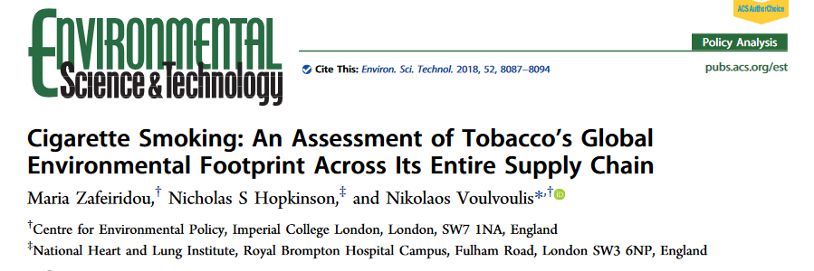

Slide 2
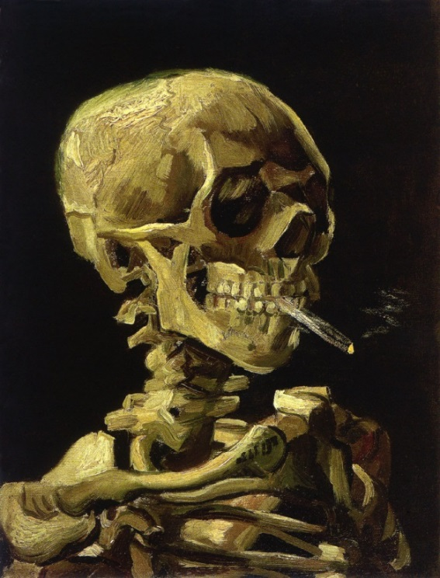
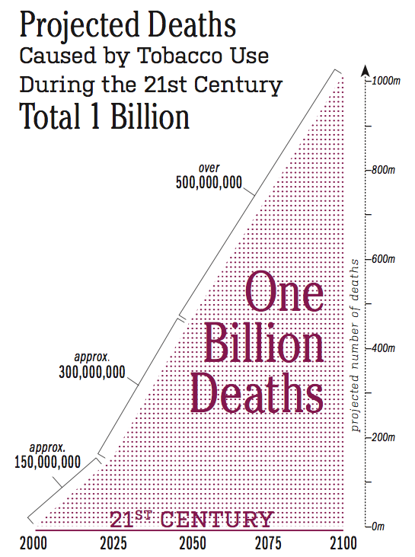

The Tobacco Industry - Climate and Environmental Impacts
WHO: http://www.tobaccoatlas.org/topic/smokings-death-toll/

Slide 3
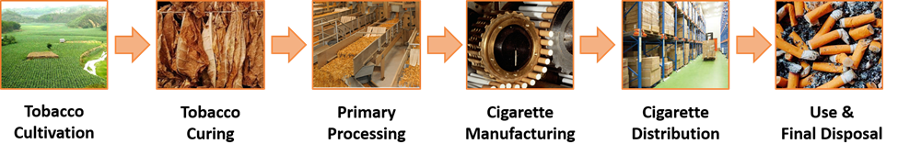
Environmental impacts of smoking are significant but poorly quantified: resources are consumed, and wastes and emissions produced, throughout the supply chain.
Tobacco competes for finite natural resources with valuable commodities such as food crops, often in regions suffering from food insecurity.
Impacts considered include: resource depletion; human toxicity; ecosystem eutrophication, ecotoxicity, and acidification; climate change
Sustainable development is threatened by both the environmental footprint and the health effects of tobacco
Zafeiridou et al Environ. Sci. Technol. 2018, 52, 8087−8094

Slide 4
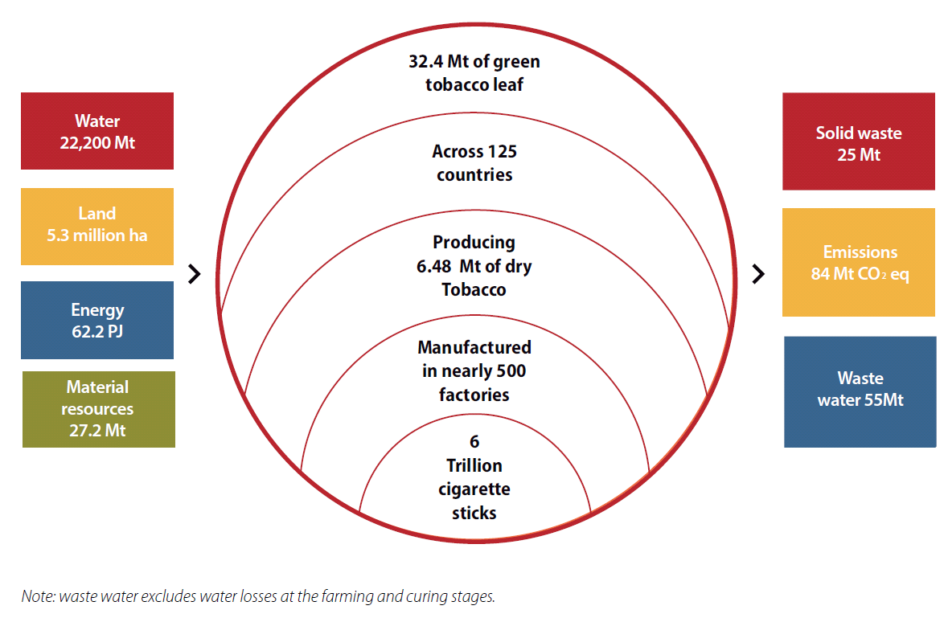
Scale of global tobacco impact
In a world facing enormous pressures on natural resources, tobacco competes with valuable commodities that are essential for human development.
Tobacco production and consumption adds completely unnecessary pressures on the health of both our planet and its most vulnerable inhabitants.
PJ
Note: waste water excludes water losses at the farming and curing stages.
Zafeiridou et al Environ. Sci. Technol. 2018, 52, 8087−8094

Slide 5
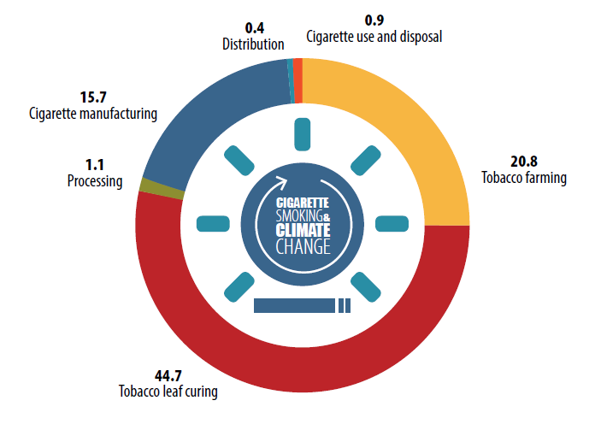
Annual contribution to climate change of the global cigarette smoking supply chain stages
Omitted by tobacco industry CSR reports
Mt CO₂ eq
Zafeiridou et al Environ. Sci. Technol. 2018, 52, 8087−8094
Notes:
Nb excluded from tobacco industry analyses

Slide 6
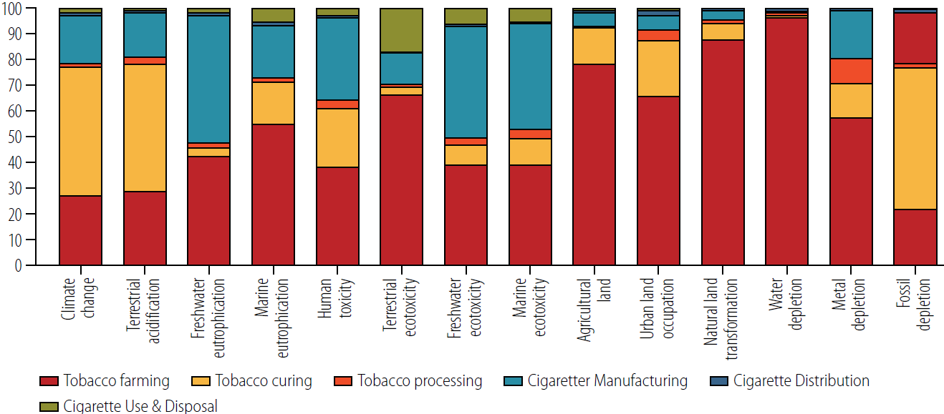
Environmental impacts across the full life cycle of cigarette production and consumption – the bulk of these fall in poorer tobacco cultivating countries
Zafeiridou et al Environ. Sci. Technol. 2018, 52, 8087−8094

Slide 7
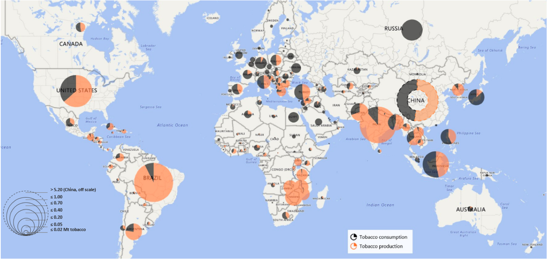
Global imbalance
“By smoking, the tobacco industry is literally burning poorer countries’ resources.”
As a result of the shift of production from richer to lower income countries, the environmental impacts of cigarettes are now mostly borne by developing regions, threatening sustainable development.
Zafeiridou et al Environ. Sci. Technol. 2018, 52, 8087−8094

Slide 8
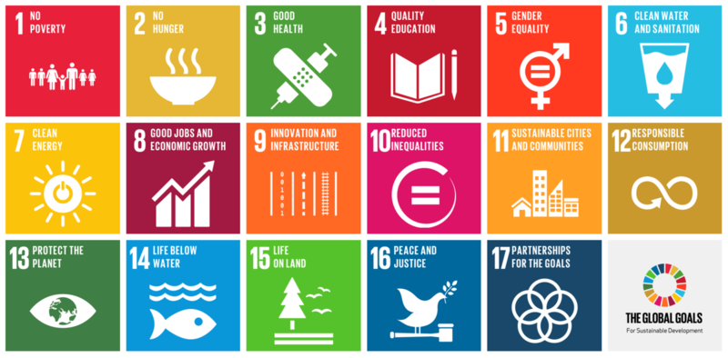
Of the world’s one billion smokers, close
to 80 percent live in LMICs
Zafeiridou et al Environ. Sci. Technol. 2018, 52, 8087−8094

Slide 9
9 out of 10 top tobacco producing countries are low or middle income
Zafeiridou et al Environ. Sci. Technol. 2018, 52, 8087−8094

Slide 10
Four of ten top tobacco producing countries are low income food deficit countries.
Zafeiridou et al Environ. Sci. Technol. 2018, 52, 8087−8094

Slide 11
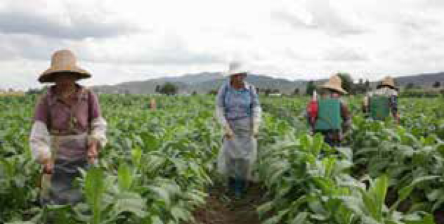
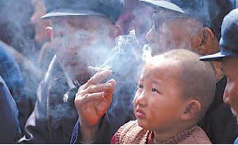
Case studies: The environmental footprint of tobacco in China
In China, the world’s top cigarette consuming country,
2.5 trillion cigarettes are produced each year
using millions of tonnes of water and
thousands of square miles of arable land.
At the same time, China is experiencing severe water shortages and nearly 134 million people suffer from undernourishment.
Zafeiridou et al Environ. Sci. Technol. 2018, 52, 8087−8094

Slide 12
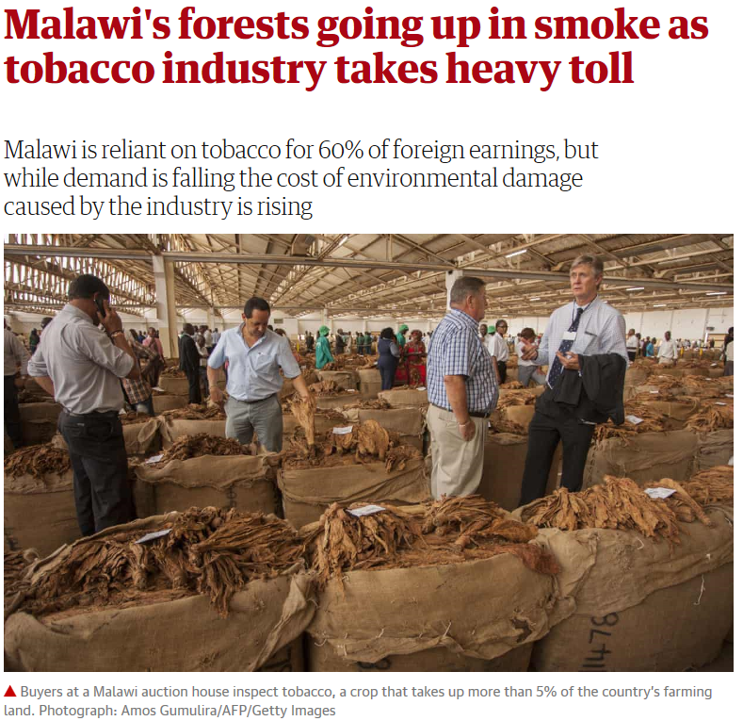
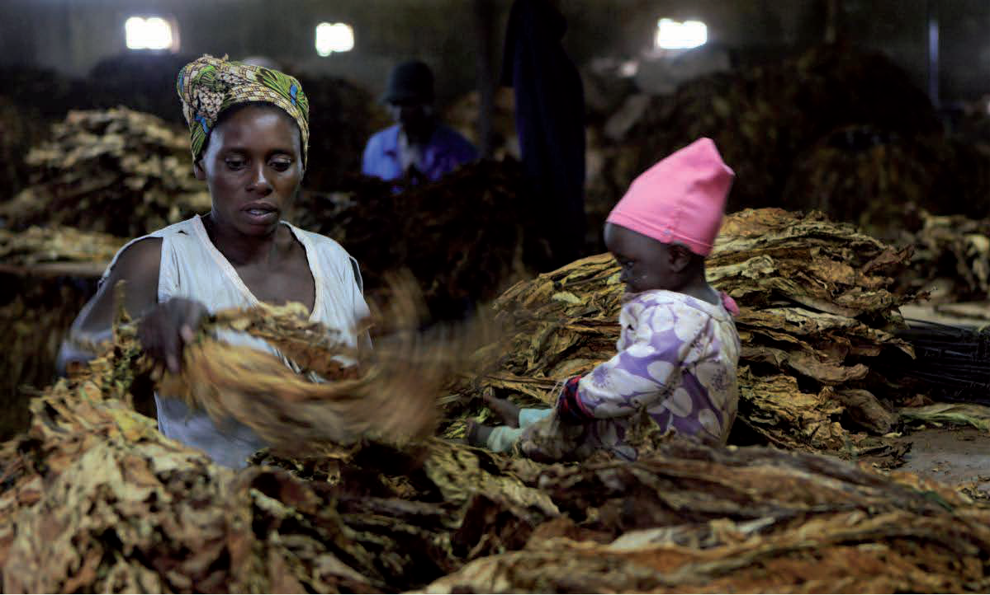
Tobacco and environmental injustice in Africa
“My country, Malawi, has lost most of its forests to tobacco,” Paul Desanker, a manager in the UN Framework Convention on Climate Change adaptation programme
Guardian 31st July 2015
Zafeiridou et al Environ. Sci. Technol. 2018, 52, 8087−8094
Notes:
https://www.theguardian.com/global-development/2015/jul/31/malawi-tobacco-industry-deforestation-chinkhoma

Slide 13
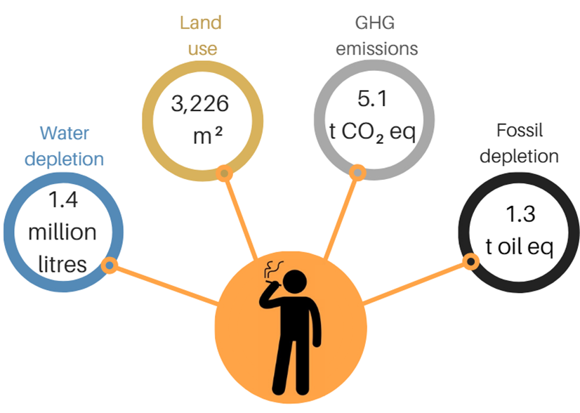
Environmental impacts of a lifetime of smoking - a person smoking 20 cigarettes/day for 50 years
In one year a smoker contributes almost 5 times more to water depletion and nearly 2 and 10 times more to fossil fuel depletion than an average consumer of red meat and sugar respectively, and 4 times more to climate change than a sugar consumer.
Tobacco consumers need to appreciate that tobacco is not just a threat to individual health but also an unethical product.
Zafeiridou et al Environ. Sci. Technol. 2018, 52, 8087−8094

Slide 14
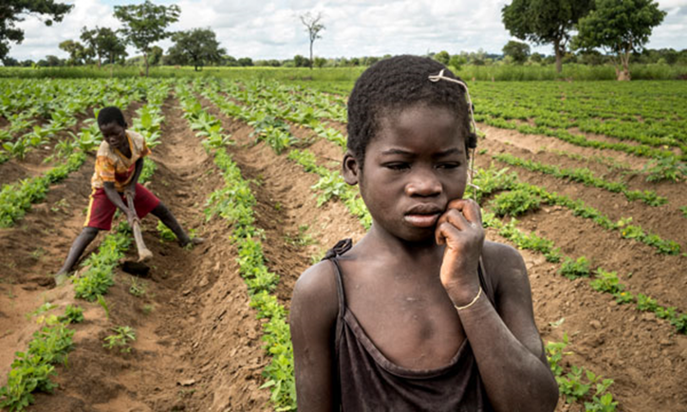
Key messages
6 trillion cigarettes are produced and smoked each year using substantial amounts of land, water, pesticides and labour – all finite resources that could be put to better use.
Environmental impacts include water and soil depletion; human toxicity; ecosystem eutrophication; acidification; and climate change.
Zafeiridou et al Environ. Sci. Technol. 2018, 52, 8087−8094

Slide 15
Key messages
The most resource-demanding and environmentally damaging stages in the supply chain are the cultivation and curing of tobacco which happens mainly in developing regions
It is therefore developing regions which suffer most of the environmental impacts, threatening sustainable development.
Zafeiridou et al Environ. Sci. Technol. 2018, 52, 8087−8094

Slide 16
Key messages
Tobacco is incompatible with the global sustainable development agenda,
Policy recommendations to support delivery of the SDGs include
  making tobacco companies accountable for environmental externalities they cause;
  raising awareness of the issue among smokers, civil society, and policy makers; and
  assisting tobacco farmers to switch to alternative crops.
Zafeiridou et al Environ. Sci. Technol. 2018, 52, 8087−8094

