Slide 1
Aims of this Workshop
recognise the need for change in PHC approach and management to CRD- Introductory talks
Small group work- one group each Asthma and COPD, then swap
debate possible courses of action aimed at altering the status quo;
elaborate a list of actions that can have a higher and sustainable impact on the care of respiratory patients in primary care
prioritise those applicable in their specific country or regional context allowing for the implementation of quaternary prevention routines with a focus on patient safety.

Slide 2
The problem
Every system is perfectly designed to get the results it gets¹
ASTHMA illustrates all the things wrong with healthcare systems globally:²
Unwarranted variation (not due to disease difference)
Harm³
Failure to prevent disease and disability
Waste of human and physical resources through low value activity
Inequity
That is, both intended and unintended consequences are designed into our systems
3. O’Byrne PM, Jenkins C, Bateman ED. The paradoxes of asthma management: time for a new approach? Eur Respir J 2017; 50: 1701103
1. Earl Conway and Paul Batalden
2. Prof Muir Gray

Slide 3
Change for improvement starts with “hunches”
32
SABA use Needs major improvement
First Saba conversations affect future use
1
Gain acceptance that improvement needed
Disrupt comfort with the way things are done
Apply the evidence about achieving change at scale
Inspire followers
Teach right care – anti-inflammatory therapy, continuous care
2
3
Asthma is low priority for change
HCPs need to want change
4
5

Slide 4
1. Gain acceptance that improvement needed
Right Care. Lancet Series 2017
“With the focus firmly on universal health coverage as a central part to the UN Sustainable Development Goals, there is an opportunity to examine how to achieve optimum access to, and delivery of, health care and services.
Underuse and overuse of medical and health services exist side-by-side with poor outcomes for health and wellbeing. This Series ….provides a framework to begin to address overuse and underuse together to achieve the right care for health and wellbeing… achieving the right care is both an urgent task and an enormous opportunity.”
Notes:
NHS cares for 65 million people. Sees more than 1million people every 36 hours.
NHS England. Sustainable Improvement and Horizons Team 2017. Leading large scale change: a practical guide.

Slide 5
Richard Horton, the Lancet 2017
“What is right care? …. it is care that weighs up benefits and harms, is patient-centred… and is informed by evidence, including cost-effectiveness… most medical services fall into a grey zone where the benefit and harm ratio for a given individual is unknown.
However, an important start is to think about and aim to influence, the drivers of poor, unnecessary, and harmful care… these drivers fall into three important categories: money, finance, and organisations; knowledge, beliefs, assumptions, bias, and uncertainty; and power and human relationships.
https://www.thelancet.com/journals/lancet/article/PIIS0140-6736(16)32588-0/fulltext

Slide 6
1 Improvement needed -Patient safety and Asthma Right care
Overuse SABA
“reliance”
Underuse ICS
Current ration
“desirable ratio’
Australian controversy-OTC budesonide
Overuse OCS
Rescue medication, Aus data, link to above

Slide 7
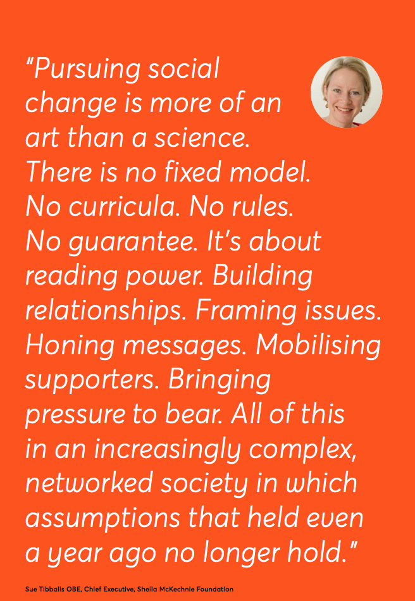
2. Disrupt comfort with the current way things are done
Nesta Innovation Foundation (2017) We change the world: what can we learn from global social movements for health? Nesta.org.uk
Notes:
Image sources HIV: https://www.google.com/url?sa=i&url=https%3A%2F%2Fcommons.wikimedia.org%2Fwiki%2FFile%3AMinnesota_AIDS_Project_-_HIV_Stigma_Stops_Here_-_Twin_Cities_Pride_Parade_(9180874836).jpg&psig=AOvVaw3Lx--5_9yEV6qtE1D79EZ_&ust=1606489655115000&source=images&cd=vfe&ved=2ahUKEwjdxYy7vqDtAhUhgM4BHeqvCNkQr4kDegQIARAc
Green: https://www.google.com/imgres?imgurl=https%3A%2F%2Fmedia.salon.com%2F2019%2F09%2Fprotesters-global-climate-strike.jpg&imgrefurl=https%3A%2F%2Fwww.salon.com%2F2019%2F12%2F23%2Fa-year-of-resistance-how-youth-protests-shaped-the-discussion-on-climate-change_partner%2F&tbnid=ihDr69EuX7TuYM&vet=12ahUKEwjdxYy7vqDtAhUhgM4BHeqvCNkQMygDegQIARAj..i&docid=2dm3W4zdtxRUSM&w=846&h=571&hl=en&safe=active&ved=2ahUKEwjdxYy7vqDtAhUhgM4BHeqvCNkQMygDegQIARAj
Disability: https://encrypted-tbn0.gstatic.com/images?q=tbn:ANd9GcQT8cUPM_QqTkxIYBJGsDdDatDh3Op09_zHKLDRqe2gFaIEZ5yIDBWNXIzd6ELPl1ByoDLthNi5AK9LU8smrak3N1Ed12jrbR4&usqp=CAU&ec=45732300

Slide 8
2. Disrupt comfort with the current way things are done
Kickstarting action Emerging and building momentum
Nurturing voices Cultivating diverse interests and motivations
2
Influencing and interacting Navigating a complex array of relationships
3
Nesta 2017. We change the world: what can we learn from global social movements for health?

Slide 9
5. Move on to addressing underuse of right asthma care – chronic disease management, ICS
Improving the value that each person with asthma derives from their own care and treatment and the value the whole population derives from the investment in asthma care by addressing unwarranted variation; reducing waste, avoidable harm and avoidable symptoms
Doing the right things and only the right things in the right way for the right people at the right time in the right place, whatever that means in the local context

Slide 10
IPCRG and Asthma Right Care-Tools to help clinicians
Asthma slide rule
Reliever reliance test
Steroid alert card

