Slide 1
WORKSHOP
Patient safety in the management of CRD
Amanda Barnard
Jaime Correia de Sousa
Miguel Román Rodriguez

Slide 2

Workshop Outline
Introduction
The IPCRG
Quaternary prevention and patient safety
The Asthma Right Care initiative
The COPD Right Care initiative
Group work
Plenary Discussion

Slide 3


Aim
The aim of this workshop is to introduce
IPCRG Asthma Right Care and
COPD Right Care,
that offer an approach to quaternary prevention that improves patient safety.

Slide 4
Objectives
At the end of the workshop, participants should be able to:
recognise the need for change in PHC approach and management to CRD;
debate possible courses of action aimed at altering the status quo;
elaborate a list of actions that can have a higher and sustainable impact on the care of respiratory patients in primary care
prioritise those applicable in their specific country or regional context allowing for the implementation of quaternary prevention routines with a focus on patient safety.

Slide 5
Introduction
Patient safety and opportunities for quality improvement
Jaime Correia de Sousa, MD, PhD
Family Physician
Affiliate Professor, School of Medicine, University of Minho, Portugal

Slide 6
Conflict of interest disclosure
I have no, real or perceived, direct or indirect conflicts of interest that relate to this presentation.
I have the following, real or perceived direct or indirect conflicts of interest that relate to this presentation:
Affiliation / financial interest | Nature of conflict / commercial company name
Tobacco-industry and tobacco corporate affiliate related conflict of interest | None
Grants/research support (to myself, my institution or department): | None
Honoraria or consultation fees: | None
Participation in a company sponsored bureau: | None
Stock shareholder: | None
Spouse/partner: | None
Other support or other potential conflict of interest: | None

Slide 7
Introduction
Asthma and COPD - two important CRD in the community
Often underdiagnosed or misdiagnosed in PHC
Effective and cost-effective pharmacological and non-pharmacological interventions
The key treatment - inhaled medicines
Problems with PHC prescribing, patient adherence to treatment
Over-reliance on or misuse of symptom relief medicines - risks to patient safety
Opportunities for QI in clinical practice.

Slide 8
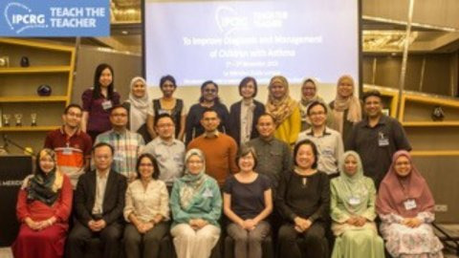
Introduction to IPCRG
Our vision is of a global population breathing and feeling well through universal access to right care.
Our mission is to work locally in primary care and collaborate globally to improve respiratory health.
We include multidisciplinary private and public providers

Slide 9
We are the only
Global primary care respiratory group
Representative of primary care on WHO-Global Alliance against chronic Respiratory Diseases (GARD)
Respiratory Group in collaborative relations with WONCA World
Respiratory Special Interest Group of WONCA Europe
And we have top 4 primary care journal (open access), npjPCRM, published by Springer Nature

Slide 10
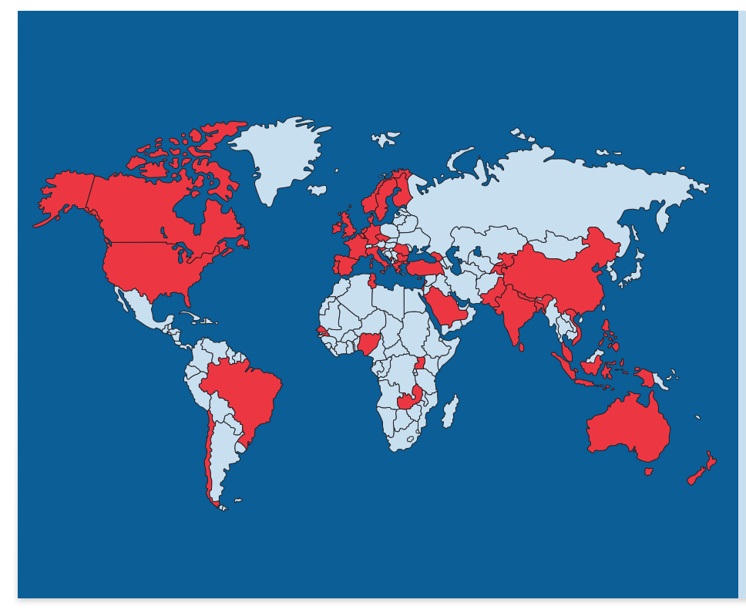
We reach 155,000 primary care colleagues through our 37 country members in high, middle and low income countries

Slide 11
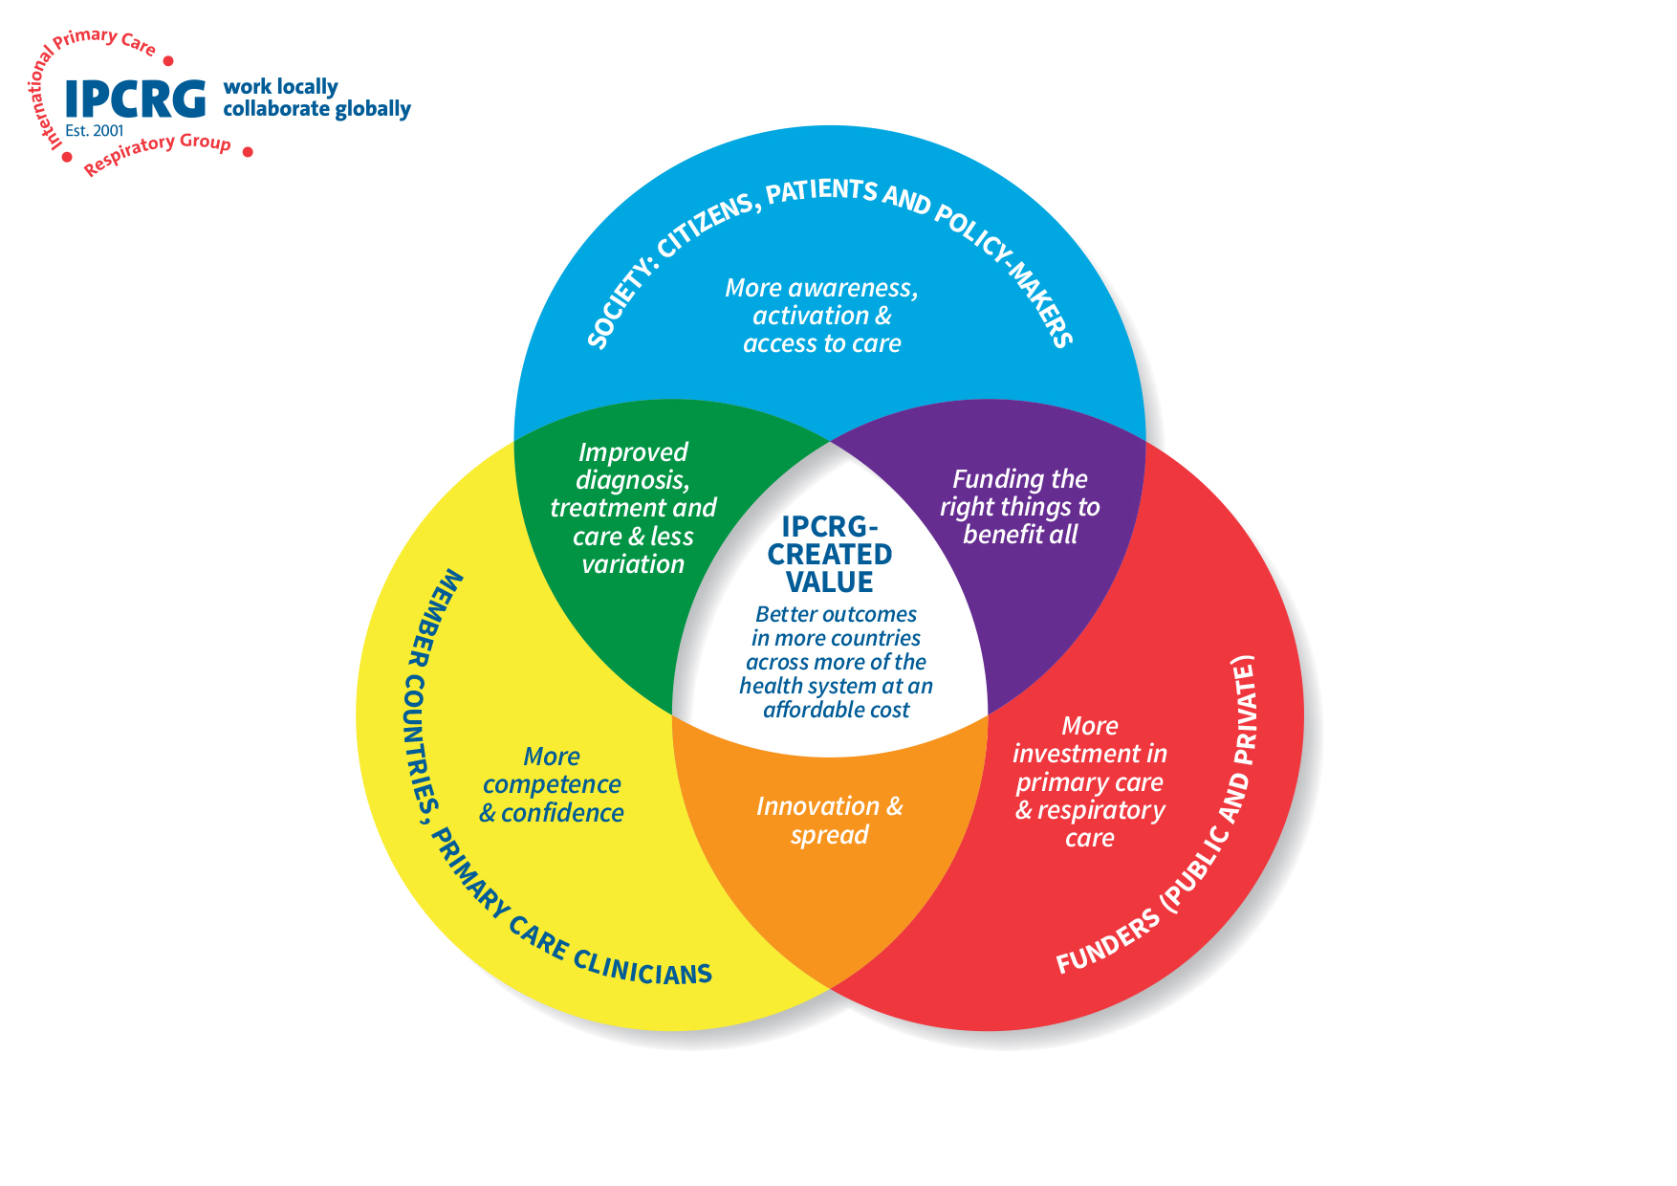
IPCRG’s strategy to add value

Slide 12
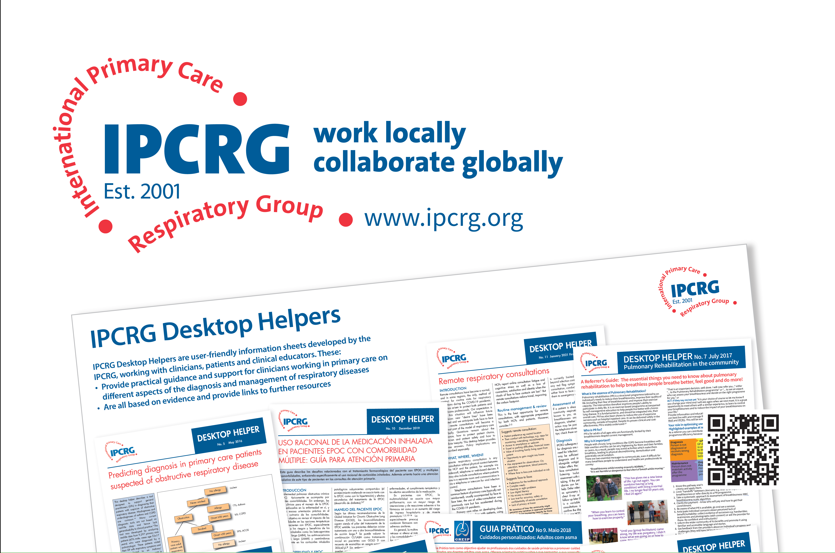

Slide 13

Patient safety
It is a critical policy issue and remains an important challenge to all health systems.
Many adverse events leading to harm could be prevented if appropriate safety protocols and clinical guidelines were followed.
Different definitions
  WHO, OECD, NHS England, etc.

Slide 14

Patient safety
NHS England definition:
  Patient safety is the avoidance of unintended or unexpected harm to people during the provision of health care.
Safety management should move from ensuring that
  ‘as few things as possible go wrong’
to ensuring that
  ‘as many things as possible go right’. *
* Hollnagel et al. From Safety-I to Safety-II: A White Paper

Slide 15
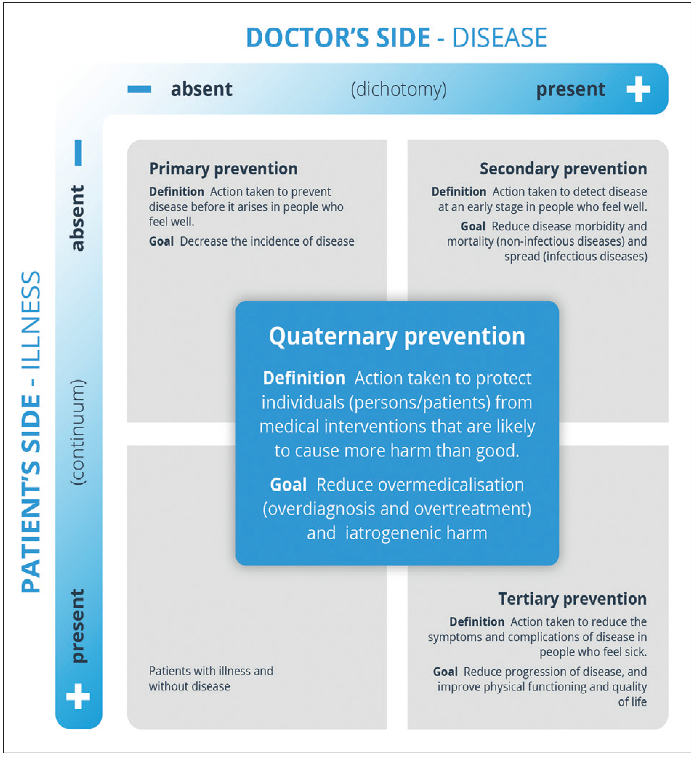
Quaternary prevention
New definition (by Brodersen et al.)
Action taken to protect individuals (persons/patients) from medical interventions that are likely to cause more harm than good
Martins, Brodersen et al. Quaternary prevention: reviewing the concept. Eur J Gen Pract. 2018

Slide 16


The EQuiP Quality Agenda on Patient Safety
EQuiP - European Society for Quality and Patient Safety in General Practice/Family Medicine
The aim of EQuiP is to contribute to the achievement of high levels of quality and safety of care for patients in general practice in all European countries.
EQuiP Working Group on Patient Safety
  Chair: Isabelle Dupie
https://equip.woncaeurope.org/
https://www.youtube.com/watch?v=SmTj-sZ9-_4

Slide 17





What is ‘right care’?
Right things
Right way
Right people
Right time
Right place
Unconscious competence
It’s easy to do the right thing

Slide 18
Asthma Right Care
Amanda Barnard
Family Physician
……………

Slide 20
COPD Right Care
Miguel Román Rodriguez
Family Physician
……………

Slide 22
Thank you for your attention!
Notes:
I hope you have enjoyed the lecture
Thank you for your attention!

