Slide 1
Asthma Case Studies
The “Chest Infection”
IPCRG received funding from AstraZeneca to develop the Asthma Right Care Initiative

Slide 2
About these slides
Please feel free to use, update and share some or all of these slides in your non-commercial presentations to colleagues or patients
The slides are provided under creative commons licence CC BY-NC-ND.
  BY stands for attribution (the obligation to credit the author and other parties designated for attribution);
  NC stands for NonCommercial (commercial use is excluded from the licence grant);
  ND means NoDerivatives (only verbatim copies of the work can be shared)
When using our slides, please retain the source attribution: IPCRG 2022 Jaime Correia de Sousa, MD, PhD, on behalf of the Asthma Right Care Team (original contribution by Dr Noel Baxter)

Slide 3
What you will learn
Why an acute breathless presentation associated with a suspected / unclear diagnosis or poor understanding of asthma is an opportunity worth spending time on
Why antibiotics don’t need to be given – ‘just in case’ – when someone has an infectious-trigger asthma attack
How to distinguish between and feel confident about what is asthma and what is a lung infection
How to avoid Asthma Wrong Care

Slide 4

The patient
Sharon is 33 years old
She is a classroom assistant at a primary school
She is a single parent with two children and has suffered domestic violence (she remains at risk)
Her children are aged 5 and 8 years (both also use salbutamol)
Her mother also lives with her and has asthma and emphysema

Slide 5
General medical history
Sharon has a diagnosis of asthma which is managed with ICS (preventer) and salbutamol as needed
  Her asthma was diagnosed at an emergency department visit when she was 8 years old
  She first received salbutamol at age 3 years

Slide 6
Respiratory history
Sharon has received 14 salbutamol inhalers in the last 12 months
Her last ICS inhaler was issued 2 years ago
She has received 5 courses of antibiotics in the last 3 years for respiratory conditions
Eosinophil from the last 2 years are 0.3, 0.4 and 0.3

Slide 7
SABA overuse:
An indicator of poor control (1)
UK National Review of Asthma Deaths 2012 to 2013
39% people on SABA at time of death had been prescribed more than 12 in the year before they died
  4% had been prescribed >50 SABA inhalers
  Those prescribed >12 were likely to have had poorly
  controlled asthma
National Review of Asthma Deaths: Available at: https://www.rcplondon.ac.uk/projects/national-review-asthma-deaths. Accessed October 2022.

Slide 8
SABA overuse:
An indicator of poor control (2)
“There is a progressive risk of hospital admission associated with the prescription of more than three SABA inhalers a year”
Healthcare resource use | 1-3 inhalers N=5888 | 4-12 inhalers N=2054 | >13 inhalers N=285
Inpatient episodes | 20 | 33 | 2
Crude inpatient episode rate per 100 population | 0.34 | 1.61 | 0.70
Hull SA, et al. npj Prim Care Respir Med. 2016;26:16049.

Slide 9
SABA overuse:
An indicator of poor control (3)
“There is some evidence that electronic alerts reduce excessive prescribing of SABAs, when delivered as part of a multicomponent intervention in an integrated health care system”
Literature review to synthesise the evidence for the use of computerised alerts that identify excessive prescribing of SABAs to improve asthma management for people with asthma
 | SABA prescribing | ICS prescribing | ICS-SABA prescribing | ICS-LABA prescribing
Study 1 |  | No effect
Study 2 | No effect | No effect
Study 3 | Positive effect | No effect |  | Positive effect
Study 4 |  | No effect | Positive effect
SABA short-acting beta₂- agonist, ICS inhaled corticosteroid, LABA long-acting beta₂-agonist.
McKibben S, et al. npj Prim Care Respir Med. 2018;28:14.

Slide 10
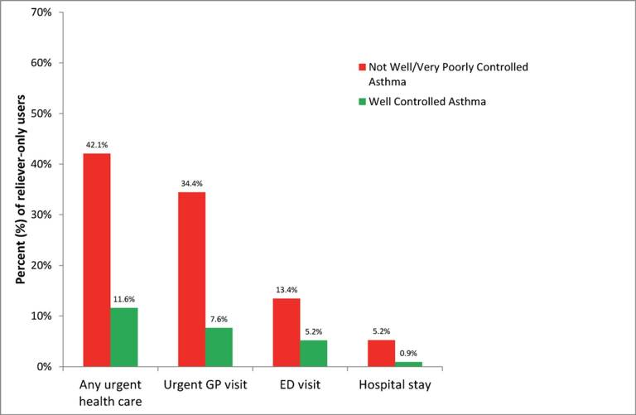
SABA overuse:
An indicator of poor control (4)
“One-quarter of the reliever-only population had needed urgent asthma healthcare in the previous year, demonstrating the importance of identifying such patients”
Cross-sectional population-based
Internet survey in Australia
Of 2686 participants ≥16 years with
current asthma randomly drawn from
a web-based panel, 1038 (50.7% male)
used only reliever medication
ED, emergency department.
Reddel HK, et al. BMJ Open. 2017;7:e016688.

Slide 11
Poor adherence to maintenance therapy and guidelines are not helpful
Poor adherence to maintenance pharmacotherapy is a reality in asthma
There is a switch in recommendation from Step 1 (use a SABA as-needed)
to Step 2 (use an ICS fixed-dose regimen and minimise SABA use)
“The medication that treats the underlying disease,
which patients are encouraged to take (the ICS) is not the one that the patient perceives is benefitting them (the SABA), which they are now discouraged from taking”
ICS, inhaled corticosteroid; SABA, short-acting β2 agonist.
O’Byrne PM, et al. Eur Respir J. 2017;50:1701103.

Slide 12
Current presentation
Sharon has booked an emergency appointment after taking her children to school
She is feeling stressed as she should be at work and needs to get in an out of the appointment quickly
She needs ‘her inhaler’ as its empty again and she needs antibiotics as she is ‘chesty’

Slide 13
Clinical considerations
Your patient…
You see Sharon and her children on a fairly regular basis
Usually your consultations with her are psychosocial
You know that she does not have time to make her own physical health a priority
…and you
You are having a busy surgery – coughs, colds, requests for antibiotics and 3 home visits requested for ‘flu’

Slide 14
What might your immediate reactions to Sharon’s current presentation be?
She seems to know what she wants
She seems busy and I don’t want to stress her more
If she has a chest infection then an inhaler and antibiotics will cover all bases
But is this Asthma Right Care?

Slide 15
Clinical considerations
Questions to consider
What does Sharon mean by ‘her inhaler’?
  How will you find out?
Is there a clinical case for antibiotics?
  What information do you have or still need?
Does she have asthma?
  What notes and data do you already have?

Slide 16
Clinical considerations
Basic evaluations and test
Respiratory rate | 20 bpm
Pulse | 98 bpm
Tympanic temperature | 36.7 Celsius
Blood pressure | 108 / 70 mm/Hg
Digital pulse oximetry SpO₂ | 97%
BMI | 24

Slide 17
Clinical considerations
Acute respiratory measures
Predicted PEFR Pre-bronchodilator PEFR | 487 L/min 260 L/min
Predicted FEV₁ Pre-bronchodilator FEV₁ | 3.01 1.35
Exhaled carbon monoxide | 21 ppm

Slide 18
Reasons for poor asthma control
Wrong diagnosis or confounding illness
Incorrect choice of inhaler or poor technique
Concurrent smoking
Concomitant rhinitis
Unintentional or intentional nonadherence
Individual variation in treatment response
Under treatment

Slide 19
Clinical considerations
Chest examination
Trachea is central
No lymphadenopathy
Chest resonant throughout, bilaterally
Bilateral expiratory wheeze present
No focal or unilateral signs

Slide 20
Lets revisit immediate reactions:
She seems to know what she wants
But does she?
You might ask: “Why do you think this is a chest infection?”
She might answer:
  When I’m like this I always get antibiotics
  I have a cough
  It feels like something is on my chest
  Even if its just a cold – that’s an infection still isn’t it?

Slide 21

Question cards

Slide 22
Lets revisit immediate reactions:
She seems busy and I don’t want to stress her more
But can I help her re-frame?
You might say:
  “I can help today but I don’t think it is the infection that is causing you to feel this way. I’d like to help you understand why. Do you have time?”
  “I also think I know a way that I can help save you time and prevent this happening in the future – we will need to spend a little more time now though”

Slide 23
Lets revisit immediate reactions:
If she has a chest infection then an inhaler and antibiotics will cover all bases
But what about my duty to antibiotic stewardship?
You might say:
  “You are right that your cold has triggered how you feel today but antibiotics wont treat a cold and they wont treat what is happening inside your airways right now”
  “At some point in the future you may need antibiotics to save your life. Today is not that day, but giving them now when there isn’t evidence of serious bacterial infection may prevent them working for you or your children in the future”

Slide 24
Clinical considerations
Does Sharon have asthma?
Sharon’s diagnosis was made in childhood and may warrant review
What can you do?
If you have old records – check them against the diagnostic criteria you use locally or in your country
Consider a reversibility test. You have prebronchodilator readings showing obstruction
Look at the response to 400 mcg salbutamol via a spacer
  Share with her if she reverses to support her learning. If she doesn’t, reconsider
  the diagnosis

Slide 25
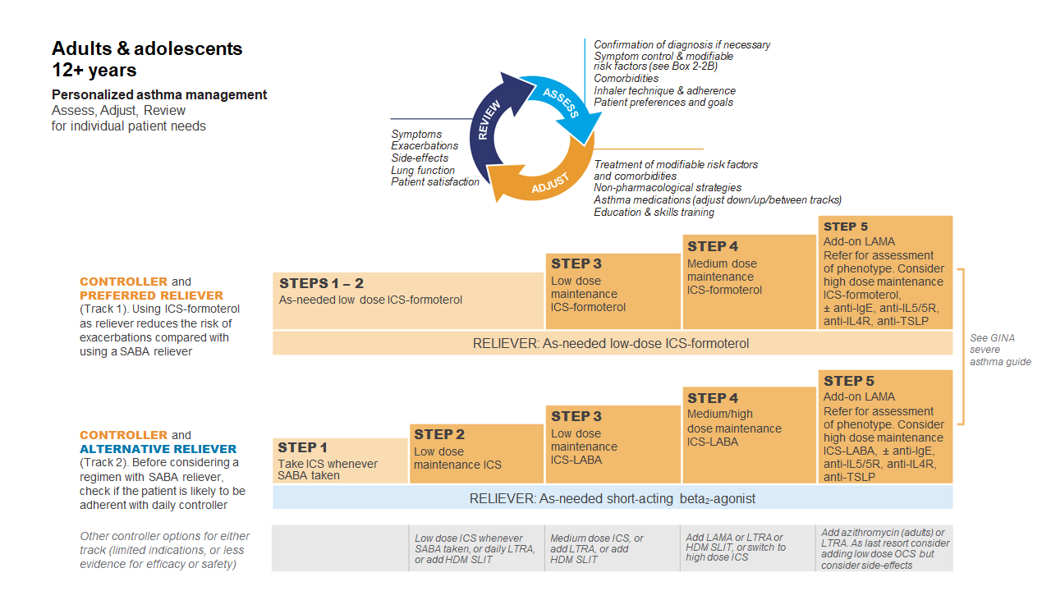
GINA 2022
Available at: www.gina.com. Accessed October 2022.

Slide 26
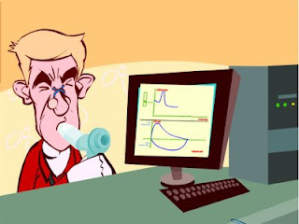
Spirometry
Spirometry measures airflow and lung volumes, and is the preferred lung function test for asthma in primary care
Forced exhalation from a maximal inspiration
FVC: Forced vital capacity | FEV1: Forced Expiratory Volume in 1 second | FEV1/FVC
Volume of air exhaled after full inspiration and full exhalation | Volume of air exhaled in the first second of forced exhalation | Ratio of vital capacity exhaled in 1 second expressed as a percentage of the total volume of air exhaled after full inspiration and full exhalation
For further guidance visit: http://bit.ly/IPCRG-SPIROMETRY-WONCA-2018

Slide 27
Spirometric patterns
FEV1/FVC
FVC
FEV1
Obstruction
N
Restriction
N
N
Mixed
Obstruction and hyperinflation
Mild Obstruction | FEV1 ≥80%
Moderate Obstruction | FEV1 <80% ≥50%
Severe Obstruction | FEV1 <50% ≥35%
Very Severe Obstruction | FEV1 <35%
For further guidance visit: http://bit.ly/IPCRG-SPIROMETRY-WONCA-2018

Slide 28
Quick spirometry assessment
FEV₁ /FVC
≥70%
Normal
<70%
Obstruction
FVC
FVC
< 80% ref value
<80% ref. value
≥80% ref value
Mixed pattern
≥80% ref value
OBSTRUCTION
+ HYPERINFLATION (↑VR)
NORMAL
RESTRICTION
OBSTRUCTION
OBSTRUCTION
+
RESTRICTION
(VR normal)
For further guidance visit: http://bit.ly/IPCRG-SPIROMETRY-WONCA-2018

Slide 29
Clinical considerations
Is there a case for antibiotics?
Sharon does not have a temperature and there are no visible or auditory signs of lung infection BUT she is tachypnoeic and tachycardic
  Is a CRP to WBC justified?
  Could this airways obstruction be infection rather than asthma response to a viral trigger?
  If I treat with steroids, oral steroids especially but also inhaled, won’t that make any bacterial infection worse?

Slide 30
Clinical considerations
Is Sharon managing her asthma appropriately?
What does Sharon mean by ‘her inhaler’?
You might say:
  “I hear from you that using your reliever inhaler gives you relief. I’m worried though that your airways are only 50% open and that explains why you feel the way you do”
  “I can give you treatment today that will start to unblock the remaining 50% and make you feel better more quickly than antibiotics or the reliever inhaler”
  “I’d like to show you this 2 minute film to help explain why your reliever isn’t helping you enough” (scroll to the bottom of the webpage to access the film)

Slide 31
Clinical considerations
The new plan
Start ICS therapy for Sharon
Consider repeating the reversibility test in 2 days, 1 week and
2 weeks having initiated steroid therapy

Slide 32
Steps to help Sharon live better with her asthma
Identify symptom triggers
Advise Sharon to avoid smoky environments
Recommend regular physical exercise
Suggest a review of inhaler technique at all future consultations

Slide 33
Why this is Asthma Right Care
You have used the extra time because of the opportunity presented to you now to convince
  Yourself
  Sharon
  Your future health professional colleagues who may see Sharon in the future
That the case is / or isn’t strong for asthma and importantly that if it is strong for asthma by showing response and reversibility that you can support her better to optimise lifelong preventive therapy for her lifelong lung health – but as a bonus - also her children

Slide 34








Key asthma triggers
Psychological
triggers³
Air pollution¹
Medications*³
Exposure to bacteria²
House dust mites⁶
Smoking^{3,4}
Flowers/pollen³
Household pets^{3,4}
Exercise⁵
Alcohol³
Air-conditioning³
URTI³
URTI = upper respiratory tract infection
*Beta-blockers and non-steroidal anti-inflammatory drugs.
1. Esposito S, et al. BMC Pulm Med 2014;14:130; 2. Beigelman A, et al. Curr Opin Allergy Clin Immunol 2014;14:137–142; 3. See K, et al. Singapore Med J 2015 epub; 4. Vernon M, et al. J Asthma 2012;49:991–998; 5. Global Initiative for Asthma. Global Strategy for Asthma Management and Prevention, 2016. Available from: www.ginasthma.org; 6. Lim FL, et al. PLoS One 2015;10:e0124905.

Slide 35
How to review inhalation technique
Ask the patient beforehand to bring their own inhaler for the consultation
Ask them to demonstrate how they use their inhaler
Correct some aspects and explain why
If possible use videos
    Observe technique and let the patient observe self (using video demonstrations)
Show you are available to review their technique if necessary
Ask the patient to bring their own inhaler for the next appointment
Notes:
Resources for reviewing inhaler technique:
Asthma review series: Part 3 - Inhaler Technique and Recording Peak Flow. Available at: https://www.youtube.com/watch?v=ZhIcT57i32g
Asthma inhaler techniques (children). Available at: https://www.youtube.com/watch?v=fHcG8DXUwdQ
Asthma: inhaler techniques: Available at: https://www.nhs.uk/Video/Pages/Childrensasthmainhaler.aspx

Slide 36
Asthma Right Care: a movement for Global Change
Movement for Global Change
IPCRG received funding from AstraZeneca to develop the Asthma Right Care Initiative

Slide 37
Every system is perfectly designed to get the results it gets
(Earl Conway and Paul Batalden)
Notes:
Both intended and unintended consequences are designed into our systems

Slide 38
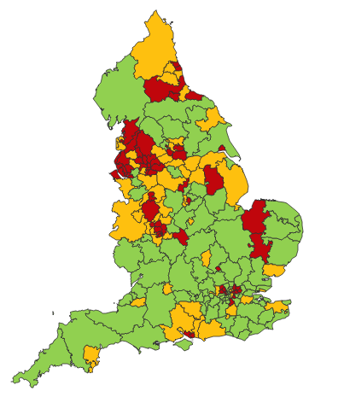

Making a case for change
Asthma illustrates all 5 global healthcare problems (Muir Gray):
Unwarranted variation
Harm, even when quality is high (over-diagnosis, over-treatment)
Failure to prevent disease and disability
Waste of human and physical resources through low value activity
Inequity
And new challenges are forming:
Financial constraints
Rising expectations of personalised care
Climate change/pollution
Increasing need
PHE Fingertips data Asthma admissions per 1000 population 2012/13 data
Notes:
Unwarranted variation as defined by Wennberg: Variation in utilization of health care services that cannot be explained by variation in patient illness or patient preferences
http://www.nhsconfed.org/~/media/Confederation/Files/Events/ACE15/1430%20Inaugural%20NHS%20value%20lecture.pdf

Slide 39
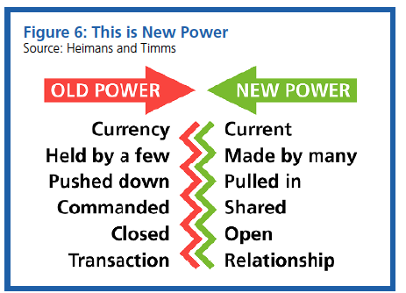
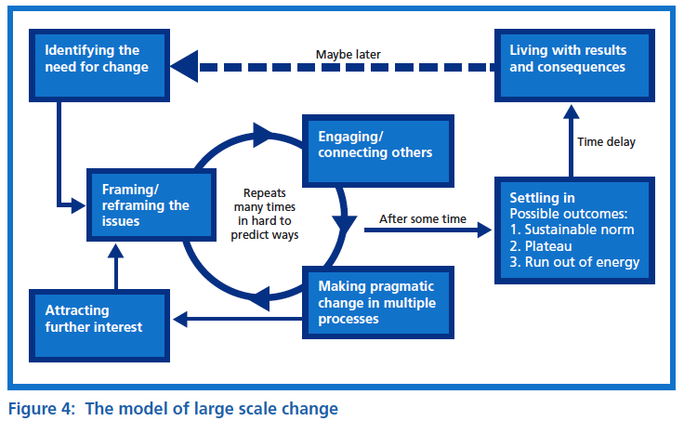
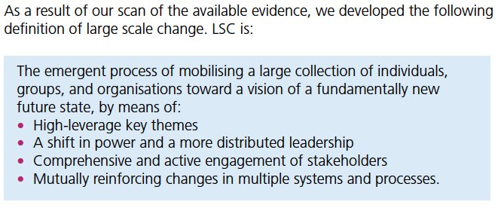

Leading large scale change: the evidence

Slide 40
What is Right Care?
Our working definitions
Doing the right things and only the right things in the right way for the right people at the right time in the right place, whatever that means in the local context
Improving the value that each person with asthma derives from their own care and treatment and the value the whole population derives from the investment in asthma care by addressing unwarranted variation; reducing waste, avoidable harm and avoidable symptoms

Slide 41
Aim
Scope
To sort asthma care once and for all for the person with asthma and for the healthcare system so that there is no unwarranted variation, and no avoidable waste or harm*.
That is
We can and should do better by getting it right first time!
The pathway from the first time someone (adult or parent) is offered a SABA, wherever that is, through to all possibilities (existing and new) for review
Phase 1: SABA use
*waste is waste of human, financial, health facility, energy and pharmacological assets.

Slide 42
Asthma Right Care as a social movement
It’s all about the FOLLOWERS: We need to get the right people engaged, who will connect through the right channels to engage the maximum numbers of followers who are inspired to do something different: to reduce reliance on short-acting beta-agonists, and to increase faith in and use of guideline-indicated effective medicines

Slide 43

Getting our social movement going
Sept 2017
May 2018
Kick starting action
Emerging and building momentum
  Nurturing voices
  Cultivating diverse interests and motivations
2
Steering Group formed and meets
3
Influencing and interacting
Navigating a complex array of relationships
National Champions Identified
SCALING UP
Delivery Team meeting
Delivery Team meeting
Delivery Team meeting
Delivery Team meeting
Symposium
Pervasiveness: affect all or just part of system?
National Steering Group Stakeholder
Mapping
Invitation UK
National Design Charrette
Pilot Phase
National Steering Group Stakeholder
Mapping
Invitation Portugal
National Design Charrette
Pilot Phase
Depth: ways of thinking and doing – cognitive, behavioural or paradigm shift?
Size: number
of people, geography
National Steering Group Stakeholder
Mapping
Invitation Canada
National Design Charrette
Pilot Phase
National Steering Group Stakeholder
Mapping
Invitation Spain
National Design Charrette
Pilot Phase
Notes:
References:
Nesta 2017. We change the world: what can we learn from global social movements for health?
NHS England. Sustainable Improvement and Horizons Team 2017. Leading large scale change: a practical guide.

Slide 44

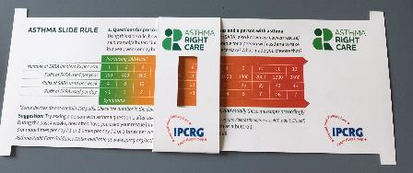
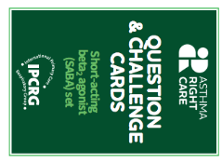
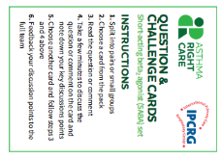
Kickstarting action
Emerging and building momentum
2
  Nurturing voices
  Cultivating diverse interests and motivations
3
Influencing and interacting
Navigating a complex array of relationships
Netherlands, Greece
France Vietnam
ENVIRONMENT
Propellant & Plastic
INFORMATION
Coding
Public Information
MEDICINES
ICS: SABA Ratio
Inhaler Use
New Cultures
& Languages
Mexico Brazil
Ireland Saudi Arabia
6 drivers in asthma health system
More parts of health system
More
geographies
Original 4
UK & Canada
Spain
Portugal
WORKFORCE
GPs / Pharmacist / Nurses
FINANCE & LEADERSHIP
PERSONAL
Networking
Policy Briefing
Going deeper:
Paradigm / behaviour shift
Unconscious Incompetence
Asthma Slide Rule & Question Cards
Conscious Incompetence: what could I do better?
Conscious Competence
Regional Teach The Teacher Master Classes to create trusted regional master teachers
What is right care?
Unconscious Competence
Mastery: Conscious Competence of Unconscious Incompetence

Slide 45
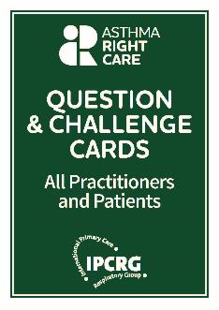
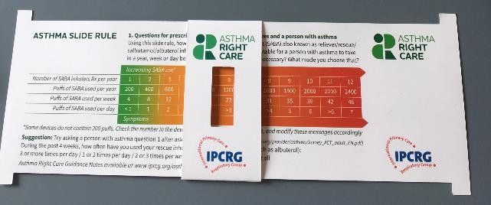
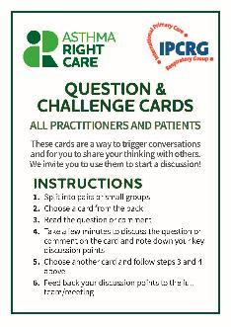
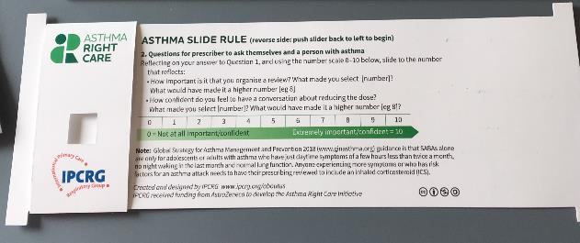
Prototype conversation pieces for discussion and co-creation in the design charrettes
Hunch 1: Lack of knowledge about how many puffs or doses in an inhaler and how many is too many in a year
Hunch 2: Pharmacists keen to do more but out of date “take your blue inhaler to open up your airways” – reveals no investment in education since this was the norm
Hunch 3: General practitioners/family physicians keen to emphasise art rather than science of the consultation, and so not up-to-date with guidelines eg “What’s the probability of them having asthma?” not routine question yet
Ambition: Embrace more people, more methods, bring joy to lives: let’s have fun, while being challenging

Slide 46
What has Asthma Right Care changed for you?
It has changed my approach to leading a large scale change for asthma management. It means to move towards a new vision that is better and fundamentally different from the Status Quo. This Project has pointed me in the right direction for creating and sustaining large scale change and transformation.This framework helps us to increase personal value, value for the population and rates of higher value intervention.
Mar Martinez, GP
ARC is changing our lives because we are reflecting about our work quality in a biopsychosocial dimension while we try to make every single step to provide all the asthma right care to patients and caregivers reconciling it with daily work. At the same time it is incredible how we can apply this knowledge to other diseases and procedures.
Teamwork is very rewarding, making us grow as a person and as a healthcare professional.
Cláudia Vicente, GP

Slide 47


Slide 48
What can you commit to?
Act now!
Find out more at www.ipcrg.org/asthmarightcare
IPCRG received funding from AstraZeneca to develop the Asthma Right Care Initiative

Slide 49
Additional resources

Slide 50
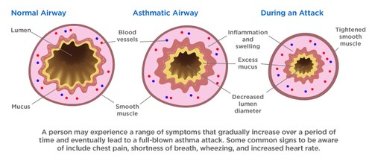
Asthma is an inflammatory disease
Asthma is a chronic inflammatory disease of the airways leading to bronchial constriction
HealthCentral. Anatomy of an asthma attack. Available at: https://www.healthcentral.com/article/anatomy-of-an-asthma-attack-infographic?ap=2012

Slide 51
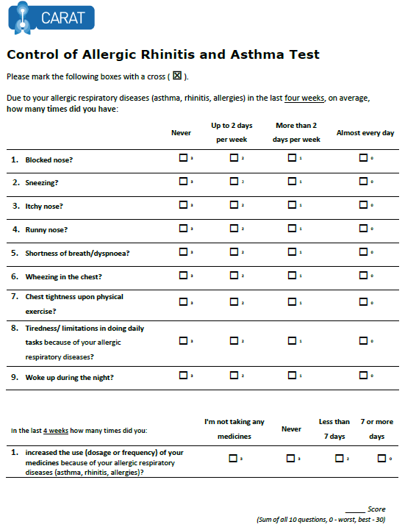
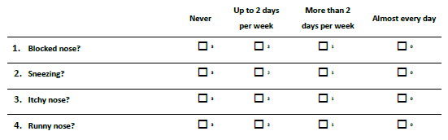
x
x
x
x
x
x
x
x
x
x
x
x
22
x
x
Lourenço O, Calado S, Sá-Sousa A, Fonseca J. Evaluation of allergic rhinitis and asthma control in a Portuguese community pharmacy setting. J Manag Care Spec Pharm. 2014 May;20(5):513-22. http://www.amcp.org/WorkArea/DownloadAsset.aspx?id=18027
CARAT, Control of Allergic Rhinitis and Asthma Test
Available at: https://www.new.caratnetwork.org. Accessed October 2022.
Notes:
CARAT has 10 questions that ask about symptoms during the previous 4 weeks (Table 1). CARAT total score (CARAT-t) ranges from 0 to 30, with a score higher than 24 indicating good overall control. The questionnaire is further divided into 2 sections: the first section relates to allergic rhinitis (CARAT-r), with a score range of 0 to 12 and a value higher than 8 identifying controlled AR; the second section relates to asthma (CARAT-a), with a score range of 0 to 18 and a value of 16 or higher identifying controlled asthma. So:
Total score ≥ 24 (good overall control)
A score ≥ 8 in questions 1 to 4 (good control for upper airways)
A score ≥ 16 in questions 5 to 10 (good control for lower airways)
People in English speaking countries might prefer to use an ACT score instead of CARAT. It’s OK to provide that alternative.

Slide 52
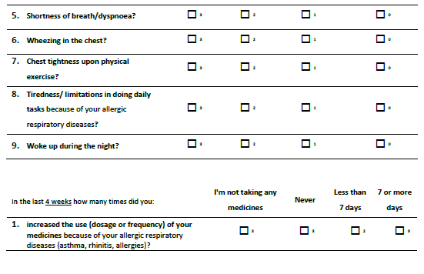
x
x
x
x
x
x
x
x
x
x
x
x
x
x
x
22
x
Lourenço O, Calado S, Sá-Sousa A, Fonseca J. Evaluation of allergic rhinitis and asthma control in a Portuguese community pharmacy setting. J Manag Care Spec Pharm. 2014 May;20(5):513-22. http://www.amcp.org/WorkArea/DownloadAsset.aspx?id=18027
CARAT, Control of Allergic Rhinitis and Asthma Test
Available at: https://www.new.caratnetwork.org. Accessed October 2022.
Notes:
CARAT has 10 questions that ask about symptoms during the previous 4 weeks (Table 1). CARAT total score (CARAT-t) ranges from 0 to 30, with a score higher than 24 indicating good overall control. The questionnaire is further divided into 2 sections: the first section relates to allergic rhinitis (CARAT-r), with a score range of 0 to 12 and a value higher than 8 identifying controlled AR; the second section relates to asthma (CARAT-a), with a score range of 0 to 18 and a value of 16 or higher identifying controlled asthma. So:
Total score ≥ 24 (good overall control)
A score ≥ 8 in questions 1 to 4 (good control for upper airways)
A score ≥ 16 in questions 5 to 10 (good control for lower airways)
People in English speaking countries might prefer to use an ACT score instead of CARAT. It’s OK to provide that alternative.

Slide 53
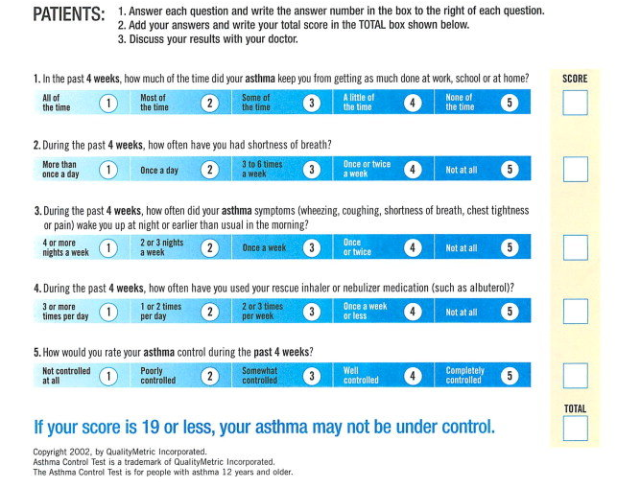
ACT: Asthma Control Questionnaire
Available at: https://www.asthmacontroltest.com/. Accessed October 2022.

Slide 54
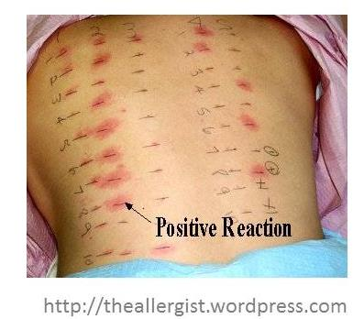
Allergy testing and how to interpret the results
Skin prick test is the most sensitive test for allergies
  Suspected allergens are mixed with liquid to form a solution
  Drops are placed on the skin surface
  The top surface of the skin is pricked beneath each drops
  A positive reaction is indicated by reddening, itch and swelling

Slide 55
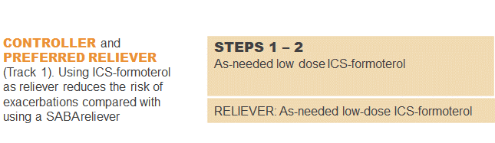
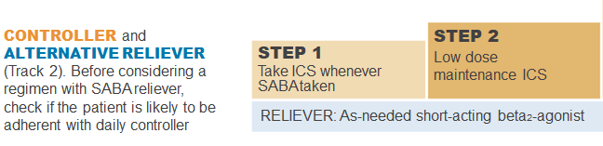
GINA 2022: Steps 1–2
Controller and preferred reliever:
As-needed low dose ICS-formoterol (off-label)
  Low dose ICS reduces symptoms and reduces risk of exacerbations and asthma-related hospitalization and death
Other controller options (Step 2):
  Low dose ICS taken whenever SABA is taken
  Leukotrine receptor antagonists
  Add house dust mite sublingual immunotherapy
ICS, inhaled corticosteroid; SABA, short-acting beta₂-agonist.
Available at: www.gina.com. Accessed October 2022.

Slide 56
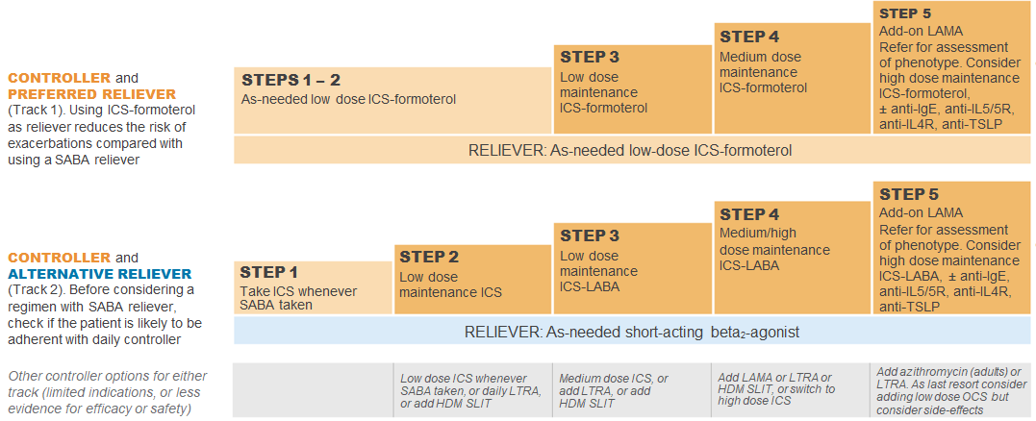
GINA 2022: Step 3
Preferred controller: Low dose ICS-formoterol maintenance plus as-needed SABA, OR low dose ICS-LABA maintenance and reliever therapy
For children aged 6-11 years the preferred controller is medium dose ICS or low dose ICS-LABA
HDM SLIT, house dust mite sublingual immunotherapy; ICS, inhaled corticosteroid; LABA, long-acting bronchodilator; LTRA, leukotrine receptor antagonist;
SABA, short-acting beta₂-agonist.
Available at: www.gina.com. Accessed October 2022.

Slide 57
GINA 2022: Step 4
Preferred controller: Medium dose ICS-formoterol as maintenance and reliever therapy, OR medium/high dose ICS-LABA maintenance plus as-needed SABA
Other controller options:
  Add-on tiotropium by mist inhaler for patients ≥6 years with a history of exacerbations
  Add-on LTRA
  Increasing to high dose ICS-LABA
Children aged 6-11 years: Continue controller, and refer for expert advice
HDM SLIT, house dust mite sublingual immunotherapy; ICS, inhaled corticosteroid; LABA, long-acting bronchodilator; LAMA, long-acting muscarinic antagonist;
LTRA, leukotrine receptor antagonist; SABA, short-acting beta₂-agonist.
Available at: www.gina.com. Accessed October 2022.

Slide 58
GINA 2022: Step 5
Add-on LAMA and refer for phenotypic investigation ± add-on treatment
Consider high-dose maintencen ICS-formoterol ± biologic therapy
Other controller options:
  Azithromycin (adults) or LTRA
  Low dose OCS (last resort) but consider side effects
ICS, inhaled corticosteroid; LABA, long-acting bronchodilator; LAMA, long-acting muscarinic antagonist; SABA, short-acting beta₂-agonist; SC; subcutaneous.
Available at: www.gina.com. Accessed October 2022.

Slide 59
Written Personalised Asthma Action Plan (PAAP)
Written PAAP
A written PAAP is an essential part of managing long-term disease¹
SIGN-BTS recommend that all people with asthma should be offered self-management education which includes a written AAP²
  In addition, GINA also highlights the importance of supporting long-term asthma management³
  These recommendations are based on literature reviews that show that supported PAAPs improve asthma control, reduce exacerbations and improve quality of life^{2,3}
Why are they useful?
  Pinpoint signs that the asthma is getting worse⁴
  Keep track of when to take medicines⁴
  Aid daily monitoring as well as long-term control⁴
  Provide information on what to do in the event of an asthma attack⁴
  The overall aim of a written PAAP is to help take early action to prevent or reduce the severity of asthma attack symptoms⁴
GINA, Global Initiative for Asthma; PAAP, personalised asthma action plan; SIGN-BTS, Scottish Intercollegiate Guidelines Network- British Thoracic Society.
1. Gibson PG, et al. Thorax 2004;59:94–99; 2. SIGN-BTS. British guideline on the management of asthma. Consultation 2016; 3. GINA Strategy for asthma management and prevention 2016; 4. Pinnock H. Breathe 2015;11:98–109.

Slide 60
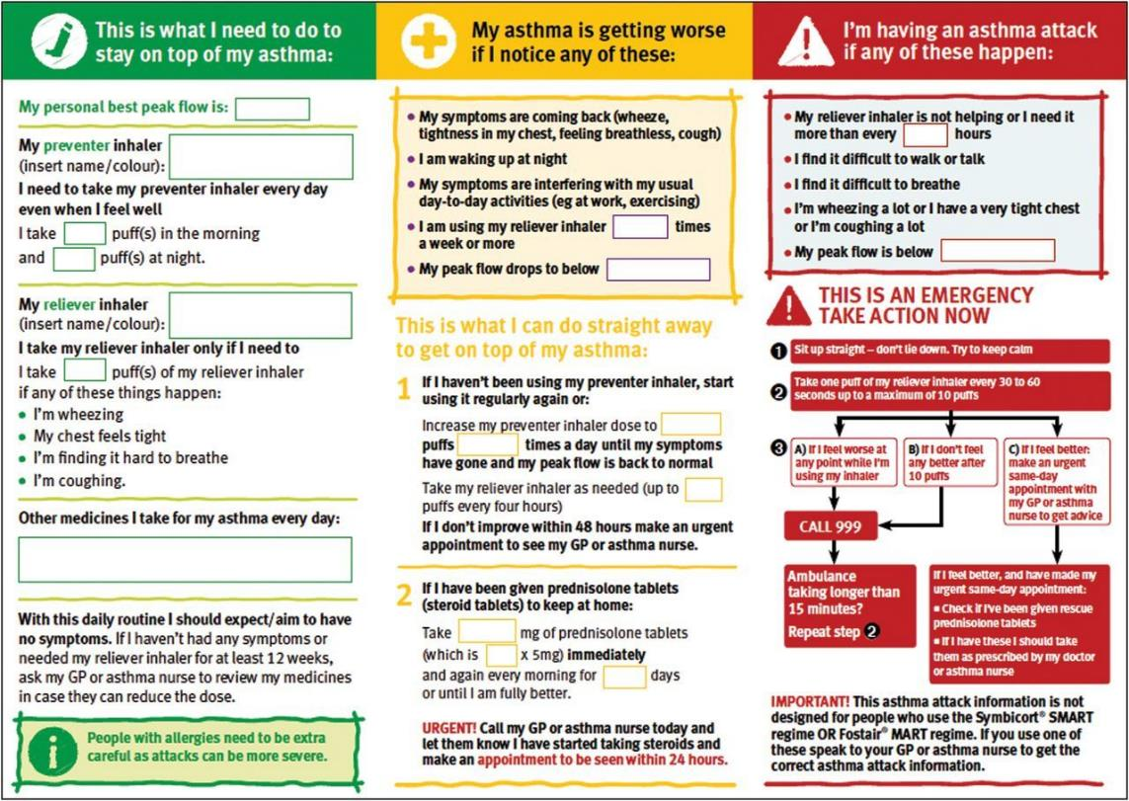
PAAP example for adults
Hilary Pinnock. Supported self-management for asthma. Breathe (Sheff). 2015 Jun; 11(2): 98–109. doi: 10.1183/20734735.015614 https://www.ncbi.nlm.nih.gov/pmc/articles/PMC4487370/pdf/EDU-0156-2014.pdf

Slide 61
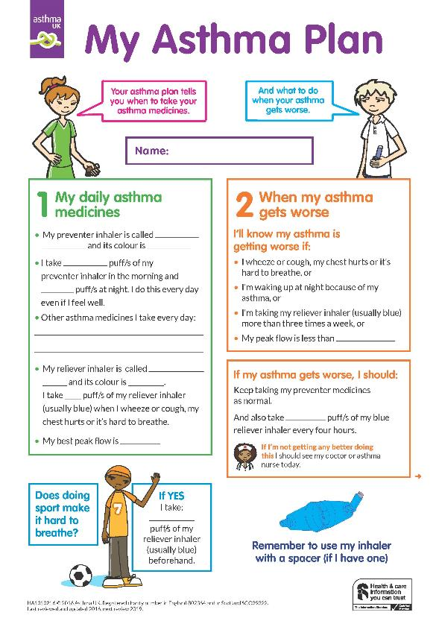
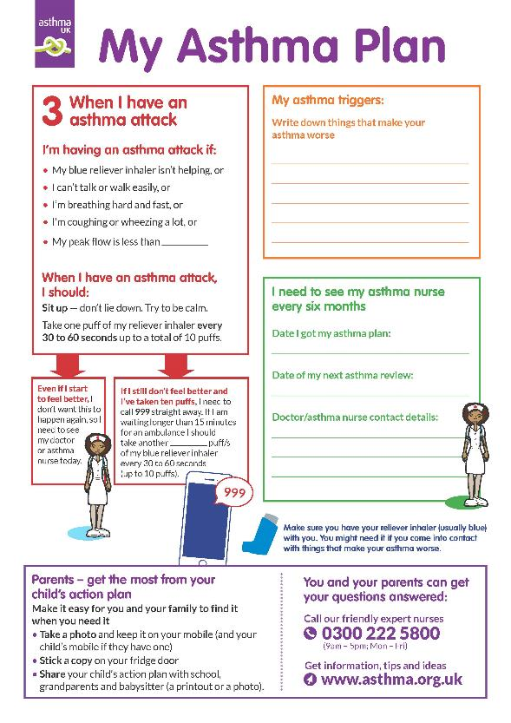
Child Asthma Action Plan
Child Asthma Action Plan
Available at: https://www.asthma.org.uk/def9655d/globalassets/health-advice/resources/children/child-asthma-action-plan.pdf . Accessed October 2022.

