Slide 1
Asthma Case Studies Martha
IPCRG received funding from AstraZeneca to develop the Asthma Right Care Initiative

Slide 2
About these slides
Please feel free to use, update and share some or all of these slides in your non-commercial presentations to colleagues or patients
The slides are provided under creative commons licence CC BY-NC-ND
BY stands for attribution (the obligation to credit the author and other parties designated for attribution);
NC stands for NonCommercial (commercial use is excluded from the licence grant);
ND means NoDerivatives (only verbatim copies of the work can be shared)
When using our slides, please retain the source attribution: IPCRG 2022 Jaime Correia de Sousa, MD, PhD, on behalf of the Asthma Right Care Team

Slide 3
What you will learn
Indicators for, and risks of over-reliance on SABAs
Recommendations for the management of current mild asthma
What is the Asthma Right Care social movement
How social movements can enable large scale change
How you can be part of that change

Slide 4
The patient
Martha is 42 years old
She is a white-collar worker in a service company
She is married with two children
She lives in a modern apartment, without carpets or pets

Slide 5
General medical history
Martha was diagnosed with asthma when she was 5 years old
Her mother and youngest brother both have asthma
She does not have any other comorbidities
Martha does not smoke and nor does her partner

Slide 6
Respiratory history
2 years ago, Martha started inhaled budesonide 200 µg twice daily and she was also prescribed a salbutamol inhaler for symptom relief
6 months ago Martha was prescribed a salbutamol inhaler during an emergency department visit for her asthma. At this time she was not advised to use her budesonide inhaler

Slide 7
Current presentation
Martha has booked an appointment as she is “not feeling well”
When specifically questioned, she admits that if she makes small efforts (e.g. walking up the stairs to the third floor) she is short of breath
On the CARAT questionnaire Martha indicates that she has nocturnal respiratory symptoms once or twice a week

Slide 8
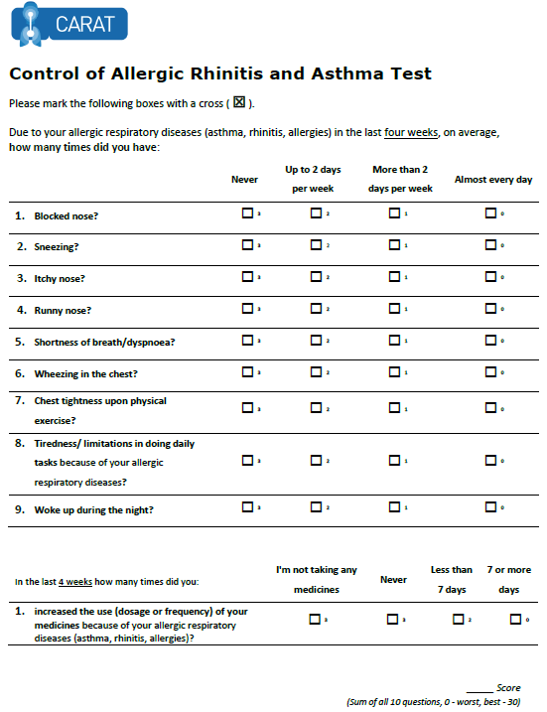
x
x
x
x
x
x
x
x
x
x
x
x
22
x
x
Lourenço O, Calado S, Sá-Sousa A, Fonseca J. Evaluation of allergic rhinitis and asthma control in a Portuguese community pharmacy setting. J Manag Care Spec Pharm. 2014 May;20(5):513-22. http://www.amcp.org/WorkArea/DownloadAsset.aspx?id=18027
CARAT, Control of Allergic Rhinitis and Asthma Test
Available at: https://www.new.caratnetwork.org. Accessed October 2022.
Notes:
CARAT has 10 questions that ask about symptoms during the previous 4 weeks (Table 1). CARAT total score (CARAT-t) ranges from 0 to 30, with a score higher than 24 indicating good overall control. The questionnaire is further divided into 2 sections: the first section relates to allergic rhinitis (CARAT-r), with a score range of 0 to 12 and a value higher than 8 identifying controlled AR; the second section relates to asthma (CARAT-a), with a score range of 0 to 18 and a value of 16 or higher identifying controlled asthma. So:
Total score ≥ 24 (good overall control)
A score ≥ 8 in questions 1 to 4 (good control for upper airways)
A score ≥ 16 in questions 5 to 10 (good control for lower airways)
People in English speaking countries might prefer to use an ACT score instead of CARAT. It’s OK to provide that alternative.

Slide 9
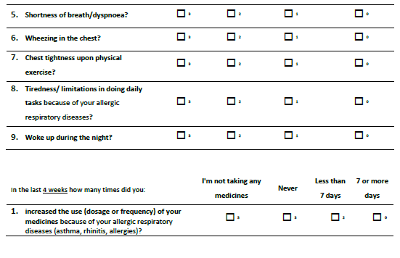
x
x
x
x
x
x
x
x
x
x
x
x
x
x
x
22
x
Lourenço O, Calado S, Sá-Sousa A, Fonseca J. Evaluation of allergic rhinitis and asthma control in a Portuguese community pharmacy setting. J Manag Care Spec Pharm. 2014 May;20(5):513-22. http://www.amcp.org/WorkArea/DownloadAsset.aspx?id=18027
CARAT, Control of Allergic Rhinitis and Asthma Test
Available at: https://www.new.caratnetwork.org. Accessed October 2022.
Notes:
CARAT has 10 questions that ask about symptoms during the previous 4 weeks (Table 1). CARAT total score (CARAT-t) ranges from 0 to 30, with a score higher than 24 indicating good overall control. The questionnaire is further divided into 2 sections: the first section relates to allergic rhinitis (CARAT-r), with a score range of 0 to 12 and a value higher than 8 identifying controlled AR; the second section relates to asthma (CARAT-a), with a score range of 0 to 18 and a value of 16 or higher identifying controlled asthma. So:
Total score ≥ 24 (good overall control)
A score ≥ 8 in questions 1 to 4 (good control for upper airways)
A score ≥ 16 in questions 5 to 10 (good control for lower airways)
People in English speaking countries might prefer to use an ACT score instead of CARAT. It’s OK to provide that alternative.

Slide 10
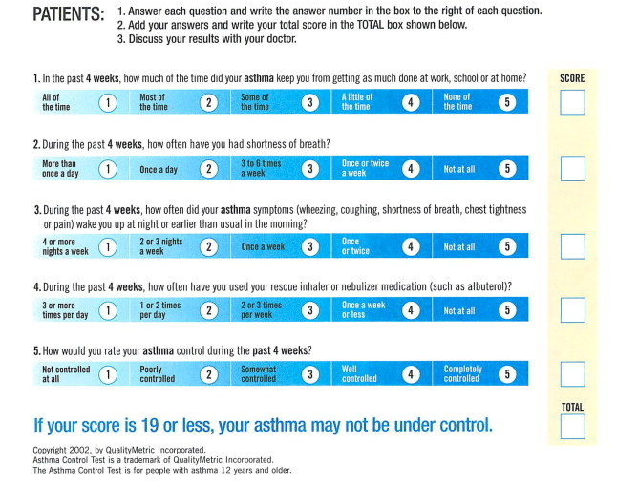
ACT: Asthma Control Questionnaire
Available at: https://www.asthmacontroltest.com/. Accessed October 2022.

Slide 11
Reasons for poor asthma control
Wrong diagnosis or confounding illness
Incorrect choice of inhaler or poor technique
Concurrent smoking
Concomitant rhinitis
Unintentional or intentional nonadherence
Individual variation in treatment response
Under treatment

Slide 12
What are your immediate reactions to Martha’s current presentation?
This is asthma, Martha should continue to use salbutamol whether she feels asthma symptoms
I need to confirm the diagnosis of asthma
I need to check Martha’s inhaler technique
I need to order allergy skin prick tests
I need to review Martha’s medication with her
(there may be more than one right answer)

Slide 13
Clinical considerations Confirm the diagnosis of asthma
Martha’s diagnosis was made in childhood and may warrant review
However:
Martha has a medical and family history of asthma
3 years ago Martha underwent spirometry which demonstrated reversible airway obstruction following administration of a bronchodilator
Everything seems to indicate that it is asthma

Slide 14
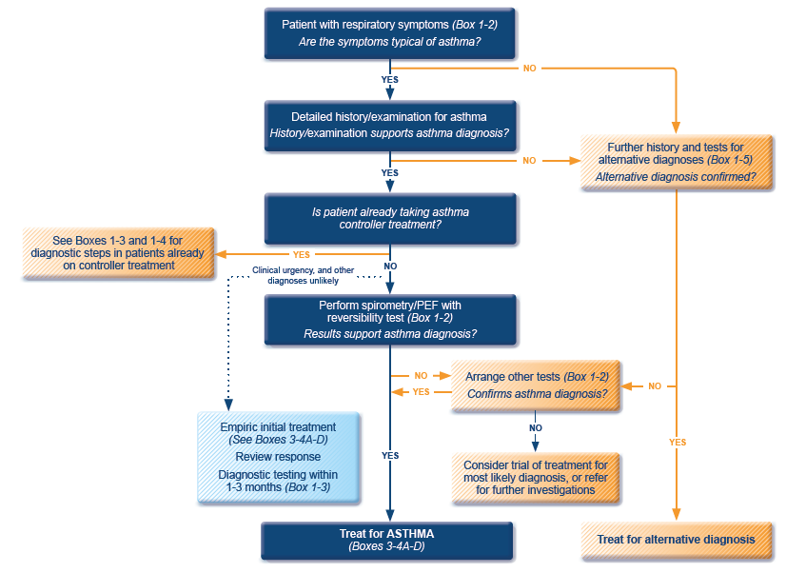
GINA 2022 guidelines for the diagnosis of asthma
ICS, inhaled corticosteroid; PEF, peak expiratory flow; SABA, short-acting beta₂-agonist.
Available at: www.gina.com. Accessed October 2022.

Slide 15
Clinical considerations Review the medical history
Martha was diagnosed with asthma when she was 5 years old
From the age of 12 until about 10 years ago she had almost no symptoms
Martha had symptoms and a new asthma attack after the birth of her youngest daughter when she was 32 years old
When she has an upper airway tract infection, she reports both cough and wheezing
She has no occupational history of relevant exposures
She has no smoking history
She has no pets at home

Slide 16
Clinical considerations Medication review
Martha reports that last month she used a whole canister of salbutamol that she bought from the pharmacy without prescription
She recognises that she is seldom using budesonide because she thinks salbutamol gives her more relief

Slide 17
Clinical considerations Evaluation and tests
Spirometry was performed 3 years ago, with a positive result
A new spirometry should be considered although it is not mandatory for her immediate clinical management
Allergy testing was performed a few years ago and Martha is sensitive to house dust mites (skin prick test and specific IgEs)
There is no need for further testing at the moment

Slide 18
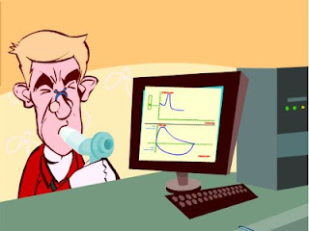
Spirometry
Spirometry measures airflow and lung volumes, and is the preferred lung function test for asthma in primary care
Forced exhalation from a maximal inspiration
FVC: Forced vital capacity | FEV1: Forced Expiratory Volume in 1 second | FEV1/FVC
Volume of air exhaled after full inspiration and full exhalation | Volume of air exhaled in the first second of forced exhalation | Ratio of vital capacity exhaled in 1 second expressed as a percentage of the total volume of air exhaled after full inspiration and full exhalation
For further guidance visit: http://bit.ly/IPCRG-SPIROMETRY-WONCA-2018

Slide 19
Spirometric patterns
FEV1/FVC
FVC
FEV1
Obstruction
N
Restriction
N
N
Mixed
Obstruction and hyperinflation
Mild Obstruction | FEV1 ≥80%
Moderate Obstruction | FEV1 <80% ≥50%
Severe Obstruction | FEV1 <50% ≥35%
Very Severe Obstruction | FEV1 <35%
For further guidance visit: http://bit.ly/IPCRG-SPIROMETRY-WONCA-2018

Slide 20
Quick spirometry assessment
FEV₁ /FVC
≥70%
Normal
<70%
Obstruction
FVC
FVC
< 80% ref value
<80% ref. value
≥80% ref value
Mixed pattern
≥80% ref value
OBSTRUCTION
+ HYPERINFLATION (↑VR)
NORMAL
RESTRICTION
OBSTRUCTION
OBSTRUCTION
+
RESTRICTION
(VR normal)
For further guidance visit: http://bit.ly/IPCRG-SPIROMETRY-WONCA-2018

Slide 21
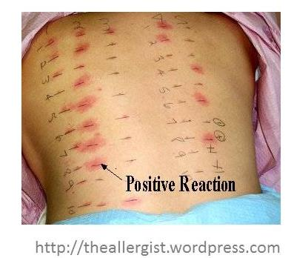
Allergy testing and how to interpret the results
Skin prick test is the most sensitive test for allergies
Suspected allergens are mixed with liquid to form a solution
Drops are placed on the skin surface
The top surface of the skin is pricked beneath each drops
A positive reaction is indicated by reddening, itch and swelling

Slide 22
Clinical considerations Inhaler technique
As Martha is using two inhalation devices with different inhalation techniques it is possible that they are not being properly used
Martha’s inhaler technique should be reviewed at all appointments
Martha should be asked to bring her own inhalers to the appointments

Slide 23
How to review inhalation technique
Ask the patient beforehand to bring their own inhaler for the consultation
Ask them to demonstrate how they use their inhaler
Correct some aspects and explain why
If possible use videos
Observe technique and let the patient observe self (using video demonstrations)
Show you are available to review their technique if necessary
Ask the patient to bring their own inhaler for the next appointment
Notes:
Resources for reviewing inhaler technique:
Asthma review series: Part 3 - Inhaler Technique and Recording Peak Flow. Available at: https://www.youtube.com/watch?v=ZhIcT57i32g
Asthma inhaler techniques (children). Available at: https://www.youtube.com/watch?v=fHcG8DXUwdQ
Asthma: inhaler techniques: Available at: https://www.nhs.uk/Video/Pages/Childrensasthmainhaler.aspx

Slide 24
Management Discuss with the patient
Shared decision on disease management is critical to treatment success
There is a need to review with Martha several aspects of her condition
Asthma as an airways inflammatory disease
Therapeutic goals
The role of each drug
How and when to use them
Martha’s fears and expectations regarding medication
Martha’s beliefs relating to the treatment effects
Any financial difficulties for buying inhalers

Slide 25
Question cards

Slide 26
Management Medication adjustment
Martha remembers that her family doctor told her about the need to use budesonide, but she forgets to do it and anyway she prefers salbutamol

Slide 27
Would you propose any medication adjustment?
To continue to use salbutamol whenever she feels asthma symptoms?
To use budesonide 200 µg twice daily (as previously prescribed) + salbutamol whenever she feels asthma symptoms?
To replace budesonide with budesonide / formoterol in the same inhaler twice daily + salbutamol inhaler whenever she feels asthma symptoms?
To replace budesonide with budesonide / formoterol in the same inhaler twice daily + when needed?
To use budesonide 200 µg twice daily (as prescribed previously) and prescribe budesonide / formoterol in the same inhaler to be used when needed?

Slide 28
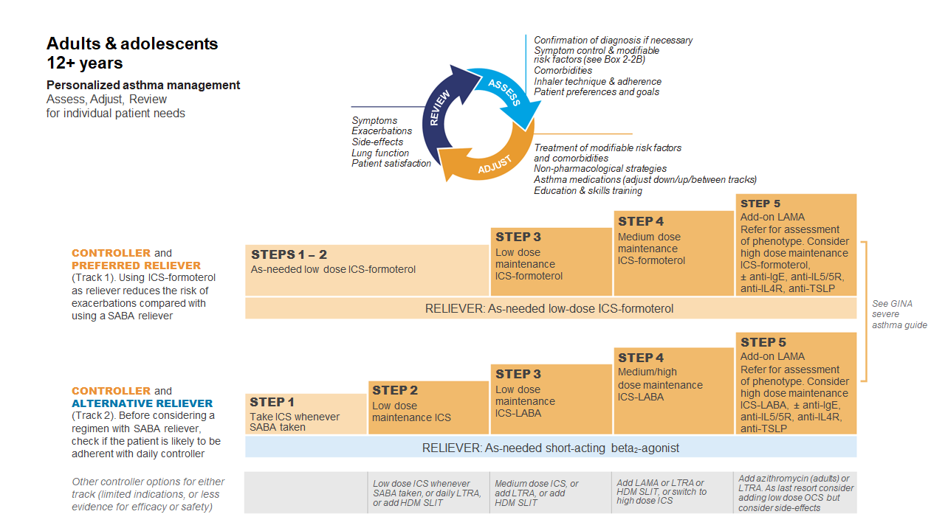
GINA 2022
Available at: www.gina.com. Accessed October 2022.

Slide 29
GINA 2022: Steps 1–2
Controller and preferred reliever: As-needed low dose ICS-formoterol (off-label)
Low dose ICS reduces symptoms and reduces risk of exacerbations and asthma-related hospitalization and death
Other controller options (Step 2):
Low dose ICS taken whenever SABA is taken
Leukotrine receptor antagonists
Add house dust mite sublingual immunotherapy
ICS, inhaled corticosteroid; SABA, short-acting beta₂-agonist.
Available at: www.gina.com. Accessed October 2022.

Slide 30
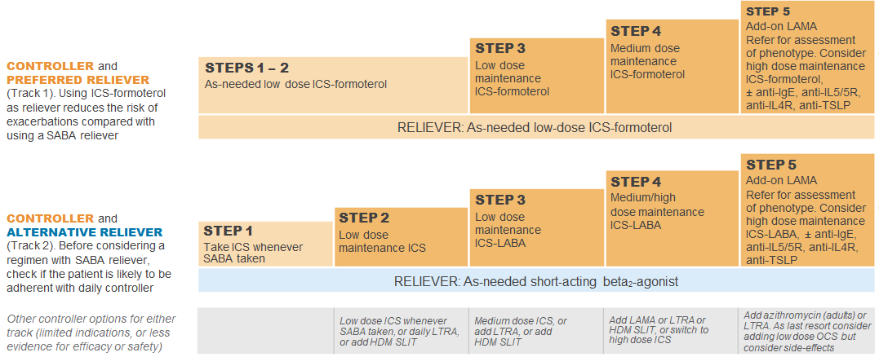
GINA 2022: Step 3
Preferred controller: Low dose ICS-formoterol maintenance plus as-needed SABA, OR low dose ICS-LABA maintenance and reliever therapy
For children aged 6-11 years the preferred controller is medium dose ICS or low dose ICS-LABA
HDM SLIT, house dust mite sublingual immunotherapy; ICS, inhaled corticosteroid; LABA, long-acting bronchodilator; LTRA, leukotrine receptor antagonist; SABA, short-acting beta₂-agonist.
Available at: www.gina.com. Accessed October 2022.

Slide 31
GINA 2022: Step 4
Preferred controller: Medium dose ICS-formoterol as maintenance and reliever therapy, OR medium/high dose ICS-LABA maintenance plus as-needed SABA
Other controller options:
Add-on tiotropium by mist inhaler for patients ≥6 years with a history of exacerbations
Add-on LTRA
Increasing to high dose ICS-LABA
Children aged 6-11 years: Continue controller, and refer for expert advice
HDM SLIT, house dust mite sublingual immunotherapy; ICS, inhaled corticosteroid; LABA, long-acting bronchodilator; LAMA, long-acting muscarinic antagonist; LTRA, leukotrine receptor antagonist; SABA, short-acting beta₂-agonist.
Available at: www.gina.com. Accessed October 2022.

Slide 32
GINA 2022: Step 5
Add-on LAMA and refer for phenotypic investigation ± add-on treatment
Consider high-dose maintencen ICS-formoterol ± biologic therapy
Other controller options:
Azithromycin (adults) or LTRA
Low dose OCS (last resort) but consider side effects
ICS, inhaled corticosteroid; LABA, long-acting bronchodilator; LAMA, long-acting muscarinic antagonist; SABA, short-acting beta₂-agonist; SC; subcutaneous.
Available at: www.gina.com. Accessed October 2022.

Slide 33
Thoughts on medication adjustment having reviewed current guidelines?
To continue to use salbutamol whenever she feels asthma symptoms?
To use budesonide 200 µg twice daily (as previously prescribed) + salbutamol whenever she feels asthma symptoms?
To replace budesonide with budesonide / formoterol in the same inhaler twice daily + salbutamol inhaler whenever she feels asthma symptoms?
To replace budesonide with budesonide / formoterol in the same inhaler twice daily + when needed?
To use budesonide 200 µg twice daily (as prescribed previously) and prescribe budesonide / formoterol in the same inhaler to be used when needed?

Slide 34
Management The new plan
Obtain Martha’s agreement to take her medications as prescribed
Provide Martha with a written action plan that has been developed and agreed on together

Slide 35
Written Personalised Asthma Action Plan (PAAP)
Written PAAP
A written PAAP is an essential part of managing long-term disease¹
SIGN-BTS recommend that all people with asthma should be offered self-management education which includes a written AAP²
In addition, GINA also highlights the importance of supporting long-term asthma management³
These recommendations are based on literature reviews that show that supported PAAPs improve asthma control, reduce exacerbations and improve quality of life^{2,3}
Why are they useful?
Pinpoint signs that the asthma is getting worse⁴
Keep track of when to take medicines⁴
Aid daily monitoring as well as long-term control⁴
Provide information on what to do in the event of an asthma attack⁴
The overall aim of a written PAAP is to help take early action to prevent or reduce the severity of asthma attack symptoms⁴
GINA, Global Initiative for Asthma; PAAP, personalised asthma action plan; SIGN-BTS, Scottish Intercollegiate Guidelines Network- British Thoracic Society.
1. Gibson PG, et al. Thorax 2004;59:94–99; 2. SIGN-BTS. British guideline on the management of asthma. Consultation 2016; 3. GINA Strategy for asthma management and prevention 2016; 4. Pinnock H. Breathe 2015;11:98–109.

Slide 36
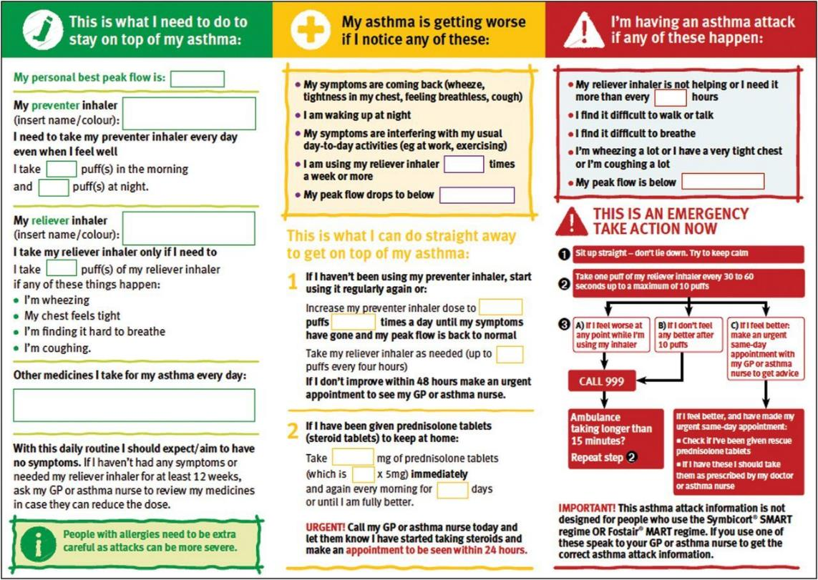
PAAP example for adults
Hilary Pinnock. Supported self-management for asthma. Breathe (Sheff). 2015 Jun; 11(2): 98–109. doi: 10.1183/20734735.015614 https://www.ncbi.nlm.nih.gov/pmc/articles/PMC4487370/pdf/EDU-0156-2014.pdf

Slide 37
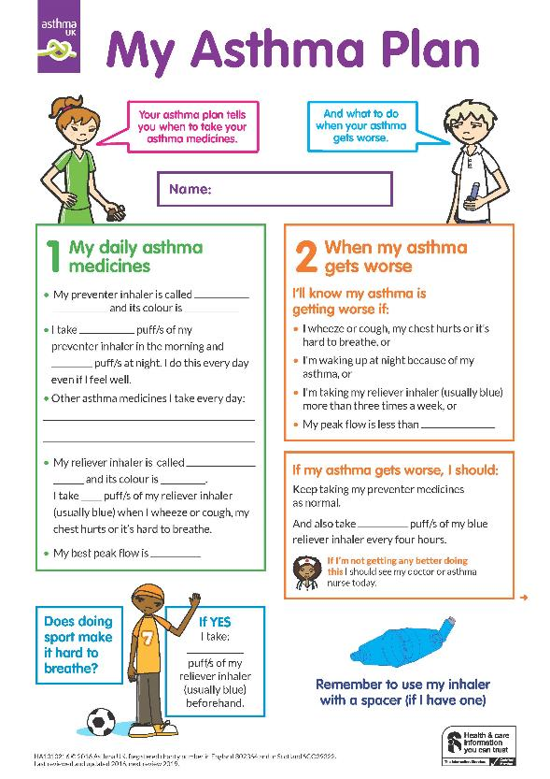
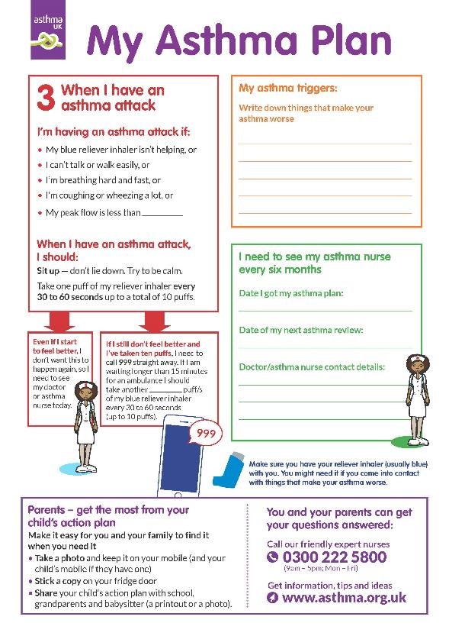
Child Asthma Action Plan
Child Asthma Action Plan
Available at: https://www.asthma.org.uk/def9655d/globalassets/health-advice/resources/children/child-asthma-action-plan.pdf . Accessed October 2022.

Slide 38
Steps to help Martha live better with her asthma
Identify symptom triggers
Advise Martha to avoid smoky environments
Recommend regular physical exercise
Suggest a review of inhaler technique at all future consultations

Slide 39
Key asthma triggers
Psychological triggers³
Air pollution¹
Medications*³
Exposure to bacteria²
House dust mites⁶
Smoking^{3,4}
Flowers/pollen³
Household pets^{3,4}
Exercise⁵
Alcohol³
Air-conditioning³
URTI³
URTI = upper respiratory tract infection
*Beta-blockers and non-steroidal anti-inflammatory drugs.
1. Esposito S, et al. BMC Pulm Med 2014;14:130; 2. Beigelman A, et al. Curr Opin Allergy Clin Immunol 2014;14:137–142; 3. See K, et al. Singapore Med J 2015 epub; 4. Vernon M, et al. J Asthma 2012;49:991–998; 5. Global Initiative for Asthma. Global Strategy for Asthma Management and Prevention, 2016. Available from: www.ginasthma.org; 6. Lim FL, et al. PLoS One 2015;10:e0124905.

Slide 40
Asthma Right Care: a movement for Global Change
Movement for Global Change
IPCRG received funding from AstraZeneca to develop the Asthma Right Care Initiative

Slide 41
Every system is perfectly designed to get the results it gets
(Earl Conway and Paul Batalden)
Notes:
Both intended and unintended consequences are designed into our systems

Slide 42
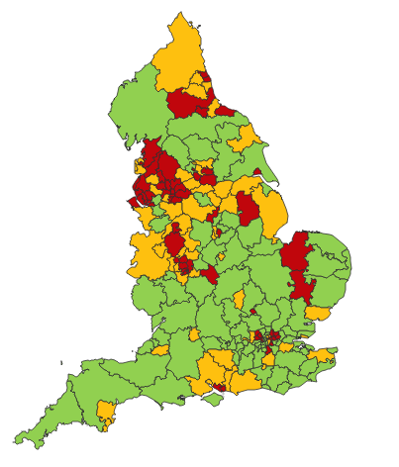
Making a case for change
Asthma illustrates all 5 global healthcare problems (Muir Gray):
Unwarranted variation
Harm, even when quality is high (over-diagnosis, over-treatment)
Failure to prevent disease and disability
Waste of human and physical resources through low value activity
Inequity
And new challenges are forming:
Financial constraints
Rising expectations of personalised care
Climate change/pollution
Increasing need
PHE Fingertips data Asthma admissions per 1000 population 2012/13 data
Notes:
Unwarranted variation as defined by Wennberg: Variation in utilization of health care services that cannot be explained by variation in patient illness or patient preferences
http://www.nhsconfed.org/~/media/Confederation/Files/Events/ACE15/1430%20Inaugural%20NHS%20value%20lecture.pdf

Slide 43
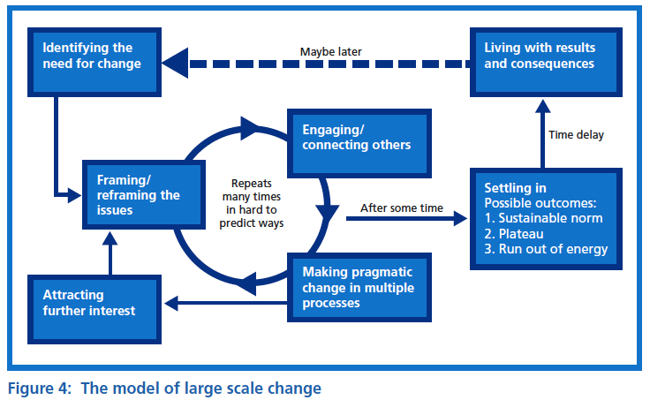
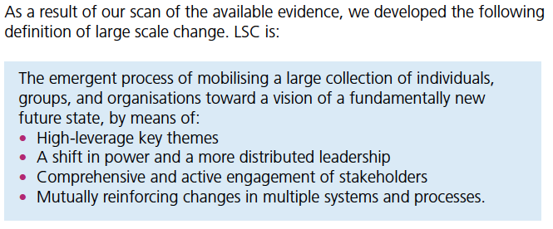
Leading large scale change: the evidence

Slide 44
What is Right Care?
Our working definitions
Doing the right things and only the right things in the right way for the right people at the right time in the right place, whatever that means in the local context
Improving the value that each person with asthma derives from their own care and treatment and the value the whole population derives from the investment in asthma care by addressing unwarranted variation; reducing waste, avoidable harm and avoidable symptoms

Slide 45
Aim
Scope
To sort asthma care once and for all for the person with asthma and for the healthcare system so that there is no unwarranted variation, and no avoidable waste or harm*. That is
We can and should do better by getting it right first time!
The pathway from the first time someone (adult or parent) is offered a SABA, wherever that is, through to all possibilities (existing and new) for review
Phase 1: SABA use
*waste is waste of human, financial, health facility, energy and pharmacological assets.

Slide 46
Asthma Right Care as a social movement
It’s all about the FOLLOWERS: We need to get the right people engaged, who will connect through the right channels to engage the maximum numbers of followers who are inspired to do something different: to reduce reliance on short-acting beta-agonists, and to increase faith in and use of guideline-indicated effective medicines

Slide 47
Getting our social movement going
Sept 2017
May 2018
Kick starting action Emerging and building momentum
Nurturing voices Cultivating diverse interests and motivations
2
Steering Group formed and meets
3
Influencing and interacting Navigating a complex array of relationships
National Champions Identified
SCALING UP
Delivery Team meeting
Delivery Team meeting
Delivery Team meeting
Delivery Team meeting
Symposium
Pervasiveness: affect all or just part of system?
National Steering Group Stakeholder
Mapping
Invitation UK
National Design Charrette
Pilot Phase
National Steering Group Stakeholder
Mapping
Invitation Portugal
National Design Charrette
Pilot Phase
Depth: ways of thinking and doing – cognitive, behavioural or paradigm shift?
Size: number of people, geography
National Steering Group Stakeholder
Mapping
Invitation Canada
National Design Charrette
Pilot Phase
National Steering Group Stakeholder
Mapping
Invitation Spain
National Design Charrette
Pilot Phase
Notes:
References:
Nesta 2017. We change the world: what can we learn from global social movements for health?
NHS England. Sustainable Improvement and Horizons Team 2017. Leading large scale change: a practical guide.

Slide 48
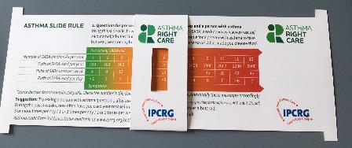
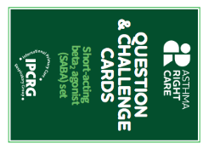
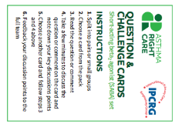
Kickstarting action Emerging and building momentum
2
Nurturing voices Cultivating diverse interests and motivations
3
Influencing and interacting Navigating a complex array of relationships
Netherlands, Greece
France Vietnam
ENVIRONMENT
Propellant & Plastic
INFORMATION
Coding
Public Information
MEDICINES
ICS: SABA Ratio
Inhaler Use
New Cultures
& Languages
Mexico Brazil
Ireland Saudi Arabia
6 drivers in asthma health system
More parts of health system
More
geographies
Original 4
UK & Canada
Spain
Portugal
WORKFORCE
GPs / Pharmacist / Nurses
FINANCE & LEADERSHIP
PERSONAL
Networking
Policy Briefing
Going deeper:
Paradigm / behaviour shift
Unconscious Incompetence
Asthma Slide Rule & Question Cards
Conscious Incompetence: what could I do better?
Conscious Competence
Regional Teach The Teacher Master Classes to create trusted regional master teachers
What is right care?
Unconscious Competence
Mastery: Conscious Competence of Unconscious Incompetence

Slide 49
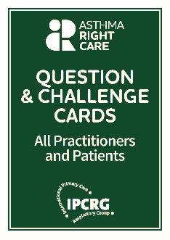
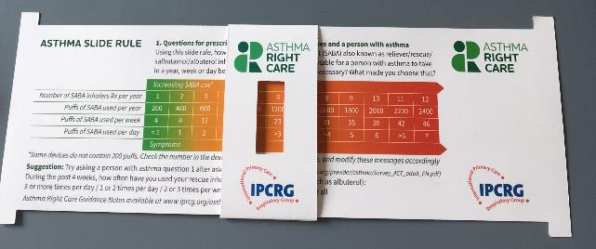
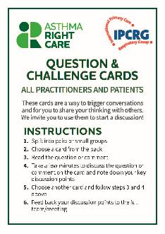
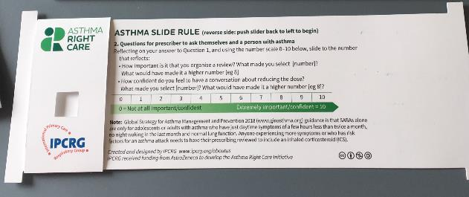
Prototype conversation pieces for discussion and co-creation in the design charrettes
Hunch 1: Lack of knowledge about how many puffs or doses in an inhaler and how many is too many in a year
Hunch 2: Pharmacists keen to do more but out of date “take your blue inhaler to open up your airways” – reveals no investment in education since this was the norm
Hunch 3: General practitioners/family physicians keen to emphasise art rather than science of the consultation, and so not up-to-date with guidelines eg “What’s the probability of them having asthma?” not routine question yet
Ambition: Embrace more people, more methods, bring joy to lives: let’s have fun, while being challenging

Slide 50
What has Asthma Right Care changed for you?
It has changed my approach to leading a large scale change for asthma management. It means to move towards a new vision that is better and fundamentally different from the Status Quo. This Project has pointed me in the right direction for creating and sustaining large scale change and transformation.This framework helps us to increase personal value, value for the population and rates of higher value intervention.
Mar Martinez, GP
ARC is changing our lives because we are reflecting about our work quality in a biopsychosocial dimension while we try to make every single step to provide all the asthma right care to patients and caregivers reconciling it with daily work. At the same time it is incredible how we can apply this knowledge to other diseases and procedures.
Teamwork is very rewarding, making us grow as a person and as a healthcare professional.
Cláudia Vicente, GP

Slide 51
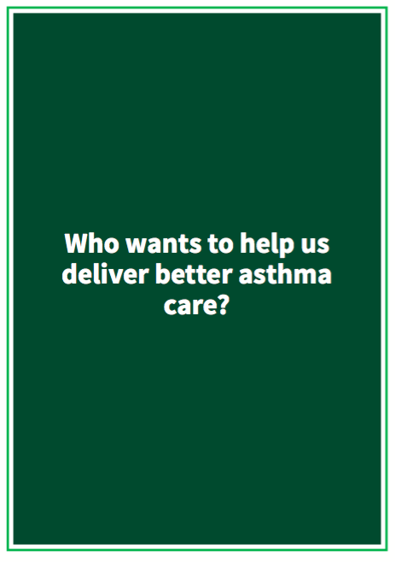

Slide 52
What can you commit to? Act now!
Find out more at www.ipcrg.org/asthmarightcare
IPCRG received funding from AstraZeneca to develop the Asthma Right Care Initiative

Slide 53
Additional resources

Slide 54
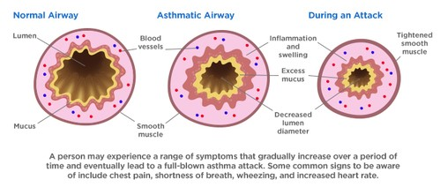
Asthma is an inflammatory disease
Asthma is a chronic inflammatory disease of the airways leading to bronchial constriction
HealthCentral. Anatomy of an asthma attack. Available at: https://www.healthcentral.com/article/anatomy-of-an-asthma-attack-infographic?ap=2012

Slide 55
SABA overuse: An indicator of poor control (1)
UK National Review of Asthma Deaths 2012 to 2013
39% people on SABA at time of death had been prescribed more than 12 in the year before they died
4% had been prescribed >50 SABA inhalers
Those prescribed >12 were likely to have had poorly controlled asthma
National Review of Asthma Deaths: Available at: https://www.rcplondon.ac.uk/projects/national-review-asthma-deaths. Accessed October 2022.

Slide 56
SABA overuse: An indicator of poor control (2)
“There is a progressive risk of hospital admission associated with the prescription of more than three SABA inhalers a year”
Healthcare resource use | 1-3 inhalers N=5888 | 4-12 inhalers N=2054 | >13 inhalers N=285
Inpatient episodes | 20 | 33 | 2
Crude inpatient episode rate per 100 population | 0.34 | 1.61 | 0.70
Hull SA, et al. npj Prim Care Respir Med. 2016;26:16049.

Slide 57
SABA overuse: An indicator of poor control (3)
“There is some evidence that electronic alerts reduce excessive prescribing of SABAs, when delivered as part of a multicomponent intervention in an integrated health care system”
Literature review to synthesise the evidence for the use of computerised alerts that identify excessive prescribing of SABAs to improve asthma management for people with asthma
 | SABA prescribing | ICS prescribing | ICS-SABA prescribing | ICS-LABA prescribing
Study 1 |  | No effect
Study 2 | No effect | No effect
Study 3 | Positive effect | No effect |  | Positive effect
Study 4 |  | No effect | Positive effect
SABA short-acting beta₂- agonist, ICS inhaled corticosteroid, LABA long-acting beta₂-agonist.
McKibben S, et al. npj Prim Care Respir Med. 2018;28:14.

Slide 58
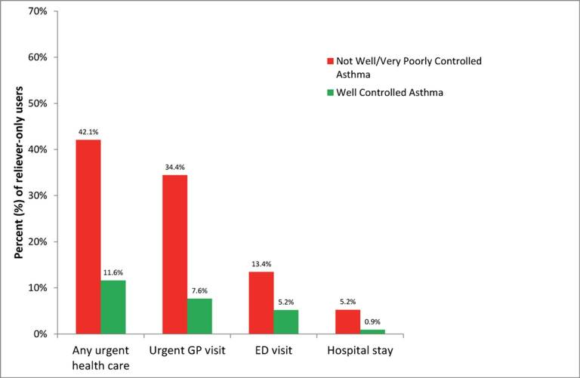
SABA overuse: An indicator of poor control (4)
“One-quarter of the reliever-only population had needed urgent asthma healthcare in the previous year, demonstrating the importance of identifying such patients”
Cross-sectional population-based Internet survey in Australia
Of 2686 participants ≥16 years with current asthma randomly drawn from a web-based panel, 1038 (50.7% male) used only reliever medication
ED, emergency department.
Reddel HK, et al. BMJ Open. 2017;7:e016688.

