Slide 1
Asthma Case Studies
Severe Asthma
IPCRG received funding from AstraZeneca to develop the Asthma Right Care Initiative

Slide 2
About these slides
Please feel free to use, update and share some or all of these slides in your non-commercial presentations to colleagues or patients
The slides are provided under creative commons licence CC BY-NC-ND
  BY stands for attribution (the obligation to credit the author and other parties designated for attribution);
  NC stands for NonCommercial (commercial use is excluded from the licence grant);
  ND means NoDerivatives (only verbatim copies of the work can be shared)
When using our slides, please retain the source attribution: IPCRG 2022 Alan Kaplan, MD, CCFP(EM), FCFP, on behalf of the Asthma Right Care Team

Slide 3
What you will learn
How to evaluate and manage the patient with poorly-controlled asthma
The important of adherence to reliever therapy and how to support patient adherence
What is the Asthma Right Care social movement
How social movements can enable large scale change
How you can be part of that change

Slide 4

The patient
Sarah is 32 years old
She is a white-collar worker in a service company
She is not married and has no children
She lives in a modern apartment, without carpets or pets

Slide 5
General medical history
Sarah was diagnosed with asthma when she was 5 years old
She has comorbid seasonal allergic rhinoconjunctivitis (ragweed, birch pollen)
  Treated with desloratadine and intranasal mometasone furoate
Sarah has never smoked

Slide 6
Respiratory history
Sarah has had 4 asthma exacerbation in the past year
She is currently taking budesonide/formoterol 400/12 mg 2 puffs BID (high dose) and short-acting bronchodilator as needed
BID, twice daily.

Slide 7
Current presentation
Sarah has booked an appointment as she is very frustrated
  She is doing exactly what you told her but has still ended up in ER twice this year
Sarah reports she is using her SABA at least daily
  Last month she used a whole canister of salbutamol that she bought from the pharmacy without prescription
She has needed oral steroids and is concerned that these are bad for her
Sarah wants to discuss whether there something else to try?
ER, emergency room; SABA, short-acting bronchodilator.

Slide 8
What are your immediate reactions to Sarah’s current presentation?
Sarah should continue with her current therapy
I need to add in another controller
I need to prescribe a systemic glucocorticoid
I need to add in a biologic
I need to conduct additional assessments of asthma severity and control
I need to refer Sarah to a severe asthma specialist
Other
(there may be more than one right answer)

Slide 9
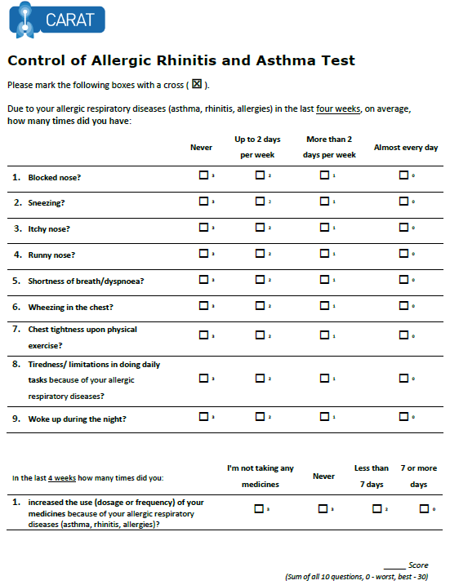
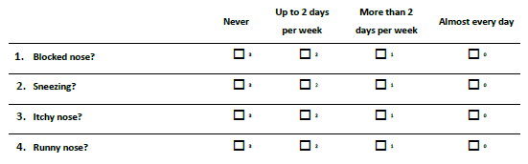
x
x
x
x
x
x
x
x
x
x
x
x
22
x
x
Lourenço O, Calado S, Sá-Sousa A, Fonseca J. Evaluation of allergic rhinitis and asthma control in a Portuguese community pharmacy setting. J Manag Care Spec Pharm. 2014 May;20(5):513-22. http://www.amcp.org/WorkArea/DownloadAsset.aspx?id=18027
CARAT, Control of Allergic Rhinitis and Asthma Test
Available at: https://www.new.caratnetwork.org. Accessed October 2022.
Notes:
CARAT has 10 questions that ask about symptoms during the previous 4 weeks (Table 1). CARAT total score (CARAT-t) ranges from 0 to 30, with a score higher than 24 indicating good overall control. The questionnaire is further divided into 2 sections: the first section relates to allergic rhinitis (CARAT-r), with a score range of 0 to 12 and a value higher than 8 identifying controlled AR; the second section relates to asthma (CARAT-a), with a score range of 0 to 18 and a value of 16 or higher identifying controlled asthma. So:
Total score ≥ 24 (good overall control)
A score ≥ 8 in questions 1 to 4 (good control for upper airways)
A score ≥ 16 in questions 5 to 10 (good control for lower airways)
People in English speaking countries might prefer to use an ACT score instead of CARAT. It’s OK to provide that alternative.

Slide 10
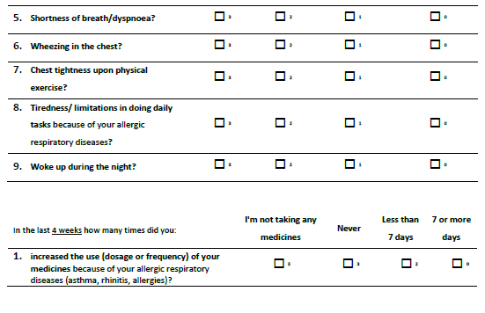
x
x
x
x
x
x
x
x
x
x
x
x
x
x
x
22
x
Lourenço O, Calado S, Sá-Sousa A, Fonseca J. Evaluation of allergic rhinitis and asthma control in a Portuguese community pharmacy setting. J Manag Care Spec Pharm. 2014 May;20(5):513-22. http://www.amcp.org/WorkArea/DownloadAsset.aspx?id=18027
CARAT, Control of Allergic Rhinitis and Asthma Test
Available at: https://www.new.caratnetwork.org. Accessed October 2022.
Notes:
CARAT has 10 questions that ask about symptoms during the previous 4 weeks (Table 1). CARAT total score (CARAT-t) ranges from 0 to 30, with a score higher than 24 indicating good overall control. The questionnaire is further divided into 2 sections: the first section relates to allergic rhinitis (CARAT-r), with a score range of 0 to 12 and a value higher than 8 identifying controlled AR; the second section relates to asthma (CARAT-a), with a score range of 0 to 18 and a value of 16 or higher identifying controlled asthma. So:
Total score ≥ 24 (good overall control)
A score ≥ 8 in questions 1 to 4 (good control for upper airways)
A score ≥ 16 in questions 5 to 10 (good control for lower airways)
People in English speaking countries might prefer to use an ACT score instead of CARAT. It’s OK to provide that alternative.

Slide 11
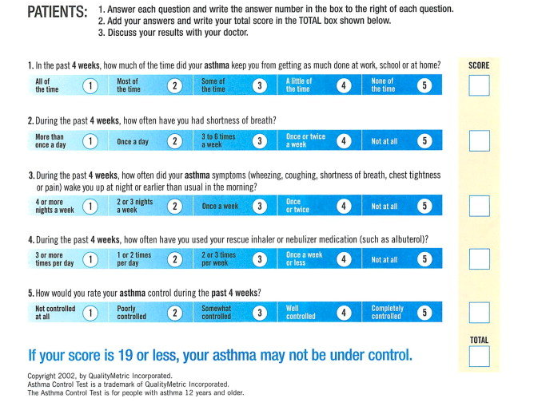
ACT: Asthma Control Questionnaire
Available at: https://www.asthmacontroltest.com/. Accessed October 2022.

Slide 12
Reasons for poor asthma control
Wrong diagnosis or confounding illness
Incorrect choice of inhaler or poor technique
Concurrent smoking
Concomitant rhinitis
Unintentional or intentional nonadherence
Individual variation in treatment response
Under treatment

Slide 13
Clinical considerations
Assessment of asthma control
Measures of symptom control | Sarah’s current status
In the past 4 weeks, has the patient had:
Daytime asthma symptoms more than twice/week? | Yes
Any night waking due to asthma? | Yes
Reliever needed for symptoms more than twice/ week? | Yes
Any activity limitation due to asthma? | Yes
Additional key factor indicating poor control: 4 asthma exacerbations in the past year despite taking high-dose ICS/LABA combination therapy plus SABA as needed
ICS, inhaled corticosteroid; LABA, long-acting bronchodilator; SABA, short-acting bronchodilator.

Slide 14
GINA 2022
Assessment of risk of poor outcomes
Assessment | Risk Factors
Exacerbations | Uncontrolled asthma symptoms ICS not prescribed, poor ICS adherence; incorrect inhaler technique Low FEV₁, especially if <60% predicted Major psychological or socioeconomic problems Exposures: smoking; allergen exposure if sensitized Comorbidities: obesity, rhinosinusitis; confirmed food allergy Sputum or blood eosinophilia Pregnancy
Fixed airflow limitation | Lack of ICS treatment in patients who have had a severe exacerbation Exposure to tobacco smoke, noxious chemicals or occupational exposures Low FEV₁ Chronic mucus hypersecretion Sputum of blood eosinophilia
Medication side effects | Systemic: Frequent OCS; long-term, high-dose and/or potent ICS; also taking P450is Local: High-dose or potent ICS; poor inhaler technique
Available at: www.gina.com. Accessed October 2022.
FEV₁, forced expiratory volume in 1 second; ICS, inhaled corticosteroid; LABA, long-acting bronchodilator; OCS, oral corticosteroid; SABA, short-acting bronchodilator.
1

Slide 15
Clinical considerations
Assessment of risk for poor outcomes
Assessment | Risk Factors
Exacerbations | Uncontrolled asthma symptoms ICS not prescribed, poor ICS adherence; incorrect inhaler technique Low FEV₁, especially if <60% predicted Major psychological or socioeconomic problems Exposures: smoking; allergen exposure if sensitized Comorbidities: obesity, rhinosinusitis; confirmed food allergy Sputum or blood eosinophilia Pregnancy
Fixed airflow limitation | Lack of ICS treatment in patients who have had a severe exacerbation Exposure to tobacco smoke, noxious chemicals or occupational exposures Low FEV₁ Chronic mucus hypersecretion Sputum of blood eosinophilia
Medication side effects | Systemic: Frequent OCS; long-term, high-dose and/or potent ICS; also taking P450is Local: High-dose or potent ICS; poor inhaler technique
FEV₁, forced expiratory volume in 1 second; ICS, inhaled corticosteroid; LABA, long-acting bronchodilator; OCS, oral corticosteroid; SABA, short-acting bronchodilator.

Slide 16
GINA 2022
Investigating uncontrolled asthma
Watch patient using their inhaler. Discuss adherence and barriers to use
Compare inhaler technique with a device-specific checklist, and correct errors; recheck frequently
Confirm the diagnosis of asthma
If lung function normal during symptoms, consider halving ICS dose and repeating lung function after 2-3 weeks
Have an empathic discussion about barriers to adherence
Remove potential risk factors. Assess and manage comorbidities
Check for risk factors or inducers such as smoking, beta-blockers, NSAIDs, allergen exposure
Check for comorbidities such as rhinitis, obesity, GERD, depression/anxiety
Consider treatment step-up
Consider step up to next treatment level
Use shared decision-making, and balance potential benefits and risks
Refer to a specialist or severe asthma clinic
If asthma still uncontrolled after 3-6 months on Step 4 treatment, refer for expert advice
Refer earlier if asthma symptoms severe, or doubts about diagnosis
1
Available at: www.gina.com. Accessed October 2022.
GERD, gastroesophageal reflux disease; ICS, inhaled corticosteroid; NSAID, non-steroidal anti-inflammatory drug.

Slide 17
How to review inhalation technique
Ask the patient beforehand to bring their own inhaler for the consultation
Ask them to demonstrate how they use their inhaler
Correct some aspects and explain why
If possible, use videos
    Observe technique and let the patient observe self (using video demonstrations)
Show you are available to review their technique if necessary
Ask the patient to bring their own inhaler for the next appointment
Notes:
Resources for reviewing inhaler technique:
Asthma review series: Part 3 - Inhaler Technique and Recording Peak Flow. Available at: https://www.youtube.com/watch?v=ZhIcT57i32g
Asthma inhaler techniques (children). Available at: https://www.youtube.com/watch?v=fHcG8DXUwdQ
Asthma: inhaler techniques: Available at: https://www.nhs.uk/Video/Pages/Childrensasthmainhaler.aspx

Slide 18

Question cards

Slide 19
Management
Discuss with the patient
Shared decision on disease management is critical to treatment success
There is a need to review with Sarah several aspects of her condition
Asthma as an airways inflammatory disease
Therapeutic goals
The role of each drug
How and when to use them
Sarah’s fears and expectations regarding medication
Sarah’s beliefs relating to the treatment effects
Any financial difficulties for buying inhalers

Slide 20
Management
Medication adjustment
Sarah remembers that her family doctor told her about the need to use budesonide, but she forgets to do it and anyway she prefers salbutamol

Slide 21
SABA overuse:
An indicator of poor control (1)
UK National Review of Asthma Deaths 2012 to 2013
39% people on SABA at time of death had been prescribed more than 12 in the year before they died
  4% had been prescribed >50 SABA inhalers
  Those prescribed >12 were likely to have had poorly
  controlled asthma
National Review of Asthma Deaths: Available at: https://www.rcplondon.ac.uk/projects/national-review-asthma-deaths. Accessed October 2022.
SABA, short-acting bronchodilator.

Slide 22
SABA overuse:
An indicator of poor control (2)
“There is a progressive risk of hospital admission associated with the prescription of more than three SABA inhalers a year”
Healthcare resource use | 1-3 inhalers N=5888 | 4-12 inhalers N=2054 | >13 inhalers N=285
Inpatient episodes | 20 | 33 | 2
Crude inpatient episode rate per 100 population | 0.34 | 1.61 | 0.70
Hull SA, et al. npj Prim Care Respir Med. 2016;26:16049.
SABA, short-acting bronchodilator.

Slide 23
SABA overuse:
An indicator of poor control (3)
“There is some evidence that electronic alerts reduce excessive prescribing of SABAs, when delivered as part of a multicomponent intervention in an integrated health care system”
Literature review to synthesise the evidence for the use of computerised alerts that identify excessive prescribing of SABAs to improve asthma management for people with asthma
 | SABA prescribing | ICS prescribing | ICS-SABA prescribing | ICS-LABA prescribing
Study 1 |  | No effect
Study 2 | No effect | No effect
Study 3 | Positive effect | No effect |  | Positive effect
Study 4 |  | No effect | Positive effect
McKibben S, et al. npj Prim Care Respir Med. 2018;28:14.
SABA, short-acting bronchodilator, ICS, inhaled corticosteroid, LABA, long-acting bronchodilator.

Slide 24
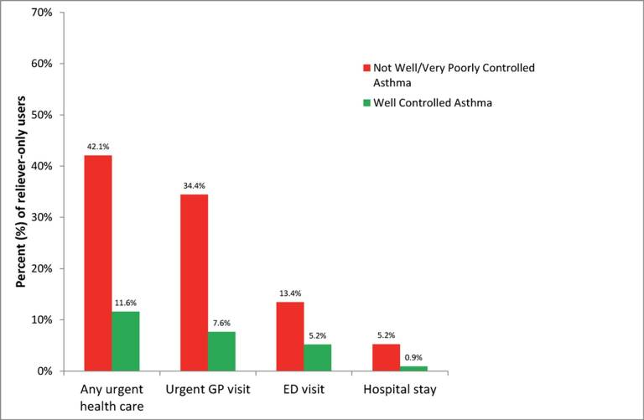
SABA overuse:
An indicator of poor control (4)
“One-quarter of the reliever-only population had needed urgent asthma healthcare in the previous year, demonstrating the importance of identifying such patients”
Cross-sectional population-based
Internet survey in Australia
Of 2686 participants ≥16 years with
current asthma randomly drawn from
a web-based panel, 1038 (50.7% male)
used only reliever medication
Reddel HK, et al. BMJ Open. 2017;7:e016688.
ED, emergency department.

Slide 25
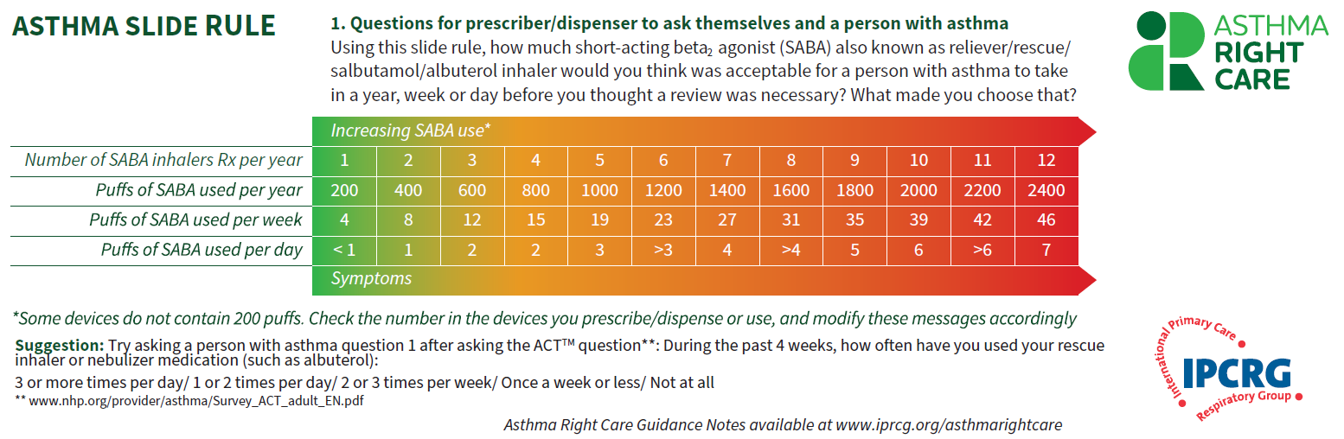
Asthma Slide Rule Front

Slide 26
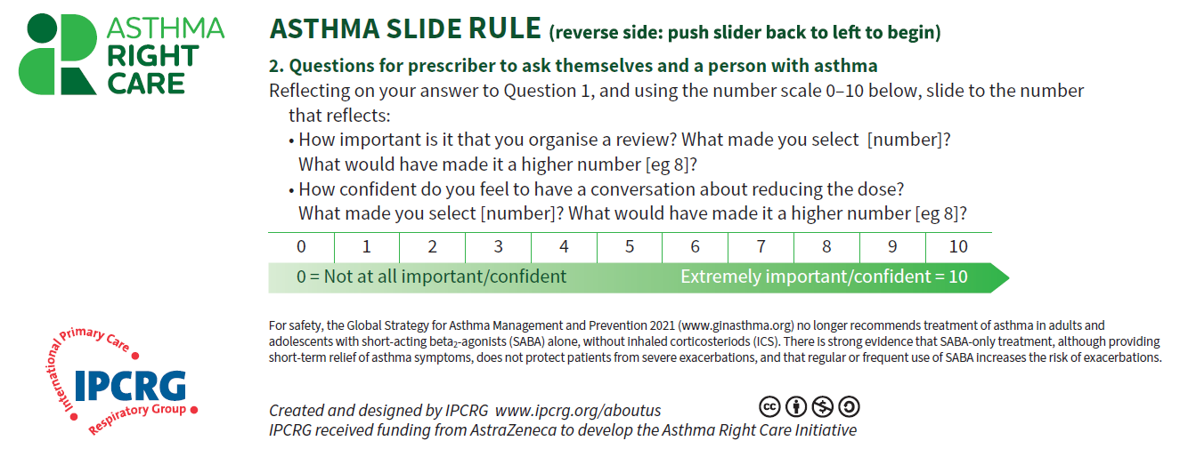
Asthma Slide Rule Back

Slide 27
Given Sarah’s situation, what are the main tasks for her family physician?
Confirm the diagnosis of asthma
Review the medical history
  Differential diagnosis
  Comorbidities
  Complications
Repeat spirometry
Check the inhalation technique and correct any errors
Review the medication with the patient
Assess triggers/ order allergy skin (prick) tests
(there may be more than one right answer)

Slide 28
Clinical considerations
Confirm the diagnosis of asthma
Sarah’s diagnosis was made in childhood and may
warrant review
However:
Sarah has a medical and family history of asthma
3 years ago Martha underwent spirometry which demonstrated reversible airway obstruction following administration of a bronchodilator
FeNO testing may be informative
Everything seems to indicate that it is asthma

Slide 29

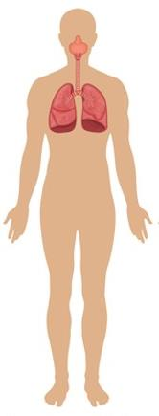
Clinical considerations
Rule out conditions that mimic asthma in adults^{1,2}
Vocal cord disorders
Endobronchial tumour / foreign body, tracheomalacia
Allergic bronchopulmonary
aspergillosis
Other OLD i.e. COPD, BO, CF, bronchiectasis
Other PIE syndrome
(HES, EAA, parasites)
Asthma plus pulmonary embolism, ILD, CHF, other
Eosinophilic granulomatosis
with polyangiitis
Connective tissue disease
Mastocytosis,
glucocorticoid resistance
Immunodeficiency
1. Adapted from FitzGerald JM, et al. Can J Respir Crit Care & Sleep Med 2017;1(4):199–221; 2. Aguilar PR, et al. Otolaryngol Clin N Am 2014;47:147–160.
BO, bronchiolitis obliterans; CF, cystic fibrosis; CHF, congestive heart failure; COPD, chronic obstructive pulmonary disease; EAA, extrinsic allergic alveolitis;
HES, hypereosinophilic syndrome; ILD, interstitial lung disease; OLD, obstructive lung disease; PIE, pulmonary infiltration with eosinophilia

Slide 30
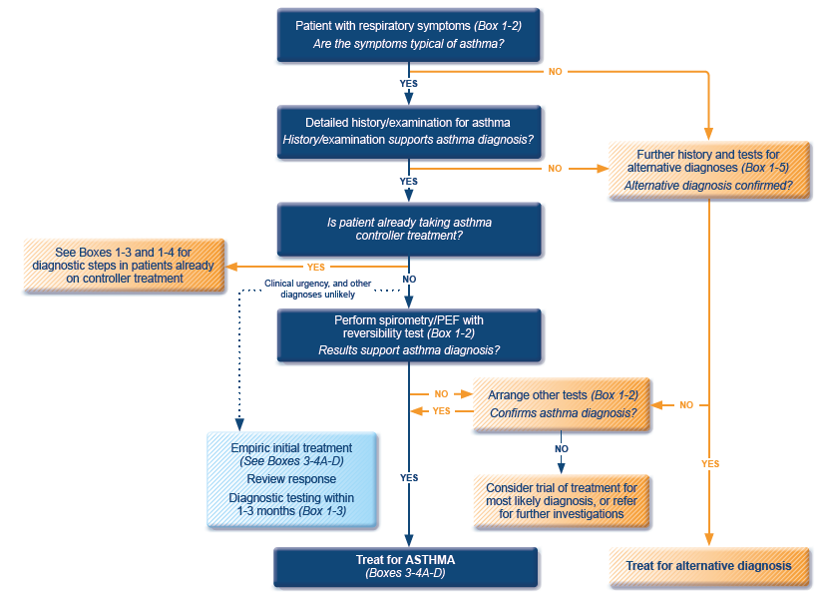
GINA 2022 guidelines for the diagnosis of asthma
ICS, inhaled corticosteroid; PEF, peak expiratory flow; SABA, short-acting beta₂-agonist.
Available at: www.gina.com. Accessed October 2022.

Slide 31
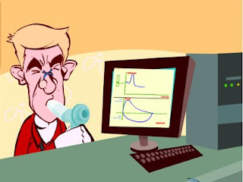
Spirometry
Spirometry measures airflow and lung volumes, and is the preferred lung function test for asthma in primary care
Forced exhalation from a maximal inspiration
FVC: Forced vital capacity | FEV1: Forced Expiratory Volume in 1 second | FEV1/FVC
Volume of air exhaled after full inspiration and full exhalation | Volume of air exhaled in the first second of forced exhalation | Ratio of vital capacity exhaled in 1 second expressed as a percentage of the total volume of air exhaled after full inspiration and full exhalation
For further guidance visit: http://bit.ly/IPCRG-SPIROMETRY-WONCA-2018

Slide 32
Spirometric patterns
FEV₁/FVC
FVC
FEV₁
Obstruction
N
Restriction
N
N
Mixed
Obstruction and hyperinflation
Mild Obstruction | FEV₁ ≥80%
Moderate Obstruction | FEV₁ <80% ≥50%
Severe Obstruction | FEV₁ <50% ≥35%
Very Severe Obstruction | FEV₁ <35%
For further guidance visit: http://bit.ly/IPCRG-SPIROMETRY-WONCA-2018.
FEV₁, forced expiratory volume in 1 second; FVC, forced vial capacity.

Slide 33
Quick spirometry assessment
FEV₁ /FVC
≥70%
Normal
<70%
Obstruction
FVC
FVC
< 80% ref value
<80% ref. value
≥80% ref value
Mixed pattern
≥80% ref value
OBSTRUCTION
+ HYPERINFLATION (↑VR)
NORMAL
RESTRICTION
OBSTRUCTION
OBSTRUCTION
+
RESTRICTION
(VR normal)
For further guidance visit: http://bit.ly/IPCRG-SPIROMETRY-WONCA-2018.
FEV₁, forced expiratory volume in 1 second; FVC, forced vial capacity.

Slide 34
Clinical considerations
Review the medical history
Allergic sensitisation to house dust mites (skin prick tests, specific IgEs)
No occupational history of exposure
Spirometry with positive bronchodilation test in 2012
No smoking history
No pets at home
Some rhinitis
No GERD symptoms
No snoring
BMI 20
BMI, body mass index; GERD, gastroesophageal reflux disease; IgE, immunoglobulin E.

Slide 35








Key asthma triggers
Psychological
triggers³
Air pollution¹
Medications*³
Exposure to bacteria²
House dust mites⁶
Smoking^{3,4}
Flowers/pollen³
Household pets^{3,4}
Exercise⁵
Alcohol³
Air-conditioning³
URTI³
URTI = upper respiratory tract infection.
*Beta-blockers and non-steroidal anti-inflammatory drugs.
1. Esposito S, et al. BMC Pulm Med 2014;14:130; 2. Beigelman A, et al. Curr Opin Allergy Clin Immunol 2014;14:137–142; 3. See K, et al. Singapore Med J 2015 epub; 4. Vernon M, et al. J Asthma 2012;49:991–998; 5. Global Initiative for Asthma. Global Strategy for Asthma Management and Prevention, 2016. Available from: www.ginasthma.org; 6. Lim FL, et al. PLoS One 2015;10:e0124905.

Slide 36
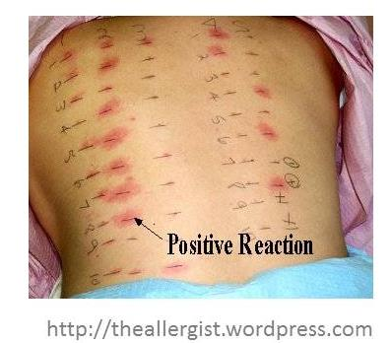
Allergy testing and how to interpret the results
Skin prick test is the most sensitive test for allergies
  Suspected allergens are mixed with liquid to form a solution
  Drops are placed on the skin surface
  The top surface of the skin is pricked beneath each drops
  A positive reaction is indicated by reddening, itch and swelling

Slide 37
Clinical consideration
Review Sarah’s medication with her
Shared decision on disease management if critical to treatment success
  Need to review adherence
  Understand Sarah’s fears and concerns about her medication
  Discuss concerns in the context of necessity to achieve asthma control

Slide 38
Adherence to controller therapy correlates with fewer severe exacerbations
Patients achieving the 75th percentile of adherence experienced the fewest exacerbations
Reference | Participants, n | Outcome | Adherence | OR | Adherent vs nonadherent
Stern et al. (2006) | 97,743 | Comb: ED/hosp | MPR: 75th perc vs less | 0.86
Delea et al. (2008) | 12,907 | OCS Comb: ED/hosp | Mean MPR: +25% Mean MPR: +25% | 0.97 0.90
Balkrishnan et al. (2000) | 751 | Comb: ED/hosp | Refills: 2 vs 0 | 0.62
Williams et al. (2004) | 405 | OCS | Median CMA: +25% | RR 0.75
Williams et al. (2011) | 298 | Comb: ED/hosp/OSC | MPR: >75% vs <25% | 0.58
McMahon et al. (2000) | 4535 | Hosp+OCS Hosp | Adh: 90 vs 1–89 days Adh: 90 vs 1–89 days | 1.02 0.91
Smith et al. (2009) | 3013 | Comb: ED/hosp | MPR: >80% vs <50% | 0.47
0
1
2
A systematic literature review of 23 publications on medication adherence and the risk of severe exacerbations
Adh, adherence; CMA, continuous measure of availability; Comb, combined; ED, emergency department visit; hosp, hospitalization; MPR, medication possession rate; OCS, oral corticosteroids; OR, odds ratio; perc, percentile; RR, relative risk
Engelkes M, et al. Eur Respir J 2015;45:396–407.

Slide 39
Would you propose any medication adjustment?
To continue to use salbutamol whenever she feels asthma symptoms?
To add montelukast?
To add tiotropium?
To continue budesonide/formoterol, but add budesonide/formoterol as the reliever instead of salbutamol?
To double the budesonide/formoterol to 4 puffs BID?
To refer for inflammatory measurements (FeNO, sputum eosinophils)?
BID, twice daily.

Slide 40
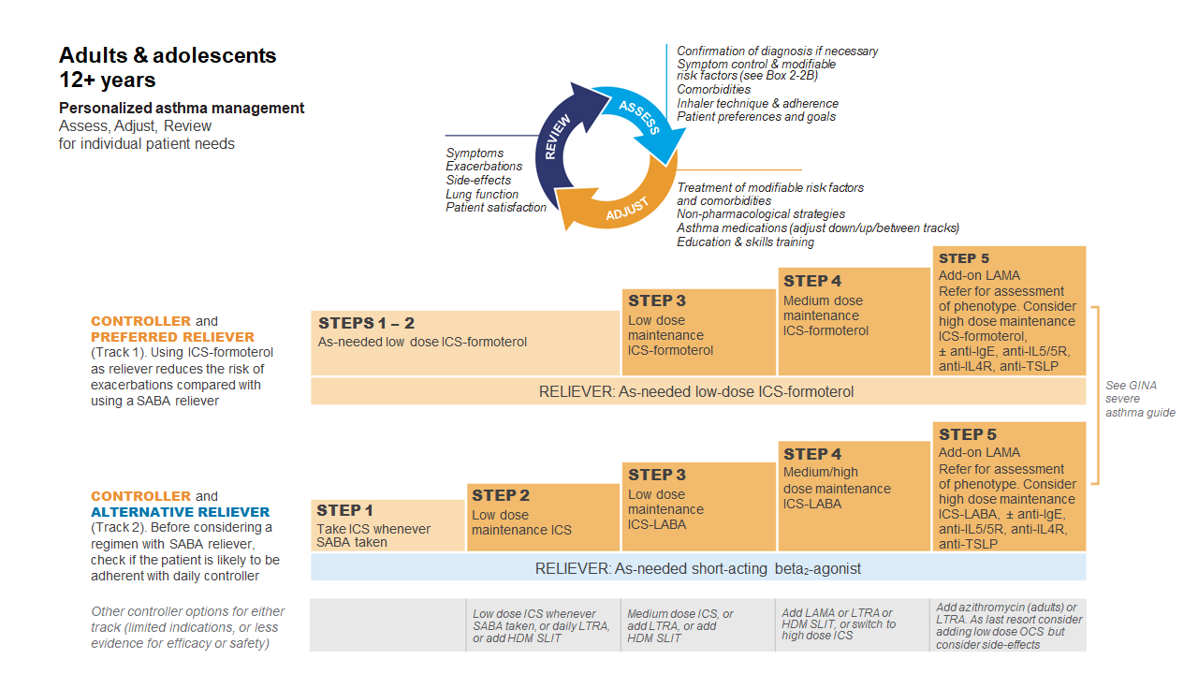
GINA 2022
Available at: www.gina.com. Accessed October 2022.

Slide 41
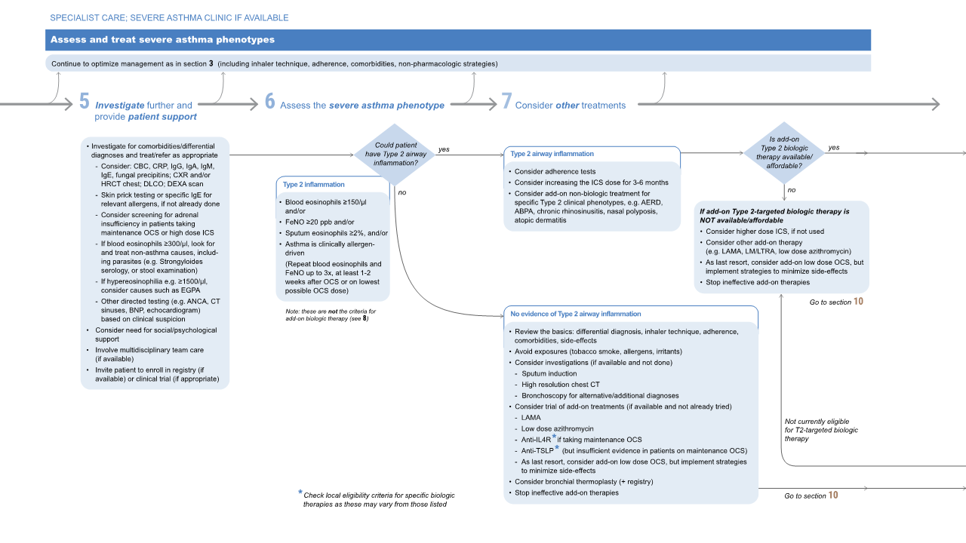

Available at: www.gina.com. Accessed October 2022.

Slide 42
Available at: www.gina.com. Accessed October 2022.

Slide 43
Available at: www.gina.com. Accessed October 2022.

Slide 44
Key learnings
Difficult to control asthma is not severe asthma
Basics first: diagnosis, adherence, technique, comorbidities
Step up therapy to adequate reliever
Anti-inflammatory reliever may help reduce some exacerbations
Biologics; though expensive, are life changing in those with severe asthma and the appropriate phenotypes

Slide 45
Asthma Right Care: a movement for Global Change
Movement for Global Change
IPCRG received funding from AstraZeneca to develop the Asthma Right Care Initiative

Slide 46
Every system is perfectly designed to get the results it gets
(Earl Conway and Paul Batalden)
Notes:
Both intended and unintended consequences are designed into our systems

Slide 47
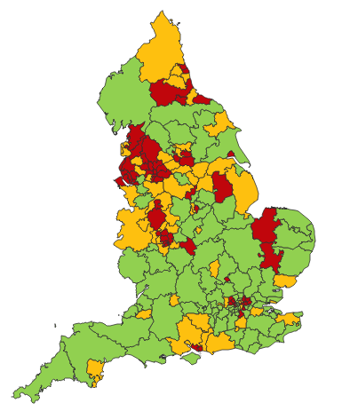

Making a case for change
Asthma illustrates all 5 global healthcare problems (Muir Gray):
Unwarranted variation
Harm, even when quality is high (over-diagnosis, over-treatment)
Failure to prevent disease and disability
Waste of human and physical resources through low value activity
Inequity
And new challenges are forming:
Financial constraints
Rising expectations of personalised care
Climate change/pollution
Increasing need
PHE Fingertips data Asthma admissions per 1000 population 2012/13 data
Notes:
Unwarranted variation as defined by Wennberg: Variation in utilization of health care services that cannot be explained by variation in patient illness or patient preferences
http://www.nhsconfed.org/~/media/Confederation/Files/Events/ACE15/1430%20Inaugural%20NHS%20value%20lecture.pdf

Slide 48
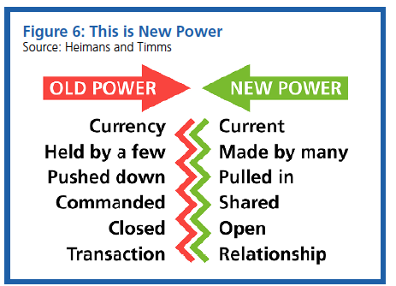
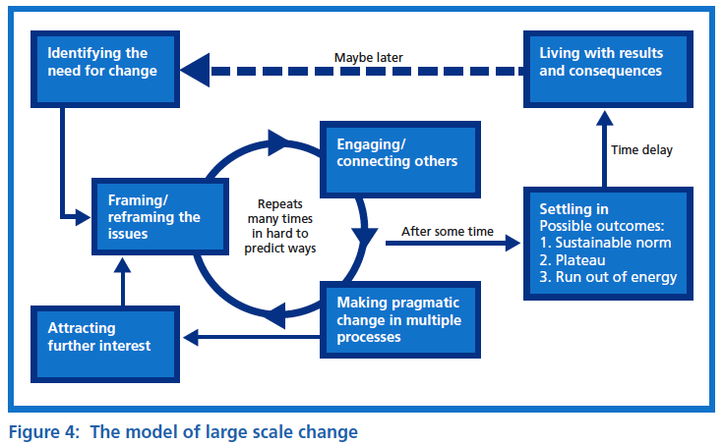
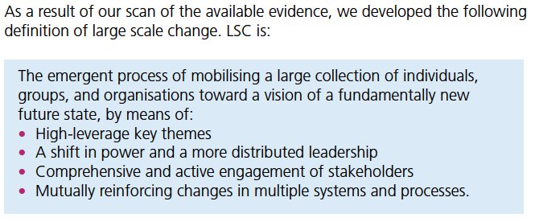

Leading large scale change: the evidence

Slide 49
What is Right Care?
Our working definitions
Doing the right things and only the right things in the right way for the right people at the right time in the right place, whatever that means in the local context
Improving the value that each person with asthma derives from their own care and treatment and the value the whole population derives from the investment in asthma care by addressing unwarranted variation; reducing waste, avoidable harm and avoidable symptoms

Slide 50
Aim
Scope
To sort asthma care once and for all for the person with asthma and for the healthcare system so that there is no unwarranted variation, and no avoidable waste or harm*.
That is
We can and should do better by getting it right first time!
The pathway from the first time someone (adult or parent) is offered a SABA, wherever that is, through to all possibilities (existing and new) for review
Phase 1: SABA use
*waste is waste of human, financial, health facility, energy and pharmacological assets.

Slide 51
Asthma Right Care as a social movement
It’s all about the FOLLOWERS: We need to get the right people engaged, who will connect through the right channels to engage the maximum numbers of followers who are inspired to do something different: to reduce reliance on short-acting beta-agonists, and to increase faith in and use of guideline-indicated effective medicines

Slide 52

Getting our social movement going
Sept 2017
May 2018
Kick starting action
Emerging and building momentum
  Nurturing voices
  Cultivating diverse interests and motivations
2
Steering Group formed and meets
3
Influencing and interacting
Navigating a complex array of relationships
National Champions Identified
SCALING UP
Delivery Team meeting
Delivery Team meeting
Delivery Team meeting
Delivery Team meeting
Symposium
Pervasiveness: affect all or just part of system?
National Steering Group Stakeholder
Mapping
Invitation UK
National Design Charrette
Pilot Phase
National Steering Group Stakeholder
Mapping
Invitation Portugal
National Design Charrette
Pilot Phase
Depth: ways of thinking and doing – cognitive, behavioural or paradigm shift?
Size: number
of people, geography
National Steering Group Stakeholder
Mapping
Invitation Canada
National Design Charrette
Pilot Phase
National Steering Group Stakeholder
Mapping
Invitation Spain
National Design Charrette
Pilot Phase
Notes:
References:
Nesta 2017. We change the world: what can we learn from global social movements for health?
NHS England. Sustainable Improvement and Horizons Team 2017. Leading large scale change: a practical guide.

Slide 53

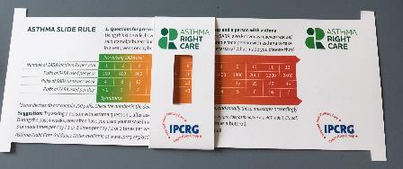
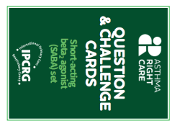
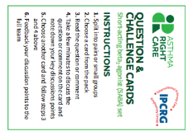
Kickstarting action
Emerging and building momentum
2
  Nurturing voices
  Cultivating diverse interests and motivations
3
Influencing and interacting
Navigating a complex array of relationships
Netherlands, Greece
France Vietnam
ENVIRONMENT
Propellant & Plastic
INFORMATION
Coding
Public Information
MEDICINES
ICS: SABA Ratio
Inhaler Use
New Cultures
& Languages
Mexico Brazil
Ireland Saudi Arabia
6 drivers in asthma health system
More parts of health system
More
geographies
Original 4
UK & Canada
Spain
Portugal
WORKFORCE
GPs / Pharmacist / Nurses
FINANCE & LEADERSHIP
PERSONAL
Networking
Policy Briefing
Going deeper:
Paradigm / behaviour shift
Unconscious Incompetence
Asthma Slide Rule & Question Cards
Conscious Incompetence: what could I do better?
Conscious Competence
Regional Teach The Teacher Master Classes to create trusted regional master teachers
What is right care?
Unconscious Competence
Mastery: Conscious Competence of Unconscious Incompetence

Slide 54

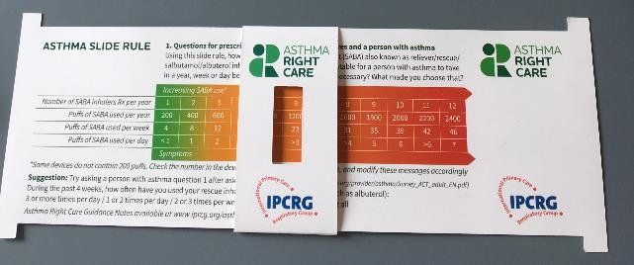
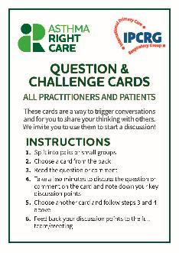
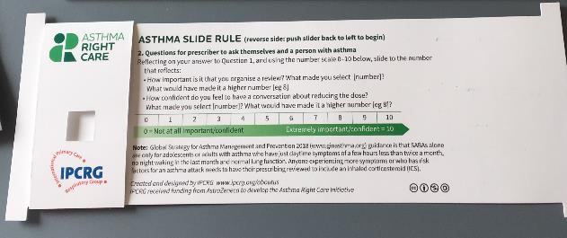
Prototype conversation pieces for discussion and co-creation in the design charrettes
Hunch 1: Lack of knowledge about how many puffs or doses in an inhaler and how many is too many in a year
Hunch 2: Pharmacists keen to do more but out of date “take your blue inhaler to open up your airways” – reveals no investment in education since this was the norm
Hunch 3: General practitioners/family physicians keen to emphasise art rather than science of the consultation, and so not up-to-date with guidelines eg “What’s the probability of them having asthma?” not routine question yet
Ambition: Embrace more people, more methods, bring joy to lives: let’s have fun, while being challenging

Slide 55
What has Asthma Right Care changed for you?
It has changed my approach to leading a large scale change for asthma management. It means to move towards a new vision that is better and fundamentally different from the Status Quo. This Project has pointed me in the right direction for creating and sustaining large scale change and transformation.This framework helps us to increase personal value, value for the population and rates of higher value intervention.
Mar Martinez, GP
ARC is changing our lives because we are reflecting about our work quality in a biopsychosocial dimension while we try to make every single step to provide all the asthma right care to patients and caregivers reconciling it with daily work. At the same time it is incredible how we can apply this knowledge to other diseases and procedures.
Teamwork is very rewarding, making us grow as a person and as a healthcare professional.
Cláudia Vicente, GP

Slide 56


Slide 57
What can you commit to?
Act now!
Find out more at www.ipcrg.org/asthmarightcare
IPCRG received funding from AstraZeneca to develop the Asthma Right Care Initiative

Slide 58
Additional resources

Slide 59
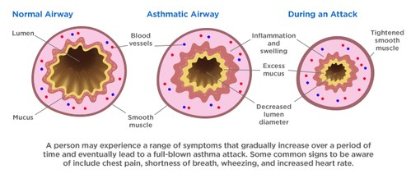
Asthma is an inflammatory disease
Asthma is a chronic inflammatory disease of the airways leading to bronchial constriction
HealthCentral. Anatomy of an asthma attack. Available at: https://www.healthcentral.com/article/anatomy-of-an-asthma-attack-infographic?ap=2012

Slide 60
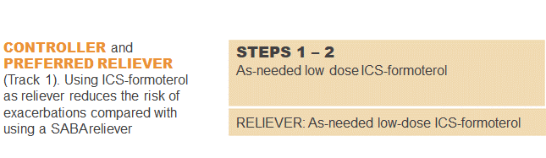
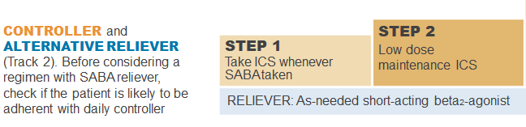
GINA 2022: Steps 1–2
Controller and preferred reliever:
As-needed low dose ICS-formoterol (off-label)
  Low dose ICS reduces symptoms and reduces risk of exacerbations and asthma-related hospitalization and death
Other controller options (Step 2):
  Low dose ICS taken whenever SABA is taken
  Leukotrine receptor antagonists
  Add house dust mite sublingual immunotherapy
ICS, inhaled corticosteroid; SABA, short-acting beta₂-agonist.
Available at: www.gina.com. Accessed October 2022.

Slide 61
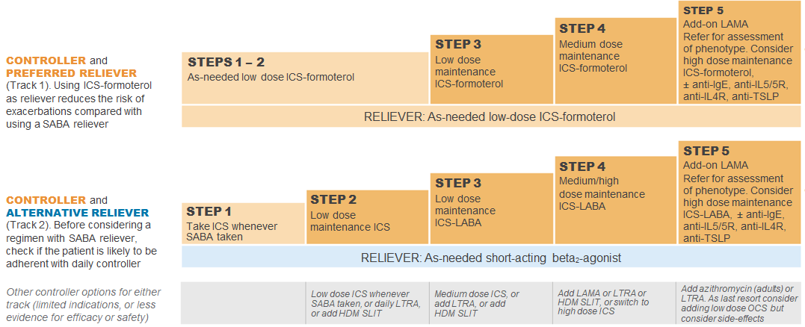
GINA 2022: Step 3
Preferred controller: Low dose ICS-formoterol maintenance plus as-needed SABA, OR low dose ICS-LABA maintenance and reliever therapy
For children aged 6-11 years the preferred controller is medium dose ICS or low dose ICS-LABA
HDM SLIT, house dust mite sublingual immunotherapy; ICS, inhaled corticosteroid; LABA, long-acting bronchodilator; LTRA, leukotrine receptor antagonist;
SABA, short-acting beta₂-agonist.
Available at: www.gina.com. Accessed October 2022.

Slide 62
GINA 2022: Step 4
Preferred controller: Medium dose ICS-formoterol as maintenance and reliever therapy, OR medium/high dose ICS-LABA maintenance plus as-needed SABA
Other controller options:
  Add-on tiotropium by mist inhaler for patients ≥6 years with a history of exacerbations
  Add-on LTRA
  Increasing to high dose ICS-LABA
Children aged 6-11 years: Continue controller, and refer for expert advice
HDM SLIT, house dust mite sublingual immunotherapy; ICS, inhaled corticosteroid; LABA, long-acting bronchodilator; LAMA, long-acting muscarinic antagonist;
LTRA, leukotrine receptor antagonist; SABA, short-acting beta₂-agonist.
Available at: www.gina.com. Accessed October 2022.

Slide 63
GINA 2022: Step 5
Add-on LAMA and refer for phenotypic investigation ± add-on treatment
Consider high-dose maintencen ICS-formoterol ± biologic therapy
Other controller options:
  Azithromycin (adults) or LTRA
  Low dose OCS (last resort) but consider side effects
ICS, inhaled corticosteroid; LABA, long-acting bronchodilator; LAMA, long-acting muscarinic antagonist; SABA, short-acting beta₂-agonist; SC; subcutaneous.
Available at: www.gina.com. Accessed October 2022.

Slide 64
Written Personalised Asthma Action Plan (PAAP)
Written PAAP
A written PAAP is an essential part of managing long-term disease¹
SIGN-BTS recommend that all people with asthma should be offered self-management education which includes a written AAP²
  In addition, GINA also highlights the importance of supporting long-term asthma management³
  These recommendations are based on literature reviews that show that supported PAAPs improve asthma control, reduce exacerbations and improve quality of life^{2,3}
Why are they useful?
  Pinpoint signs that the asthma is getting worse⁴
  Keep track of when to take medicines⁴
  Aid daily monitoring as well as long-term control⁴
  Provide information on what to do in the event of an asthma attack⁴
  The overall aim of a written PAAP is to help take early action to prevent or reduce the severity of asthma attack symptoms⁴
GINA, Global Initiative for Asthma; PAAP, personalised asthma action plan; SIGN-BTS, Scottish Intercollegiate Guidelines Network- British Thoracic Society.
1. Gibson PG, et al. Thorax 2004;59:94–99; 2. SIGN-BTS. British guideline on the management of asthma. Consultation 2016; 3. GINA Strategy for asthma management and prevention 2016; 4. Pinnock H. Breathe 2015;11:98–109.

Slide 65
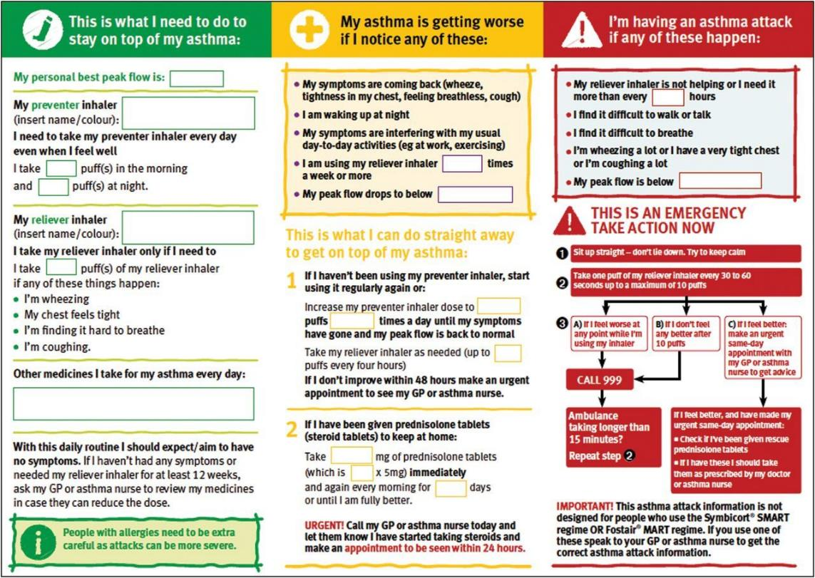
PAAP example for adults
Hilary Pinnock. Supported self-management for asthma. Breathe (Sheff). 2015 Jun; 11(2): 98–109. doi: 10.1183/20734735.015614 https://www.ncbi.nlm.nih.gov/pmc/articles/PMC4487370/pdf/EDU-0156-2014.pdf

Slide 66
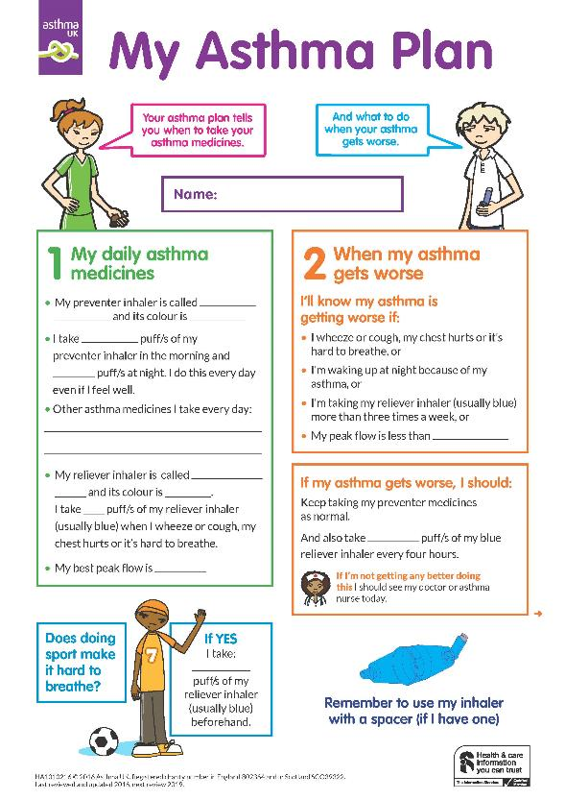
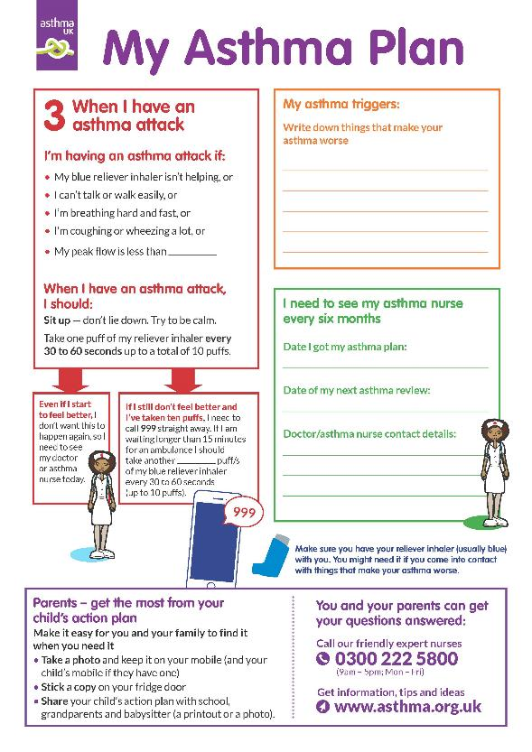
Child Asthma Action Plan
Child Asthma Action Plan
Available at: https://www.asthma.org.uk/def9655d/globalassets/health-advice/resources/children/child-asthma-action-plan.pdf. Accessed October 2022

