Slide 1
Patient seen by ED doctor, not admitted to hospital
IPCRG received funding from AstraZeneca to develop the Asthma Right Care Initiative

Slide 2
About these slides
Please feel free to use, update and share some or all of these slides in your non-commercial presentations to colleagues or patients
The slides are provided under creative commons licence CC BY-NC-ND.
  BY stands for attribution (the obligation to credit the author and other parties designated for attribution);
  NC stands for NonCommercial (commercial use is excluded from the licence grant);
  ND means NoDerivatives (only verbatim copies of the work can be shared)
When using our slides, please retain the source attribution: IPCRG 2022 Mar Martinez, MD, PhD, on behalf of the Asthma Right Care Team

Slide 3
What you will learn
Indicators for, and risks of over-reliance on SABAs
Recommendations for the management of current mild asthma
The role of SABA/ICS therapy for patients with mild asthma
How to avoid Asthma Wrong Care
What is the Asthma Right Care social movement

Slide 4

The patient
Marc is 20 years old
He is a student at an industrial engineering college
He lives in an old students apartment, without carpets or pets
He smokes on weekends
Marc does not have any comorbid conditions

Slide 5
Respiratory history
Marc was diagnosed with asthma at age 6 years
  His diagnosis was intermittent asthma and he was prescribed a SABA (pMDI) for use as-needed
A few years ago Marc underwent spirometry which demonstrated reversible airway obstruction
His youngest sister also has a diagnosis of asthma

Slide 6
ED presentation
Marc attends the emergency department as he is breathlessness
He reports that his breathlessness has worsened over the last
2 weeks despite using 2 puffs of his SABA four times daily
On presentation:
  He talks in phrases and has a clear wheeze
  His oxygen saturation is 93%, his pulse rate is 100 bpm and his respiratory rate is 26 bpm
  No accessory muscle use
  Abnormal auscultation with expiratory wheeze
  PEF 60% predicted

Slide 7
Clinical considerations
ED management
Marc is initiated on:
  Repetitive SABA: 4-10 puffs (pMDI) every 20 minutes for the first hour
  Oral corticosteroids
  Controlled flow oxygen supplementation
Marc’s symptoms improve: PEF 80% predicted, oxygen saturation >94% on room air
Discharge is arranged with SABA as-needed and 5-day course of oral corticosteroids
Marc is also initiated on ICS maintenance therapy

Slide 8
Clinical considerations
Follow-up
Marc is advised to arrange a follow-up appointment with his primary care provider in 2-7 days
One week later Marc feels better and decides not to attend the appointment
One month later, he stops maintenance ICS

Slide 9
Current presentation
Marc presents to your office as he has started to feel breathless again and is using his SABA twice a day on at least 4 days each week
His pharmacist advised him to make an appointment when he went to collect his seventh SABA inhaler this year
Marc reports that his pharmacist says that because he has stopped his ICS, his SABA may not work so well when his asthma gets worse

Slide 10
Reasons for poor asthma control
Wrong diagnosis or confounding illness
Incorrect choice of inhaler or poor technique
Concurrent smoking
Concomitant rhinitis
Unintentional or intentional nonadherence
Individual variation in treatment response
Under treatment

Slide 11
SABA overuse:
An indicator of poor control (1)
UK National Review of Asthma Deaths 2012 to 2013
39% people on SABA at time of death had been prescribed more than 12 in the year before they died
  4% had been prescribed >50 SABA inhalers
  Those prescribed >12 were likely to have had poorly
  controlled asthma
National Review of Asthma Deaths: Available at: https://www.rcplondon.ac.uk/projects/national-review-asthma-deaths. Accessed October 2022.

Slide 12
SABA overuse:
An indicator of poor control (2)
“There is a progressive risk of hospital admission associated with the prescription of more than three SABA inhalers a year”
Healthcare resource use | 1-3 inhalers N=5888 | 4-12 inhalers N=2054 | >13 inhalers N=285
Inpatient episodes | 20 | 33 | 2
Crude inpatient episode rate per 100 population | 0.34 | 1.61 | 0.70
Hull SA, et al. npj Prim Care Respir Med. 2016;26:16049.

Slide 13
SABA overuse:
An indicator of poor control (3)
“There is some evidence that electronic alerts reduce excessive prescribing of SABAs, when delivered as part of a multicomponent intervention in an integrated health care system”
Literature review to synthesise the evidence for the use of computerised alerts that identify excessive prescribing of SABAs to improve asthma management for people with asthma
 | SABA prescribing | ICS prescribing | ICS-SABA prescribing | ICS-LABA prescribing
Study 1 |  | No effect
Study 2 | No effect | No effect
Study 3 | Positive effect | No effect |  | Positive effect
Study 4 |  | No effect | Positive effect
SABA short-acting beta₂- agonist, ICS inhaled corticosteroid, LABA long-acting beta₂-agonist.
McKibben S, et al. npj Prim Care Respir Med. 2018;28:14.

Slide 14
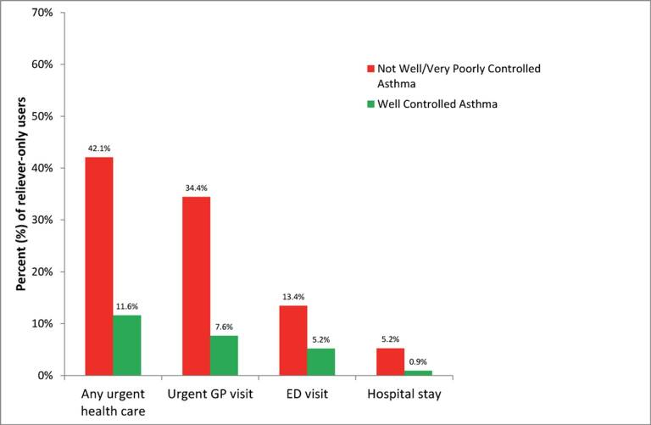
SABA overuse:
An indicator of poor control (4)
“One-quarter of the reliever-only population had needed urgent asthma healthcare in the previous year, demonstrating the importance of identifying such patients”
Cross-sectional population-based
Internet survey in Australia
Of 2686 participants ≥16 years with
current asthma randomly drawn from
a web-based panel, 1038 (50.7% male)
used only reliever medication
ED, emergency department.
Reddel HK, et al. BMJ Open. 2017;7:e016688.

Slide 15
What are your priorities?
Confirm the diagnosis of asthma
Review Marc’s medical history
Request a new spirometry
Order allergy skin (prick) tests
Check Marc’s inhalation technique and correct any errors
Review Marc’s medication with him
(there may be more than one right answer)

Slide 16
Clinical considerations
Confirm the diagnosis of asthma
Marc’s diagnosis was made in childhood and may warrant review
However:
Marc has a medical and family history of asthma
3 years ago Marc underwent spirometry which demonstrated reversible airway obstruction following administration of a bronchodilator
Everything seems to indicate that it is asthma

Slide 17
Clinical considerations
Review the medical history
Marc was diagnosed with asthma when he was 6 years old
  His diagnosis was intermittent asthma and he was prescribed a SABA (pMDI)
  as-needed
  From the age of 12 he has had almost no symptoms
Whenever he has a upper airway tract infection, he reports both cough and wheezing
He studies at an industrial engineering college and has no occupational history of exposure
He does not have any pets at home
Marc has not attended for his regular asthma review appointments in the last couple of years

Slide 18
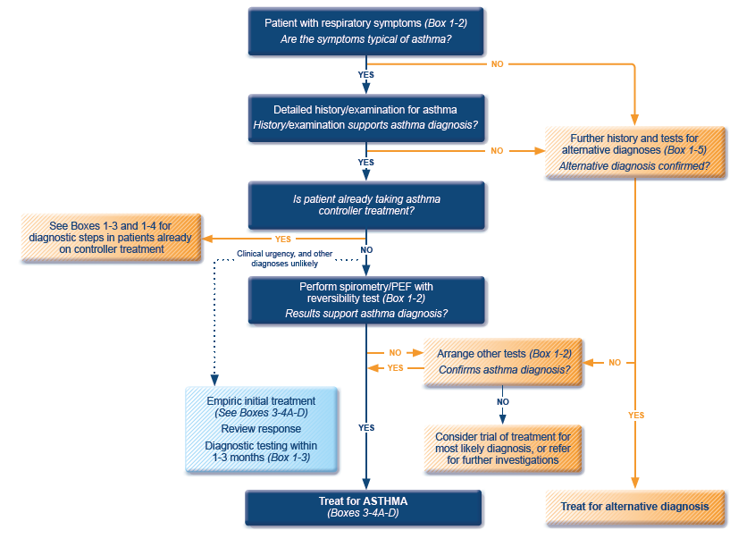
GINA 2022 guidelines for the diagnosis of asthma
ICS, inhaled corticosteroid; PEF, peak expiratory flow; SABA, short-acting beta₂-agonist.
Available at: www.gina.com. Accessed October 2022.

Slide 19
Clinical considerations
Review the medical history
Marc reports that he has had symptoms since he moved into an
old students apartment and has started smoking on weekends (at age 18)
He suffered a moderate exacerbation two months ago and after visiting the ED, ICS was prescribed (inhaled budesonide 200 µg twice a day)

Slide 20
Clinical considerations
Evaluation and tests
Spirometry was performed in 2015, with a positive result
  A new spirometry should be considered although it is not mandatory for his immediate clinical management
Allergy testing was performed a few years ago and Marc is sensitive to house dust mites (skin prick test and specific IgEs)
  There is no need for further testing at the moment

Slide 21
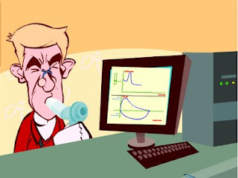
Spirometry
Spirometry measures airflow and lung volumes, and is the preferred lung function test for asthma in primary care
Forced exhalation from a maximal inspiration
FVC: Forced vital capacity | FEV1: Forced Expiratory Volume in 1 second | FEV1/FVC
Volume of air exhaled after full inspiration and full exhalation | Volume of air exhaled in the first second of forced exhalation | Ratio of vital capacity exhaled in 1 second expressed as a percentage of the total volume of air exhaled after full inspiration and full exhalation
For further guidance visit: http://bit.ly/IPCRG-SPIROMETRY-WONCA-2018

Slide 22
Spirometric patterns
FEV1/FVC
FVC
FEV1
Obstruction
N
Restriction
N
N
Mixed
Obstruction and hyperinflation
Mild Obstruction | FEV1 ≥80%
Moderate Obstruction | FEV1 <80% ≥50%
Severe Obstruction | FEV1 <50% ≥35%
Very Severe Obstruction | FEV1 <35%
For further guidance visit: http://bit.ly/IPCRG-SPIROMETRY-WONCA-2018

Slide 23
Quick spirometry assessment
FEV₁ /FVC
≥70%
Normal
<70%
Obstruction
FVC
FVC
< 80% ref value
<80% ref. value
≥80% ref value
Mixed pattern
≥80% ref value
OBSTRUCTION
+ HYPERINFLATION (↑VR)
NORMAL
RESTRICTION
OBSTRUCTION
OBSTRUCTION
+
RESTRICTION
(VR normal)
For further guidance visit: http://bit.ly/IPCRG-SPIROMETRY-WONCA-2018

Slide 24
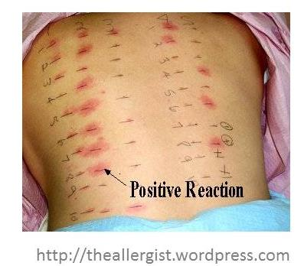
Allergy testing and how to interpret the results
Skin prick test is the most sensitive test for allergies
  Suspected allergens are mixed with liquid to form a solution
  Drops are placed on the skin surface
  The top surface of the skin is pricked beneath each drops
  A positive reaction is indicated by reddening, itch and swelling

Slide 25
Clinical considerations
Inhaler technique
Marc’s inhaler technique should be reviewed at all appointments
Marc should be asked to bring his own inhalers to the appointments

Slide 26
How to review inhalation technique
Ask the patient beforehand to bring their own inhaler for the consultation
Ask them to demonstrate how they use their inhaler
Correct some aspects and explain why
If possible use videos
    Observe technique and let the patient observe self (using video demonstrations)
Show you are available to review their technique if necessary
Ask the patient to bring their own inhaler for the next appointment
Notes:
Resources for reviewing inhaler technique:
Asthma review series: Part 3 - Inhaler Technique and Recording Peak Flow. Available at: https://www.youtube.com/watch?v=ZhIcT57i32g
Asthma inhaler techniques (children). Available at: https://www.youtube.com/watch?v=fHcG8DXUwdQ
Asthma: inhaler techniques: Available at: https://www.nhs.uk/Video/Pages/Childrensasthmainhaler.aspx

Slide 27
Clinical considerations
Medication review
Marc admits that he stopped using his ICS because he thinks his SABA gives him more relief

Slide 28
Would you propose any medication adjustment?
To continue to use salbutamol whenever he feels asthma symptoms?
To use budesonide 200 µg twice daily (as previously prescribed) + salbutamol whenever he feels asthma symptoms?
To replace budesonide with budesonide / formoterol in the same inhaler twice daily + salbutamol inhaler whenever he feels asthma symptoms?
To replace budesonide with budesonide / formoterol in the same inhaler twice daily + when needed?
To use budesonide 200 µg twice daily (as prescribed previously) and prescribe budesonide / formoterol in the same inhaler to be used when needed?

Slide 29
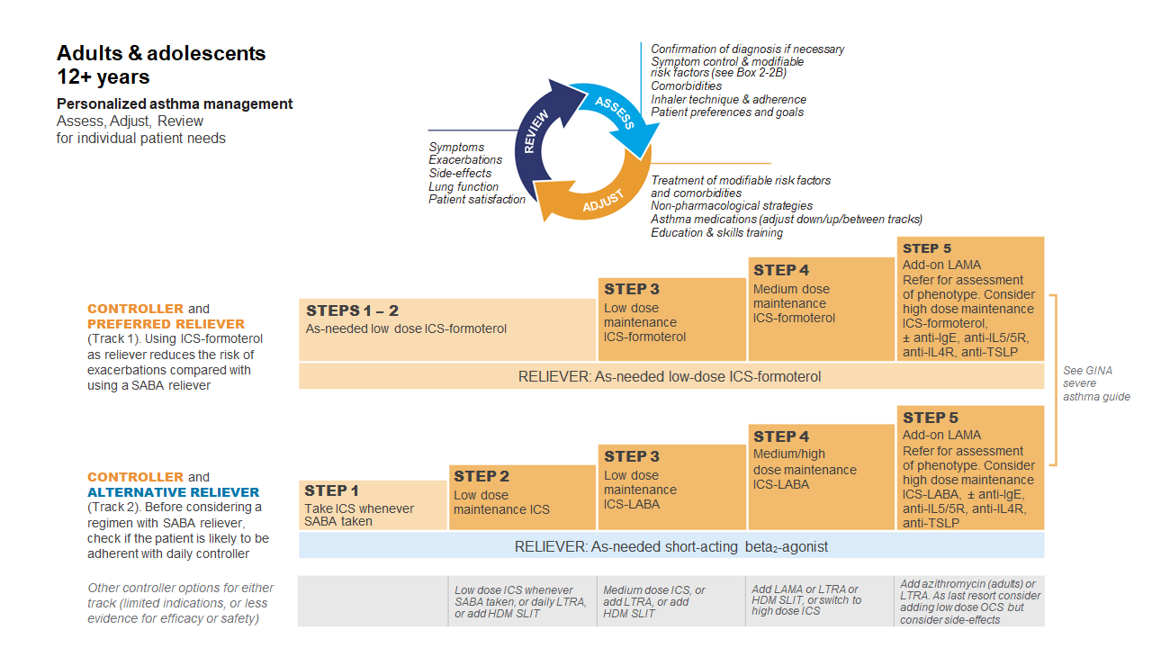
GINA 2022
Available at: www.gina.com. Accessed October 2022.

Slide 30
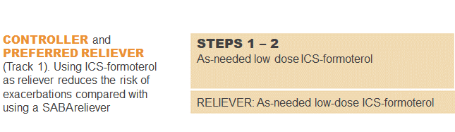
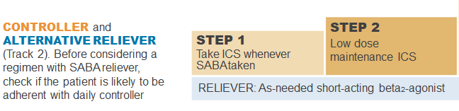
GINA 2022: Steps 1–2
Controller and preferred reliever:
As-needed low dose ICS-formoterol (off-label)
  Low dose ICS reduces symptoms and reduces risk of exacerbations and asthma-related hospitalization and death
Other controller options (Step 2):
  Low dose ICS taken whenever SABA is taken
  Leukotrine receptor antagonists
  Add house dust mite sublingual immunotherapy
ICS, inhaled corticosteroid; SABA, short-acting beta₂-agonist.
Available at: www.gina.com. Accessed October 2022.

Slide 31
Thoughts on medication adjustment having reviewed current guidelines?
To continue to use salbutamol whenever he feels asthma symptoms?
To use budesonide 200 µg twice daily (as previously prescribed) + salbutamol whenever he feels asthma symptoms?
To replace budesonide with budesonide / formoterol in the same inhaler twice daily + salbutamol inhaler whenever he feels asthma symptoms?
To replace budesonide with budesonide / formoterol in the same inhaler twice daily + when needed?
To use budesonide 200 µg twice daily (as prescribed previously) and prescribe budesonide / formoterol in the same inhaler to be used when needed?

Slide 32
Management
Discuss with the patient
Shared decision on disease management is critical to treatment success
There is a need to review with Marc several aspects of his condition
Asthma as an airways inflammatory disease
Therapeutic goals
The role of each drug
How and when to use them
Marc’s fears and expectations regarding medication
Marc’s beliefs relating to the treatment effects
Any financial difficulties for buying inhalers

Slide 33
Self-management support
Ensure Marc has a written asthma action plan appropriate to his age and self-management capability
Encourage self-management and provide support and education. Repeat the key information at each visit
Explore whether new technology is appropriate
  Text message reminders
  Online information
  Electronic written asthma action plan and direct them to appropriate resources and programs (e.g. peer-led asthma education, if available)

Slide 34
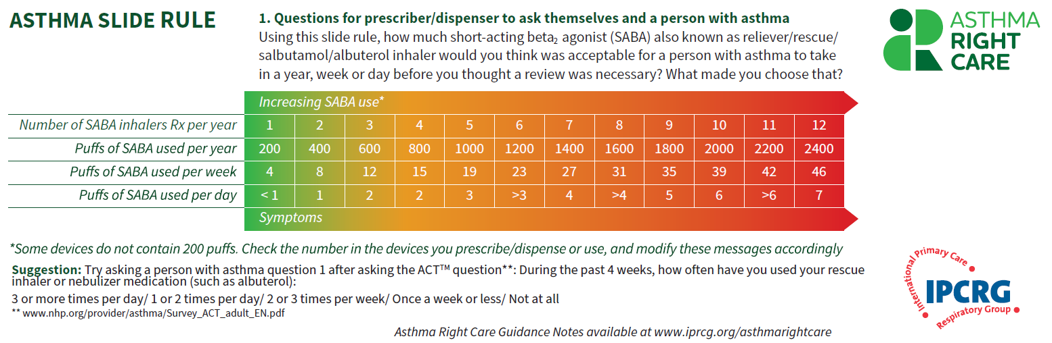
Asthma Slide Rule Front

Slide 35
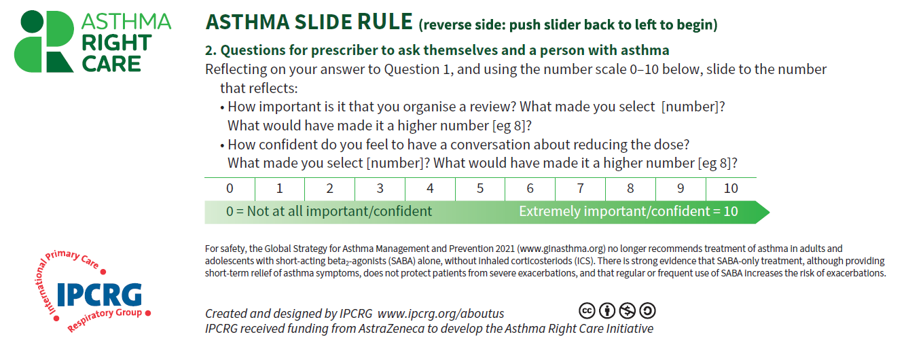
Asthma Slide Rule Back

Slide 36

Initiating challenging conversations

Slide 37
Management
The new plan
Obtain Marc’s agreement to take his medications as prescribed
Provide Marc with a written action plan that has been developed and agreed on together

Slide 38
Written Personalised Asthma Action Plan (PAAP)
Written PAAP
A written PAAP is an essential part of managing long-term disease¹
SIGN-BTS recommend that all people with asthma should be offered self-management education which includes a written AAP²
  In addition, GINA also highlights the importance of supporting long-term asthma management³
  These recommendations are based on literature reviews that show that supported PAAPs improve asthma control, reduce exacerbations and improve quality of life^{2,3}
Why are they useful?
  Pinpoint signs that the asthma is getting worse⁴
  Keep track of when to take medicines⁴
  Aid daily monitoring as well as long-term control⁴
  Provide information on what to do in the event of an asthma attack⁴
  The overall aim of a written PAAP is to help take early action to prevent or reduce the severity of asthma attack symptoms⁴
GINA, Global Initiative for Asthma; PAAP, personalised asthma action plan; SIGN-BTS, Scottish Intercollegiate Guidelines Network- British Thoracic Society.
1. Gibson PG, et al. Thorax 2004;59:94–99; 2. SIGN-BTS. British guideline on the management of asthma. Consultation 2016; 3. GINA Strategy for asthma management and prevention 2016; 4. Pinnock H. Breathe 2015;11:98–109.

Slide 39
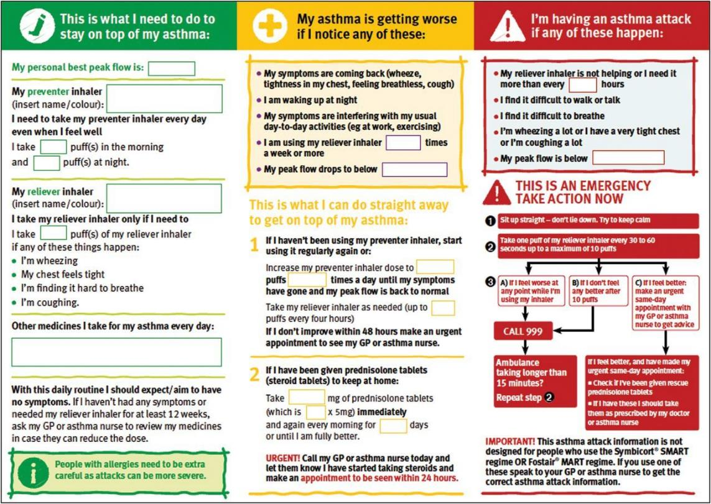
PAAP example for adults
Hilary Pinnock. Supported self-management for asthma. Breathe (Sheff). 2015 Jun; 11(2): 98–109. doi: 10.1183/20734735.015614 https://www.ncbi.nlm.nih.gov/pmc/articles/PMC4487370/pdf/EDU-0156-2014.pdf

Slide 40
Steps to help Marc live better with his asthma
Identify symptom triggers
Advise Marc not to smoke and to avoid smoky environments
Discuss the importance of maintenance ICS therapy with Marc
Recommend regular physical exercise
Suggest a review of inhaler technique at all future consultations

Slide 41
Asthma Right Care: a movement for Global Change
Movement for Global Change
IPCRG received funding from AstraZeneca to develop the Asthma Right Care Initiative

Slide 42
Every system is perfectly designed to get the results it gets
(Earl Conway and Paul Batalden)
Notes:
Both intended and unintended consequences are designed into our systems

Slide 43
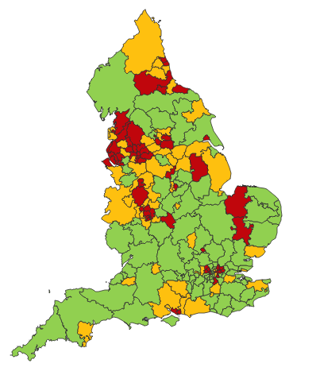

Making a case for change
Asthma illustrates all 5 global healthcare problems (Muir Gray):
Unwarranted variation
Harm, even when quality is high (over-diagnosis, over-treatment)
Failure to prevent disease and disability
Waste of human and physical resources through low value activity
Inequity
And new challenges are forming:
Financial constraints
Rising expectations of personalised care
Climate change/pollution
Increasing need
PHE Fingertips data Asthma admissions per 1000 population 2012/13 data
Notes:
Unwarranted variation as defined by Wennberg: Variation in utilization of health care services that cannot be explained by variation in patient illness or patient preferences
http://www.nhsconfed.org/~/media/Confederation/Files/Events/ACE15/1430%20Inaugural%20NHS%20value%20lecture.pdf

Slide 44
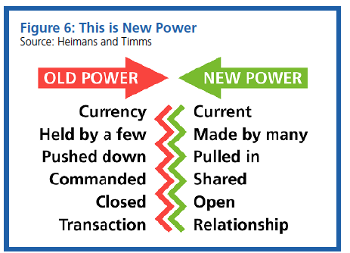
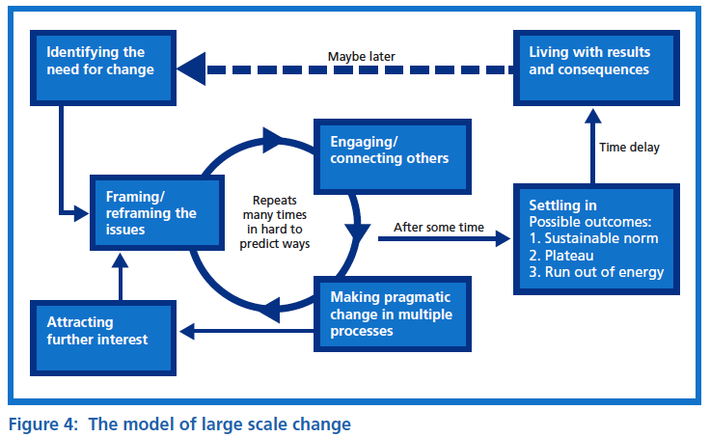
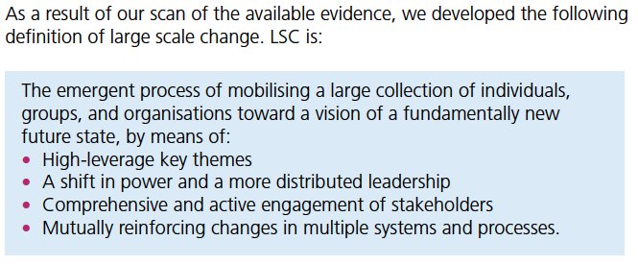

Leading large scale change: the evidence

Slide 45
What is Right Care?
Our working definitions
Doing the right things and only the right things in the right way for the right people at the right time in the right place, whatever that means in the local context
Improving the value that each person with asthma derives from their own care and treatment and the value the whole population derives from the investment in asthma care by addressing unwarranted variation; reducing waste, avoidable harm and avoidable symptoms

Slide 46
Aim
Scope
To sort asthma care once and for all for the person with asthma and for the healthcare system so that there is no unwarranted variation, and no avoidable waste or harm*.
That is
We can and should do better by getting it right first time!
The pathway from the first time someone (adult or parent) is offered a SABA, wherever that is, through to all possibilities (existing and new) for review
Phase 1: SABA use
*waste is waste of human, financial, health facility, energy and pharmacological assets.

Slide 47
Asthma Right Care as a social movement
It’s all about the FOLLOWERS: We need to get the right people engaged, who will connect through the right channels to engage the maximum numbers of followers who are inspired to do something different: to reduce reliance on short-acting beta-agonists, and to increase faith in and use of guideline-indicated effective medicines

Slide 48

Getting our social movement going
Sept 2017
May 2018
Kick starting action
Emerging and building momentum
  Nurturing voices
  Cultivating diverse interests and motivations
2
Steering Group formed and meets
3
Influencing and interacting
Navigating a complex array of relationships
National Champions Identified
SCALING UP
Delivery Team meeting
Delivery Team meeting
Delivery Team meeting
Delivery Team meeting
Symposium
Pervasiveness: affect all or just part of system?
National Steering Group Stakeholder
Mapping
Invitation UK
National Design Charrette
Pilot Phase
National Steering Group Stakeholder
Mapping
Invitation Portugal
National Design Charrette
Pilot Phase
Depth: ways of thinking and doing – cognitive, behavioural or paradigm shift?
Size: number
of people, geography
National Steering Group Stakeholder
Mapping
Invitation Canada
National Design Charrette
Pilot Phase
National Steering Group Stakeholder
Mapping
Invitation Spain
National Design Charrette
Pilot Phase
Notes:
References:
Nesta 2017. We change the world: what can we learn from global social movements for health?
NHS England. Sustainable Improvement and Horizons Team 2017. Leading large scale change: a practical guide.

Slide 49

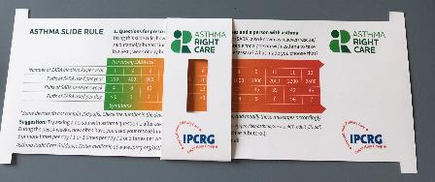
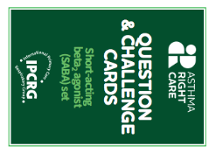
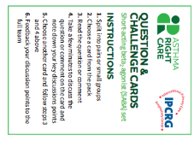
Kickstarting action
Emerging and building momentum
2
  Nurturing voices
  Cultivating diverse interests and motivations
3
Influencing and interacting
Navigating a complex array of relationships
Netherlands, Greece
France Vietnam
ENVIRONMENT
Propellant & Plastic
INFORMATION
Coding
Public Information
MEDICINES
ICS: SABA Ratio
Inhaler Use
New Cultures
& Languages
Mexico Brazil
Ireland Saudi Arabia
6 drivers in asthma health system
More parts of health system
More
geographies
Original 4
UK & Canada
Spain
Portugal
WORKFORCE
GPs / Pharmacist / Nurses
FINANCE & LEADERSHIP
PERSONAL
Networking
Policy Briefing
Going deeper:
Paradigm / behaviour shift
Unconscious Incompetence
Asthma Slide Rule & Question Cards
Conscious Incompetence: what could I do better?
Conscious Competence
Regional Teach The Teacher Master Classes to create trusted regional master teachers
What is right care?
Unconscious Competence
Mastery: Conscious Competence of Unconscious Incompetence

Slide 50
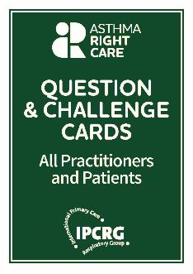
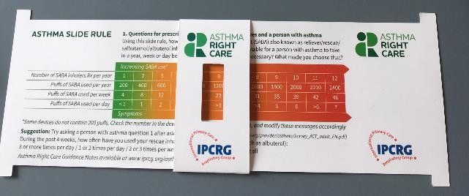
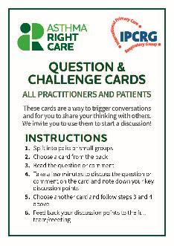
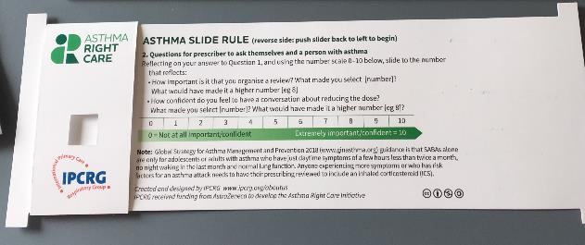
Prototype conversation pieces for discussion and co-creation in the design charrettes
Hunch 1: Lack of knowledge about how many puffs or doses in an inhaler and how many is too many in a year
Hunch 2: Pharmacists keen to do more but out of date “take your blue inhaler to open up your airways” – reveals no investment in education since this was the norm
Hunch 3: General practitioners/family physicians keen to emphasise art rather than science of the consultation, and so not up-to-date with guidelines eg “What’s the probability of them having asthma?” not routine question yet
Ambition: Embrace more people, more methods, bring joy to lives: let’s have fun, while being challenging

Slide 51
What has Asthma Right Care changed for you?
It has changed my approach to leading a large scale change for asthma management. It means to move towards a new vision that is better and fundamentally different from the Status Quo. This Project has pointed me in the right direction for creating and sustaining large scale change and transformation.This framework helps us to increase personal value, value for the population and rates of higher value intervention.
Mar Martinez, GP
ARC is changing our lives because we are reflecting about our work quality in a biopsychosocial dimension while we try to make every single step to provide all the asthma right care to patients and caregivers reconciling it with daily work. At the same time it is incredible how we can apply this knowledge to other diseases and procedures.
Teamwork is very rewarding, making us grow as a person and as a healthcare professional.
Cláudia Vicente, GP

Slide 52


Slide 53
What can you commit to?
Act now!
Find out more at www.ipcrg.org/asthmarightcare
IPCRG received funding from AstraZeneca to develop the Asthma Right Care Initiative

Slide 54
Additional resources

Slide 55
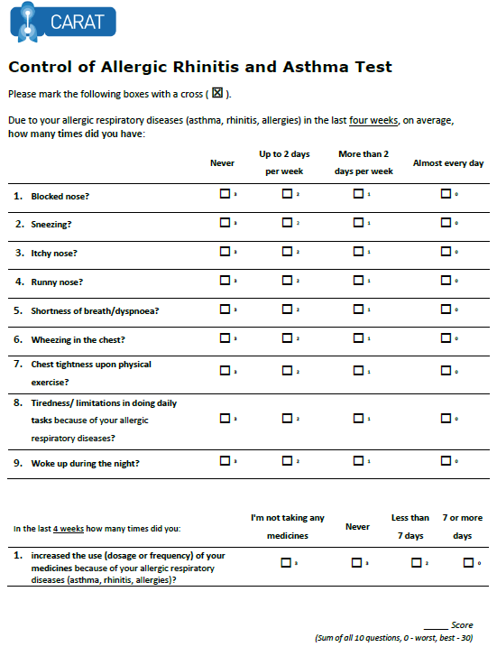
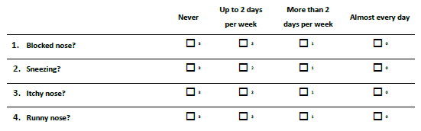
x
x
x
x
x
x
x
x
x
x
x
x
22
x
x
Lourenço O, Calado S, Sá-Sousa A, Fonseca J. Evaluation of allergic rhinitis and asthma control in a Portuguese community pharmacy setting. J Manag Care Spec Pharm. 2014 May;20(5):513-22. http://www.amcp.org/WorkArea/DownloadAsset.aspx?id=18027
CARAT, Control of Allergic Rhinitis and Asthma Test
Available at: https://www.new.caratnetwork.org. Accessed October 2022.
Notes:
CARAT has 10 questions that ask about symptoms during the previous 4 weeks (Table 1). CARAT total score (CARAT-t) ranges from 0 to 30, with a score higher than 24 indicating good overall control. The questionnaire is further divided into 2 sections: the first section relates to allergic rhinitis (CARAT-r), with a score range of 0 to 12 and a value higher than 8 identifying controlled AR; the second section relates to asthma (CARAT-a), with a score range of 0 to 18 and a value of 16 or higher identifying controlled asthma. So:
Total score ≥ 24 (good overall control)
A score ≥ 8 in questions 1 to 4 (good control for upper airways)
A score ≥ 16 in questions 5 to 10 (good control for lower airways)
People in English speaking countries might prefer to use an ACT score instead of CARAT. It’s OK to provide that alternative.

Slide 56
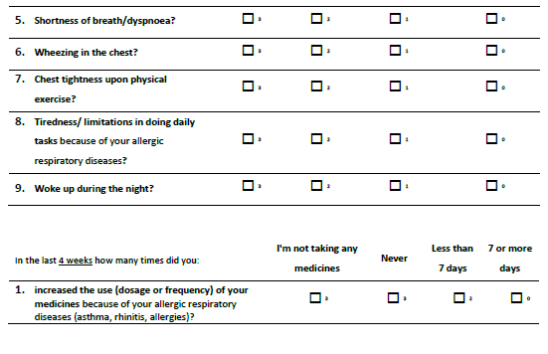
x
x
x
x
x
x
x
x
x
x
x
x
x
x
x
22
x
Lourenço O, Calado S, Sá-Sousa A, Fonseca J. Evaluation of allergic rhinitis and asthma control in a Portuguese community pharmacy setting. J Manag Care Spec Pharm. 2014 May;20(5):513-22. http://www.amcp.org/WorkArea/DownloadAsset.aspx?id=18027
CARAT, Control of Allergic Rhinitis and Asthma Test
Available at: https://www.new.caratnetwork.org. Accessed October 2022.
Notes:
CARAT has 10 questions that ask about symptoms during the previous 4 weeks (Table 1). CARAT total score (CARAT-t) ranges from 0 to 30, with a score higher than 24 indicating good overall control. The questionnaire is further divided into 2 sections: the first section relates to allergic rhinitis (CARAT-r), with a score range of 0 to 12 and a value higher than 8 identifying controlled AR; the second section relates to asthma (CARAT-a), with a score range of 0 to 18 and a value of 16 or higher identifying controlled asthma. So:
Total score ≥ 24 (good overall control)
A score ≥ 8 in questions 1 to 4 (good control for upper airways)
A score ≥ 16 in questions 5 to 10 (good control for lower airways)
People in English speaking countries might prefer to use an ACT score instead of CARAT. It’s OK to provide that alternative.

Slide 57
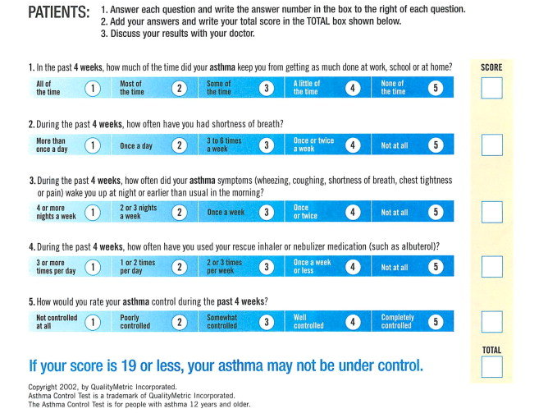
ACT: Asthma Control Questionnaire
Available at: https://www.asthmacontroltest.com/. Accessed October 2022.

Slide 58
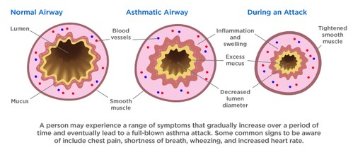
Asthma is an inflammatory disease
Asthma is a chronic inflammatory disease of the airways leading to bronchial constriction
HealthCentral. Anatomy of an asthma attack. Available at: https://www.healthcentral.com/article/anatomy-of-an-asthma-attack-infographic?ap=2012

Slide 59
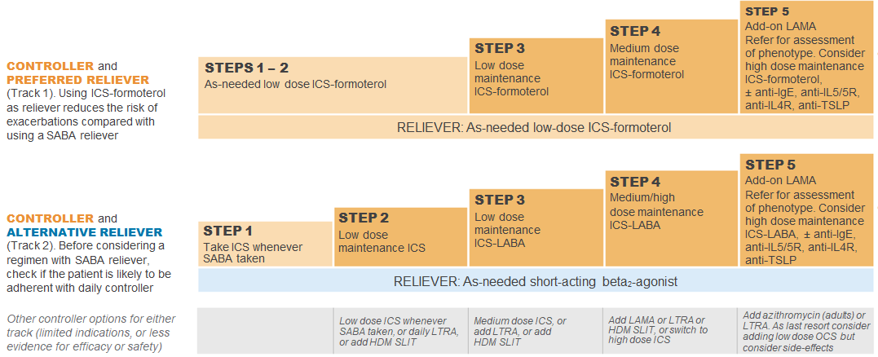
GINA 2022: Step 3
Preferred controller: Low dose ICS-formoterol maintenance plus as-needed SABA, OR low dose ICS-LABA maintenance and reliever therapy
For children aged 6-11 years the preferred controller is medium dose ICS or low dose ICS-LABA
HDM SLIT, house dust mite sublingual immunotherapy; ICS, inhaled corticosteroid; LABA, long-acting bronchodilator; LTRA, leukotrine receptor antagonist;
SABA, short-acting beta₂-agonist.
Available at: www.gina.com. Accessed October 2022.

Slide 60
GINA 2022: Step 4
Preferred controller: Medium dose ICS-formoterol as maintenance and reliever therapy, OR medium/high dose ICS-LABA maintenance plus as-needed SABA
Other controller options:
  Add-on tiotropium by mist inhaler for patients ≥6 years with a history of exacerbations
  Add-on LTRA
  Increasing to high dose ICS-LABA
Children aged 6-11 years: Continue controller, and refer for expert advice
HDM SLIT, house dust mite sublingual immunotherapy; ICS, inhaled corticosteroid; LABA, long-acting bronchodilator; LAMA, long-acting muscarinic antagonist;
LTRA, leukotrine receptor antagonist; SABA, short-acting beta₂-agonist.
Available at: www.gina.com. Accessed October 2022.

Slide 61
GINA 2022: Step 5
Add-on LAMA and refer for phenotypic investigation ± add-on treatment
Consider high-dose maintencen ICS-formoterol ± biologic therapy
Other controller options:
  Azithromycin (adults) or LTRA
  Low dose OCS (last resort) but consider side effects
ICS, inhaled corticosteroid; LABA, long-acting bronchodilator; LAMA, long-acting muscarinic antagonist; SABA, short-acting beta₂-agonist; SC; subcutaneous.
Available at: www.gina.com. Accessed October 2022.

