Slide 1
Asthma Case Studies
Transition From Paediatric to Adult Asthma
IPCRG received funding from AstraZeneca to develop the Asthma Right Care Initiative

Slide 2
About these slides
Please feel free to use, update and share some or all of these slides in your non-commercial presentations to colleagues or patients
The slides are provided under creative commons licence CC BY-NC-ND.
  BY stands for attribution (the obligation to credit the author and other parties designated for attribution);
  NC stands for NonCommercial (commercial use is excluded from the licence grant);
  ND means NoDerivatives (only verbatim copies of the work can be shared)
When using our slides, please retain the source attribution: IPCRG 2022 Miguel Román-Rodriguez on behalf of the Asthma Right Care Team

Slide 3
What you will learn
The challenges associated with managing the adolescent patient with asthma
The importance of supporting self-management of enhancing an adolescent’s sense of control and independence
The role of SABA/ICS therapy for adolescent patients with asthma

Slide 4

The patient
Anna is 16 years old
She lives at home with her parents
She is in her 6th year of high school

Slide 5
General medical history
Anna was diagnosed with asthma during childhood
Her current prescribed regimen is:
  Beclomethasone 250 µg, 2 puffs BID
  Salbutamol as needed
Anna has seasonal allergic rhinitis (ragweed, birch pollen)
  Treated with desloratadine + intranasal mometasone furoate

Slide 6
Respiratory history
Her last ICS inhaler was issued 1.5 years ago
She has visited the emergency department twice in the last
2 years

Slide 7
Current presentation
Anna has been experiencing severe asthma symptoms for
the last 4-7 days
  Continuously wheezing
  Persistent cough
  Dyspnoea
She has tried to avoid coming to see you but is now feeling
really unwell

Slide 8
Clinical considerations
Medication use
Anna tells you she has been taking >12 puffs/day of salbutamol for the last 2 weeks
Anna reports she is not taking any maintenance medication for her asthma

Slide 9
Reasons for poor asthma control
Wrong diagnosis or confounding illness
Incorrect choice of inhaler or poor technique
Concurrent smoking
Concomitant rhinitis
Unintentional or intentional nonadherence
Individual variation in treatment response
Under treatment

Slide 10
Clinical considerations
Initial examination
Anna cannot complete full sentences
She has expiratory wheeze
Her O₂ saturation is 95%
Her PEF is 250 L/min (45% of her best personal value)
You prescribe nebulized salbutamol for Anna as an immediate treatment

Slide 11
What are your immediate reactions to Anna’s current presentation?
Anna is having an asthma flare and needs oral corticosteroids
Anna is having an asthma flare and needs to go straight to the emergency department
Anna needs to step up her maintenance treatment to formoterol/budesonide combination
Anna may have a chest infection
Anna needs to start taking her maintenance therapy regularly
(there may be more than one right answer)

Slide 12
Clinical considerations
Review of medical records
At her last scheduled primary care visit 2 years ago, Anna was not smoking and her mother was happy and felt Anna was coping perfectly with her asthma
  No asthma symptoms
  Salbutamol us <2-3 times a week
  ACT score 23
  No exacerbations in the previous 3 years
  Spirometry: FEV₁ 85% of predicted, PEF 520 L/min
  BMI 22
  Good adherence, taking >80% of prescribed doses
Anna was last seen by a paediatrician 2 years ago and has not seen a primary care team member since then; she does not know her current primary care physician or nurse

Slide 13
Clinical considerations
What has changed in the last 2 years?
While Anna is receiving her nebulizer you speak with Anna’s mother who reports that:
  Anna has been smoking “not much, but regularly”
  No longer participates in sport and has gained weight
  Anna is difficult to control and will not take her parents advice
  She never speaks about her asthma but uses salbutamol compulsively
  …Anna is not adhering to her maintenance treatment and you decide Anna’s asthma is poorly controlled

Slide 14
What has changed during these 2 years?
THE PAST | THE PRESENT
Does sport | Does no sport
No smoking | Smoking
Good adherence | Poor adherence
Follow-up visits | No follow-up visits
Infrequent salbutamol use | Compulsive salbutamol use
Asthma controlled | Asthma uncontrolled
No exacerbations | Exacerbations

Slide 15
Adolescence is a challenging time for the management of chronic conditions
Physiological changes
Psychological challenges
Life-style changes
Poor medication adherence

Slide 16
Asthma in adolescents
Physiological changes
Hormonal changes can affect asthma control
  More boys than girls experience remission of asthma during adolescence
Early puberty has been reported to be an independent risk factor for the persistence of asthma into adolescence, and for the severity of asthma in adulthood
Increased BMI in girls has been associated with both early puberty and increased asthma risk
Bender BG. Am J Respir Crit Care Med 2006; 173: 953-957.

Slide 17
Asthma in adolescents
Psychological challenges
An adolescent’s age is not a reliable indicator of cognitive, emotional or social maturity
Adolescents may deny or disregard asthma symptoms
Adolescents’ concerns about confidentiality may prevent them using health care services
Mental health disorders are common among young people
  Psychological distress is common (e.g. feelings of hopelessness or recent loss)
  A significant proportion of adult mental health problems emerge during adolescence
Bender BG. Am J Respir Crit Care Med 2006; 173: 953-957.

Slide 18
Asthma in adolescents
Life-style changes
Adolescence is a time when people can begin risky behaviour which can continue into adulthood:¹
  Smoking: Among adolescent boys, those with lower quality of life are most likely to start smoking.
  Drug and alcohol use
  Poor eating habits
  Physical inactivity
Life events (new school, moving house) and family problems¹
Adolescents with chronic disease show higher rates of health risk behaviours than healthy adolescents¹
Specific intervention to address risk factors such as smoking, alcohol consumption and obesity can be effective in reducing premature mortality²
1. Bender BG. Am J Respir Crit Care Med 2006; 173: 953-957; 2. Watkins D, et al. BMJ Global Health 2019;4:e001335.

Slide 19
Asthma in adolescents
Poor medication adherence
Poor adherence to treatment is common
  Depression, risk-taking behaviour and poor adherence to medicines are interrelated
Adolescents with asthma who adhere poorly to asthma treatment and hide their asthma are more likely to start smoking than other adolescents with asthma
Bender BG. Am J Respir Crit Care Med 2006; 173: 953-957.

Slide 20
Asthma management in adolescents
Confirm the diagnosis if possible
Consider whether exercise-related symptoms may be due to a non-asthma cause
Consider psychosocial and behavioural factors such as non-adherence to preventer medicines, smoking or exposure to other people’s tobacco smoke
Consider possible hormonal management if flare-ups are affected by the menstrual cycle
Plan regular asthma review as for adults in a primary care physician who treats adults
Explain to young people that asthma medicines do not have any effects on sexual activity
Discuss the transition and check that the adolescent is satisfied with the adult services
Explore barriers for proper adherence and motivating factors
Consider step-down for adolescents taking regular inhaled corticosteroid whose asthma has been well controlled for at least 3 months
Available at: http://www.asthmahandbook.org.au/populations/adolescents/.

Slide 21
Management
The new plan
You initiate guideline-based treatment for the management of an asthma exacerbation and prescribe oral corticosteroids
You prescribe a combination SABA/ICS inhaler
You schedule a follow-up visit in 24 hours

Slide 22
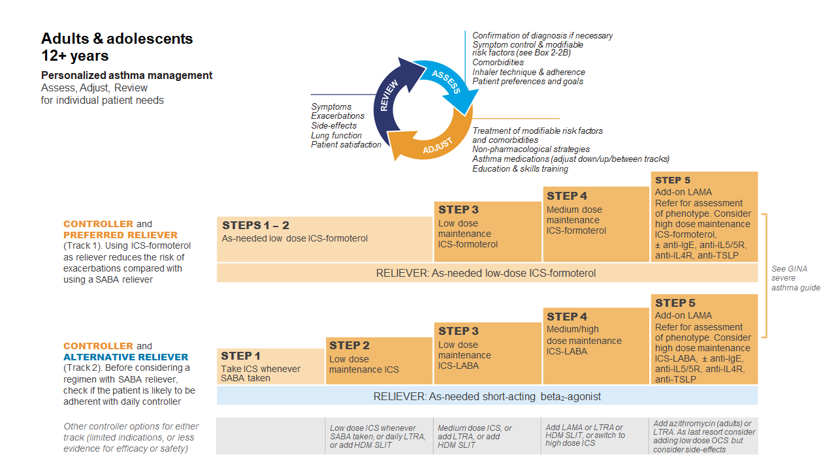
GINA 2022
Available at: www.gina.com. Accessed October 2022.

Slide 23
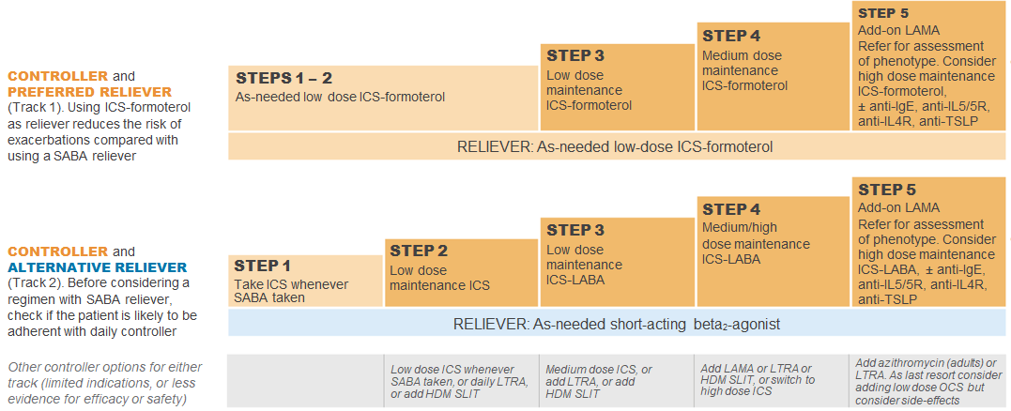
GINA 2022: Step 4
Preferred controller: Medium dose ICS-formoterol as maintenance and reliever therapy, OR medium/high dose ICS-LABA maintenance plus as-needed SABA
Other controller options:
  Add-on tiotropium by mist inhaler for patients ≥6 years with a history of exacerbations
  Add-on LTRA
  Increasing to high dose ICS-LABA
Children aged 6-11 years: Continue controller, and refer for expert advice
HDM SLIT, house dust mite sublingual immunotherapy; ICS, inhaled corticosteroid; LABA, long-acting bronchodilator; LAMA, long-acting muscarinic antagonist;
LTRA, leukotrine receptor antagonist; SABA, short-acting beta₂-agonist.
Available at: www.gina.com. Accessed October 2022.

Slide 24
At the follow-up visit 24-hours later
Explore Anna’s over reliance on SABA and help Anna understand the need for maintenance treatment
Offer self-management support and aim to enhance Anna’s sense of control and independence
Explore motivation for tobacco cessation
Explore possible mental disorders

Slide 25
Self-management support
Ensure Anna has a written asthma action plan appropriate to her age and self-management capability
Encourage self-management and provide support and education. Repeat the key information at each visit
Explore whether new technology is appropriate
  Text message reminders
  Online information
  Electronic written asthma action plan and direct them to appropriate resources and programs (e.g. peer-led asthma education, if available)

Slide 26
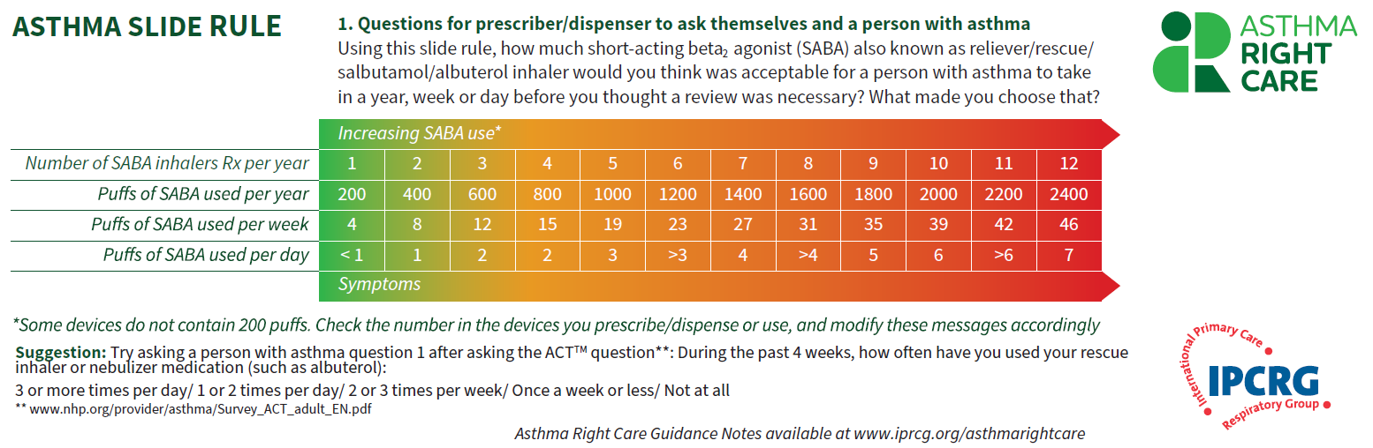
Asthma Slide Rule Front

Slide 27
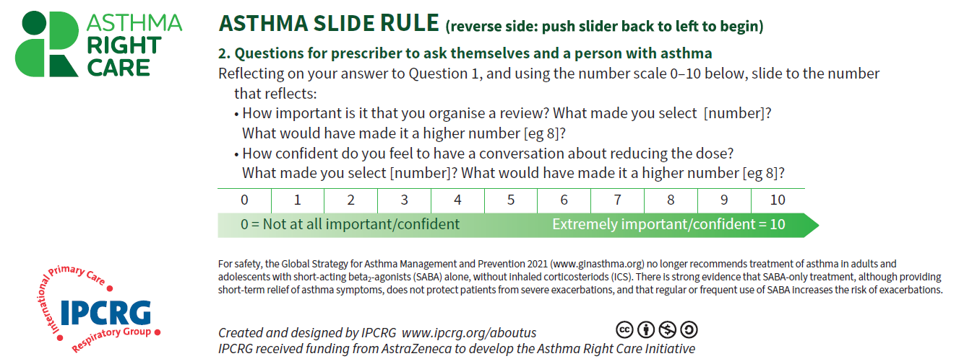
Asthma Slide Rule Back

Slide 28

Initiating challenging conversations

Slide 29
Written Personalised Asthma Action Plan (PAAP)
Written PAAP
A written PAAP is an essential part of managing long-term disease¹
SIGN-BTS recommend that all people with asthma should be offered self-management education which includes a written AAP²
  In addition, GINA also highlights the importance of supporting long-term asthma management³
  These recommendations are based on literature reviews that show that supported PAAPs improve asthma control, reduce exacerbations and improve quality of life^{2,3}
Why are they useful?
  Pinpoint signs that the asthma is getting worse⁴
  Keep track of when to take medicines⁴
  Aid daily monitoring as well as long-term control⁴
  Provide information on what to do in the event of an asthma attack⁴
  The overall aim of a written PAAP is to help take early action to prevent or reduce the severity of asthma attack symptoms⁴
GINA, Global Initiative for Asthma; PAAP, personalised asthma action plan; SIGN-BTS, Scottish Intercollegiate Guidelines Network- British Thoracic Society.
1. Gibson PG, et al. Thorax 2004;59:94–99; 2. SIGN-BTS. British guideline on the management of asthma. Consultation 2016; 3. GINA Strategy for asthma management and prevention 2016; 4. Pinnock H. Breathe 2015;11:98–109.

Slide 30
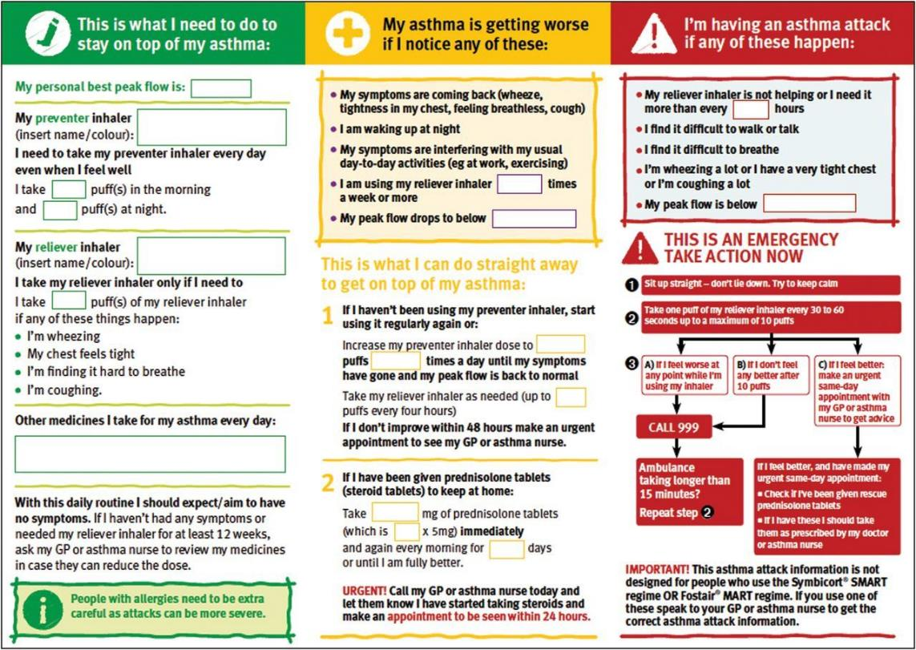
PAAP example for adults
Hilary Pinnock. Supported self-management for asthma. Breathe (Sheff). 2015 Jun; 11(2): 98–109. doi: 10.1183/20734735.015614 https://www.ncbi.nlm.nih.gov/pmc/articles/PMC4487370/pdf/EDU-0156-2014.pdf

Slide 31
Steps to help Anna live better with her asthma
Arrange to see Anna alone with no parents around
Discuss confidentiality with her
Discuss the risks associated with smoking and other risky behaviours with her
Assess Anna for the presence of mental health disorders
Arrange follow-up visits to monitoring Anna so that her medicines can be adjusted at the lowest effective doses
Take an open, non-judgemental approach to assessing and discussing Anna’s adherence to her medicine

Slide 32

Adolescent transition programs
"A purposeful, planned process that addresses the medical, psychosocial and educational/vocational needs of adolescents and young adults with chronic physical and medical conditions as they move from child-centred to adult-oriented health care systems"
Available at: https://www.rch.org.au/transition/for_health_professionals/For_Health_Professionals/
.

Slide 33
The aims of transition
Provide high quality, coordinated, uninterrupted health care that is patient-centred, age and developmentally appropriate and culturally competent, flexible, responsive and comprehensive with respect to all persons involved
Promote skills in communication, decision-making, assertiveness and self-care, self-determination and self-advocacy
Enhance the young person's sense of control and independence
Provide support and guidance for the parent/carer of the young person
To maximize life-long functioning and potential
Available at: https://www.rch.org.au/transition/for_health_professionals/For_Health_Professionals/
.

Slide 34
Asthma Right Care: a movement for Global Change
Movement for Global Change
IPCRG received funding from AstraZeneca to develop the Asthma Right Care Initiative

Slide 35
Every system is perfectly designed to get the results it gets
(Earl Conway and Paul Batalden)
Notes:
Both intended and unintended consequences are designed into our systems

Slide 36
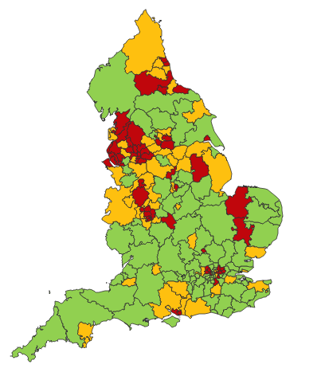

Making a case for change
Asthma illustrates all 5 global healthcare problems (Muir Gray):
Unwarranted variation
Harm, even when quality is high (over-diagnosis, over-treatment)
Failure to prevent disease and disability
Waste of human and physical resources through low value activity
Inequity
And new challenges are forming:
Financial constraints
Rising expectations of personalised care
Climate change/pollution
Increasing need
PHE Fingertips data Asthma admissions per 1000 population 2012/13 data
Notes:
Unwarranted variation as defined by Wennberg: Variation in utilization of health care services that cannot be explained by variation in patient illness or patient preferences
http://www.nhsconfed.org/~/media/Confederation/Files/Events/ACE15/1430%20Inaugural%20NHS%20value%20lecture.pdf

Slide 37
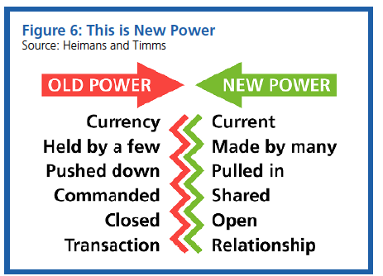
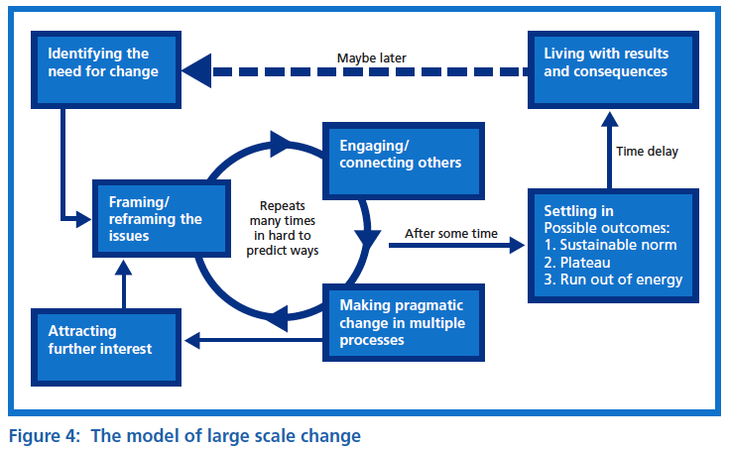
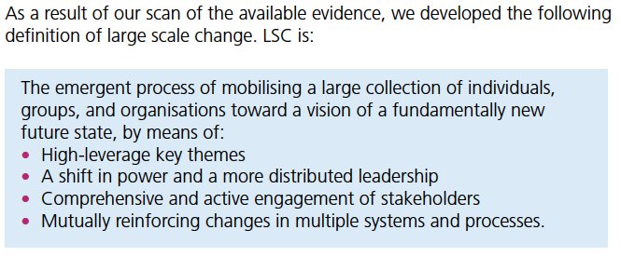

Leading large scale change: the evidence

Slide 38
What is Right Care?
Our working definitions
Doing the right things and only the right things in the right way for the right people at the right time in the right place, whatever that means in the local context
Improving the value that each person with asthma derives from their own care and treatment and the value the whole population derives from the investment in asthma care by addressing unwarranted variation; reducing waste, avoidable harm and avoidable symptoms

Slide 39
Aim
Scope
To sort asthma care once and for all for the person with asthma and for the healthcare system so that there is no unwarranted variation, and no avoidable waste or harm*.
That is
We can and should do better by getting it right first time!
The pathway from the first time someone (adult or parent) is offered a SABA, wherever that is, through to all possibilities (existing and new) for review
Phase 1: SABA use
*waste is waste of human, financial, health facility, energy and pharmacological assets.

Slide 40
Asthma Right Care as a social movement
It’s all about the FOLLOWERS: We need to get the right people engaged, who will connect through the right channels to engage the maximum numbers of followers who are inspired to do something different: to reduce reliance on short-acting beta-agonists, and to increase faith in and use of guideline-indicated effective medicines

Slide 41

Getting our social movement going
Sept 2017
May 2018
Kick starting action
Emerging and building momentum
  Nurturing voices
  Cultivating diverse interests and motivations
2
Steering Group formed and meets
3
Influencing and interacting
Navigating a complex array of relationships
National Champions Identified
SCALING UP
Delivery Team meeting
Delivery Team meeting
Delivery Team meeting
Delivery Team meeting
Symposium
Pervasiveness: affect all or just part of system?
National Steering Group Stakeholder
Mapping
Invitation UK
National Design Charrette
Pilot Phase
National Steering Group Stakeholder
Mapping
Invitation Portugal
National Design Charrette
Pilot Phase
Depth: ways of thinking and doing – cognitive, behavioural or paradigm shift?
Size: number
of people, geography
National Steering Group Stakeholder
Mapping
Invitation Canada
National Design Charrette
Pilot Phase
National Steering Group Stakeholder
Mapping
Invitation Spain
National Design Charrette
Pilot Phase
Notes:
References:
Nesta 2017. We change the world: what can we learn from global social movements for health?
NHS England. Sustainable Improvement and Horizons Team 2017. Leading large scale change: a practical guide.

Slide 42

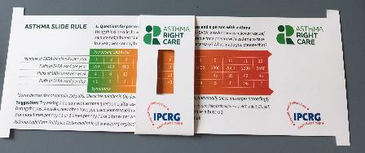
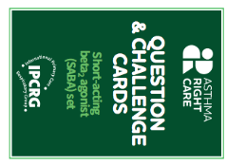
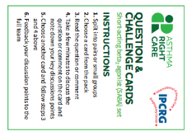
Kickstarting action
Emerging and building momentum
2
  Nurturing voices
  Cultivating diverse interests and motivations
3
Influencing and interacting
Navigating a complex array of relationships
Netherlands, Greece
France Vietnam
ENVIRONMENT
Propellant & Plastic
INFORMATION
Coding
Public Information
MEDICINES
ICS: SABA Ratio
Inhaler Use
New Cultures
& Languages
Mexico Brazil
Ireland Saudi Arabia
6 drivers in asthma health system
More parts of health system
More
geographies
Original 4
UK & Canada
Spain
Portugal
WORKFORCE
GPs / Pharmacist / Nurses
FINANCE & LEADERSHIP
PERSONAL
Networking
Policy Briefing
Going deeper:
Paradigm / behaviour shift
Unconscious Incompetence
Asthma Slide Rule & Question Cards
Conscious Incompetence: what could I do better?
Conscious Competence
Regional Teach The Teacher Master Classes to create trusted regional master teachers
What is right care?
Unconscious Competence
Mastery: Conscious Competence of Unconscious Incompetence

Slide 43
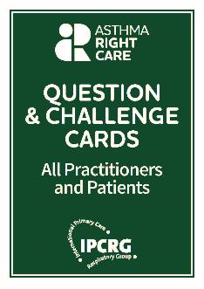
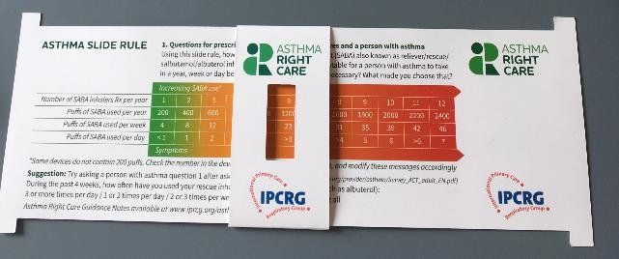
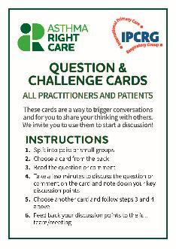
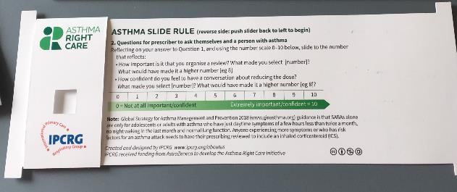
Prototype conversation pieces for discussion and co-creation in the design charrettes
Hunch 1: Lack of knowledge about how many puffs or doses in an inhaler and how many is too many in a year
Hunch 2: Pharmacists keen to do more but out of date “take your blue inhaler to open up your airways” – reveals no investment in education since this was the norm
Hunch 3: General practitioners/family physicians keen to emphasise art rather than science of the consultation, and so not up-to-date with guidelines eg “What’s the probability of them having asthma?” not routine question yet
Ambition: Embrace more people, more methods, bring joy to lives: let’s have fun, while being challenging

Slide 44
What has Asthma Right Care changed for you?
It has changed my approach to leading a large scale change for asthma management. It means to move towards a new vision that is better and fundamentally different from the Status Quo. This Project has pointed me in the right direction for creating and sustaining large scale change and transformation.This framework helps us to increase personal value, value for the population and rates of higher value intervention.
Mar Martinez, GP
ARC is changing our lives because we are reflecting about our work quality in a biopsychosocial dimension while we try to make every single step to provide all the asthma right care to patients and caregivers reconciling it with daily work. At the same time it is incredible how we can apply this knowledge to other diseases and procedures.
Teamwork is very rewarding, making us grow as a person and as a healthcare professional.
Cláudia Vicente, GP

Slide 45
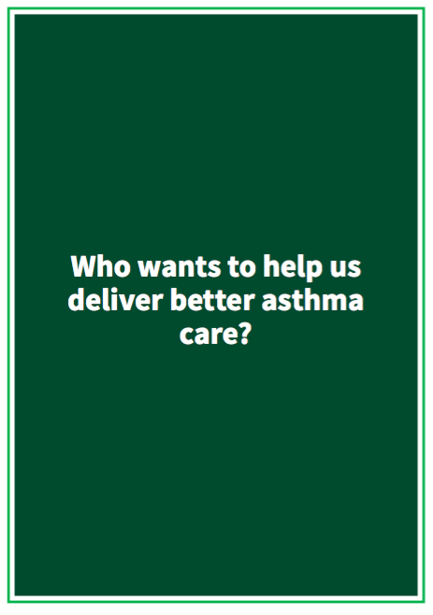

Slide 46
What can you commit to?
Act now!
Find out more at www.ipcrg.org/asthmarightcare
IPCRG received funding from AstraZeneca to develop the Asthma Right Care Initiative

Slide 47
Additional resources

Slide 48
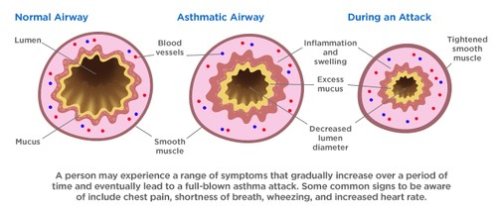
Asthma is an inflammatory disease
Asthma is a chronic inflammatory disease of the airways leading to bronchial constriction
HealthCentral. Anatomy of an asthma attack. Available at: https://www.healthcentral.com/article/anatomy-of-an-asthma-attack-infographic?ap=2012

Slide 49
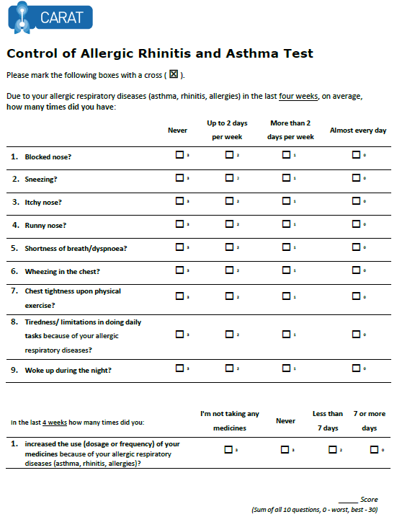
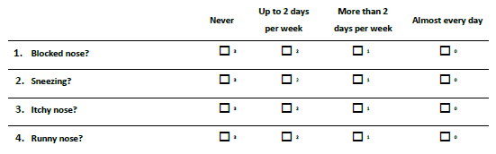
x
x
x
x
x
x
x
x
x
x
x
x
22
x
x
Lourenço O, Calado S, Sá-Sousa A, Fonseca J. Evaluation of allergic rhinitis and asthma control in a Portuguese community pharmacy setting. J Manag Care Spec Pharm. 2014 May;20(5):513-22. http://www.amcp.org/WorkArea/DownloadAsset.aspx?id=18027
CARAT, Control of Allergic Rhinitis and Asthma Test
Available at: https://www.new.caratnetwork.org. Accessed October 2022.
Notes:
CARAT has 10 questions that ask about symptoms during the previous 4 weeks (Table 1). CARAT total score (CARAT-t) ranges from 0 to 30, with a score higher than 24 indicating good overall control. The questionnaire is further divided into 2 sections: the first section relates to allergic rhinitis (CARAT-r), with a score range of 0 to 12 and a value higher than 8 identifying controlled AR; the second section relates to asthma (CARAT-a), with a score range of 0 to 18 and a value of 16 or higher identifying controlled asthma. So:
Total score ≥ 24 (good overall control)
A score ≥ 8 in questions 1 to 4 (good control for upper airways)
A score ≥ 16 in questions 5 to 10 (good control for lower airways)
People in English speaking countries might prefer to use an ACT score instead of CARAT. It’s OK to provide that alternative.

Slide 50
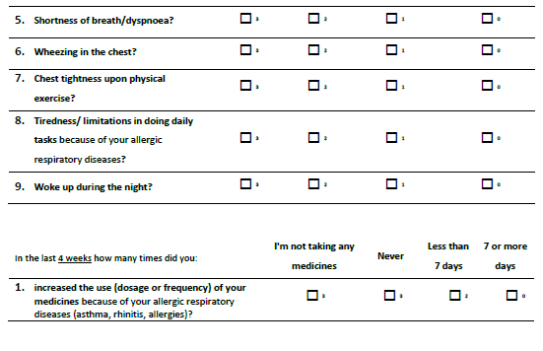
x
x
x
x
x
x
x
x
x
x
x
x
x
x
x
22
x
Lourenço O, Calado S, Sá-Sousa A, Fonseca J. Evaluation of allergic rhinitis and asthma control in a Portuguese community pharmacy setting. J Manag Care Spec Pharm. 2014 May;20(5):513-22. http://www.amcp.org/WorkArea/DownloadAsset.aspx?id=18027
CARAT, Control of Allergic Rhinitis and Asthma Test
Available at: https://www.new.caratnetwork.org. Accessed October 2022.
Notes:
CARAT has 10 questions that ask about symptoms during the previous 4 weeks (Table 1). CARAT total score (CARAT-t) ranges from 0 to 30, with a score higher than 24 indicating good overall control. The questionnaire is further divided into 2 sections: the first section relates to allergic rhinitis (CARAT-r), with a score range of 0 to 12 and a value higher than 8 identifying controlled AR; the second section relates to asthma (CARAT-a), with a score range of 0 to 18 and a value of 16 or higher identifying controlled asthma. So:
Total score ≥ 24 (good overall control)
A score ≥ 8 in questions 1 to 4 (good control for upper airways)
A score ≥ 16 in questions 5 to 10 (good control for lower airways)
People in English speaking countries might prefer to use an ACT score instead of CARAT. It’s OK to provide that alternative.

Slide 51
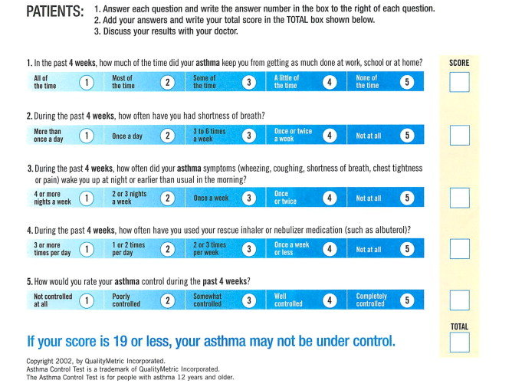
ACT: Asthma Control Questionnaire
Available at: https://www.asthmacontroltest.com/. Accessed October 2022.

Slide 52
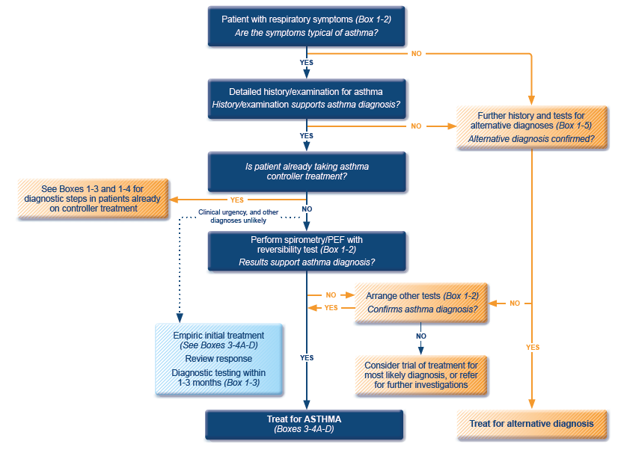
GINA 2022 guidelines for the diagnosis of asthma
ICS, inhaled corticosteroid; PEF, peak expiratory flow; SABA, short-acting beta₂-agonist.
Available at: www.gina.com. Accessed October 2022.

Slide 53
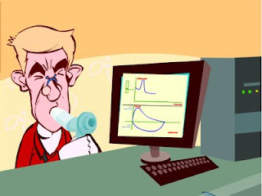
Spirometry
Spirometry measures airflow and lung volumes, and is the preferred lung function test for asthma in primary care
Forced exhalation from a maximal inspiration
FVC: Forced vital capacity | FEV1: Forced Expiratory Volume in 1 second | FEV1/FVC
Volume of air exhaled after full inspiration and full exhalation | Volume of air exhaled in the first second of forced exhalation | Ratio of vital capacity exhaled in 1 second expressed as a percentage of the total volume of air exhaled after full inspiration and full exhalation
For further guidance visit: http://bit.ly/IPCRG-SPIROMETRY-WONCA-2018

Slide 54
Spirometric patterns
FEV1/FVC
FVC
FEV1
Obstruction
N
Restriction
N
N
Mixed
Obstruction and hyperinflation
Mild Obstruction | FEV1 ≥80%
Moderate Obstruction | FEV1 <80% ≥50%
Severe Obstruction | FEV1 <50% ≥35%
Very Severe Obstruction | FEV1 <35%
For further guidance visit: http://bit.ly/IPCRG-SPIROMETRY-WONCA-2018

Slide 55
Quick spirometry assessment
FEV₁ /FVC
≥70%
Normal
<70%
Obstruction
FVC
FVC
< 80% ref value
<80% ref. value
≥80% ref value
Mixed pattern
≥80% ref value
OBSTRUCTION
+ HYPERINFLATION (↑VR)
NORMAL
RESTRICTION
OBSTRUCTION
OBSTRUCTION
+
RESTRICTION
(VR normal)
For further guidance visit: http://bit.ly/IPCRG-SPIROMETRY-WONCA-2018

Slide 56
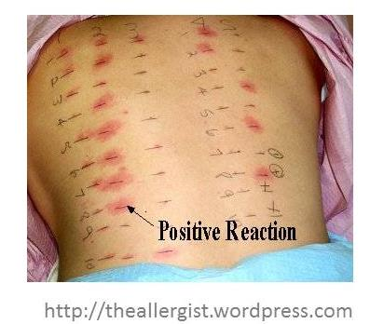
Allergy testing and how to interpret the results
Skin prick test is the most sensitive test for allergies
  Suspected allergens are mixed with liquid to form a solution
  Drops are placed on the skin surface
  The top surface of the skin is pricked beneath each drops
  A positive reaction is indicated by reddening, itch and swelling

Slide 57
How to review inhalation technique
Ask the patient beforehand to bring their own inhaler for the consultation
Ask them to demonstrate how they use their inhaler
Correct some aspects and explain why
If possible use videos
    Observe technique and let the patient observe self (using video demonstrations)
Show you are available to review their technique if necessary
Ask the patient to bring their own inhaler for the next appointment
Notes:
Resources for reviewing inhaler technique:
Asthma review series: Part 3 - Inhaler Technique and Recording Peak Flow. Available at: https://www.youtube.com/watch?v=ZhIcT57i32g
Asthma inhaler techniques (children). Available at: https://www.youtube.com/watch?v=fHcG8DXUwdQ
Asthma: inhaler techniques: Available at: https://www.nhs.uk/Video/Pages/Childrensasthmainhaler.aspx

Slide 58
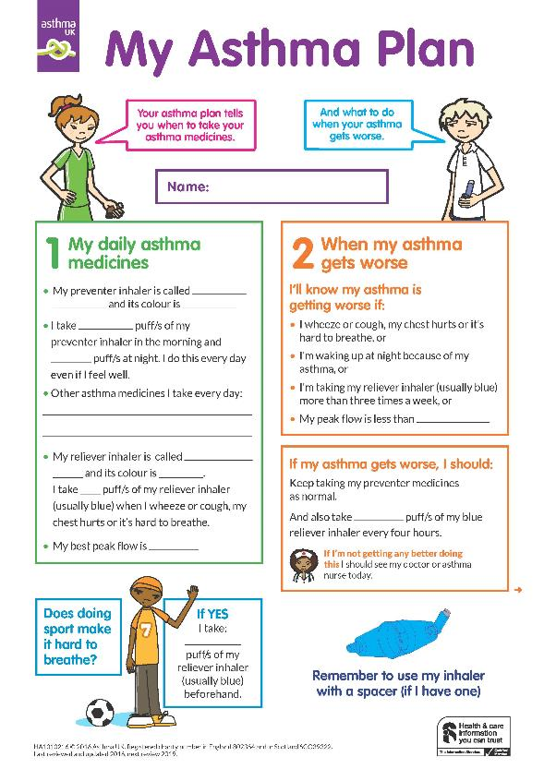
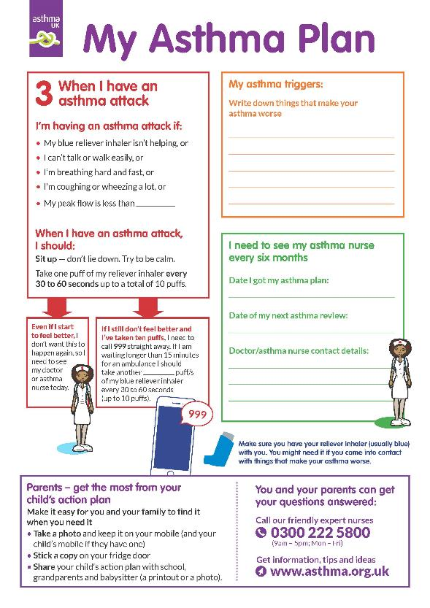
Child Asthma Action Plan
Child Asthma Action Plan
Available at: https://www.asthma.org.uk/def9655d/globalassets/health-advice/resources/children/child-asthma-action-plan.pdf . Accessed October 2022.

Slide 59
GINA 2022
Available at: www.gina.com. Accessed October 2022.

Slide 60
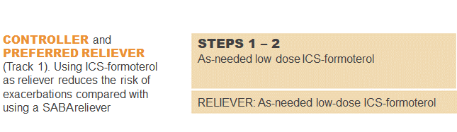
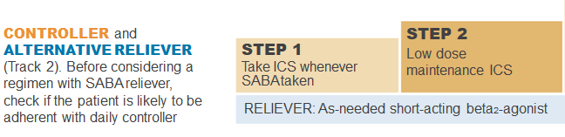
GINA 2022: Steps 1–2
Controller and preferred reliever:
As-needed low dose ICS-formoterol (off-label)
  Low dose ICS reduces symptoms and reduces risk of exacerbations and asthma-related hospitalization and death
Other controller options (Step 2):
  Low dose ICS taken whenever SABA is taken
  Leukotrine receptor antagonists
  Add house dust mite sublingual immunotherapy
ICS, inhaled corticosteroid; SABA, short-acting beta₂-agonist.
Available at: www.gina.com. Accessed October 2022.

Slide 61
GINA 2022: Step 3
Preferred controller: Low dose ICS-formoterol maintenance plus as-needed SABA, OR low dose ICS-LABA maintenance and reliever therapy
For children aged 6-11 years the preferred controller is medium dose ICS or low dose ICS-LABA
HDM SLIT, house dust mite sublingual immunotherapy; ICS, inhaled corticosteroid; LABA, long-acting bronchodilator; LTRA, leukotrine receptor antagonist;
SABA, short-acting beta₂-agonist.
Available at: www.gina.com. Accessed October 2022.

Slide 62
GINA 2022: Step 4
Preferred controller: Medium dose ICS-formoterol as maintenance and reliever therapy, OR medium/high dose ICS-LABA maintenance plus as-needed SABA
Other controller options:
  Add-on tiotropium by mist inhaler for patients ≥6 years with a history of exacerbations
  Add-on LTRA
  Increasing to high dose ICS-LABA
Children aged 6-11 years: Continue controller, and refer for expert advice
HDM SLIT, house dust mite sublingual immunotherapy; ICS, inhaled corticosteroid; LABA, long-acting bronchodilator; LAMA, long-acting muscarinic antagonist;
LTRA, leukotrine receptor antagonist; SABA, short-acting beta₂-agonist.
Available at: www.gina.com. Accessed October 2022.

Slide 63
GINA 2022: Step 5
Add-on LAMA and refer for phenotypic investigation ± add-on treatment
Consider high-dose maintencen ICS-formoterol ± biologic therapy
Other controller options:
  Azithromycin (adults) or LTRA
  Low dose OCS (last resort) but consider side effects
ICS, inhaled corticosteroid; LABA, long-acting bronchodilator; LAMA, long-acting muscarinic antagonist; SABA, short-acting beta₂-agonist; SC; subcutaneous.
Available at: www.gina.com. Accessed October 2022.

Slide 64








Key asthma triggers
Psychological
triggers³
Air pollution¹
Medications*³
Exposure to bacteria²
House dust mites⁶
Smoking^{3,4}
Flowers/pollen³
Household pets^{3,4}
Exercise⁵
Alcohol³
Air-conditioning³
URTI³
URTI = upper respiratory tract infection
*Beta-blockers and non-steroidal anti-inflammatory drugs.
1. Esposito S, et al. BMC Pulm Med 2014;14:130; 2. Beigelman A, et al. Curr Opin Allergy Clin Immunol 2014;14:137–142; 3. See K, et al. Singapore Med J 2015 epub; 4. Vernon M, et al. J Asthma 2012;49:991–998; 5. Global Initiative for Asthma. Global Strategy for Asthma Management and Prevention, 2016. Available from: www.ginasthma.org; 6. Lim FL, et al. PLoS One 2015;10:e0124905.

Slide 65
SABA overuse:
An indicator of poor control (1)
UK National Review of Asthma Deaths 2012 to 2013
39% people on SABA at time of death had been prescribed more than 12 in the year before they died
  4% had been prescribed >50 SABA inhalers
  Those prescribed >12 were likely to have had poorly
  controlled asthma
National Review of Asthma Deaths: Available at: https://www.rcplondon.ac.uk/projects/national-review-asthma-deaths. Accessed October 2022.

Slide 66
SABA overuse:
An indicator of poor control (2)
“There is a progressive risk of hospital admission associated with the prescription of more than three SABA inhalers a year”
Healthcare resource use | 1-3 inhalers N=5888 | 4-12 inhalers N=2054 | >13 inhalers N=285
Inpatient episodes | 20 | 33 | 2
Crude inpatient episode rate per 100 population | 0.34 | 1.61 | 0.70
Hull SA, et al. npj Prim Care Respir Med. 2016;26:16049.

Slide 67
SABA overuse:
An indicator of poor control (3)
“There is some evidence that electronic alerts reduce excessive prescribing of SABAs, when delivered as part of a multicomponent intervention in an integrated health care system”
Literature review to synthesise the evidence for the use of computerised alerts that identify excessive prescribing of SABAs to improve asthma management for people with asthma
 | SABA prescribing | ICS prescribing | ICS-SABA prescribing | ICS-LABA prescribing
Study 1 |  | No effect
Study 2 | No effect | No effect
Study 3 | Positive effect | No effect |  | Positive effect
Study 4 |  | No effect | Positive effect
SABA short-acting beta₂- agonist, ICS inhaled corticosteroid, LABA long-acting beta₂-agonist.
McKibben S, et al. npj Prim Care Respir Med. 2018;28:14.

Slide 68
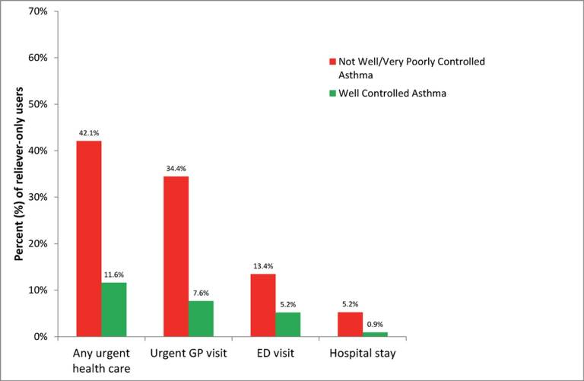
SABA overuse:
An indicator of poor control (4)
“One-quarter of the reliever-only population had needed urgent asthma healthcare in the previous year, demonstrating the importance of identifying such patients”
Cross-sectional population-based
Internet survey in Australia
Of 2686 participants ≥16 years with
current asthma randomly drawn from
a web-based panel, 1038 (50.7% male)
used only reliever medication
ED, emergency department.
Reddel HK, et al. BMJ Open. 2017;7:e016688.

