Slide 1
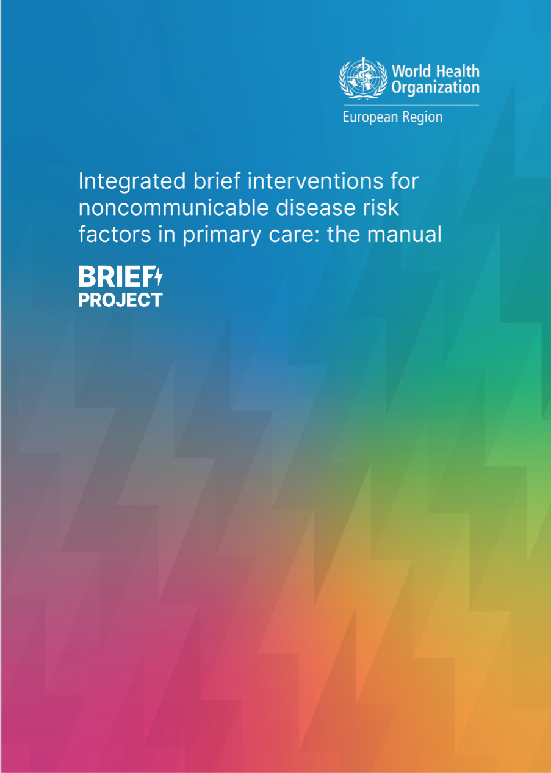
WHO Europe
https://www.who.int/europe/publications/i/item/9789289058551
Integrated brief interventions for noncommunicable disease risk factors in primary care: the manual. BRIEF project. Copenhagen: WHO Regional Office for Europe; 2022. Licence: CC BY-NC-SA 3.0 IGO.

Slide 2
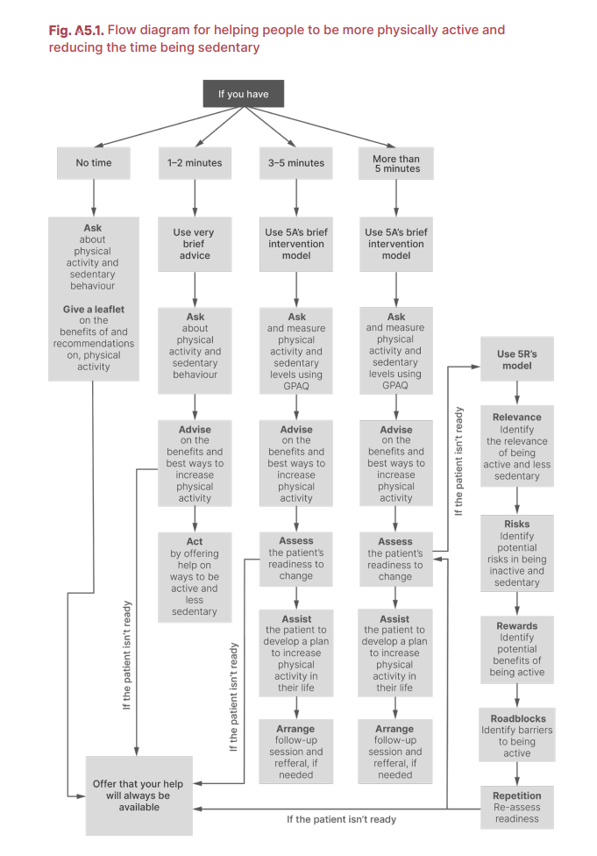

Slide 3
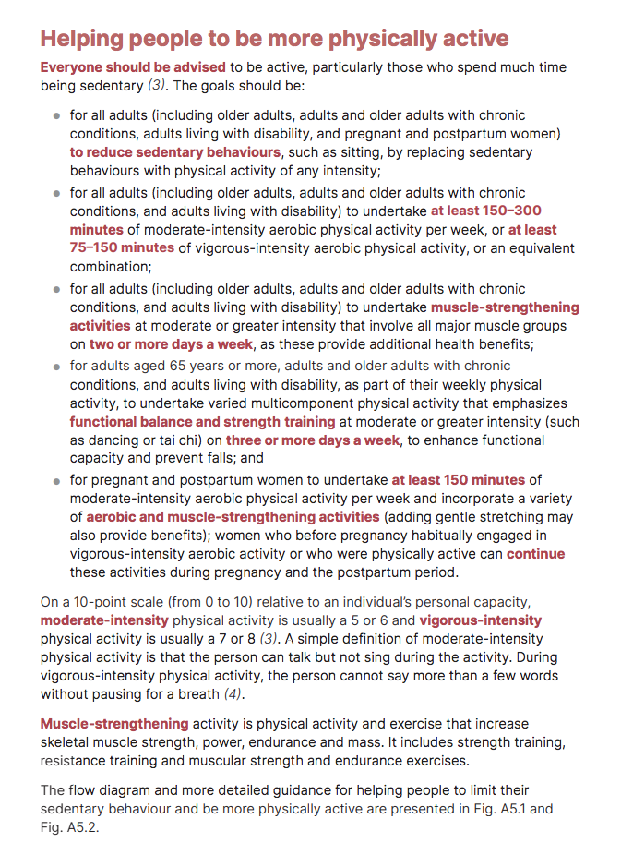

Slide 4
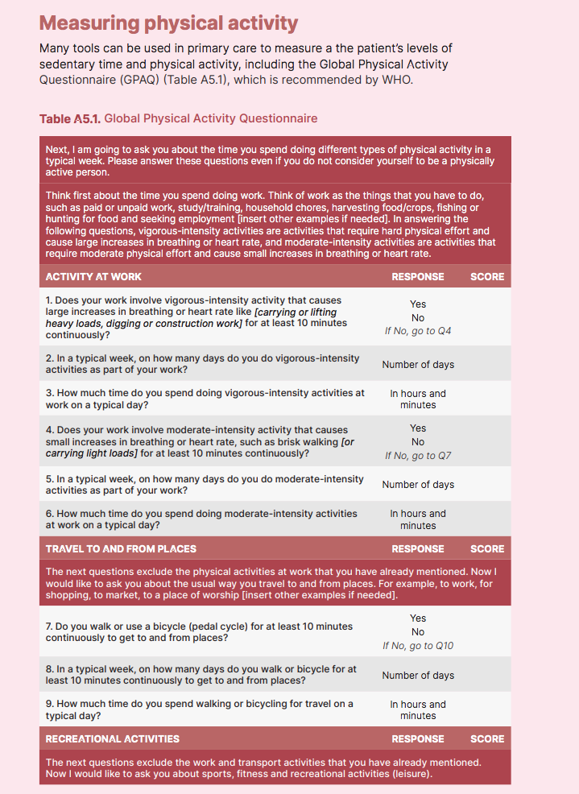
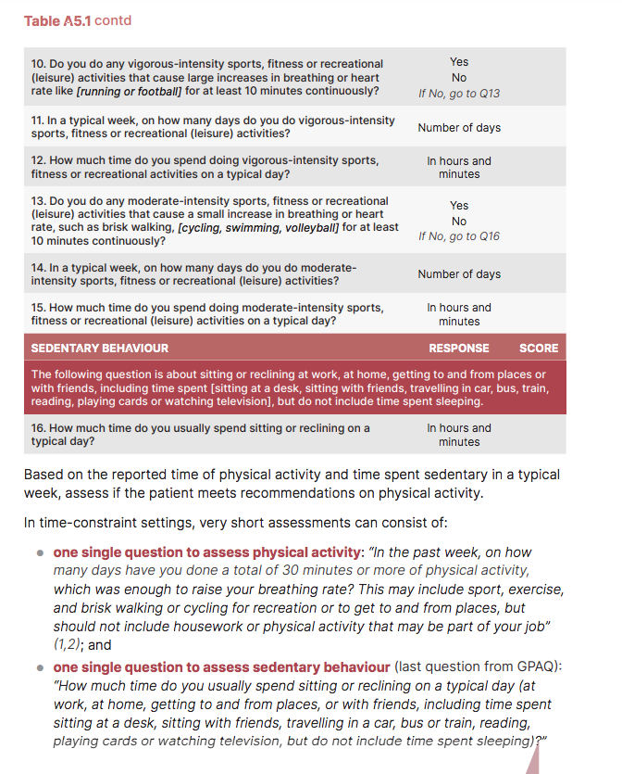

Slide 5
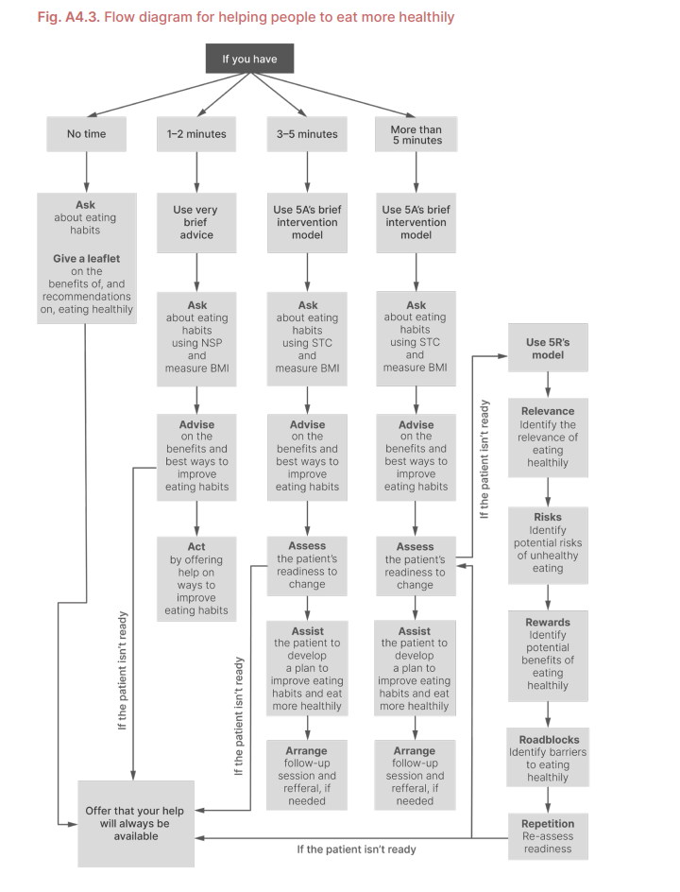
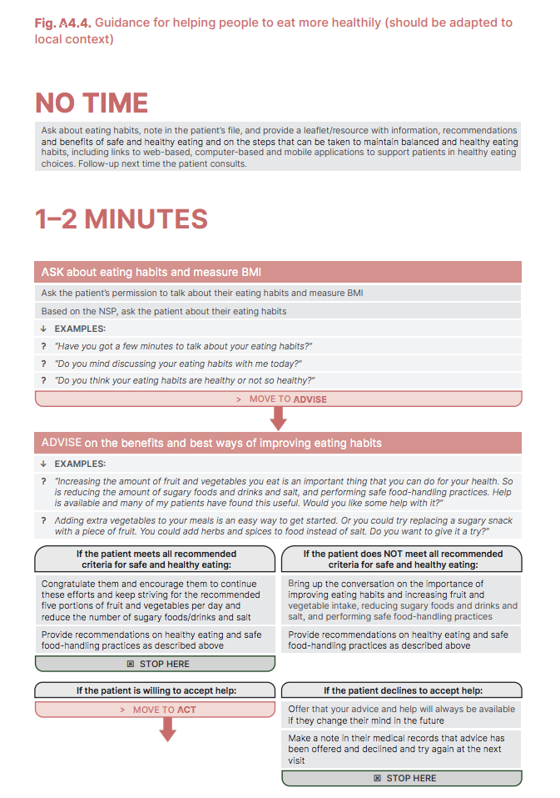

Slide 6
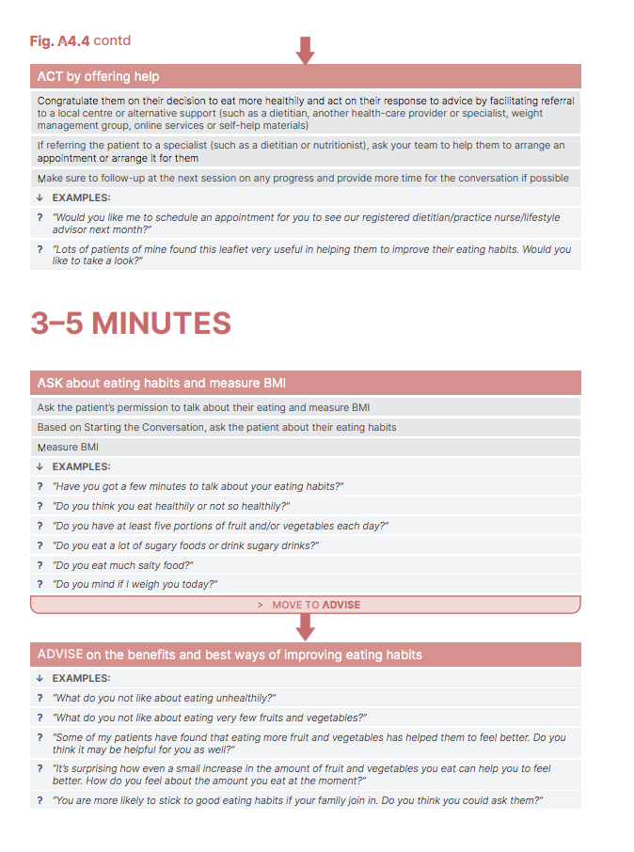

Slide 7
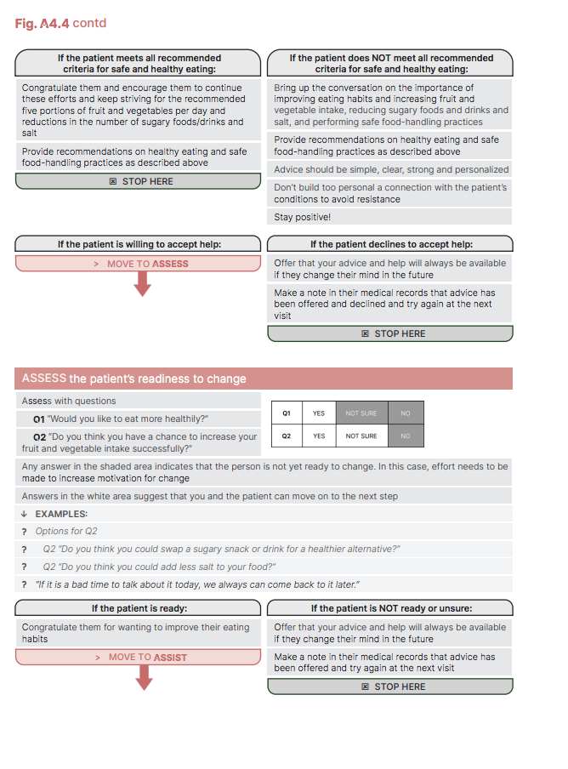

Slide 8
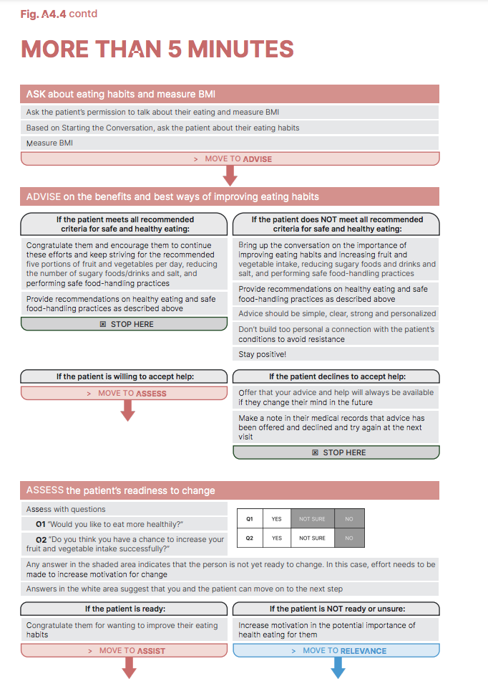
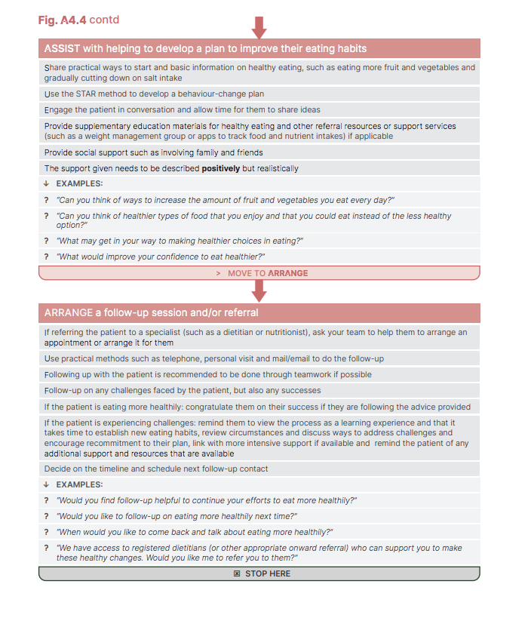

Slide 9
