Slide 1
Design Charrette

Slide 2
What is a Design Charrette?
A Design Charrette is an intensive, hands-on workshop that brings people from different disciplines and backgrounds together with members of the community to explore design options for a particular area. It differs from a traditional community consultation process in that it is design based.

Slide 3
What are the items?
Slide Rule
Question and Challenge cards
The name of the movement
Other ideas

Slide 4
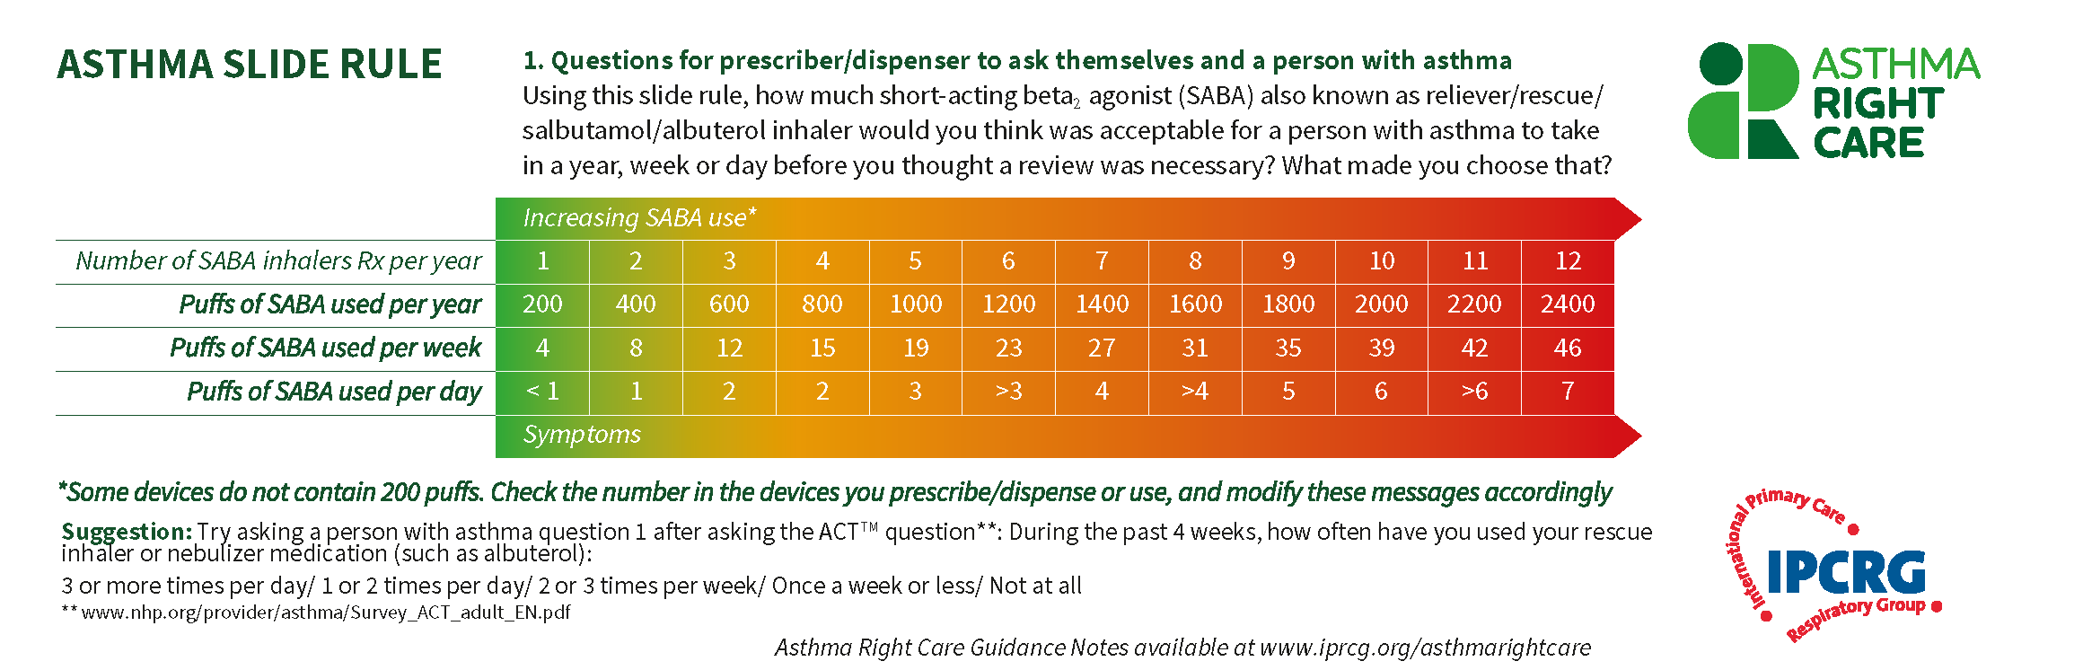
The Asthma Slide Rule - front

Slide 5
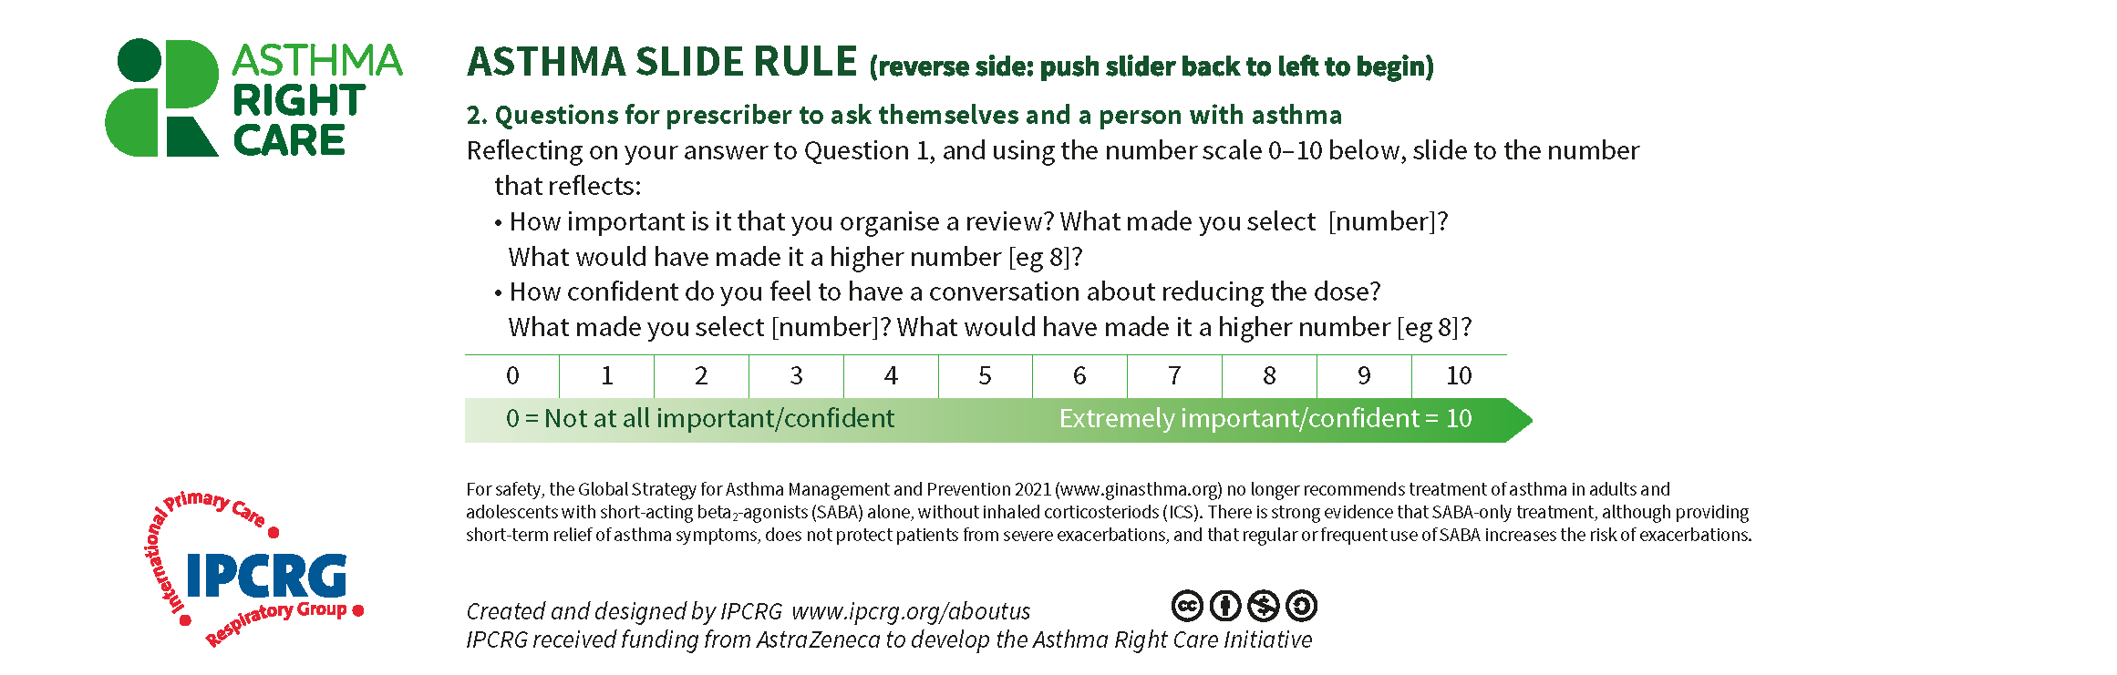
The Asthma Slide Rule - back

Slide 6
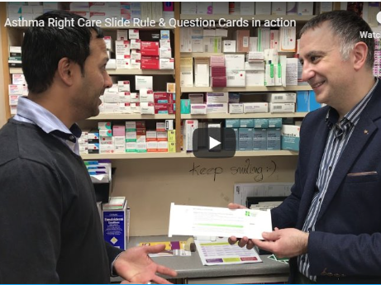

Slide 7
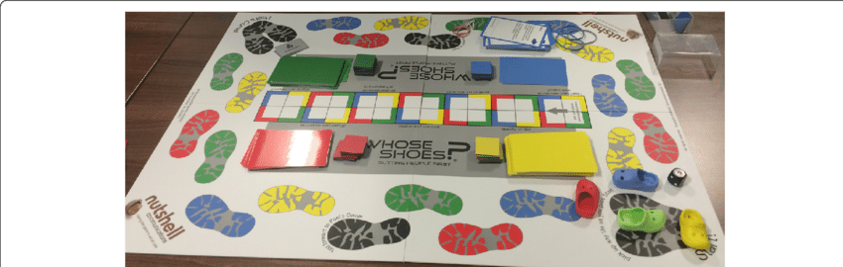
Inspired by Whose Shoes board game
Hypotheses:
Husbands are vital determinants of the likelihood of facility-based delivery by women in LICs in their roles as bread winners, key decision makers in the household and control over economic resources [5]. Involving men in maternal health encourages spousal communication, the making of birth plans and the uptake of health facility based deliveries in a timely manner
https://bmcpregnancychildbirth.biomedcentral.com/articles/10.1186/s12884-018-1704-6

Slide 8
Inspired by Whose Shoes board game
Hypotheses:
Health belief model theory: what people know and think affects how they act. An individual’s readiness to act is influenced by perceptions of whether one is susceptible or not to the health problem, how serious the problem is and benefits of avoiding the problem
https://bmcpregnancychildbirth.biomedcentral.com/articles/10.1186/s12884-018-1704-6

Slide 9
Example: `Whose Shoes?` Can an educational board game engage Ugandan men in pregnancy and childbirth?
Diet during pregnancy | Changing the culture | Which place?
• When a pregnant woman has a balanced diet, it helps the proper development of the unborn child and also keeps her from sickness. • A balanced diet includes fruits, vegetables, meat and grain foods. | • My mother told me that she was forced to give birth at home. She lost so much blood that she almost died. • Which cultural norms prevent pregnant women from giving birth in a health facility? | • Women seldom know that they have a right to choose where they wish to give birth. • How can men be of help to their pregnant wives?
https://bmcpregnancychildbirth.biomedcentral.com/articles/10.1186/s12884-018-1704-6

Slide 10
Findings on educational board games
Offer a unique approach to present health information to target group
Learning is reinforced through group discussions supporting peer-to-peer interactions
Communication tool that bridges gap between awareness and behaviour change
Cost effective mechanism for improving health literacy skills amongst literate and illiterate populations
Visual metaphor gives players an opportunity to acquire new knowledge through the content of the game:
  can enhance critical thinking, collective learning and inter-personal communication in a relaxed environment

Slide 11
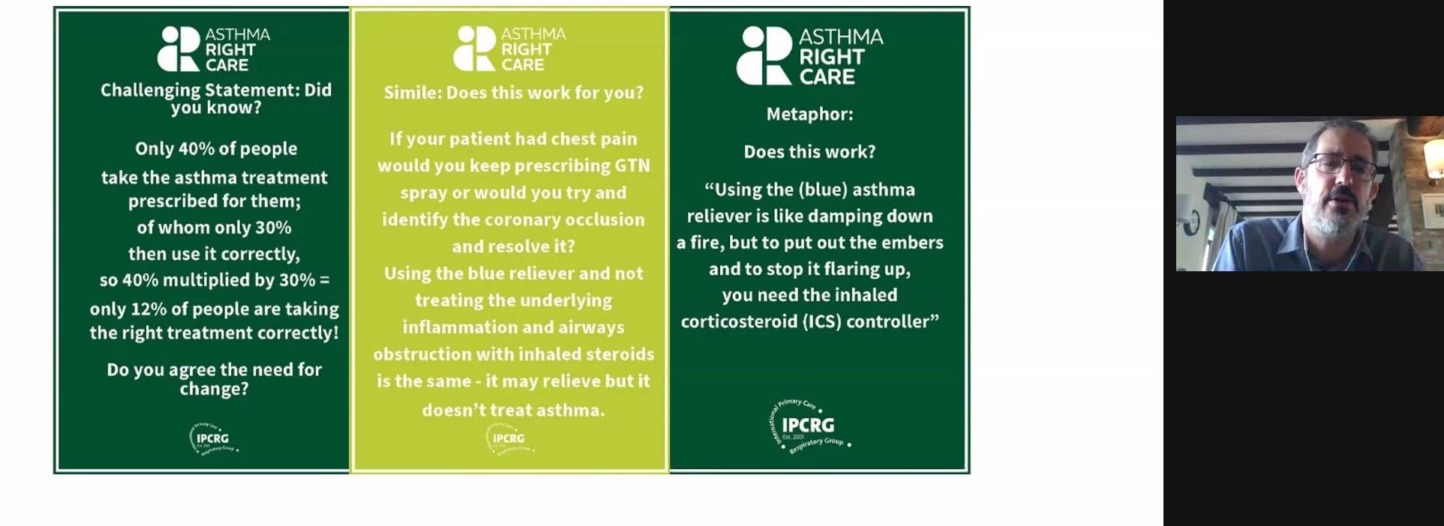
Question & Challenge Cards

Slide 12

Portuguese Logo
In Portugal the Asthma Right Care colours and icon were used but the logo uses the words “Proper care for the person with asthma”.
The initials CAPA also mean cloak or cape, a protective cover.

Slide 13
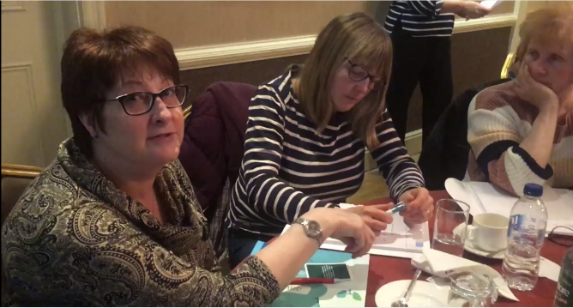
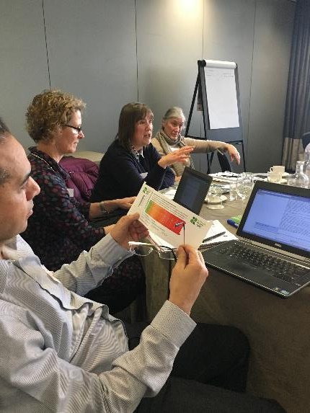
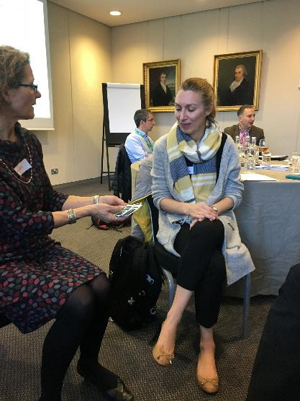
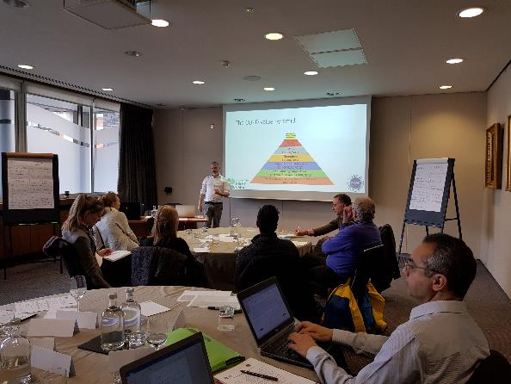
UK Design Charrette

Slide 14



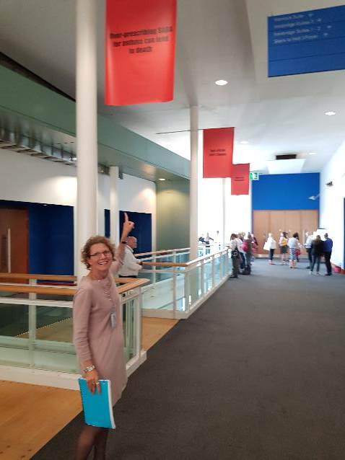
UK – 3 Billboards

Slide 15
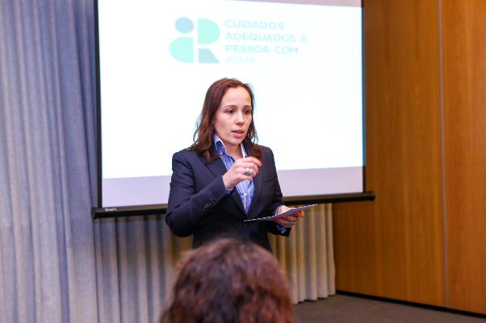
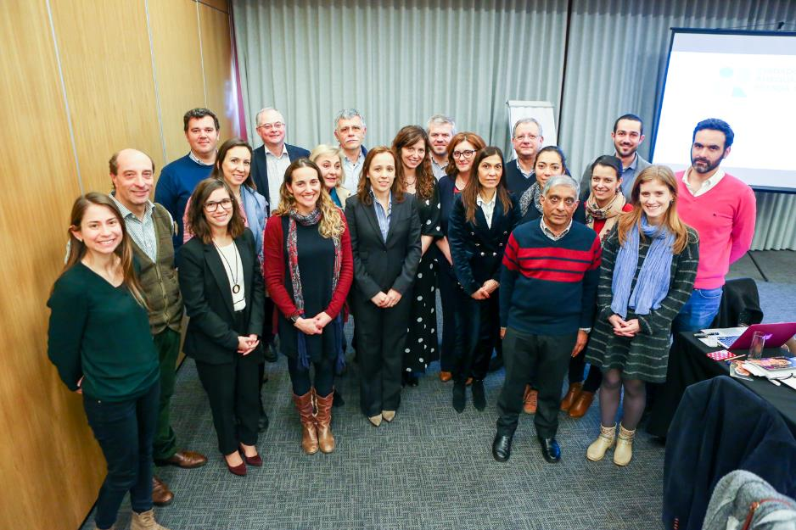
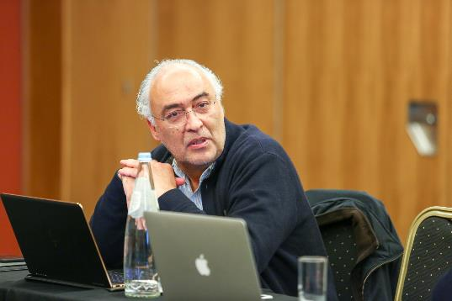
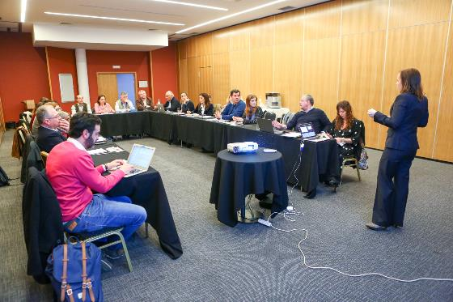
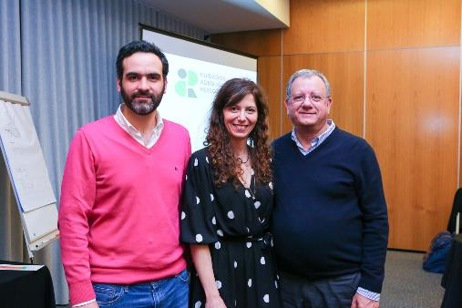
Portuguese Design Charrette

Slide 16
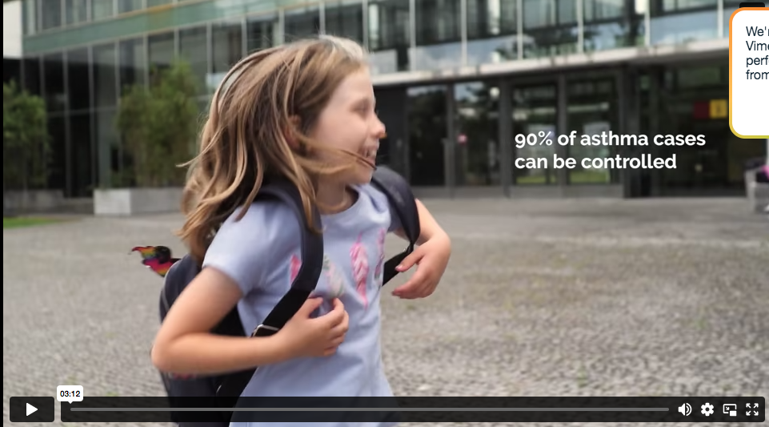
https://vimeo.com/637430048

Slide 17
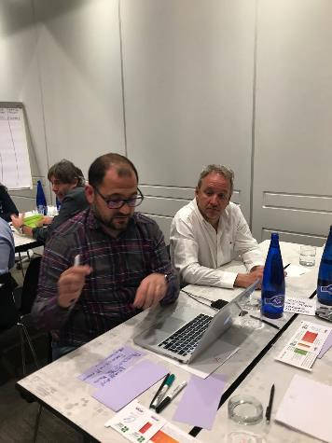
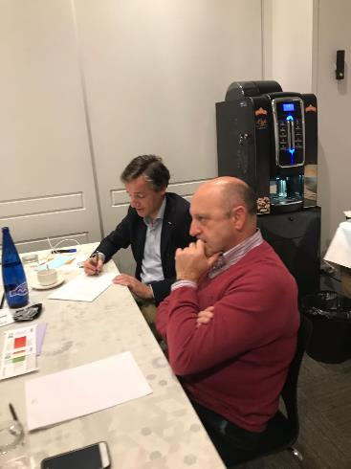
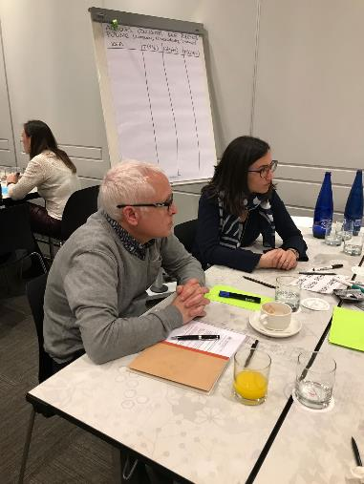
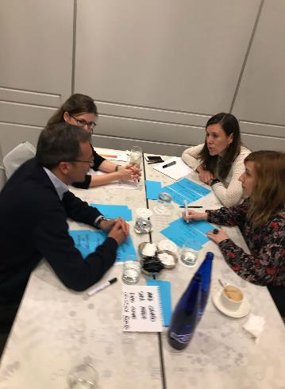
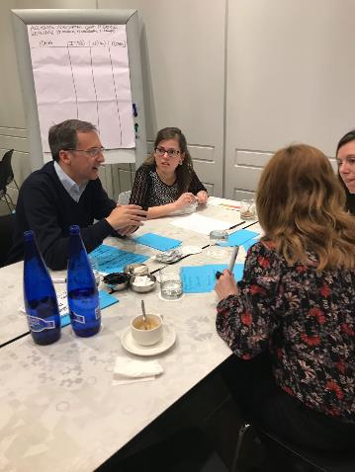
Spanish Design Charrette

Slide 18
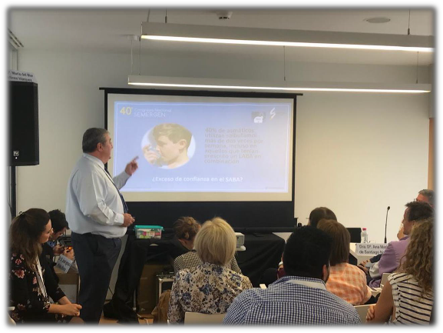
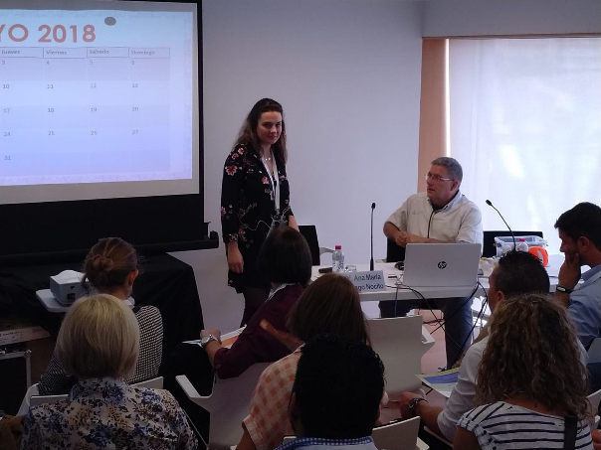
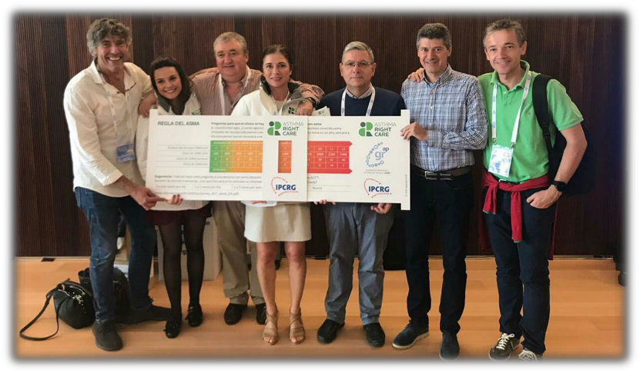
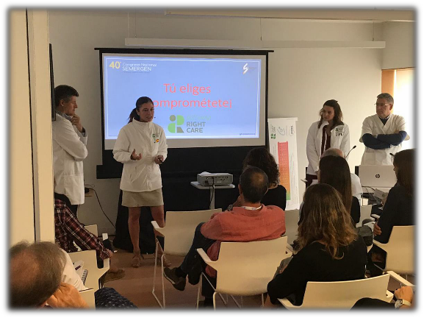
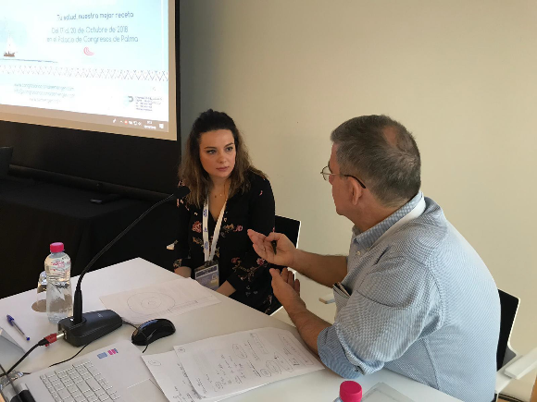
Spanish Workshop on Asthma Right Care

Slide 19
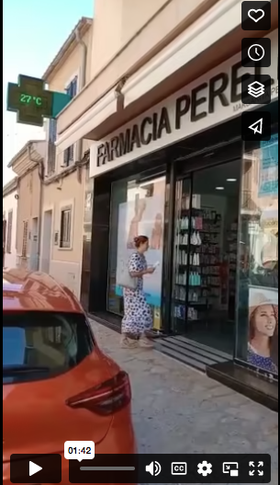

https://vimeo.com/597150943

